Slide 1
EPICS-FPGA Interface Implementation
Part B
Ross Hogan
Date: 16 November 2018

Slide 2
Convergence of FPGA and Processors
Flexibility of a Processor system
Performance of a FPGA
Move the configuration and monitoring out of the data path
Tighter integration for simpler interfacing

Slide 3
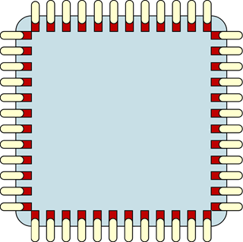
On board Processor:
Micro - Controller
FPGA Settings Registers in processor’s address range
Standard UDP Protocol
Processor translates Protocol to register read and write.
No limitation on IOC location
Use in the ‘FFM’ project
FPGA
Register 1
Register 2
Register 3
Address bus
Register 4
Data bus
.
.
.
Eth.
IF
Register N
Remote
EPICS IOC
Ethernet UDP
Memory
block
Memory
block
Eth.
header
Protocol
header
Protocol
data payload
Ethernet payload

Slide 4
In Chip Processor:
EPICS IOC running ‘on chip’
FPGA Settings Registers in processor’s address range
Device driver reads and writes memory directly.
Use in the Redpitaya
FPGA
Address bus
Register 1
EPICS IOC
Register 2
Micro - Processor
Register 3
Register 4
Data bus
.
.
.
Eth.
IF
Register N
Channel Access
Memory
block

Slide 5
Is on board or in chip better?

Slide 6
Is on board or in chip better?
Yes!

Slide 7
Is on board or in chip better?
Processor In Chip | Processor On Board
Tighter integration between CPU and FPGA | More flexibility in device choice
Higher transfer speed | CPU can interface to more than one FPGA
Lower power | Varity of protocols

