Slide 1
Red Pitaya with EPICS
Andraz Pozar
EPICS Collaboration Meeting
Melbourne 12 – 16/11/18

Slide 2
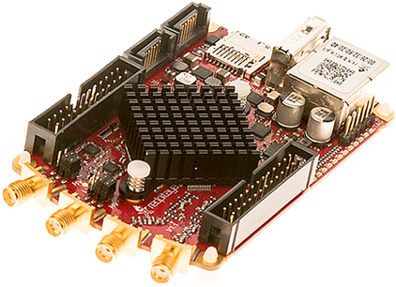
What is Red Pitaya?
“Swiss army knife for engineers” – redpitaya.com
CPU: Dual core ARM Cortex A9+ FPGA
FPGA: Xilinx Zynq 7010 SoC
I/O
2 RF inputs and outputs with:
Sample rate: 125 MS/s
ADC resolution: 14 bits
Connector type: SMA
2 configurable voltage ranges: +-1 V or +-20 V
Bandwidth: 50 MHz
4 slow ADCs, 4 slow DACs
16 digital I/Os

Slide 3
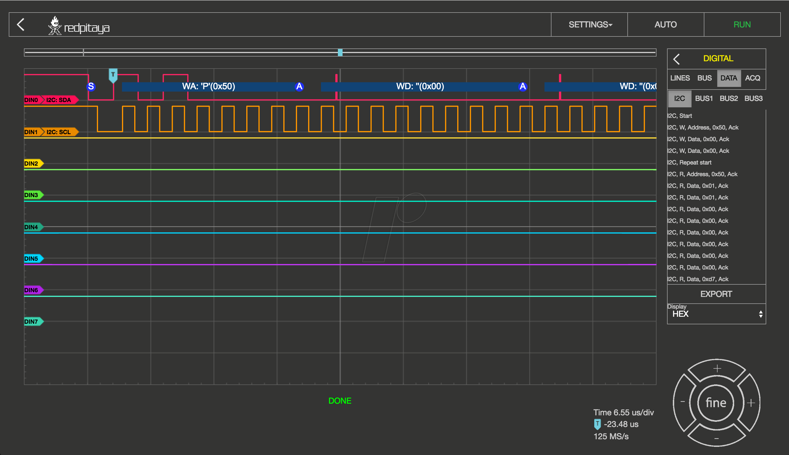
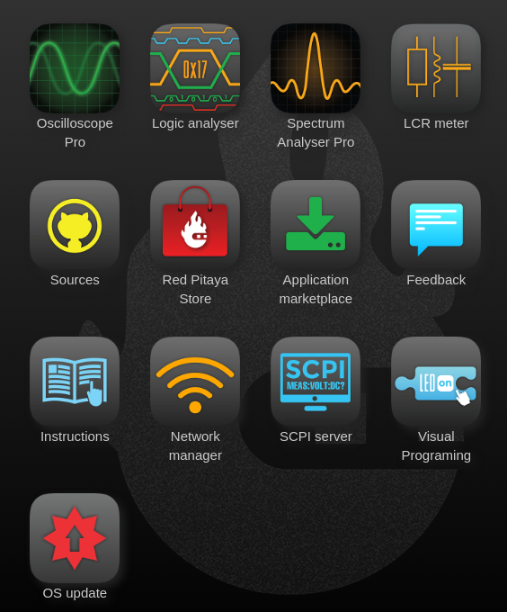
What is Red Pitaya?
Software
Debian OS
Shipped with a suite of tools available via website. Web server is hosted on Red Pitaya
SCPI server (avoid)

Slide 4
What Red Pitaya Isn’t!
Developed to be used in industrial environment. It is sold as an electronics enthusiast toolbox
Uses SD card for the OS image
Realistically 12 bit ADC resolution at higher sampling rates
Not sure about radiation resilience
Quite a few bugs in the API
SCPI interface has (had) misleading documentation and is (was) in general broken

Slide 5
When in doubt, write your own!

Slide 6
Red Pitaya asyn port driver - acquisition
Fast inputs
16354 elements per channel in a waveform
Trigger sources:
Soft
Threshold on one of the fast input channels
External 3.3 V
Acquisition modes:
Single shot
Continuous
Acquisition setup:
Decimation
Sampling rates
Averaging

Slide 7
Red Pitaya asyn port driver - generation
Fast outputs
16354 elements per channel in a waveform
Trigger sources:
Soft, external 3.3 V
Generated signal characteristics:
Amplitude, offset, frequency, phase
Generated signal types:
Standard stuff (square, sine, triangle, ramp, …)
Arbitrary
Acquisition modes:
Burst
Configurable number of signal repetitions in one burst
Configurable number of burst repetitions
Configurable duration of one burst
Continuous

Slide 8
Building the IOC
Can be built on the Red Pitaya itself (faster with cooling shield)
20 minutes for EPICS base
5 minutes for asyn
1 minute for the IOC
Cross compile
We use this option for our production environment
Instructions on how to do it are no github (link on the last slide)

Slide 9
Running the IOC
SCPI service needs to be turned off
NGINX service needs to be turned off or you get funny behavior
FPGA image needs to be loaded before the IOC is started
Standard EPICS environment variables need to be set up
IOC needs to be run as root

Slide 10
Usage at the AS
As a data acquisition device:
We use it to monitor pulse profiles of booster to storage ring kicker magnets
As a signal generator:
It generates a custom waveform used to ramp up the booster RF.
We utilize the burst option to generate 16k signal point ramp once a second

Slide 11
Conclusion
Decent little board with a nice array of I/O
Cheap: 320 EUR
Seems to be very reliable once you hack your way around the API
Bear in mind that it was not meant to be used in industrial environment. With that in mind, the driver is only tested on one version of the firmware and I’m afraid to test it on anything else ☺
Code: https://github.com/AustralianSynchrotron/redpitaya-epics
Pull requests and issues are welcome and encouraged

Slide 12
Thank you

