Slide 1
EPICS Qt –Workshop
EPICS Collaboration Meeting
Australian Synchrotron
Andrew Starritt
Date: 13 November 2018

Slide 2
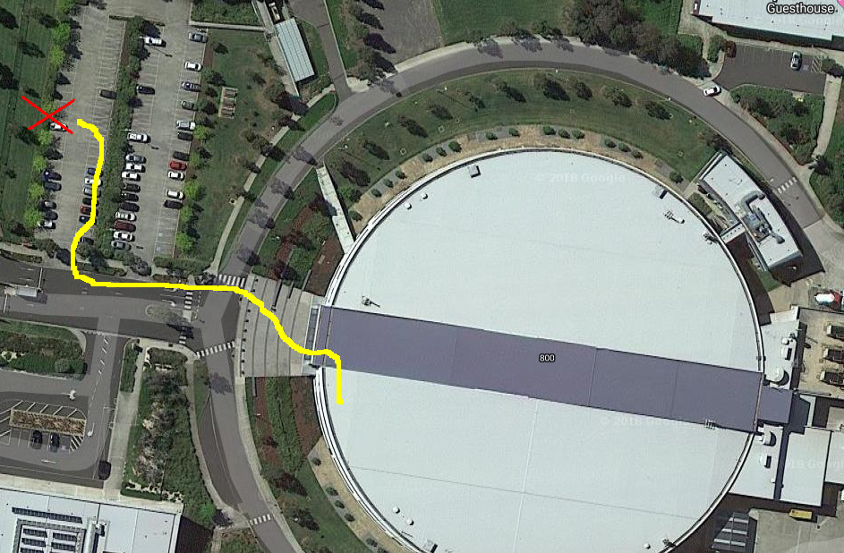
Safety

Slide 3
Tutorial Outline
Overview of EPICS Qt
Downloading from github
Building EPICS Qt
Widget overview
Afternoon Tea
QEGui display manager
Substitutions
Customisation
Creating own plugin
--- includes a few hands on exercises

Slide 4
VM Image
VM image available at https://events01.synchrotron.org.au/event/85/
  md5sum: 9f37b50e 62cdff1f 6667550e d443c22f
WiFi access is via eduroam – access using your own own facility credentials.
The guest image is CentOS 7
Login using as qtuser - password is qtuser18
I have copy of the image on some USB keys.

Slide 5
Brief Summary of EPICS Qt (QE)
Integrates Qt with EPICS Channel Access
  Qt - is a platform independent GUI++ system
  EPICS Qt provides a set of EPICS aware set of widgets
Can be used code free:
  Ui forms (xml) created/edited using designer
  Use qegui as the display manger
  The QE widgets can be used in other display mangers
The QE widgets can be used to create more complex application widgets
  Later we will build a simple plugin to show how to do this
When used in a bespoke display manager, QE widgets can be created programmatically:
  QELabel* label = new QELabel (pvName, mainForm)
  calling the setupUi function in the header file created by uic (ui compiler)

Slide 6
Widget Kinds
Basic bread-and-butter widgets
  Simple monitor and control widgets
  Typically only need a single Process Variable (PV)
  Often based on native widgets: QLabel, QPushButton, QComboBox, QLineEdit, QSlider
Complex widgets
  Often take many PVs, some being capable of being set at run-time.
  Examples: QEImage, QEPeriodic, QEStripChart, QEPlotter, QEPvProperties.
Support widgets
  QEArchiveStatus – information relating to the CA Archiver or Archive Appliance.
  Own base class widgets, e.g. QNumericEdit as a base class for QENumericEdit
  QEForm – allows one ui file to be embedded in another ui file.
  QECalcout/QElink – allows a PV value to modify the attributes of another widget

Slide 7
Major updates since ICALEPCS 2015
EPICS Qt has moved from SourceForge to GitHub
  Main page: https://github.com/qtepics
  We have a separate repo for each component (qeframework, qegui, …)
  Restructured so that each component has a standard top directory
  Includes a bespoke make file to handle Qt – essentially:
  qmake -o Generated_Makefile project_file.pro
  make -f Generated_Makefile
    Linux okay, Windows mingw okay.
  Split the QEPlugin library into a load time QEFramework library and a small-ish run time widget plugin library - this made the build easier.
    QEFramework.so => <top>/lib/linux_x86_64/
    QEPlugin.so => <top>/lib/linux_x86_64/designer/
  Avoids the main library being loaded twice (on Windows)

Slide 8
Major updates - continued
Added support for Archive Appliance
  Requires Archive Appliance Fall 2017 release or later
  Requires Google protocol buffers.
  Requires Qt5 – needs the json library.
    With Qt 4 , the build just excludes the Archive Appliance parts. If wedded to Qt4, a 3rd party library could probably be used, but you are on your own.
  Environment variables control if Archive Appliance built - warns if cannot be built (Qt4)
  Environment variables control if Archive Appliance or Channel Access archive used at run time.
  Defaults are (currently) no Archive Appliance, and to use CA Archive.

Slide 9
Other significant updates
  QEPvLoadSave now shows live and delta value as well as the snapshot value (inspired by CSS)
  QEStripChart now has an inbuilt calculate function, and stores up to 400,000 points in internal buffer.
  New widgets:
    QECalcout - more sophisticated than QELink
    QELCDNumber - based on QLCDNumber
  Forms respond to ctrl+'+' , ctrl+'-' and ctrl+'0' to rescale (like a browser)
  New forms opened "near" opening form
  List PV names functionality added
  Screen shot functionality added
  Pre-built binaries and MSI files now available – but needs a new home.

Slide 10
What’s Next?
Using PV Access - this has been prototyped using base-7.0.1.1
  With minor changes - it would prob. work with base-3.15/16 and EPICS 4
  Needed CPP -std=gnu++11 flag on Linux for building PV Access modules to avoid a couple of name mangling issues (have not tried Windows yet).
  Uses the ACAI library for Channel Access
  Includes support for NTScalar, NTScalarArray, NTEnum, NTTable (NTNDArray/QEImage still being worked on – currently mono-chrome only)
  New widget available to support NTTable type.
  PV names can be qualified with a protocol prefix
    ca:// - Channel Access - the default
    pva:// - PV Access
  An environment variable controls if PV Access support is built.

Slide 11
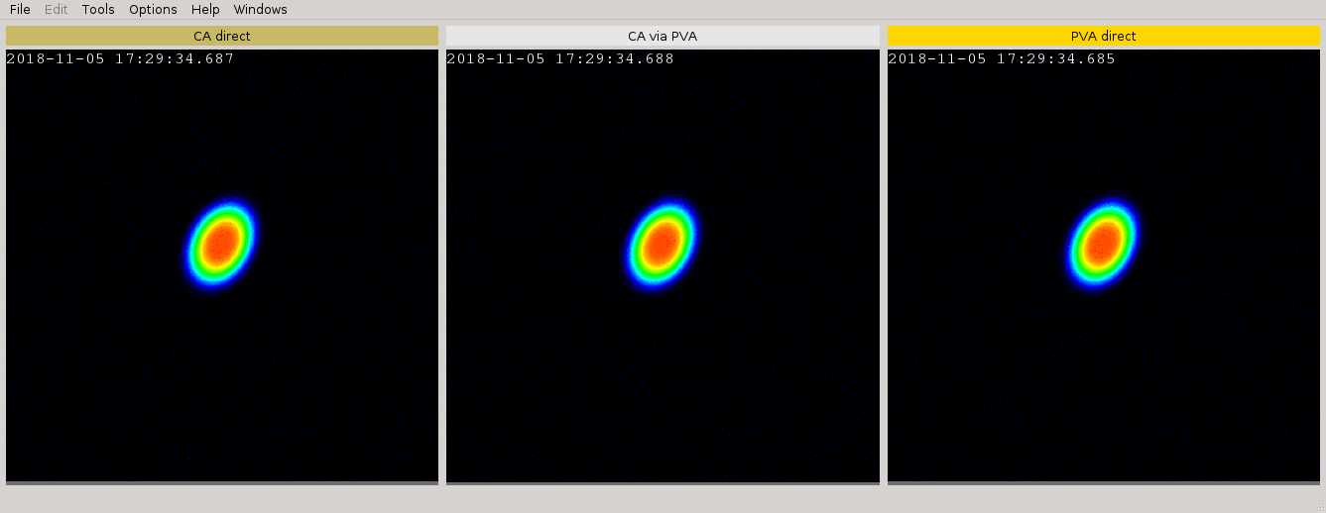
qegui and PV Access

Slide 12
Downloading From GitHub
Installing Prerequisites
  Beyond the scope of this tutorial: require c/c++ compiler, make, git and Qt
  These have already been installed on the VM.
  Qt can be down loaded from: https://www.qt.io/download
Epics Qt is hosted on GitHub
  Main page: https://github.com/qtepics
  Documentation: https://qtepics.github.io/
  qeframework: https://github.com/qtepics/qeframework
  qegui: https://github.com/qtepics/qegui
The qeframework and qegui components have also been downloaded into the VM.

Slide 13
First exercise
Login as qtuser - password is qtuser18
Open console terminal
  cd ~/qe
  git clone https://github.com/qtepics/qeMonitor.git
  cd qeMonitor/configure
  vi RELEASE or kwrite RELEASE
Modify the RELEASE file such that:
  QE_FRAMEWORK=/home/qtuser/qe/qeframework
  EPICS_BASE=/epics/base
Now we make qeframework, qegui and qeMonitor

Slide 14
Building /checking
This should be like making any other EPICS module.
  cd ~/qe/qeframework
  make # mostly pre-built.
  cd ~/qe/qegui
  make
  cd ~/qe/qeMonitor
  make
The PATH environment variable is already defined.
  qegui –v
  QEGui version: 3.6.2 (Production) Nov 7 2018 12:06:27 (using QT 5.7.1)
  Framework version: 3.6.2 (Production) Oct 29 2018 16:56:11 (using QT 5.7.1)
  Framework attributes: Archiver Appliance
  Support packages: EPICS 3.15.5 and QWT 6.1.3
  Library path: /opt/Qt/5.7/gcc_64/lib
  Plugin path: /opt/Qt/5.7/gcc_64/plugins

Slide 15
Starting an IOC
In a new console window:
  cd ~/ioc
  make
  cd iocBoot/iocDemo_IOC
  ./st.cmd
This IOC currently hosts the following records:
  DEMO:SO stringout
  DEMO:BO bo
  DEMO:COMPRESS compress
  DEMO:MBBO mbbo
  DEMO:AO ao
  DEMO:MBBI_DIRECT mbbiDirect
  DEMO:CALC calc
  DEMO:LO longout
This used to support the exercises

Slide 16
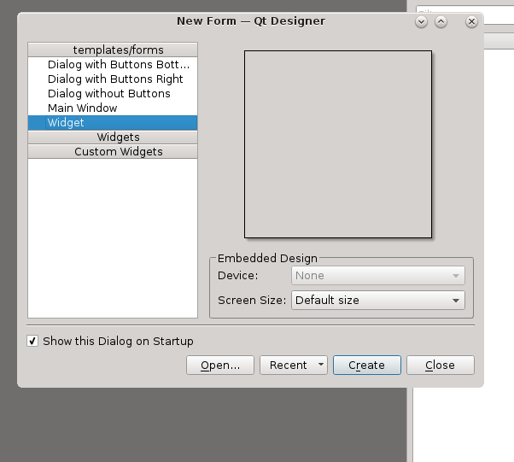
Notes:
Running designer

Slide 17
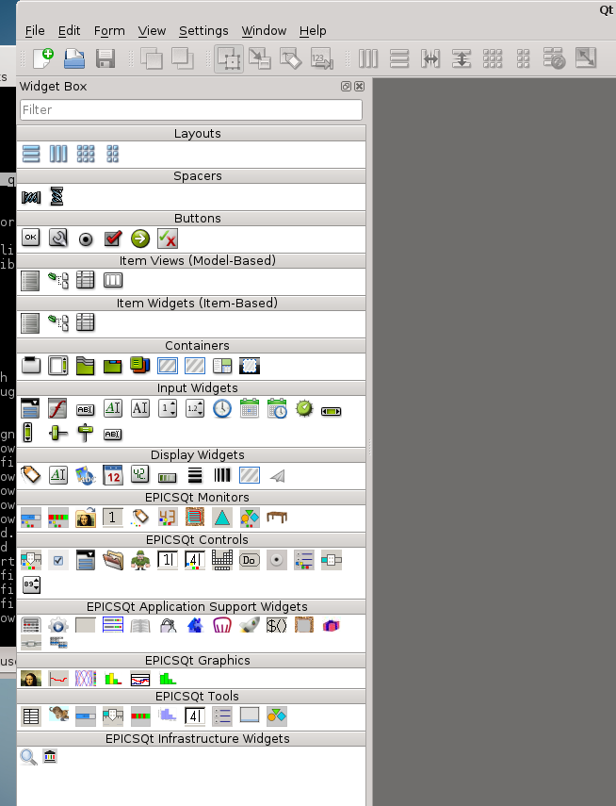
Notes:
Verify widgets available, icon view

Slide 18
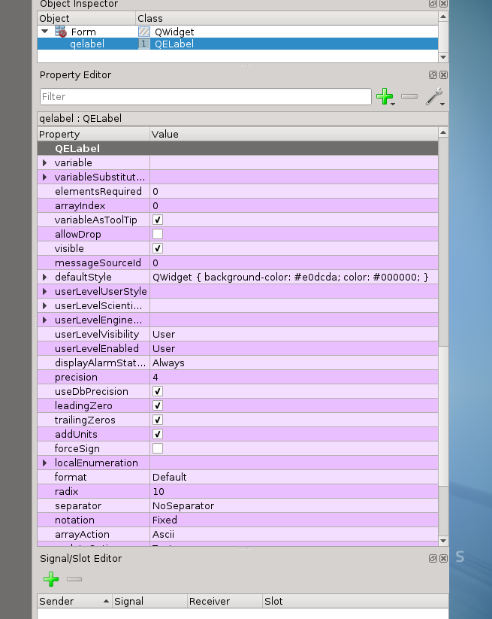
Notes:
General overview of properties.

Slide 19
Lighting tour of monitor widgets
Full documentation in:
  ~/qe/qeframework/documentation/QE_QEGuiAndUserInterfaceDesign.pdf
  QELabel – displays numeric/enum/text values
  QEDescriptionLabel – like QELabel but different default property values
  QEAnalogProgressBar - graphical display of numerical values
  QEBitStatus – graphical display of bits of an integer values
  QELCDNumber – displays numeric values
  QEShape – can use upto 6 PVs to control upto 6 attributes.
  QESimpleShape - fixed shape; colour and/or text from PV value.
  QETable – tabular display of up-to 20 array PVs
  QEPlot – graphical display of waveform or mini strip chart for a scalar.
Notes:
No pdf viewer installed – firefox works for me; or use host machine.

Slide 20
Overview of control widgets – 1
QEAnalogSlider – writes numeric float values – has an axis scale
QECheckBox – writes "on"/"off" values – text or numeric.
QEPushButton – write on click, press and/or release
QERadioButton - writes "on"/"off" values – text or numeric.
  All buttons can write to PV and/or open new gui file and/or execute program.
  Note: For the QE button widgets, when writing to a bo/mbbo record,
  the pressText, releaseText, clickText and clickChecktedText
  properties must exactly match the ZNAM,ONAM or ZRST,ONST,TWST,THST etc … fields.
  Tip: set the format property to Integer, then the text can be ‘0’, ‘1, ‘2’ etc.
QEComboBox – writes 1 of N integer values

Slide 21
Overview of control widgets - 2
QEGeneralEdit – morphs into “best" widget depending on PV data type
  Designed for context menu edit option, but may be used in own form.
QELineEdit – general purpose value entry – text or numeric.
QENumericEdit – specialised numeric entry - decimal, hex or binary
QEPeriodic – specialised element/value(s) selection.
QERadioGroup - writes 1 of N integer values (0 to N-1)
  QGroupBox plus a number of a number of QRadioButtons
QESlider - writes numeric float values
QESpinBox – writes numeric float values
  Based on QDoubleSpinBox

Slide 22
Exercise 2
Create a form to monitor and/or write to the IOC’s PVs.
Note that designer is “live” with respect to monitoring
Save (regularly) to ~/ui/exercise2.ui
To test, try “Form | Preview…" or Ctrl+R
Set a form title using the windowTitle property
Consider setting the minimumSize and maximumSize properties.
Be imaginative, have fun.

Slide 23
Using qegui to display your form
Open a terminal
Run: qegui ~/ui/exercise2.ui ~/ui/basic.ui
Features:
  Default menu – this is configurable – do read the manual
  Tool tip – PV name, DESCription and alarm severity
  Middle click – PV name to paste buffer (like MEDM) and the status line
  Rescale by Ctrl+’+’, Ctrl+’-’, Ctrl+’0’
  Inbuilt screen capture
  List all PV names
  Saves configuration – exit and try qegui –r ExitSave
  Context menu – right click bring up standard QE widget context menu.
  qegui –h provides help information

Slide 24
Common context menu actions
Most QE widgets provide the following standard actions
  Examine Properties – launches the QEPvPropeties widget in own form
    Shows all fields for know record types.
  Plot in StripChart – opens a new form with a QEStripChart widget
    Additional PVs can be dragged or copy/pasted to the form.
  Show in ScratchPad – opens a new form with a QEStripChart widget.
    I find really useful during testing.
For array PVs we also get:
  Show in Plotter – opens a new form with a QEPlotter widget
  Show as Histogram - opens a new form with a QEWaveformHistogram widget
  Show in Table - opens a new form with a QETable widget.
Notes:
Spend 5 minutes talking about each one

Slide 25
Other qegui features - 1
Messaged Log…
  Opens up the QELog widget – will only start logging one opened.
PV LoadSave ….
  Opens a form holding a QEPvLoadSave widget
  This provides a mean manage configured set of PV values (scalar or array)
  Values can be read from/written to file
  Values can be read from/written to the control system
  Values can be retrieved from the archiver
  Values can be moved from one “side” to the other “side”
  Two set of values can be compared
  Is hierarchical

Slide 26
Other qegui features - 2
Archive Status…
  Provides information about the Archive (CA or Archive Appliance)
Archive Name Search
  Provides a less strict search capability
Save/Restore/Managed Configurations ….
  Allows named form layout configurations to be saved
  Special names: Default, AutoSave, ExitSave
  The latter can be inhibited using the –o oprtion
  A configuration can be restored using the -r and –c options

Slide 27
Other qegui features - 3
User Level – allows different levels of access
  Controlled by the userLevelStyle, userLevelVisible and userLevelEnabled properties.
  Can be password protected.
  QEFrame and QEGroupBox allow user level access to be set in “one spot”
  Engineer user level adds “Edit PV” option to the standard context menu.
Help About – provides useful information
  Both compile tine and run time.
Windows – provides details about currently open windows

Slide 28
Widget wrap-up - 1
Other common widgets
  QEForm – allows one ui file to be embedded in another
  QEFormGrid – allows a number of copies if a sub-form to be included.
    Relies on regular PV naming
  QESubstitutedLabel – allows title/header label content to be substituted
  QEMenuButton – provides a simplified QEPushButton like functionality
  for each menu entry
    Open context menu in designer
    Select Edit Menu Info…
  QEWaveformHistogram – used to present a single array PV
  QEScalerHistorgram – used to present up-to 120 scaler PVs
  None-EPICS aware base class widgets – QBitStatus, QSimpleShape etc.

Slide 29
Widget wrap-up - 2
QELink
  Receives a value via slot, makes a true/false decision, writes a value via a signal.
    Use the Edit Signal/Slots view
    Each QE widget typically signals dbConnectionChange (bool) and
    dbValueChanged (int/long/bool/QString/double/qlonglong)
    QELink accepts: int/long/bool/QString/double/qlonglong
    QElink signals: out (int/long/bool/QString/double/qlonglong)
  Can be used to provide a value or control enabled, visible, style (colour, font)
QECalcout
  Provides a much more comprehensive evaluation capability
    Accepts upto 12 int or double inputs
    Signals out (int/long/bool/QString/double/qlonglong)
    Is the Qt equivalent of the calcout record
Note: Mitigates need to create PVs just to support GUI, however do
consider if should actually be done in and IOC.

Slide 30
Search Paths
EPICS Qt finds ui (and other) files using a search path.
  This is similar to EDM (EDMDATAFILES) and MEDM (DISPLAYPATH)
EPICS Qt uses the QE_UI_PATH environment variable.
  This is a colon ( : ) separated list of directories on Linux.
  This is a space separated list on Windows
  Example: export QE_UI_PATH=“/home/qtuser/ui:/gui/common”
The search path may also be specified using the -p path command line option
  The –p option and QE_UI_PATH data is merged, -p option takes precedence.
Path search by passed for absolute path names and resource file names

Slide 31
Substitutions
Substitutions follows the usual EPICS format
  Values are specified as key=value pairs, e.g.
    "KEY=DEMO, NUMBER=14"
  Macros are embedded in variableName properties like this:
    variableName : $(KEY):CURRENT_$(NUMBER).RBV
  Other widgets can also use macro substitutions
    labelText – is available for the QESubstitutedLabel widget
    substitutedLabel – is available on the QEGroupBox widget.

Slide 32
Setting substitution
Using the -m command line option:
  qegui -m "KEY=DEMO, NAME=Example" some_file.ui
Macro values may also be set within the prioritySubstitutions property of the QEPushButton (and QECheckBox & QERadioButton) widgets:
  guiFile property defines the ui file to be opened.
  prioritySubstitutions: defines addtitonal values, e.g. KEY=DEMO,NAME=Example
Substitutions accumulate, i.e.
  the prioritySubstitutions values are merged with any -m option values.
  The new form may also contain a QEPushButton with own prioritySubstitutions that opens a third form – all three sets of macro definitions are merged.
  Note: the path to a form may lead to different substitutions.

Slide 33
Exercise 3
Create ~/ui/exercise3.ui
Modify the ~/ui/exersise2.ui to replace all instances of DEMO with a macro, e.g. ‘$(NAME)’
Add a QESubstitutedLabel - set labelText property to some text including ‘$(NAME)’
Save as ~/ui/exercise3.ui
Run
qegui -m "NAME=DEMO" ~/ui/exersise3.ui

Slide 34
Exercise 4
Create a new form ~/ui/exercise4.ui with two (or more) QEPushButtons
Define the guiFile and prioritySubstitutions properties.
Also specify the creationOption property – suggest NewWindow
Set NAME to DEMO and XXXX respectively
Modify the IOC substitution file: /home/qtuser/ioc/Demo_IOCApp/Db/xxx.substitutions
to add additional sets of PVs
Remake and restart the IOC.
Run
qegui ~/ui/exercise4.ui

Slide 35
Customisation
The layout of qegui’s menus (and toolbar) may be customised to suit your specific application needs, i.e. reordering, adding and/or removing menu items
The customisation is specified in an xml file. qegui comes with an in-built default customisation resource file.
The customisation file and customisation name can be specified using
the –w, -n and –d command line options.
The customisation name may also be specified in a QEPushButton’s customisationName property – different windows can have a different look and feel.
Do read the documentation: QE_QEGuiAndUserInterfaceDesign.pdf

Slide 36
Exercise 5 – a simple customisation
cd test
cp ~/qe/qegui/qeguiApp/project/src/QEGuiCustomisationDefault.xml \
test.xml
Using vi or kwrite edit test.xml.
Modify the "QEGui_Default" section (about 10 lines from bottom, and insert a new IncludeCustiomisation section:
<IncludeCustomisation Name="QEGui_Exercise"/>
Add a new "QEGui_Exercise" customise section – next slide

Slide 37
Exercise 5 – Part 2
<Customisation Name="QEGui_Exercise">
<Menu Name="Exercises">
<Item Name="Ex5 AAAA">
<Window>
<UiFile>/home/qtuser/ui/exercise3.ui</UiFile>
<Title>Exercise Five AAAA</Title>
<MacroSubstitutions>NAME=AAAA</MacroSubstitutions>
<CreationOption>NewWindow</CreationOption>
</Window>
</Item>
</Menu>
</Customisation>

Slide 38
Exercise 5 – Part 3
Run:
export QE_UI_PATH=/home/qtuser/ui
qegui –w test.xml exercise4.ui
Note: the search path applies to customisation files as well as ui files.

Slide 39
Creating a plugin
Why create a plugin?
To create a brand new widget, or tailor an existing widget.
  Example: QEDescriptionLabel – just a QELabel but with different default properties.
To add some "smarts" to an application, typically bringing a number of standards widgets together.
  Our facility status display, batch scanning on the SXR beamline.

Slide 40

Two examples to build now and take home to study
cd ~/plugin
make
ls -l lib/linux-x86_64/designer/
designer
Create new form ~/ui/exercise5.ui
Add one of each MySimpleShape and MyTuplet widgets.
  The former is just a QESimpleShape with different defaults
  The latter brings 4 widgets together to provide an edit widget
  Run qegui ~/ui/exersize5.ui

