Slide 1
OPC UA and EPICS Introduction
Ralph Lange
ITER IO – Control System Division
EPICS Collaboration Meeting, 12-17 Nov 2018, Melbourne

Slide 2
History (I): OPC and OPC UA
1996: OPC (Classic) = OLE for Process Control
Based on COM/DCOM, only on Microsoft Windows
Complex security configuration (access lists)
Uses many ports (not firewall friendly)
Absolute addressing
2006: OPC UA = OPC Unified Architecture
Superset of OPC Classic services
Open network protocols
Certificate based security
Symbolic addressing

Slide 3
History (II): EPICS OPC Classic Support
Upstream Author: Bernhard Kuner (HZB / BESSY II) (first release ~ 2004)
Based on commercial client SDK (SoftIng)
APIs were often changed (complete rewrite necessary)
Only on Windows
Hard to support multiple versions of Windows and Compilers
License model allows free distribution of binaries: Windows IOC downloadable
Approx. 10 users, robust, scalable
http://www-csr.bessy.de/control/SoftDist/OPCsupport/

Slide 4
Why OPC UA?
Industrial standard that is gaining ground: servers for more and more devices available
Symbolic addressing: PLC side may change as long as the names stay (IOC does not even have to reboot)
Single TCP connection: WAN capable
Security: certificate based authentication, encrypted transport
Browsing: powerful free GUI clients available
Server logically on top of device: status variables in standard namespace provided even if device is off

Slide 5
EPICS Support for S7 PLCs
s7plc: Block read/write on TCP/IP
Only complete DBs, raw data (no timestamps)
PLC program has to actively send and receive data
High performance
s7nodave: S7 native protocol
Reverse-engineered native Siemens protocol
Only single data items
No PLC programming (handled by PLC firmware)
Low performance
Both use byte-offset-into-data-block addressing

Slide 6
OPC UA on S7 PLCs
Symbolic addressing
All items are found by name
PLC side may change – even without IOC reboot
Wide range of scalar types, arrays and structures
Supports everything from single data items to complete DBs
Server and device timestamps available
Support in TIA Portal
No programming, just checking a box
Embedded OPC UA server on S7-1500 series PLCs
Medium to high performance (varies with CPU type)

Slide 7
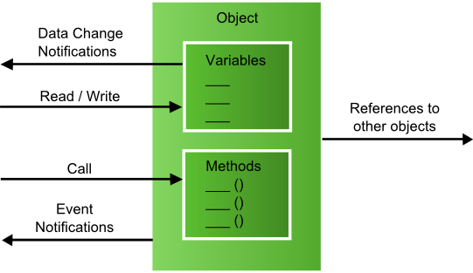
OPC UA Basics (Object Model)
Current Scope

Slide 8
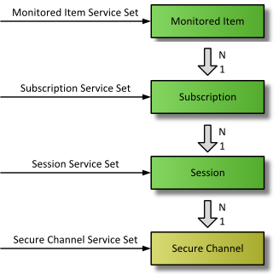
OPC UA Basics (Connection Model)
EPICS Record
Device Support
Not Implemented Yet

Slide 9
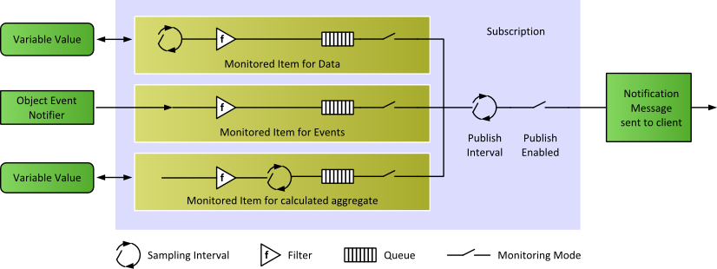
OPC UA Basics (Subscription Model)

Slide 10
OPC UA Support Prototype (2017-2018)
Upstream Author: Bernhard Kuner (HZB / BESSY II)
Based on commercial SDK by Unified Automation
API fits EPICS Device Support Architecture
UaExpert client application (same vendor) is widely used
Binaries can be distributed royalty-free
Runs on Windows and Linux
Some limitations:
No support for structures, only basic array support
Scaling issues when going >1000 items
https://github.com/bkuner/opcUaUnifiedAutomation

Slide 11
OPC UA Use Cases at ITER
Original scope: connect to central interlock functions via WinCC-OA (< 100 variables, read-only)
Fusion for Europe (F4E) are pushing for OPC UA to connect to Siemens S7-1500 series PLC
F4E wants to use OPC UA for the next bunch of building management I&C
Functional and performance testing at F4E and Tata Consulting (India), using patched prototype
Tests started 2017 -> Decision taken in early 2018

Slide 12
Block R/W vs. OPC UA @1516 (20kB)

Slide 13
Block R/W vs. OPC UA @1518 (32kB)

Slide 14
S7-1500 Limitations
TIA Portal V14: Few thousand items up to 10K@1518 100ms update 200ms publishing (50/100 @1518)
TIA Portal V15: 50K items up to 200K@1518 100ms update 500ms publishing (10/10 @1518)
1000 monitored items (10K @1518)
Single item subscriptions do not scale Use of structures and arrays is up to 100x faster

Slide 15
Current Status of Support
Scalar data types and usual record types supported
Boolean, signed and unsigned integers, double, string
ai/ao, bi/bo, mbbi/mbbo, mbbiDirect/mbboDirect, longin/longout, stringin/stringout, lsi/lso
Still missing:
Support for structures
Support for arrays
Support for remote procedures
Status details and health monitoring
https://github.com/ralphlange/opcua
Feedback and contributions welcome!

Slide 16
Roadmap
Feature-complete release until end of 2018
Still need to think about workflow that allows changes and merges with configuration tools/databases
For ITER, OPC UA is a promising candidate to replace the traditional S7 interface
Will have to continue support for s7plc because of S7-300 and redundant PLC systems

Slide 17
So…
SDK source code license is ~3.5k€ incl. 1 year support
Development help would be useful
Bug fixes
Robustness
Tests
What do you think?
What is missing?
What are the next steps?

