Slide 1
babyIOC – Control System in a Box from NSLS2
Oksana Ivashkevych and Thomas Caswell, 2018-11-14,
EPICS Collaboration Meeting, ANSTO

Slide 2
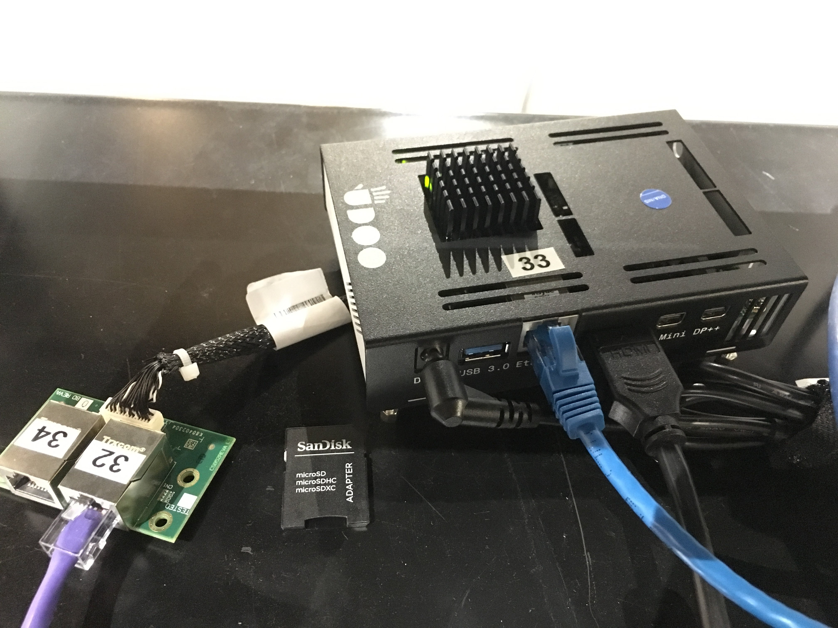
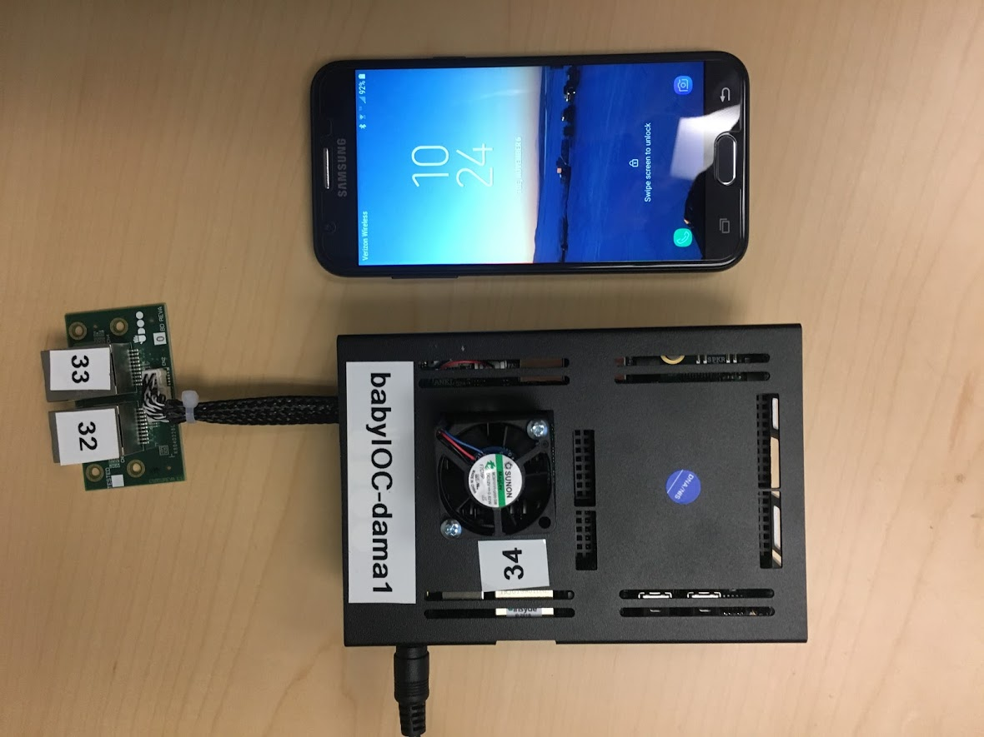
What is babyIOC?
Controls System in Box
64 bit Intel architecture
x4 core 2.56 GHz and 8GB RAM
x3 1Gbit Ethernet interfaces
1x HDMI, 2x miniDP++
3 x USB 3.0
2x UART serial ports
Intel HD Graphics 405
IR interface
Arduino 101-Compatible
diskless SBC
boots and runs from microSD
Building another system like this comes to copying the image to another microSD card.
What is on the image?
Debian Jessie
NSLS2 EPICS distribution built from https://github.com/epicsdeb
compiled areaDetector-3-3-1,
Prosilica IOC example
Bluesky Data Collection Suite
X2Go server.

Slide 3
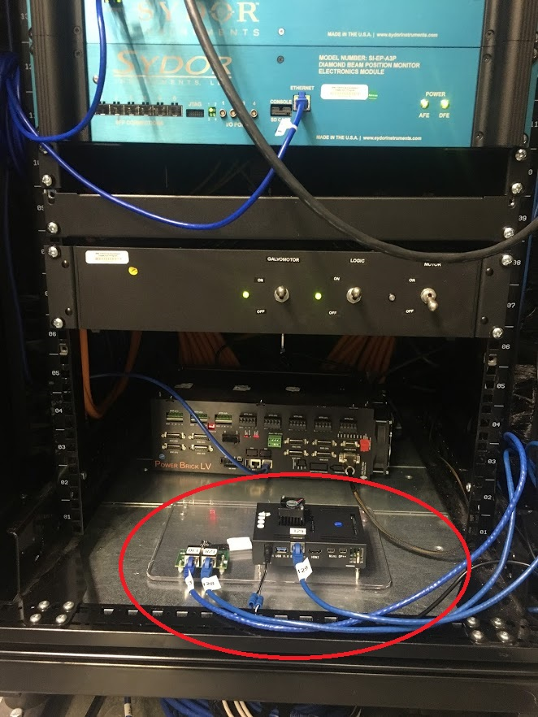
“Why babyIOC?
Mobile end-stations, which could travel from beamline to beamline, from one facility to another.
For testing software upgrades in real environment, can be easily put onto a beamline.
To gain confidence in new software at the beamline and accelerator.
To ease learning curve for people new to EPICS
To allow other labs try bluesky Data Acquisition Suit.

Slide 4
Why Udoo? (not raspberryPi, beagleboard)
Requirements:
Accomodate several areaDetector IOC (decent CPU muscles and at least 2GB RAM)
bluesky Data Collection Suite
Deliver decent performance and customer satisfaction.
We have conducted a research, reviewing many vendors which offer small SBCs:
Beagleboard
RaspberryPI
BoundaryDevices
Nvidia
Hardkernel
PCengineering
EmbeddedArm
Udoo
Udoo X86 Ultra from Italian startup was the winner, offering most RAM, CPU power for $356 USD. Project was funded on Kickstarter in 2016.

Slide 5
Links and credits
https://oksanagit.github.io/babyIOC
Credits
Oksana Ivashkevych^{BNL}vision, driver, babyIOC mother
Thomas Smith^{BNL} sysadmin, babyIOC father
Dennis Poshka^{BNL} babyIOC technician
Leon Flaks^{BNL}image conditioning
Thomas Caswell^{BNL} bluesky deployment
Matt Cowan^{BNL} sysadmin help
Kevin Peterson^{ANL} ideas for disc size expansion
28ID1, Milinda Abeykoon, Julian Adams^{BNL} project support
Christopher Stelmach^{BNL} adding cutoff to a drawing.
We are open to community suggestions

