Slide 1
Alarm History Service EPICS Collaboration Meeting 2018
John Sinsheimer, Kunal Shroff, Evan Smith, Tanvi Ashwarya
15th November 2018

Slide 2
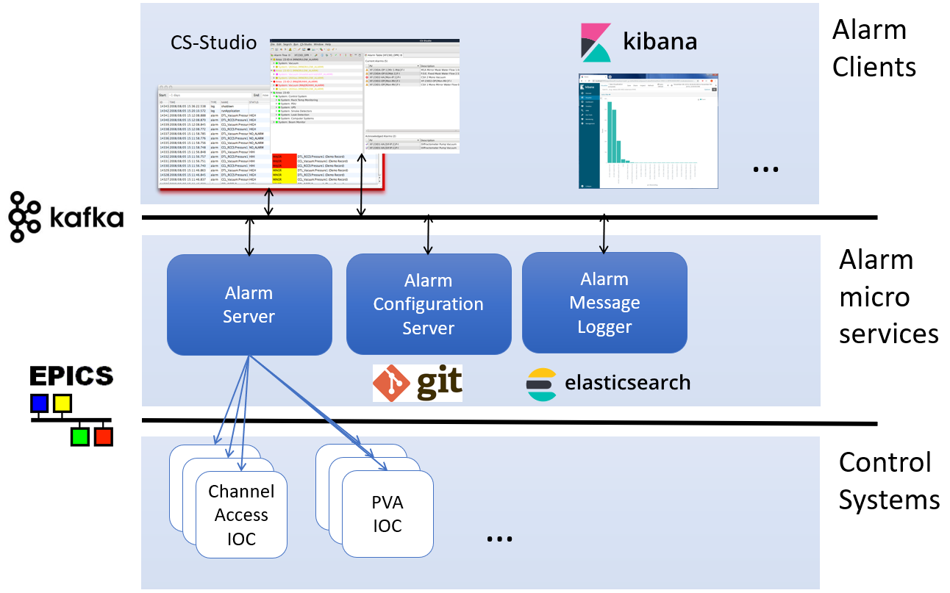
Notes:
Phoebus alarm server

Slide 3
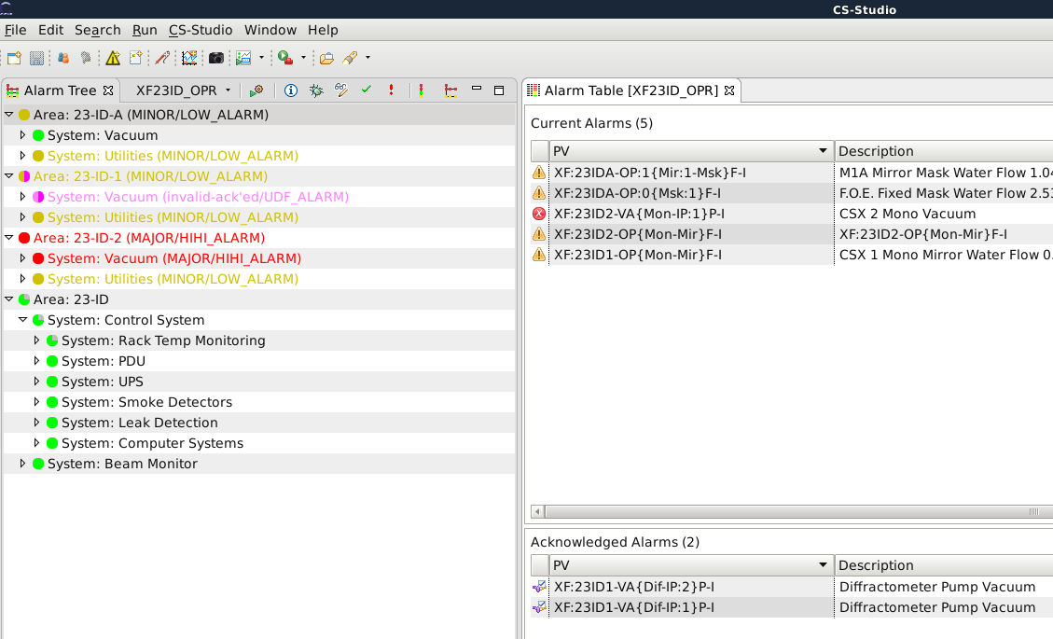
Notes:
At one of the beamlines an alarm tree configuration was implemented – having alarm monitoring on vacuum, utilities, and other systems such as rack temperature monitors, power distribution units, UPSs and even some computer performance monitoring. However, several PVs are noisy, on the edge of being in a minor alarm state for example, and it was difficult to determine how to configure the alarm server.
Not well configured – have many noisy alarms which then may send out email alerts when no immediate action is required. Too many of these types of alerts or notifications and they can become ignored.

Slide 4
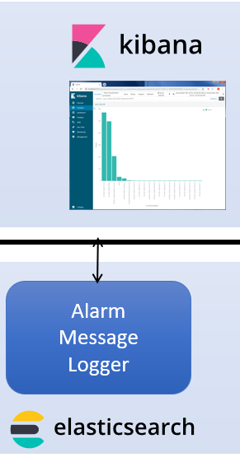
Alarm Message Logger
Logs alarm state from the alarm server and other messages to an elastic backend
Notes:
Using the alarm message logger we can now gather data

Slide 5
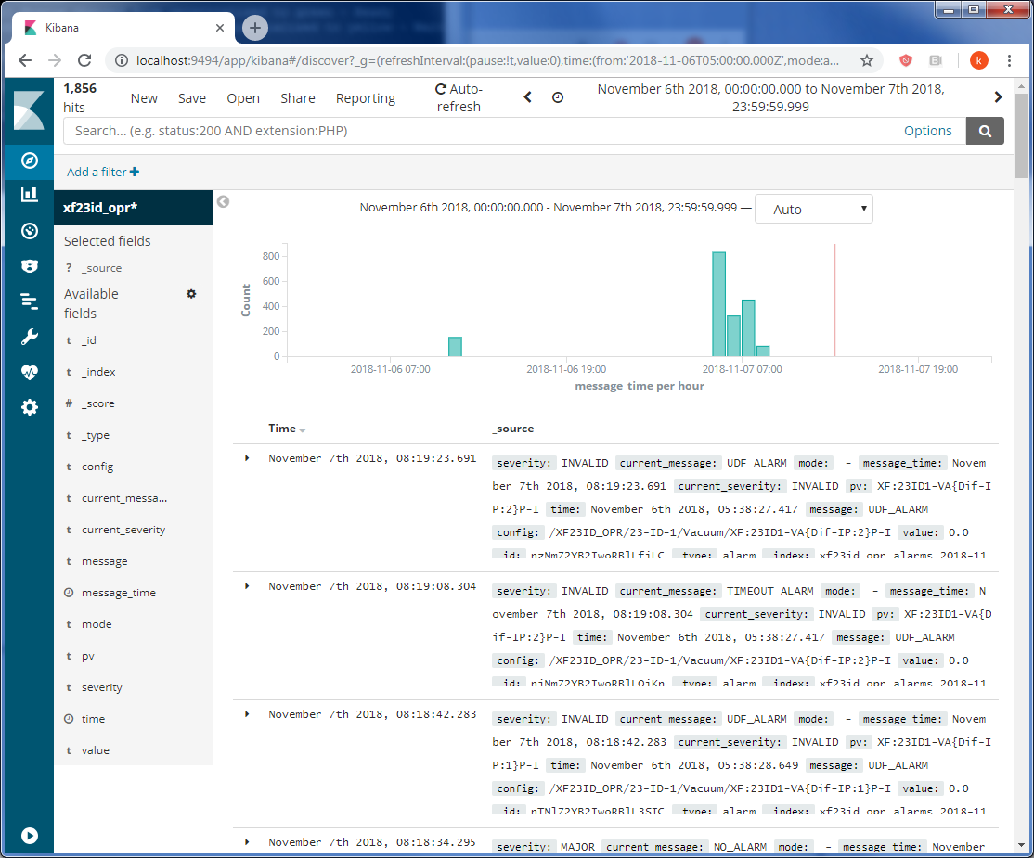
Notes:
Once you have the logging service up and running, the messages in the elastic backend can then be consumed through kibana
Kibana is a web tool to help visualize the data from the elastic server
This first slide shows the raw text log in time series of all alarm messages
Can zoom in on some of this data to understand what was happening
This shows a burst of 800 messages – so we can look at the events here to understand what is going on.

Slide 6
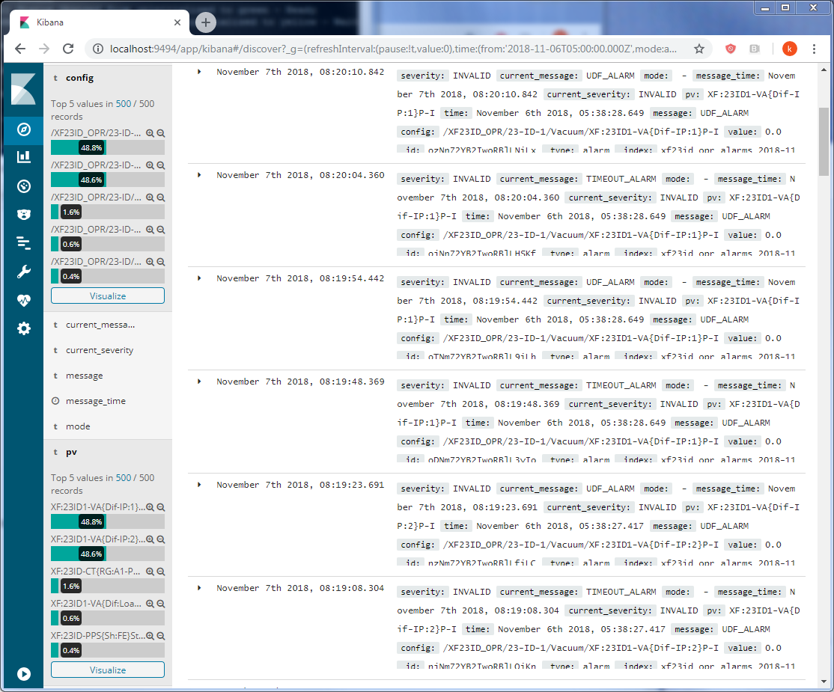
Notes:
For this time selected, we can get statstics on which PVs are triggering most of the laarm events. 2 PVs in this case responsible for 80% of alarms

Slide 7
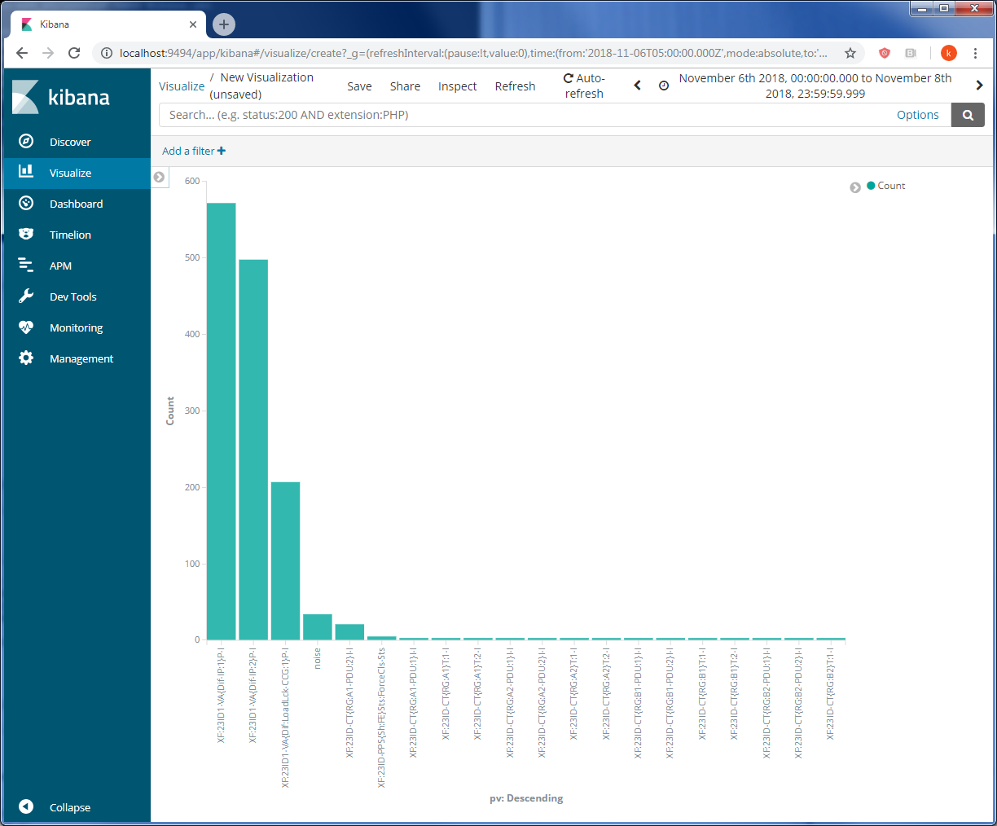
Notes:
Same data from previous slide visualized in a bar graph – the alarm configuration should be revisited for these 3 noisy PVs and reassessed.

