Slide 1
Alarm Configuration Service
Kunal Shroff
Evan Smith
Tanvi Ashwarya

Slide 2
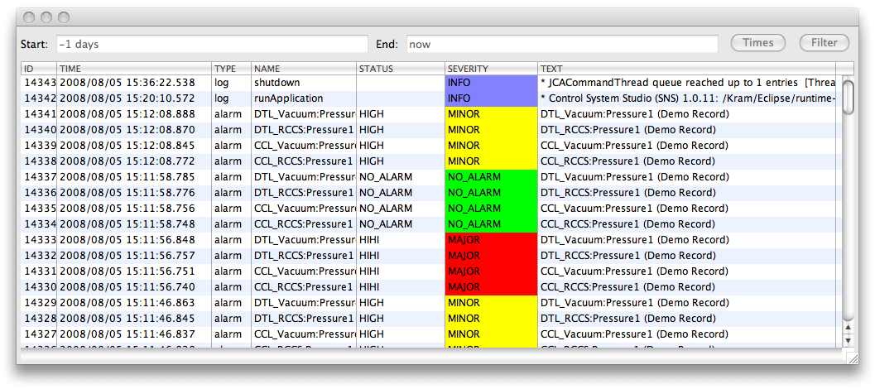
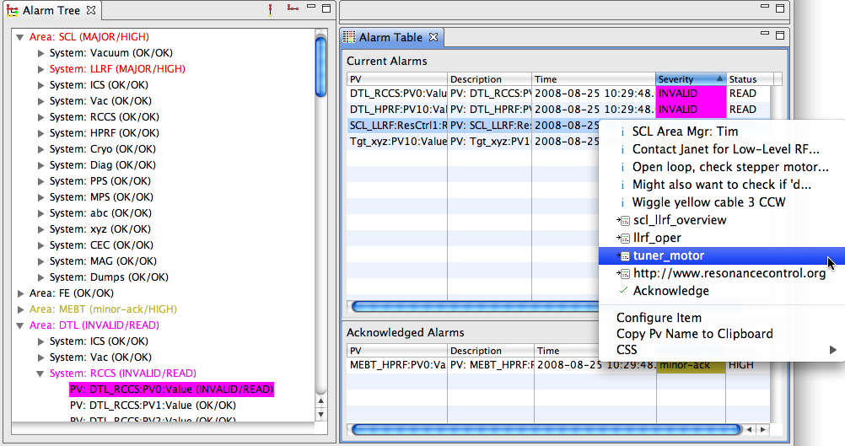
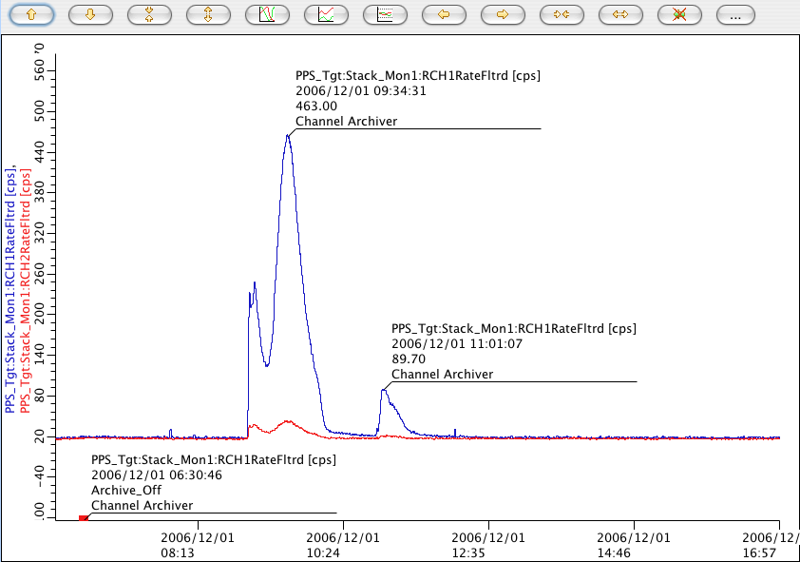
BEAST
IOCs
PV Updates (Channel Access, …)
Alarm Server
Current Alarms: Acknowledged? Transient? Annunciated?
Tomcat
Reports
Log Messages
Annunciations
Alarm Updates
Ack’; Config Updates
JMS
Alarm Cfg & State
RDB
LOG
TALK
ALARM_SERVER
ALARM_CLIENT
JMS 2 RDB
JMS 2 Speech
Alarm Client GUI
Message RDB
CSS Applications

Slide 3
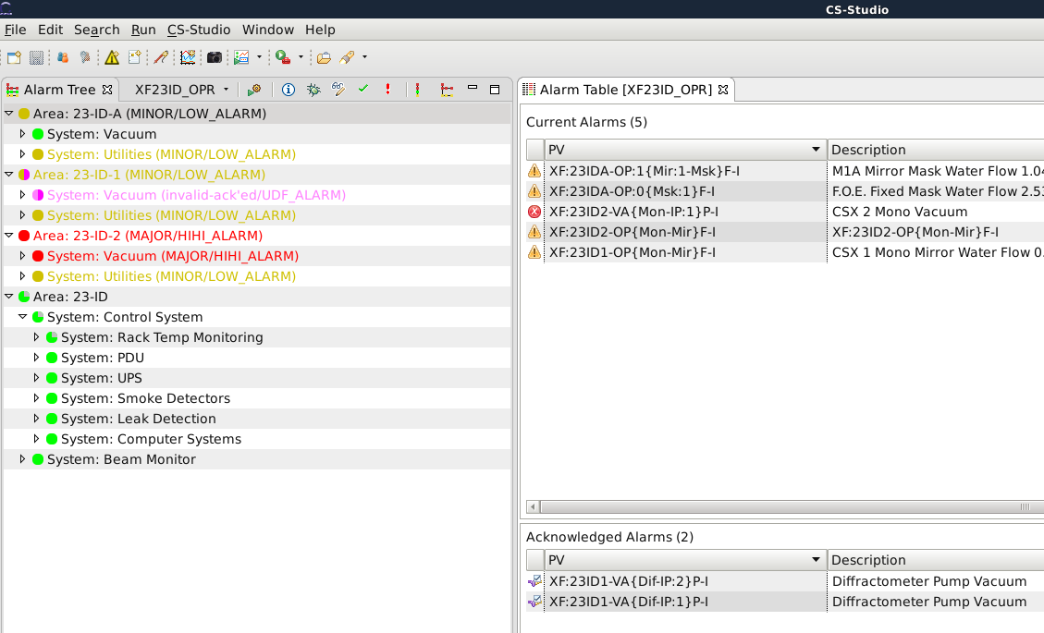
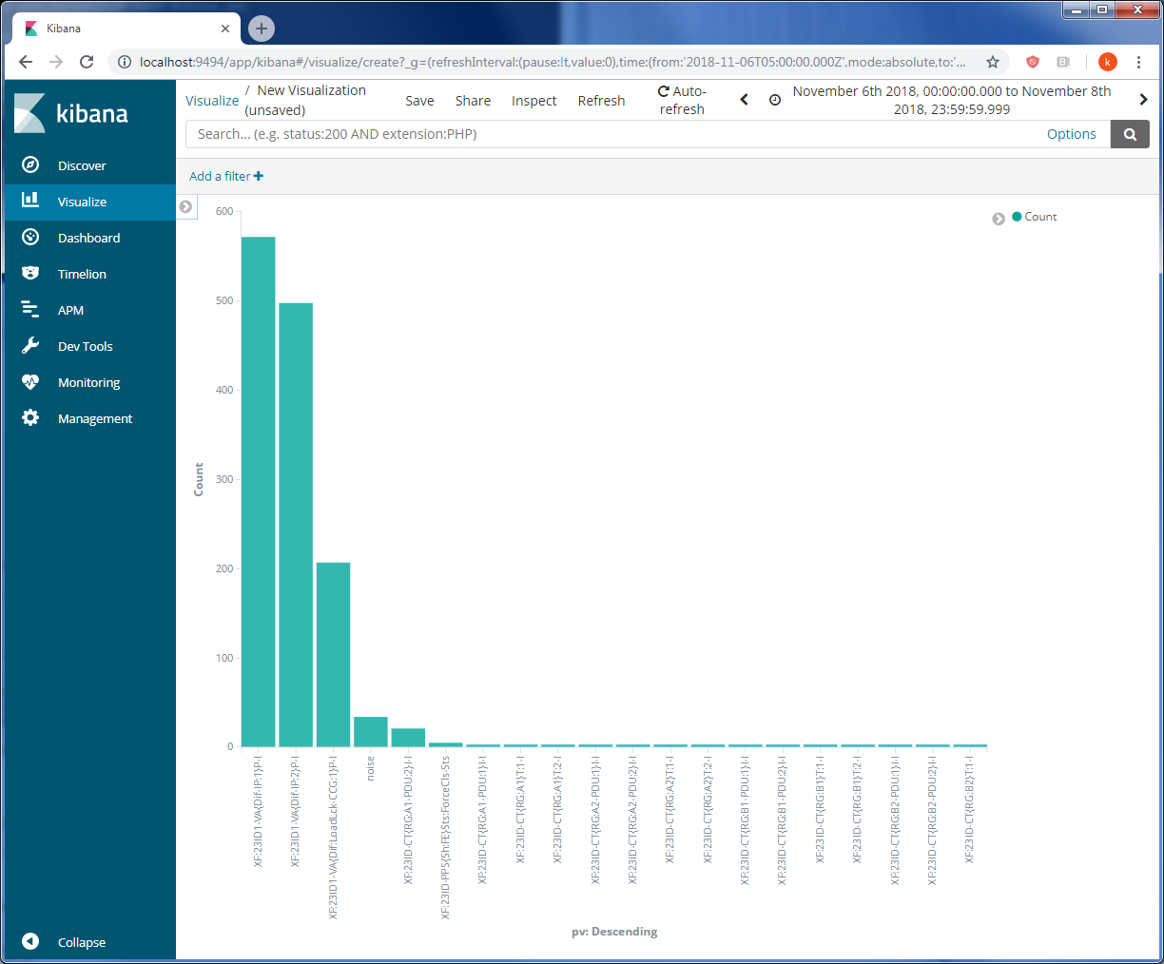
Alarm
Clients
CS-Studio
…
Alarm micro services
Alarm
Server
Alarm
Configuration
Server
Alarm
Message
Logger
Control
Systems
Channel
Access
IOC
PVA
IOC
…

Slide 4
Alarm Configuration Service
Alarm Configuration Messages
Motivation
Log the configuration changes made to the alarm server configuration
Build and Run
git https://github.com/shroffk/phoebus.git
cd services/alarm-config-logger
mvn exec:java
Alarm
Configuration
Server
Subscribe,
Filter,
Timestamp,
Process

Slide 5
Alarm Configuration Tree
Notes:
Mapping of the alarm tree to the file structure

Slide 6
Configuration History

Slide 7
Configuration events

Slide 8
Configuration events

Slide 9
Restore Scripts
Each alarm configuration change results in the creation or an update to the config.xml file.
The config.xml can be directly imported into the alarm server to restore it to the alarm configuration to that instant.

