Slide 1
Integrating the ESS Cryoplant into EPICS
Ivana Mustac, Robert Modic, COSYLAB

Slide 2
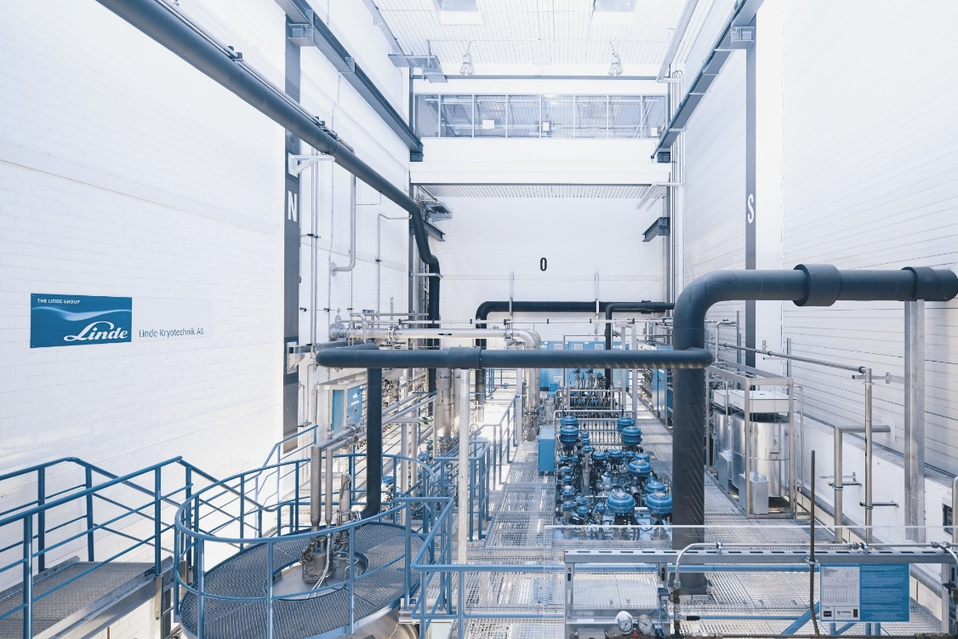
ESS cryogenic plants

Slide 3
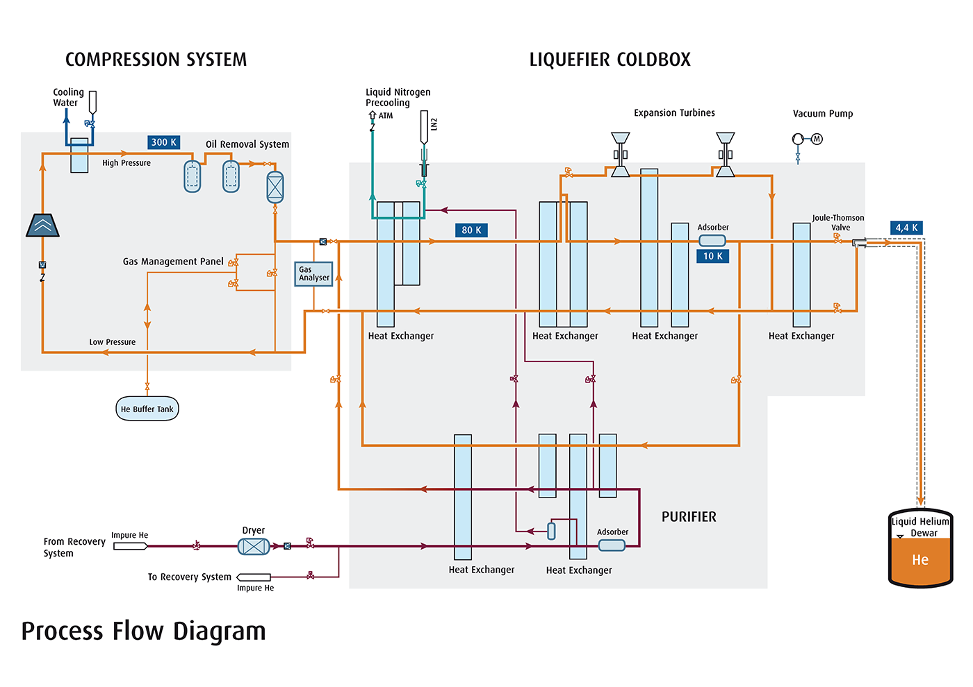
The cryo process

Slide 4
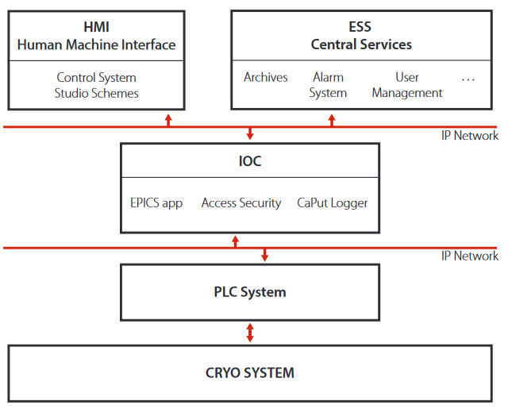
Control System Architecture

Slide 5
Highlights
Cryoplant is complex industrial grade system from Linde
Cosylab provided complete integration into EEE
On TMCP we used CS-studio Display Builder

Slide 6
Thank you!
Robert Modic, robert.modic@cosylab.com

