Slide 1
COSY upgrade for JEDI experiment
Ziga Oven, Robert Modic, COSYLAB

Slide 2
COSY JEDI

Slide 3
Existing control system
BUMP
SWEEP
RAMP

Slide 4
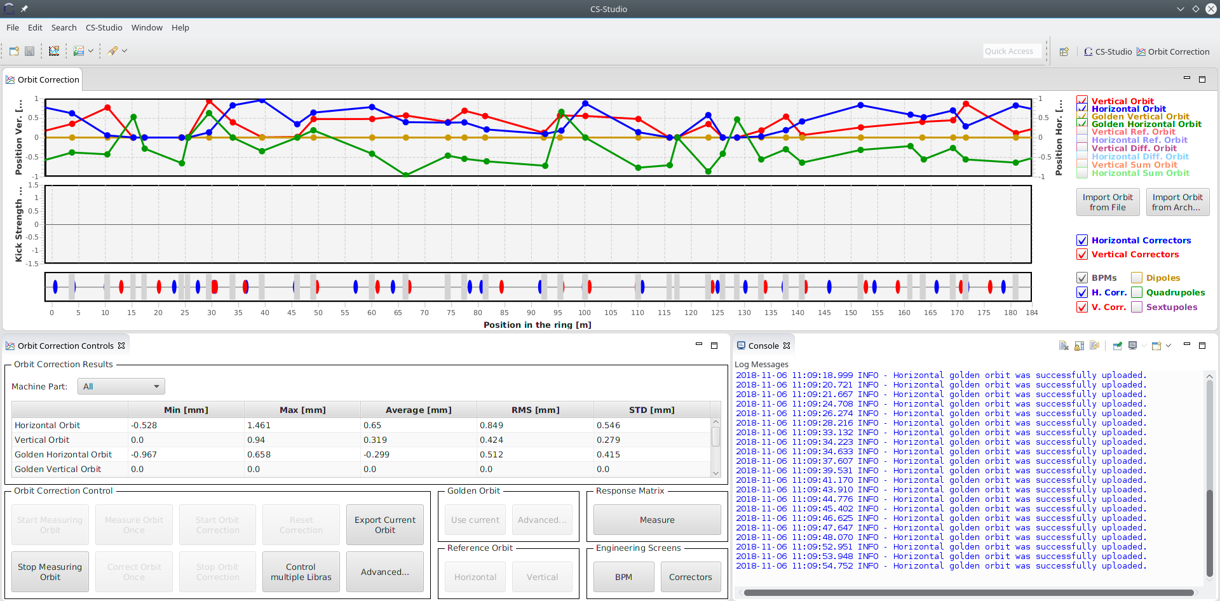
Upgrade to EPICS

Slide 5
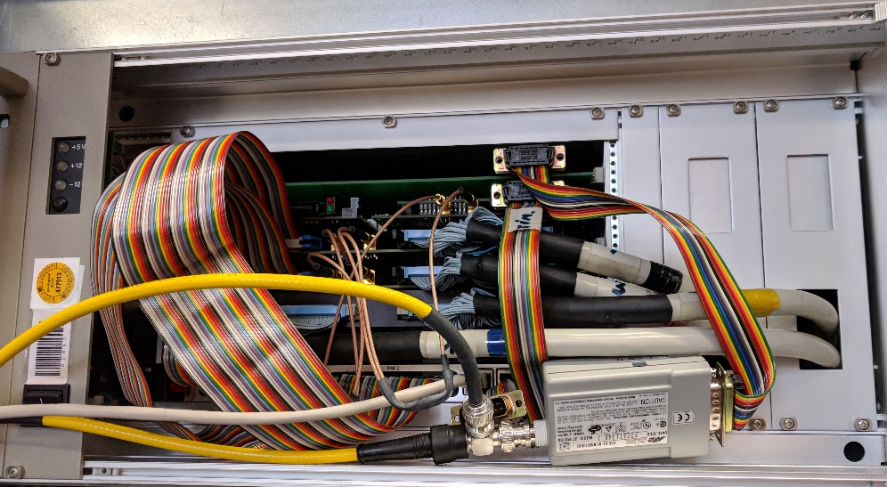
Migration of Magnet PS to EPICS

Slide 6
Thank you!
Robert Modic, robert.modic@cosylab.com

