Slide 1
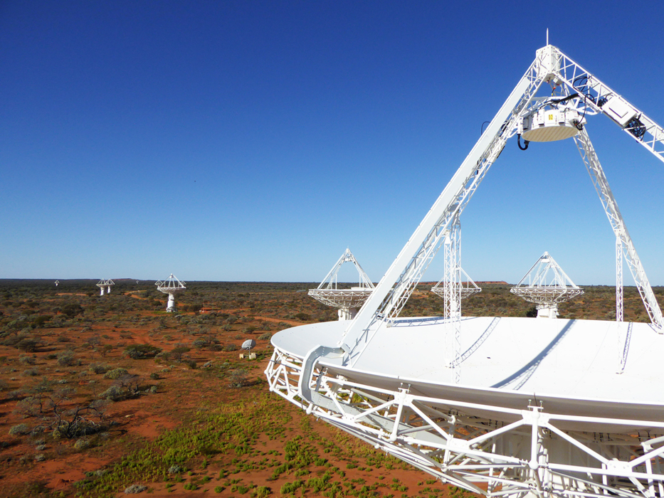
TANGO from an EPICS perspective
Astronomy AnD SPACE
Euan Troup | Developer
15 November 2018

Slide 2
TANGO – TACO Next Generation Objects
TACO – Telescope and Accelerator Control with Objects
http://tango-controls.org
OO software framework for distributed control systems
CORBA & 0MQ network transport layer cf Channel access/PVaccess
Software ecosystem
C++, Java, Python libraries & toolkits – others as well
Core applications
Astor (TANGO Manager), Jive, ATKPanel, Pogo (Class Generator), Synoptic and Jdraw, Tango Application Toolkit “ATK”, LogViewer,Qtango,Canone
Other applications
Archiver
Alarm handler

Slide 3
TANGO Concepts
OO software framework for distributed control systems
CORBA & 0MQ network transport layer
Tango device & device servers plus clients
SQL database for configuration
Name service
Addressing is hierarchical
domain/family/member
mid_csp_cbf/bf_type1/5
Full [protocol://][host:port/]device_name[/attribute][->property][#dbase=xx]
IDL defined software interface for clients & server including
Defined data types
Tango::DevBoolean,Tango::DevShort,Tango::DevLong,Tango::DevLong64,Tango::DevFloat,Tango::DevDouble,Tango::DevUChar,Tango::DevUShort,Tango::DevULong,Tango::DevULong64,Tango::DevString,Tango::DevState,Tango::DevEncoded
Scalar, Spectrum, Image
Commands (RPC)
0 or 1 parameter, returns 0 or 1 parameter
Attributes (PVs)
Properties: Quality factor, timestamp, alarm limits
Polling
Change event, archive event, periodic event, data ready event
Events
User defined, interface change
Defined states
14: ON, OFF, CLOSE, OPEN, INSERT, EXTRACT, MOVING, STANDBY, FAULT, INIT, RUNNING, ALARM, DISABLE, and UNKNOWN.
State machine coder implemented

Slide 4
More TANGO
POGO code generator
Multi-language C++, Java, Python
Device class & state machine
Jive Configuration Tool
device names
attribute names
dynamic attributes
attribute properties
free properties
stored properties

Slide 5
TANGO on its own
Documentation a bit lacking
Not enough worked examples
No example source code in TangoBox
More emphasis on coding rather than configuration
Hundreds of devices in Jive?
How to do hierarchy
Client code in device looks clunky
Threading? Locking?
cf EPICS IOC – CA server & CA client

Slide 6
Thank you
Astronomy & Space
Euan Troup
t +61 2 9372 4066
e Euan.Troup@csiro.au
ASTRonomy & SPace

