Slide 1
ANSTO/Australian Synchrotron BR–GHT (new beamline) program
Andrew Stevenson, MCT beamline, ANSTO/Australian Synchrotron
EPICS Collaboration Meeting
– 14th November, 2018

Slide 2
BR–GHT program – beamline projects, Common Systems & BR–GHT+
BRIGHT Program | Projects |  |  |  |  |  |  |  |  | BRIGHT + Projects
 | MCT | MEX | BioSAXS | ADS | HMX | MMN | MMC | ICA
Photon Delivery Mirrors Monochromator Slits & apertures Stops, absorbers, windows Beam diagnostics |  |  |  |  |  |  |  |  |  | BRIGHT Site & Logistics (FY18) Ring Upgrades Monument Survey network (FY17 – near completion) Front End plus BPM’s (FY18) Insertion Device (FY19) BioSAXS (Undulator); ADS (SCM Wiggler); HMX (Undulator); MMN (Undulator); MMC (Bend Magnet); ICA (TBD). Machine PSS (FY18) & EPS upgrade (FY17)
End Station Sample Environment Sample manipulation Detectors Tables & supports
BL Control & Computing
Civil Works |  |  |  |  |  |  |  |  |  | Facility Upgrades: Engineering workshop extension (FY19) Stores building (FY19) Laboratory extension (FYXX) Office space reconfiguration (TBD) LN2 distribution (FY19) Utility distribution upgrade (water) (FY19) BL UPS Replacement (FY18) Environmental Hutch Control (FY19) Data storage upgrade (FYXX) High Performance Computing (FYXX)
Common Systems
Hutches
Vacuum
Cryogenics
Compressed air
Water cooling
Power, network, signal cabling
PSS and EPS
Mechatronics & Electronics
Software Engineering
IT Infrastructure
Temperature control
Gas exhaust
User Cabins

Slide 3
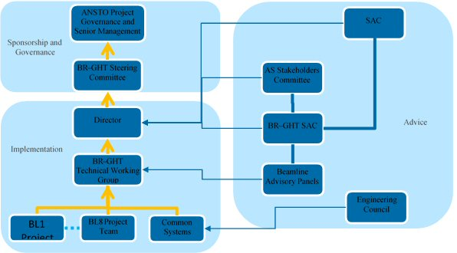
BR–GHT - related structure

Slide 4
important practical points
The MCT beamline project has strong inter-dependencies with other projects:
BRIGHT Common Systems program, including key elements such as standardisation, hutches & PSS upgrade
BRIGHT+ projects
MCT located at BM1 on sector 9, where
there is an existing (spare) front end
MCT user program to start
(Thursday) 1st July, 2021

Slide 5
key to success of MCT,
& BR–GHT beamlines more generally
fully developed & agreed facility standards for
motion control
IT infrastructure
software & GUIs
utilities
cabling
vacuum
hutches & environments
cryogenics
PSS/EPS
specialised user equipment
water cooling
user cabins

Slide 6
Micro-Computed Tomography (MCT) beamline
9-BM1
(MCT)
8-ID
(IMBL)
synchrotron
entrance

Slide 7
Micro-Computed
Tomography (MCT)
beamline

Slide 8
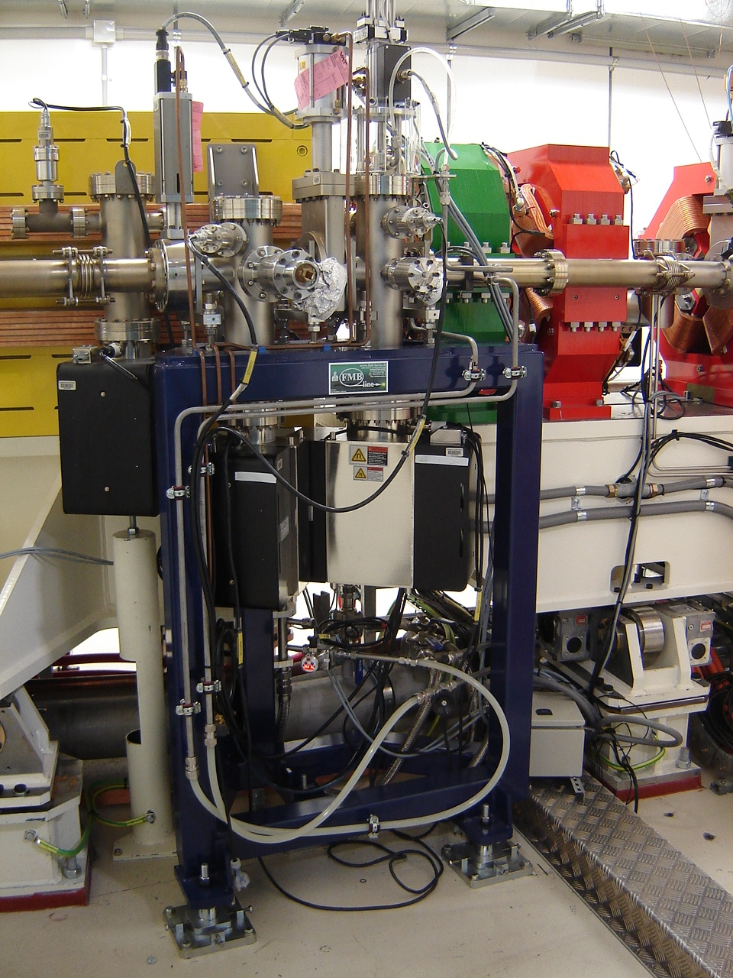
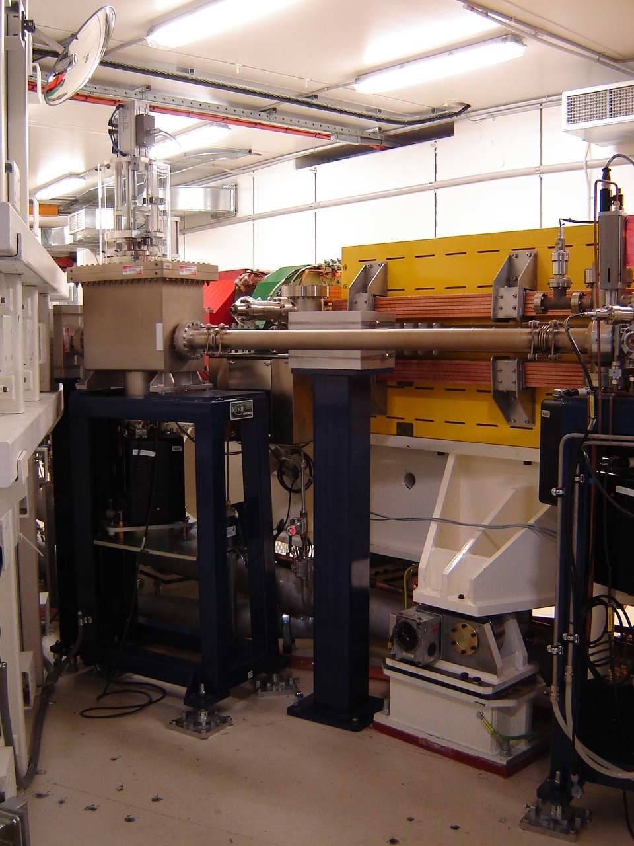

Slide 9
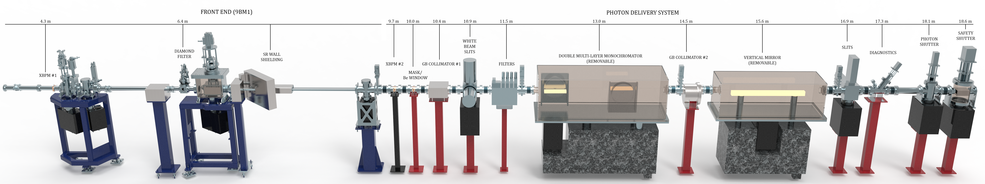
MCT FE & PDS schematic

Slide 10
MCT aims
To design & build a world-class MCT beamline capable of:
  non-destructive, 3D sample characterisation with sub-micron spatial resolution
  supporting state-of-the-art IT infrastructure for data processing, reconstruction, visualisation & analysis
  innovative phase-contrast modality to improve sample information content
  high-throughput/high-speed sample
  mode
  use of non-ambient sample
  environments
  robotics for automatic
  sample change

Slide 11
MCT photon-delivery system items
item | MCT component | distance (m)
1 | BM source | 0.0
2 | XBPM | 9.7
3 | fixed mask | 10.0
4 | GB collimator #1 | 10.4
5 | high-heat-load slits (A) | 10.9
6 | filters | 11.5
7 | DMM | 13.0
8 | GB collimator #2 | 14.4
9 | pre-mirror slits (B) | 14.9
10 | vertical-bounce mirror | 16.1
11 | diagnostics | 17.3
12 | beam-defining slits (C) | 18.5
13 | photon shutter | 19.0
14 | safety shutter | 19.5
15 | hutch wall | 20.0
16 | vacuum (Be) window | 20.2

Slide 12
MCT brief summary

Slide 13
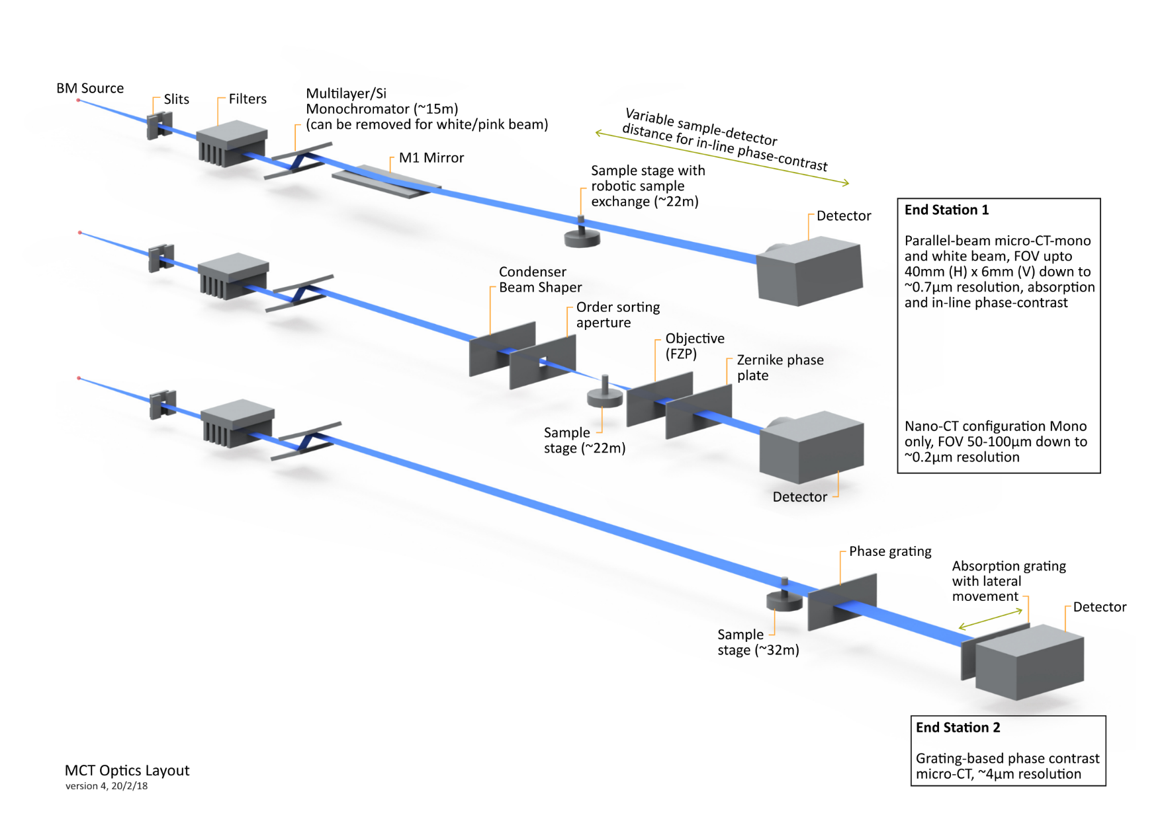
MCT - modes
Two end stations do not run simultaneously

Slide 14
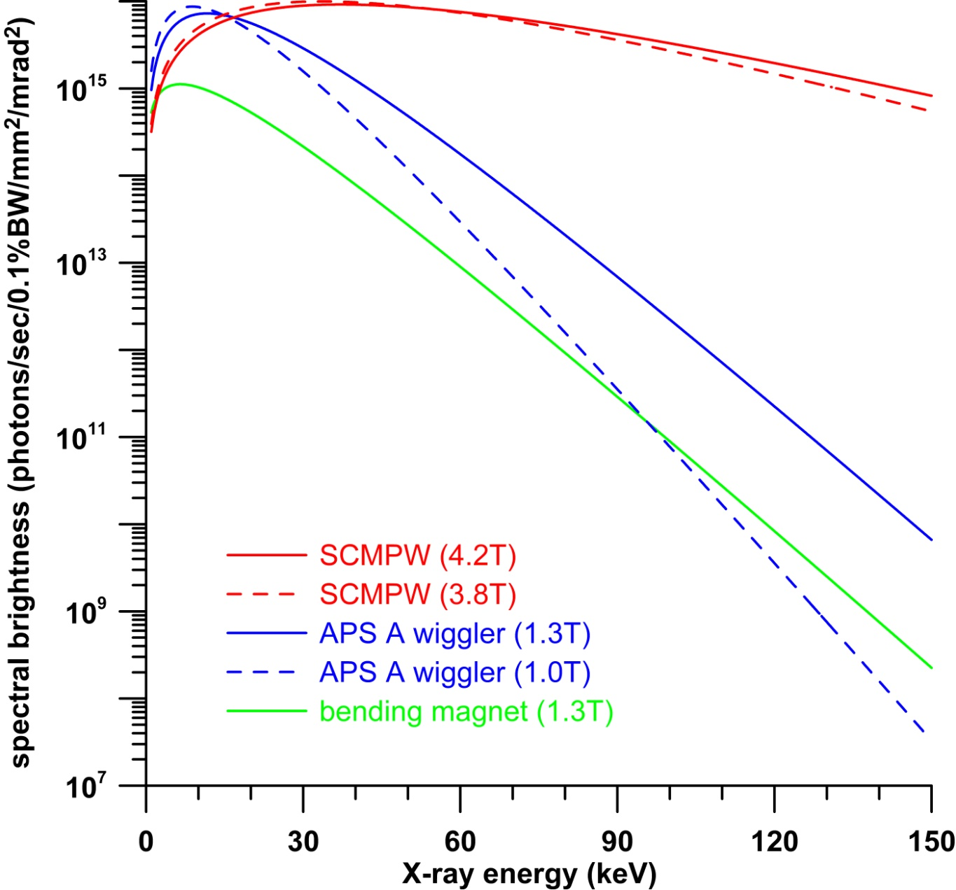
spectral brightness (20 m from source)

Slide 15
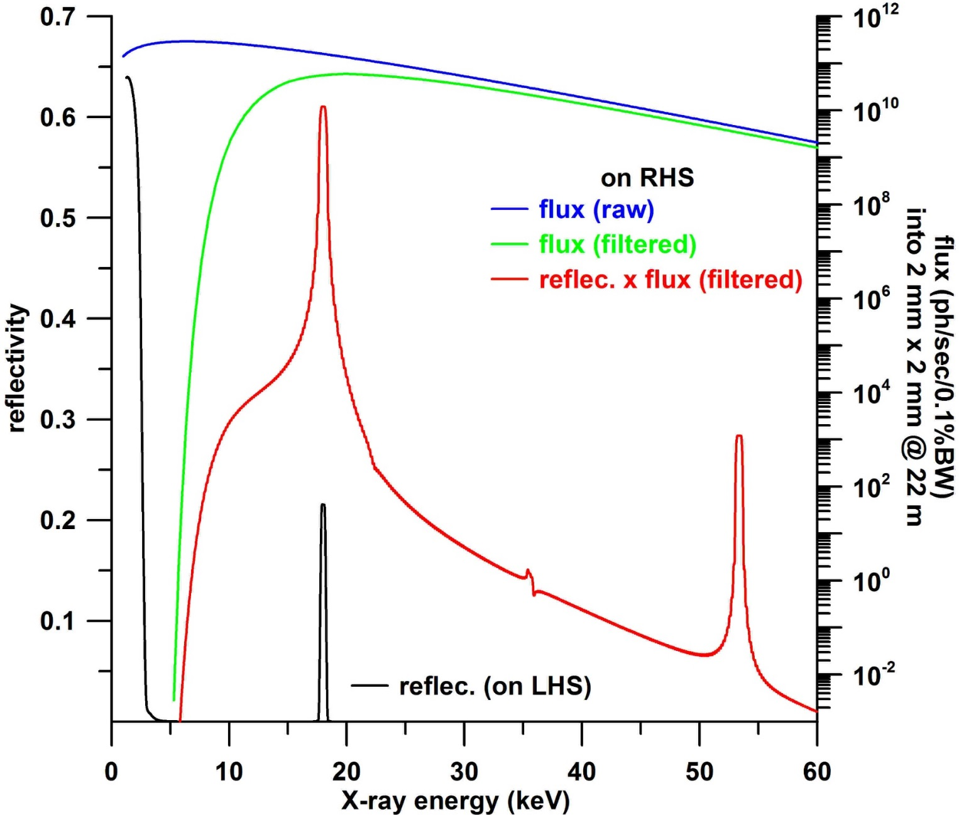
MCT – DMM reflectivity calculations

Slide 17
MANY THANKS TO
Adam Walsh, David Ferry, Hima Cherukuvada & Harvey
Those at ANSTO/Australian Synchrotron (AS)
who have contributed, are contributing
and/or will contribute to MCT
MCT BAP, AS SAC, our future users

Slide 18
MCT beamline, ANSTO/Australian Synchrotron
Dr Andrew Stevenson
Phone: +61 3 8540 4259
Email: stevensa@ansto.gov.au
Thank you for your attention

