Slide 1
The Australian Synchrotron
Control System Breakdown Structure (csbs)
Epics Collaboration Meeting 2018
Rosemary Waghorn

Slide 2
Why and why now
Bright project (8 new beamlines) allows us to create common systems software for them.
Single source for design and update of components and their physical and data flow relationships in an operational area.
Standardise reference data like Device Type.
Standardise naming convention.
Standardise output API that can be used by other systems.
Can be part of a microservice architecture.
Notes:
As William mentioned, the bright project allows us the time and funding to create common software systems.
So we can create tools that enable and enforce constancy.
We want to reduce double entry of information, so this system will be the single location for this particular information.
Change textfields to reference data dropdowns where possible.
The output API is still in the requirements gathering stage, since we need to determine all the systems that will use data from this system, and their data format needs.

Slide 3
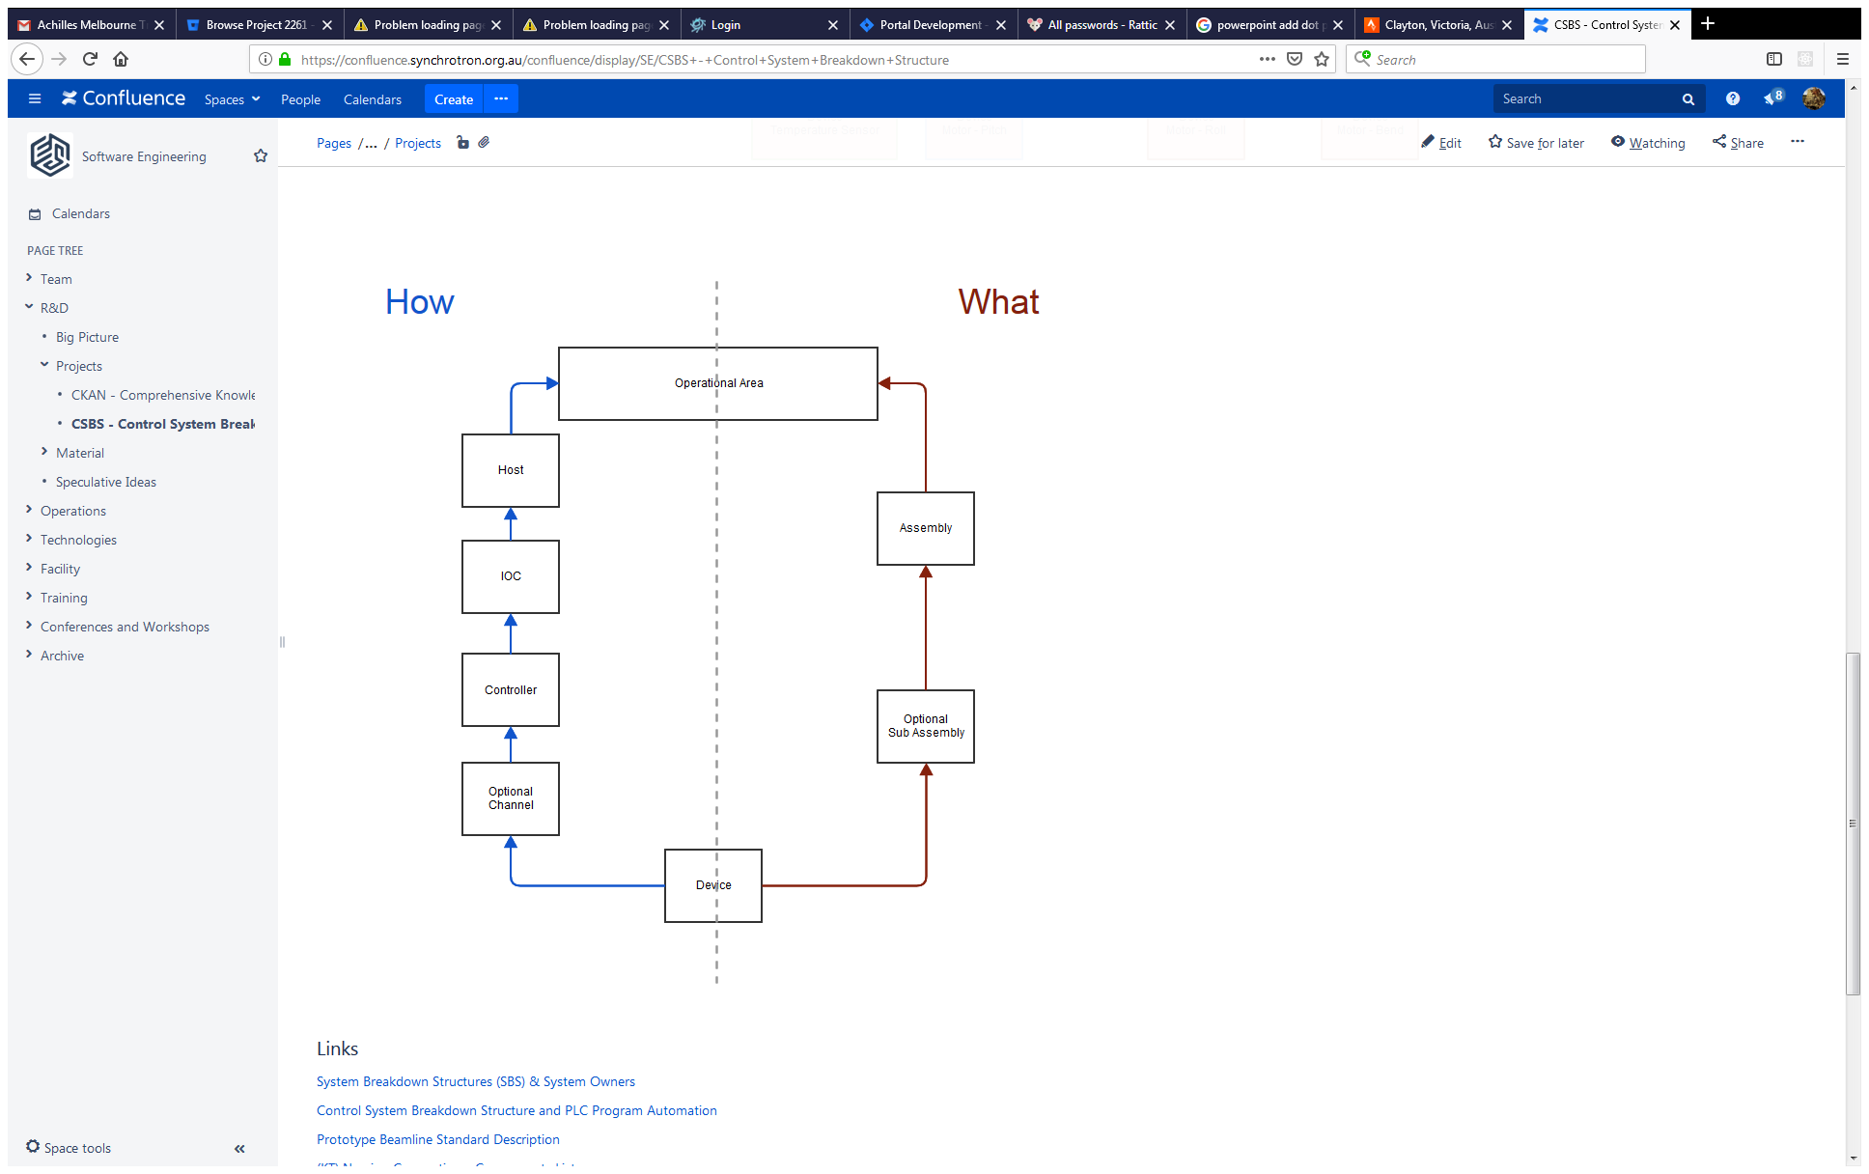
Relationships
Data Flow relationship
Needed by PLC group for safety systems.
Other systems ?
Physical Relationship
Not likely to change.
Used to determine PV name
Notes:
Right side is the physical relationship.
Left side is the data flow relationship.
We decided not to have location because we could not rely on it being updated correctly.
Currently the ‘what’ path will be used for creating the PV, since it is less likely to change.
The ‘How’ path will be needed by the PLC group to create the PVs needed by that group for the safety systems.
There will also be the device parameters needed for substitution files.
Simple and concrete

Slide 4
Component Glossary
Term | Definition | Examples
Host | Computing device - hosts software and hardware that implements the control system. | Computer - real or virtual, Platform Type: PC, VME etc Operating System: VX Works, Linux, Windows etc
IOC | Epics application. Uses internal database and software drivers to communicate with devices through 'controllers'. | AreaDetector, Motor, Temperature, Data Acquisition, Optics Delivery (combined), General Purpose, Support records.
Assembly | Collection of devices which are physically, functionally or logically connected. Can have multiple levels of sub assemblies | Vertical focusing mirror (VFM), Linear Stage
Controller | Implements and interprets the communications protocol to and from the IOC. It reads and controls the devices. | Vacuum controller, Temperature controller, Data Acquisition
Device | Usually physical hardware to measure or control some physical property. Usually linked to a PV | Thermocouple, Motor, Gauge, Detector
Channel | Attribute of controller to indicate which communication channels are connected to a given device/s. | Channel A of motor controller
Notes:
Decided to limit scope to just devices and their how and what hierarchies, and probably device parameters (with sensible defaults based on device type) needed for substitution files.

Slide 5
Autogenerate PVs from API
PVs are fundamental to EPICs
We want them autogenerated because although we originally had rules for them, over time we drifted.
If we take it out of manually control, we will always be consistent.
API - List of Epics PVs and descriptions to contribute to autocreate IOCs
API - Reverse lookup of PVs to get relevant details about it for reporting, metadata etc.
Notes:
combines data feed with other resources as needed.
Because PV names are unique and are linked to a single device hierarchy, there will be a api for lookup for useable information from a pv.
Output can include calculated items like epics PV name.
Standardise reference data like Device Type
Capture relationships between components.
One slide
PV names
Reverse lookup
Engineering GUIs
Dream of auto generate IOCs
Documentation
Data entry
Will have a draft mode so can test before it becomes part of the official API output.

Slide 6
Autogenerate GUIs from API
Since the CSBS has the list of all the devices, can autogenerate an engineering GUI in a sensible manner.
This will use pre defined templates.
Display manager technology still under investigation.
Notes:
combines data feed with other resources as needed.
Because PV names are unique and are linked to a single device hierarchy, there will be a api for lookup for useable information from a pv.
Output can include calculated items like epics PV name.
Standardise reference data like Device Type
Capture relationships between components.
One slide
PV names
Reverse lookup
Engineering GUIs
Dream of auto generate IOCs
Documentation
Data entry
Will have a draft mode so can test before it becomes part of the official API output.

Slide 7
Autogenerate IOCs from API
Is a long term plan.
Will use templates for different controller and device types.
CSBS may be one of several data feeds required.
Notes:
combines data feed with other resources as needed.
Because PV names are unique and are linked to a single device hierarchy, there will be a api for lookup for useable information from a pv.
Output can include calculated items like epics PV name.
Standardise reference data like Device Type
Capture relationships between components.
One slide
PV names
Reverse lookup
Engineering GUIs
Dream of auto generate IOCs
Documentation
Data entry
Will have a draft mode so can test before it becomes part of the official API output.

Slide 8
Autogenerate Documentation from API
Because it is the single source for the data, the CSBS can be used as a data feed for confluence pages or other documentation pages.
Notes:
combines data feed with other resources as needed.
Because PV names are unique and are linked to a single device hierarchy, there will be a api for lookup for useable information from a pv.
Output can include calculated items like epics PV name.
Standardise reference data like Device Type
Capture relationships between components.
One slide
PV names
Reverse lookup
Engineering GUIs
Dream of auto generate IOCs
Documentation
Data entry
Will have a draft mode so can test before it becomes part of the official API output.

Slide 9
Data Entry
Based on Web technology
Mysql/MariaDB relational database
Python flask backend service
Restful interface for data entry API, and export API
ReactJS for interface.
Notes:
combines data feed with other resources as needed.
Because PV names are unique and are linked to a single device hierarchy, there will be a api for lookup for useable information from a pv.
Output can include calculated items like epics PV name.
Standardise reference data like Device Type
Capture relationships between components.
One slide
PV names
Reverse lookup
Engineering GUIs
Dream of auto generate IOCs
Documentation
Data entry
Will have a draft mode so can test before it becomes part of the official API output.

Slide 10
Thank you

