Slide 1

The Next EPICS Collaboration Meeting

Slide 2

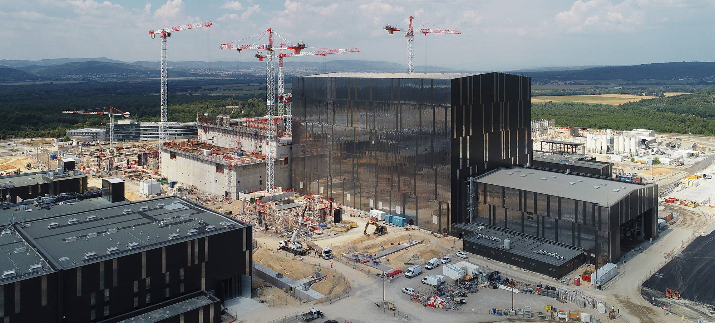
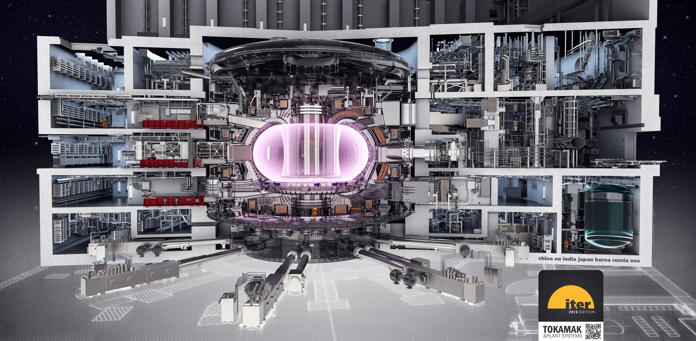
03 – 07 June 2019 at the ITER Site in Cadarache

Slide 3
Tentative Agenda
Mon 03 June: Workshops Smaller working groups covering special topics: OPI, Motion Control, Timing, ... you name it. |  | Tue 04 - Thu 06 June: Plenary Meeting The main course: Big talks and smalltalk, industrial exhibits, visit of the construction site.
Fri 07 June: Demonstrations and Training Things to take home: Demonstrations of tools and applications, EPICS 7 Training, ... |  | Accompanying Events Conference dinner, meetings of committees and special interest groups.
EPICS Collaboration Meeting June 2019 Tentative Agenda

Slide 4
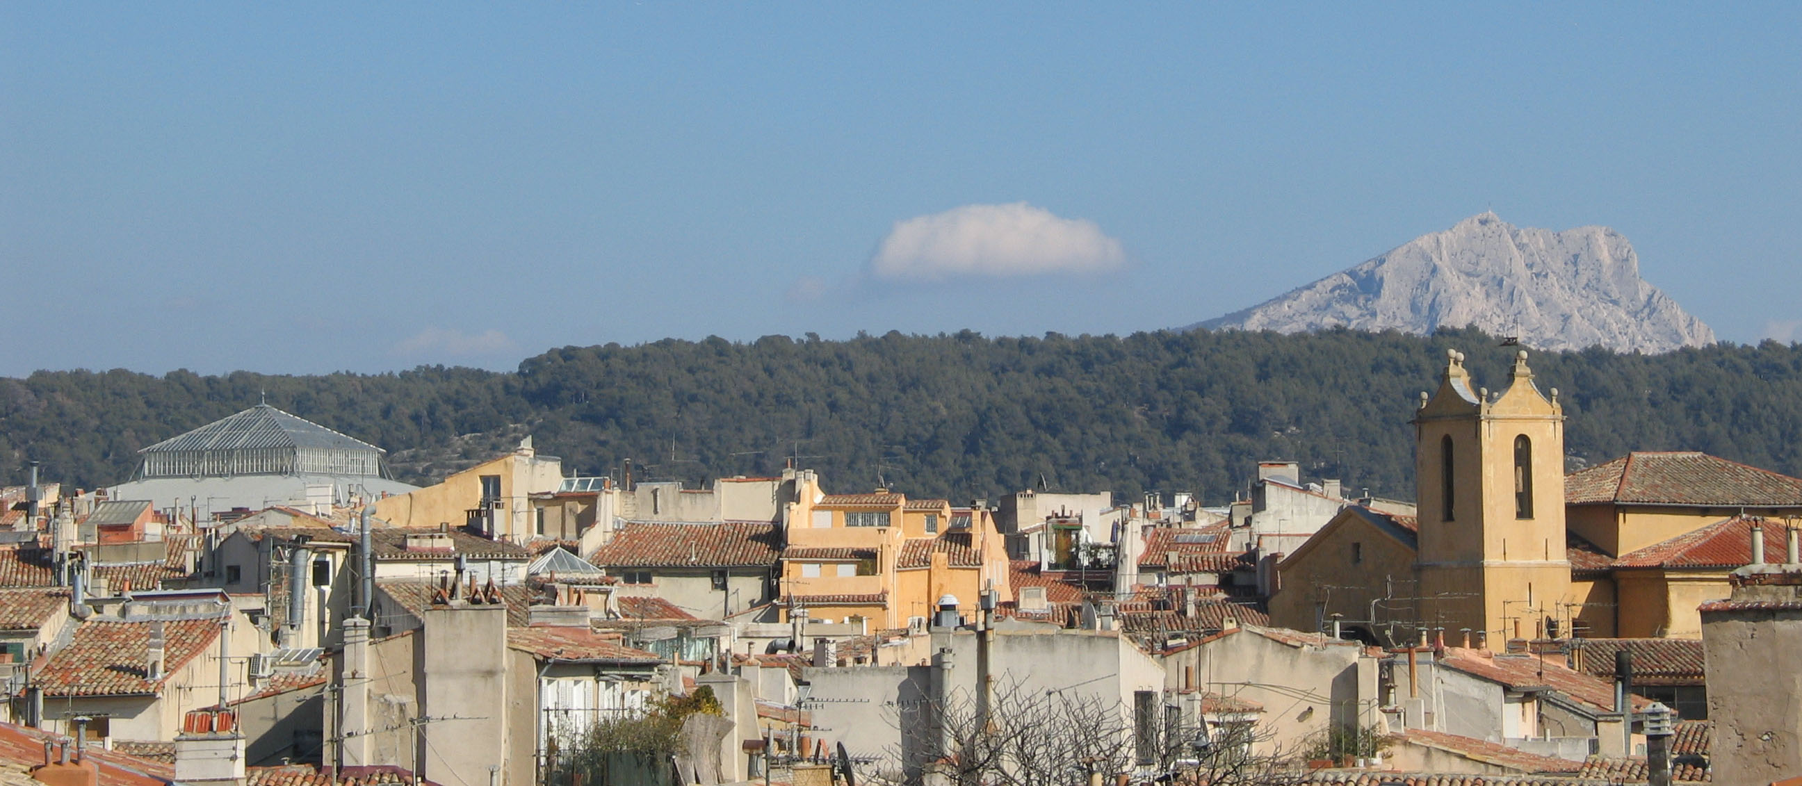
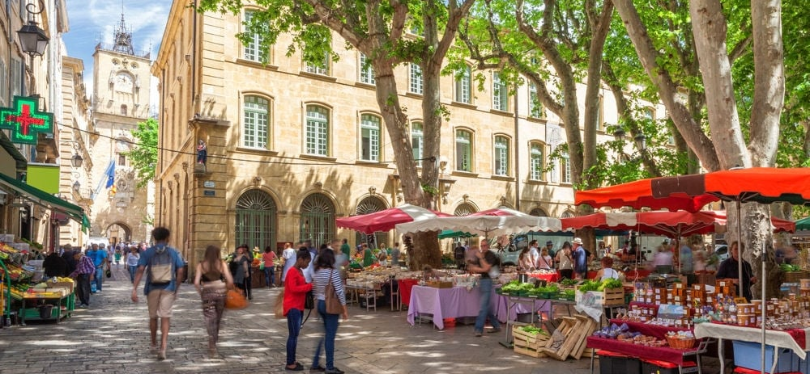
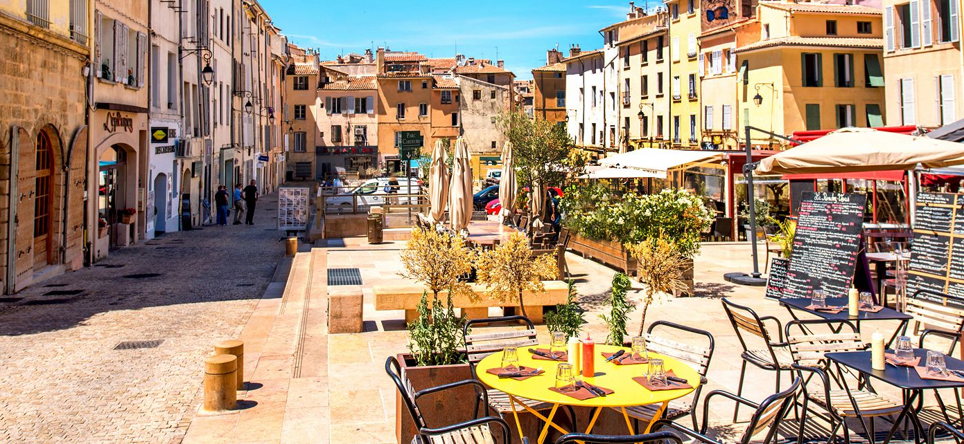
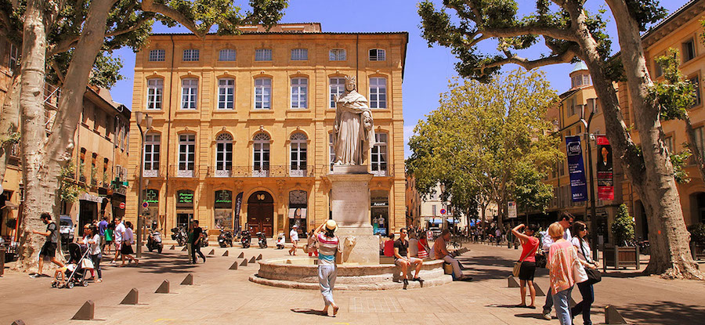
Accommodation: Aix-en-Provence

Slide 5
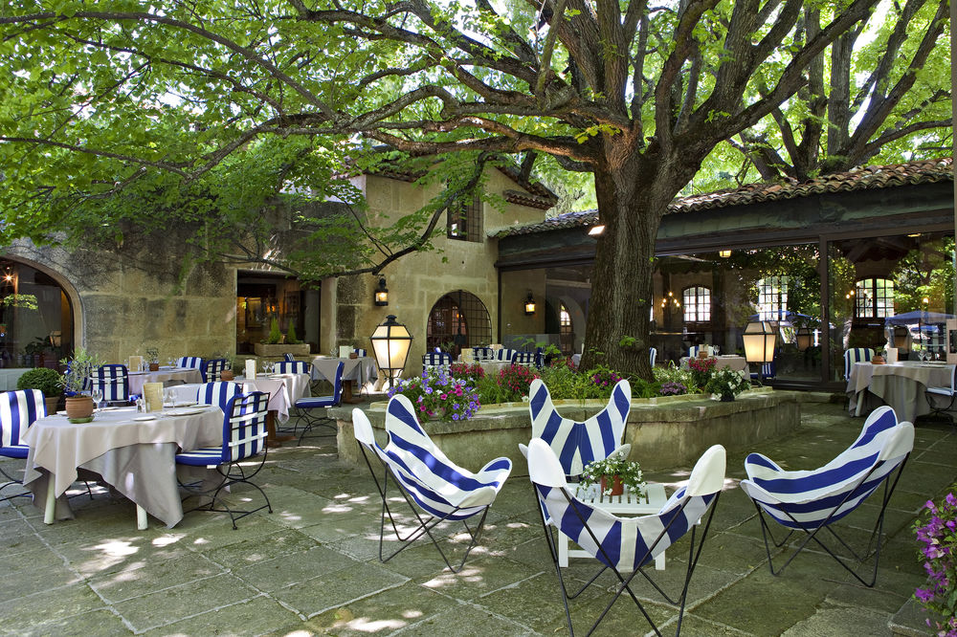
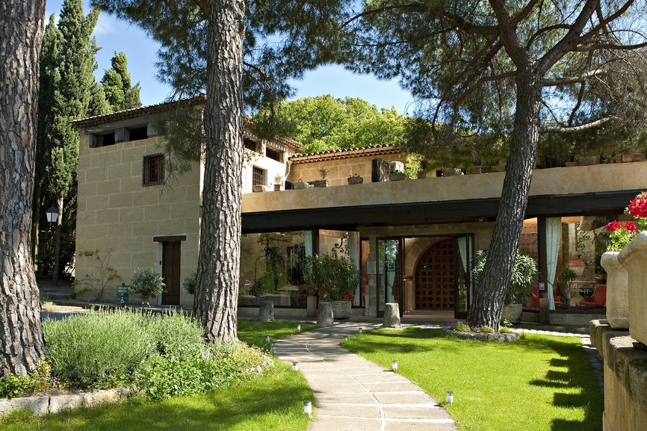
Dinner: Le Mas d’Entremont, Aix

Slide 6
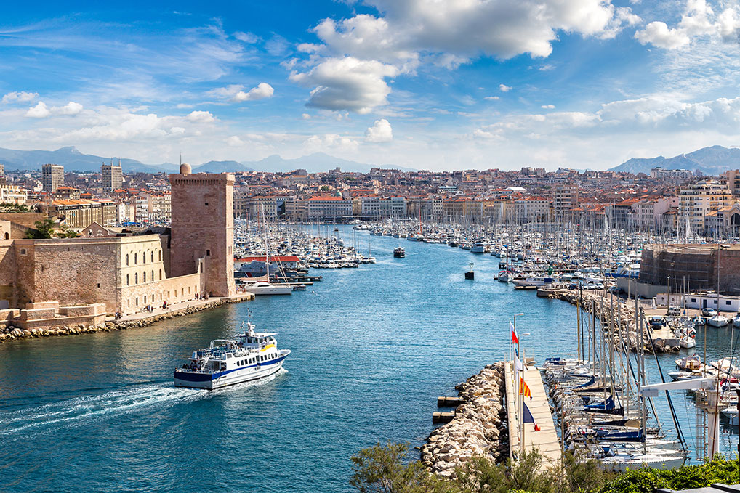
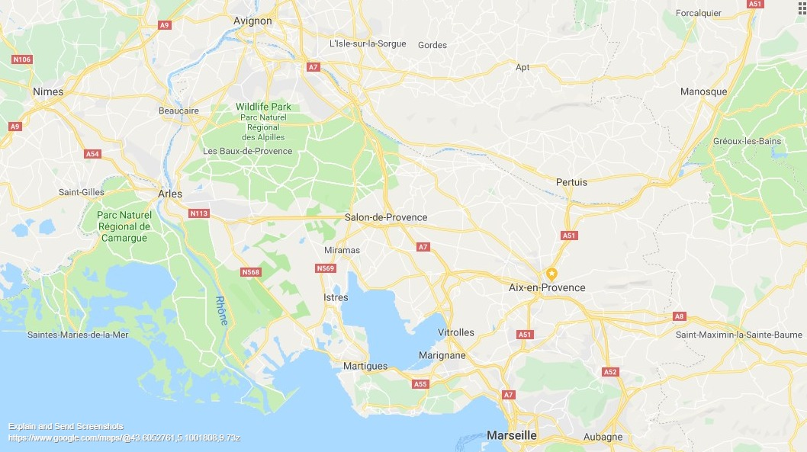
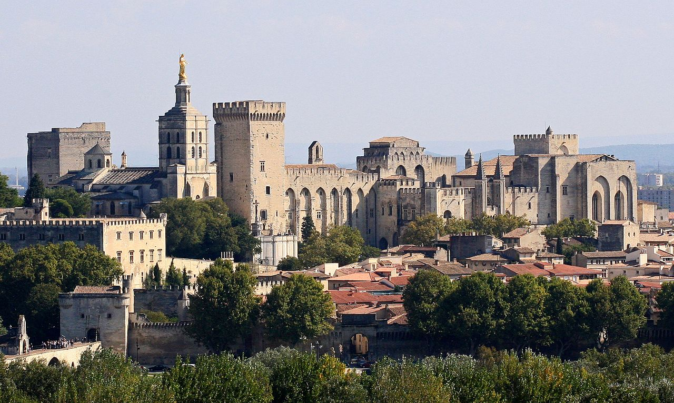
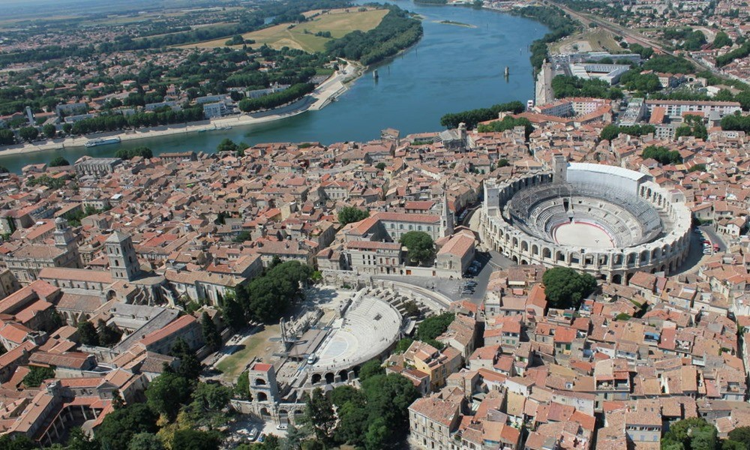
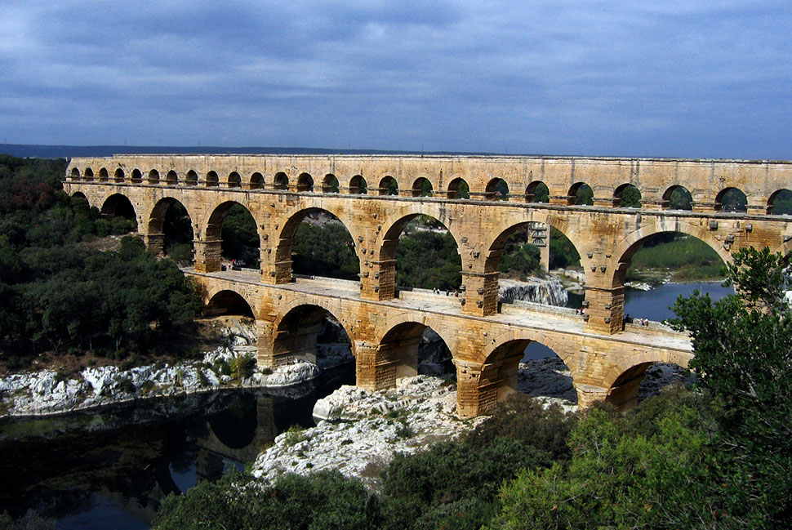
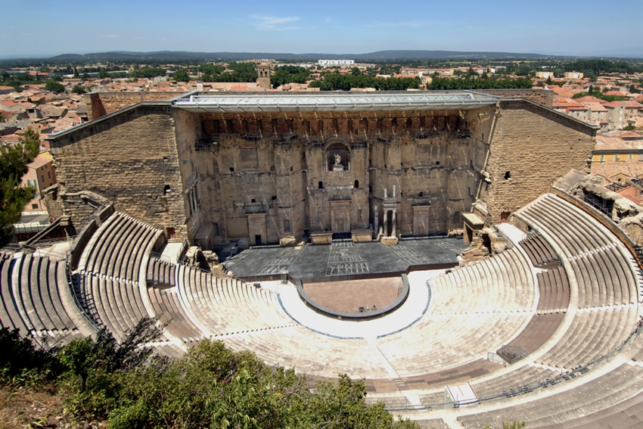
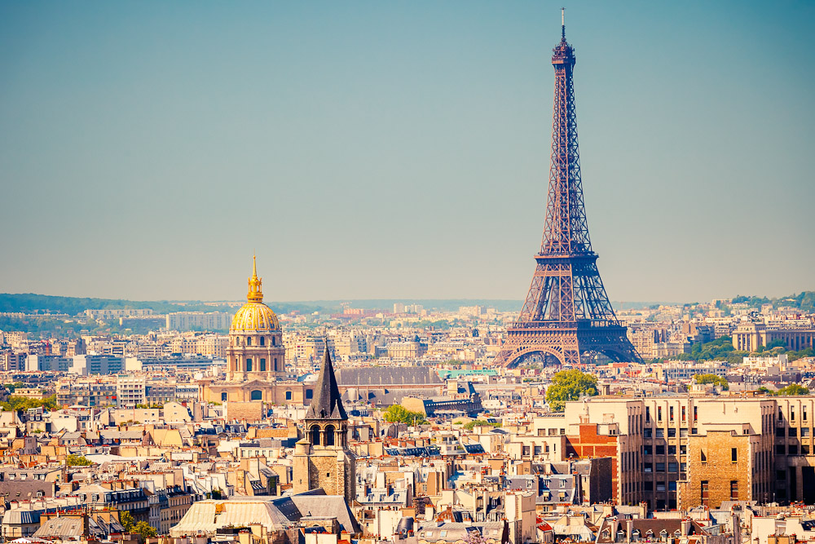
Possible Destinations for Aixcursions:
Marseille (30min)
Avignon (1h)
Arles (1h)
Nimes (1.5h)
Orange (1.5h)
Paris (3h by TGV)

Slide 7

See you in Cadarache!
Meeting Website:
https://indico.cern.ch/e/epicsjune2019
Announcements:
Tech-Talk
EPICS Website https://epics-controls.org

