Slide 1
Update of APS-U Database Application Activities
Guobao Shen, Ned Arnold, Dariusz Jarosz
Argonne National Laboratory
Nov 2018 EPICS Collaboration Meeting
2018-11-15

Slide 2
Content
Component Database (CDB)
Traveler System
Cable Maganement

Slide 3
Thanks
Sinisa Veseli for his contributions on CDB, especially original design, and initial implementation
Dong Liu from Osprey for his contributions on traveler enhancement
COSYlab for their contributions on Cable tool survey
APS-U team, especially APS/APS-U Controls group for their feedback, requirement, suggestion, discussion, ...

Slide 4
Component Database (CDB)
Good introduction
  "Database Applications for the APS-U”, Ned Arnold
    June 2018 EPICS Collaboration Meeting at APS
    https://epics.anl.gov/meetings/2018-06/talks/06-15/AM/9.3-Database-Applications-for-APS-U.pdf
Basic questions
  Do we have all the parts?
  Where are they?
  Are they ready?
  Are you sure?

Slide 5
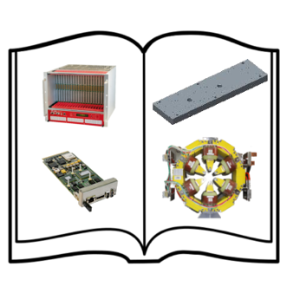
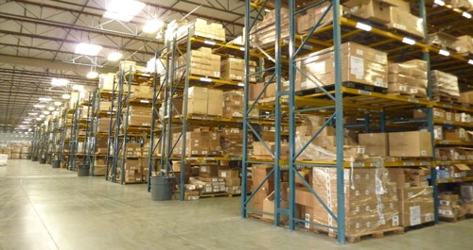
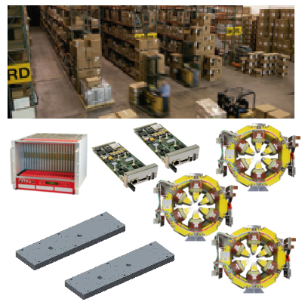
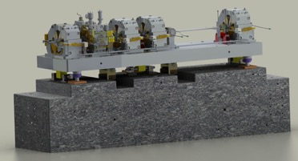
Component Database (CDB)
Vocabulary
Catalog
(each unique type of component or component design or COTS item + properties/drawings/specification/..)
Inventory
(each unique instance of component procured or fabricated) + properties/serial #/QR code/travelers/pictures/…)
Machine Designs
(A group of catalog components to perform a particular function + inventory items to build it +
Properties/pictures/locations/…)

Slide 6
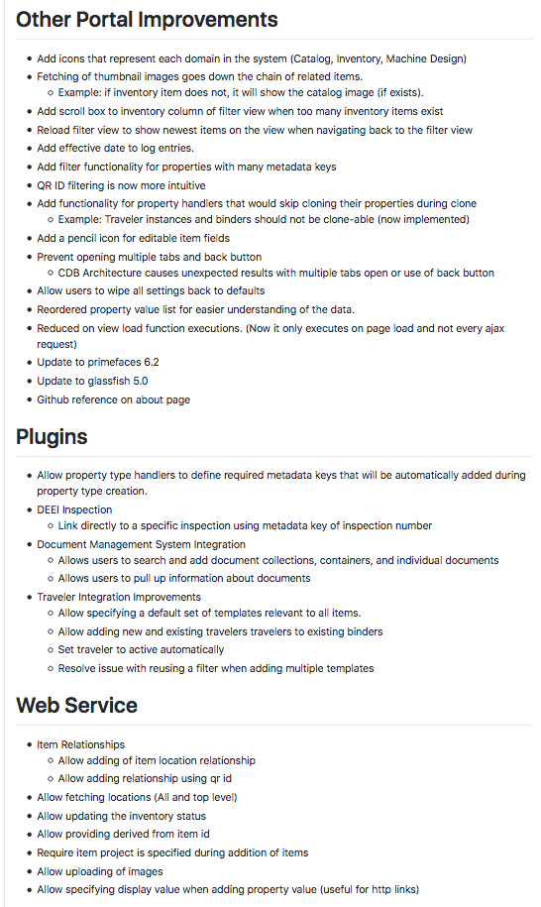
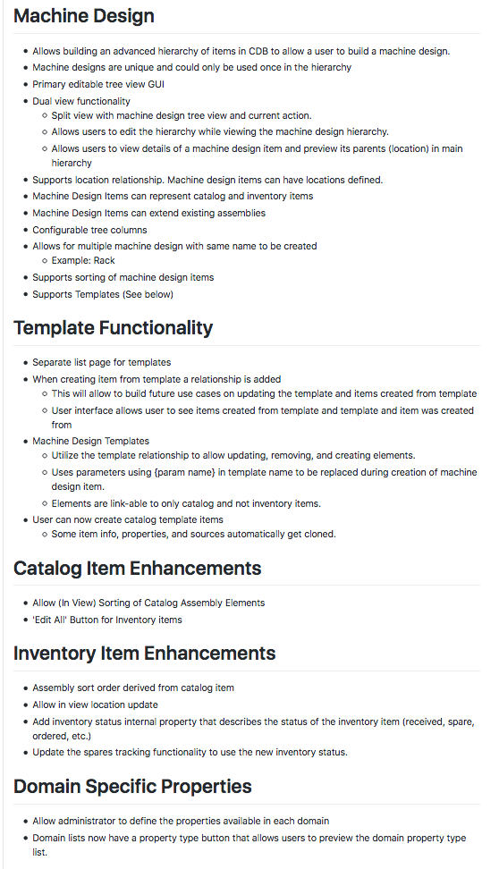
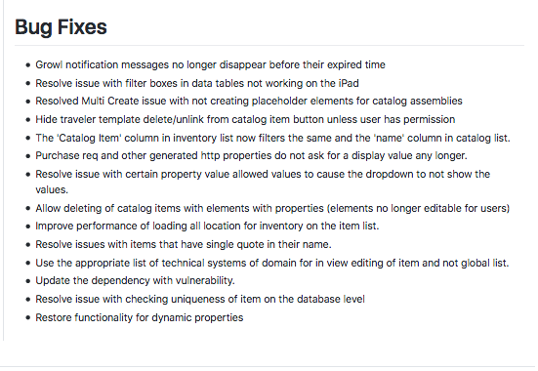
Component Database (CDB)
What’s New?
A new release 3.5.0 on 10/31/2018
Extremely long change log
Many new features
  Machine Design
  Machine Design template
  Catalog template
  ...

Slide 7
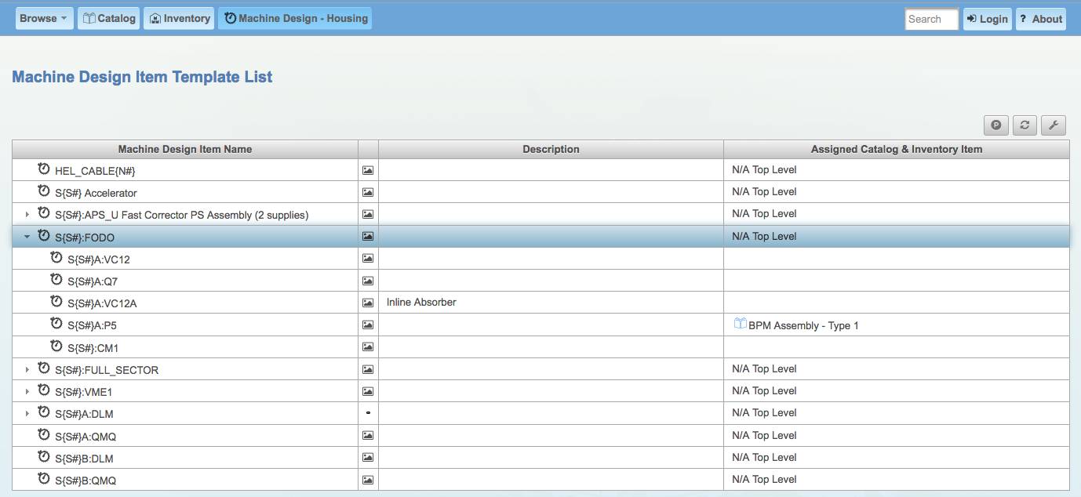
Component Database (CDB)
What’s New?: Machine Design Template

Slide 8
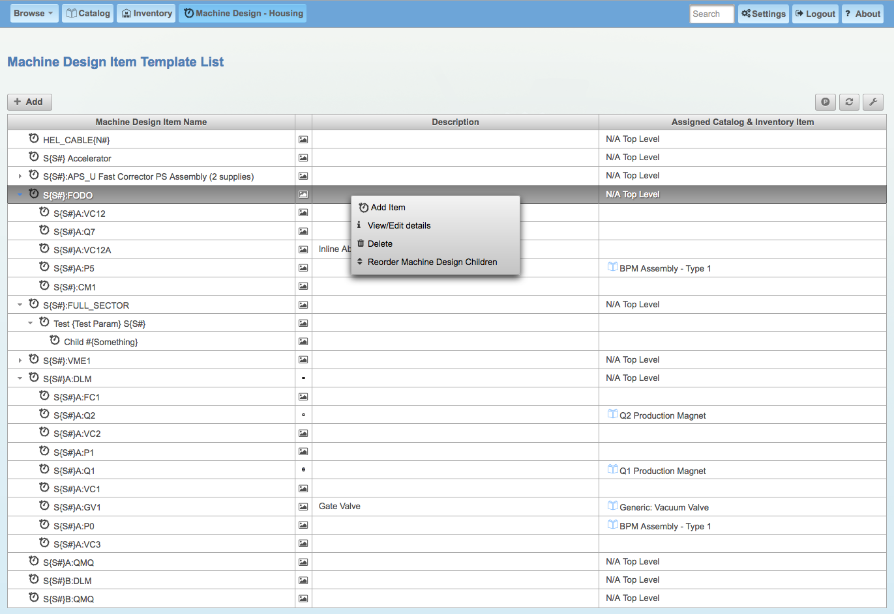
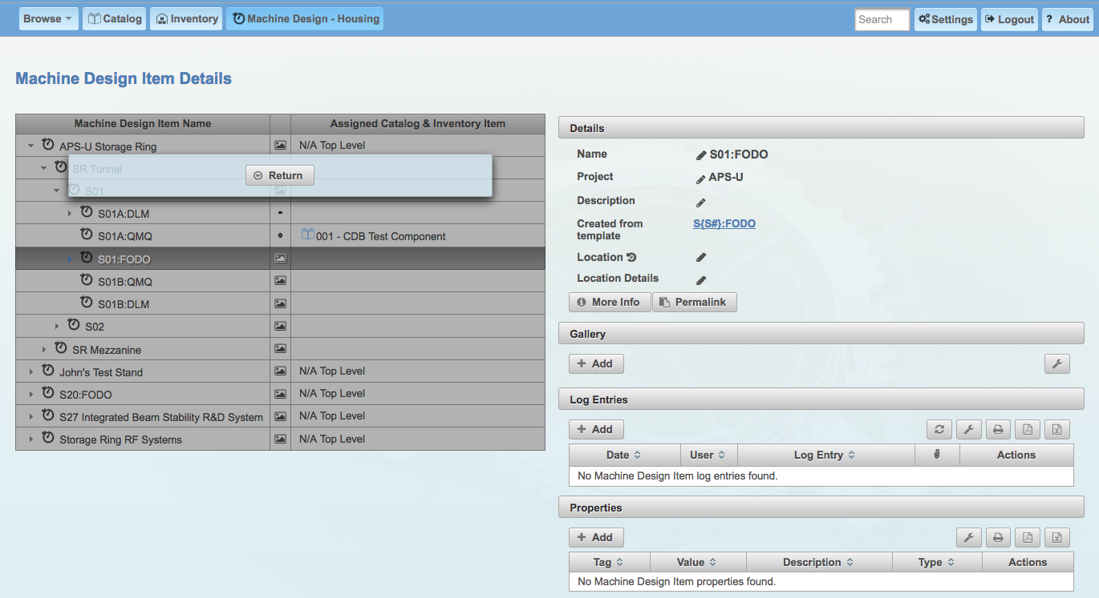
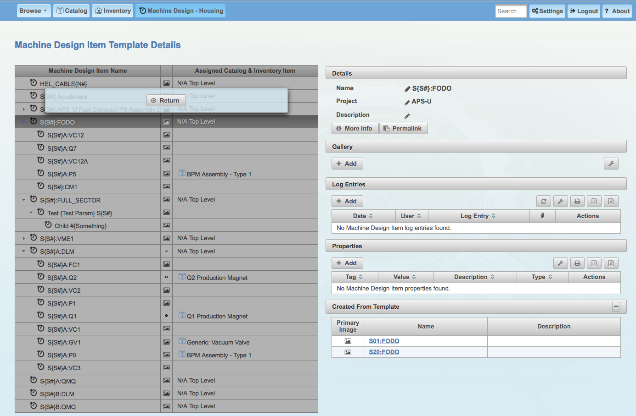
Component Database (CDB)
What’s New?: Machine Design Template

Slide 9
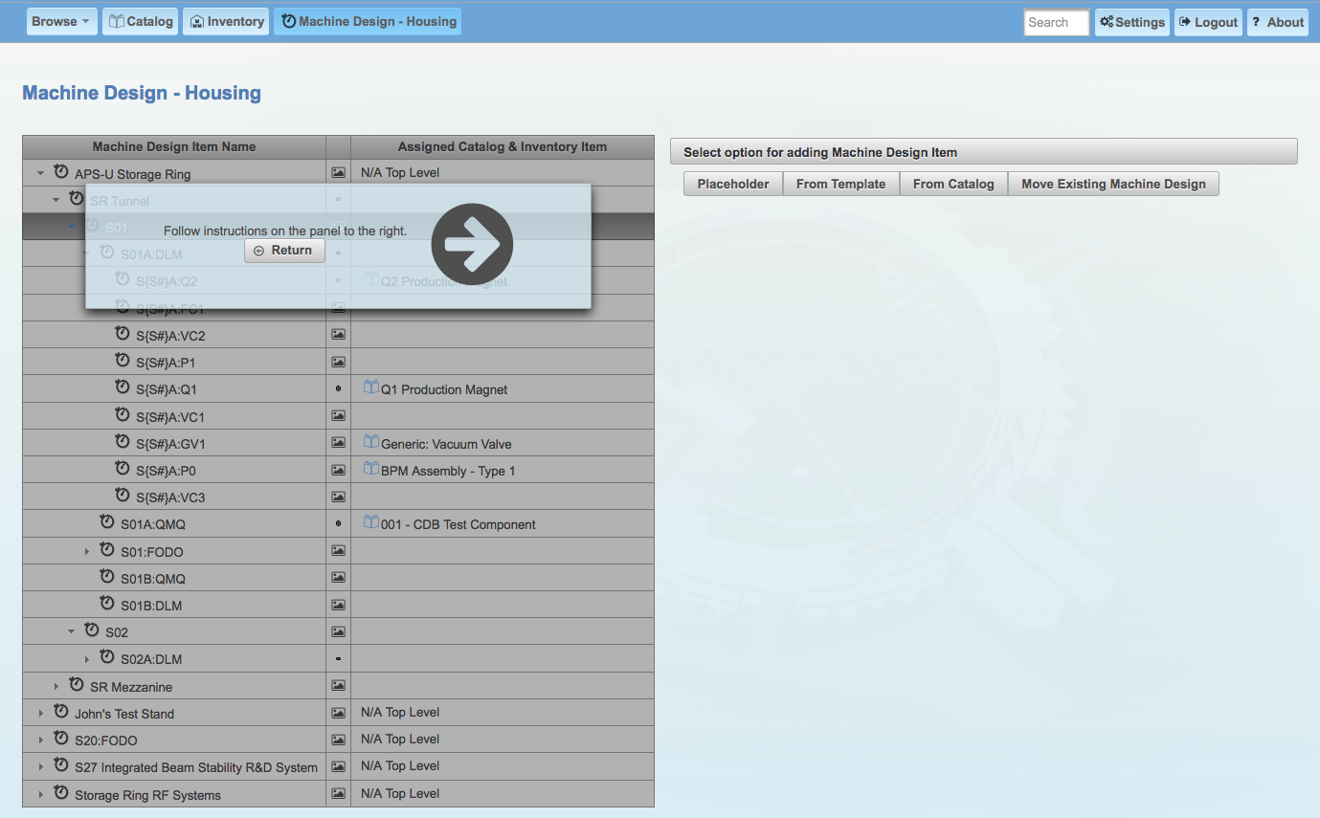
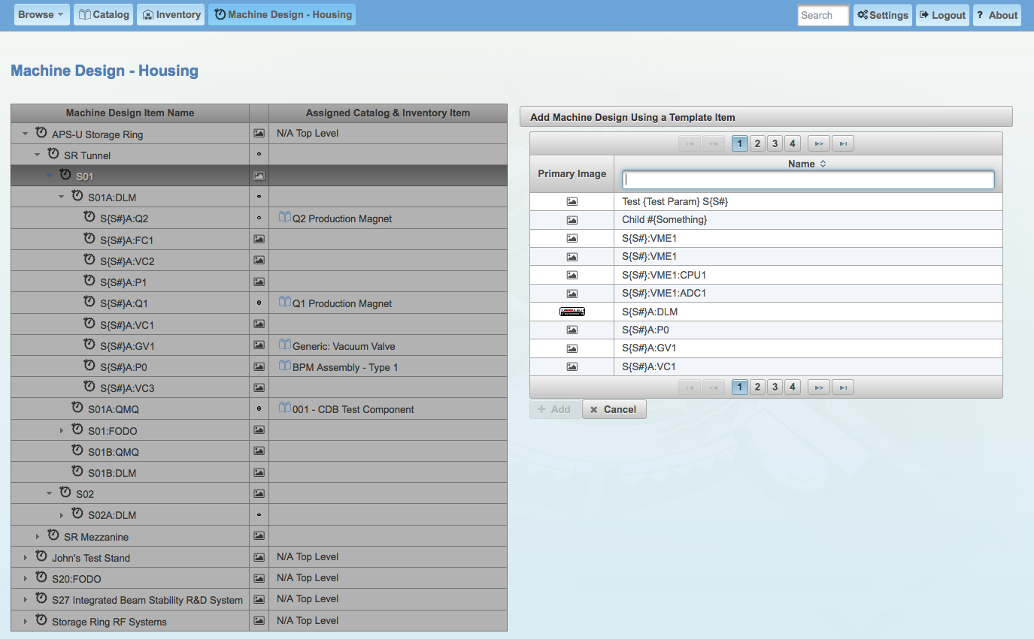
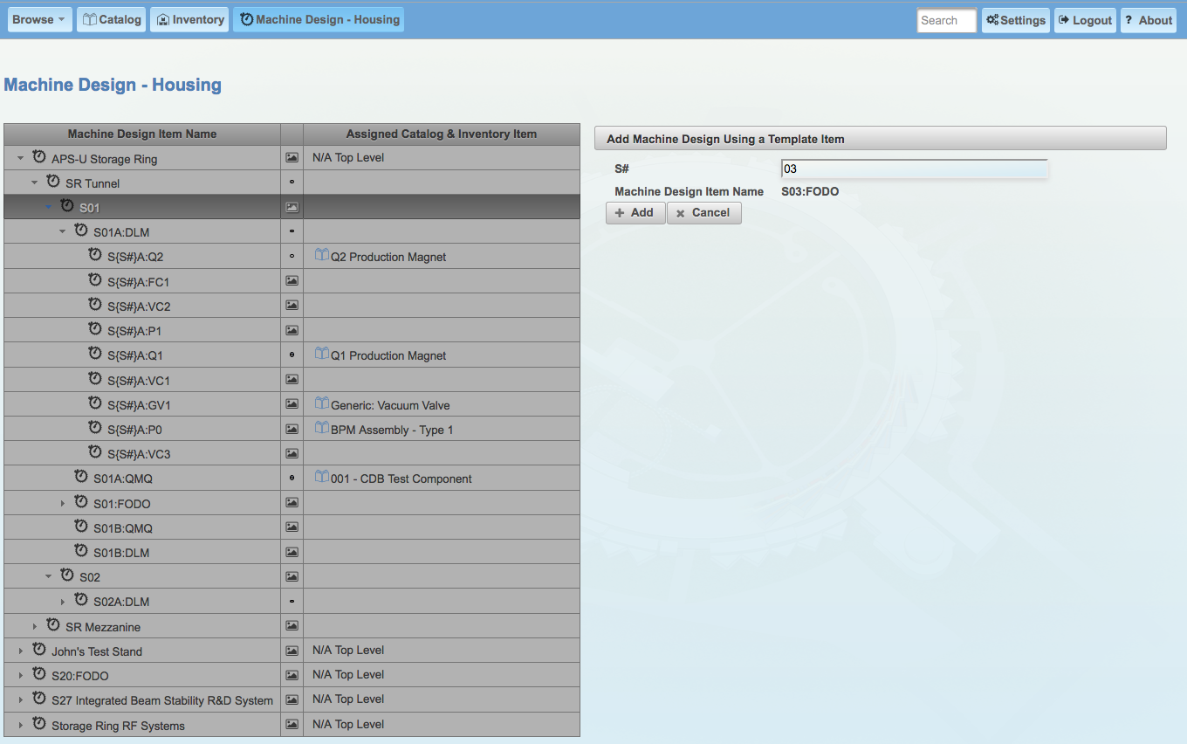
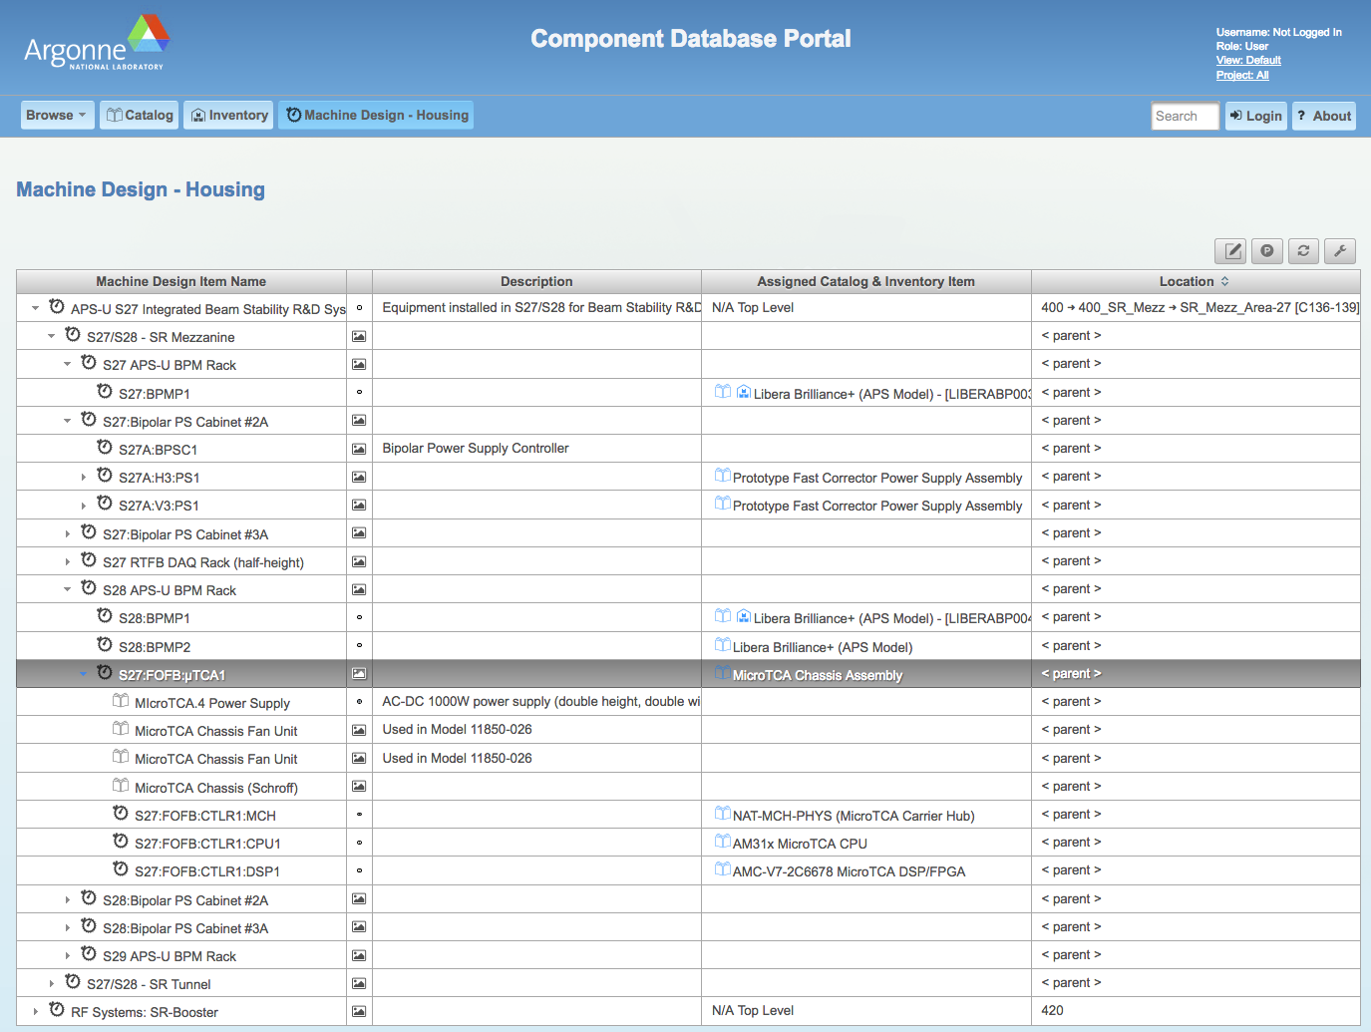
Component Database (CDB)
What’s New?: Machine Design with Template

Slide 10
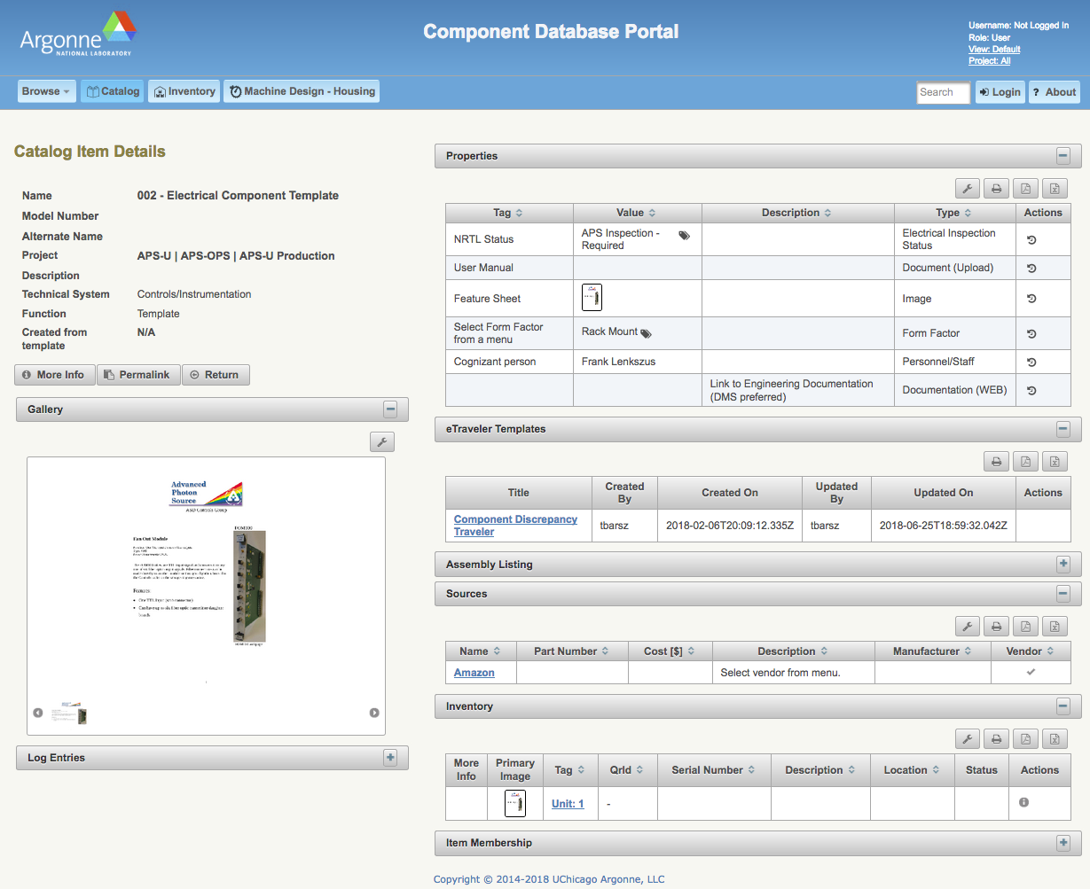
Component Database (CDB)
What’s New?: Catalog Template

Slide 11
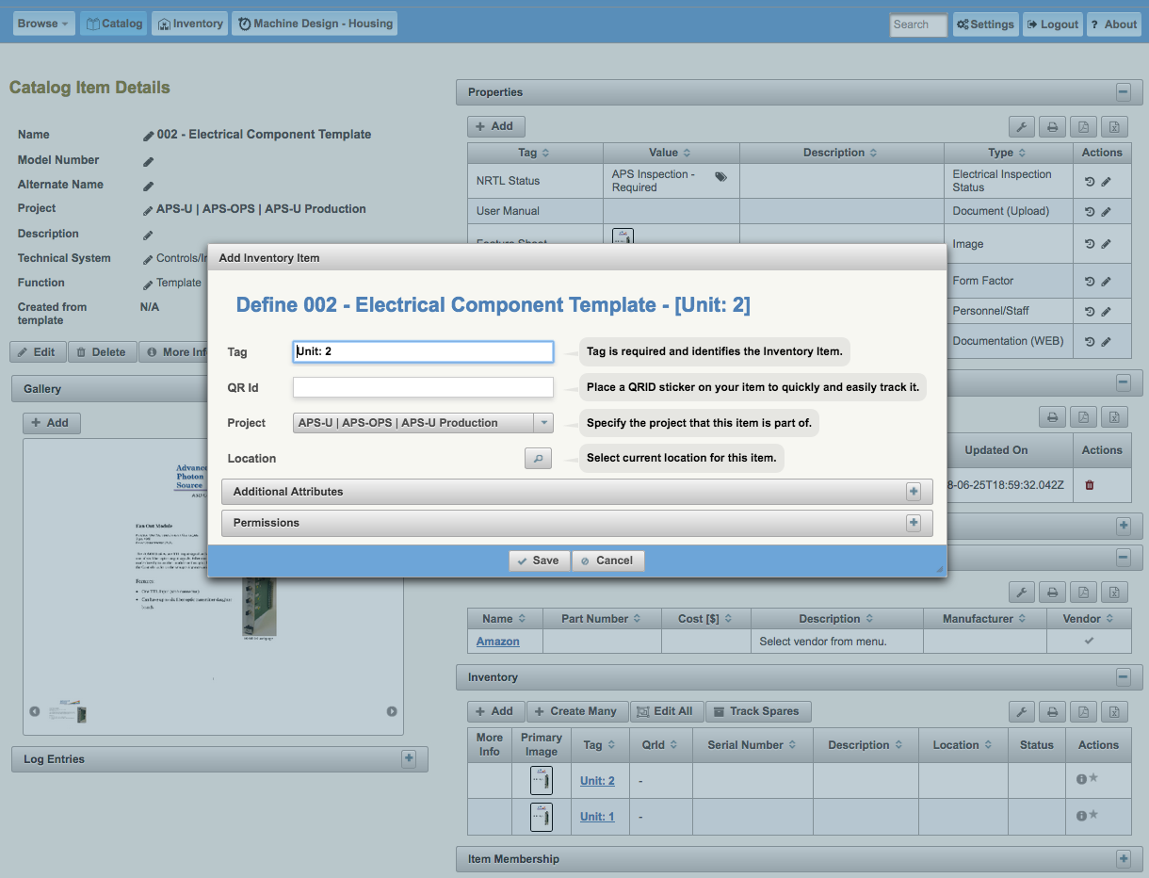
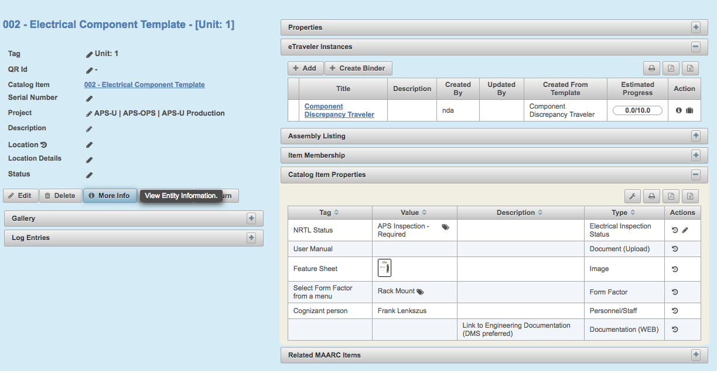
Component Database (CDB)
What’s New?: Catalog from Template

Slide 12
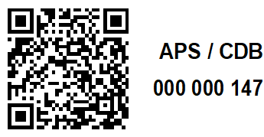
Component Database (CDB)
What’s New?: Mobile Apps

Slide 13
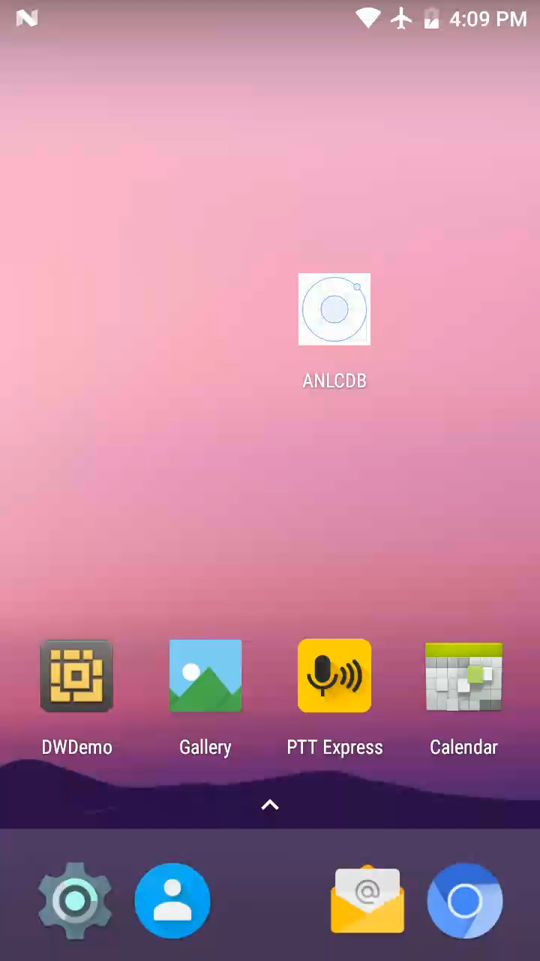
Component Database (CDB)
What’s New?: Mobile Apps

Slide 14
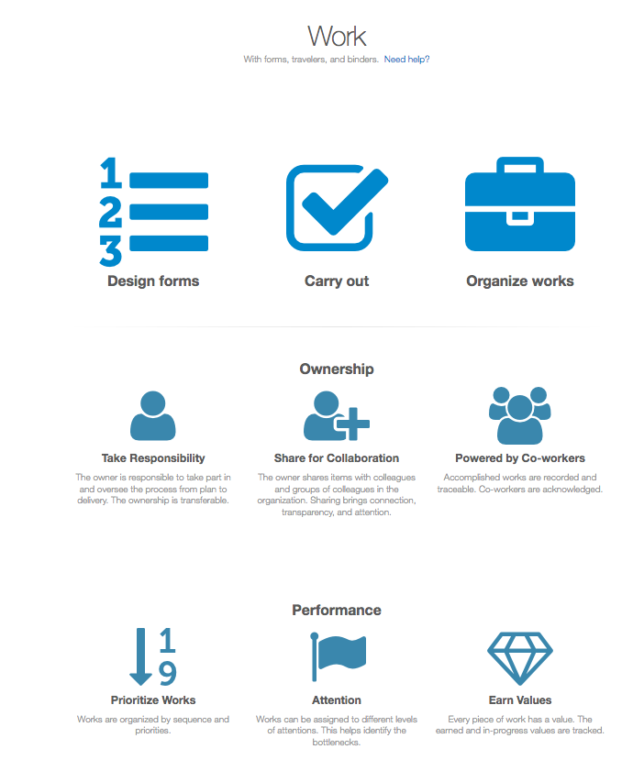
Traveler System
Electronic traveler system to replace traditional paper-based approach
Assist receiving inspection, characterization of incoming equipment, tracking accelerator component processing work flow
  Q/A inspection, recording of test results, assembly, installation, etc.
FRIB eTraveler has been chosen. The code of APS version is now hosted at:
  https://github.com/AdvancedPhotonSource/traveler
Basic concept: "Traveler @ FRIB”, Dong Liu
  May 2015 EPICS Collaboration Meeting at FRIB/MSU
  https://indico.fnal.gov/event/9718/session/5/contribution/10/material/slides/0.pdf

Slide 15
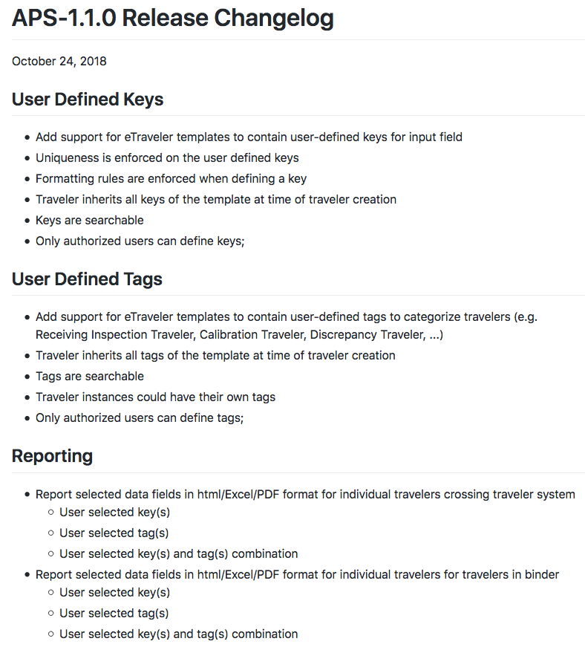
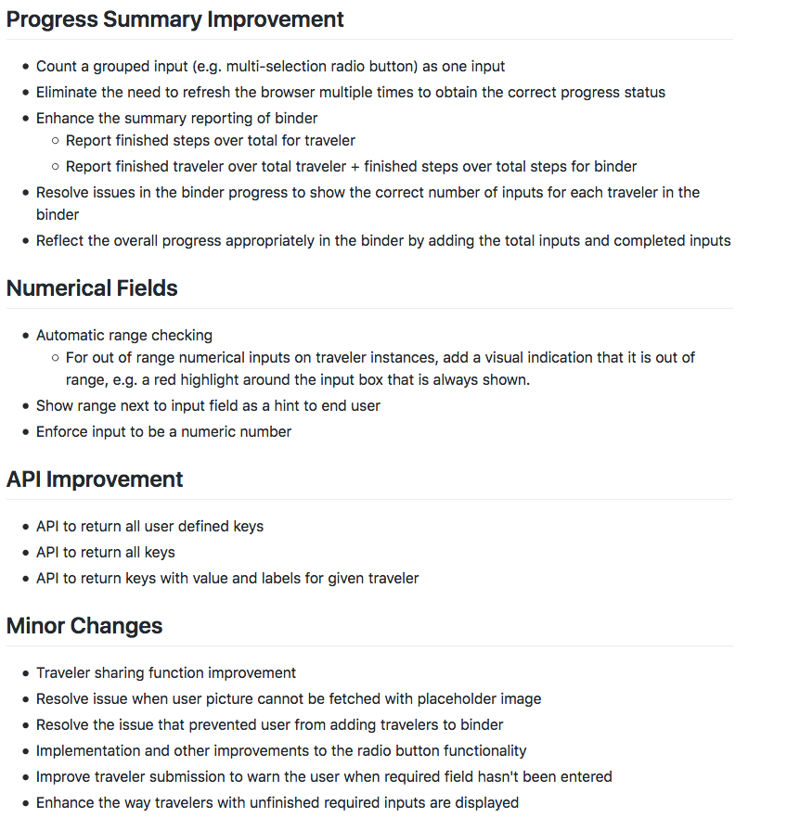
Traveler System
What’s New?

Slide 16
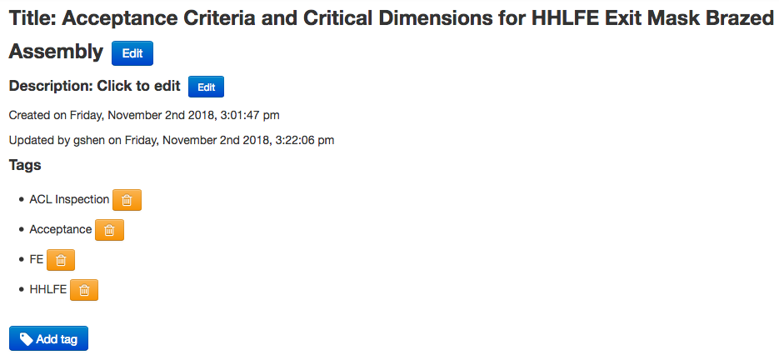
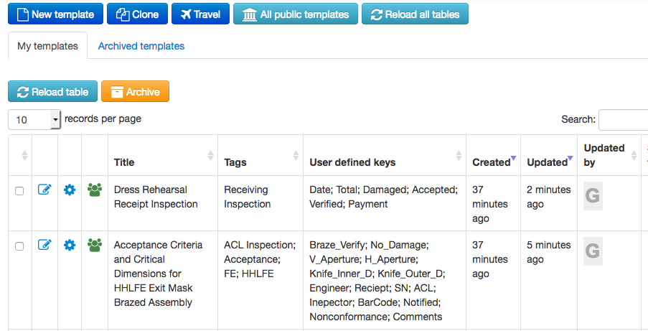
Traveler System
What’s New?: User defined tags of traveler form/template
  Categorize travelers, for example discrepancy traveler, ACL traveler

Slide 17
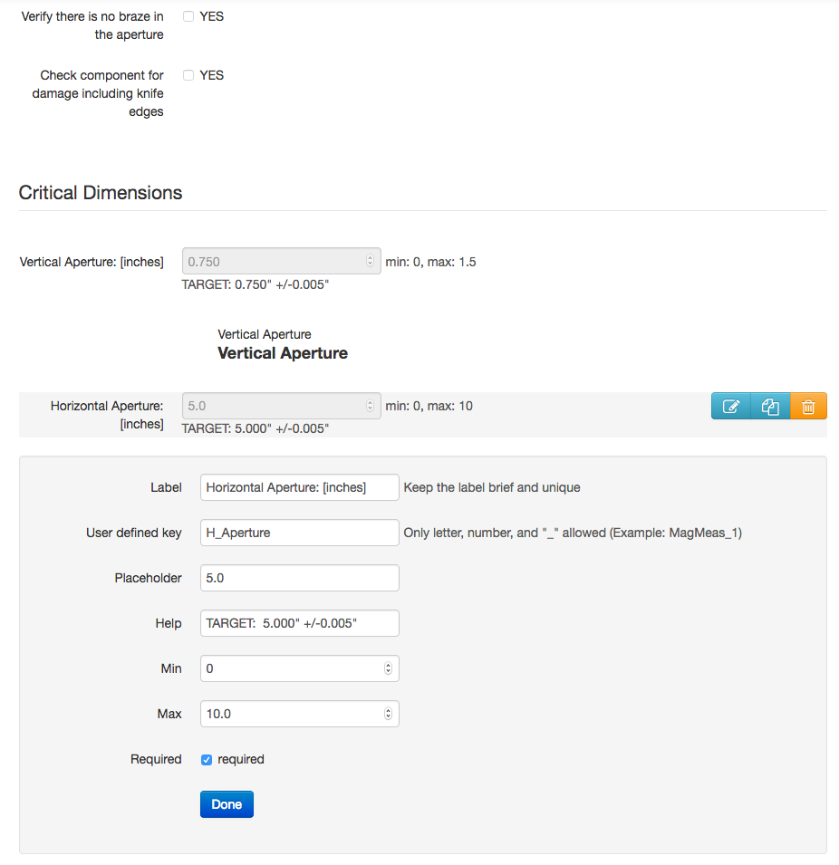
Traveler System
What’s New?: Key-Value pairs for input field of traveler template

Slide 18
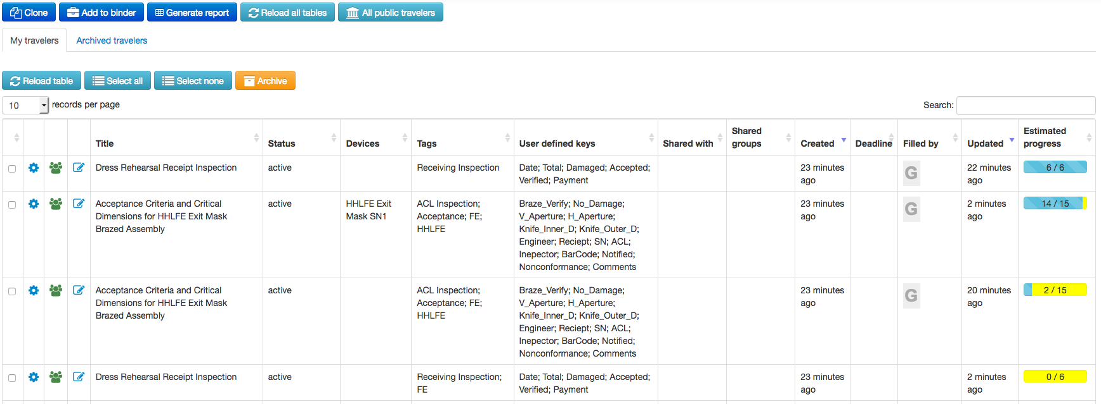
Traveler System
What’s New?: Tags & keys for traveler instance
Keys & tags from template
Tags for
traveler instance

Slide 19
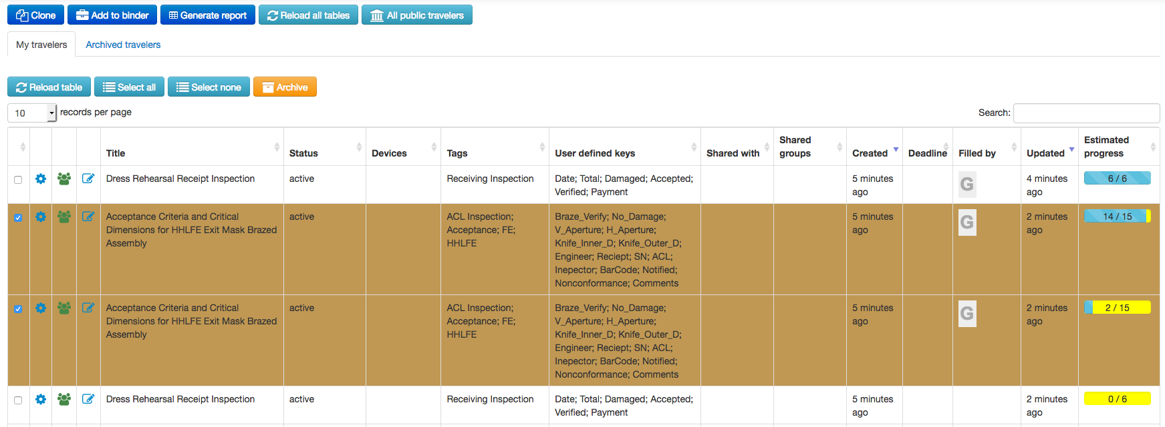
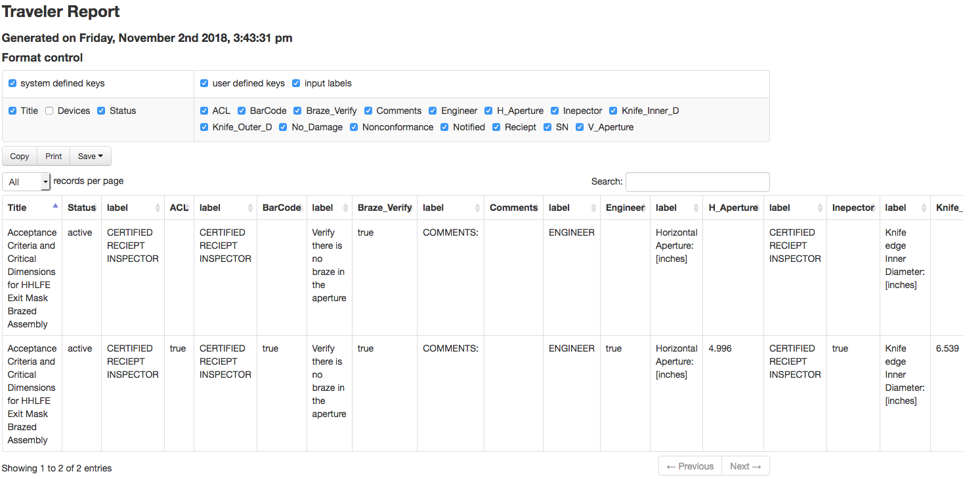
Traveler System
What’s New?: Reporting

Slide 20
Other Activities
Cable Management System
  Cable system caught attention at APS-U
  Initial activity started
    Contract COSYLAB for the survey
  Any suggestion, comment?
    Lesson learned?
    System using at your facility?
    User requirements?
    Critical functions?
  Any comment/suggestion is great appreciated

Slide 21
Backup

Slide 22
System Integration
Catalog
(each unique type of component or component design or COTS item + properties/drawings/specification/..)
Inventory
(each unique instance of component procured or fabricated) + properties/serial #/QR code/travelers/pictures/…)
Machine Designs
(A group of catalog components to perform a particular function + inventory items to build it +
Properties/pictures/locations/…)
eTraveler Templates/Forms
(an electronic form designed to guide the user through a set of steps <for specific component types>)
eTraveler [Instances]
(A copy of a Traveler Template filled in for a particular instance of a part)
eTraveler Example
Hydro Test for Mask Type #2:
Qrid = 000 001 679
Hydro Test for Mask Type #2
Vacuum Test Type #2
Hydro Test for Mask Type #2:
Qrid = 000 001 682
ACL for Mask Type #2
Vacuum Certification
Hydro Test for Mask Type #2:
Qrid = 000 001 683

Slide 23
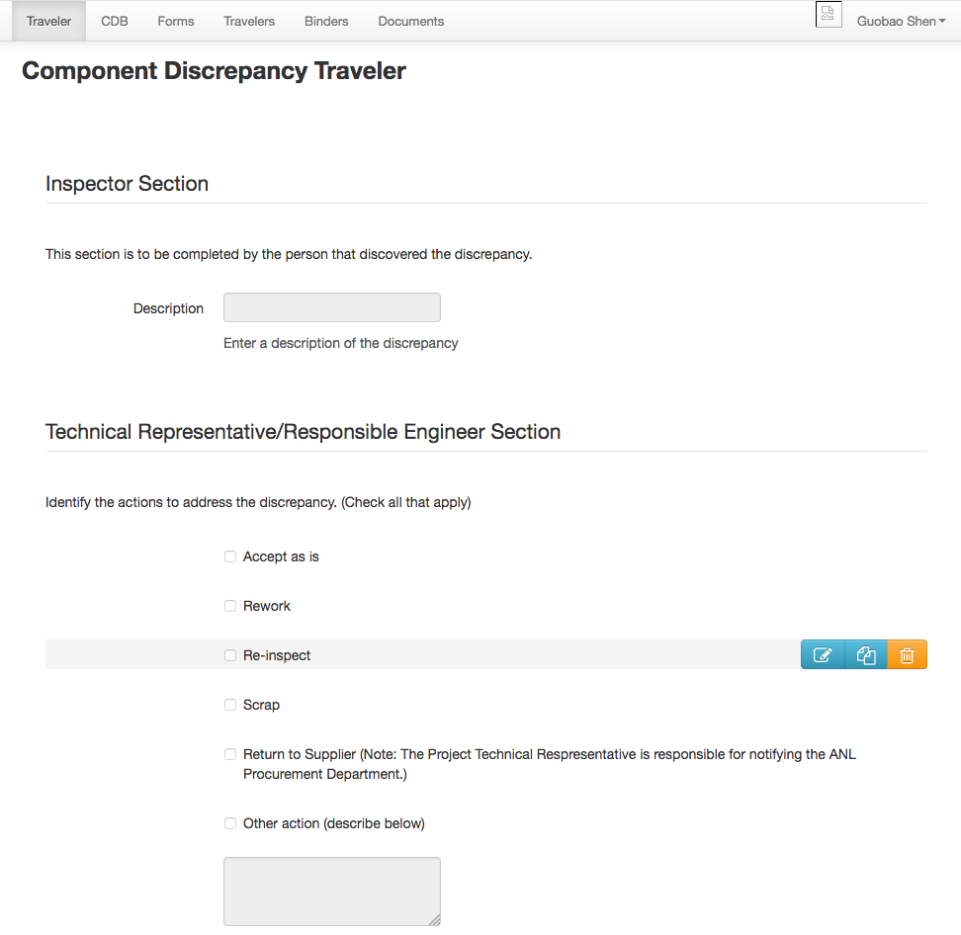
System Integration
Catalog item link to
traveler ”Templates (Forms)”

Slide 24
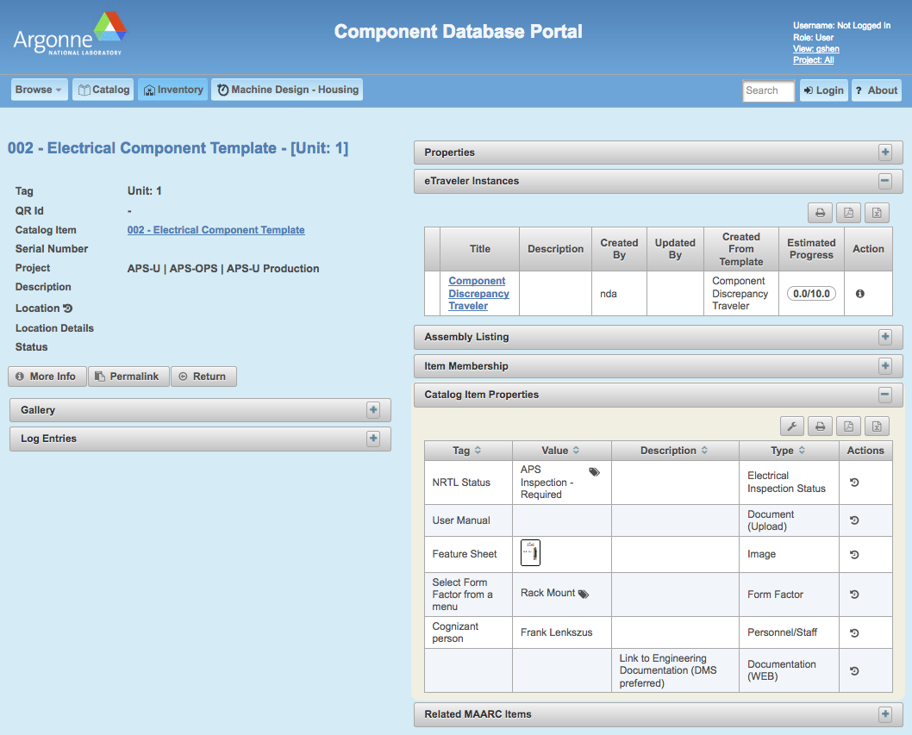
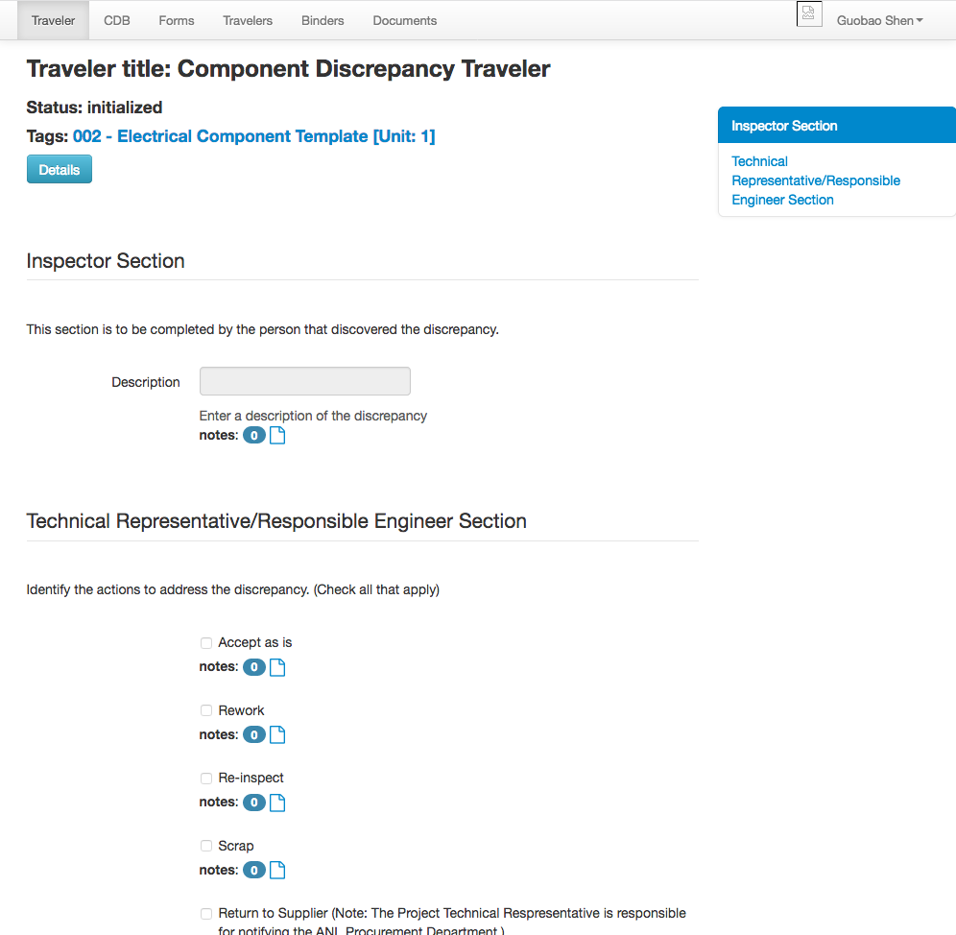
System Integration
Inventory item
link to traveler instance

