Slide 1

The New EPICS Website: epics-controls.org

Slide 2



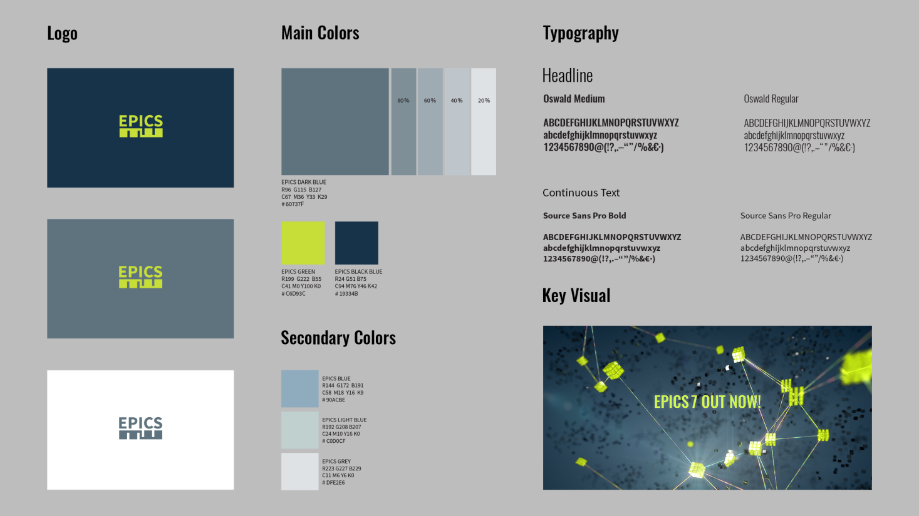
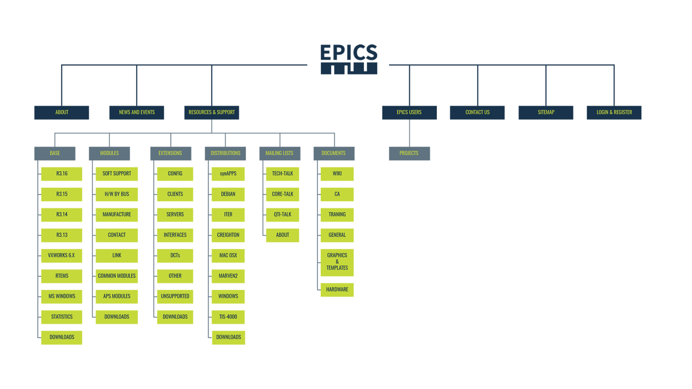
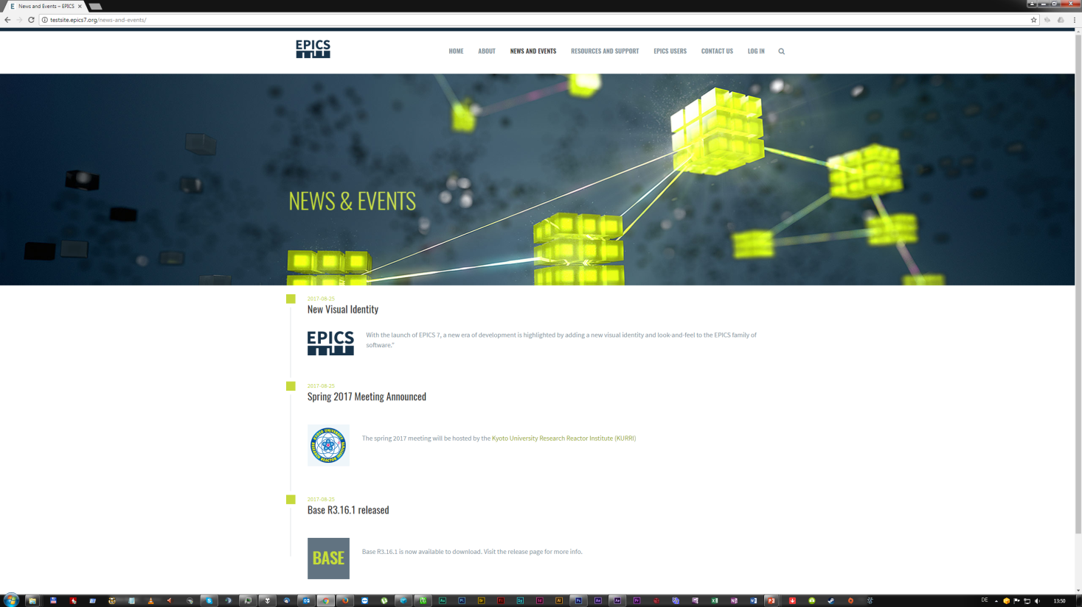
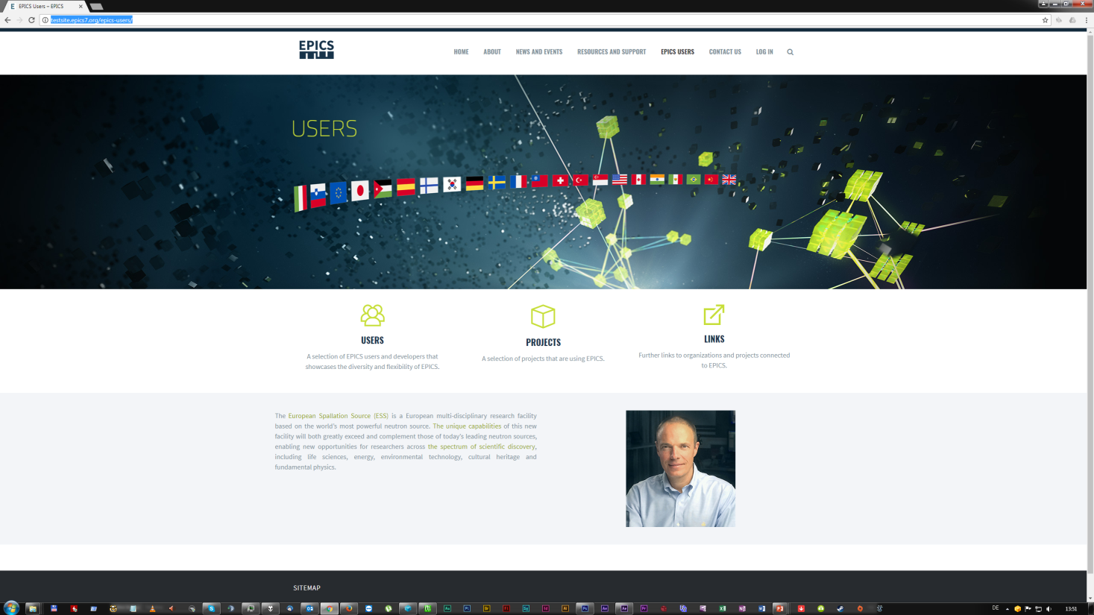
About a year ago, the new EPICS graphical identity and website were introduced at the Collaboration Meeting in Barcelona...

Slide 3
After a long winter pause, a lot happened:
Hosting was moved to the Fritz-Haber-Institute
A summer student at the ESS completed the Wordpress site
  User management for web contributor accounts
  Database for device support modules
  Download area for Base releases
  Workflow for review of articles and posts
  How-to-contribute website documentation
More EPICS installations were added to the „Projects“ list (now >20)
A handful of perspective contributors have asked for accounts
The new site was announced on September 1st

Slide 4
Still, a lot did not happen yet:
We received only a very limited number of contributions
(low single-digit range)
Web Team is largely a subset of Core Developers
Many links still point to the old EPICS site
Moved content has no redirections from the old EPICS site
Site structure is still not clear and clean enough
Existing web site documentation (how-to) does not cover enough
Issue tracker (on GitHub) has not been well adapted
Layout/rendering issues (low-level WordPress CSS) are not resolved

Slide 5
The „Presentation to the Outside“ aspect works:
Received positive feedback on graphics and web site
Projects pages are impressive (showing diversity)
Got a few inquiries (industrial) through the contact form
Still needs a high level technical overview and „EPICS for Dummies“
The „Site for EPICS Users“ aspect has not improved:
Misleading and outdated content is still misleading and outdated
Need to optimise usability (three clicks to download EPICS Base under „Resources and Documents“)
PVA documentation is most needed and in a bad state

Slide 6
Roadmap:
The website team is small and often busy with other tasks. There are a number of ideas for additional features (e.g. offering binary distribution, improved Q&A database) that are not backed by existing manpower.
Hosting is secured and well maintained (courtesy of Heinz Junkes)
There is limited but continuous support by the graphics designer (courtesy of ESS)
For everything else (especially all EPICS content), we would like the community to get more involved

Slide 7
Help Wanted (WordPress part):
The website engine needs to be maintained. These are mainly small tasks that may appear anytime as things are discovered and/or plugins are changing.
Currently open issues:
Fine-tune margins and spaces for different viewports
Small fixes for rendering of lists, blockquotes etc.
Fix print layout for some of the pages
If you know (or you are) someone who could be helping out...
Contact: webmaster@epics-controls.org

Slide 8
Help Wanted (Content part):
Most of the remaining content of the old site needs to be moved to the new site.
(Re-)Create existing pages on the new site (allow switching redirects), while actualising and cleaning up
Review and consolidate PVA documentation (PVA user)
Add project listings
We have a review process in place: you won‘t break the live site, other reviewers will help ensuring accuracy before content is being published.
Content updated by users is a good way for new users to help the community.
Contact: contact@epics-controls.org

Slide 9

Thank You for Your Attention!
Credits:
Dirk Nordt graphics design and outlook
Keijo Korhonen structure, content and site setup
Azadeh Sarkheyli structure, setup and content
Heinz Junkes hosting and technical support
Andrew Johnson,
Ralph Lange,
Timo Korhonen steering, advice and content
Henrik Carling funding and resources
Annika Nordt producer

