Slide 1
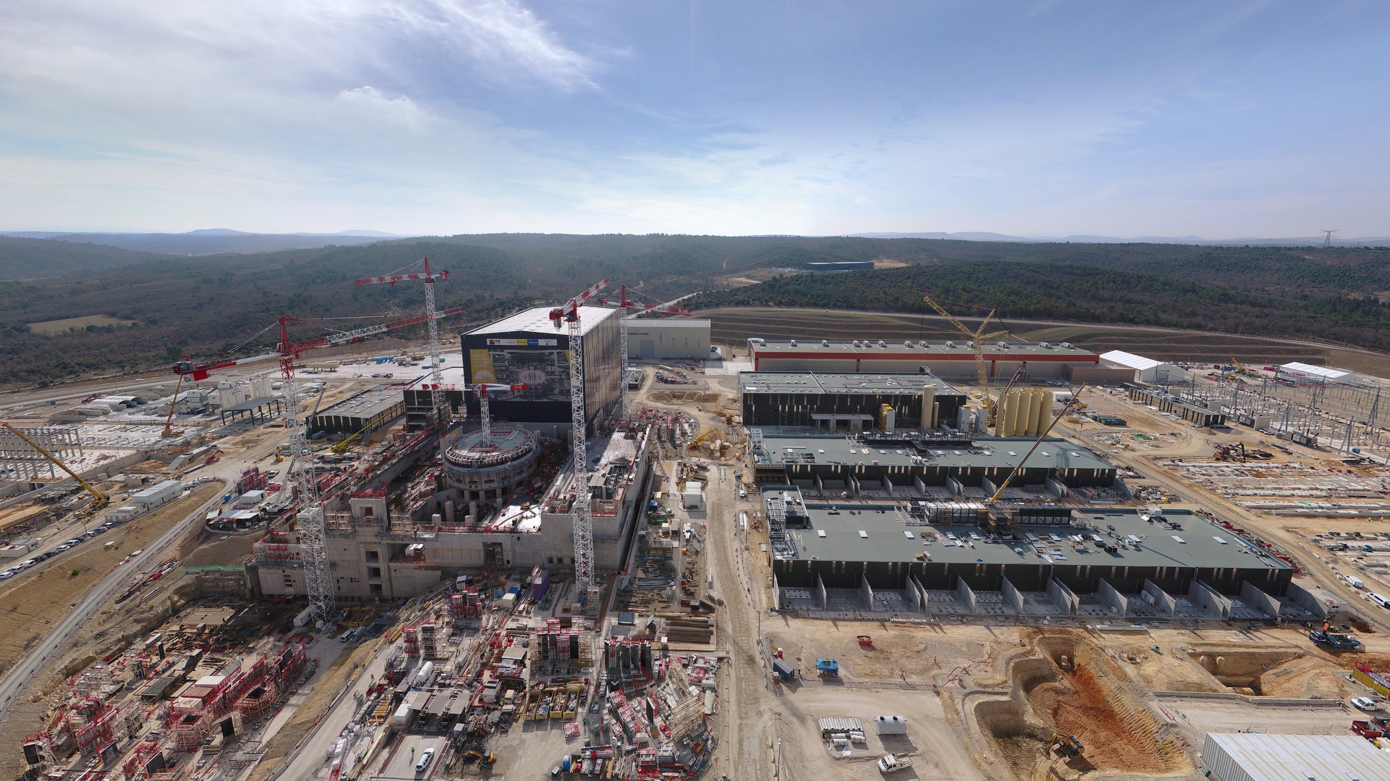
ITER & CODAC Core System Status Update
Ralph Lange
Control System Division
ITER Organization
Disclaimer: The views and opinions expressed herein do not necessarily reflect those of the ITER Organization.
Disclaimer: The views and opinions expressed herein do not necessarily reflect those of the ITER Organization.

Slide 2
Outline
Update: Overview and Status
  Architecture, Networks, Infrastructure
  Standardization: Specification, Hardware, Software, Support
  Central Systems and Applications
Challenge 1: Control with no Building
  Integration Schedule
  Mitigation of Controls Building Delay
Challenge 2: Scale
  Example: Nuclear Safety
  Example: Cubicles (19” racks), Buildings, Cryo

Slide 3
Overview and Status
Update

Slide 4
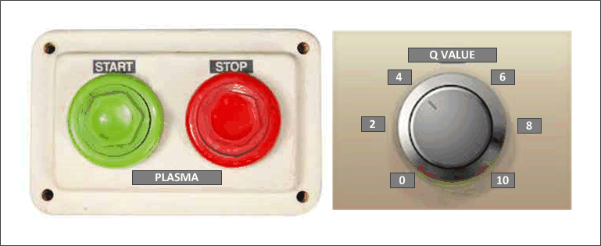
High Level Requirements
The ITER control system
performs the
functional integration of the ITER plant
and
enables integrated and automated operation

Slide 5
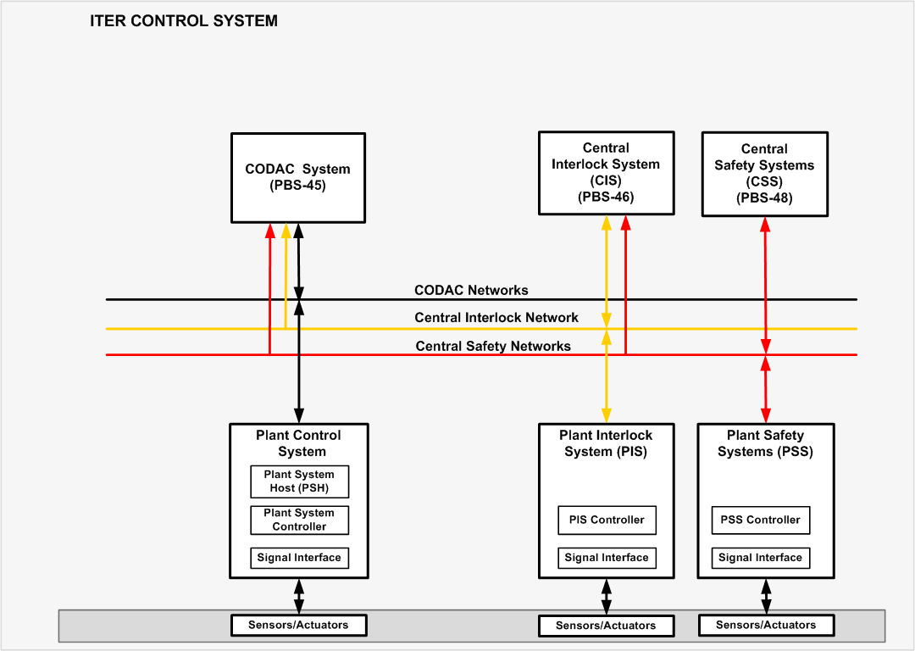
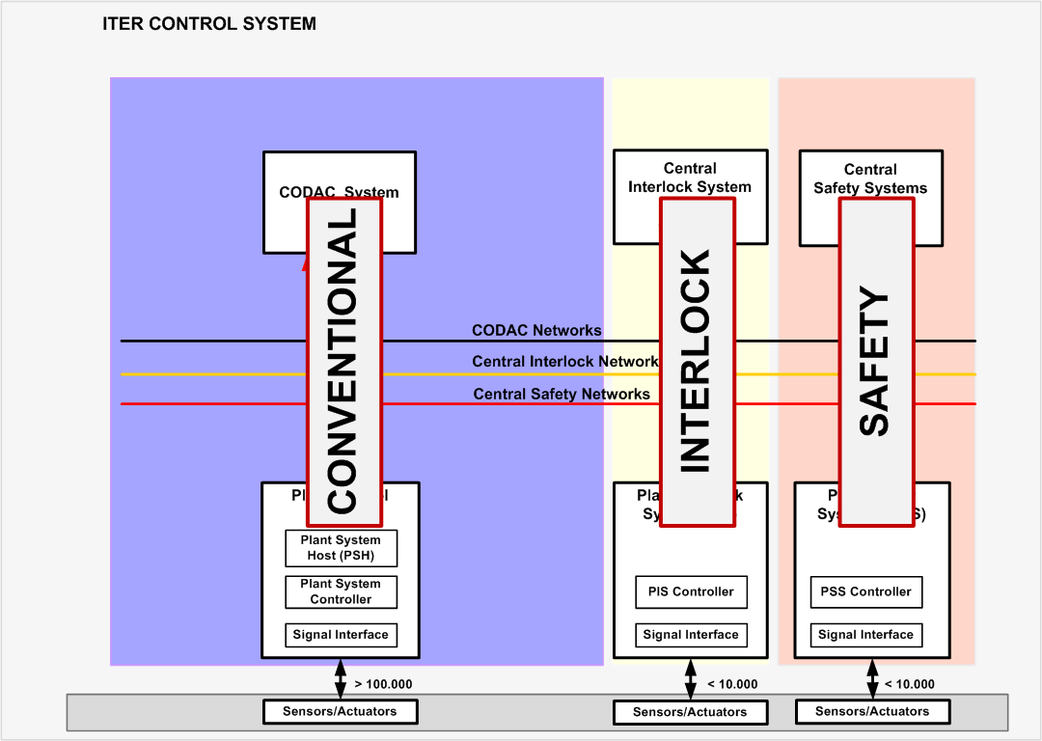
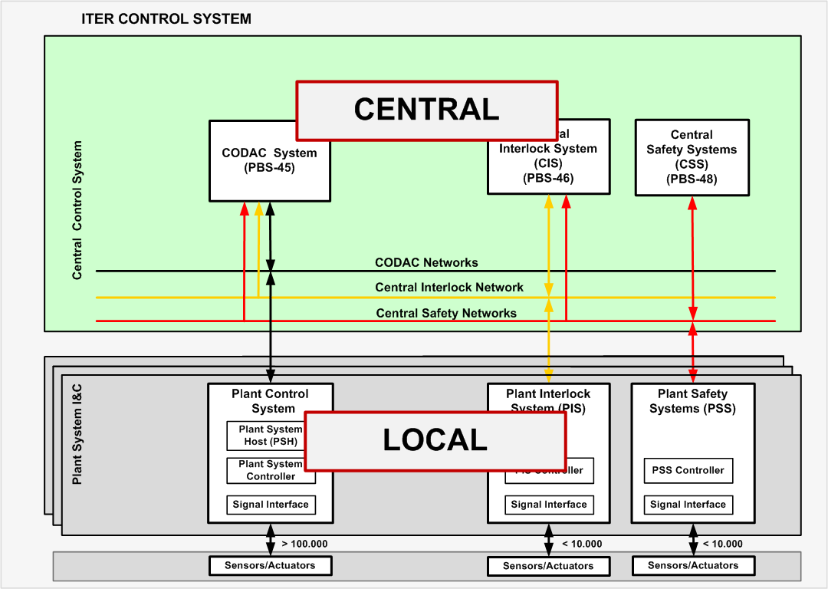
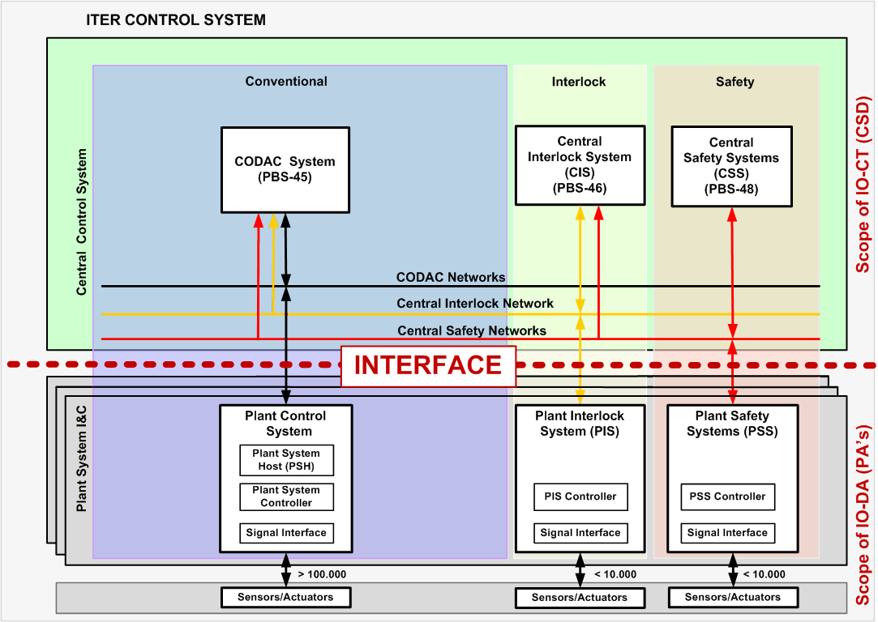
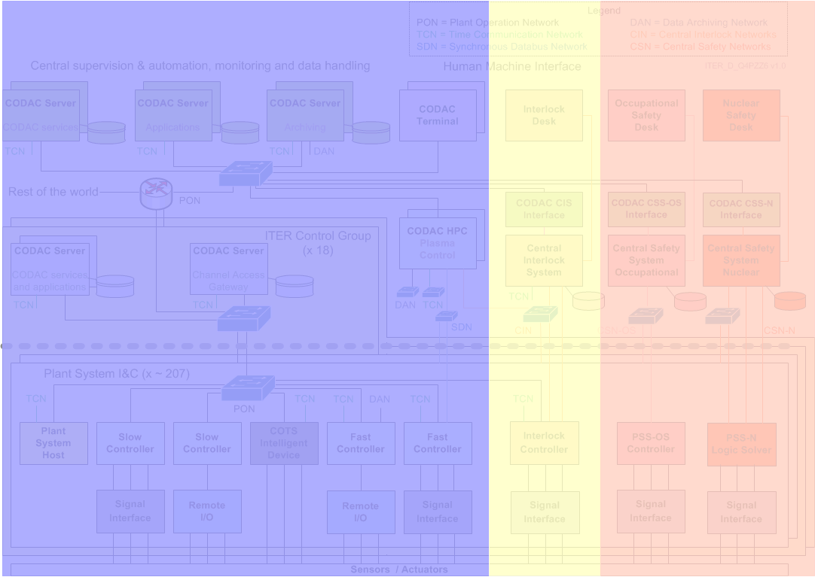
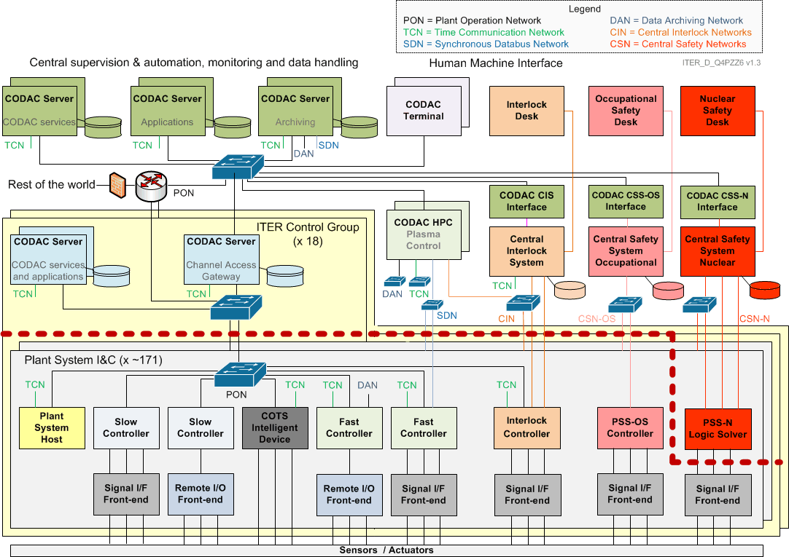
Architecture

Slide 6
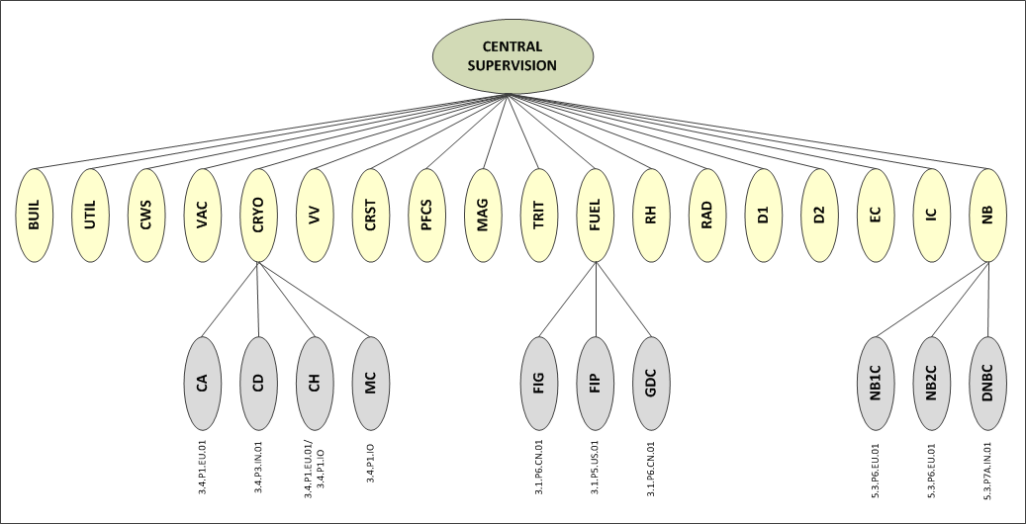
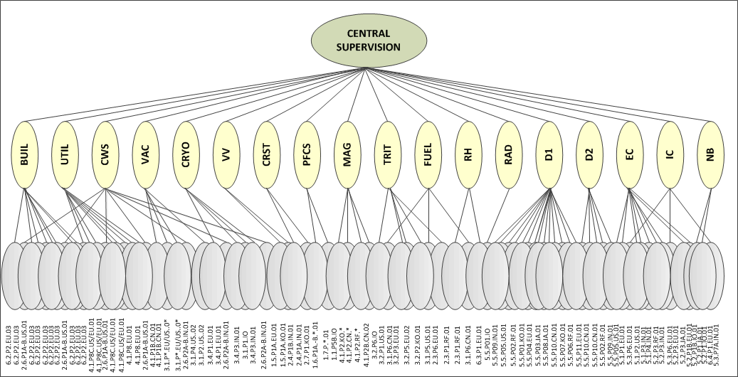
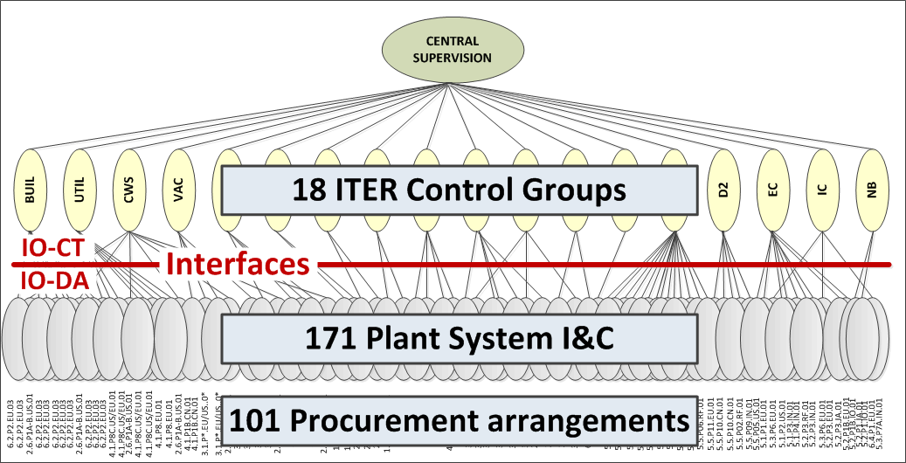
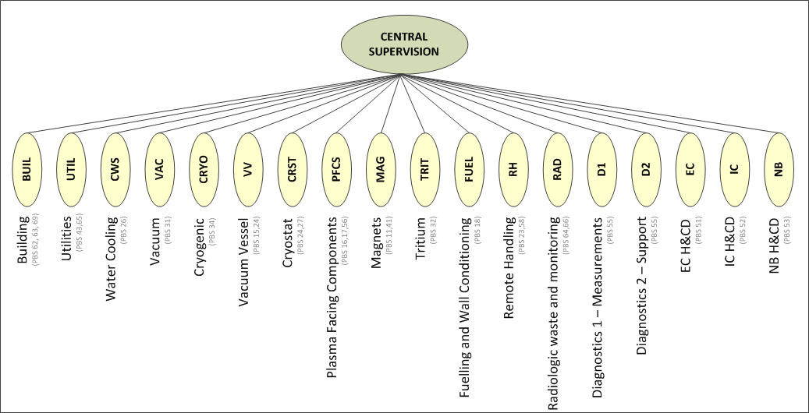
Architecture
CBS 1
CBS = Control Breakdown Structure
CBS 2
Breakdown in 18 ITER control groups (CBS level 1) covering 28 PBS
An ITER control group contains many Plant System I&C, total no. 171 (CBS level 2)
A Plant System I&C is a deliverable from a procurement arrangement (IN-KIND)
A procurement arrangement delivers a part, one or many Plant System I&C

Slide 7
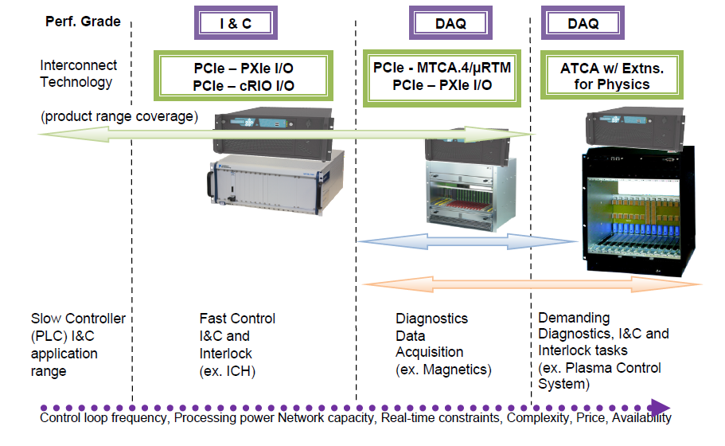
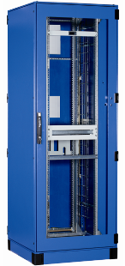

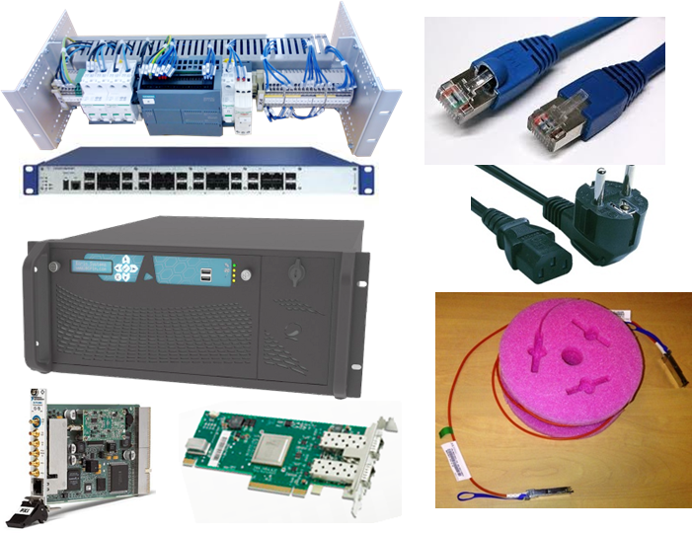

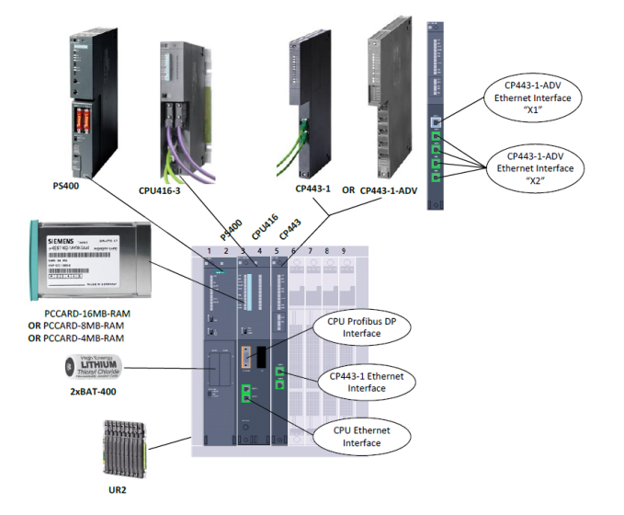
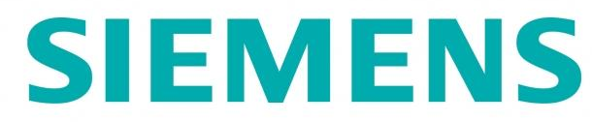




Standardization
Documentation – Plant Control Design Handbook (PCDH)
  Specifications, guidelines, catalogues
Hardware
  cubicles, controllers, input/output, network interfaces
Software (common open source framework)
  CODAC Core System
Instrumentation & Control Integration Kit
  Distributed for free to all plant system I&C

Slide 8
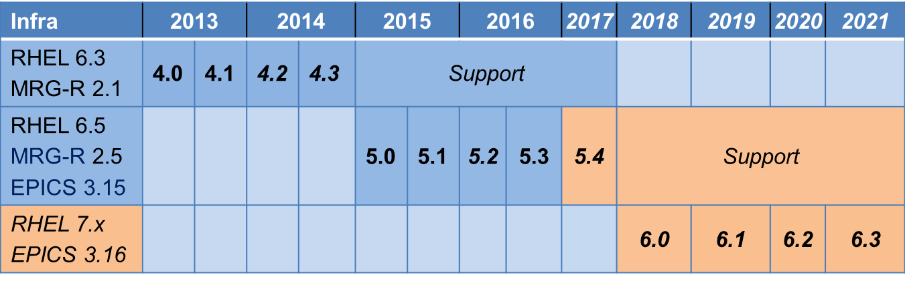
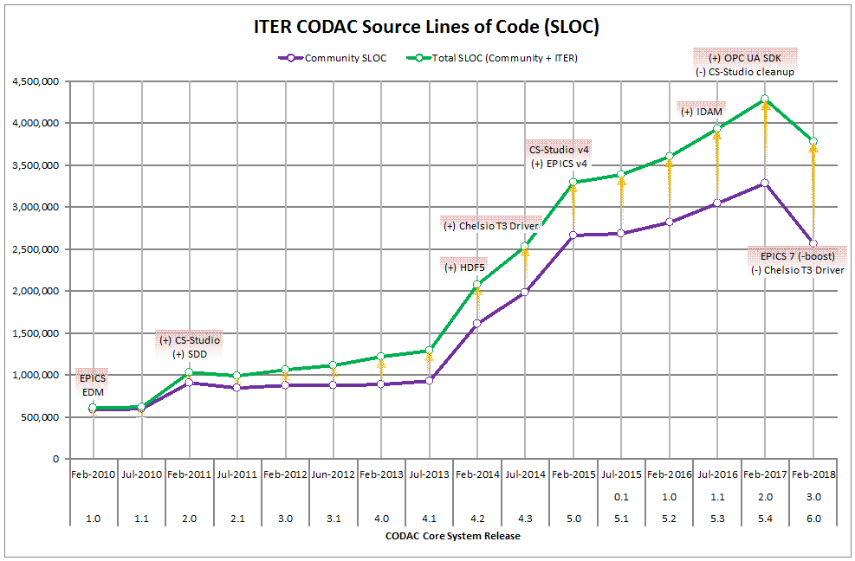
CODAC Core System
The base software for ITER Control System released once or twice per year and providing common services like:
Communication
Configuration
Human Machine Interface
Archiving
Alarming
Input/output device drivers
….

Slide 9


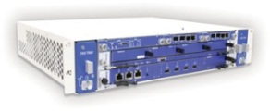
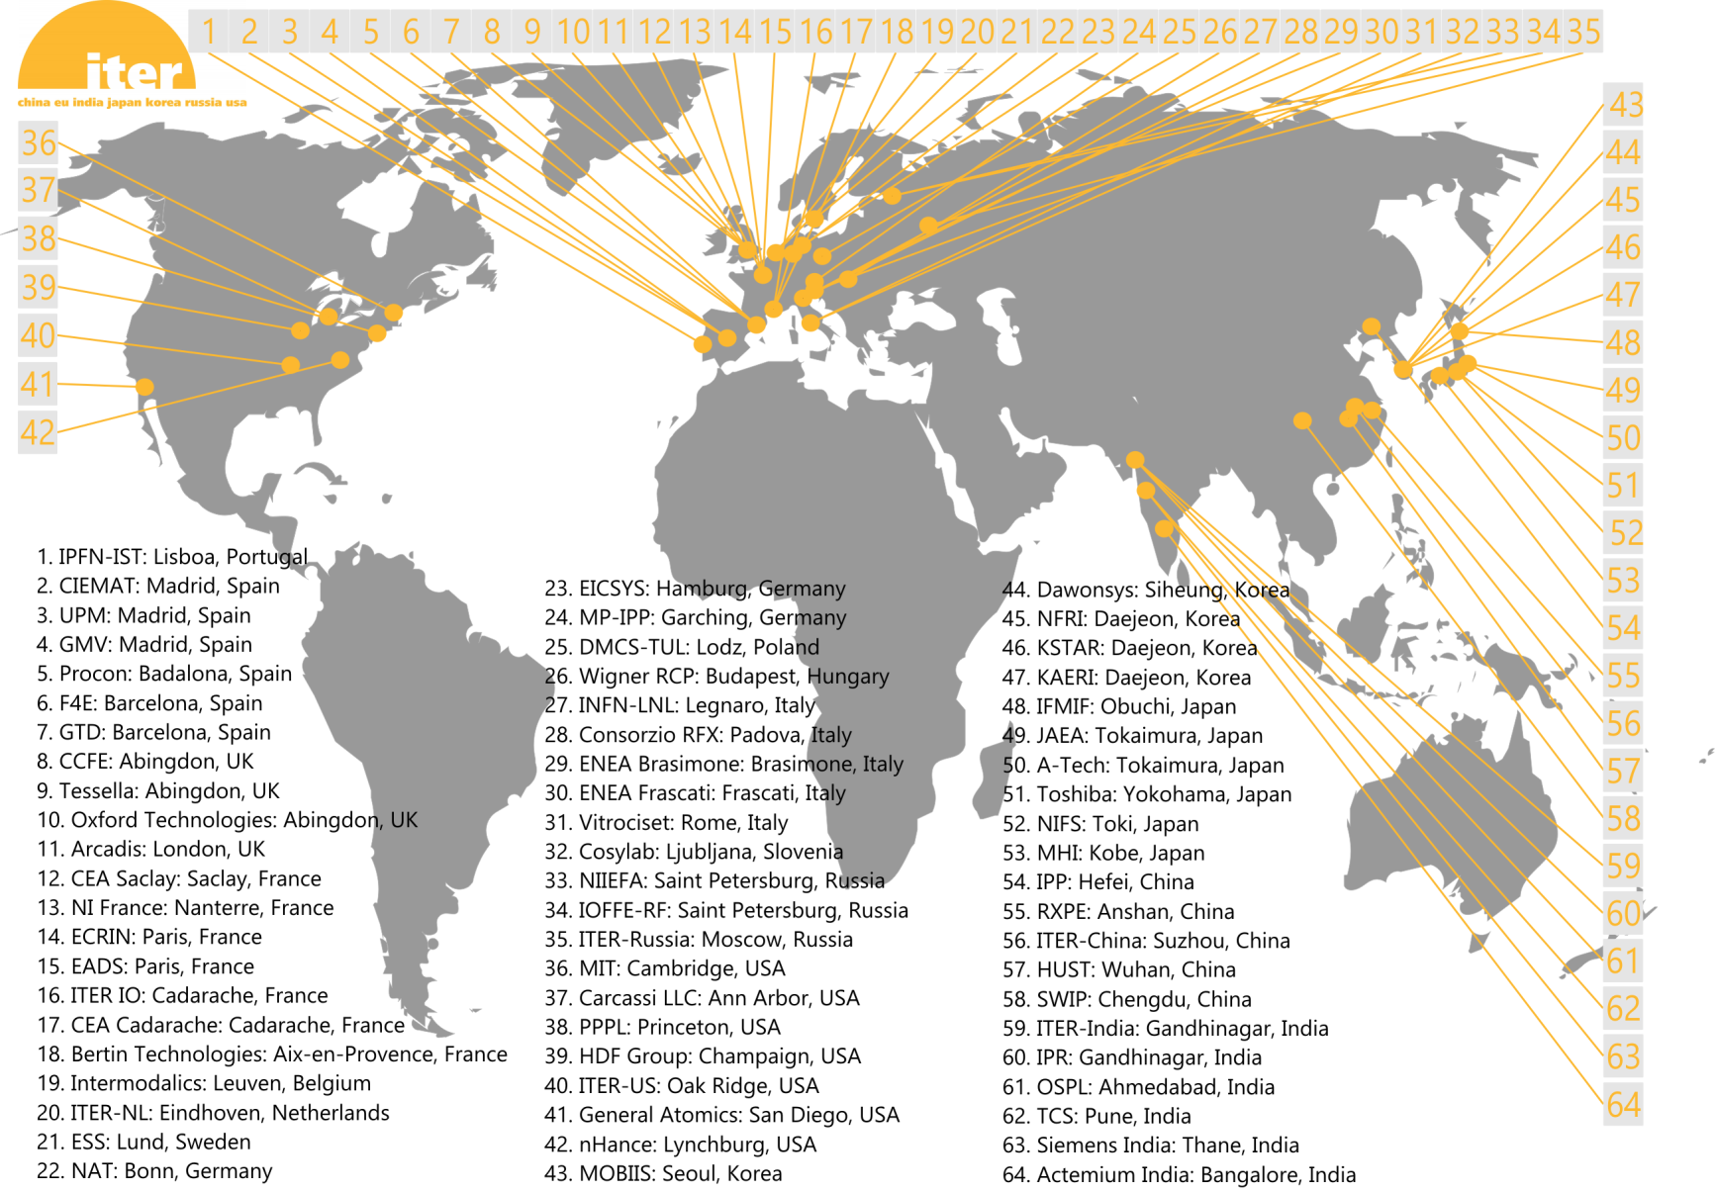
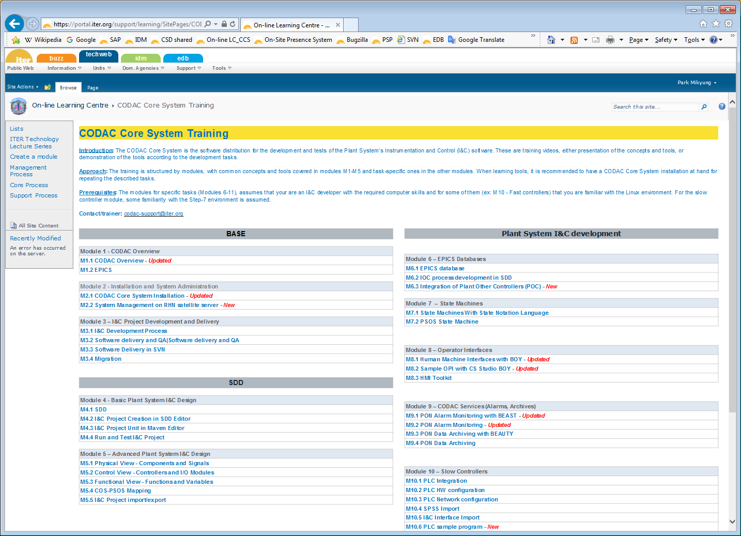
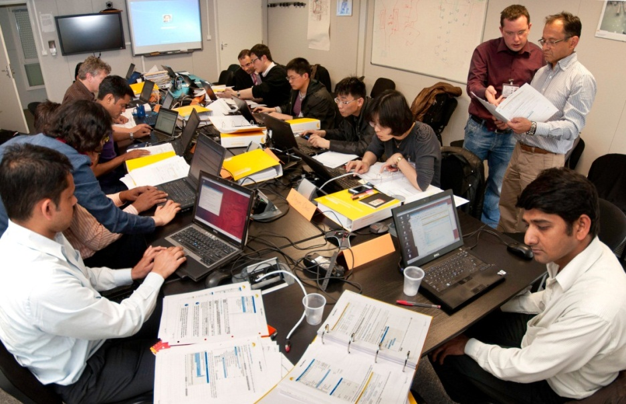
CODAC Core System
Development & Tests
Distributed to all plant system suppliers
154 instances at 63 organizations
Maintained and upgraded throughout ITER lifetime
Supported by
CCS Hands-On workshop at IO and DA premises
CCS Training in IO On-Line Learning Center
Help-desk : codac-support@iter.org
Published
Versions
IO’s RedHat Network
Satellite
Server
Internet

Slide 10

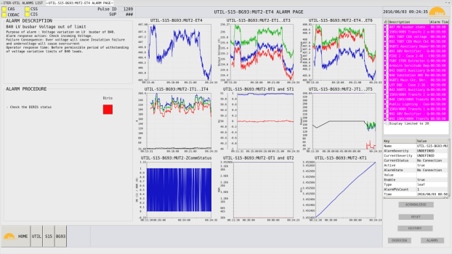
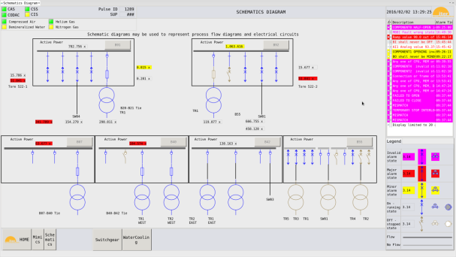
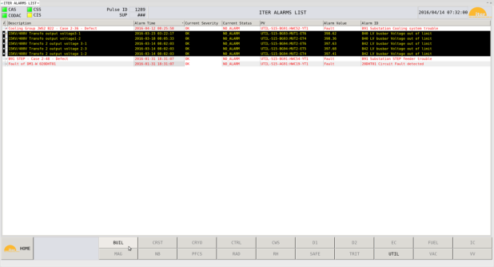


Human Machine Interface Standardization
Plant System operator workstation: 3 screens, 1 keyboard/mouse
  Ultra high definition resolution
  3840 x 2160 (4K) at 60Hz
  24 inches
  Aspect ratio of 16:9

Slide 11
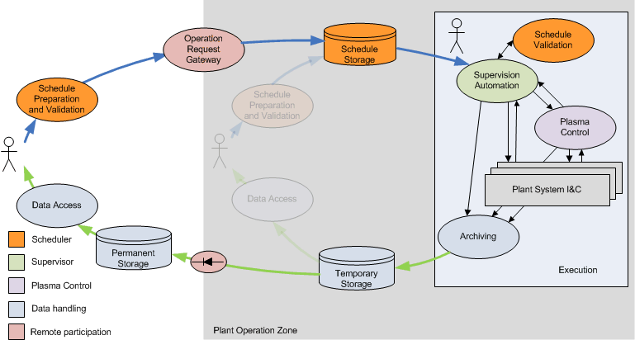
CODAC Operation Applications
CODAC Operation Applications are ITER dedicated software packages deployed on dedicated central servers
Preparation
Scheduling (PSPS)
Gateway (ORG)
Execution
Control (PCS)
Supervision (SUP)
Analysis
Data handling
Data access
eXternal to POZ

Slide 12
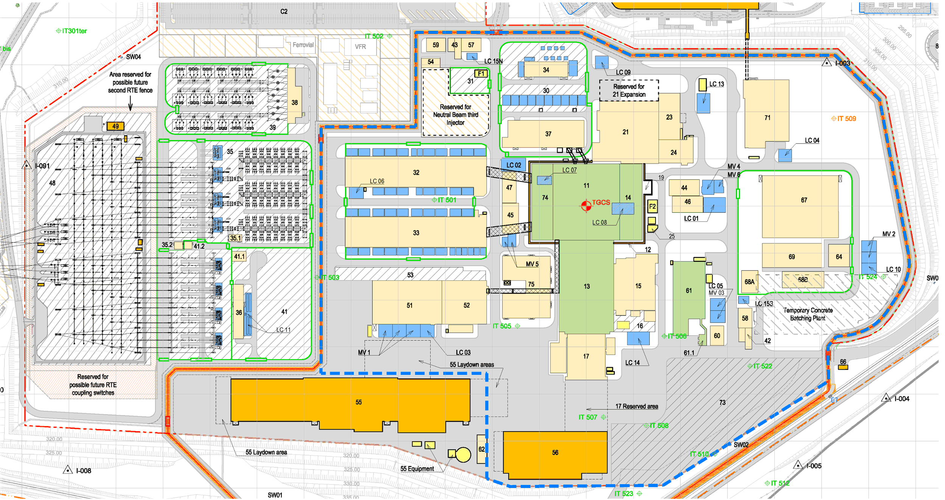
Infrastructure
Control building
Neutral beam
Hot cell
Backup control building
Coil power supplies
Tokamak complex
Electrical
Cryoplant
ICH/
ECH
Cooling water

Slide 13
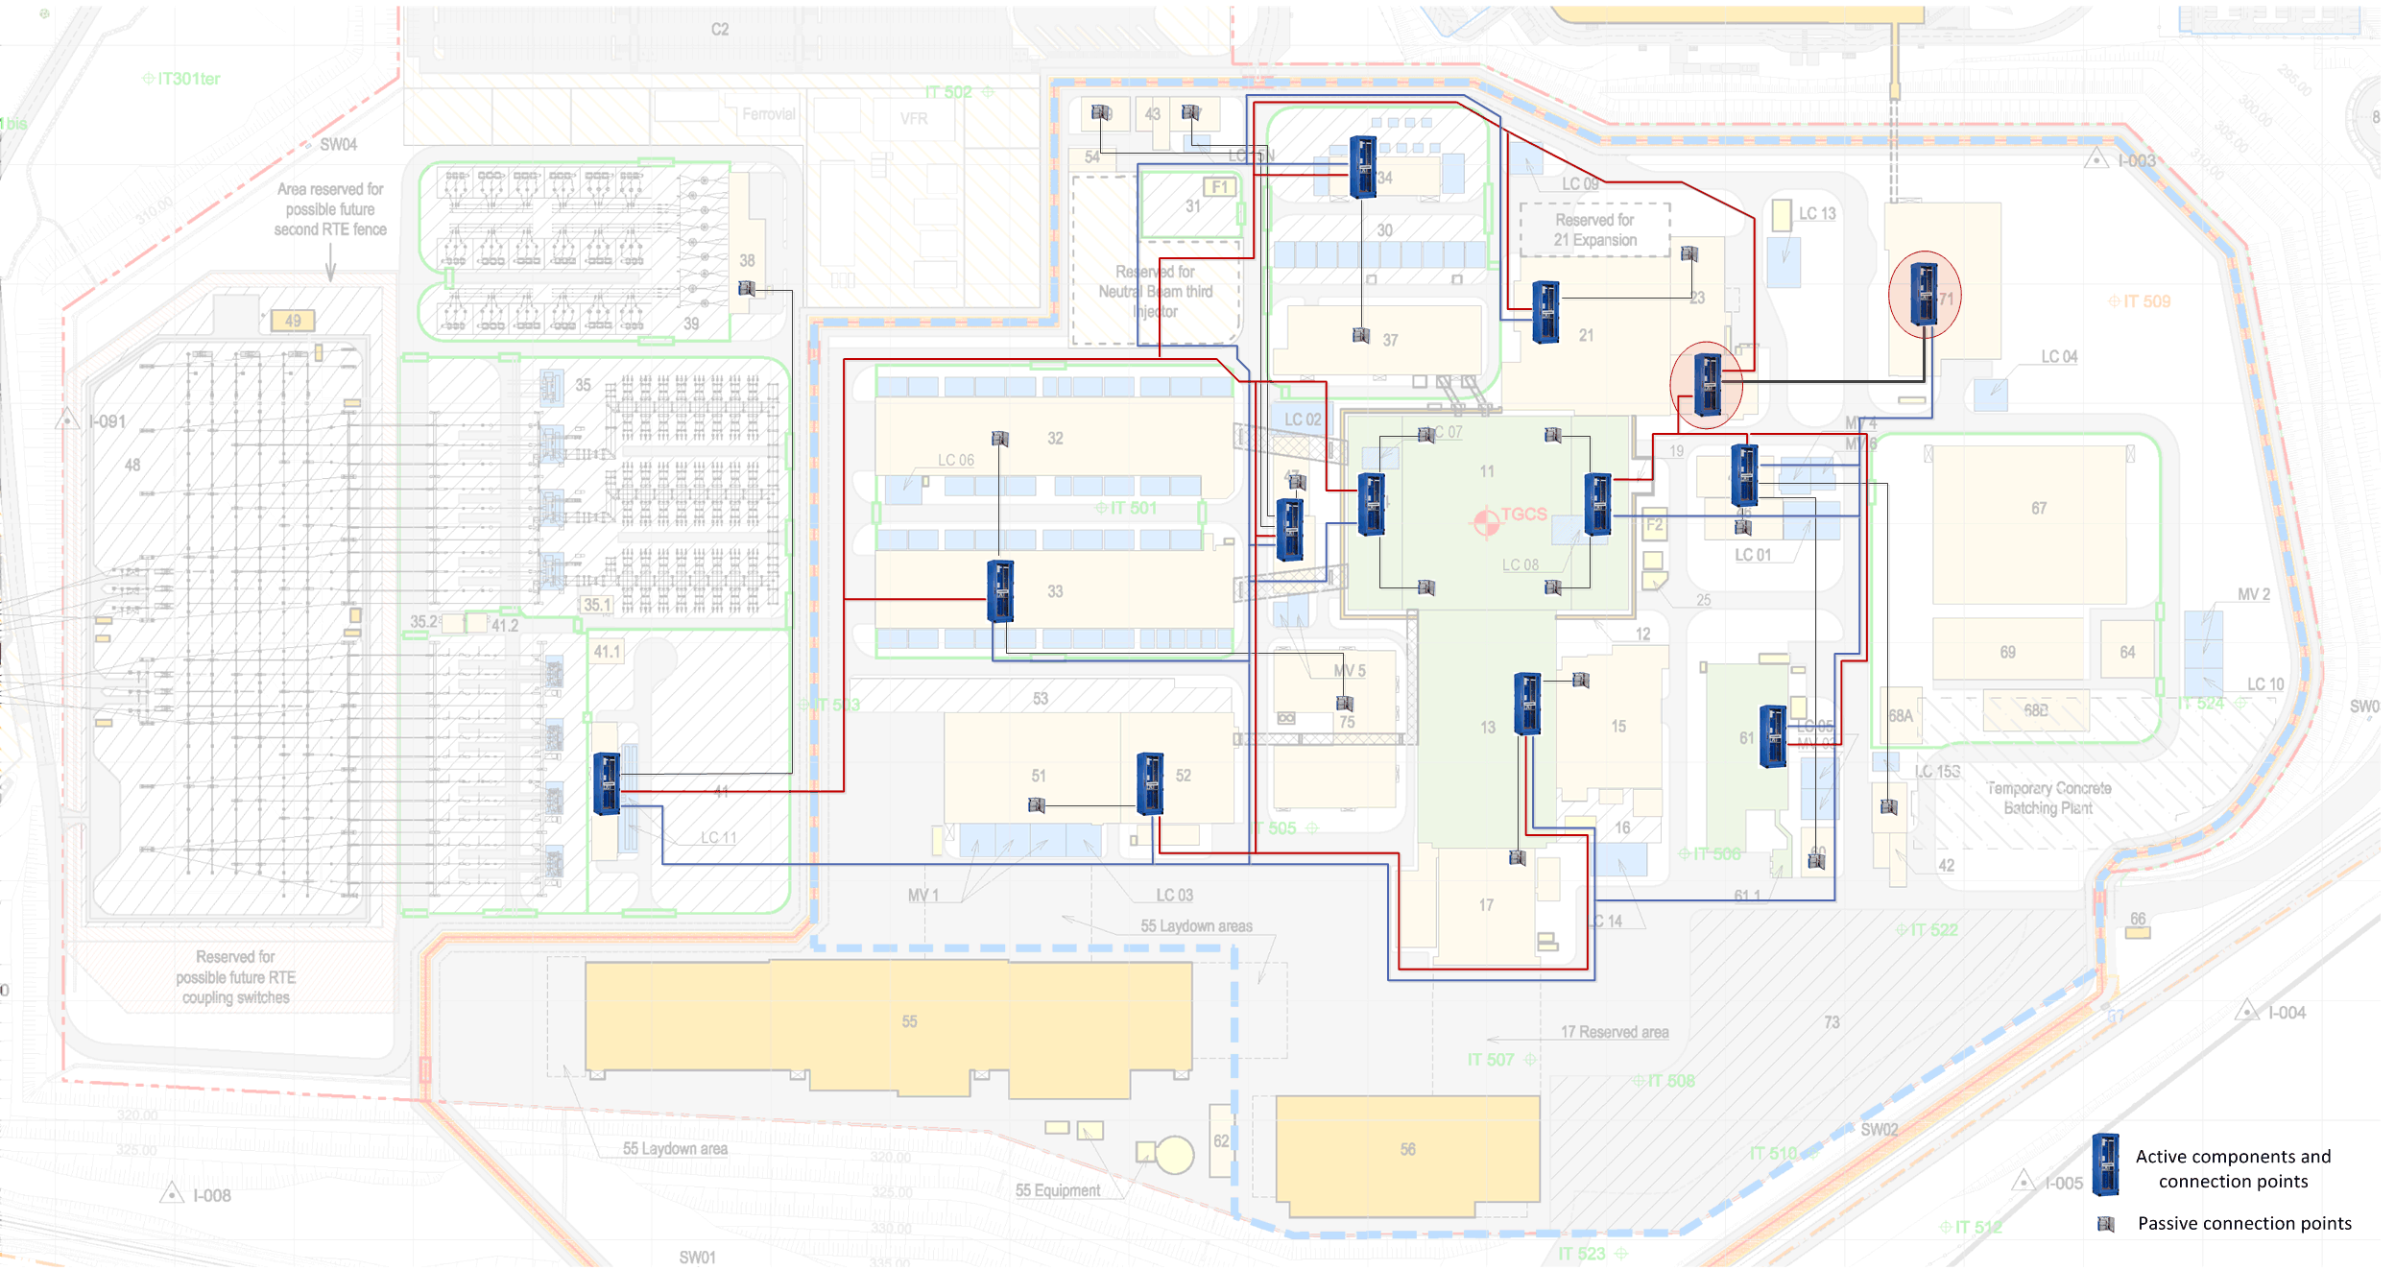
Infrastructure
Redundant dual star configuration
All cables end up in B71 and B24
Bill of Material
173 cubicles
175 passive network panels
300 km multi-core single mode
170 km multi-pair copper cables
Connecting thousands of plant system I&C client cubicles via network panels located in 28 buildings

Slide 14
Schedule
ITER 2016 baseline approved by ITER Council in November 2016
Underpinned with detailed resource loading
Staged approach
End of Pre-Fusion Power Operation-II and Start of Pre- Nuclear Shutdown for Assembly IV
Mar. 2034
End of Pre-Fusion Power Operation-I and Start of Assembly III
Jun. 2030
Start of Pre-Fusion Power Operation-I (SP)
Dec. 2028
End of Pre-Nuclear Shutdown for Assembly IV
Mar. 2035
Pre-Fusion Power Operation-II (TP)
Jun. 2032
Fusion Power Operation
(DT)
Dec. 2035
FP Finished and Start of Assembly II
Jun. 2026
First Plasma (FP)
Dec. 2025
End of Assembly II
Jun. 2028
End of Assembly III
Sep. 2031
Engineering Operation (SC Magnets)
(6 Months)
Assembly II
(24 Months)
Integrated Comm. II (6 Months)
Pre-Fusion Power Operation-I (18 Months)
Assembly III (15 Months)
Integrated Comm. III (9 Months)
Pre-Fusion Power Operation-II (21 Months)
Assembly IV (12 Months)
Integrated Comm. IV (9 Months)
add 46 add 29 add 18
plant system I&C plant system I&C plant system I&C

Slide 15
Control with no building
Challenge 1

Slide 16
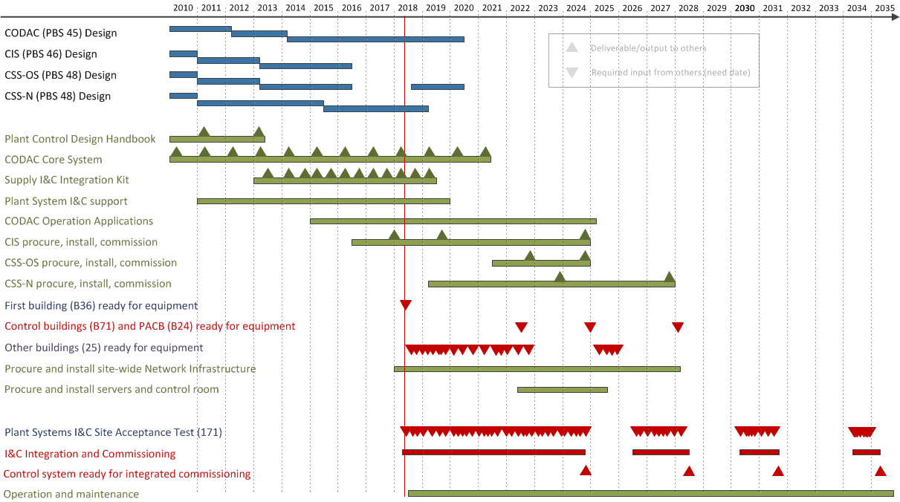
Schedule
Design of central control systems almost complete
Deliveries to project (plant system I&C and site)
Dependency on buildings availability
Dependency on plant system I&C installation and site acceptance test

Slide 17
Schedule
Control building (B71)

Slide 18
Mitigation: Temporary Control Rooms
Requirements
The central infrastructure and services must be available soon
Human Machine Interfaces must be provided for plant system I&C integration
Migration of all plant systems I&C control to B71 must be achieved within 18 months
Implementation
Create temporary local autonomous control room “islands” (TCR) in strategic buildings, providing central services and Human Machine Interfaces
Connect islands with temporary cables to provide inter building connectivity
Create Temporary Main Control Room (T-MCR) in HQ building for central supervision and initial operation

Slide 19
TCR – Functions
Human Machine Interface
Data handling including archiving, storage and access
Inter plant communication
Role based access control
Alarm handling including SMS/email notification
Time synchronization
Electronic logbook
Access to central software repository and issue tracking (configuration control)
Development stations for software updates (fast turn-around)
Central supervision and monitoring
Archive data access from office

Slide 20
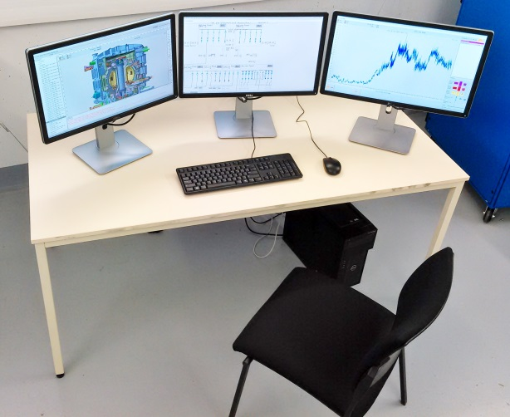
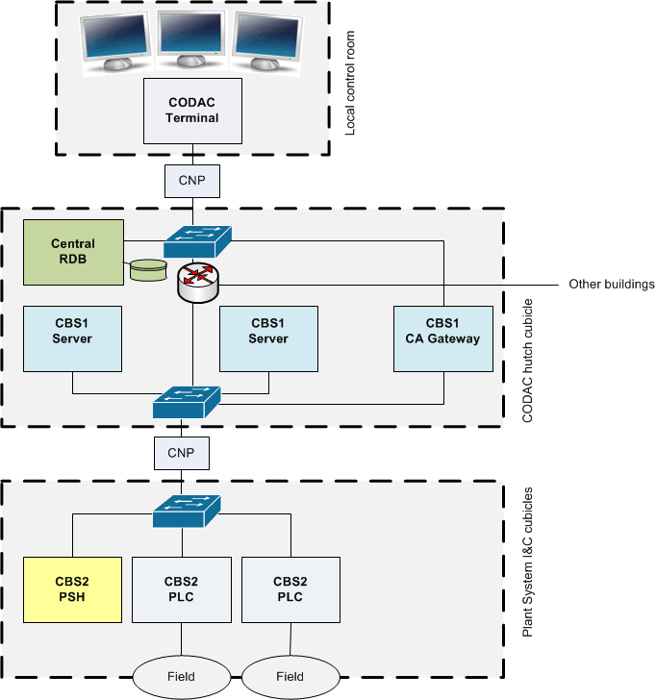
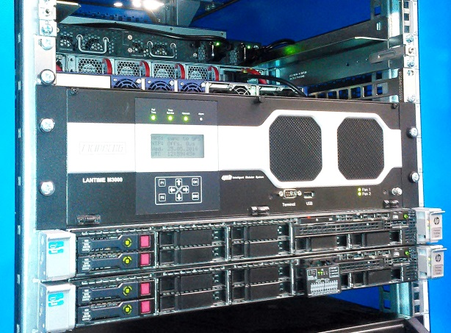
TCR – Implementation
Install central servers in existing CODAC network cubicles
Standard HMI stations in suitable room
Add Interlock and Safety when applicable (local test tools)
Cover all Plant Systems for First Plasma (before Control Building availability) by eleven Temporary Control Rooms

Slide 21
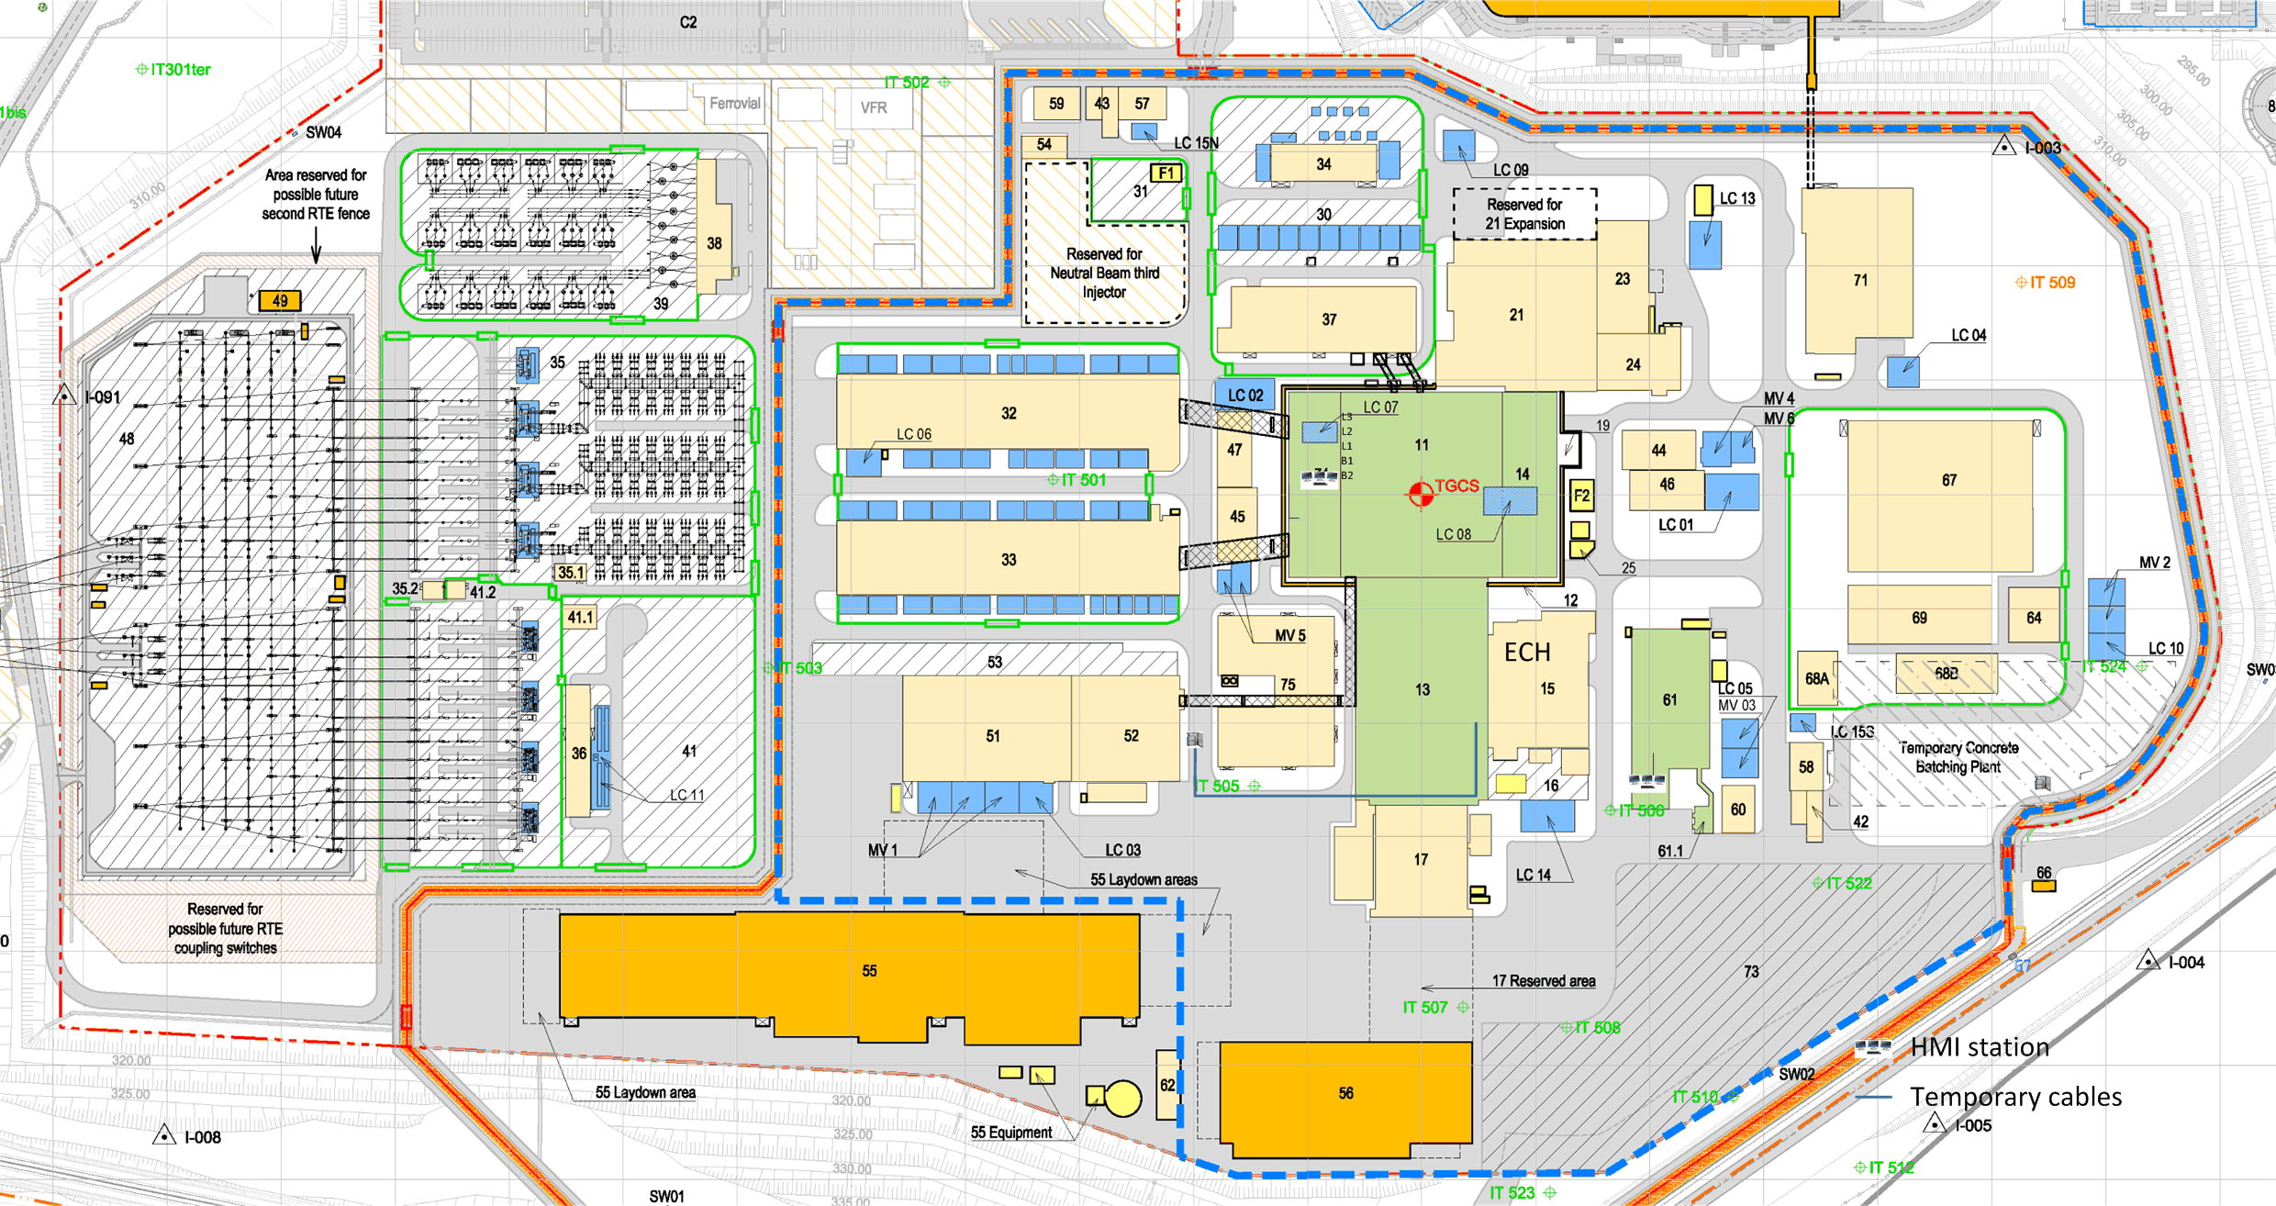
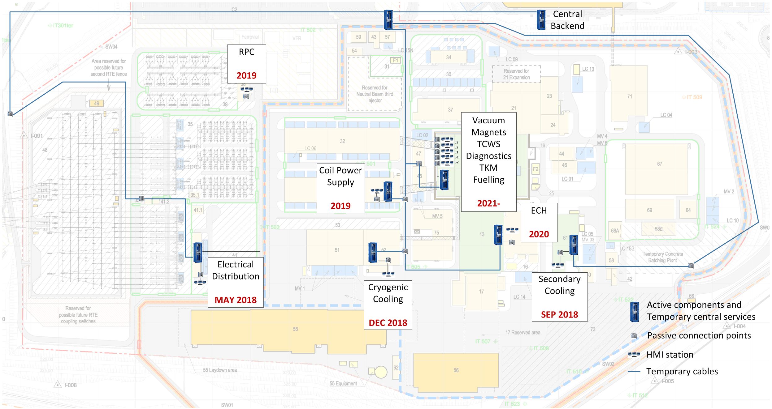
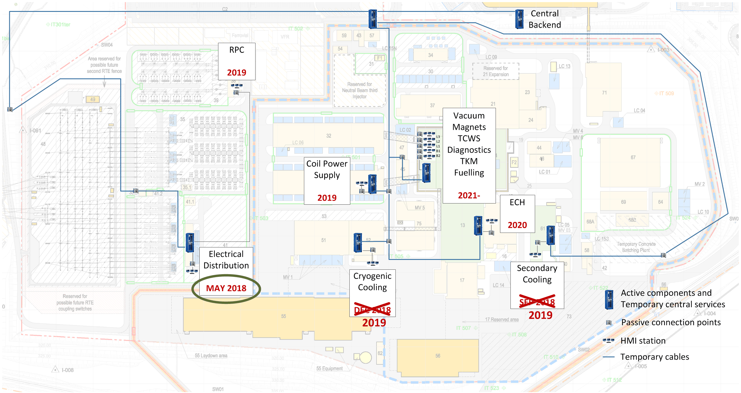
TCR – Schedule

Slide 22
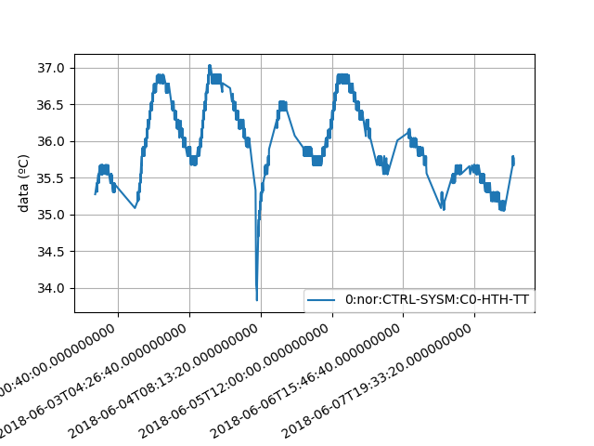
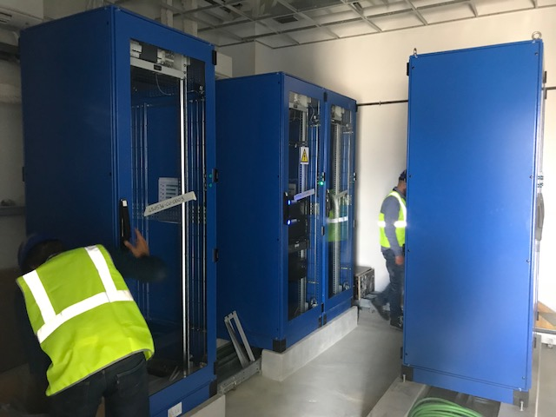
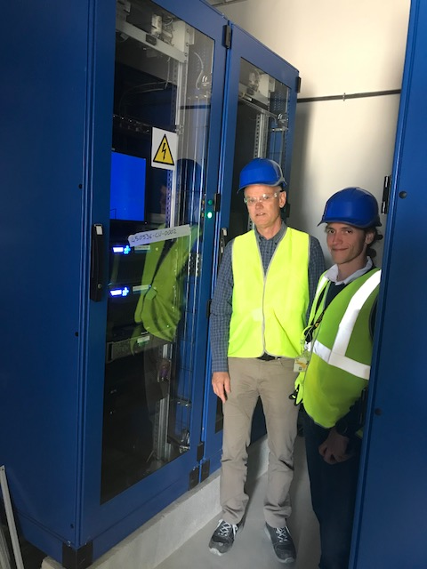
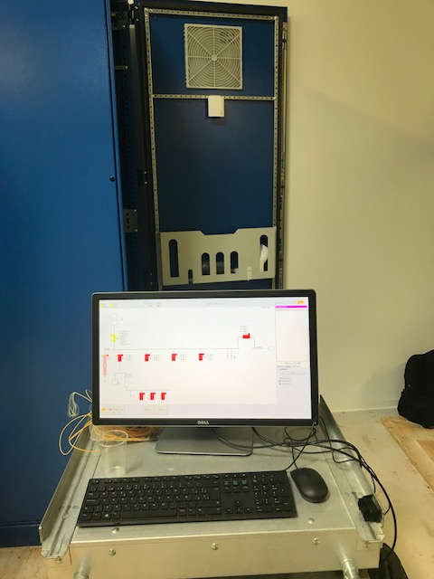
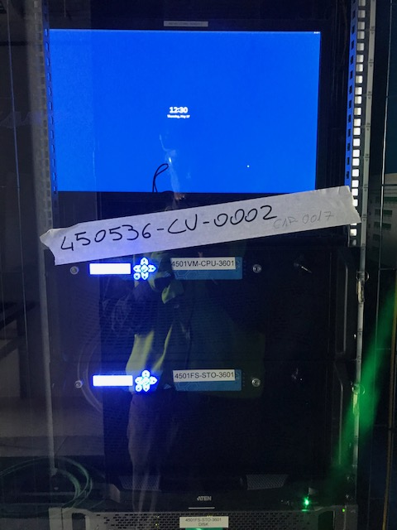
TCR – Status
First Temporary Control Room in Building 36 (electrical) was powered up in May
I&C Integration and Commissioning of 400kV system done in July/August
I&C Integration and Commissioning of 22kV system currently ONGOING

Slide 23
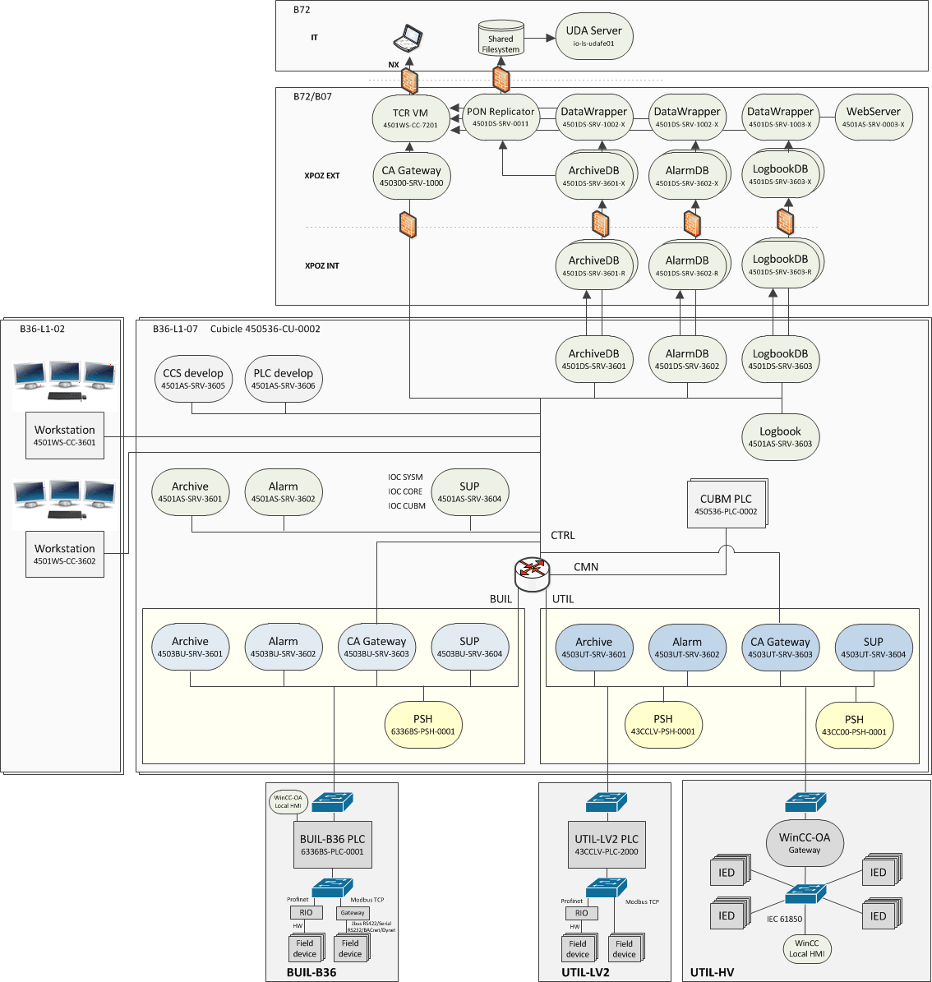
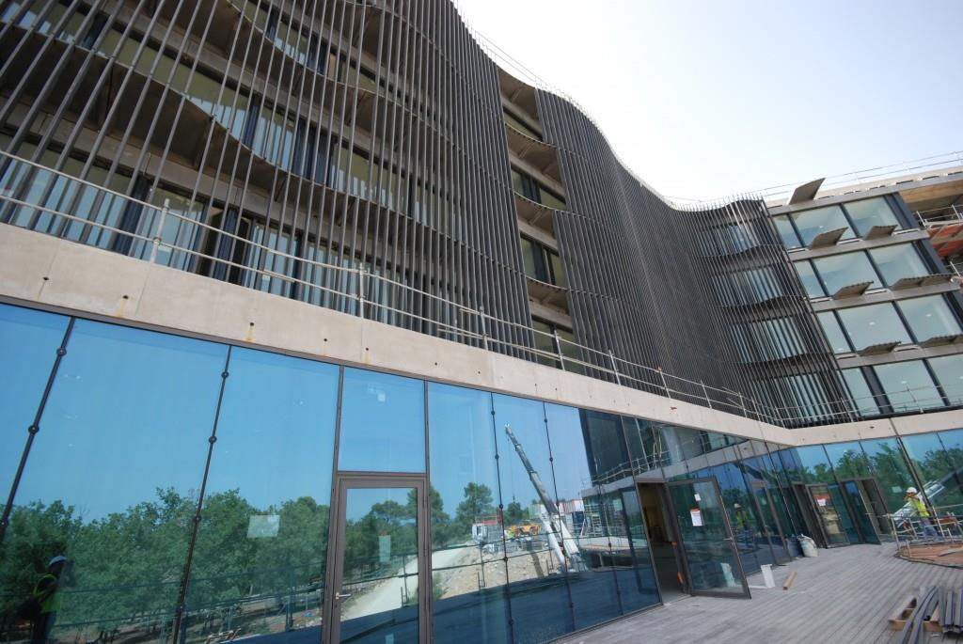
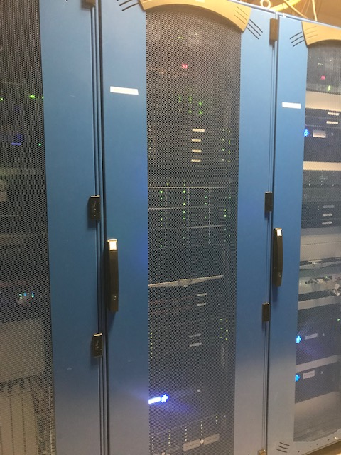
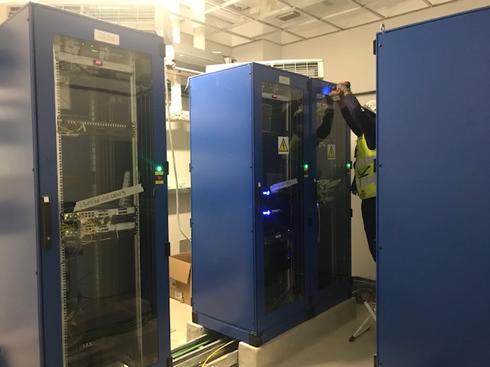
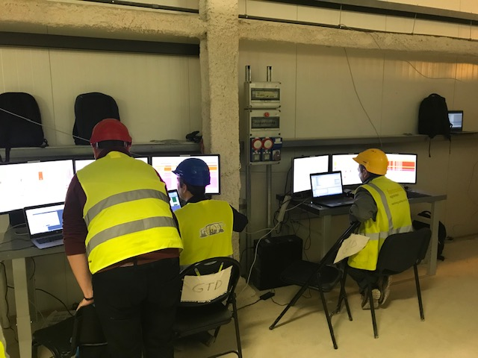
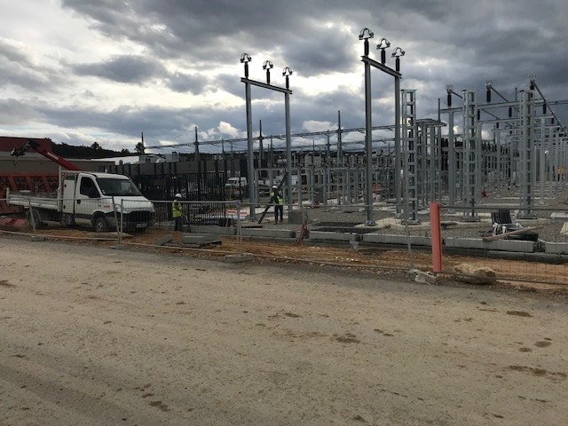
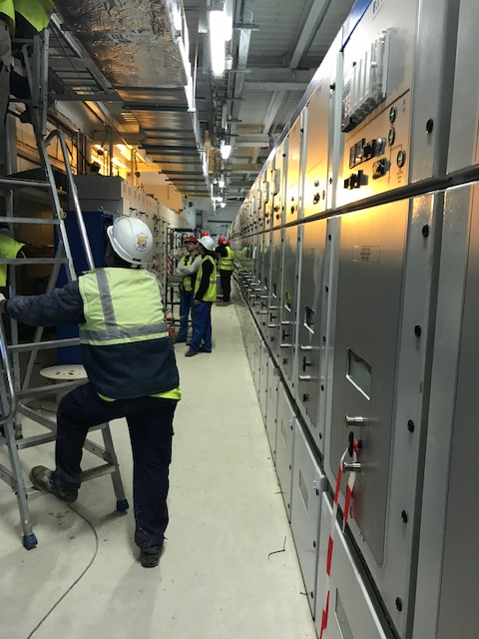
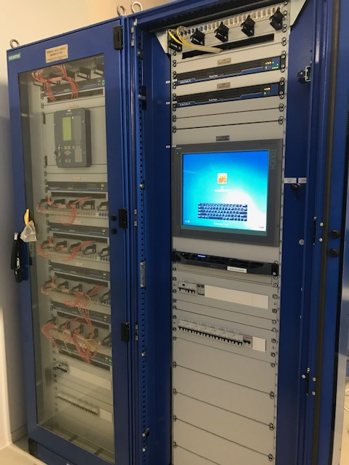

Slide 24
Scale
Challenge 2

Slide 25
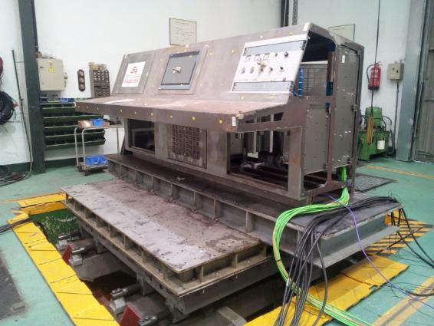


Examples: Nuclear Safety
Confinement of radioactive material
Protection from exposure to ionizing radiation
Two separate signal chains
Extensive qualification of components
Cost per signal:
Fission reactor: ~3,000 € (proprietary hw)
ITER: ~1,500 € (commercial hw)
Number of signals:
Fission reactor: 200-400
ITER: 40,000
24.1 m/s² at the shaking table
101 m/s² in heaviest sampler

Slide 26
Examples: Cubicles, Buildings, Cryo
ITER will use about 3,500 cubicles (19” racks), each with a small PLC for monitoring the cubicle status
  Assuming an EPICS database of 20 records per cubicle, that’s 70,000 records just for cubicle monitoring (doors, temp, fan)
The building automation integrator plans to install large PLCs (Siemens S7-1518) with ~40,000 signals per PLC (building)
The Cryo system contractor was testing a single IOC loading an EPICS database of 120,000 records

Slide 27

Thank you ps. Check out the drone flight videos!

