Slide 1
Development of energy-selective and element-sensitive imaging using a compact D-D fast-neutron generator
Benoit Soubelet, Dr Robert Adams, Heiko Kromer, Dr Robert Zboray, Dr H.-M. Prasser
WCNR 11 – Sydney – September 2nd-7th 2018

Slide 2
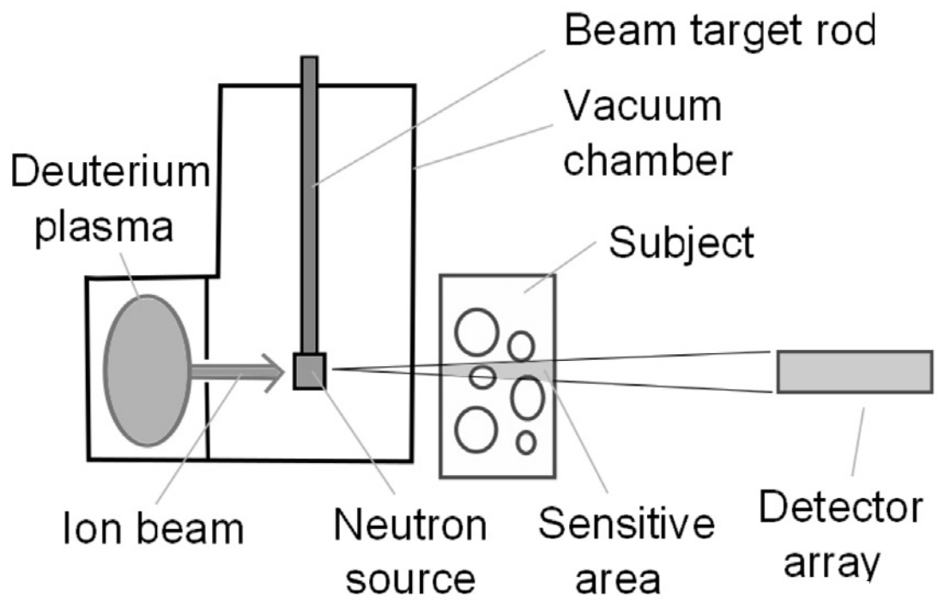
The compact D-D fusion generator
(Early-stage version)

Slide 3
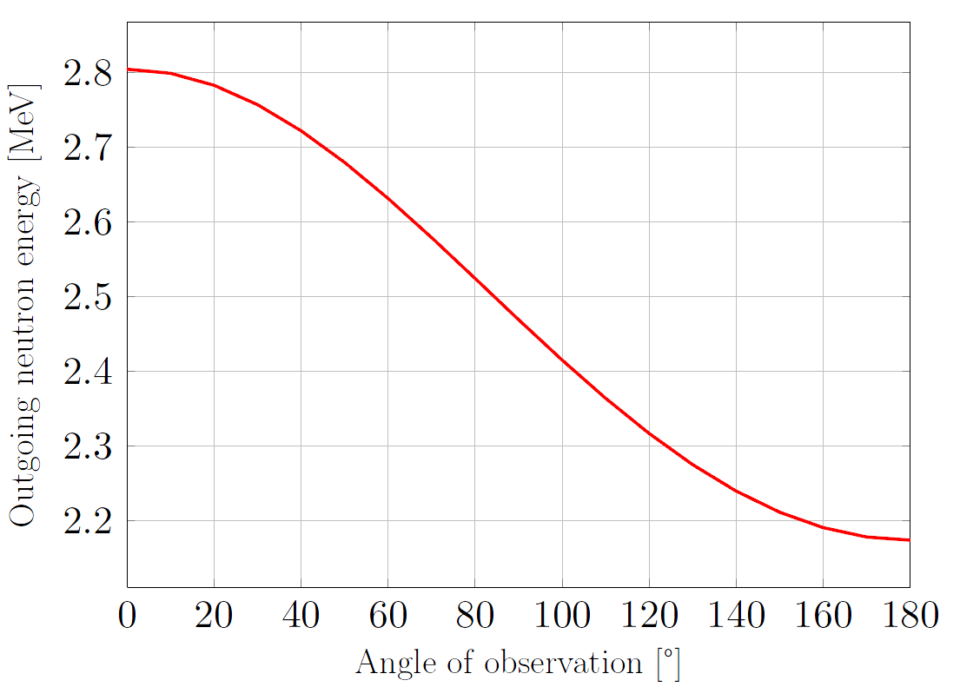
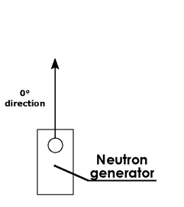
A bit more about these D-D neutrons
D-D generator: natural 2-3 MeV range
(conservation energy/momentum)
2.80 MeV
2.45 MeV
2.18 MeV
(for 80 keV deuteron beam)

Slide 4
What do we call element sensitivity?

Slide 5
Back to the theory: Neutron interaction with matter
Unique element- and energy-dependences
Unique signature with attenuation measurements
High attenuation
Low attenuation

Slide 6
Element-specific signature: superiority of fast neutrons over photons

Slide 7
Thus qualitative distinction is possible with fast neutrons.
But can it be quantitative as well?

Slide 8
From element sensitivity to elemental content determination
Attenuation of neutrons: Beer-Lambert
$$I_{0}$$
$$I\left(x\right)$$
$$I_{1}$$
$$I\left(x\right)=I_{0}⋅e^{−Σ_{t}⋅x}$$
$$Σ_{t}=\underset{known}{\underbrace{\frac{1}{x_{1}}}}⋅\underset{measured}{\underbrace{\ln\left(\frac{I_{0}}{I_{1}}\right)}}$$
Beam
$$x$$
$$x_{1}$$
Simplest sample with only one element → $\underset{calculated}{\underbrace{Σ_{t}}}=N_{1}⋅\underset{tabulated}{\underbrace{σ_{1}}}$
➔ $N_{1}$ immediately accessible with 1 measurement
For random samples with M elements → $Σ_{t}=N_{1}⋅σ_{1}+N_{2}⋅σ_{2}+…+N_{M}⋅σ_{M}$
➔ Under-defined problem to get all the $N_{i}$ if 1 measurement

Slide 9
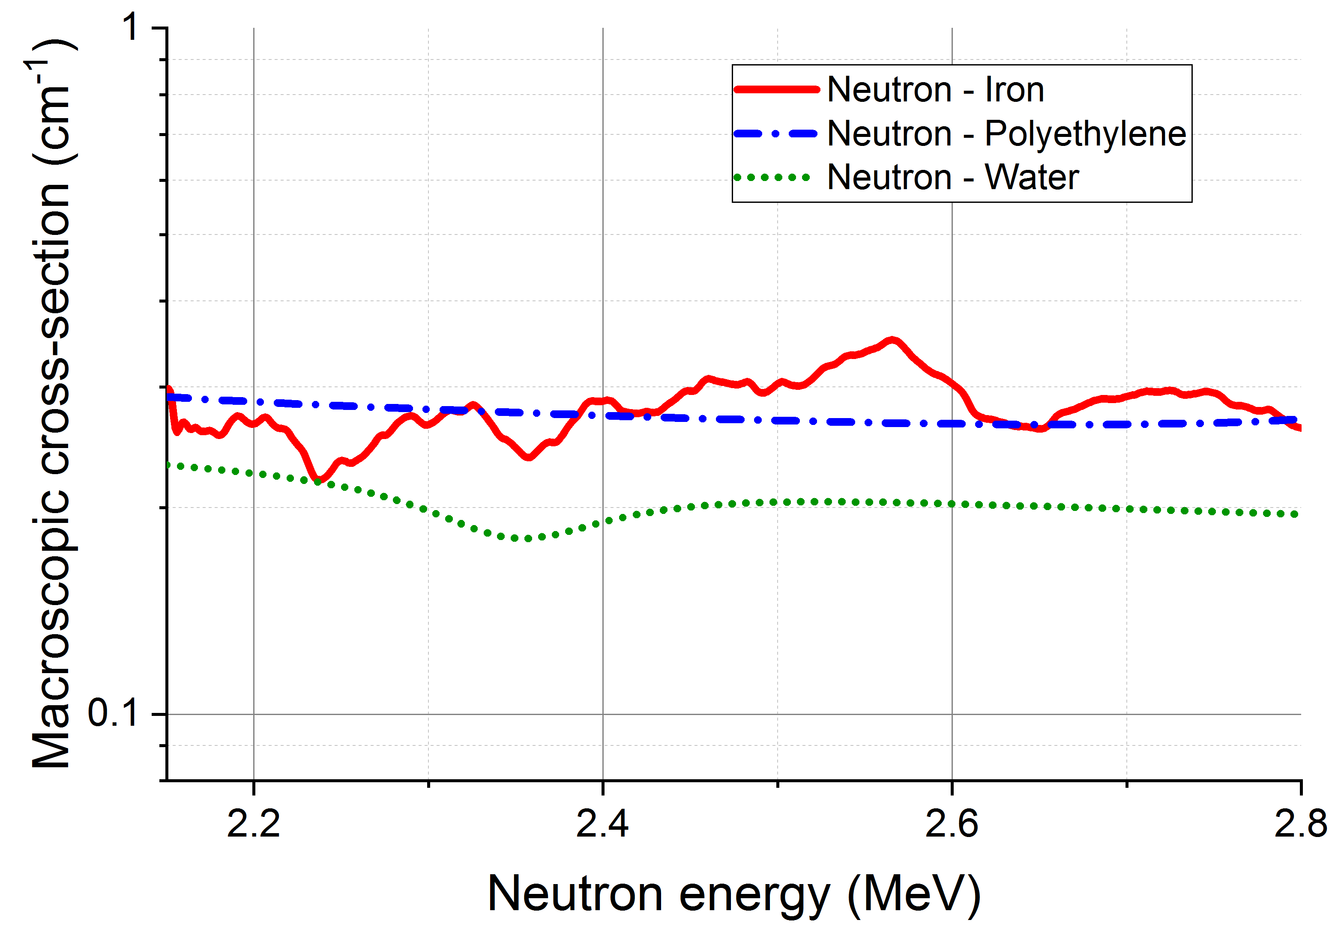
Looking for a fully defined problem
At least M independent equations needed … where will we find them?
Remember: unique energy- and element-dependence of the neutron XS!
Let’s look at water
120°
0°
$↔$ direction of emission (°)

Slide 10
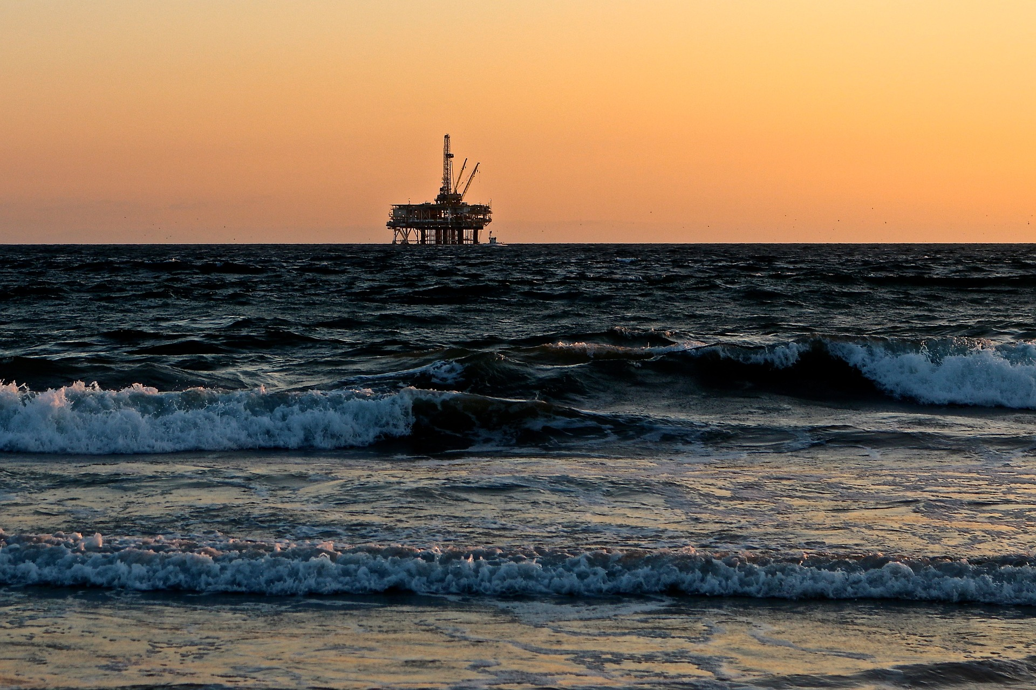
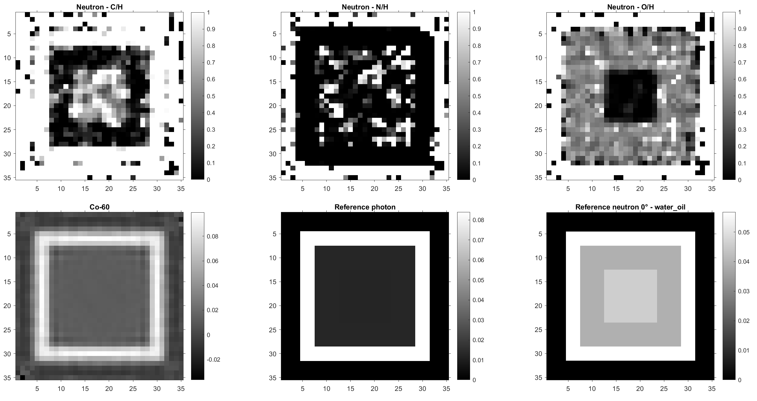
Example of elemental contrast with fast neutrons
5-cm iron pipe with mix of water and oil
5e7 n/s, 90 CT projections, every 10 deg, 600s/CT (120h), 2mm, HCNO guess, Gaussian noise
water$→\frac{C}{H}=0,\frac{N}{H}=0,\frac{O}{H}=0.5$ and oil$→\frac{C}{H}=0.68,\frac{N}{H}=0.002,\frac{O}{H}=0.007$

Slide 11
That was all theoretical.
1st work package: feasibility study

Slide 12
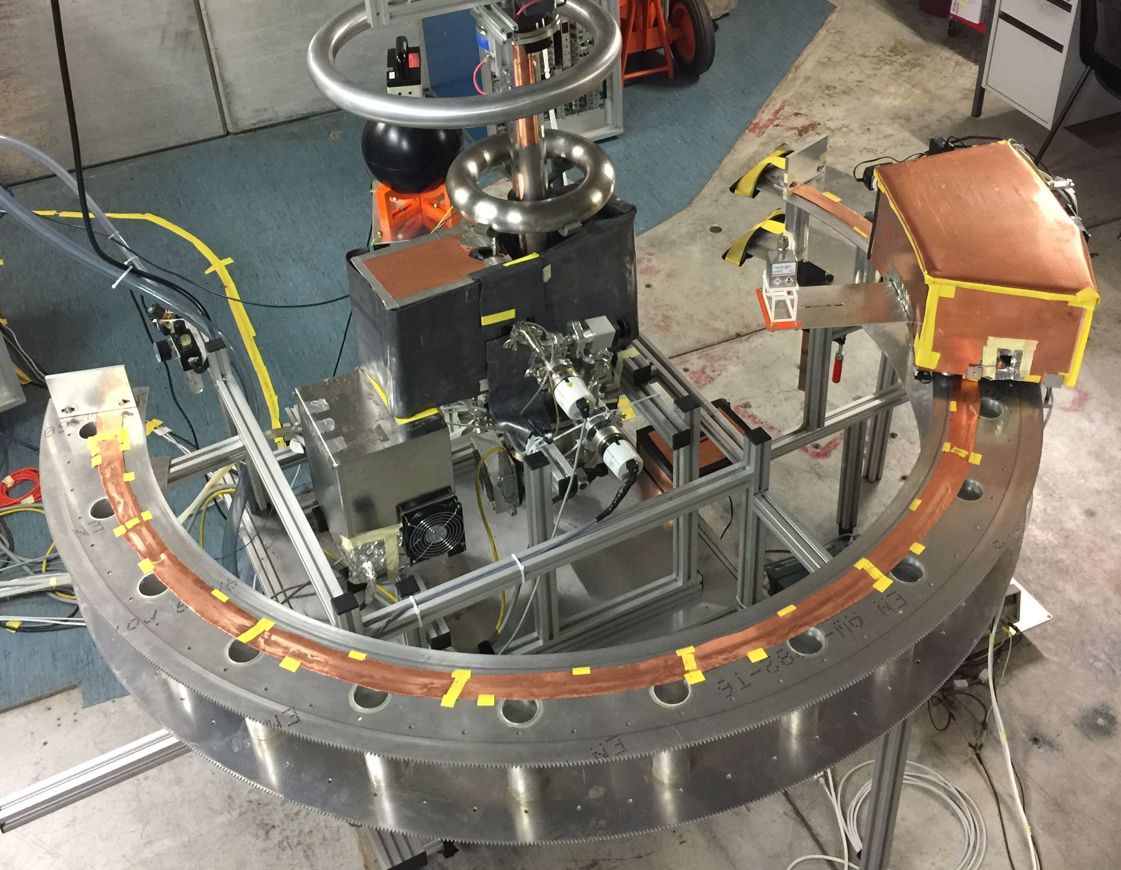
Feasibility study with custom setup
Automated goniometric measurement setup
Proof of principle with selected samples
Alumina, magnesia, water
Sample
Neutron detectors
1m
Electronics
1st journal article with all details (under review)

Slide 13
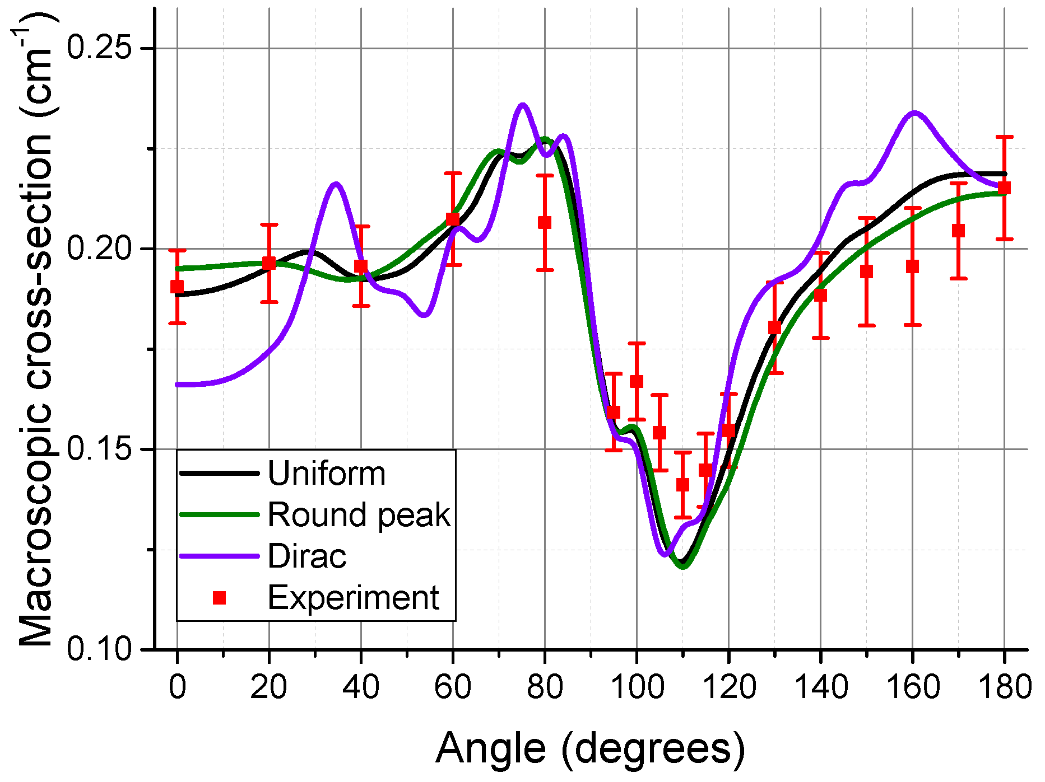
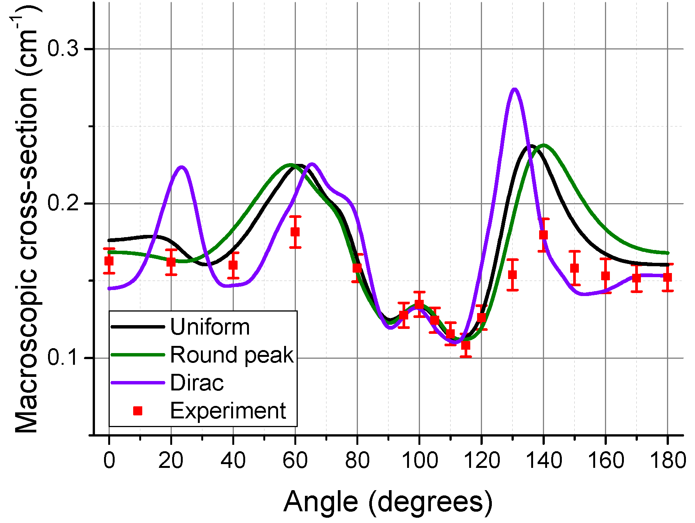
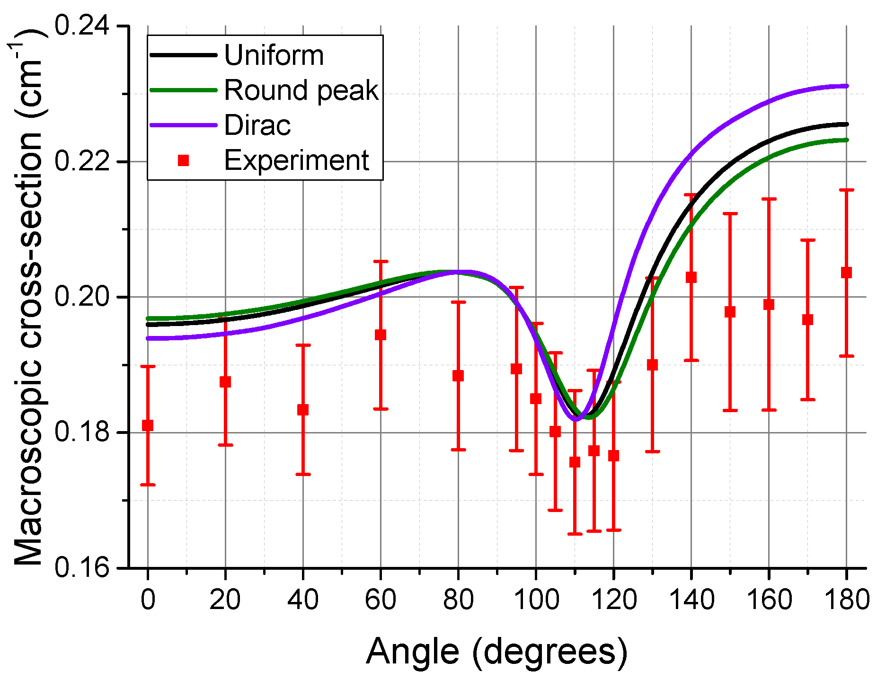
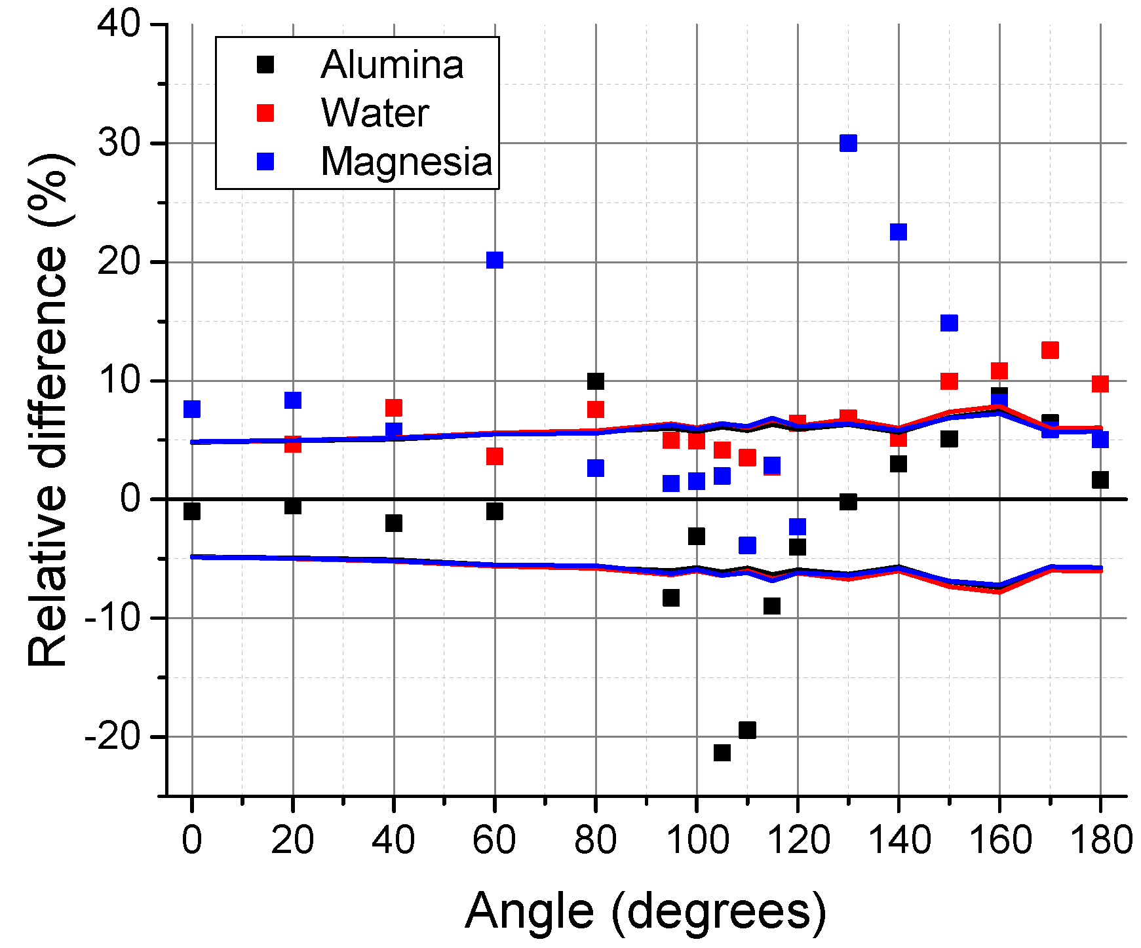
Good agreement of the results
Al₂O₃
MgO
Some deviations still
H₂O
Relative
difference

Slide 14
What is the main cause of the deviations?
How can we correct it to get a robust quantitative method?

Slide 15
Spectral uncertainties: a quasi-monoenergetic source?
Deuterons slowing down in the target: fusion at different deuteron energies
Wide distributions forward and backward
Mono-energetic around 90 degrees
Energy/momentum conservation
DD cross-section
Energy of deuterons
Target depth
Incoming deuterons
Target
Neutron flux (A.U.)
2.8 MeV
2.7 MeV
Neutron energy (MeV)
2.6 MeV
2.6
2.7
2.8
Fusion event
Neutron

Slide 16
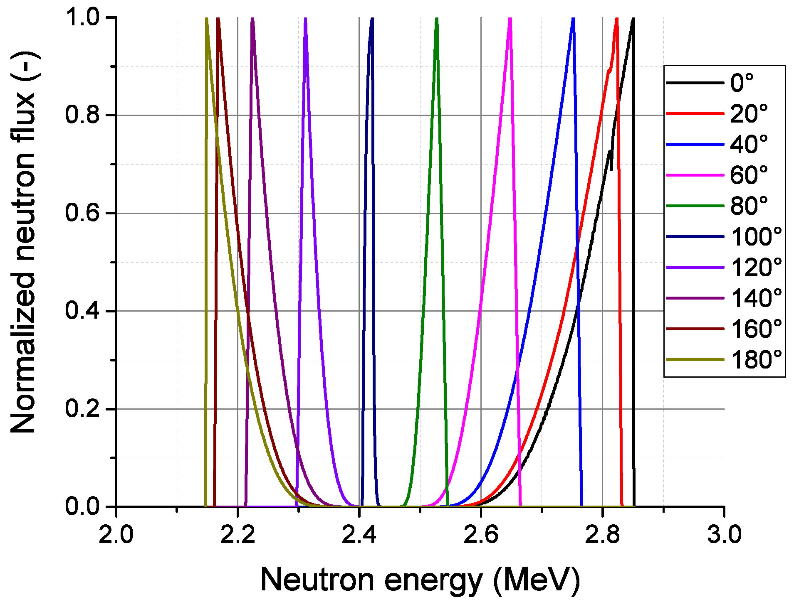
Spectral uncertainties: a quasi-monoenergetic source?
Neutron flux (A.U.)
Neutron energy (MeV)
2.6
2.7
2.8

Slide 17
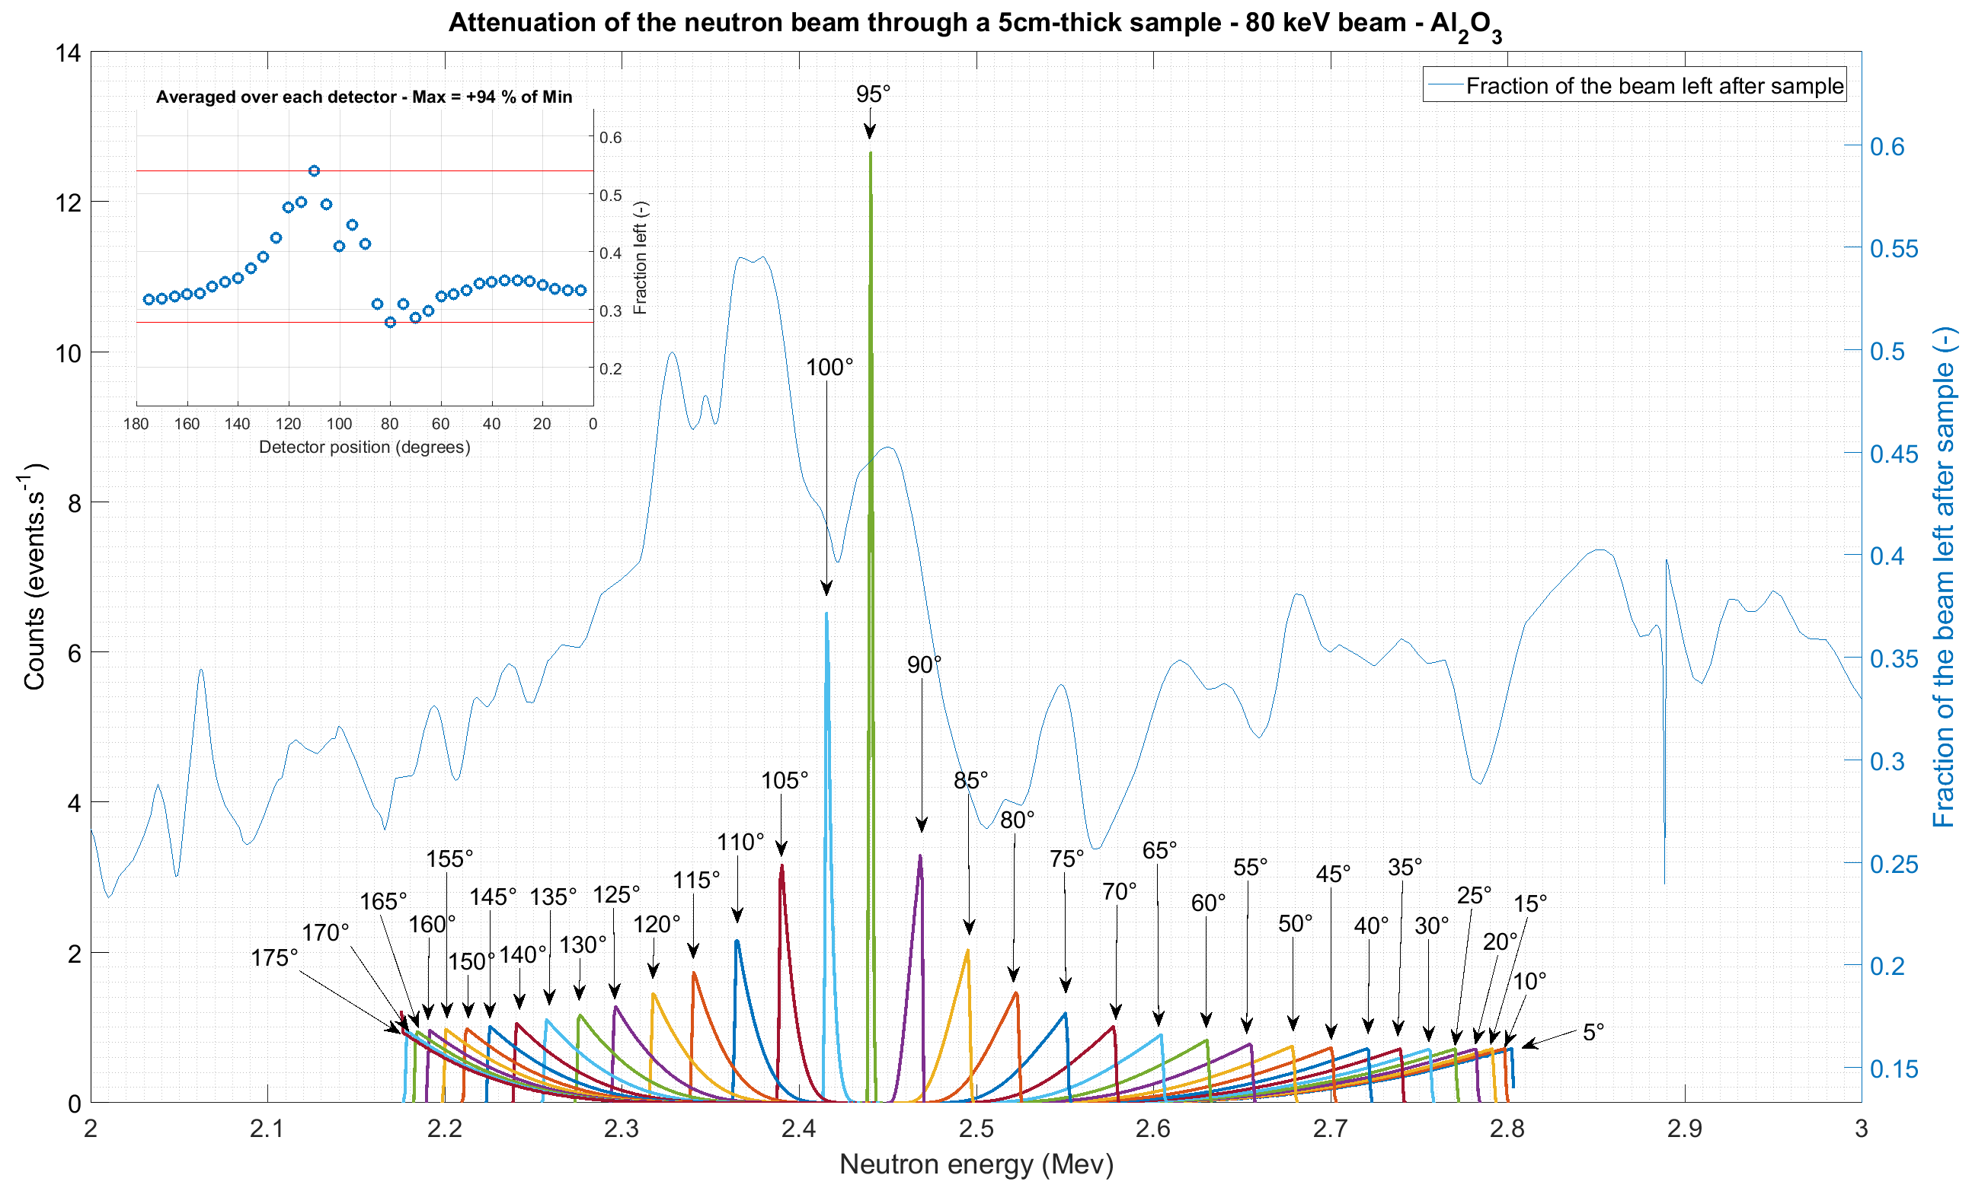
Polychromatic beam: effect on the results
“Smoothing” the cross-sections
Problematic for reconstruction
$Σ_{t}=N_{i}⋅σ_{i}$ → tabulated $σ_{i}\left(E\right)$

Slide 18
The solution?
Calibration!
i.e. building our own cross-section database
(2nd work package – in progress)

Slide 19
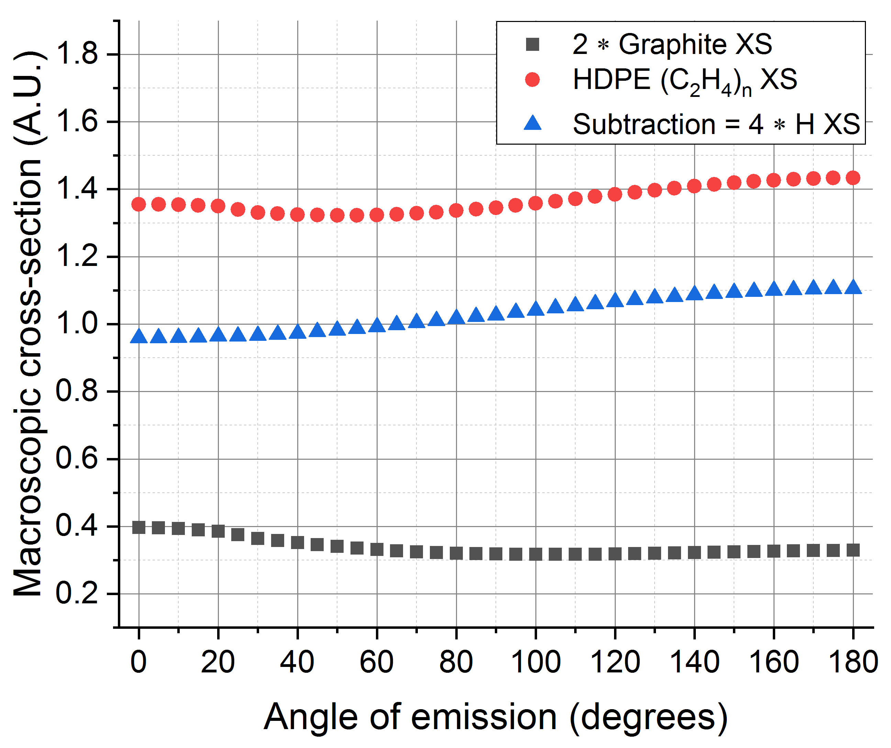
Custom cross-section database
Pure samples measured with custom setup will solve
All spectral uncertainties
All tabulated/evaluated data uncertainties
Not all the nuclides available under mono-nuclide form → subtraction method
Example with
hydrogen

Slide 20
Conclusion and outlook

Slide 21
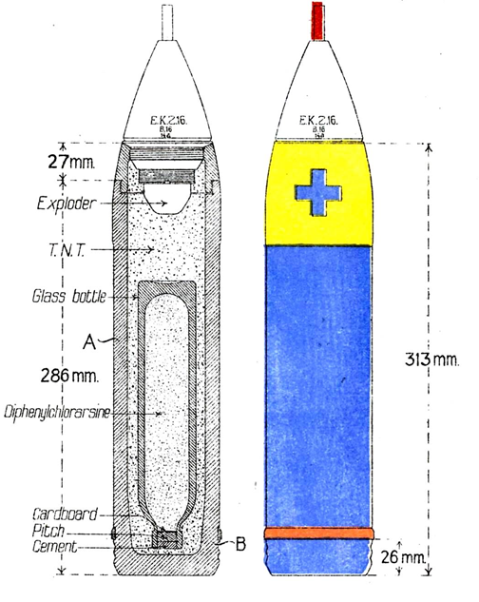
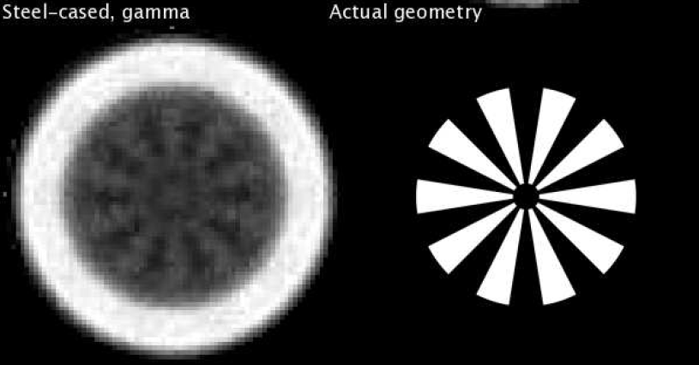
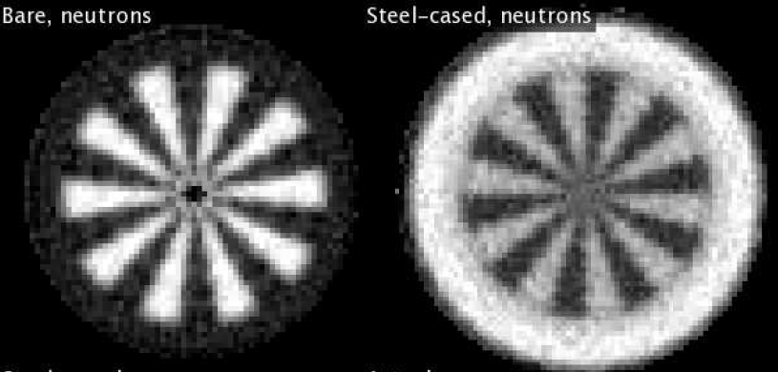
Achievements and perspectives
Successful feasibility study of energy-sensitivity
Albeit with some deviation from models
Current calibration: custom cross-section database
Spectral/XS database uncertainties corrected
Challenges of pure samples
Future developments (3rd work package)
Full tomographic setup
Combined X-ray capability
Oil/water, WWI-II chemical ammunition
Clark I C₁₂H₁₀ClAs
Comparative computed tomography of the Siemens star with neutrons and gammas (Co-60 source) in R. Adams’s work

Slide 22
Wir schaffen Wissen – heute für morgen
Thank you for your attention ☺
Do you have questions?

Slide 23
Backup slides

Slide 24
The compact D-D fusion generator
Neutron
Deuteron
³He
Target
80 kV
Plasma

Slide 25
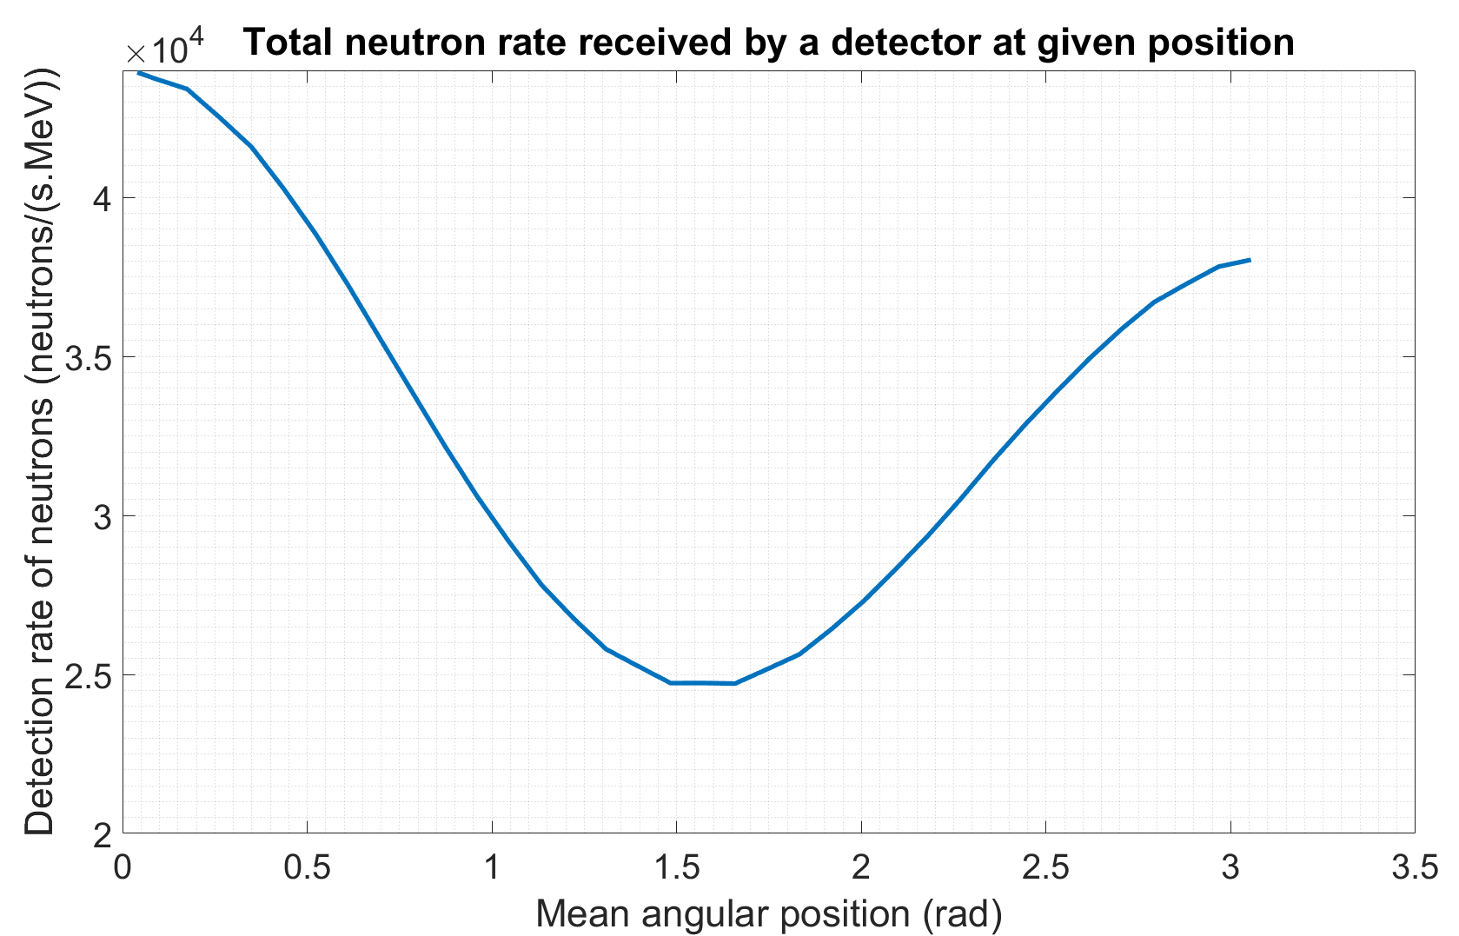
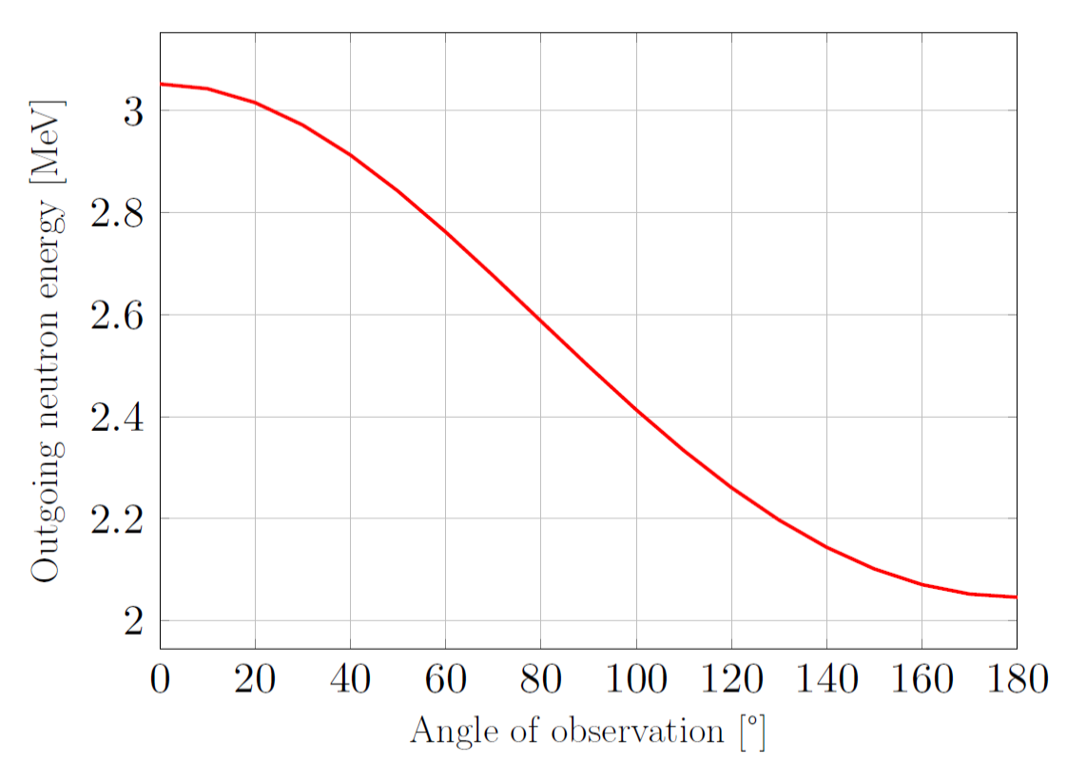
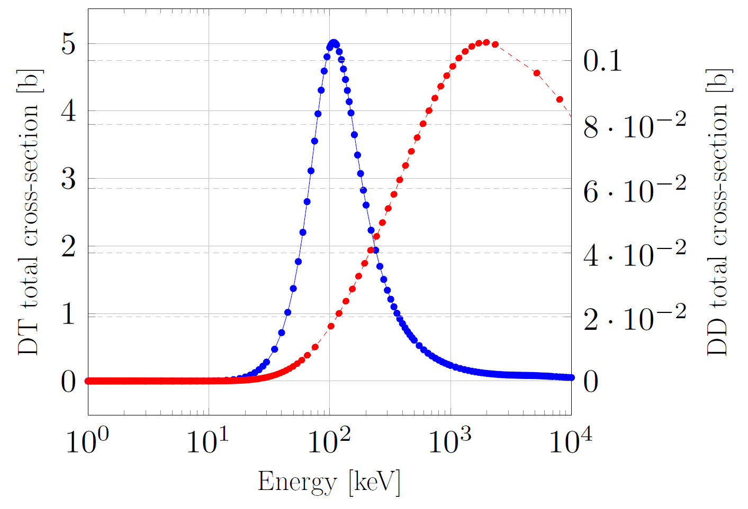
Characteristics of the PSI neutron generator
Conservation of momentum and energy: angular energy distribution between 2-3 MeV
Non-isotropic yield
2 orders of magnitude smaller cross-section (compared to DT)
←Forward
Backward →
~1.8
~1.6
Reference
Forward direction
Backward direction
Angular distribution of the outgoing neutron energy, for a 200 keV incoming deuteron

Slide 26
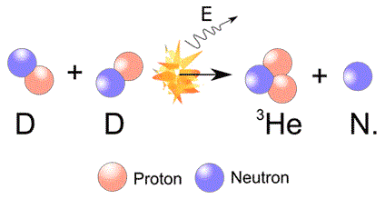
Compact fast neutron generators
Availability of a wide range of neutron sources
Large-scale facilities: research reactors, spallation sources
Small radioisotope sources: (alpha, n) with Am-241 and Be-9; spontaneous fission with Cf-252. Low polychromatic output.
Compact sources: based on one of the “Big 4”
Transfer reactions:
${}_{1}^{3}H+{}_{1}^{1}H→{}_{2}^{3}{He}+{}_{0}^{1}n$ Qvalue = -0.734 MeV Threshold = 1 MeV
${}_{3}^{7}{Li}+{}_{1}^{1}H→{}_{4}^{7}Be+{}_{0}^{1}n$ Qvalue = -1.640 MeV Threshold = 1.9 MeV
Fusion reactions
${}_{1}^{3}H+{}_{1}^{2}H→{}_{2}^{4}He+{}_{0}^{1}n$ Qvalue = 17.6 MeV (DT)
${}_{1}^{2}H+{}_{1}^{2}H→{}_{2}^{3}He+{}_{0}^{1}n$ Qvalue = 3.27 MeV (DD)
Selection among the “Big 4”
Transfer: Threshold too high
DT: handling radioactive tritium is unpractical
DD: lower cross-section issue

Slide 27
Detecting fast neutrons
Incoming
neutron
Recoil proton
Interaction with plastic scintillator: Hydrogen scattering, ionization by recoil proton, light production (St Gobain BC400)
Light converted into electrical signal by SiPMs (Silicon PhotoMultipliers) And amplification by avalanche.
Signal is cleaned by pre-amplifier/amplifier
Signal is acquired by acquisition unit
Photons
Electrons
Readable signal
Histogram
(or other)
Summary

Slide 28
Outgoing neutron energy

Slide 29
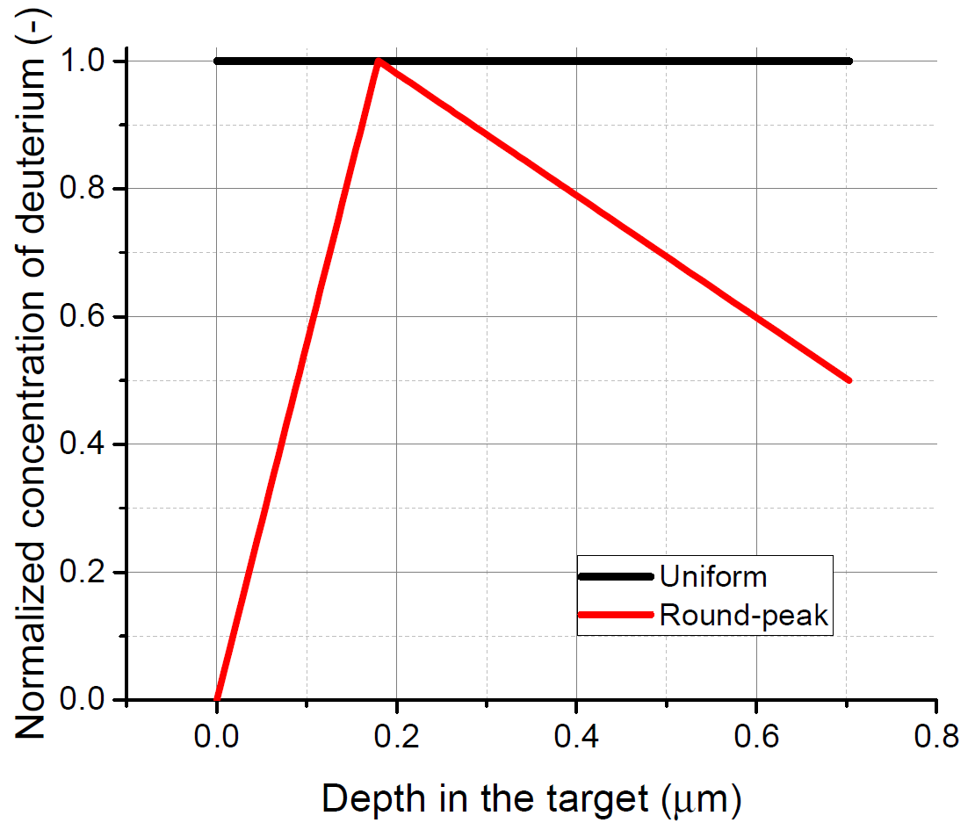
Other explanation for the deviations
Reference = custom models, simulations
Beyond deuteron slowing down
Deuterium distribution in target (migration, outgassing)
Impurities in samples
XS database issues
Disagreement
Scarcity
Energy of
deuterons
Target depth

Slide 30
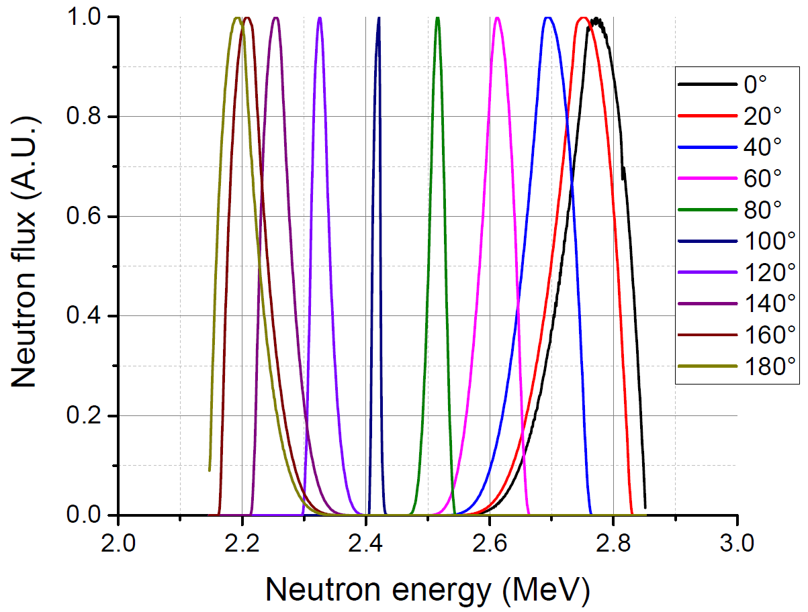
Effect of the deuterium implantation in the target on the neutron spectrum
Different neutron spectrum = different $\overline{σ\left(E\right)}$

Slide 31
The complementary properties of photons and neutrons-based methods
Fast neutrons
100keV 0.0253 eV 662 keV ~1.25 MeV ~2.5 MeV ~14 MeV

Slide 32
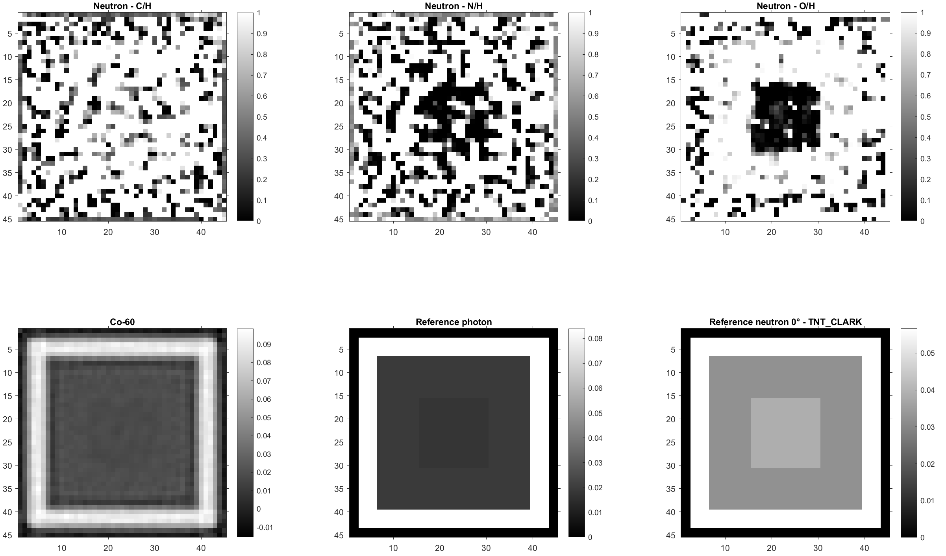
Computed Tomography: shell simulation
Test object:
“L.F.H Gr. Blaukreuz”
Caliber 77 mm
14 mm walls
49 mm product, so about
25 mm TNT: O/H = 1.2
25 mm Clark I: O/H = 0
Source/detector
5e7 neutrons/s
Source-detector 1m
90 projections/CT, 300s/CT angle every 10 deg around the source
Gaussian noise
~140h measurement (can be improved)
Pixels can be binned together

Slide 33
Carousel: the solution to save time around the DD generator

Slide 34
CT arc, sample and plasma
New idea: energy-selective imaging capability → Elemental information

Slide 35
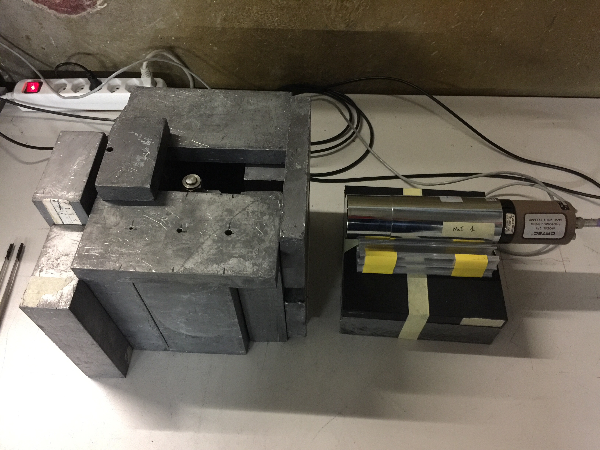
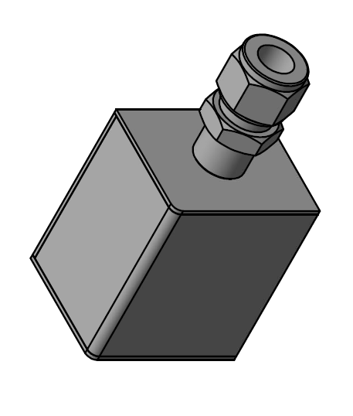
Custom sealed containers
Some of the stable compounds are hazardous: As, CCl₄, P, Mg, etc.
Custom built sealed stainless steel container
Powder, liquid or solid form
Density measurement of powders with Cs-137 source
Well-defined XS, mono-energetic source

Slide 36
References
R. Zboray, R. Adams, M. Cortesi, and H.-M. Prasser, “Development of a fast neutron imaging system for investigating two-phase flows in nuclear thermal–hydraulic phenomena: A status report,” Nuclear Engineering and Design, vol. 273, pp. 10–23, July 2014.
R. Adams, R. Zboray, M. Cortesi, and H.-M. Prasser, “Conceptual design and optimization of a plastic scintillator array for 2d tomography using a compact D–D fast neutron generator,” Applied Radiation and Isotopes, vol. 86, pp. 63–70, Apr. 2014.
R. Zboray, I. Mor, V. Dangendorf, M. Stark, K. Tittelmeier, M. Cortesi, and R. Adams, “High-frame rate imaging of two-phase flow in a thin rectangular channel using fast neutrons,” Applied Radiation and Isotopes, vol. 90, pp. 122–131, Aug. 2014.
R. Adams, L. Bort, R. Zboray, and H.-M. Prasser, “Development and characterization of a D–D fast neutron generator for imaging applications,” Applied Radiation and Isotopes, vol. 96, pp. 114–121, Feb. 2015.
R. Adams, Computed tomography with a compact fast neutron generator. PhD thesis, ETH Zürich, 2015.
R. Adams, R. Zboray, and H.-M. Prasser, “A novel fast-neutron tomography system based on a plastic scintillator array and a compact D–D neutron generator,” Applied Radiation and Isotopes, vol. 107, pp. 1–7, Jan. 2016.
T. Shimizu, H. Sakane, S. Furuichi, M. Shibata, K. Kawade, and H. Takeuchi, “An improved pneumatic sample transport system for measurement of activation cross-sections with d-D neutrons in the energy range between 2.1 and 3.1mev,” Nuclear Instruments and Methods in Physics Research Section A: Accelerators, Spectrometers, Detectors and Associated Equipment, vol. 527, pp. 543–553, July 2004.

