Slide 1
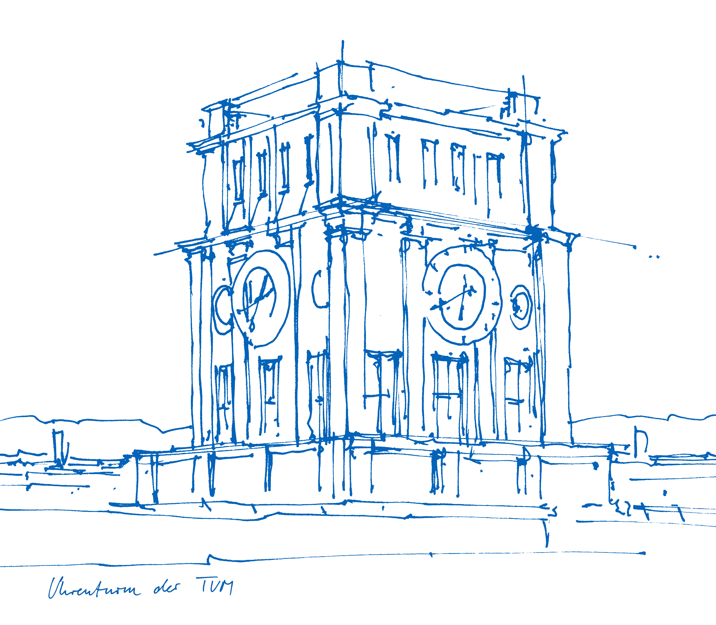
Fission Neutron Tomography of a 280-L Waste Package - A feasibility study
Dr. Thomas Bücherl
Technische Universität München
ZTWB Radiochemie München (RCM)
Sydney, September 5, 2018

Slide 2
Content
Motivation
NECTAR
Test sample
Measurements
Transmission measurements
Data evaluation
Results
Emission measurements
Data evaluation
Results
Summary

Slide 3
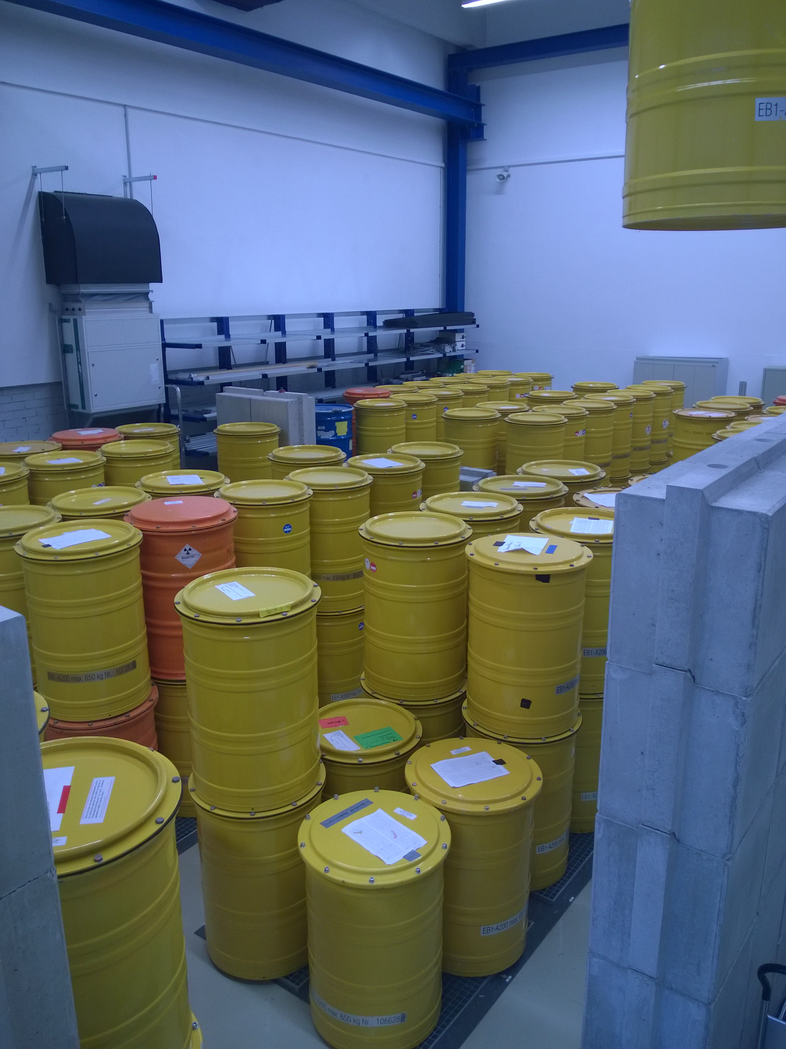
Motivation
Radioactive waste has many origins
nuclear power plants
nuclear medicine
research institutes
research reactors
accelerators
radionuclide sources
...
Radioactive material has isotope specific half-lives
intermediate disposal: wait for free release or storage in ..
final disposal
⇨ Non-destructive characterization of waste packages
Some of the waste packages to be characterized
Notes:
Most of you are working with neutrons; Generation of Neutrons; Reactors; Accelerators; Radionuclide sources; etc.

Slide 4
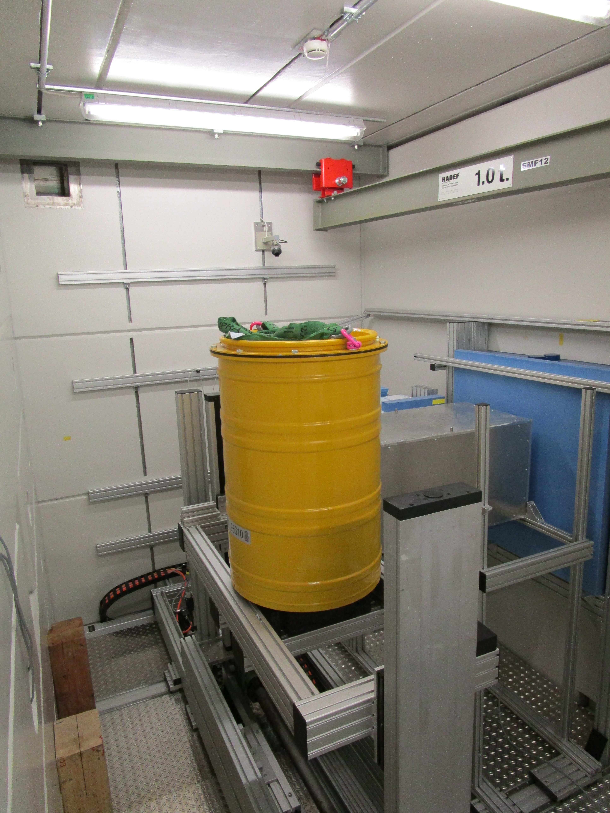
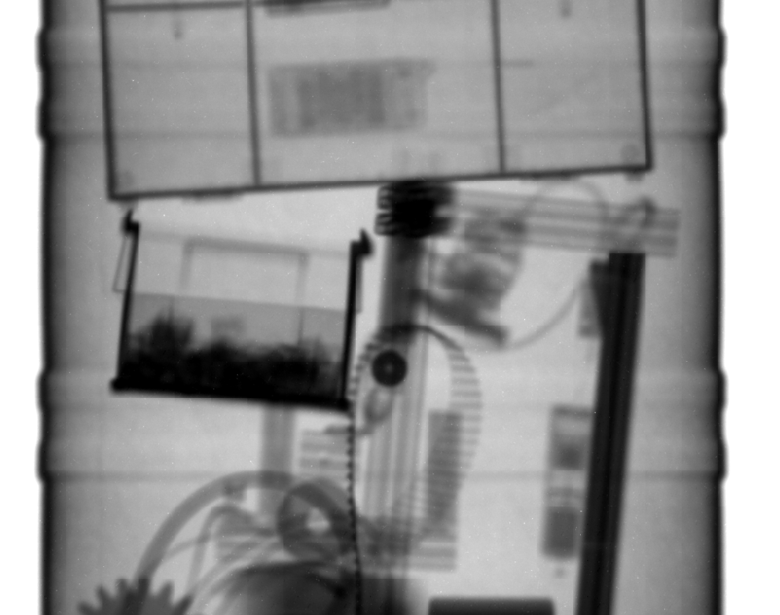
Motivation
At ITMNR-9 (Beijing, China) results of a feasibility study on reactor based fission neutron radiography of 200-l waste packages was presented ^{[1]}.
⇨ Extend study to fission neutron tomography
fission neutrons
γ-radiography (⁶⁰Co)
^{[1]} T. Bücherl, O. Kalthoff, Ch. Lierse von Gostomski, A feasibility study on reactor based fission neutron radiography of 200-l waste packages, Physics Procedia (2017) pp. 64-72 DOI: 10.1016/j.phpro.2017.06.008.
NECTAR

Slide 5
Motivation
Radioactive waste may contain neutron emitters.
Estimation of detection limits for neutron sources located inside waste packages
Feasability study on neutron emission tomography
Photograph of a radionuclide based neutron source (AmBe)
200-l drum on the sample manipulator at NECTAR
NECTAR

Slide 6
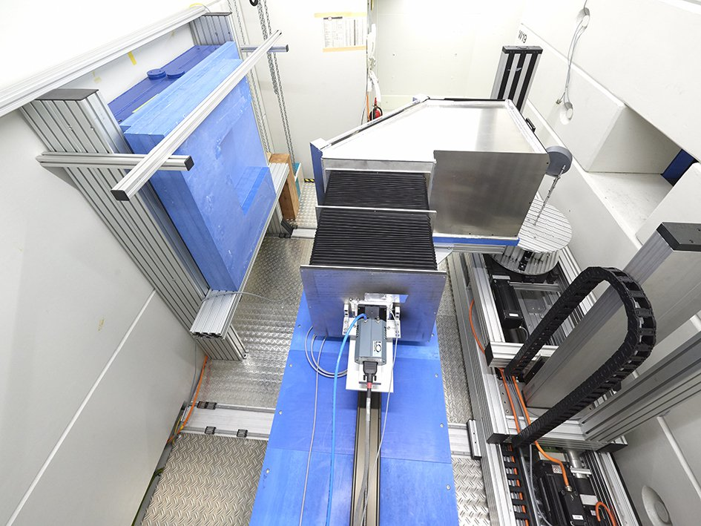
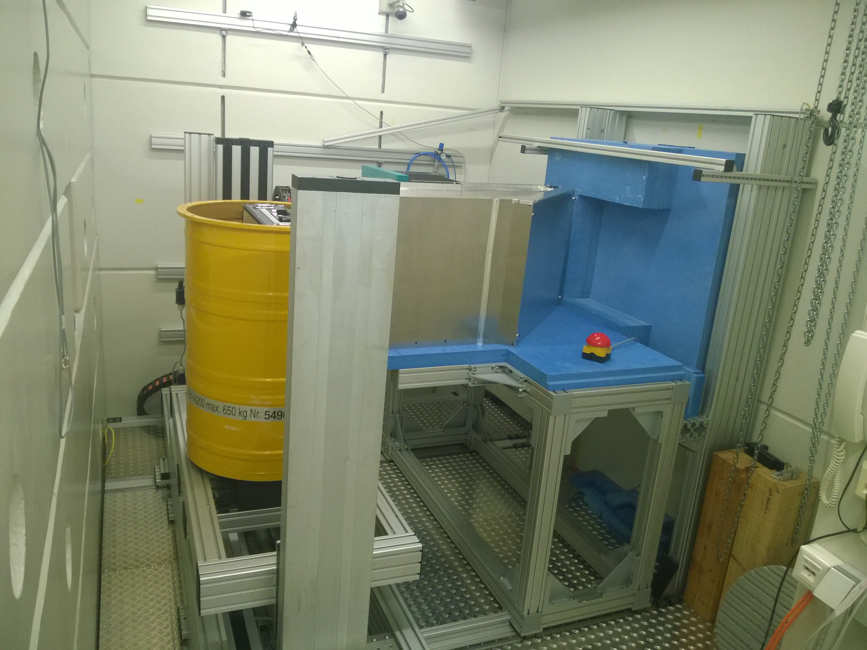
NECTAR
Fission neutron spectrum
E_{mean}= 1.8 MeV
Φ_{min} = 8.7E+05 cm⁻²s⁻¹
Φ_{max} = 4.7E+07 cm⁻²s⁻¹
(L/D) ~ 135 up to 233
Sample space (max)
approx. 80 cm x 80 cm x 80 cm
approx. 800 kg
Detection system
different converters
CCD-camera (e.g. Andor iKon-L 936)
FOV ∼ 30 cm x 30 cm
NEW: Thermal spectrum available, too!
⇨ Presentation of Samantha Zimnik

Slide 7
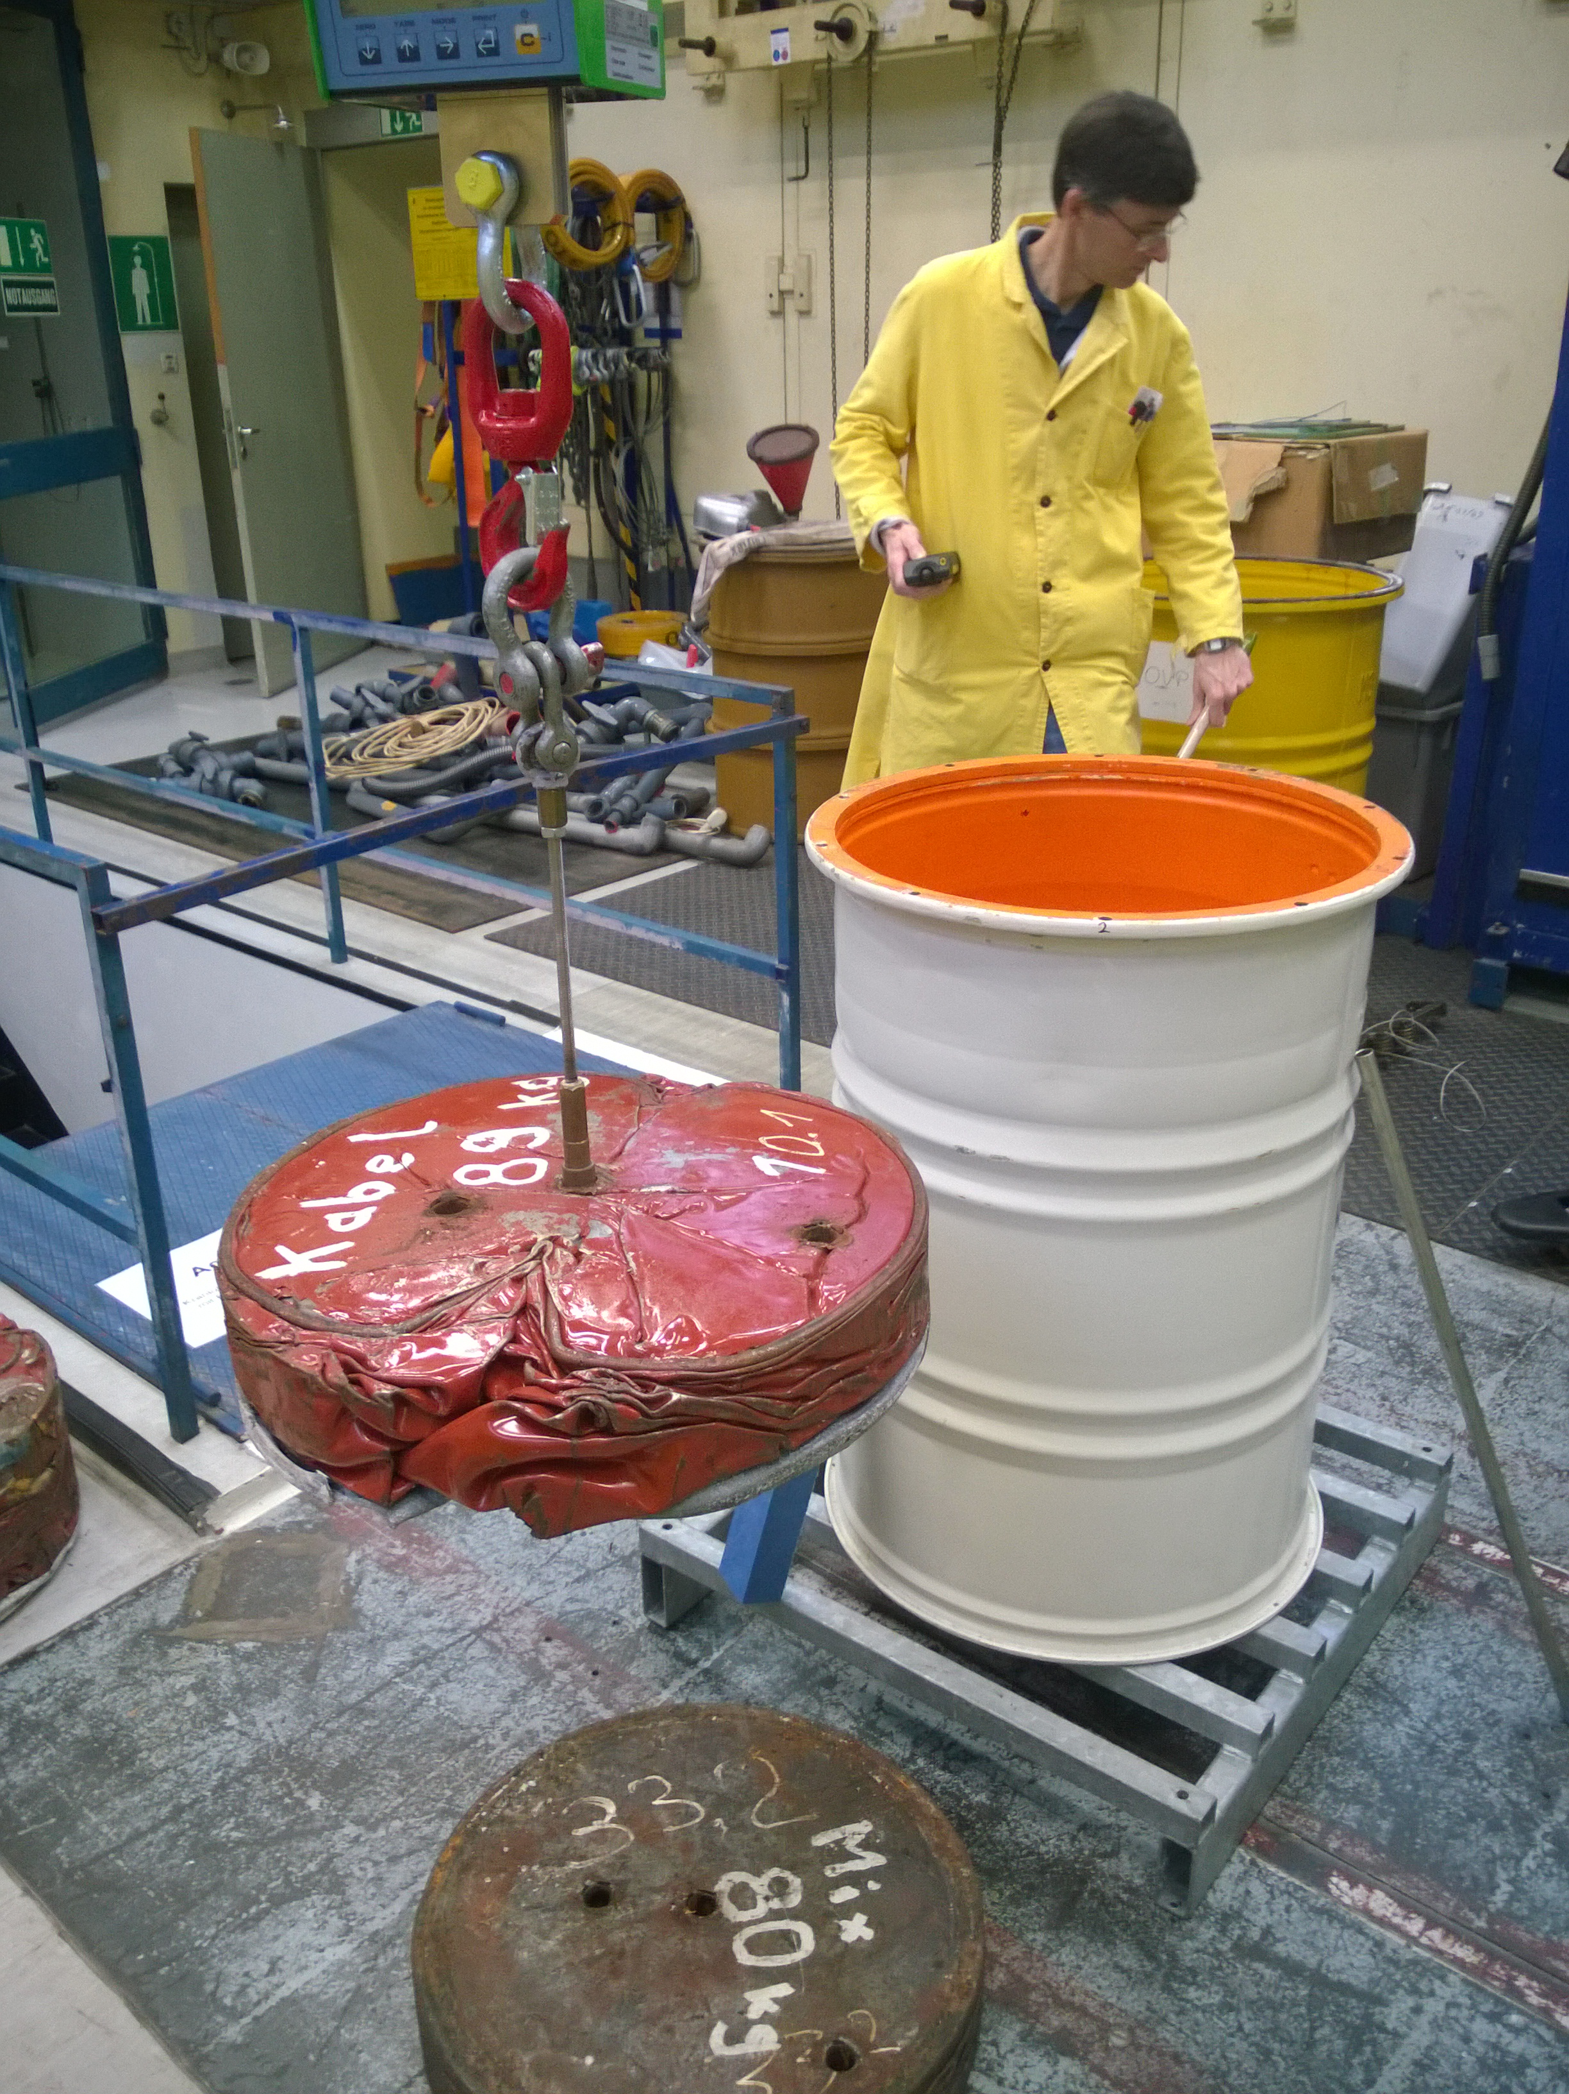
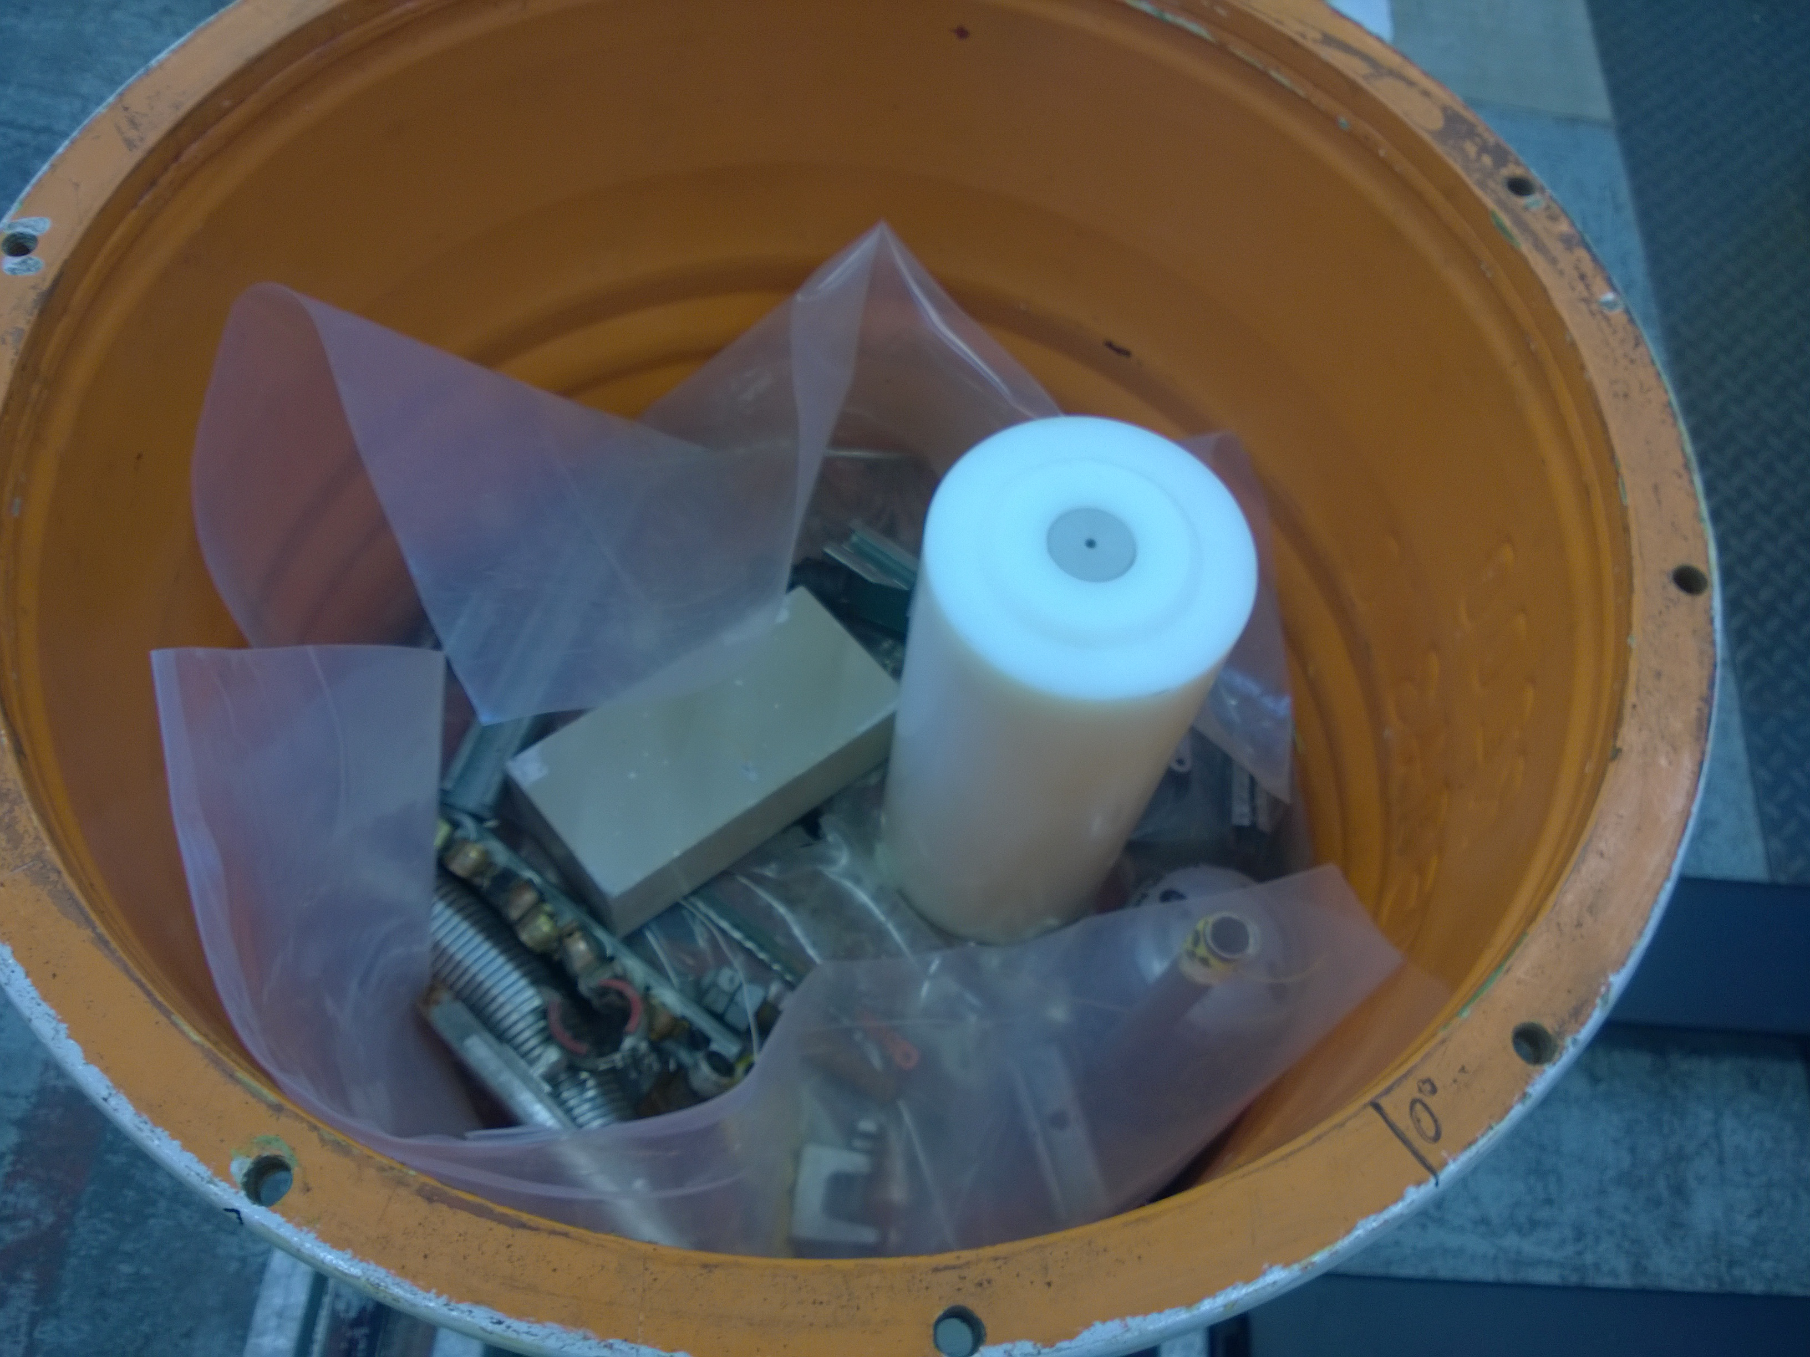
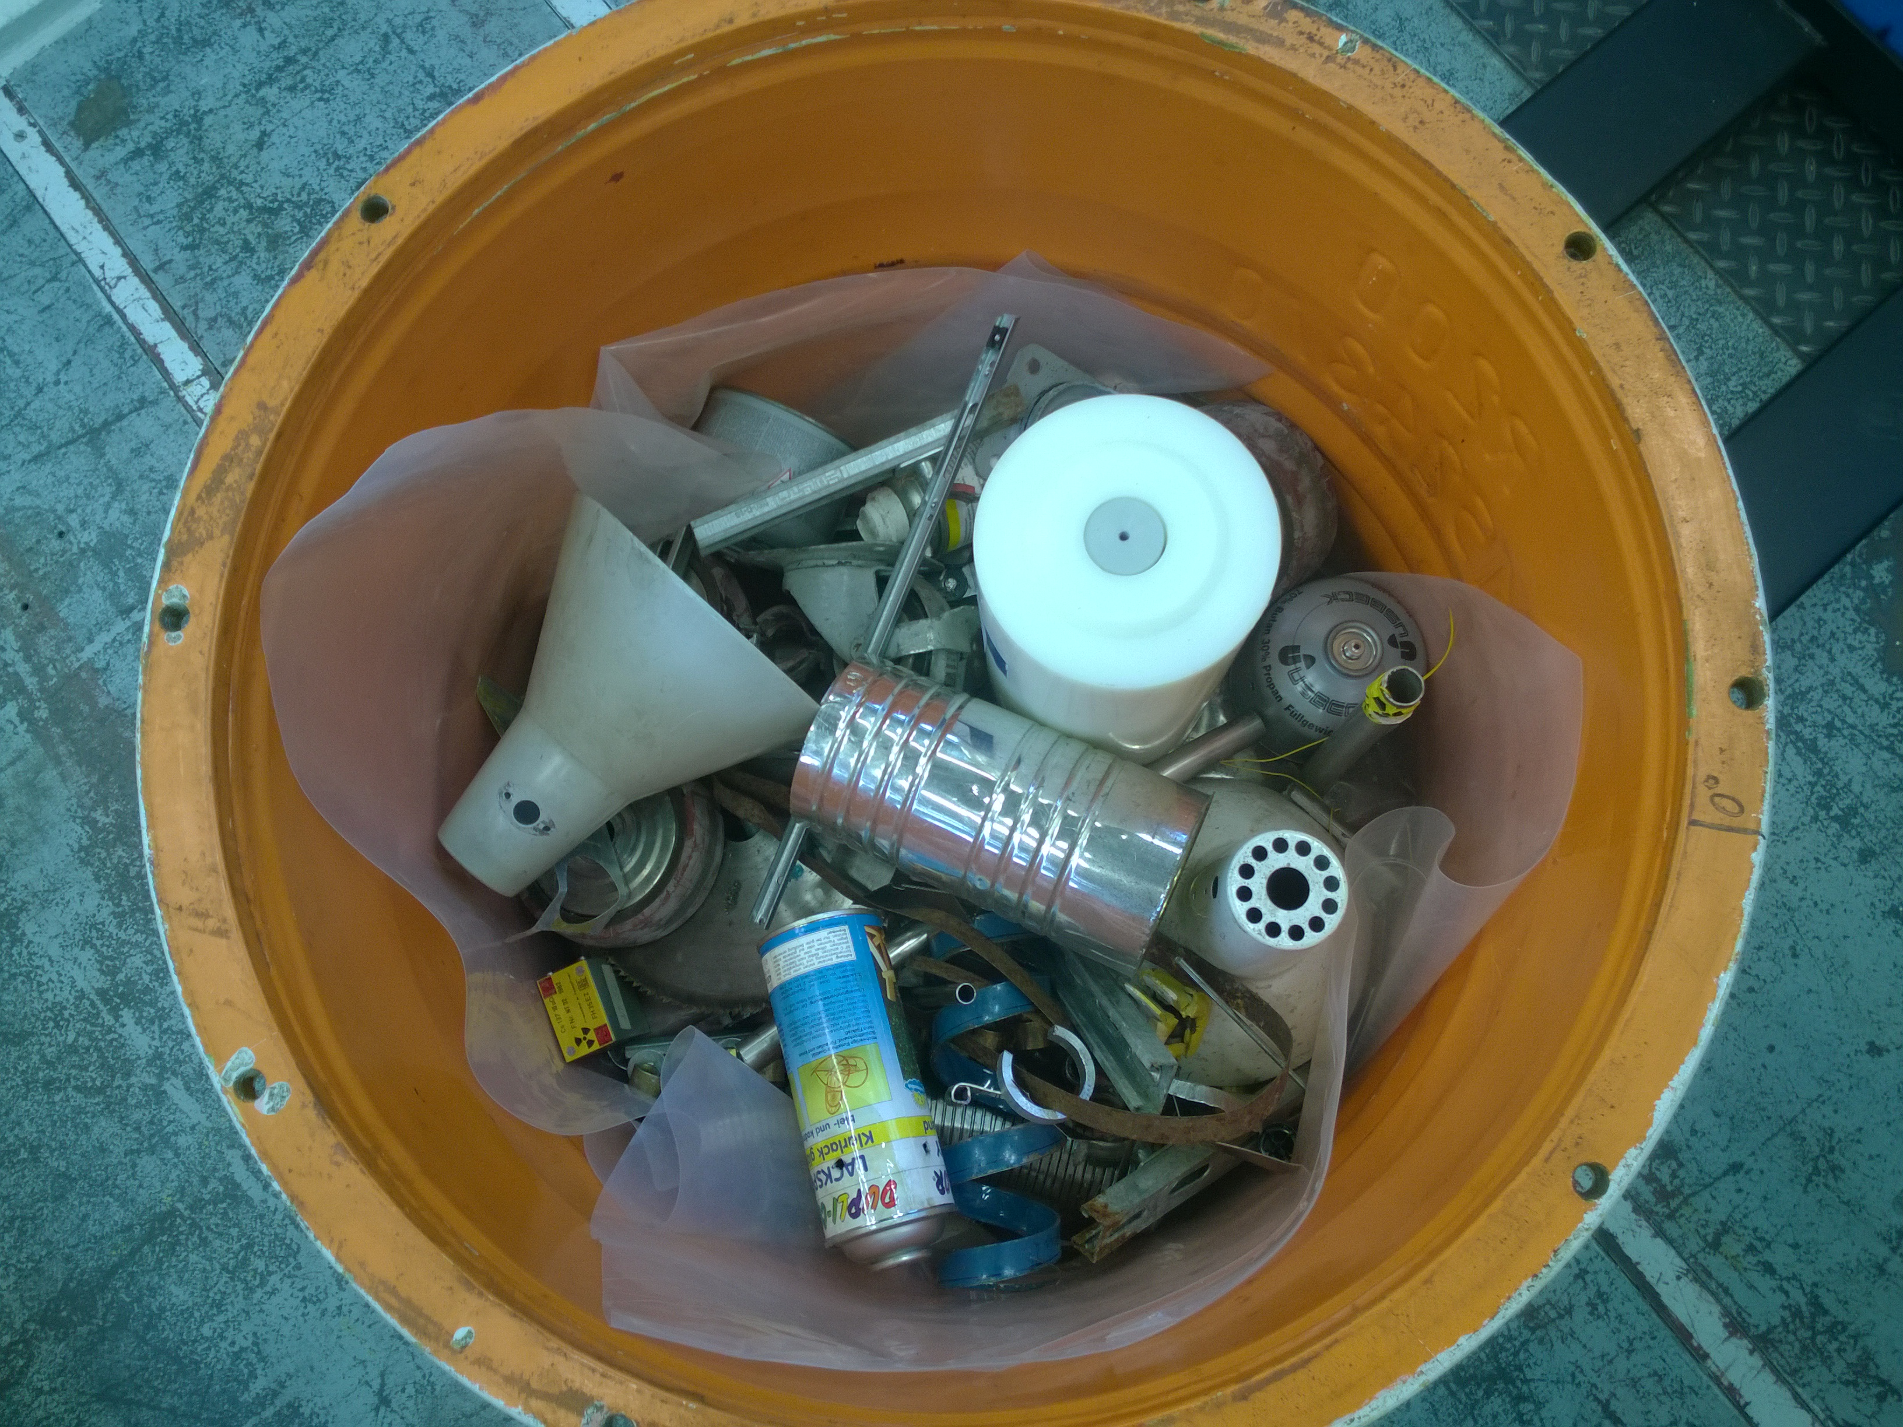
Test sample
Preparation of the sample
insert pellets ….
… and some scrap in a 200-l drum

Slide 8
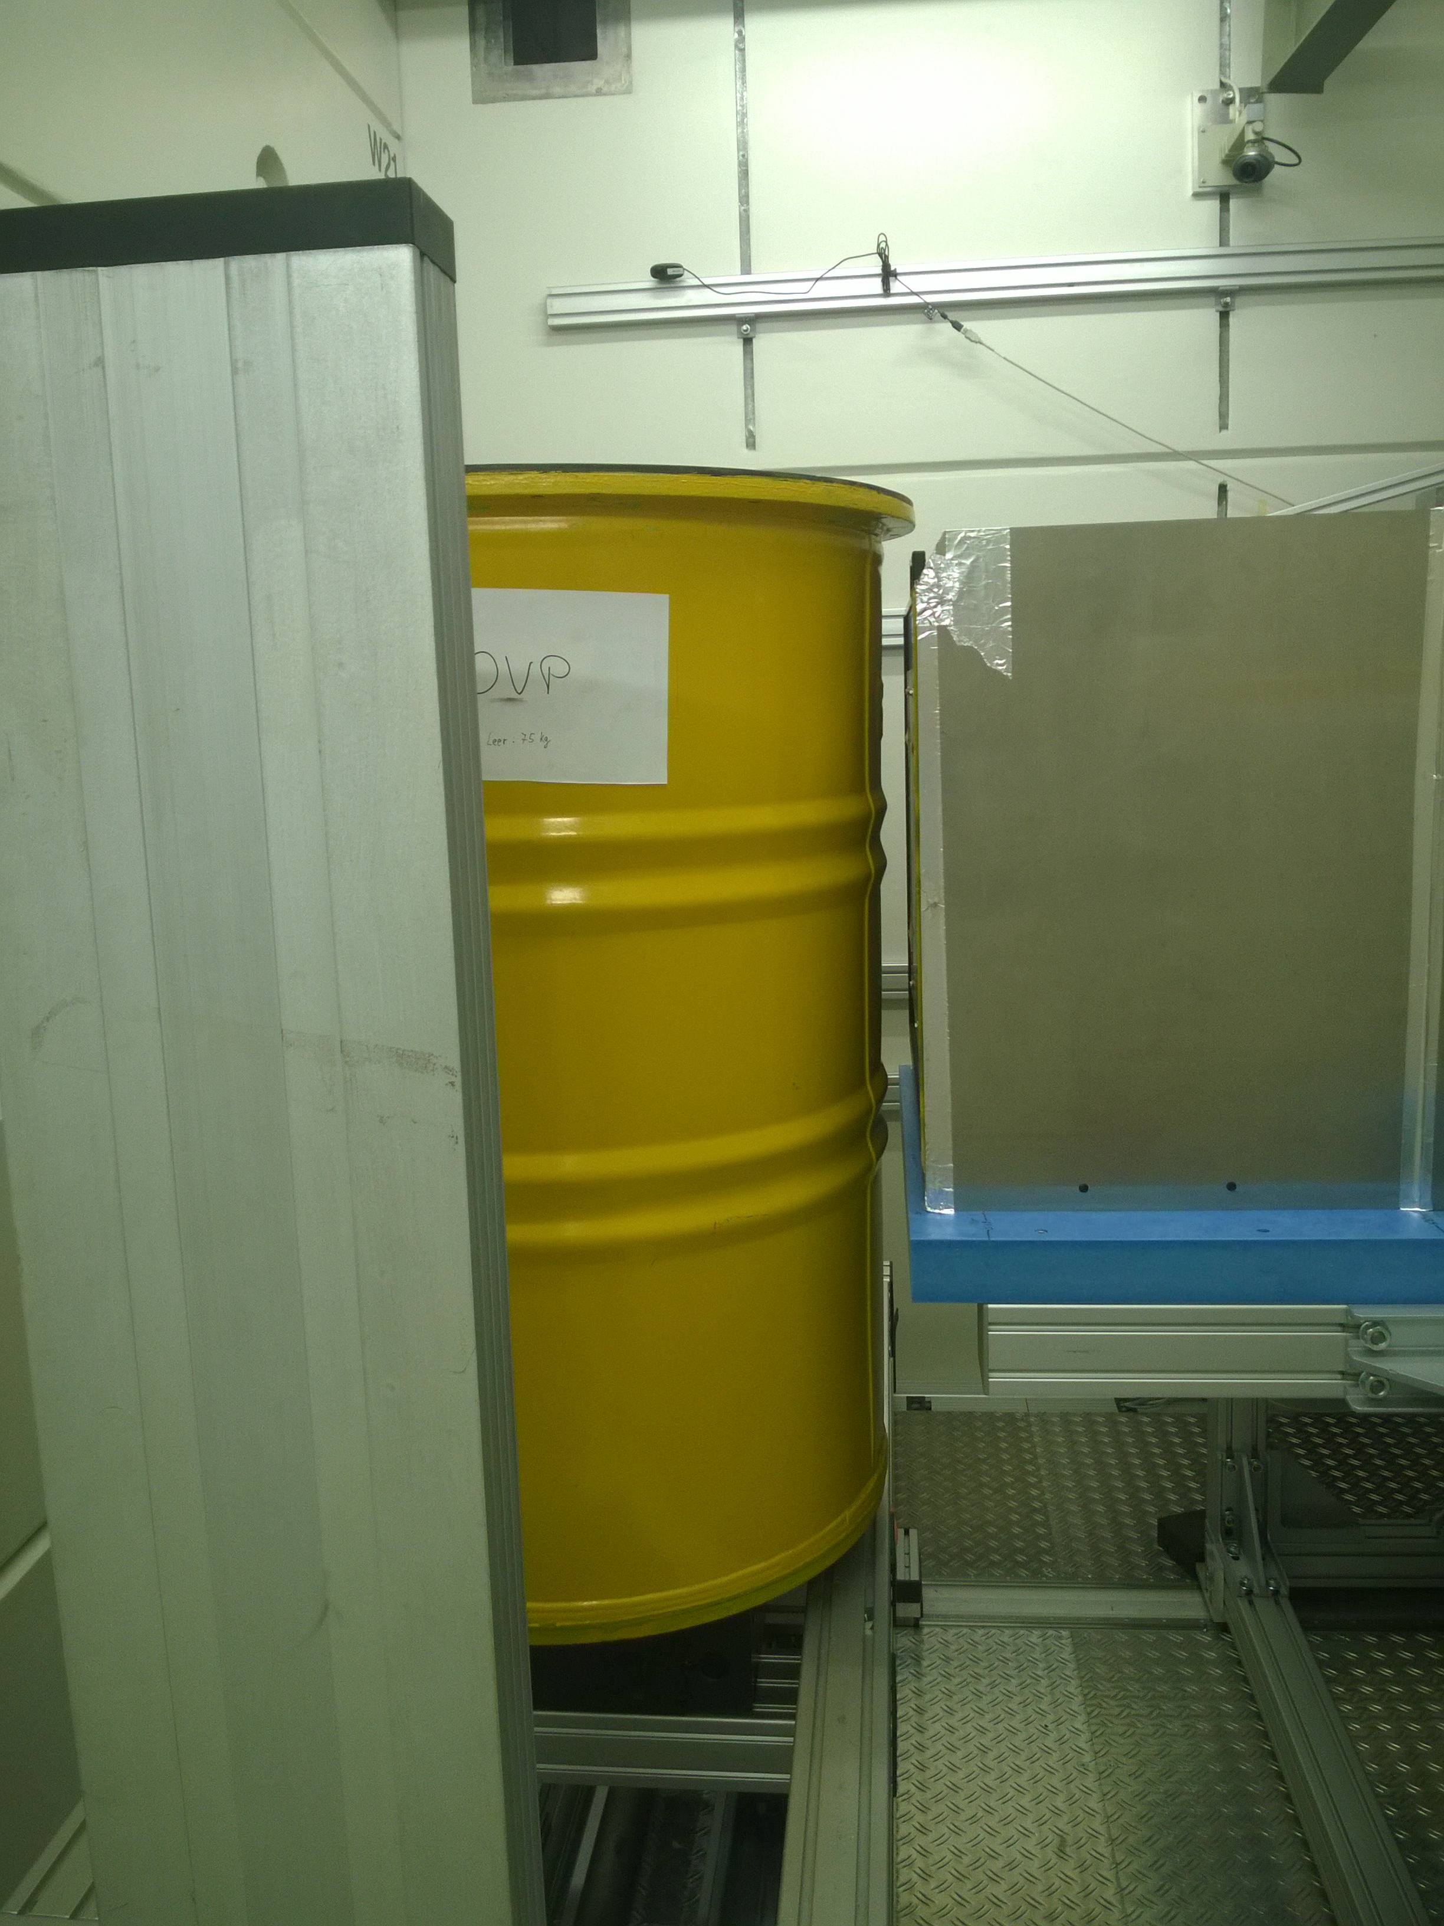
Test sample
Preparation of the sample (cont.)
The equipped 200-l drum is then placed in a 280-l drum.
Data:
total weight: about 500 kg
diameter: 71.0 cm
height : 100.3 cm
280-l drum on the sample manipulator at NECTAR

Slide 9
Measurements
Transmission measurements (TCT)
Object: 280-l drum
max. FOV: 291 mm x 288 mm (w x h)
scanning: 3 images/projection with distance of 230 mm each (70 mm, 300 mm, 530 mm)
scan-direction: forward-rotation-backward (minimization of measuring time)
measuring time: 60 s per position
measuring mode: golden ratio (in total 491 angular positions over 360°)

Slide 10
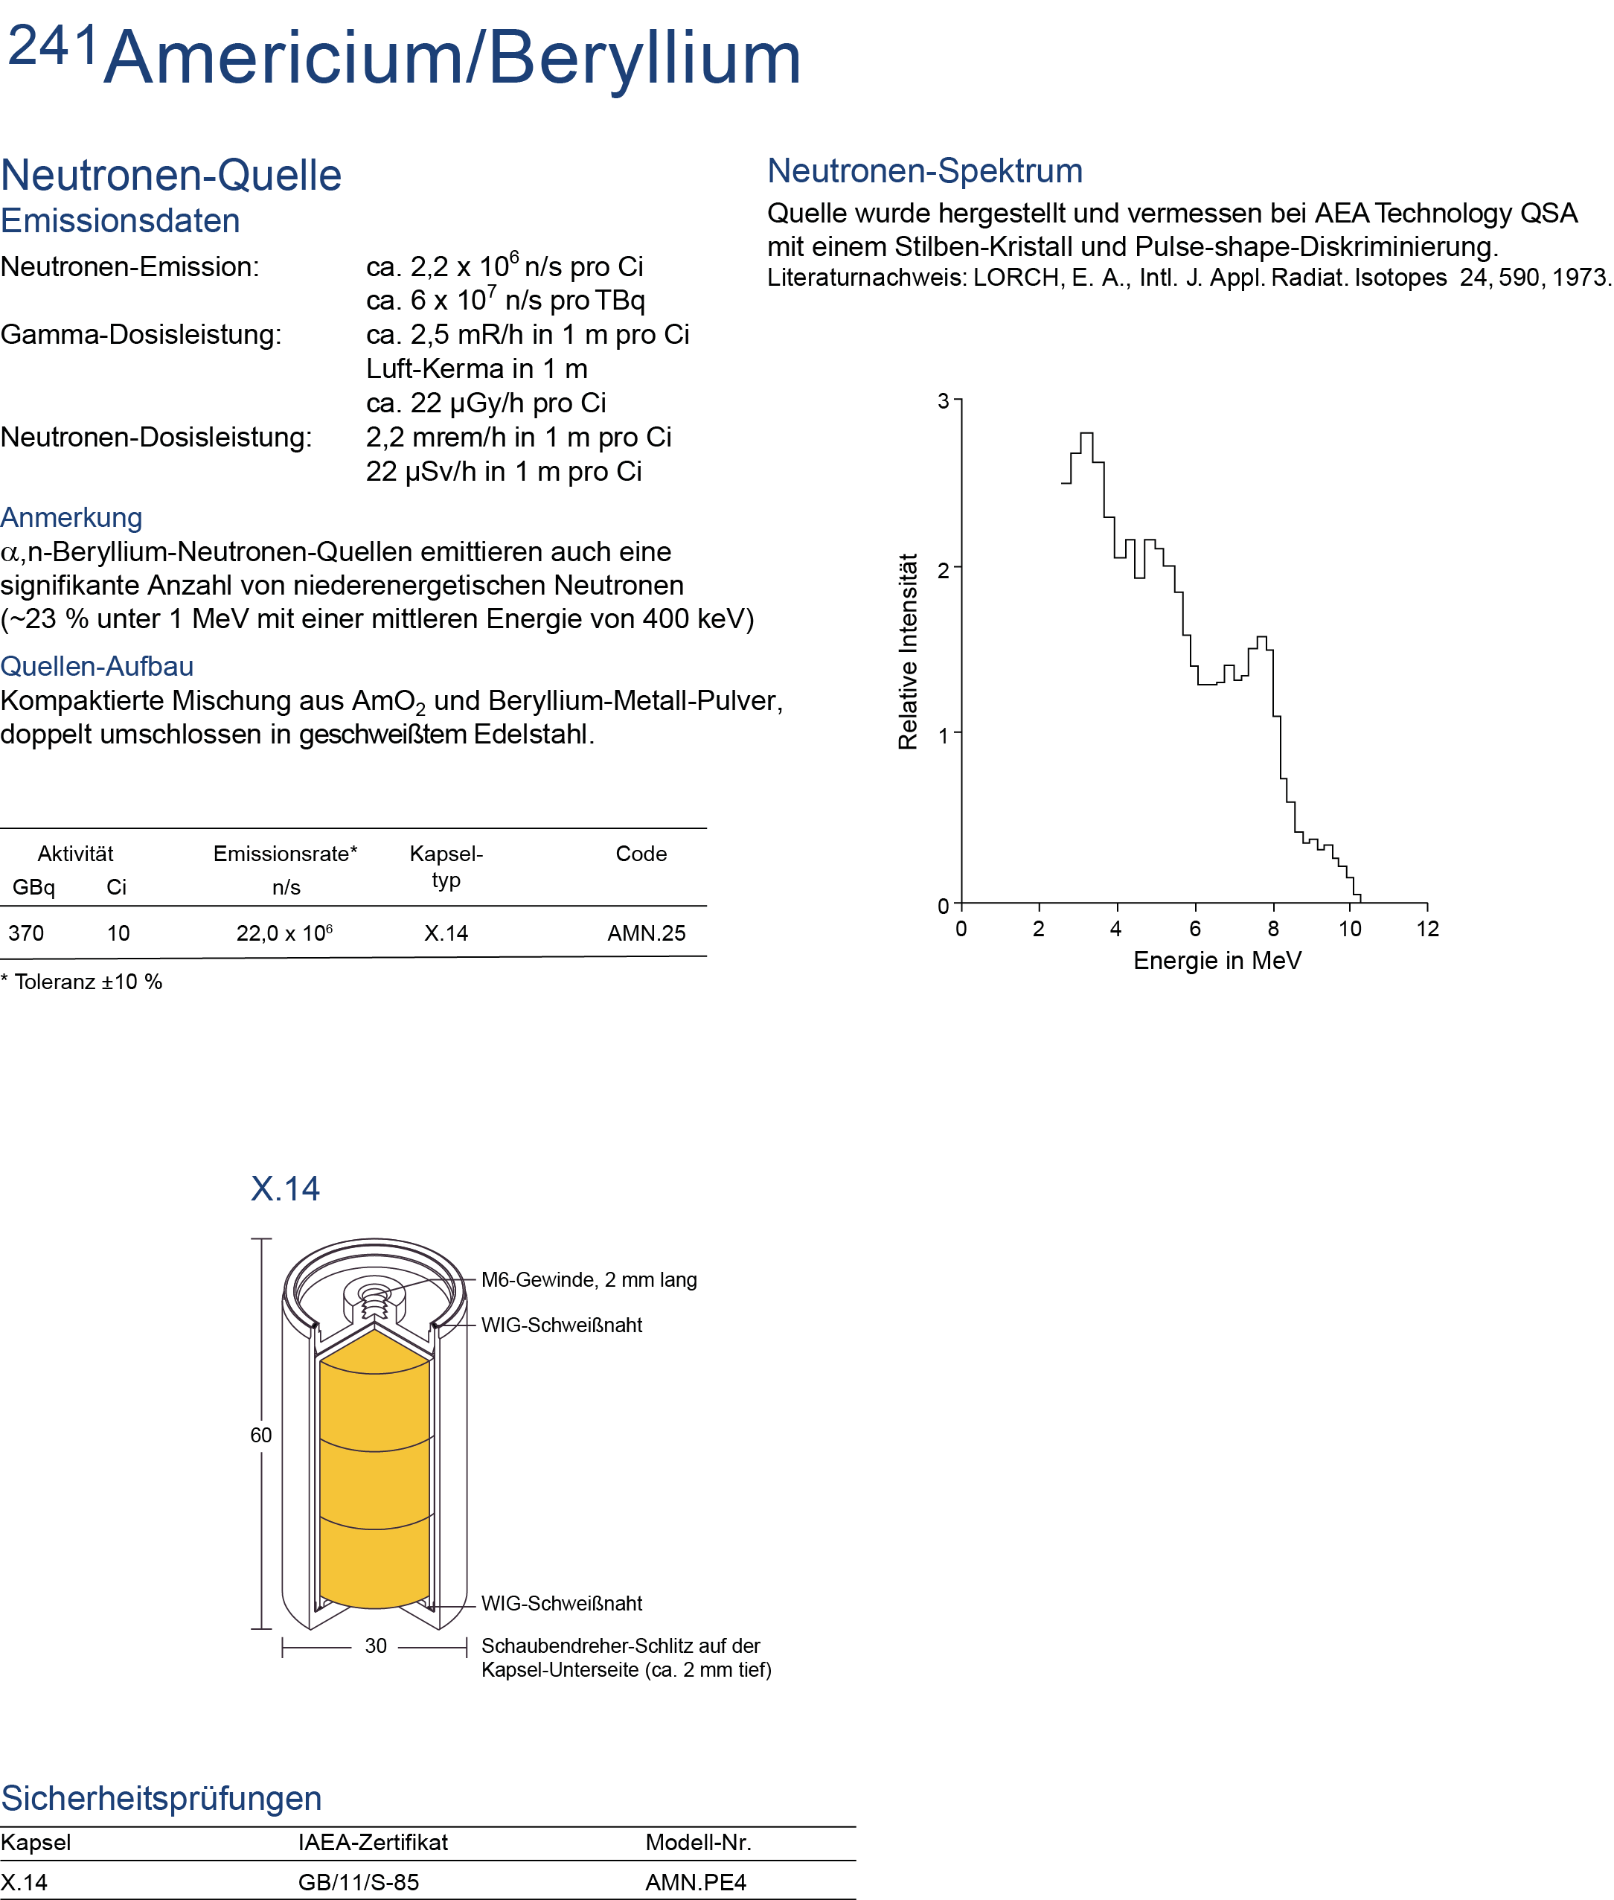
Measurements
Emission measurements (ECT)
Objects:
AmBe-sources
37 GBq (1 Ci) and 2.2·10⁵ n/s
370 GBq (10 Ci) and 2.2·10⁶ n/s
Measurements
source(s) in PE-cylinder in drum
source(s) in drum (outside PE cylinder)
10 Ci source in front of detector
Remark: Measurements performed with different converter screens (thermal and fast neutron types)
Photograph of a radionuclide based neutron source (AmBe)

Slide 11
Data evaluation - transmission measurements
raw data
filtering ^{[2]}
normalization
corrected for dark image and open beam image
limit to interval [0;1]
multiply data by a factor of 20000 to store as *.tif
cropping (150 pixels on all sides of)
tilt-correction
stitching
shift-correction
reconstruction (FBP)
^{[2]} K. Osterloh, T. Bücherl, U. Zscherpel und U. Ewert, Image recovery by removing stochastic artefacts identified as local asymmetries, Journal of Instrumentation, 7(04):C04018, 2012, DOI: 10.1088/1748-0221/7/04/C0401

Slide 12
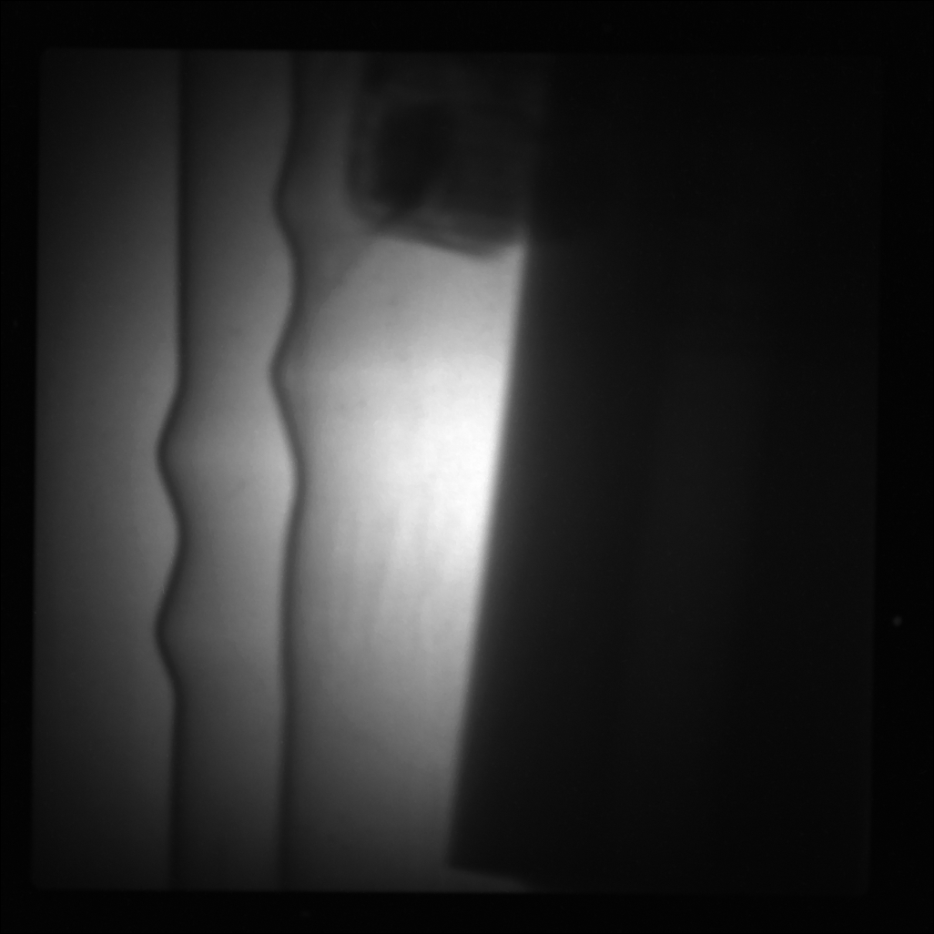
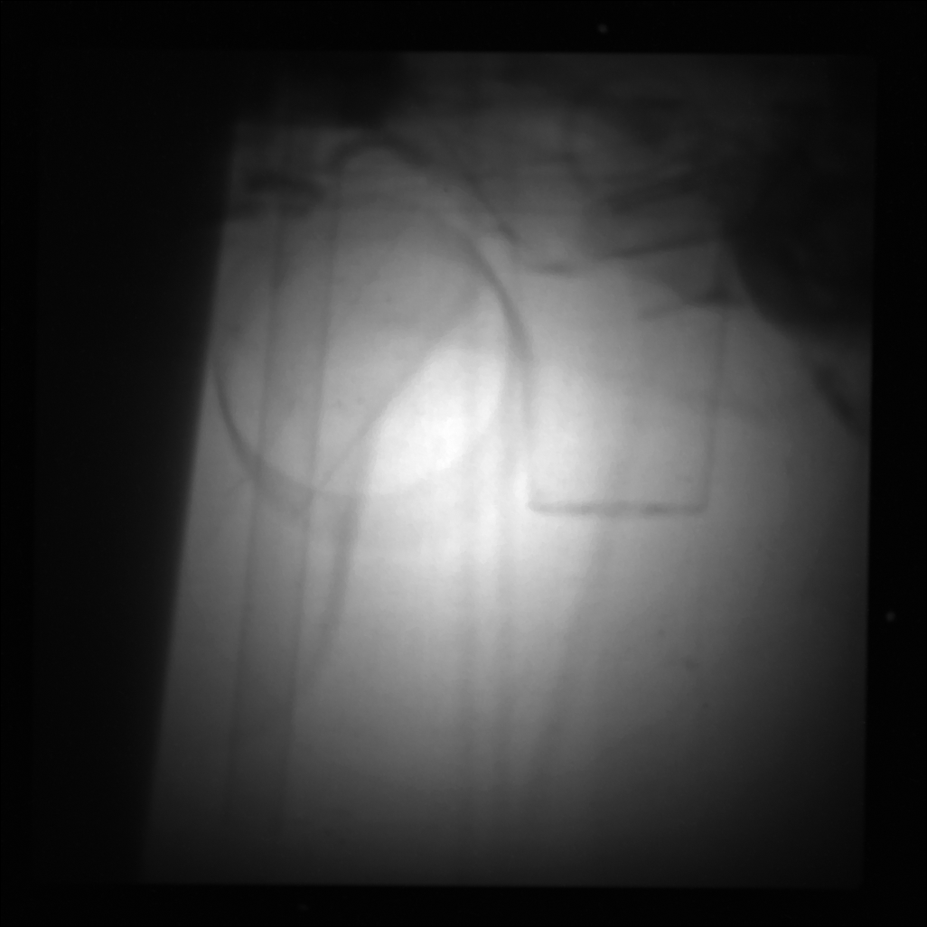
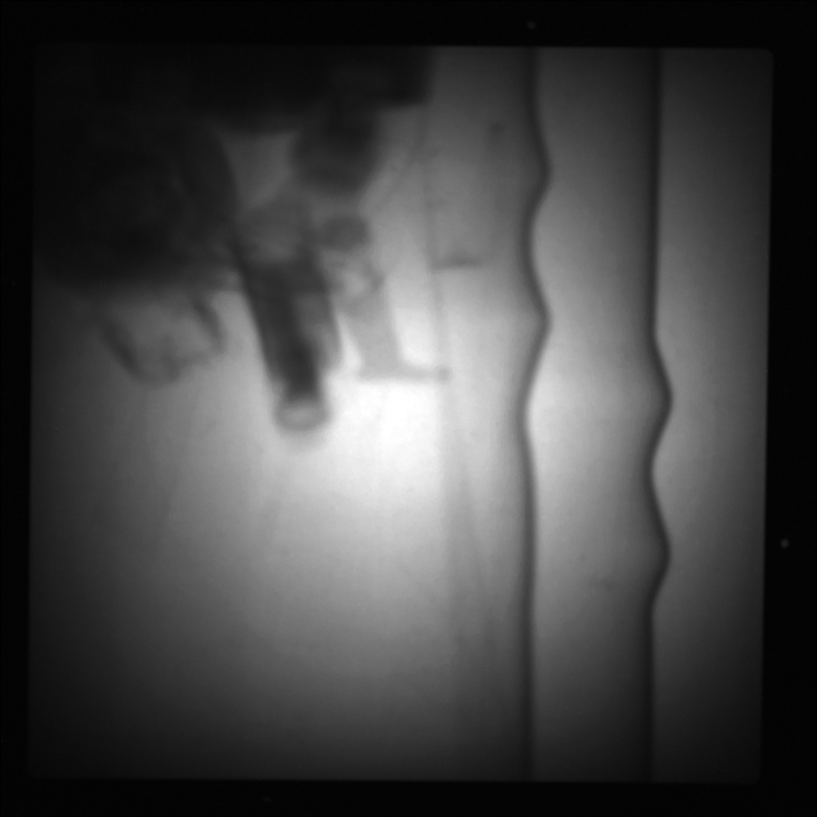
Results – transmission measurements
Raw data after filtering
„Dynamic“ range: 1000 to 1660

Slide 13
Results – Transmission measurements
Data ready for reconstruction
Some “interesting” observations:
Some “moving” objects
Stitching not really satisfying!

Slide 14
Results – Transmission measurements
Stitching

Slide 15
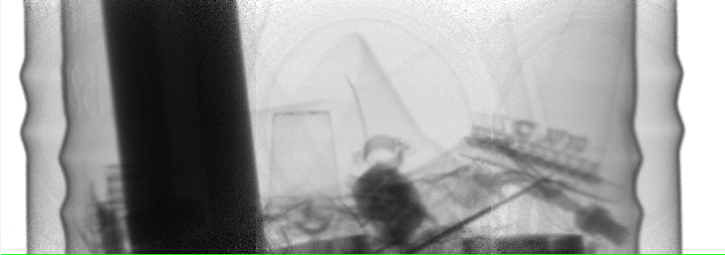
Results – Transmission measurements
Stitching
327.54 °
327.54°
Overlap of 143 pixels

Slide 16
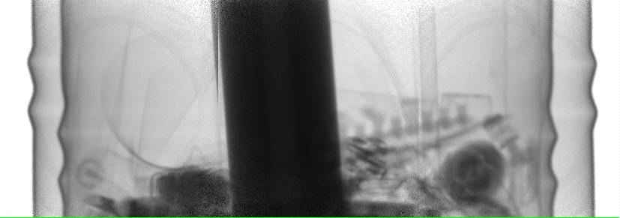
Results – Transmission measurements
Stitching
52.52°
Overlap of 143 pixels
327.54°
Overlap of 143 pixels

Slide 17
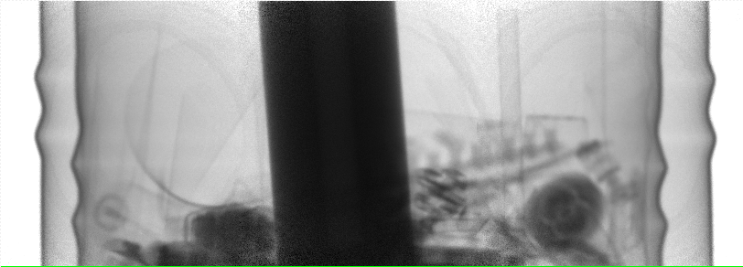
Results – Transmission measurements
Stitching
52.52°
Overlap of 143 pixels
52.52 °
Overlap of 189 pixels

Slide 18
Results – Transmission measurements
52.52°
Overlap of 143 pixels
Stitching process remains a big challange!
Difference of ~ 7 mm
52.52 °
Overlap of 189 pixels

Slide 19
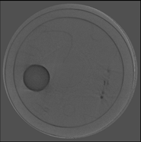
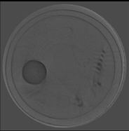
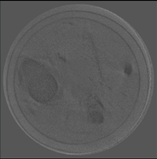
Results – Transmission measurements
Due to beam divergence, scattering effects etc. reconstruction does not result in an acceptable image quality

Slide 20
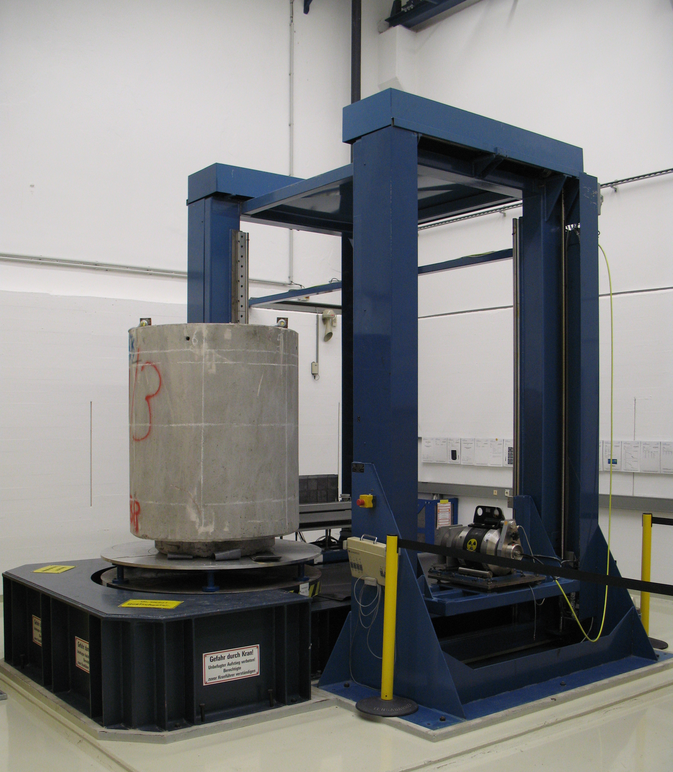
Comparison with γ-transmission measurements
γ-transmission tomography is still superior to fission neutron transmission tomography!
Integrated Tomgraphy System (ITS) @ RCM
2D
3D

Slide 21
Data evaluation - emission measurements
raw data (2048 pixels x 2048 pixels)
binning (5 pixels)
shift-correction
reconstruction with
FBP and
Maximum likelihood maximum estimator^{[3]} (MLEM)
^{[3]} http://campar.in.tum.de/twiki/pub/Main/MoritzBlume/EMPET.pdf

Slide 22
Results – emission measurements
No images, when sources were in the drum (any position)
Sources too weak!
Rough estimation:
minimum distance sample – converter: 30 cm
no attenuation assumed
source strength: 2.2∙10⁶ s⁻¹
⇨ about 900 n/cm²
⇨ about 0,2 n/pixel
⇨ measuring time of much more than 1 hour per projection required!

Slide 23
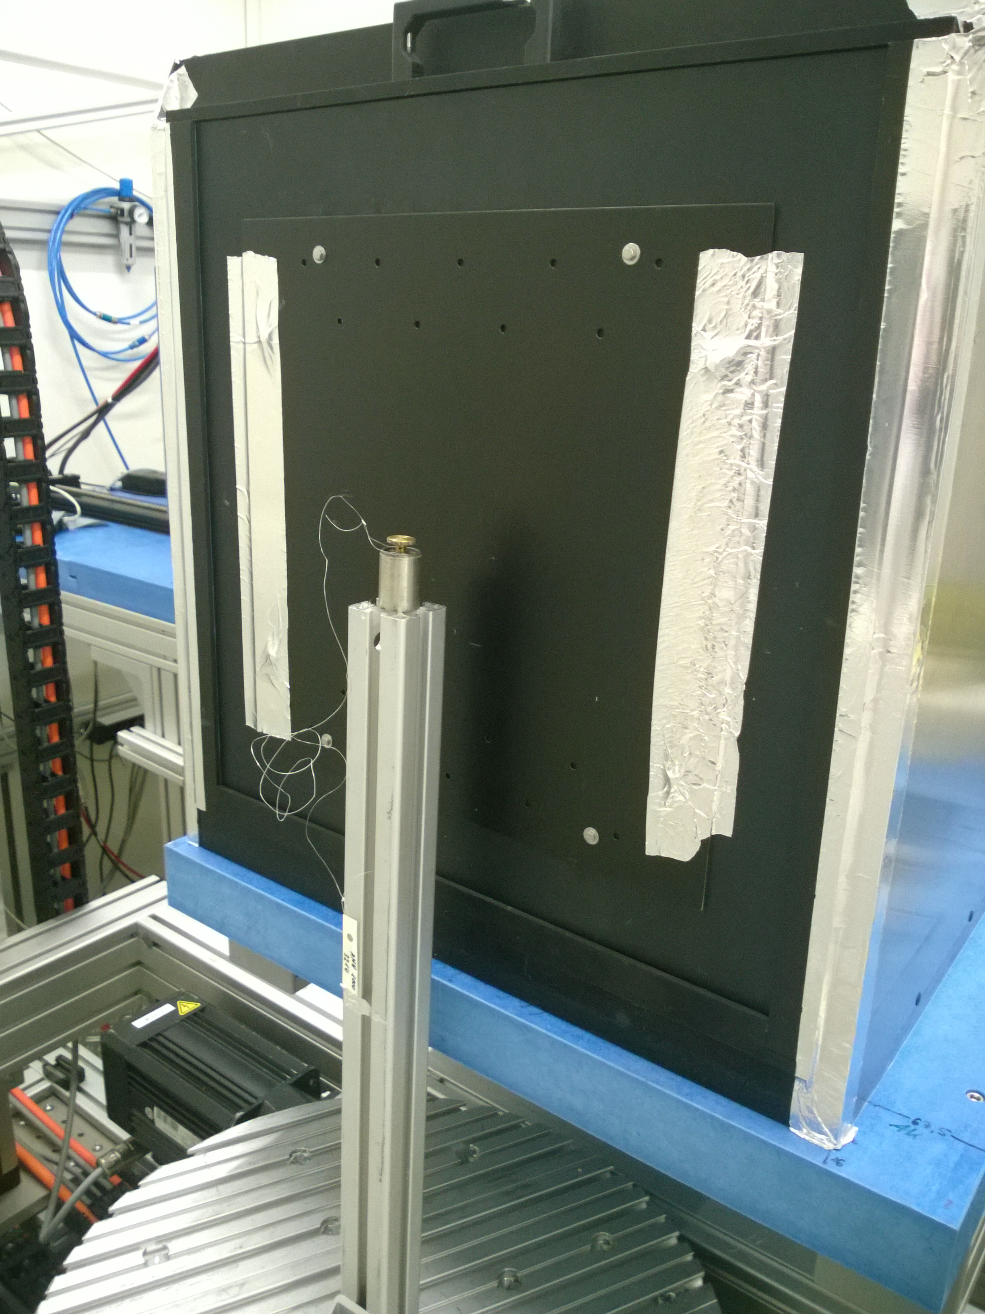
Results – emission measurements
„Strong“ source close to the detector
distance: 3 cm
converter for fast neutrons
measuring time per image: 3500 s per projection
golden ratio (in total 207 angular positions)

Slide 24
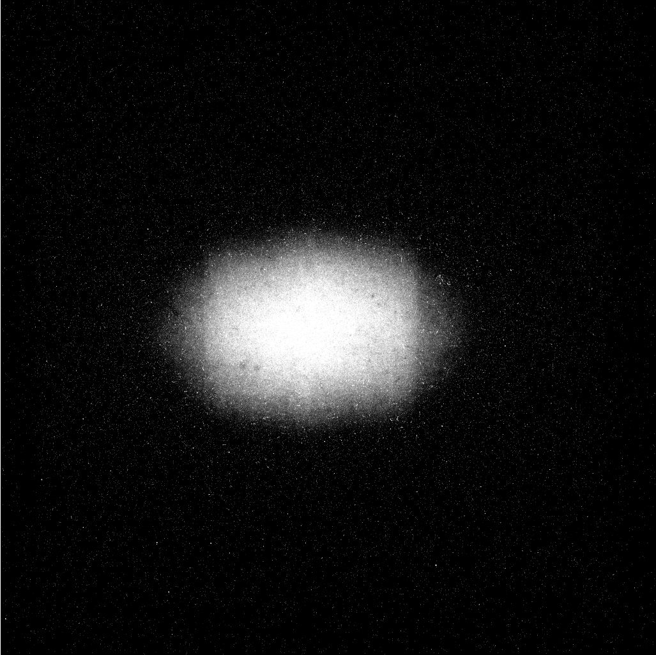
Results – emission measurements
„Dynamic“ range: 1662 to 1926

Slide 25
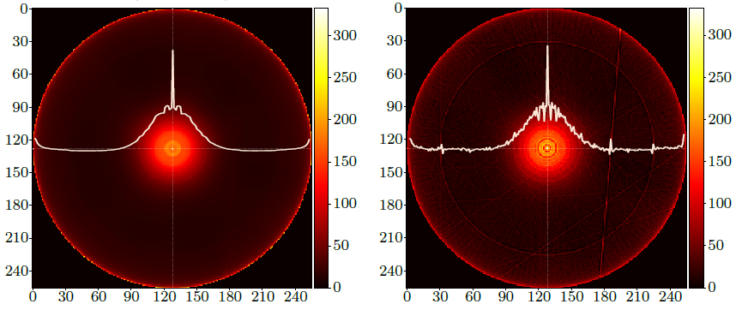
Results – emission measurements
MLEM-reconstruction after 30 iterations and smoothing filter applied
FBP-reconstruction using ramp-filter

Slide 26
Summary and Outlook
Is fission neutron tomography on large volume samples possible?
Yes, but …
challenges arise from
image processing (especially stitching) and
“moving” objects
Further investigations required ⇨ next R&D topics!
applicability depends strongly on the matrix composition (material, density, thickness)
neutron flux available at NECTAR is on the lower limit for these investigations

Slide 27
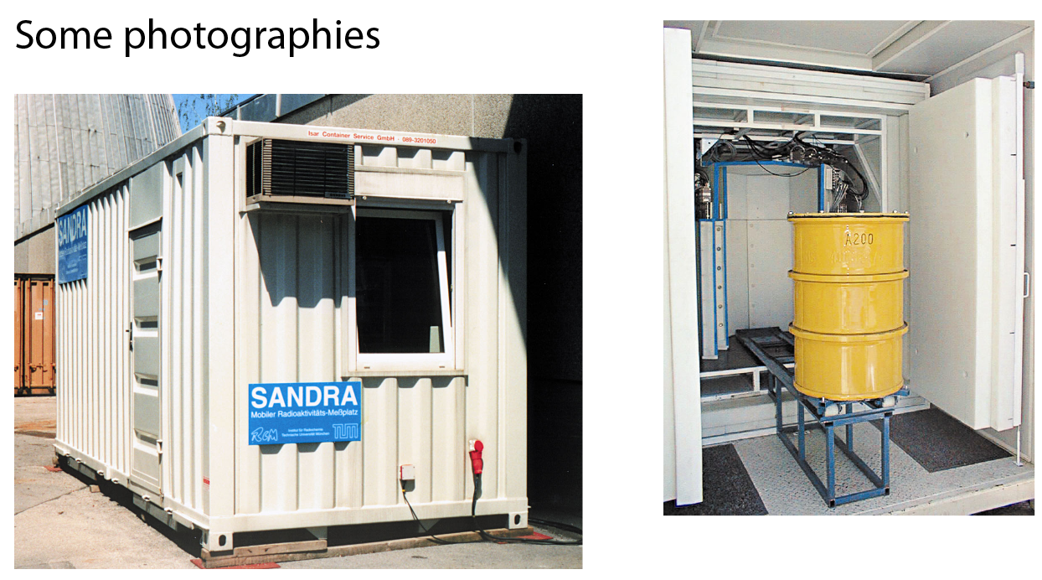
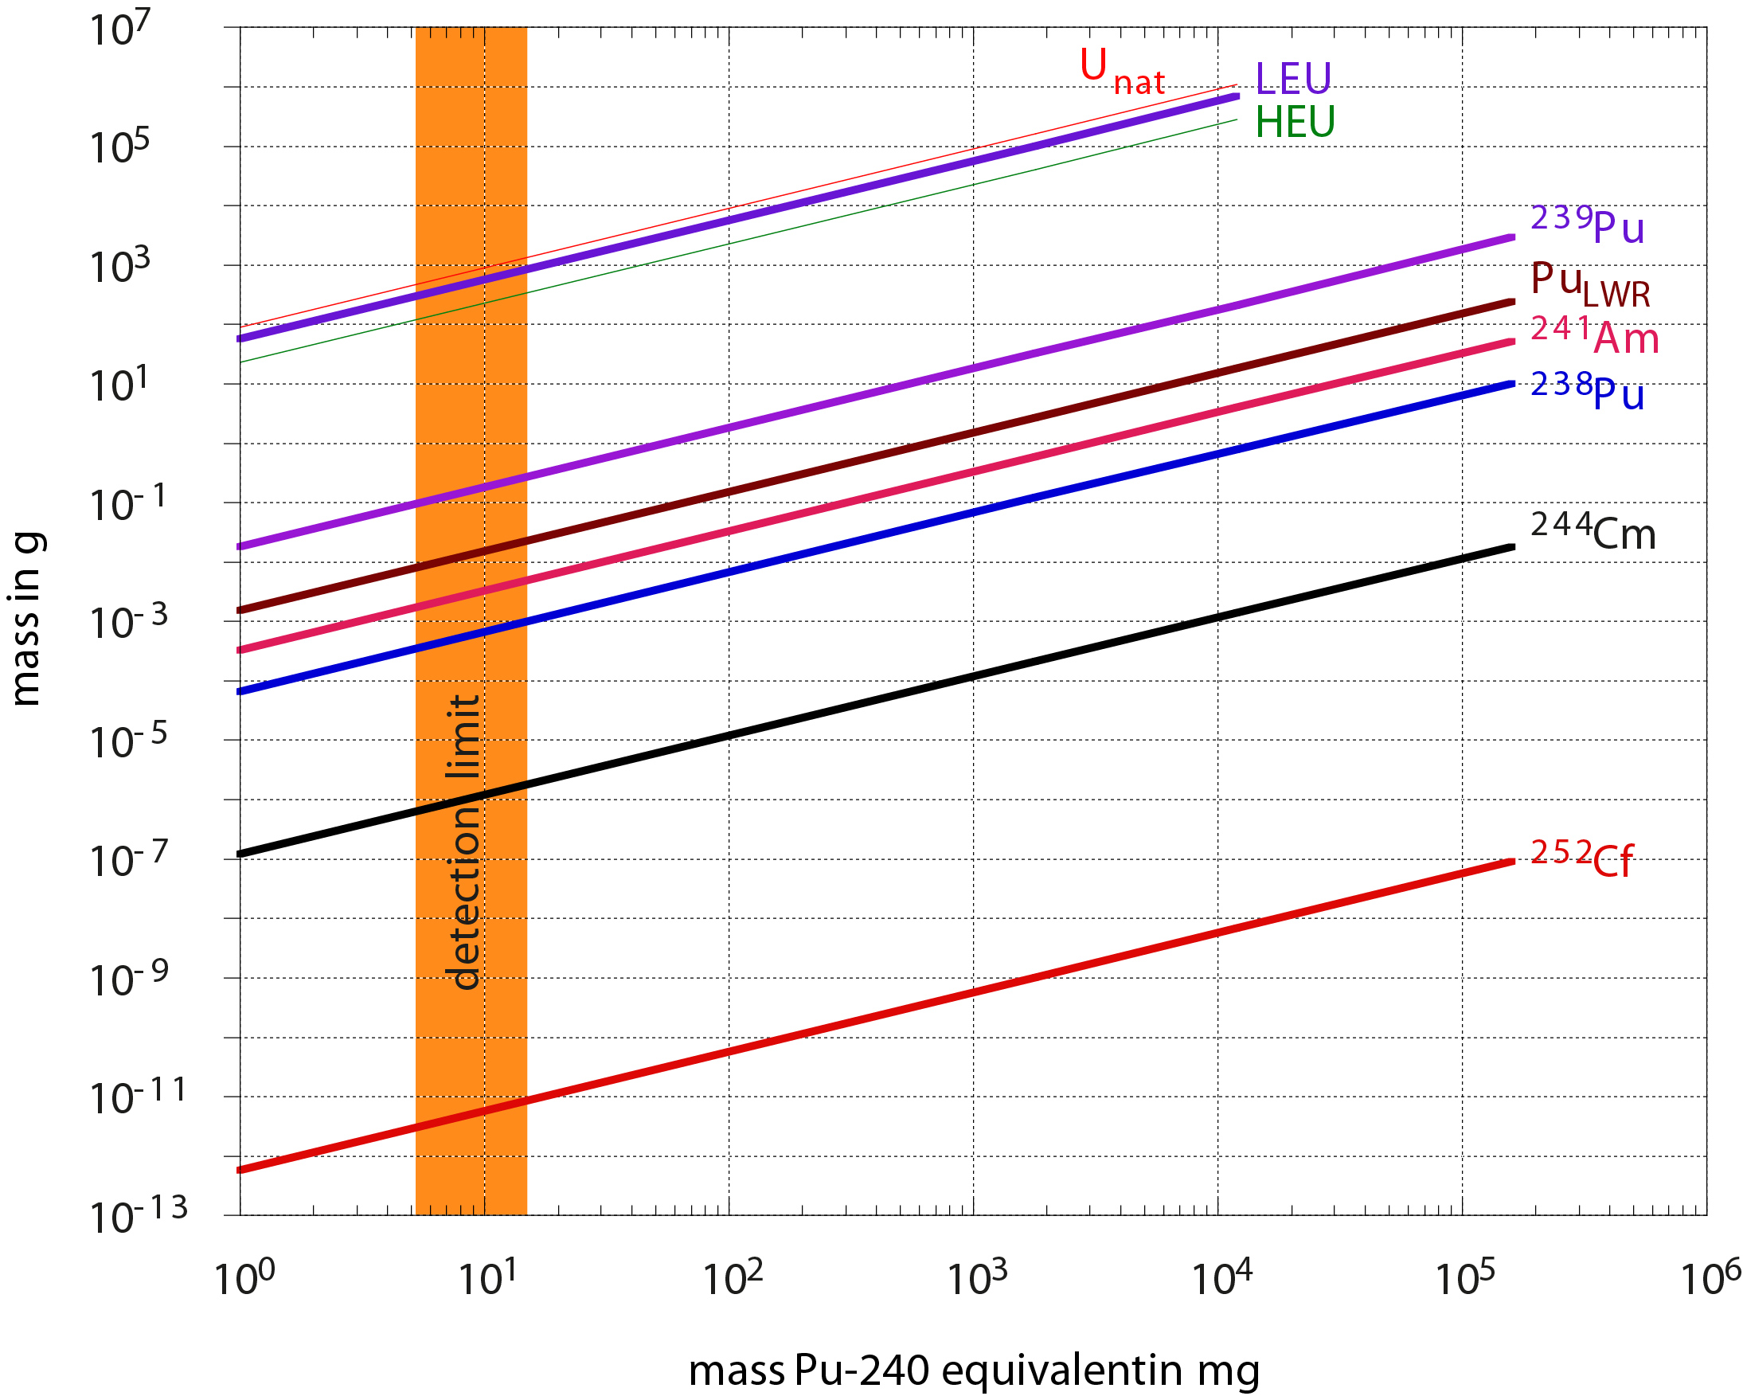
Summary and Outlook
Is neutron emission tomography on large volume samples possible?
Yes, but …
- it strongly depends on their neutron emission rates
⇨ Emission neutron tomography at NECTAR was demonstrated, but is only applicable in praxis on large samples (like real waste packages) for extremely high neutron emission rates.
SANDRA
Special Arrangement for Neutron Detection in Radioactive Waste packages

Slide 28
How to get beam time at NECTAR
get into contact with me (thomas.buecherl@tum.de)
discuss feasibility of planned measurement
submit a proposal (see http://mlz-garching.de/user-office)
if accepted, contact me for arranging beam time
NEW: Thermal neutrons available at NECTAR, too!

Slide 29
Acknowledgment:
Dr. Christoph Lierse von Gostomski
Thomas Baldauf

