Slide 1

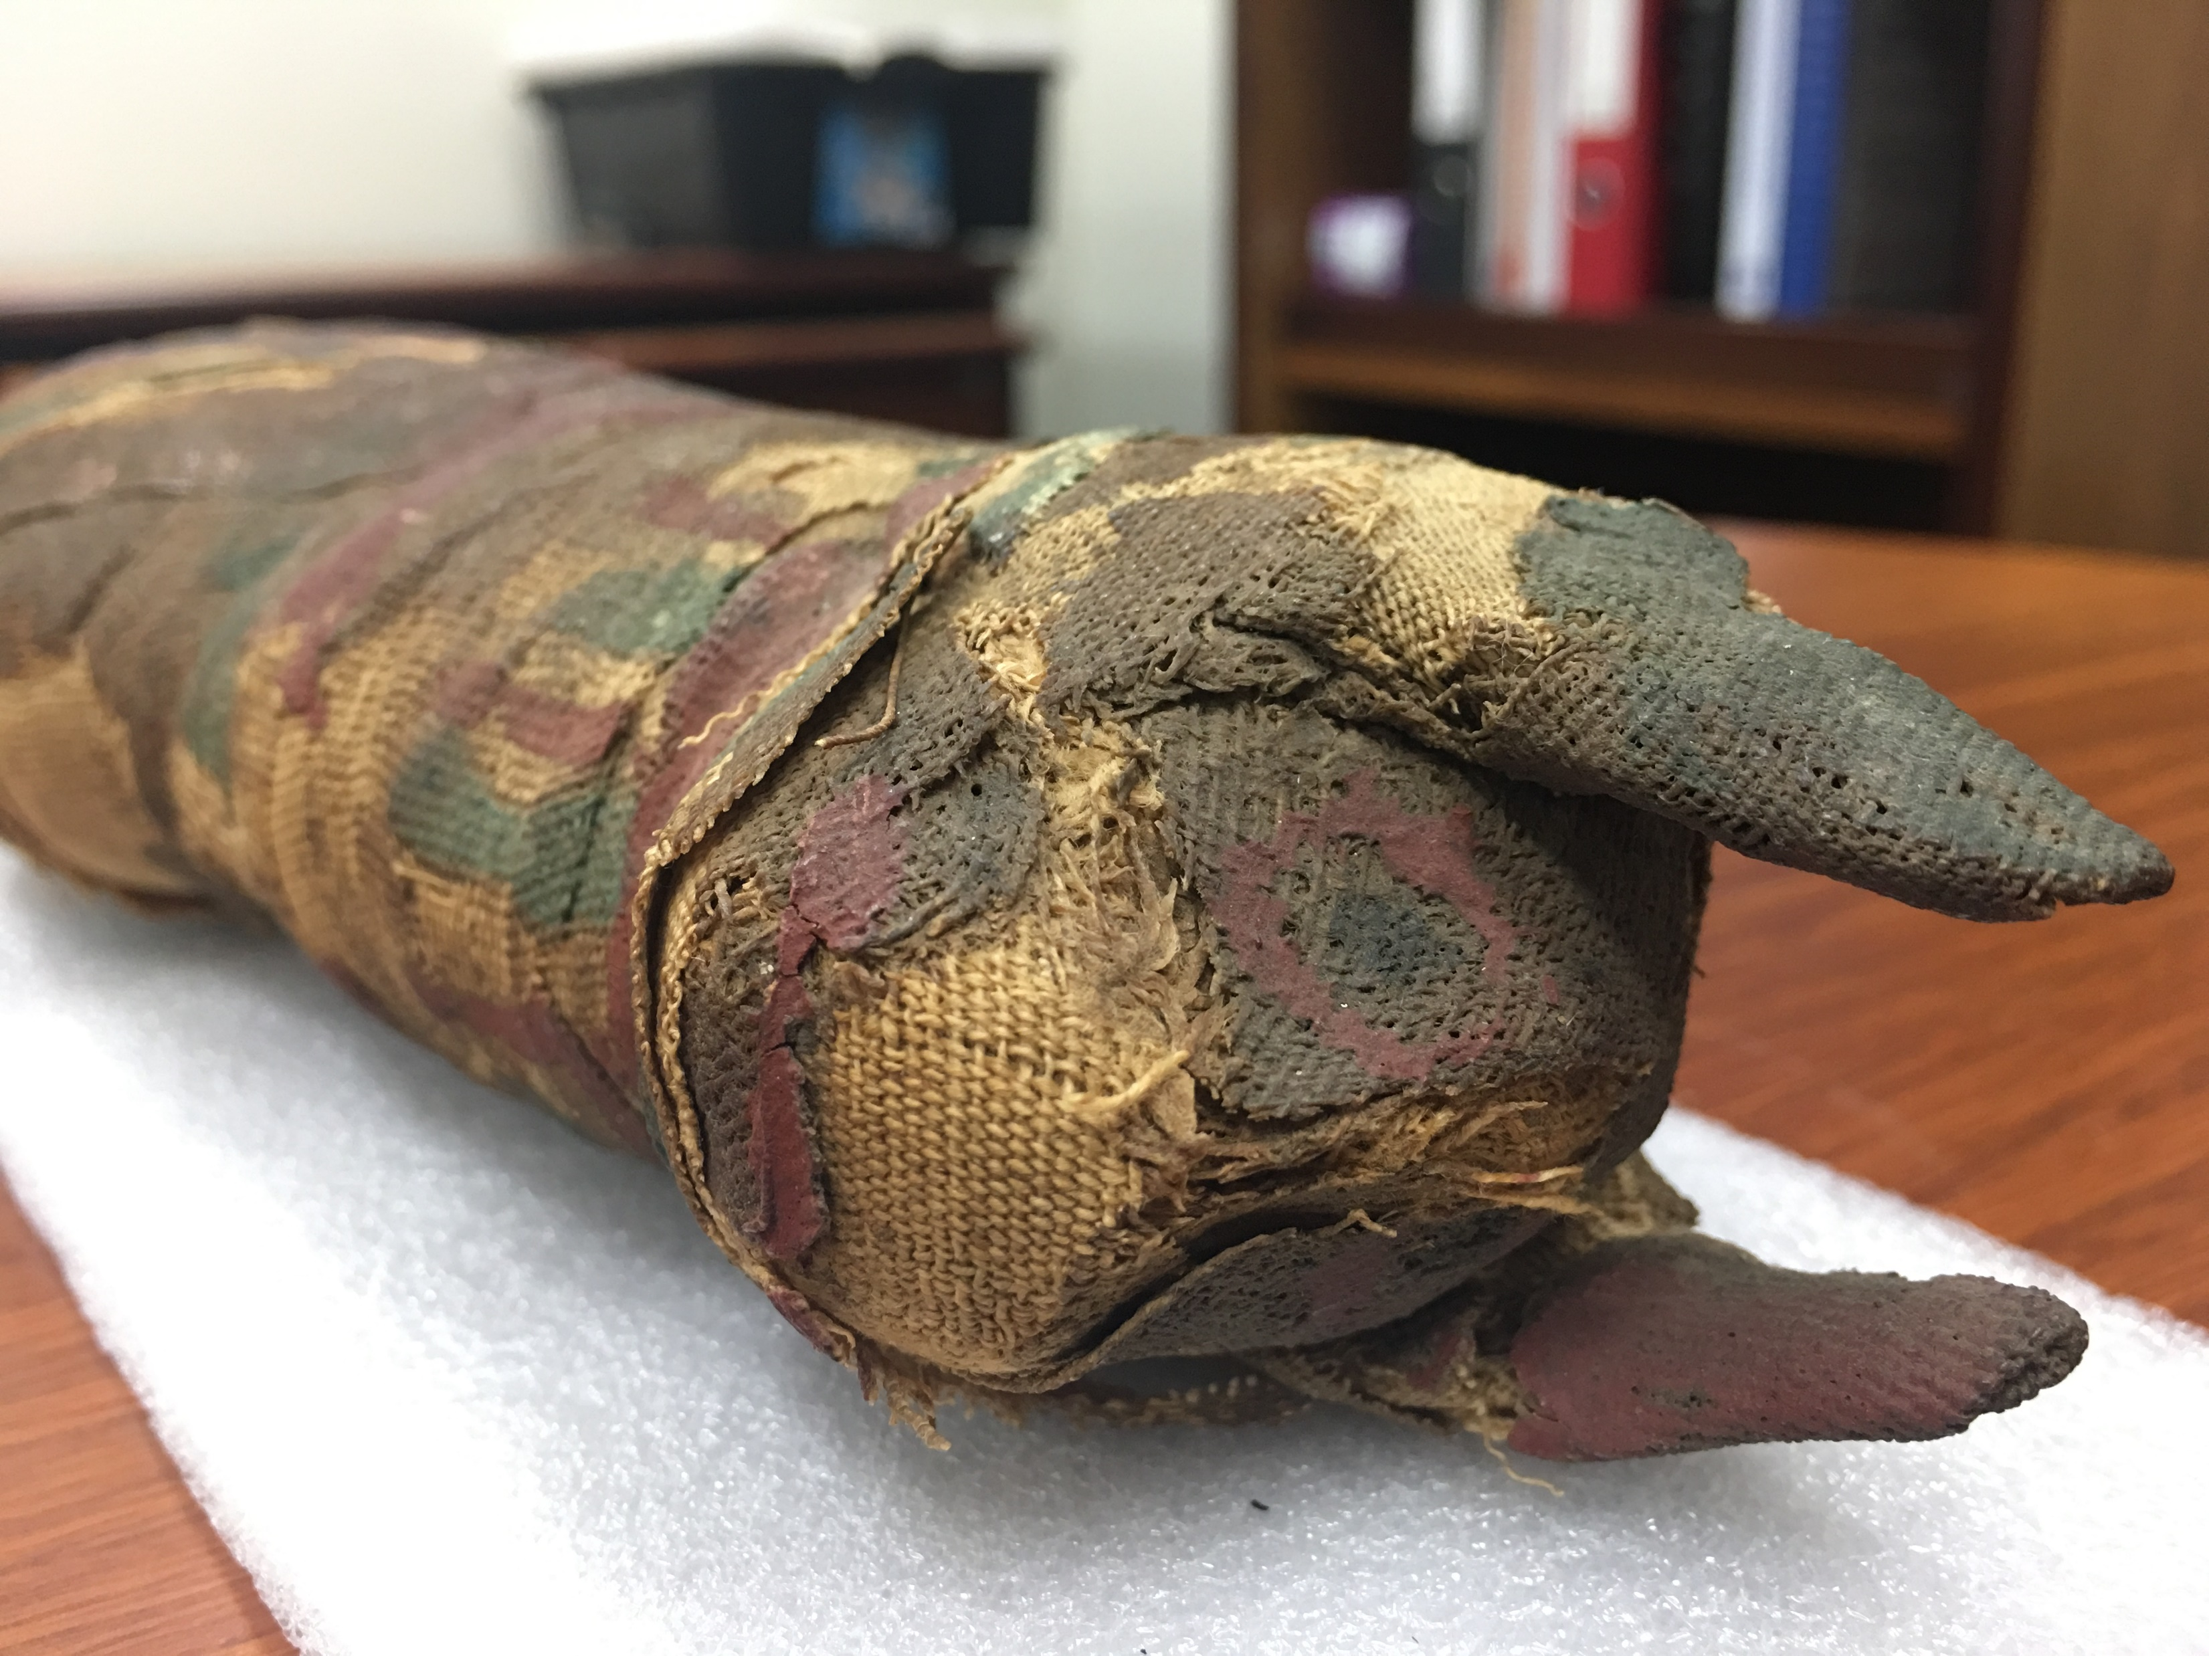




Investigating an unprovenanced Mummified votive offering using neutron and X-ray CT
Carla Raymond BA BSc MRes
WCNR11 Sydney, Australia | September 4th, 2018
Collaborators: Dr Jospeh Bevitt, Dr Yann Tristant, Dr Ronika K. Power, Mr Anthony Lanati,
Dr Christopher J. Davey, Dr John S. Magnussen, and Prof Simon M. Clark

Slide 2

Overview
Animal mummies and challenges of studying them
X-ray CT Study
Neutron tomography Study
Discussion
Conclusions

Slide 3
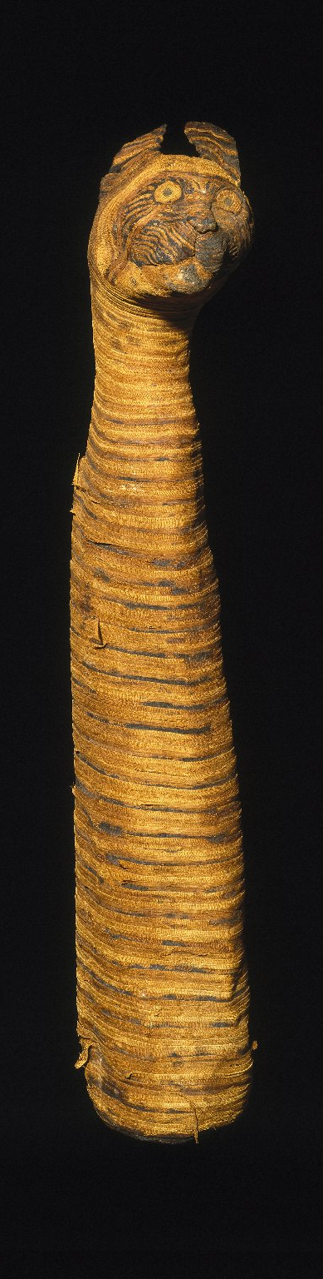
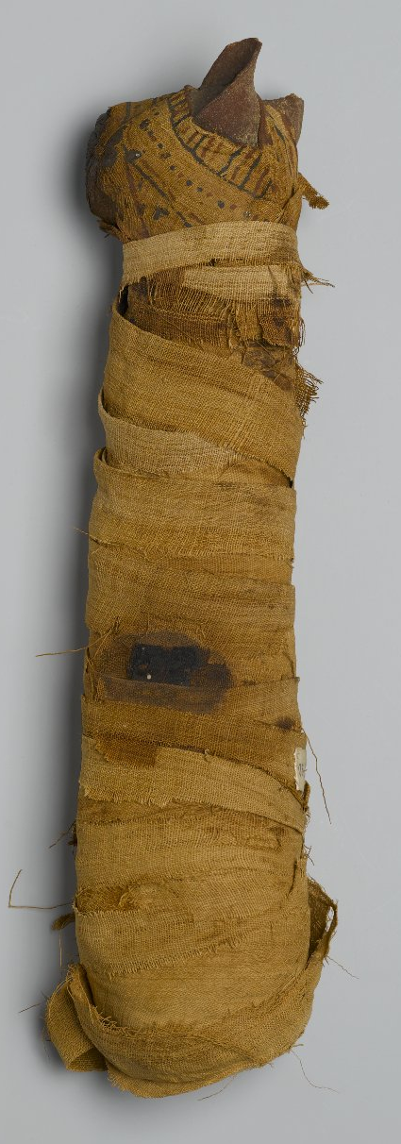
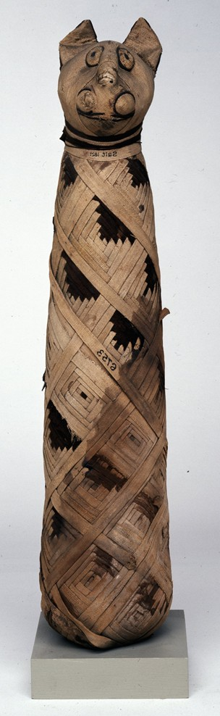
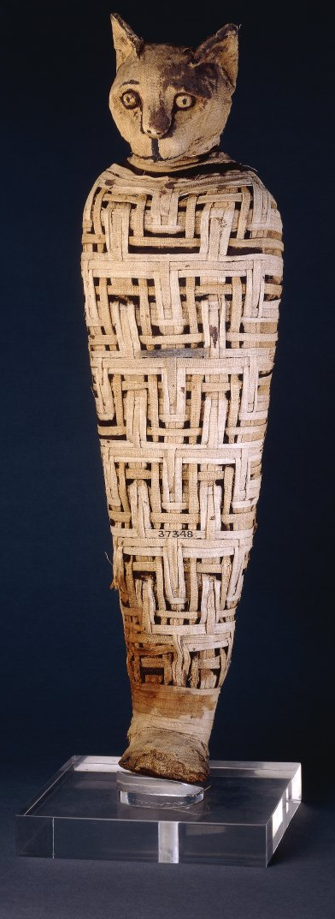
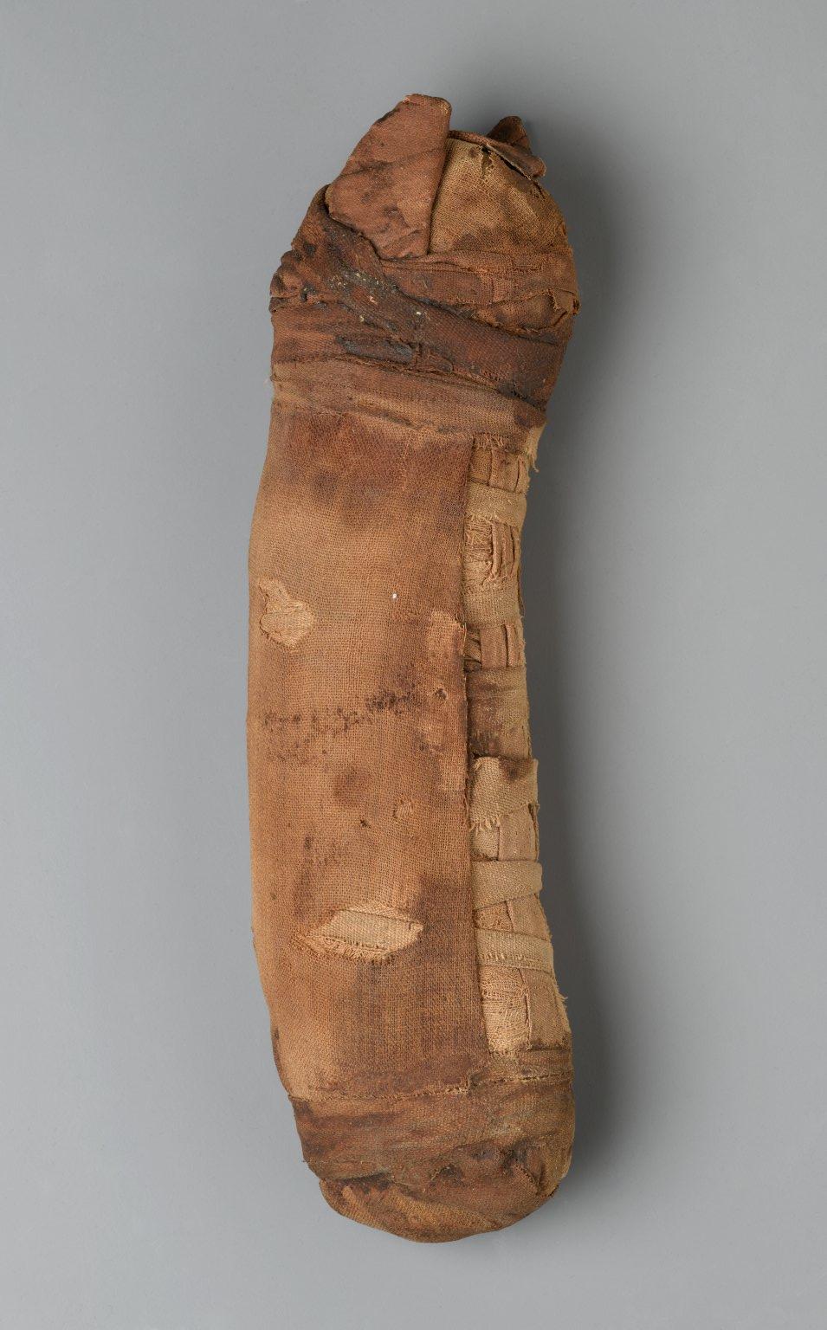
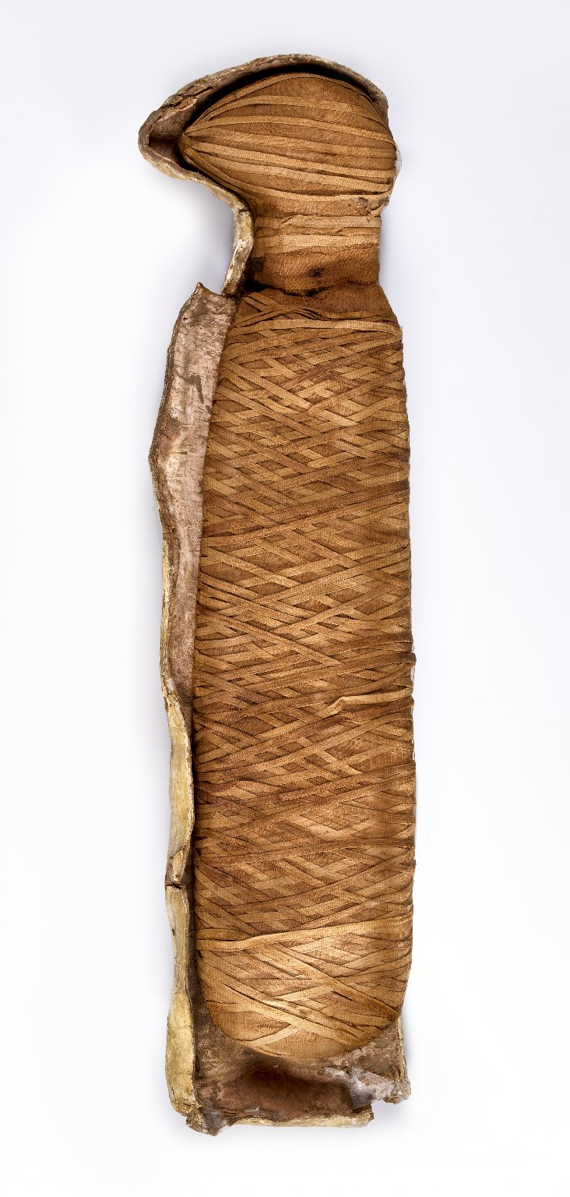
Votive animal mummies
a
b
c
d
e
f
a) 37.1991Ea-c Third Intermediate period, Unprovenanced (760 – 390 BC); b) 37.1988E Third Intermediate period (750 – 400 BC), Unprovenanced; c) X1179.3 Late Period (664 – 308 BC) Unprovenanced; d) 05.307 Graeco-Roman Period, Unprovenanced (305 BC – 395 AD); e) EA37348 Roman period, Abydos; f) EA6753 Roman period (post 30BC), Thebes.
(Images from Brooklyn Museum, Manchester Museum and British Museum collections).

Slide 4
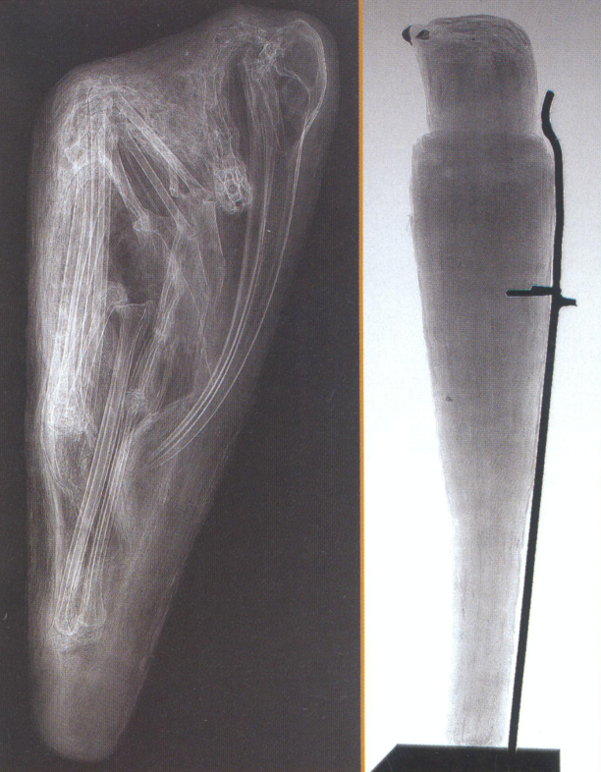
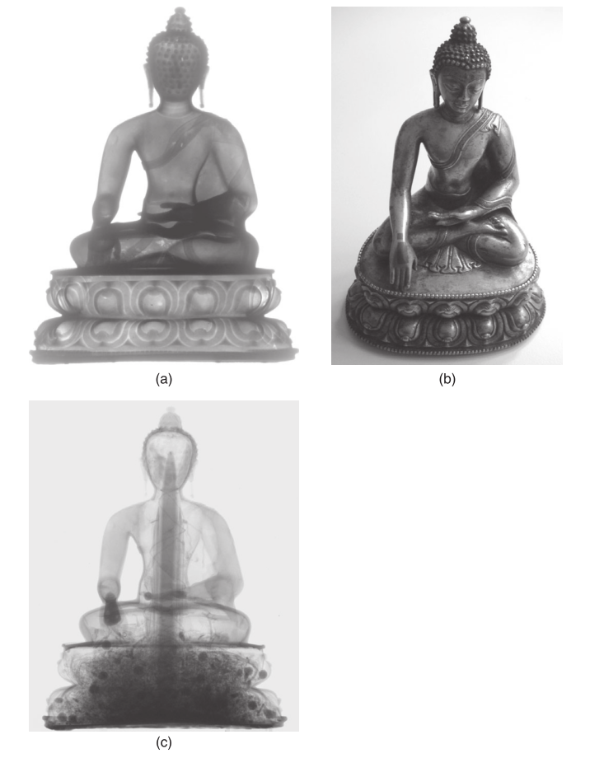
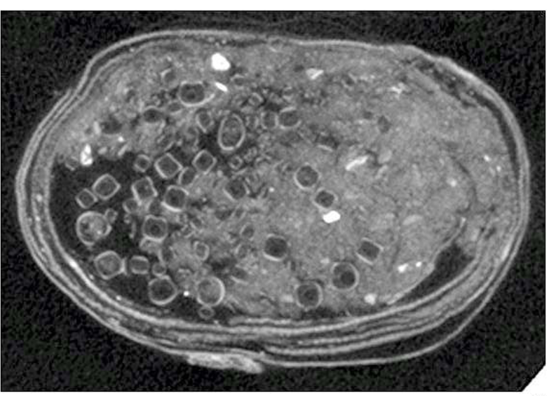
Archaeometry and 3D Imaging
a) X-ray radiograph of Buddha statue. b) Photograph of Buddha statue.
c) Neutron tomograph of Buddha statue (Lehmann et al., 2010).
(Brier, 2001)
(Cornelius et al., 2012)
Notes:
Identify contents of the mummy? Identify the species? Investigate mummification process? Compare the technqiues

Slide 5
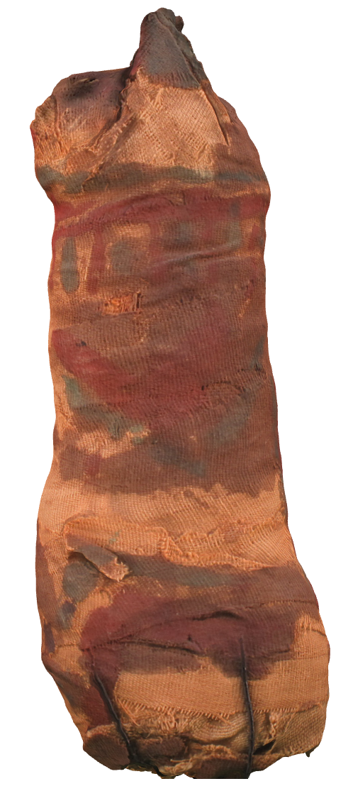
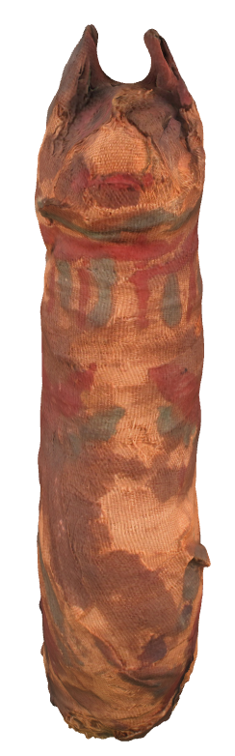
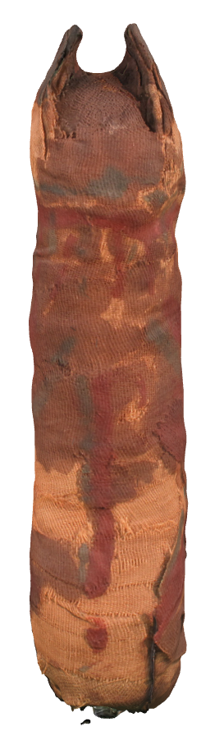
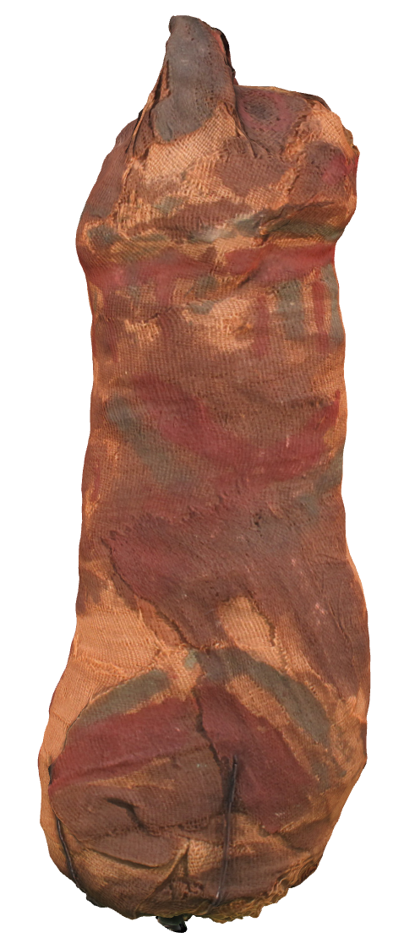

Votive animal mummies
IA.2402
Australian Institute of Archaeology collection, Melbourne

Slide 6
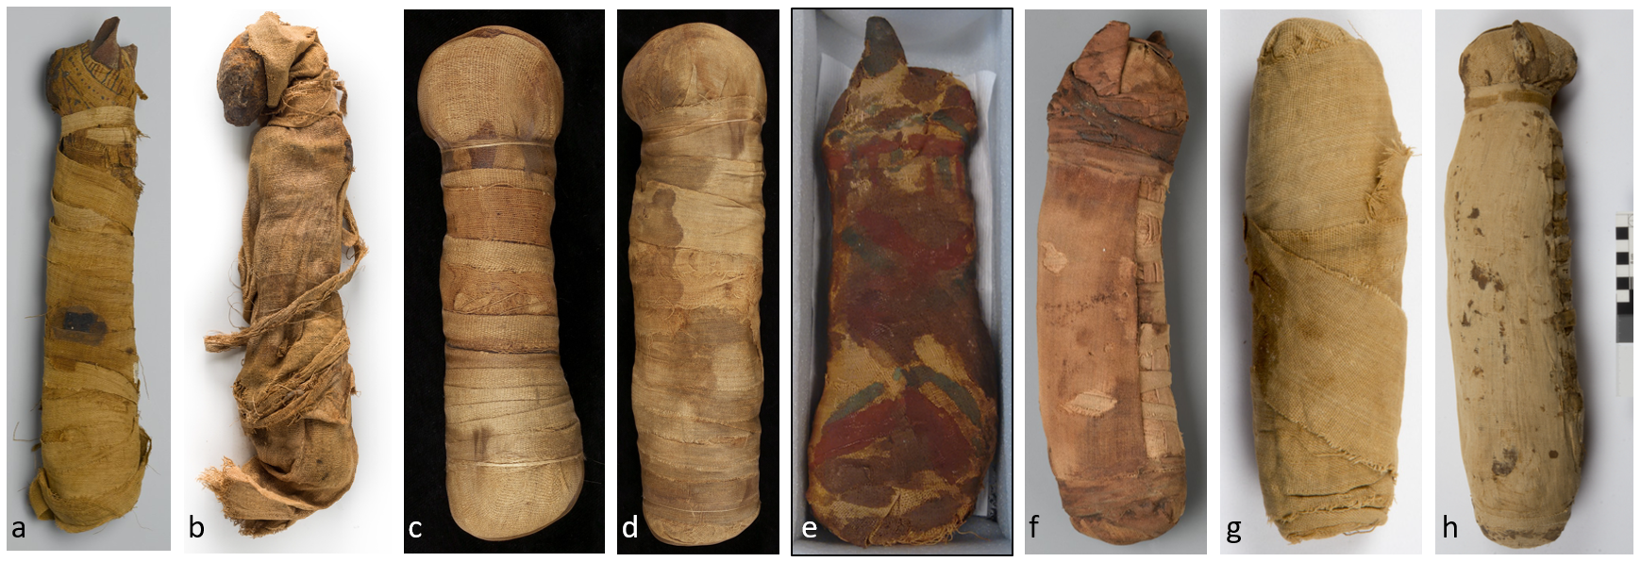
Votive animal mummies
a) 05.307 305 BC to 395 AD; b) NMR.30 525 to 30 BC; c) 79.3 300 to 200 BC; d) 79.2 400 to 200 BC; e) IA.2402 unknown date; f) X1179.3 664 – 308 BC; g) NM84.2 525 BC to c.300 AD; h) NM62.586 525 BC to c.300 AD.
(Images from various museum collections).

Slide 7
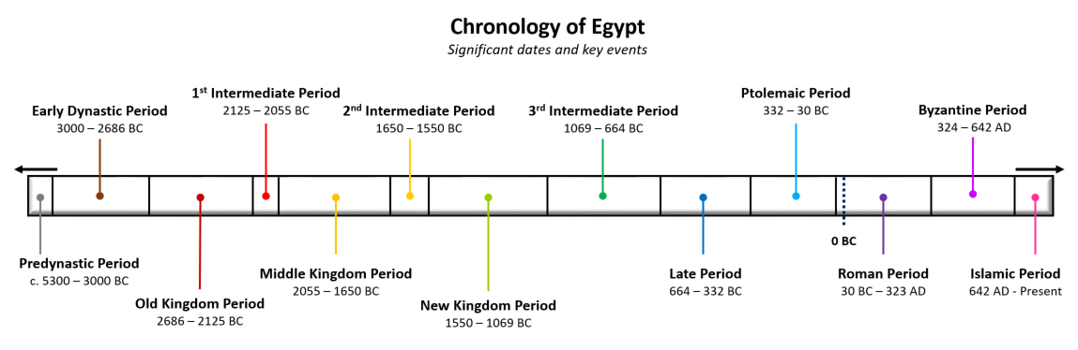

Ancient Egypt and animal mummies
Hypothesis for age of IA.2402

Slide 8
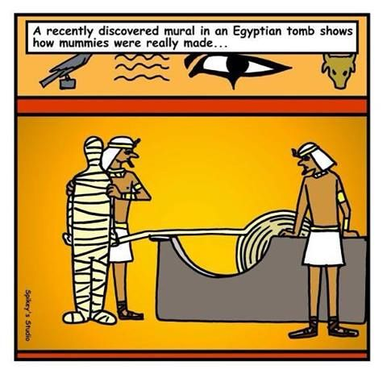
Key objectives
Is there anything inside the wrappings?
Is it authentic or fake?
How old are the remains?
Can we better understand mummification from this example?

Slide 9
Overview of project
Imaging techniques
X-ray Computed Tomography
Neutron CT
Imaging techniques
X-ray Computed Tomography
Neutron CT
Pigment study
Scanning Electron Microscope (SEM)
Elemental analysis (EBSD)
Raman Spectroscopy
X-ray Diffraction (XRD)
Radiocarbon dating
Accelerator mass spectrometry (AMS)
Radiocarbon dating
Accelerator mass spectrometry (AMS)

Slide 10
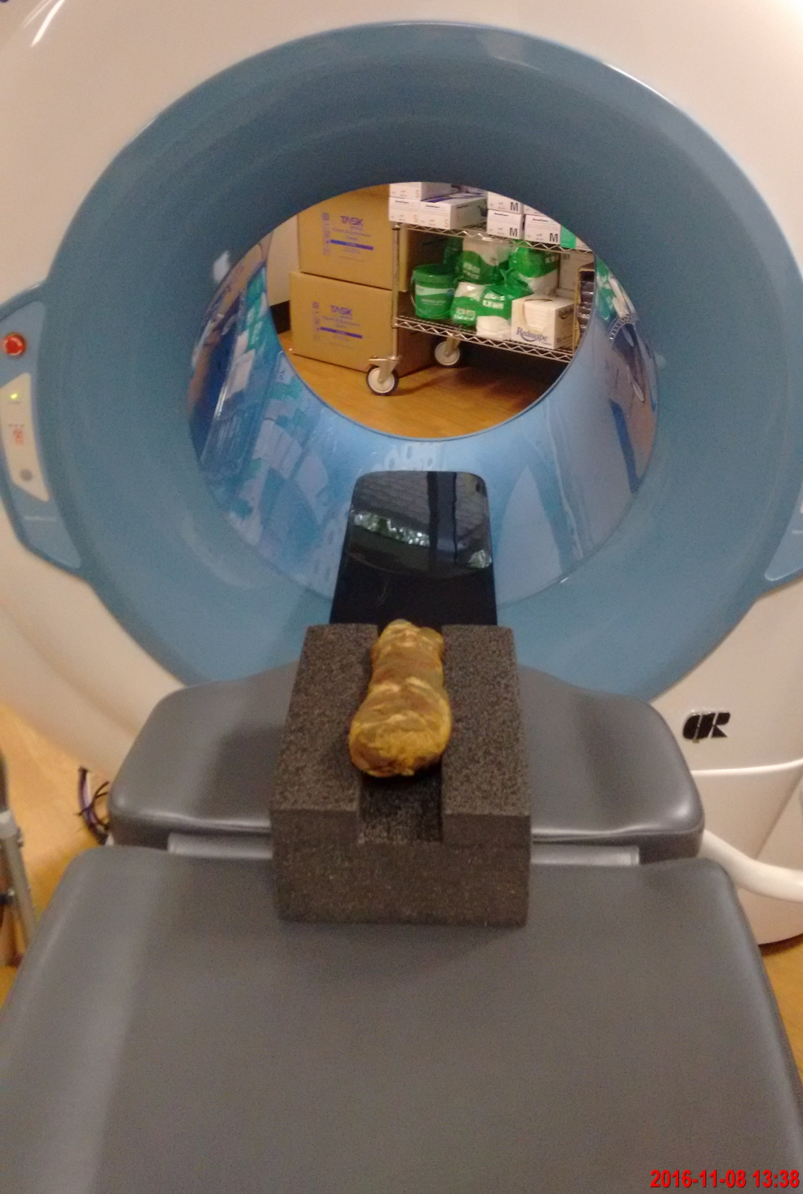
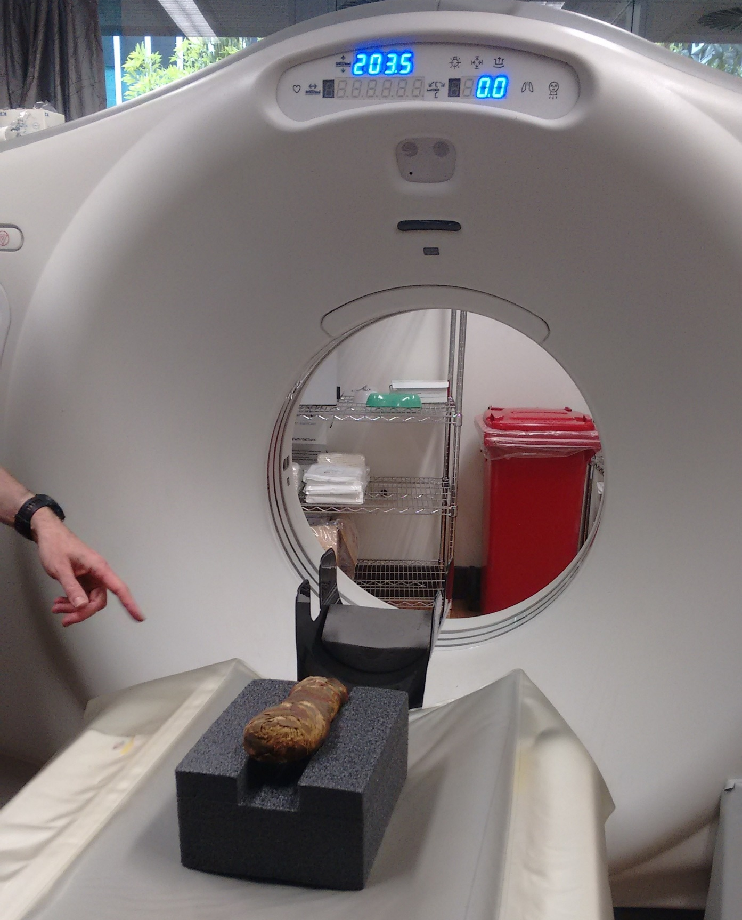
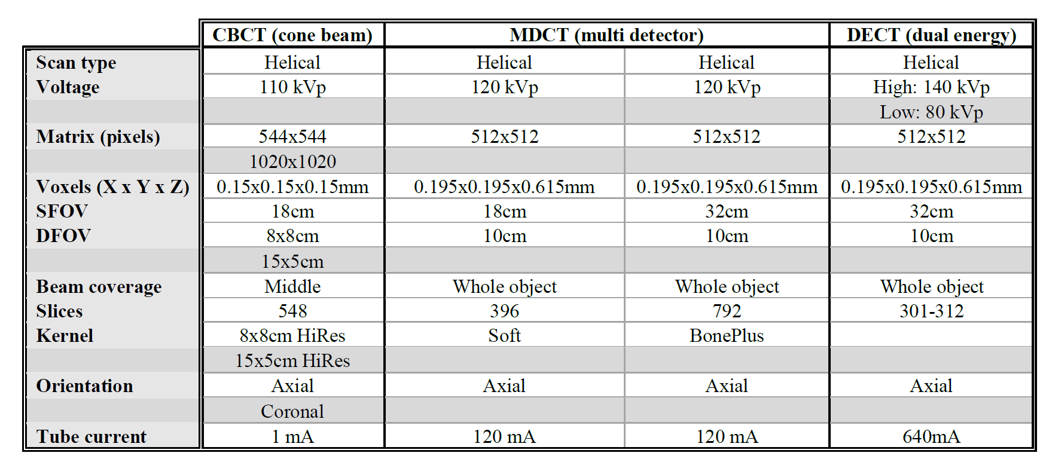
X-ray CT scans
General Electric HD750
Multi-detector Dual Energy CT Scanner
Newtom 5G Cone beam CT Scanner

Slide 11
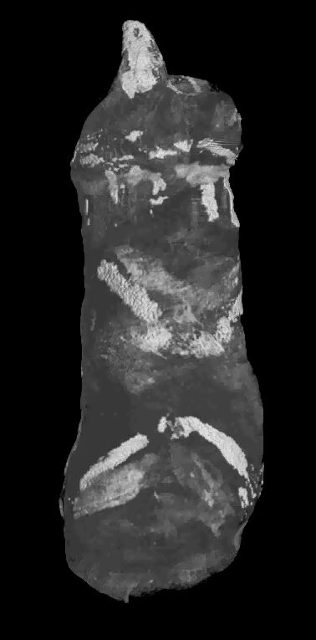
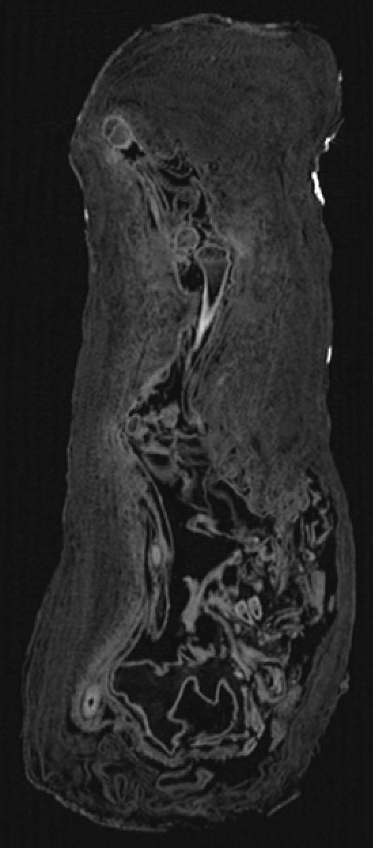
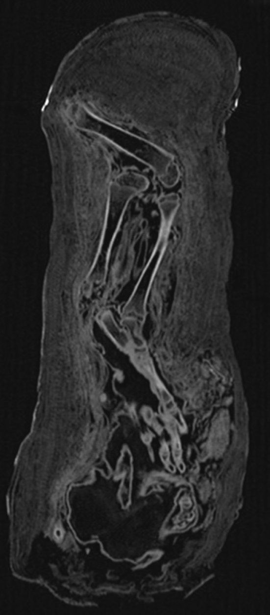
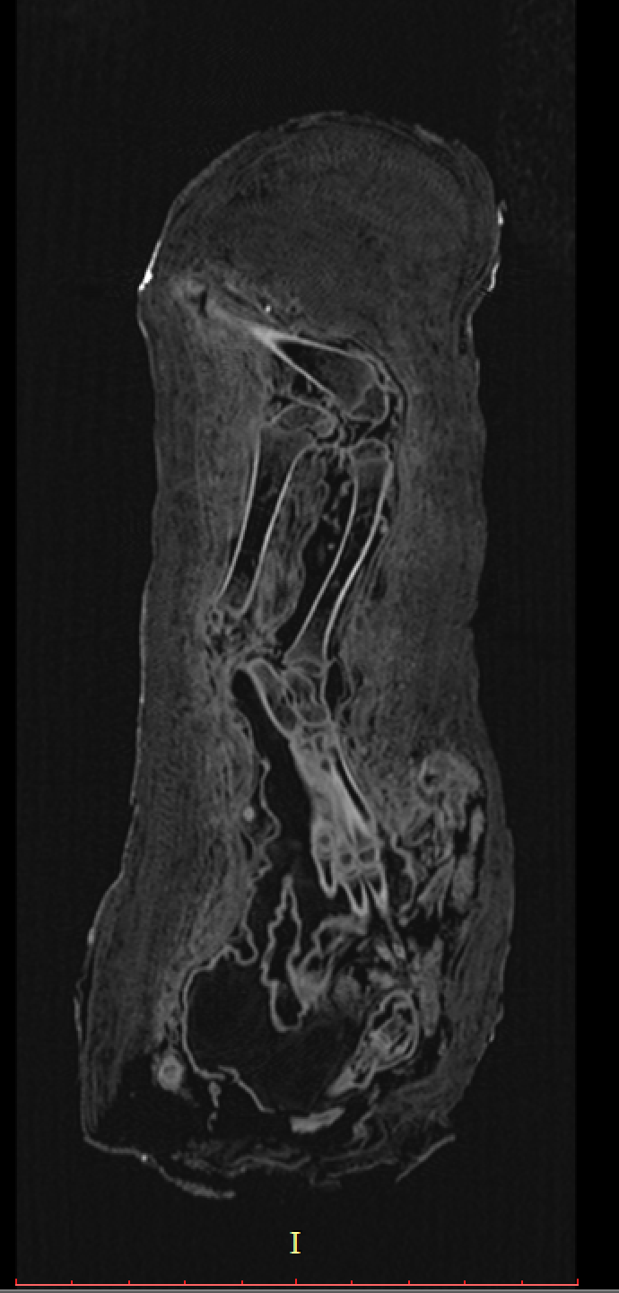
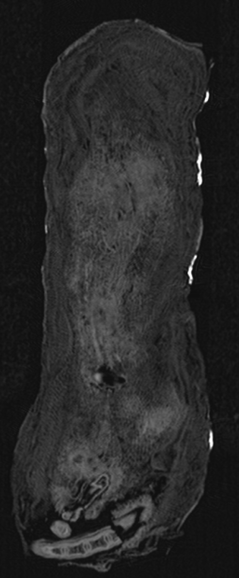
Results
2D slices through the mummy

Slide 12
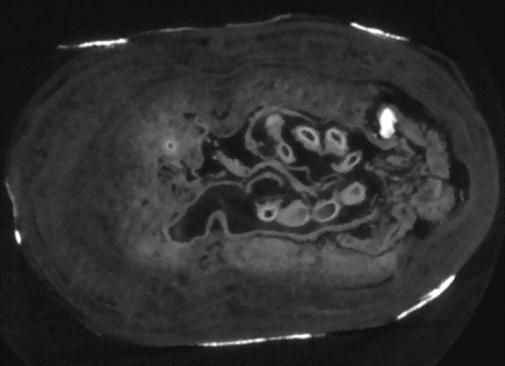
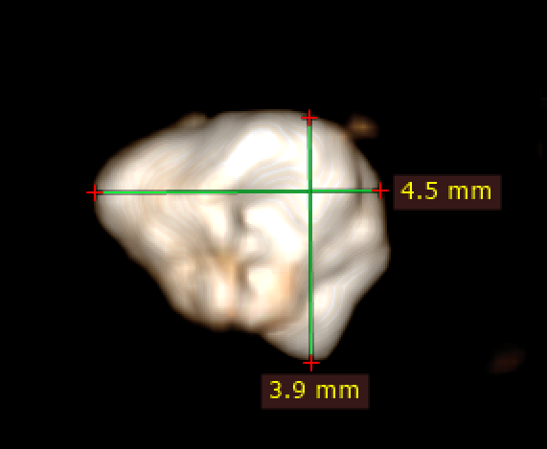
Results
X-ray CT
Small highly absorbent object near the paws

Slide 13
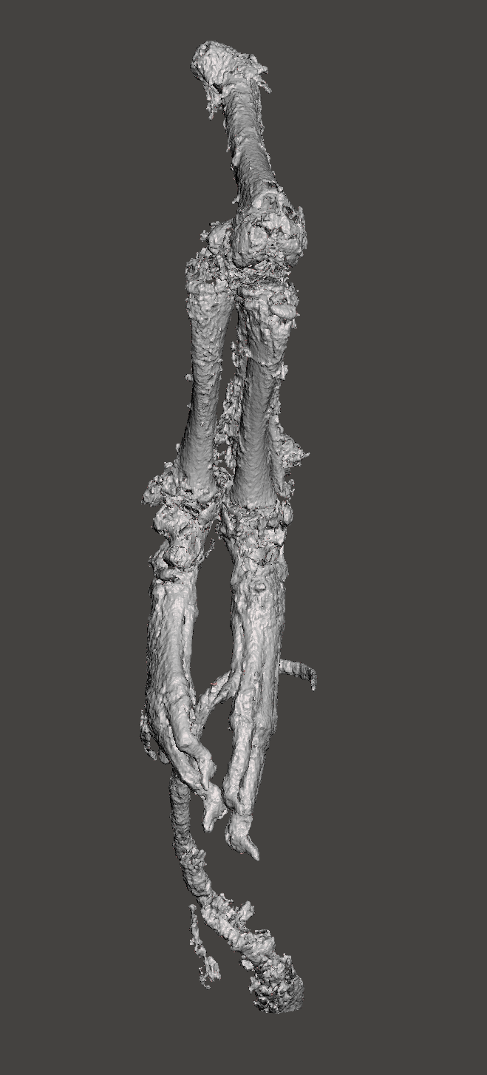
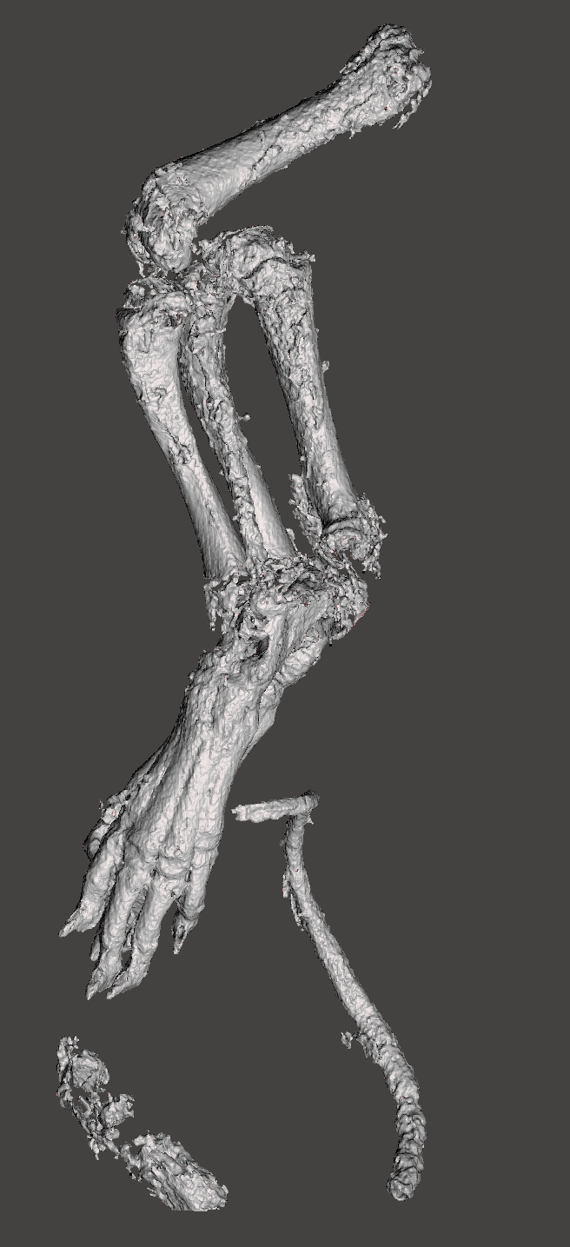
Results
3D reconstruction of the X-ray data.

Slide 14
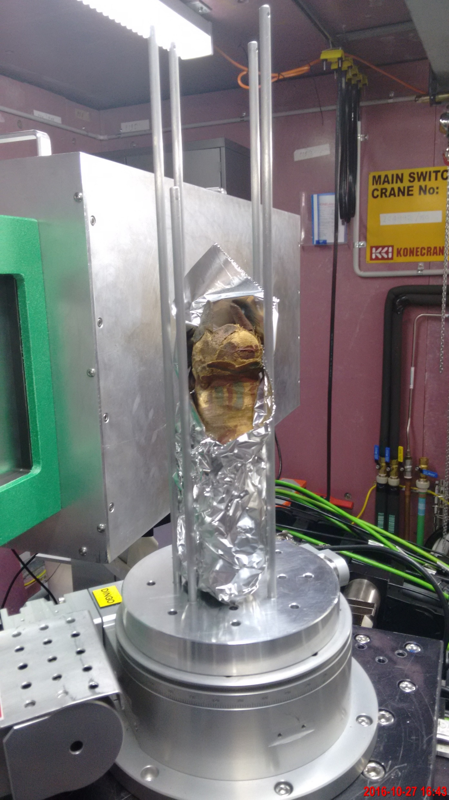
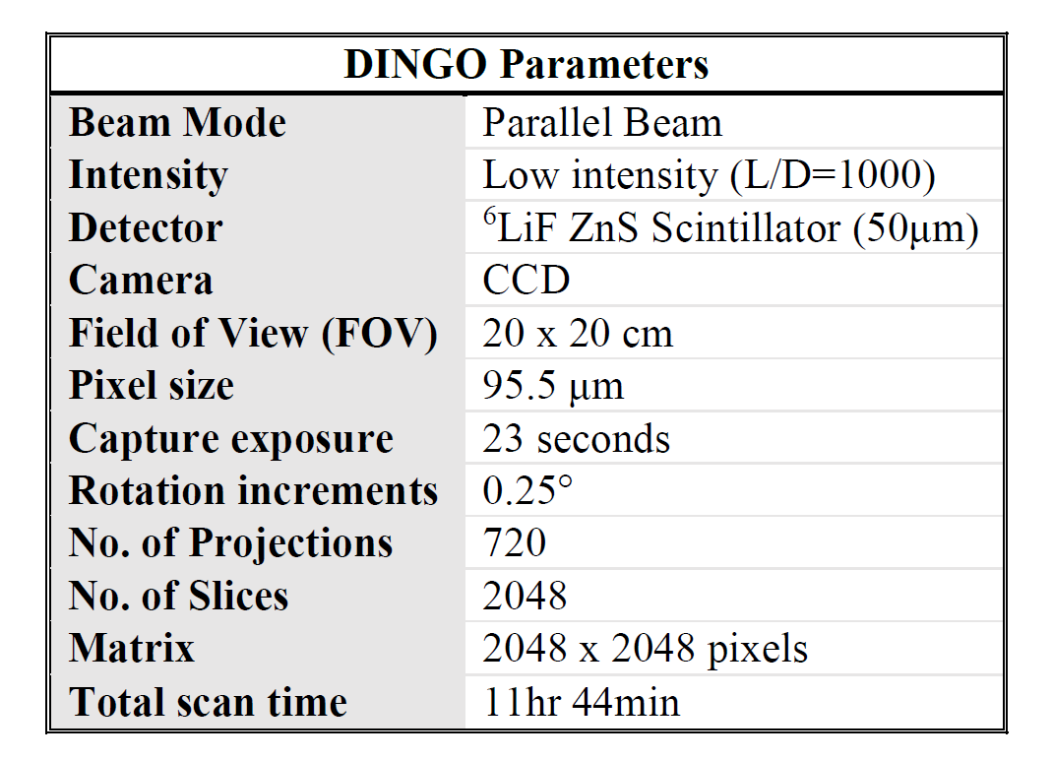
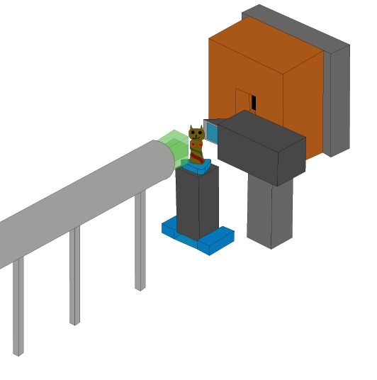
Neutron tomography
Adapted from Garbe et al 2015.

Slide 15
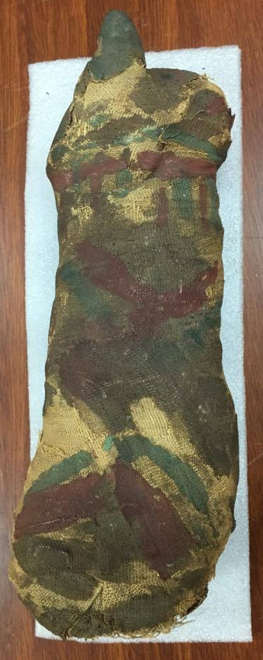
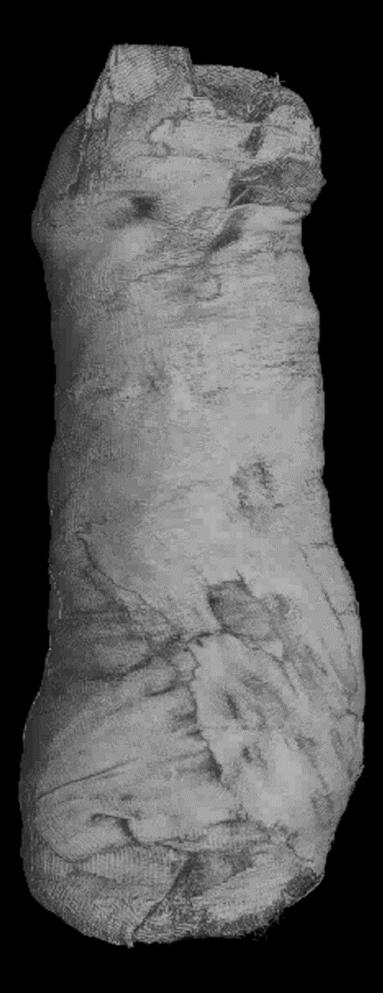
Results
X-ray CT reconstruction
Neutron CT reconstruction

Slide 16
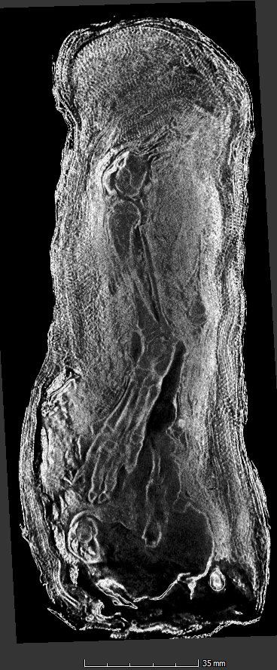
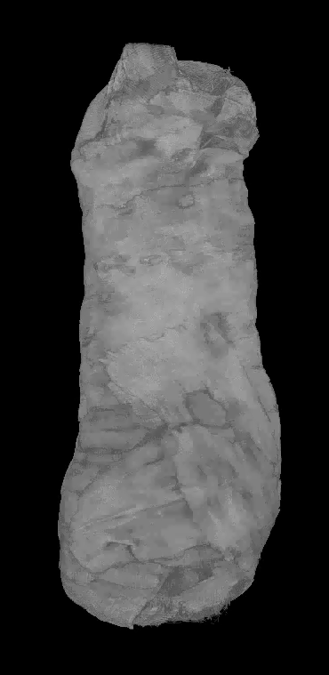
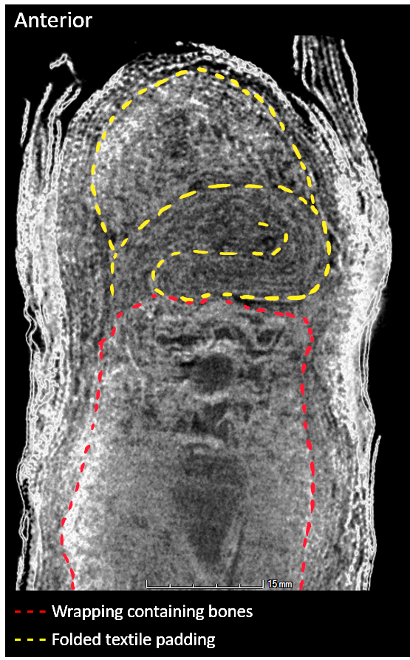
Results

Slide 17
Results
Comparing data
X-ray CT reconstruction
Neutron CT reconstruction

Slide 18
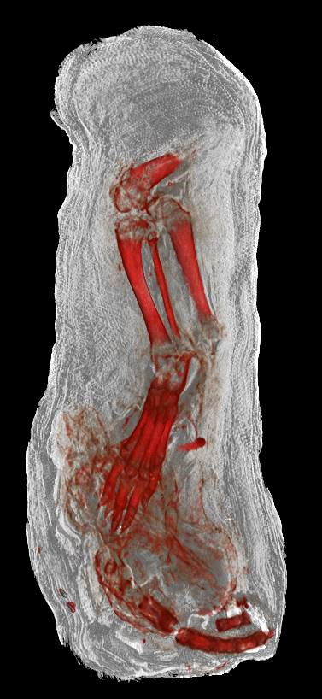
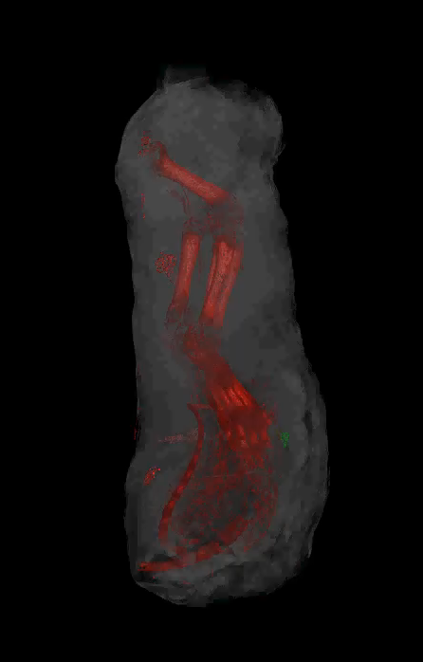
Results
Combining data

Slide 19
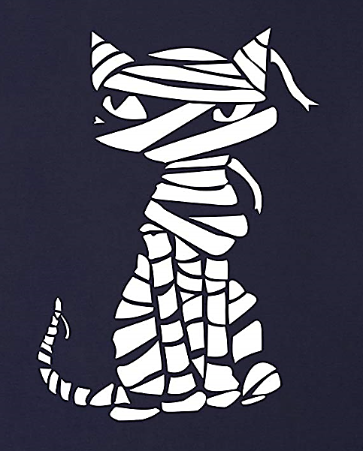
Discussion
What do these findings mean?
How can this data help us better understand mummification techniques?
What can we learn from the remains?
What are the benefits of using both techniques?

Slide 20
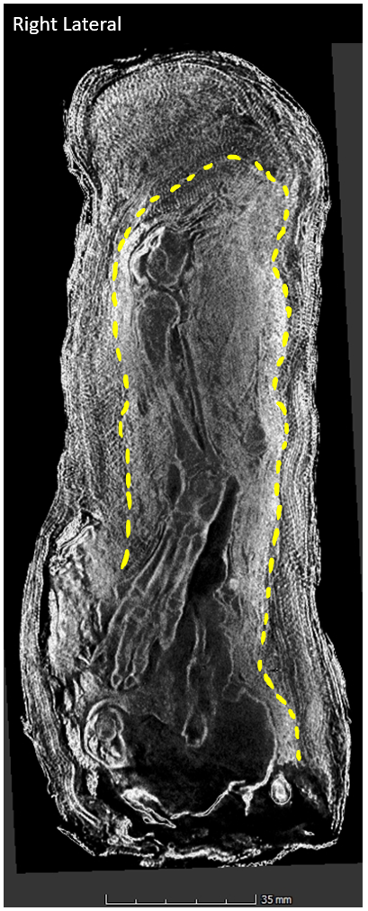
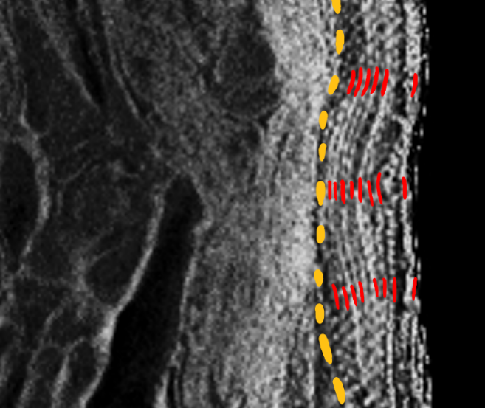
Discussion
Mummification technique?
Right paw
Notes:
Ginsburg comparison

Slide 21
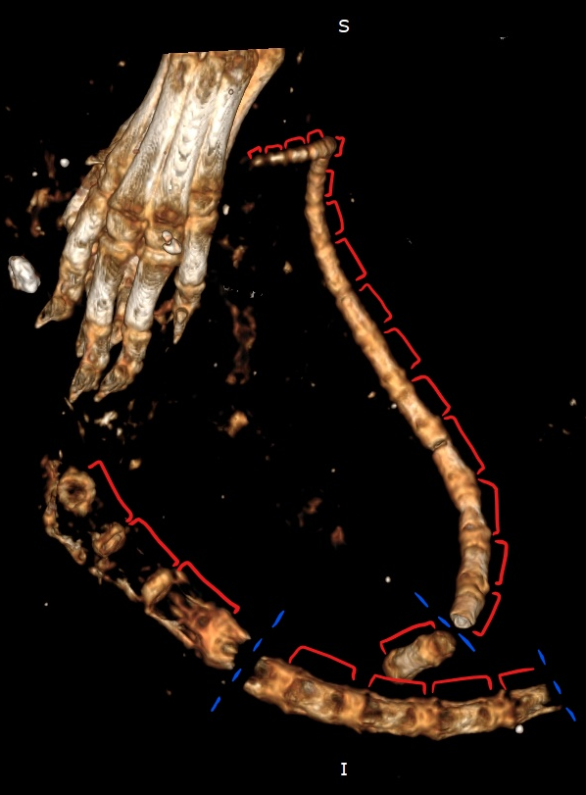
Discussion
Speciation + age at death?
1 cm
1 cm

Slide 22
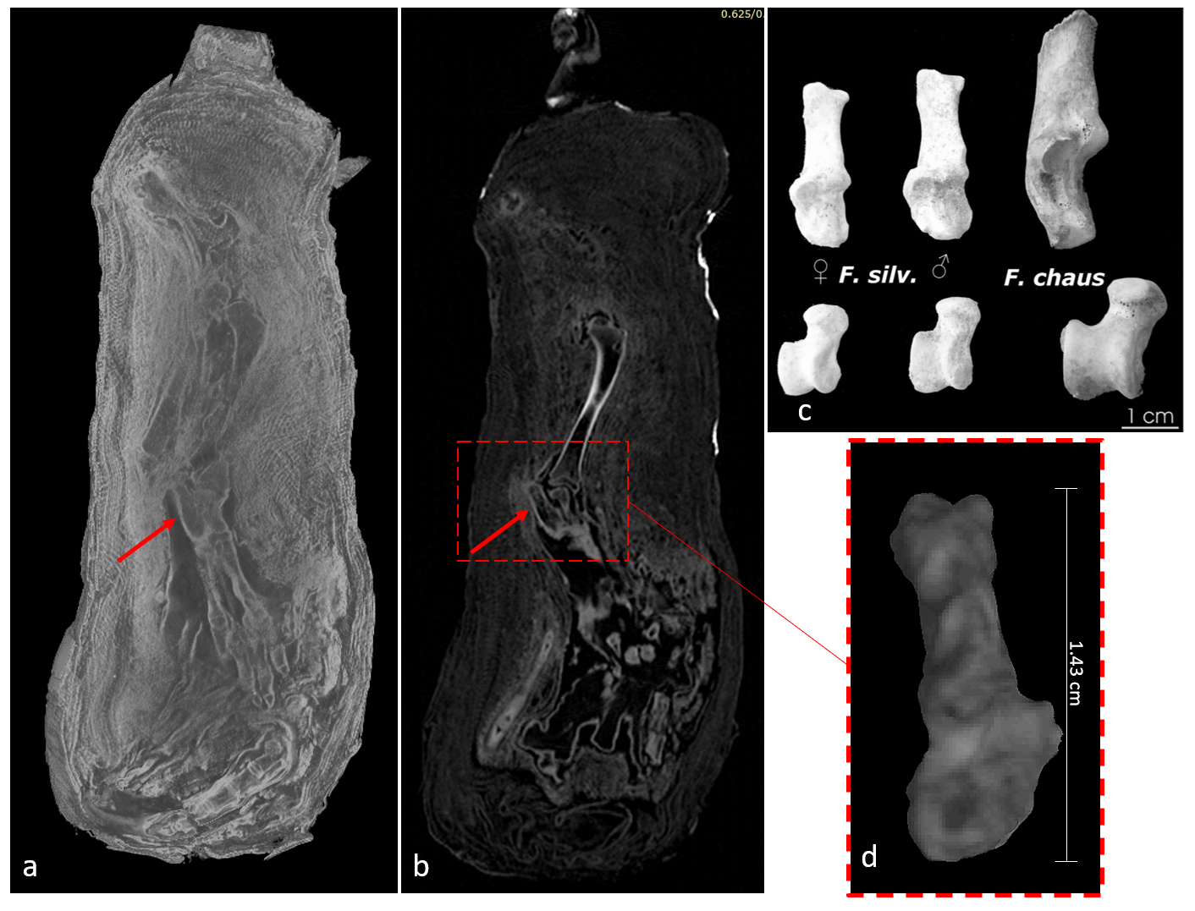
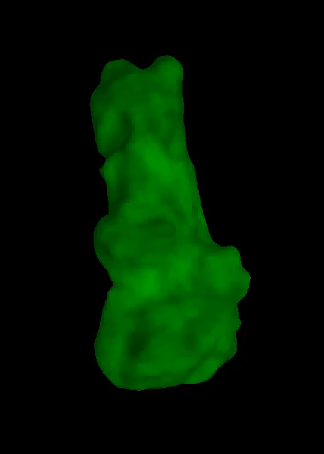
Discussion
Speciation?
a) Neutron and b) X-ray data showing location of calcaneus (red arrow). c) Shapes of calcaneus in adult cats (Van Neer et al., 2014); d) Calcaneus extracted manually from X-ray CT data using VG Studio.

Slide 23
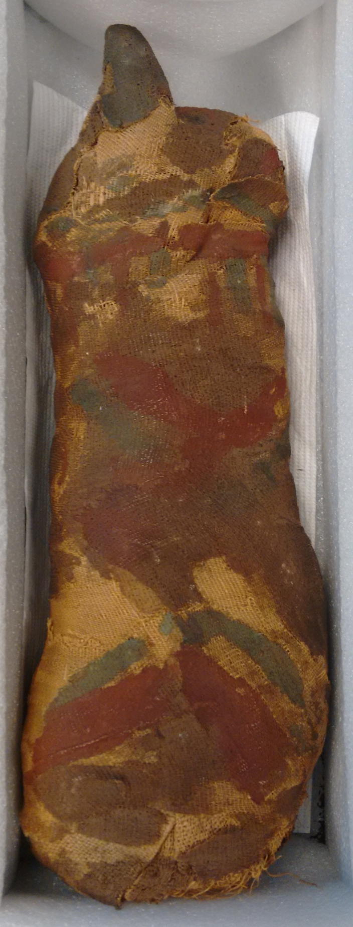
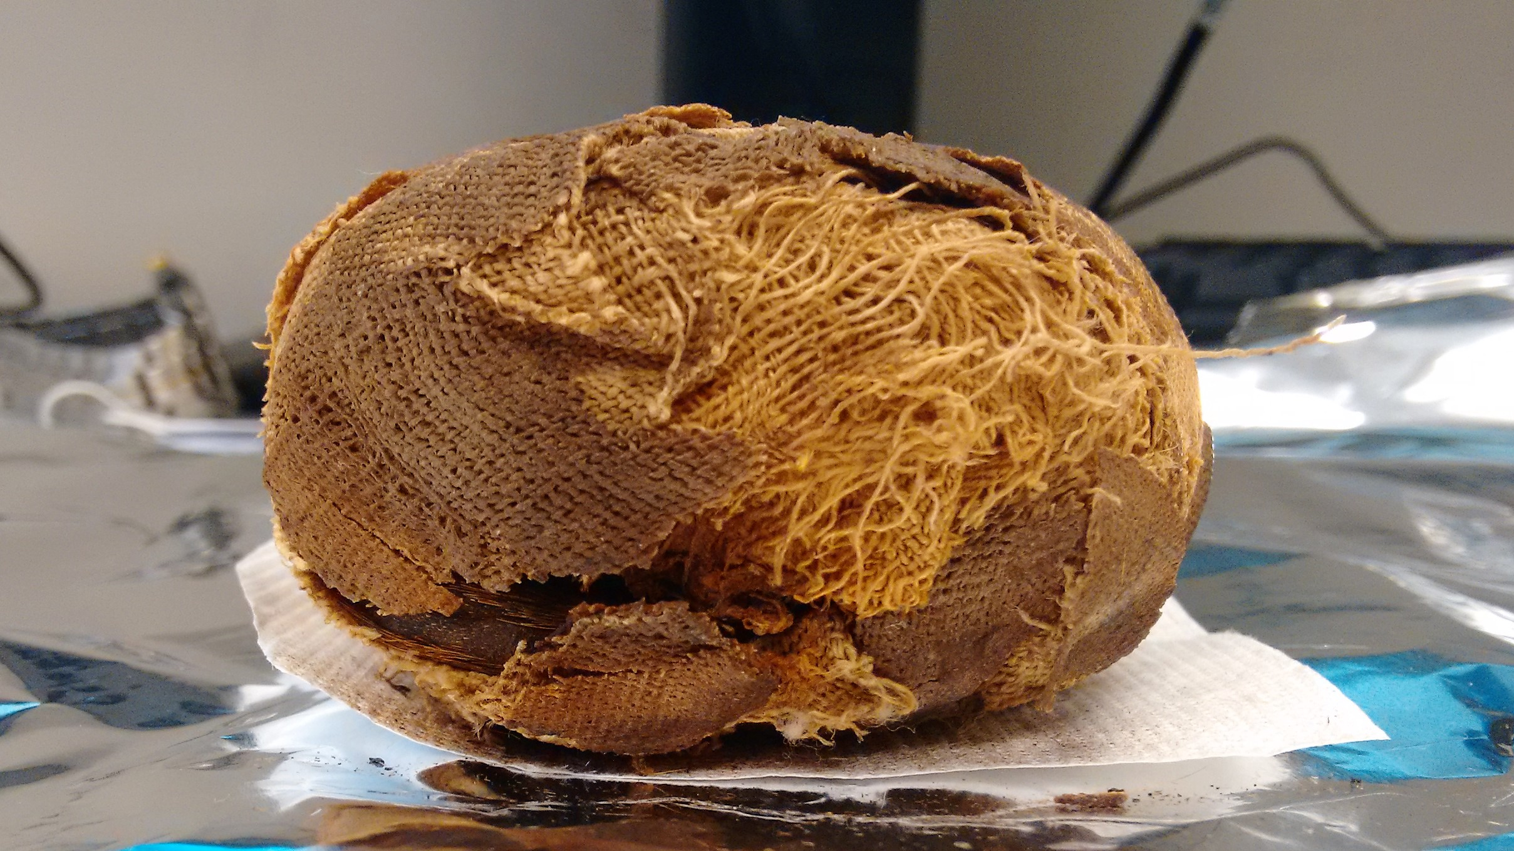
Radiocarbon dating
Textile sample
Fur sample

Slide 24
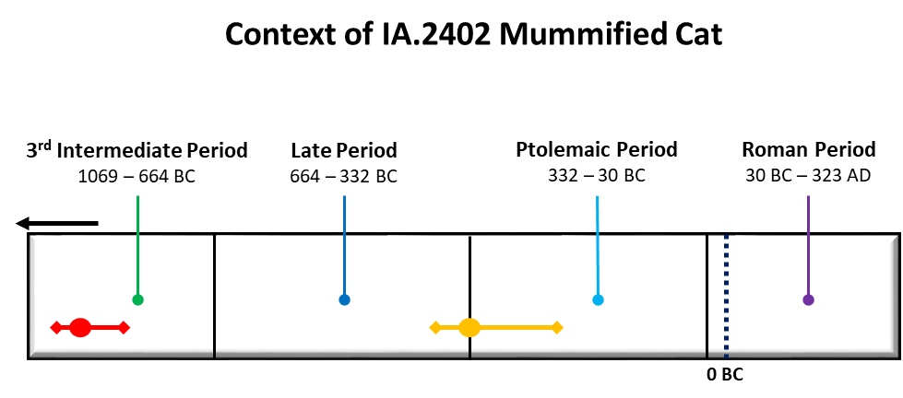
Radiocarbon Dating
~350-200 BCE
~900-800 BCE

Slide 25
Discussion
Signs of reuse?
Was this always a partial skeleton? Were the remains broken up from the original?
X-ray CT data showing peri-mortem fractured femurs of a mummified cat (Petaros et al., 2015).

Slide 26

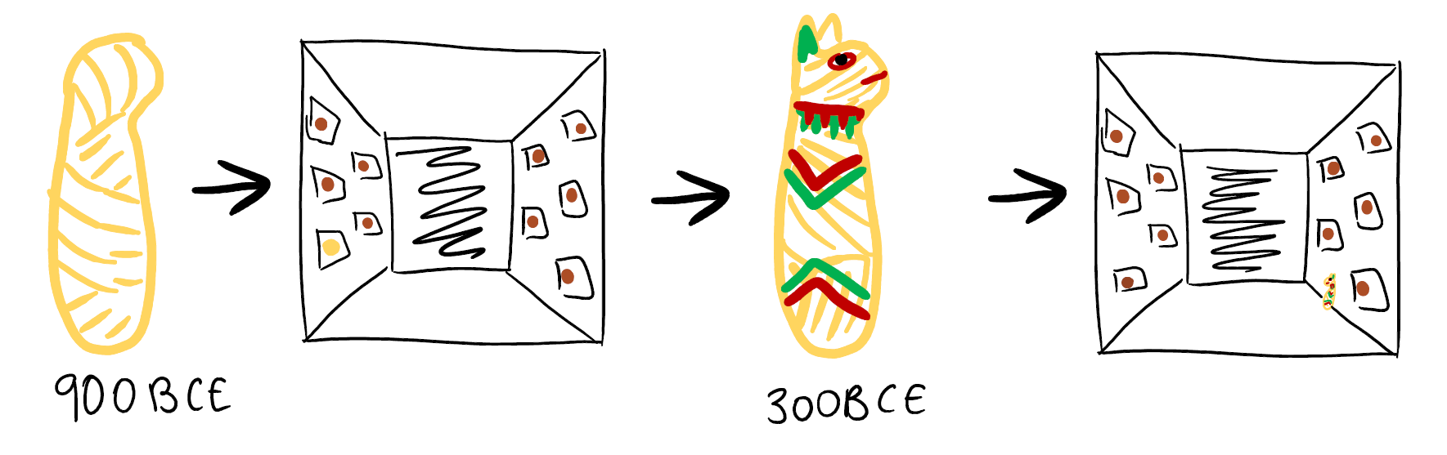

Discussion
Recycled votive offering hypothesis
1856-7 CE

Slide 27
Conclusions
Species and age – Juvenile Felis silvestris
Mummification techniques – various densities and tightness of wrapping
C14 age – 500 year difference → recycling of votive offerings?
Using a combination of techniques

Slide 28

Acknowledgements
Prof Simon Clark
Dr Yann Tristant
Dr Ronika K Power
Dr Christopher J Davey
Dr David Saunders
Dr Joseph Bevitt
Dr John Magnussen
Dr Timothy D Murphy
Dr Anton Maksimenko

Slide 29

Thanks for listening!
Any questions?

