Slide 1
Neutron imaging instrument DINGO – moving to 1μm resolution by U. Garbe

Slide 2
DINGO team and supporter
Team:
Floriana Salvemin
(Joseph Bevitt)
Supporter and consultant:
Eberhard Lehmann
Burghard Schillinger
Mohamed Arif
ISNR-members
Technical Support:
David Roach
Andrew Berry
Frank Darmann

Slide 3
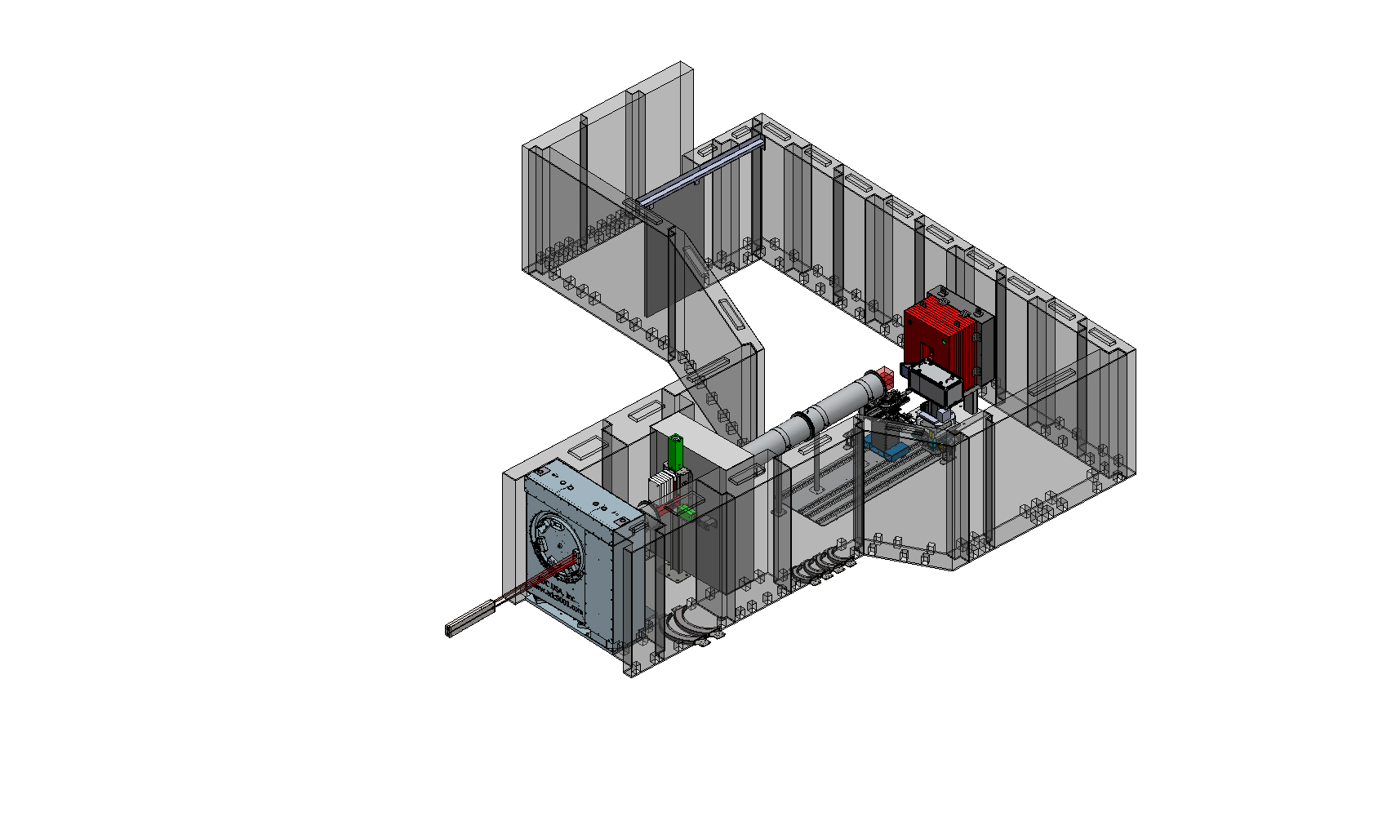
New Imaging Beamline at ANSTO DINGO Layout
Sample Stage
Sliding door
Beam Stop
Flight Tubes
Selector Wheel / Secondary Shutter Unit
Detector Stage
Rail System
Primary Collimator
Tertiary and Fast Shutter

Slide 4
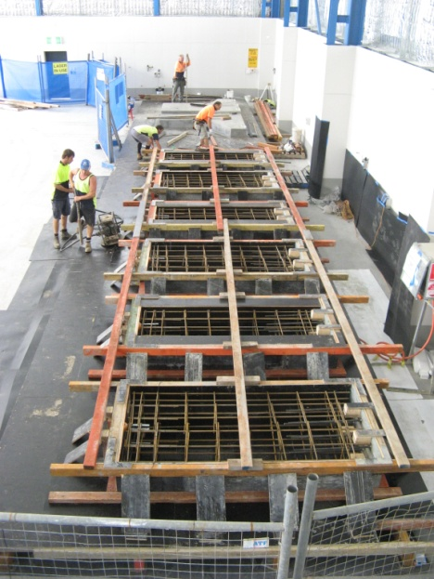
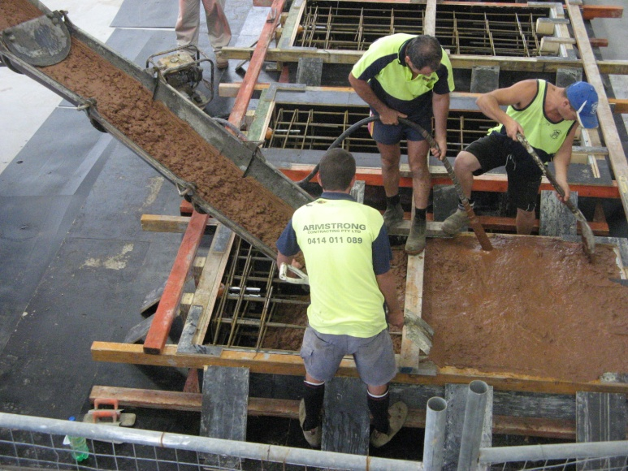
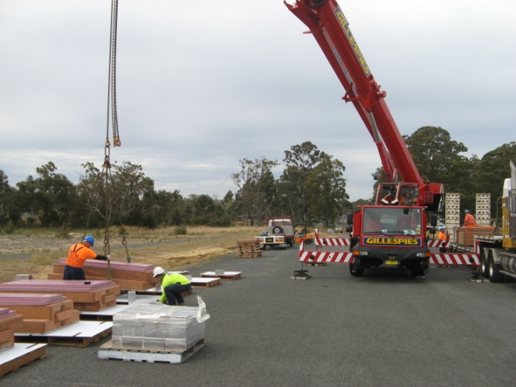
Major components
Shielding elements build

Slide 5
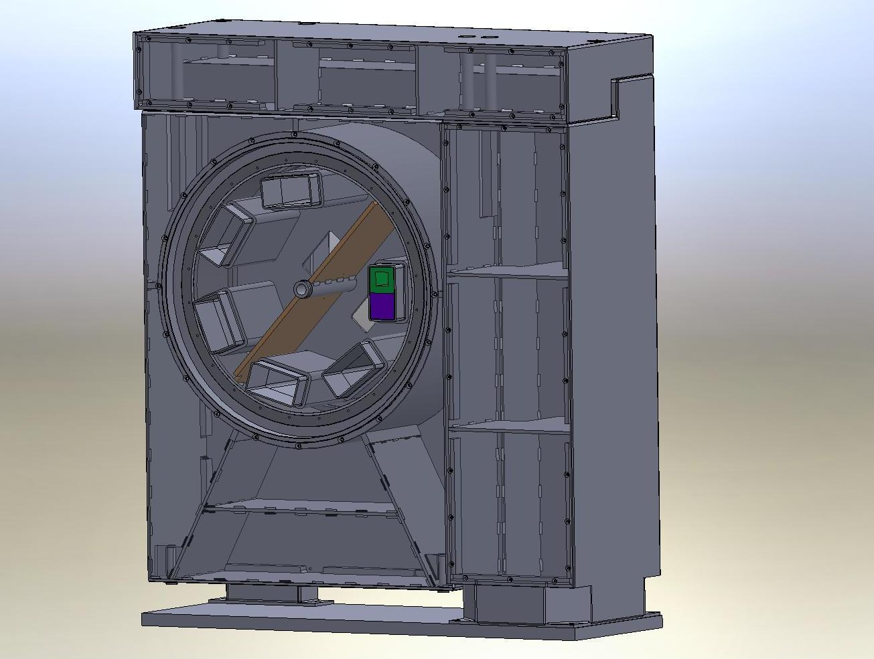
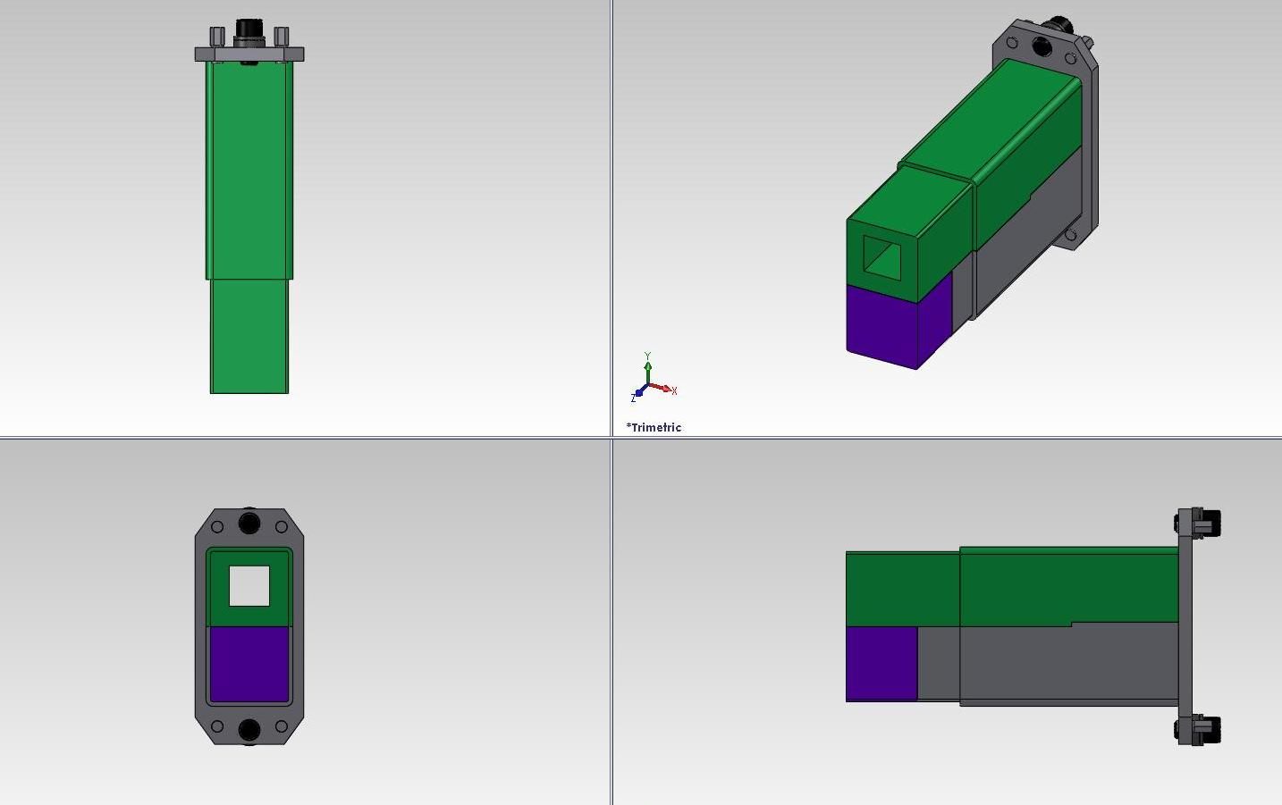
Selector wheel / shutter unit
Different inserts to generate different beam sizes at sample position
One block design
Adjustment screws for fine alignment
Internal structure filled with steel / wax mixture
Modular system

Slide 6
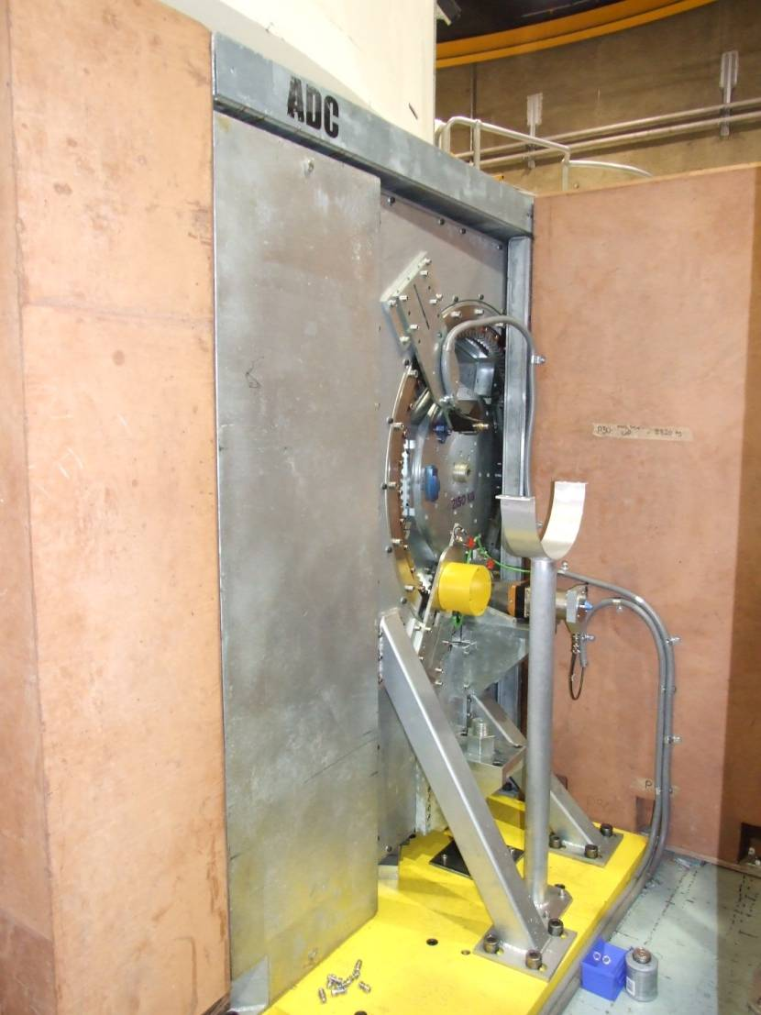
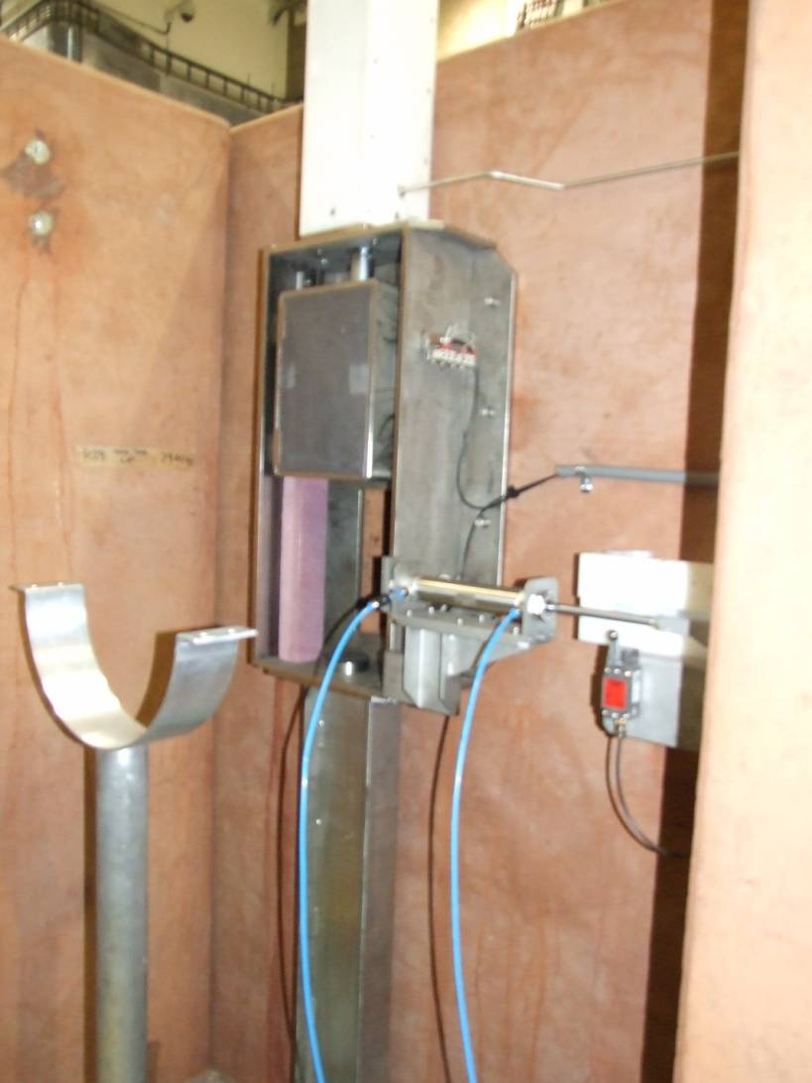
Selector wheel
Shutter unit

Slide 7
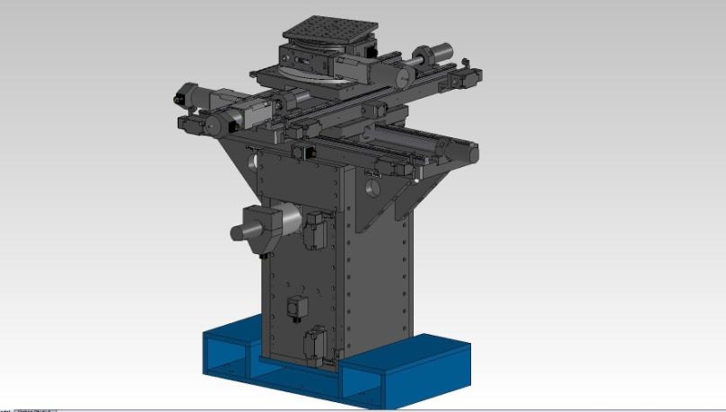
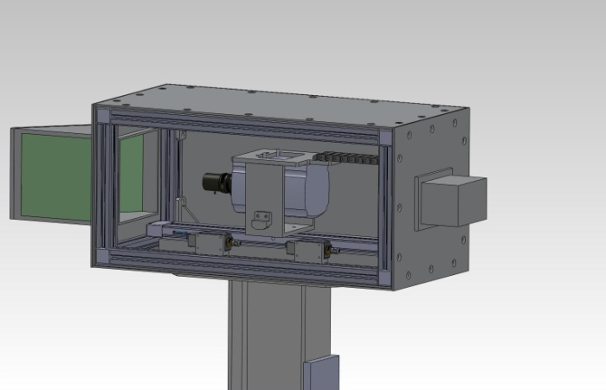
Instrument characteristics
Sample stage
Specs translation:
400mm travel length (xyz)
~ 500kg load
Specs rotation stage 1:
360° rotation stage
resolution of 0.001°
~200kg load
Specs rotation stage 1:
resolution of 0.001°
~20kg load
Detector box
Ikon-l CCD, NEO CMOS camera
Two Zeiss macro lens (50mm and 100mm)
Three beam sizes 200 x 200, 100 x 100 and 50 x 50 mm²
Pixel size 10 – 100 µm
25fps fast imaging under development

Slide 8
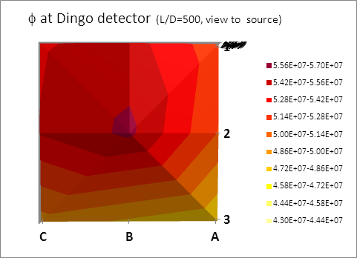
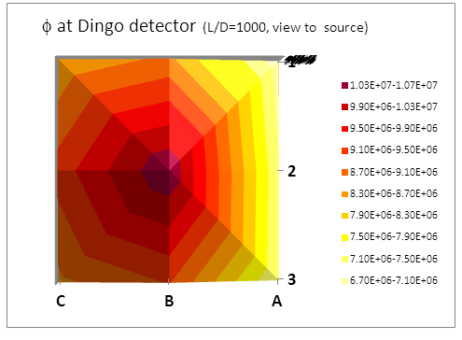
DINGO flux distribution
Resolution (L/D) | Dingo - peak foil [n/s*cm²] | Dingo - foil average [n/s*cm²]
500 | 5.59 * 107 | 5.30 * 107
1000 | 1.06 * 107 | 9.00 * 106
ratio | 5.3 | 5.9

Slide 9
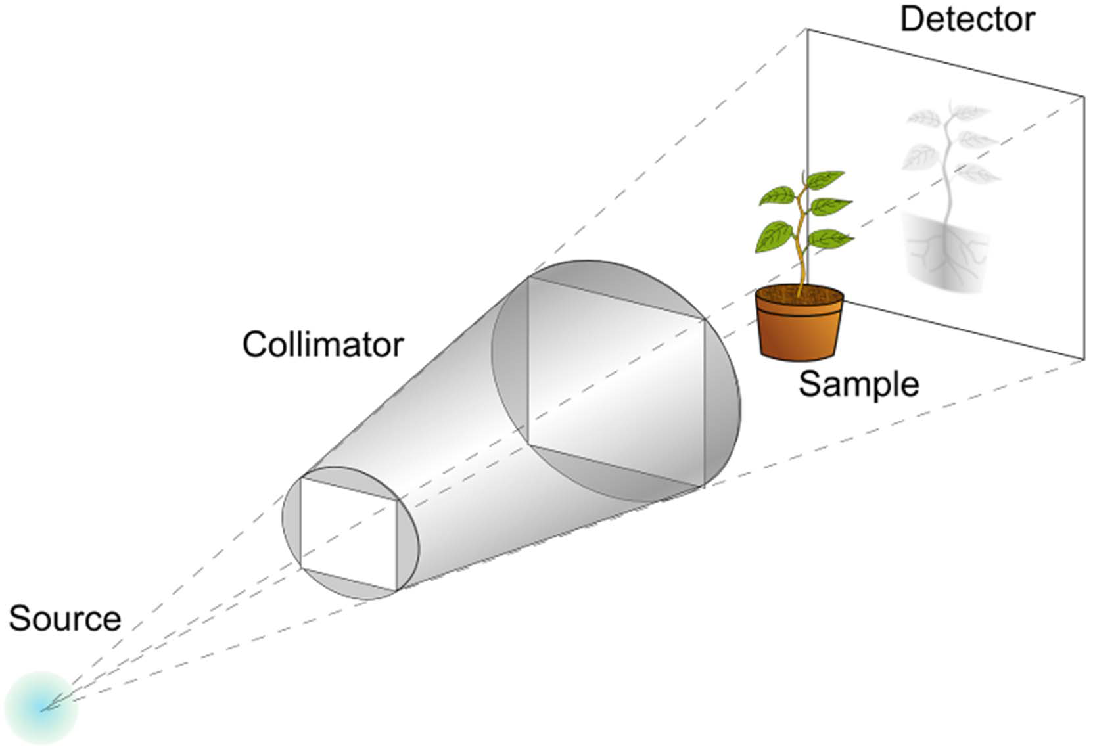
Neutron tomography measurement
[E. Lehmann, PSI]

Slide 10
Attenuation Coefficient (X-rays)
[A. Kaestner, PSI]

Slide 11
Attenuation Coefficient (neutrons)
[A. Kaestner, PSI]

Slide 12
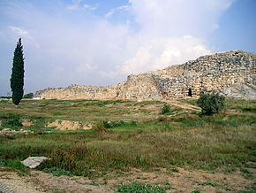
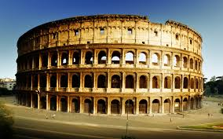
History of Concrete
First concrete experience approx. 2 million years old
1400BC in Greece
Ancient roman infrastructure

Slide 13
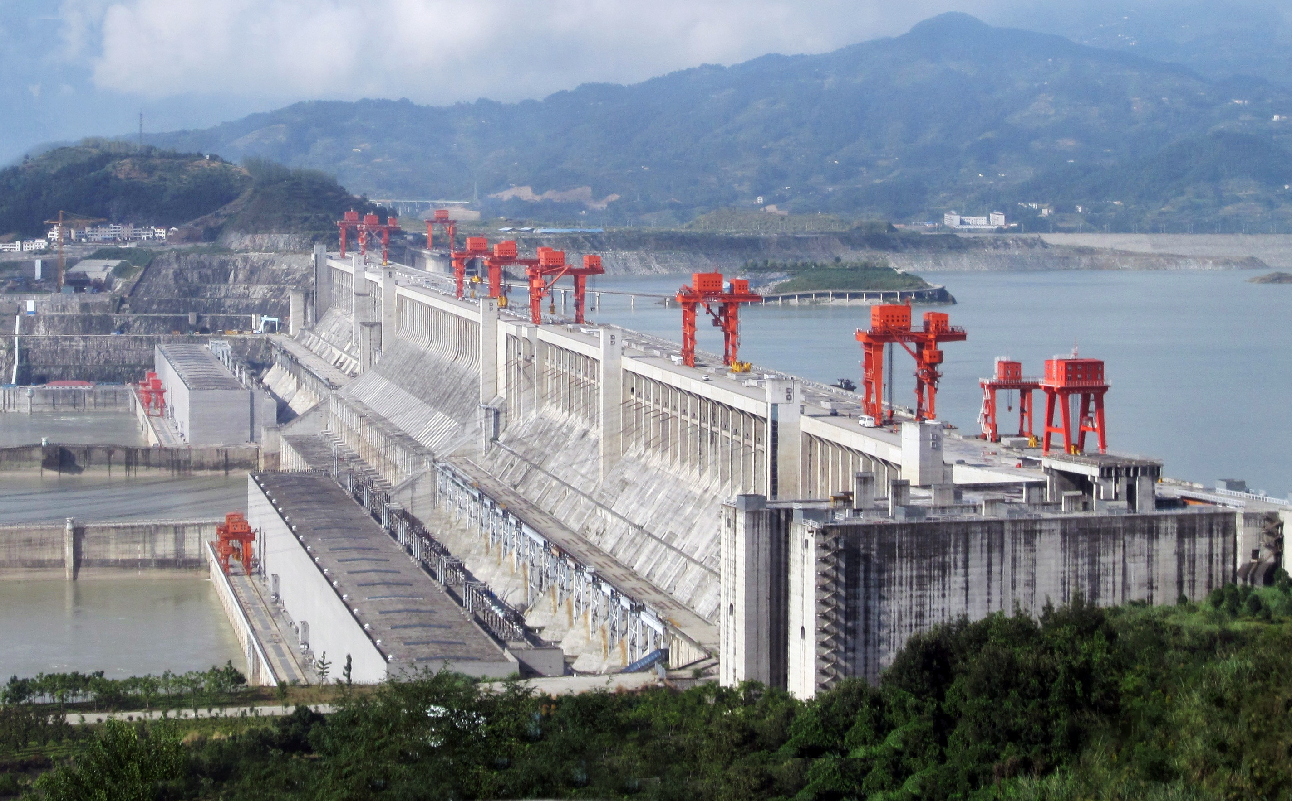
Concrete world record
The world record for the largest concrete pour in a single project is the Three Gorges Dam in Hubei Province, China by the Three Gorges Corporation. The amount of concrete used in the construction of the dam is estimated at 16 million cubic meters over 17 years. The previous record was 12.3 million cubic meters held by Itaipu hydropower station in Brazil.

Slide 14
Economic importance of concrete
Globally consuming 25 gigatonnes/year
annual costs of remediation and premature replacement reaching 3.8% of global GDP
Reinforced Concrete is the most widely used building material, owing to its versatility and relatively low cost
If we make Australian roads last 5 years longer it would pay off for hundreds of OPAL research reactors

Slide 15
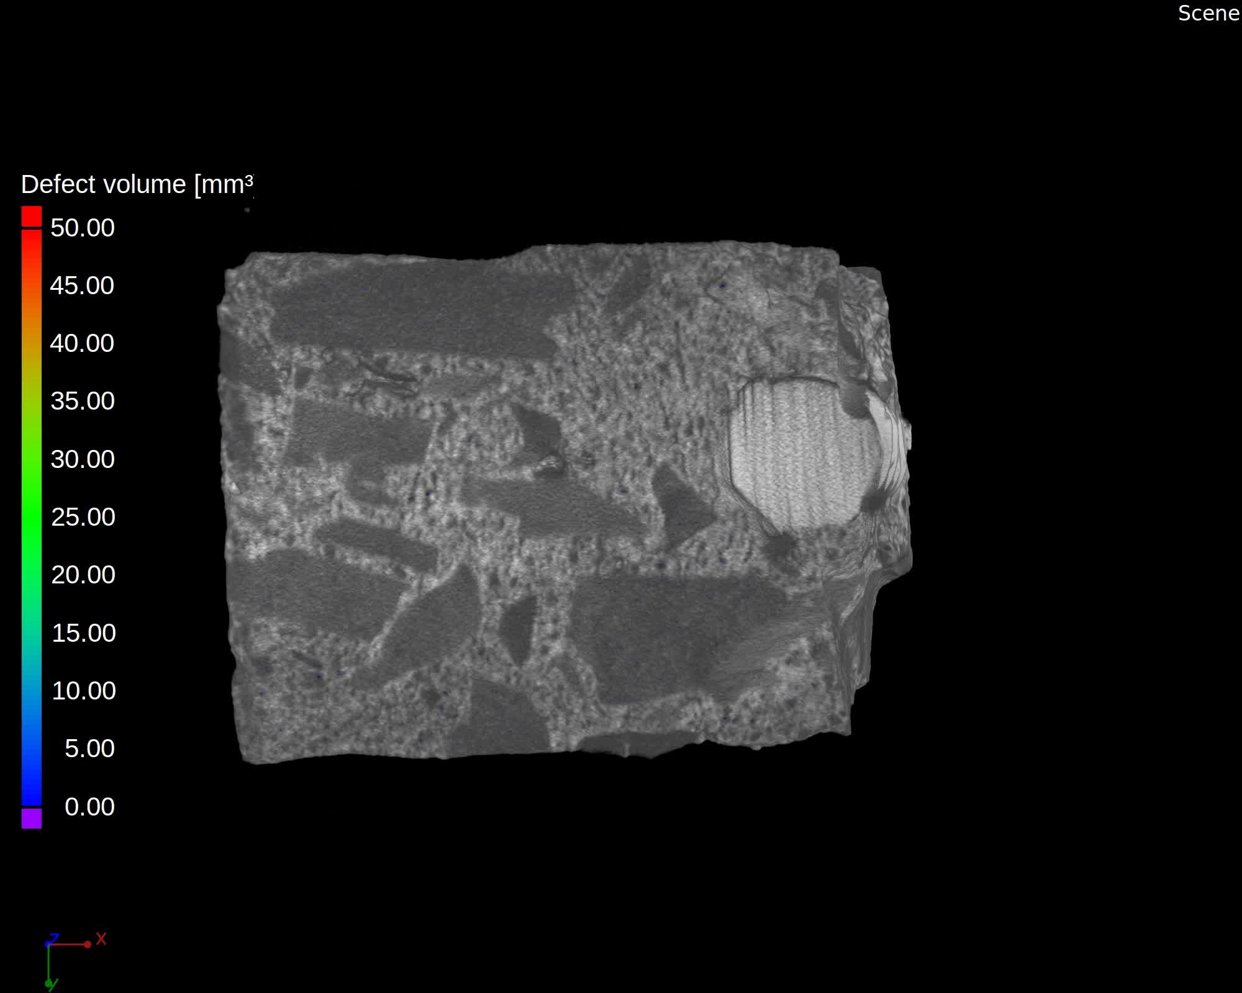
Porosity distribution in concrete sample

Slide 16
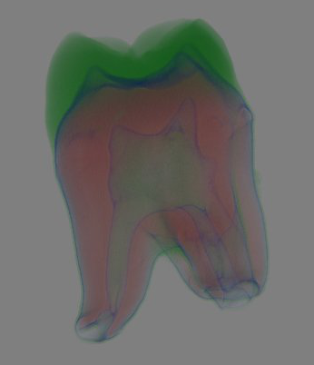
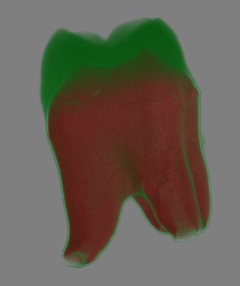
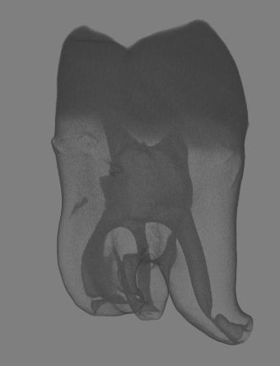


Neutron imaging on ancient teeth
Visualising enamel, apatite,
border in transparent mode
Visualising enamel transparent
and apatite solid
Visualising root canal in
transparent grey
In collaboration with
International Centre for Theoretical Physics in Trieste (Italy)

Slide 17
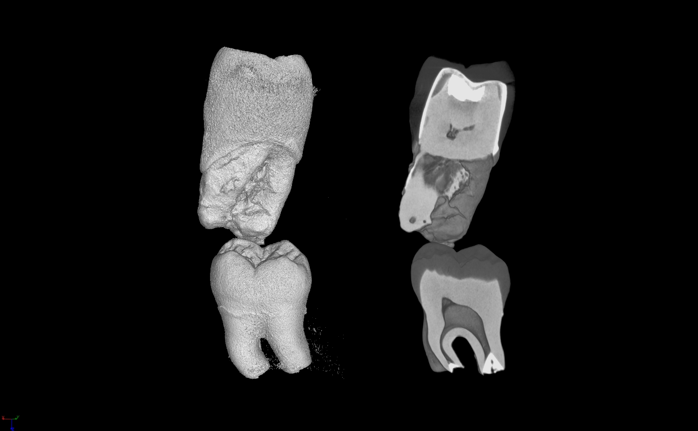
Treated and Untreated Tooth

Slide 18
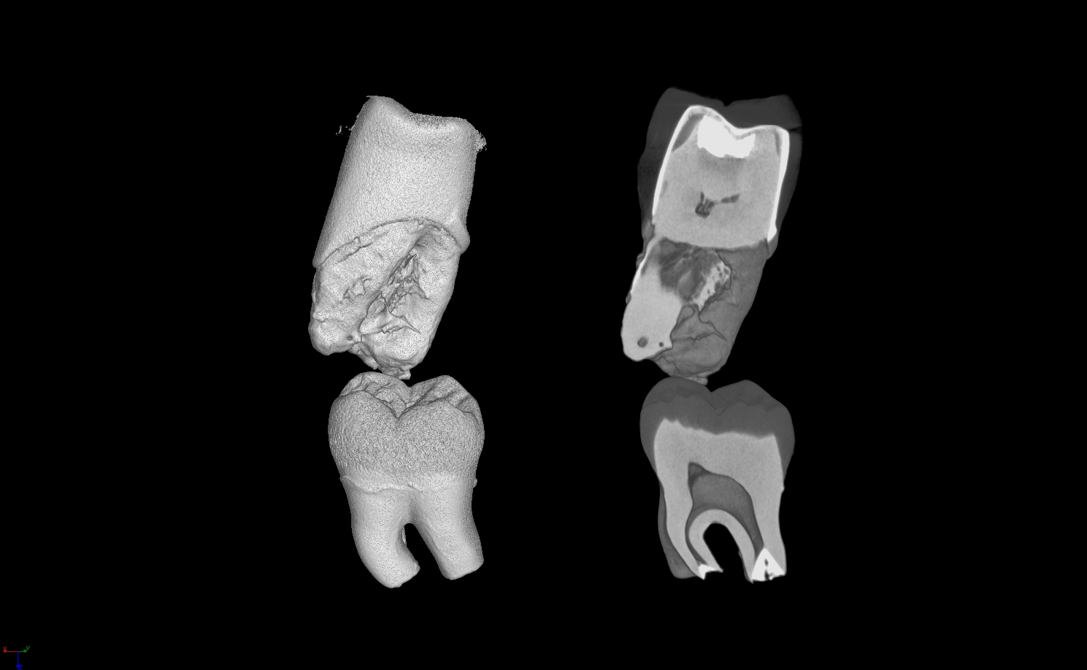
Ceramic on left side removed

Slide 19
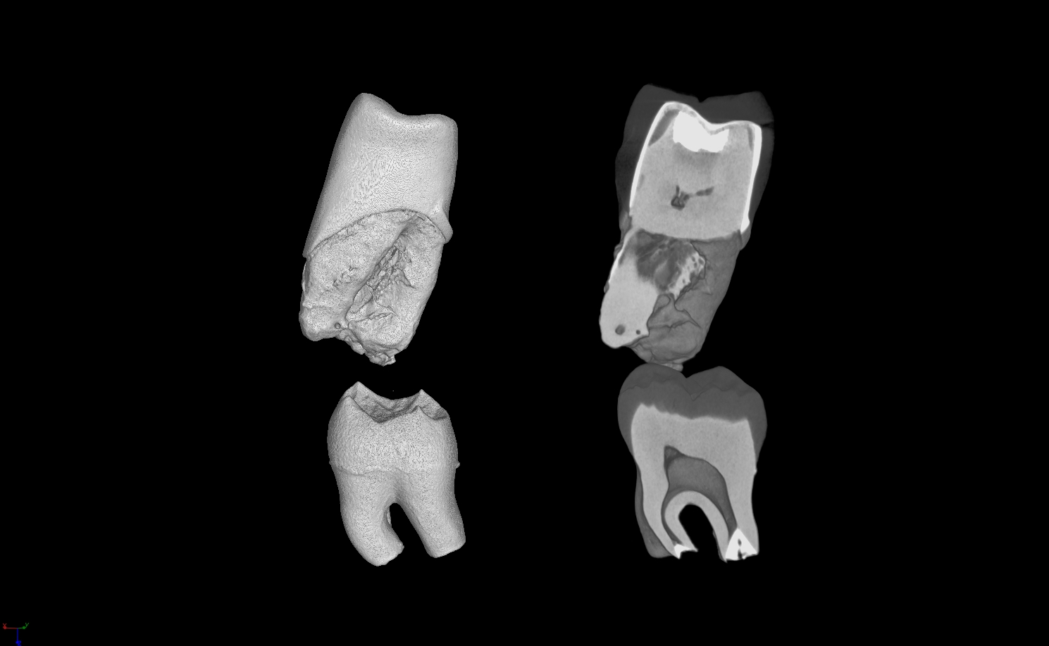
Enamel on left side removed

Slide 20
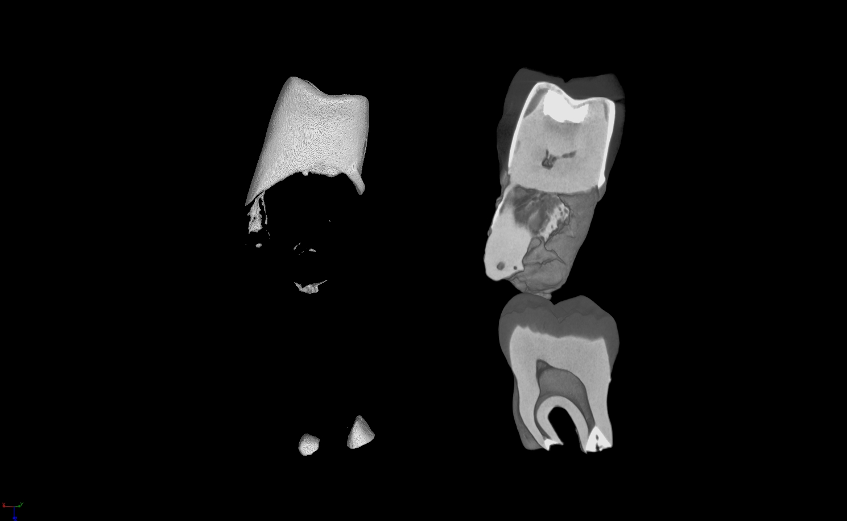
Dentin on left side removed

Slide 21
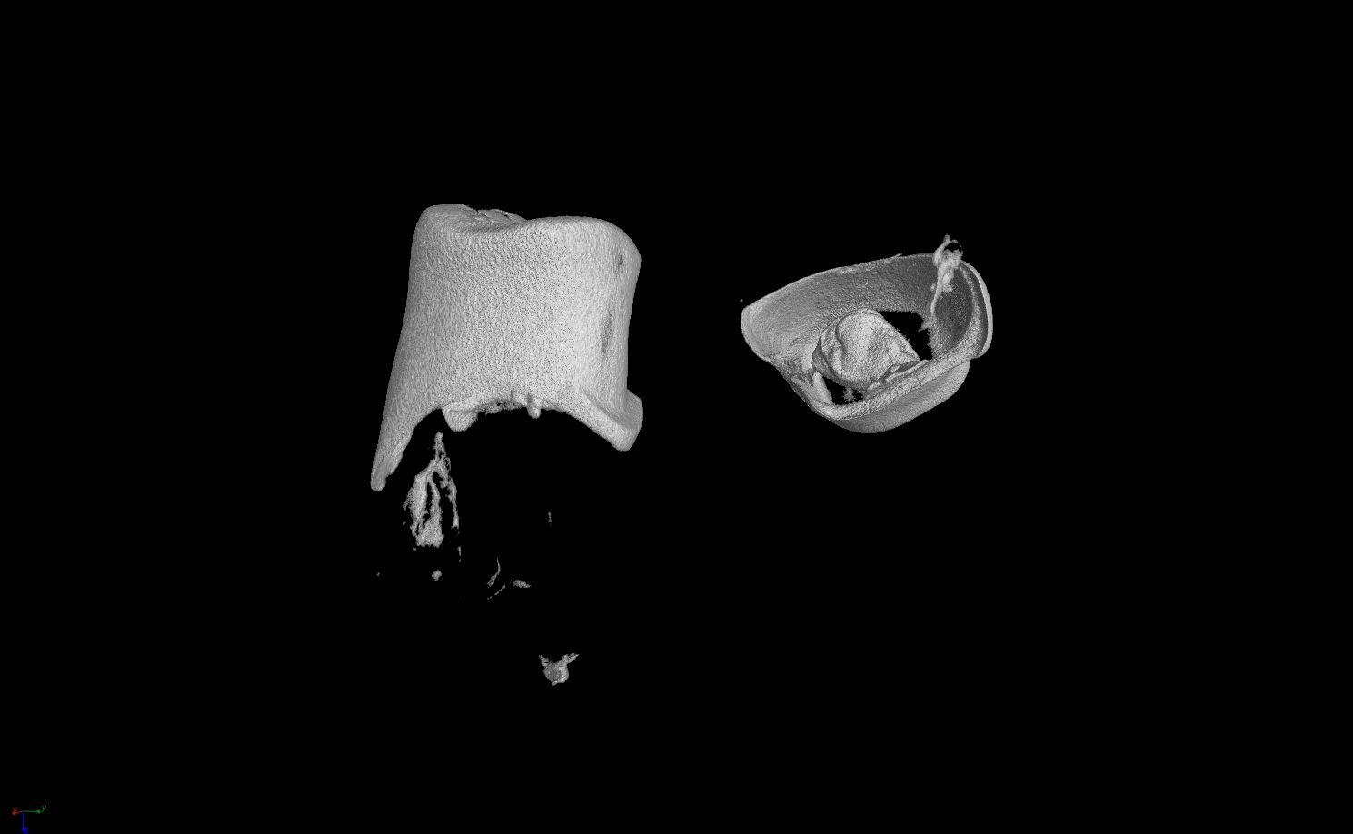
Metal and filler material of upper tooth only

Slide 22
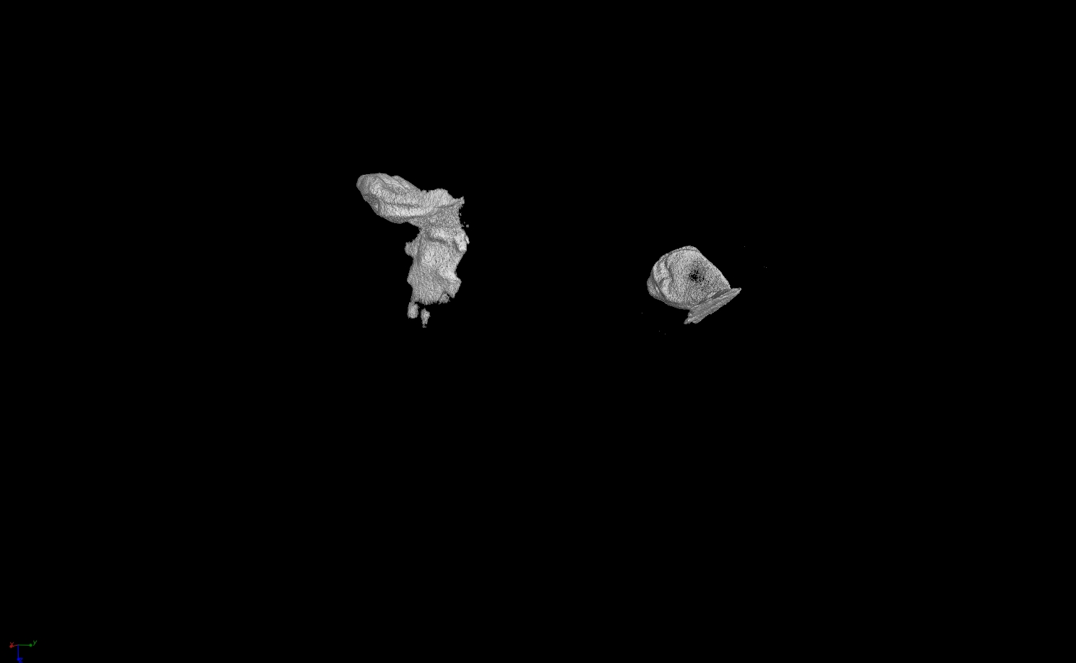
Filler material of upper tooth only

Slide 23
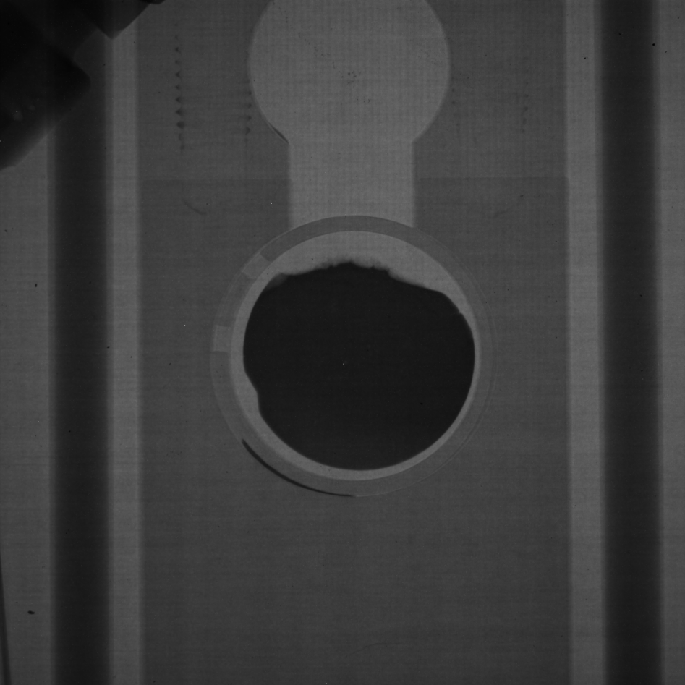
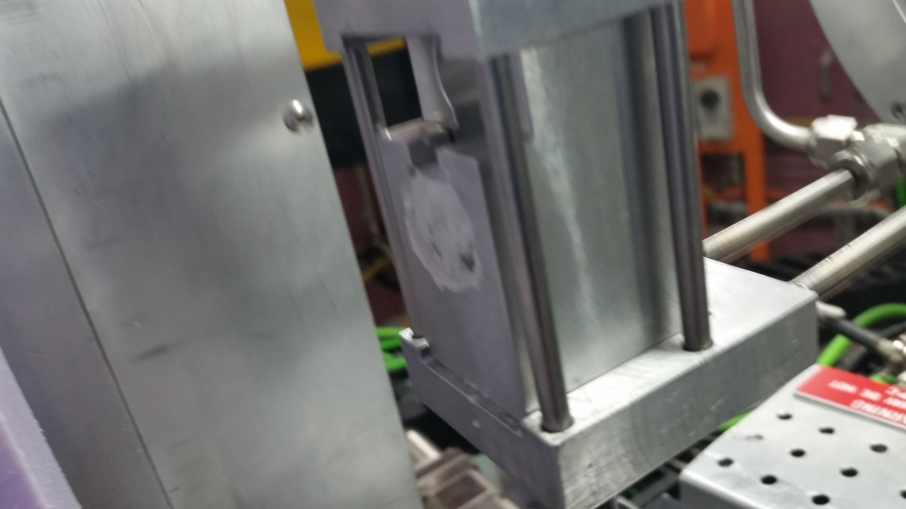
Dingo radiography – “Woods metal”
Wt%
Bi – 42.5
Pb – 37.7
Sn – 11.3
Cd – 8.5
Non-eutectic
Solidification Processing – 25-28 July 2017, SP17

Slide 24
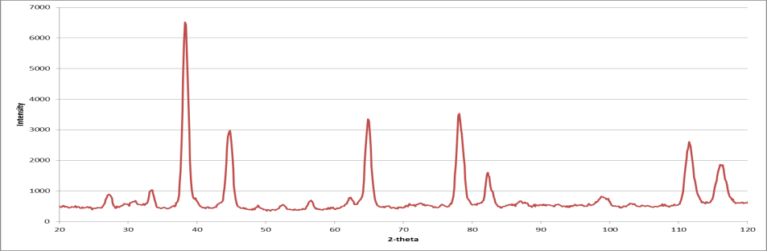
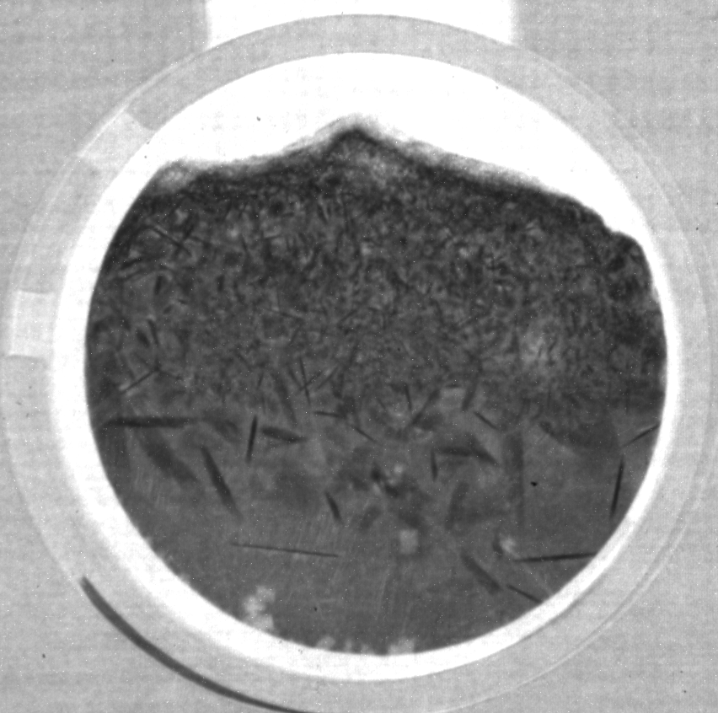
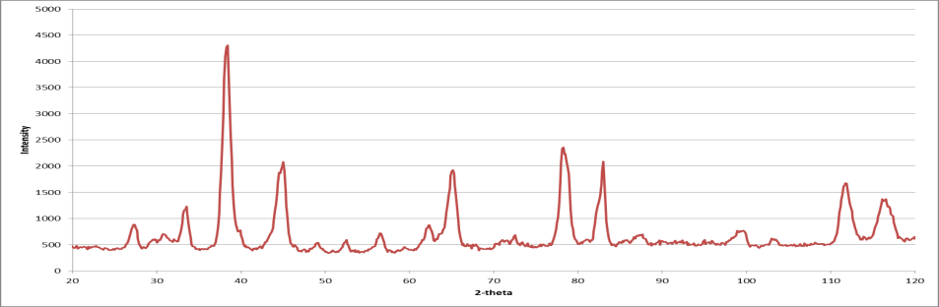
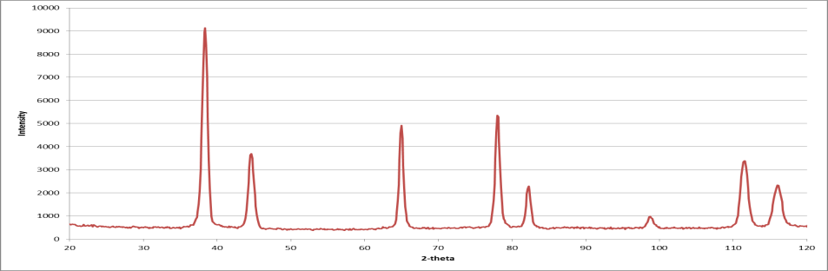
Dingo radiography – “Woods metal”
0.1C/min
Solidification Processing – 25-28 July 2017, SP17

Slide 25
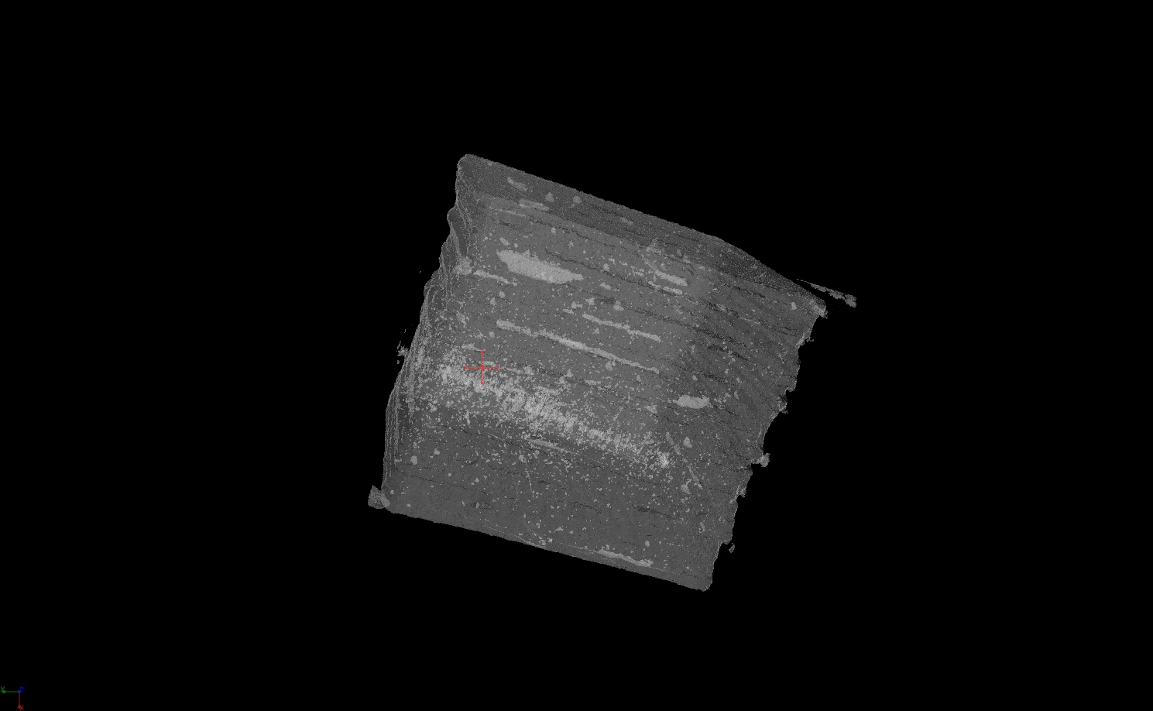
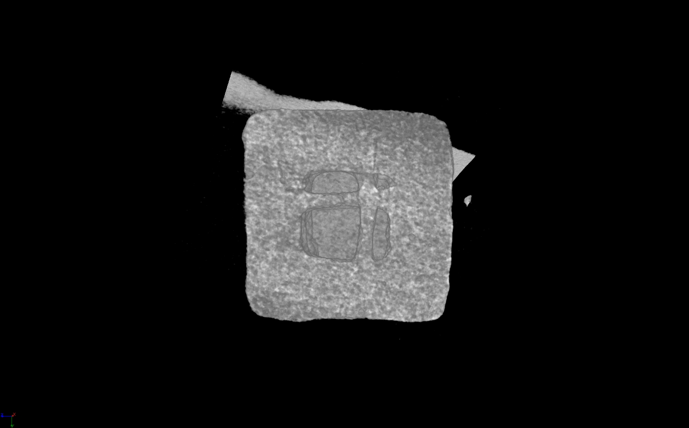
First results of 14μm pixel size tomography
Setup:
10μm Gadox screen with IKON-L CCD
ZEISS macro lens with Kenko adapter
Transparent setting to visualize internal defects
Cut through reconstructed sample
Peng, E et al, RSC Adv. 7(43), 27128-27138 (2017)

Slide 26

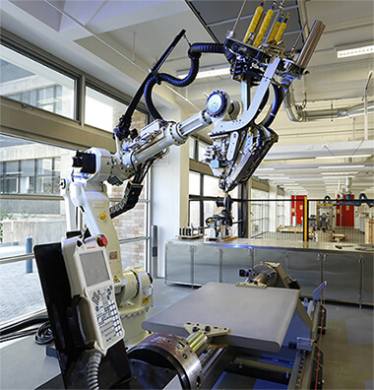
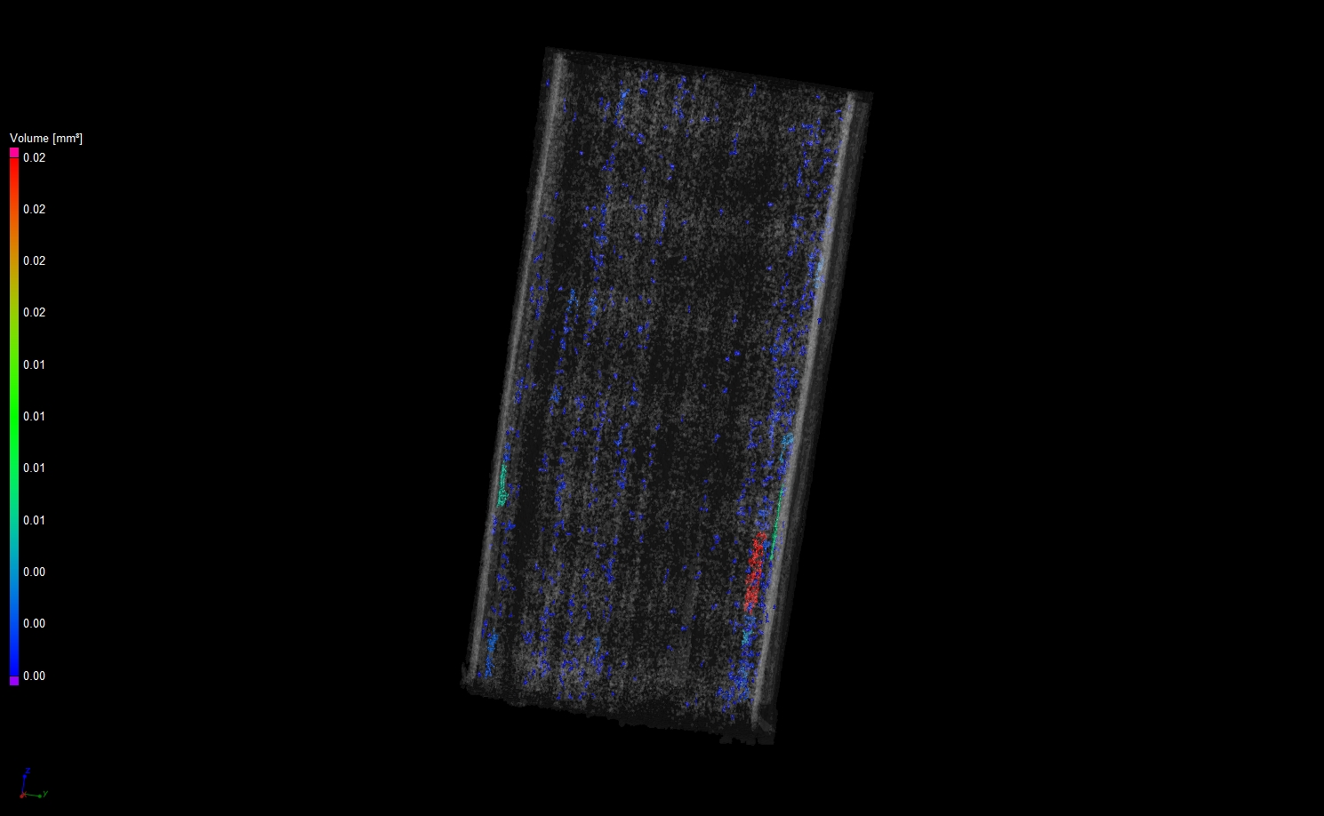
Composite Manufacturing Robot

Slide 27
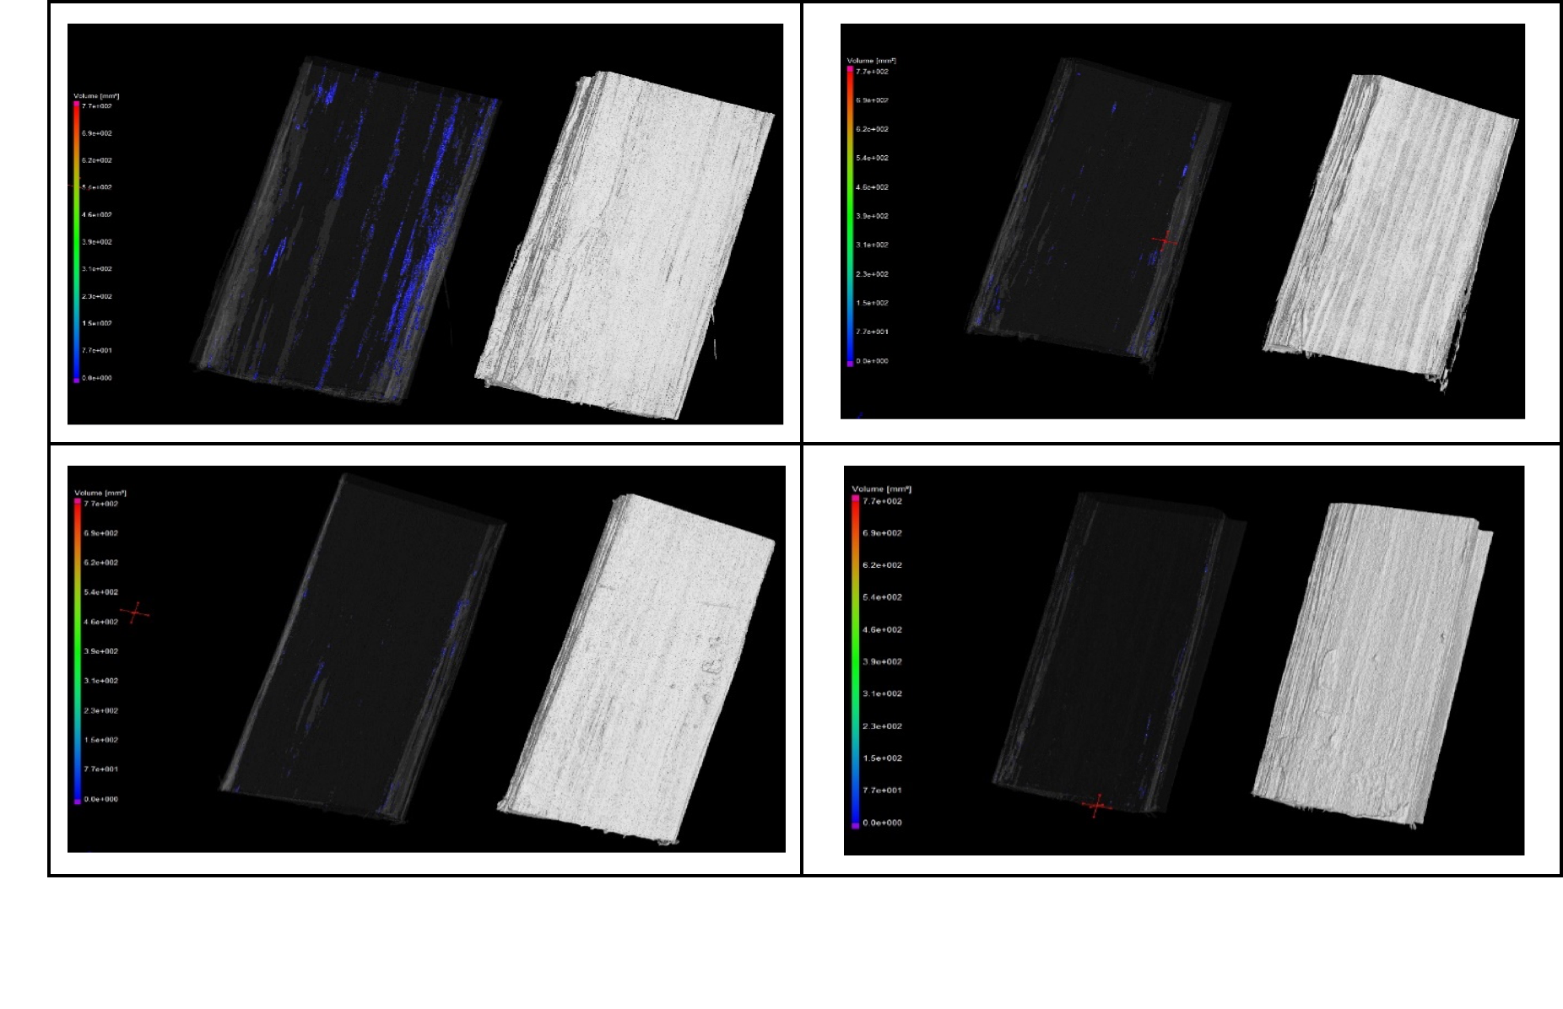
Porosity analysis after CT reconstruction

Slide 28
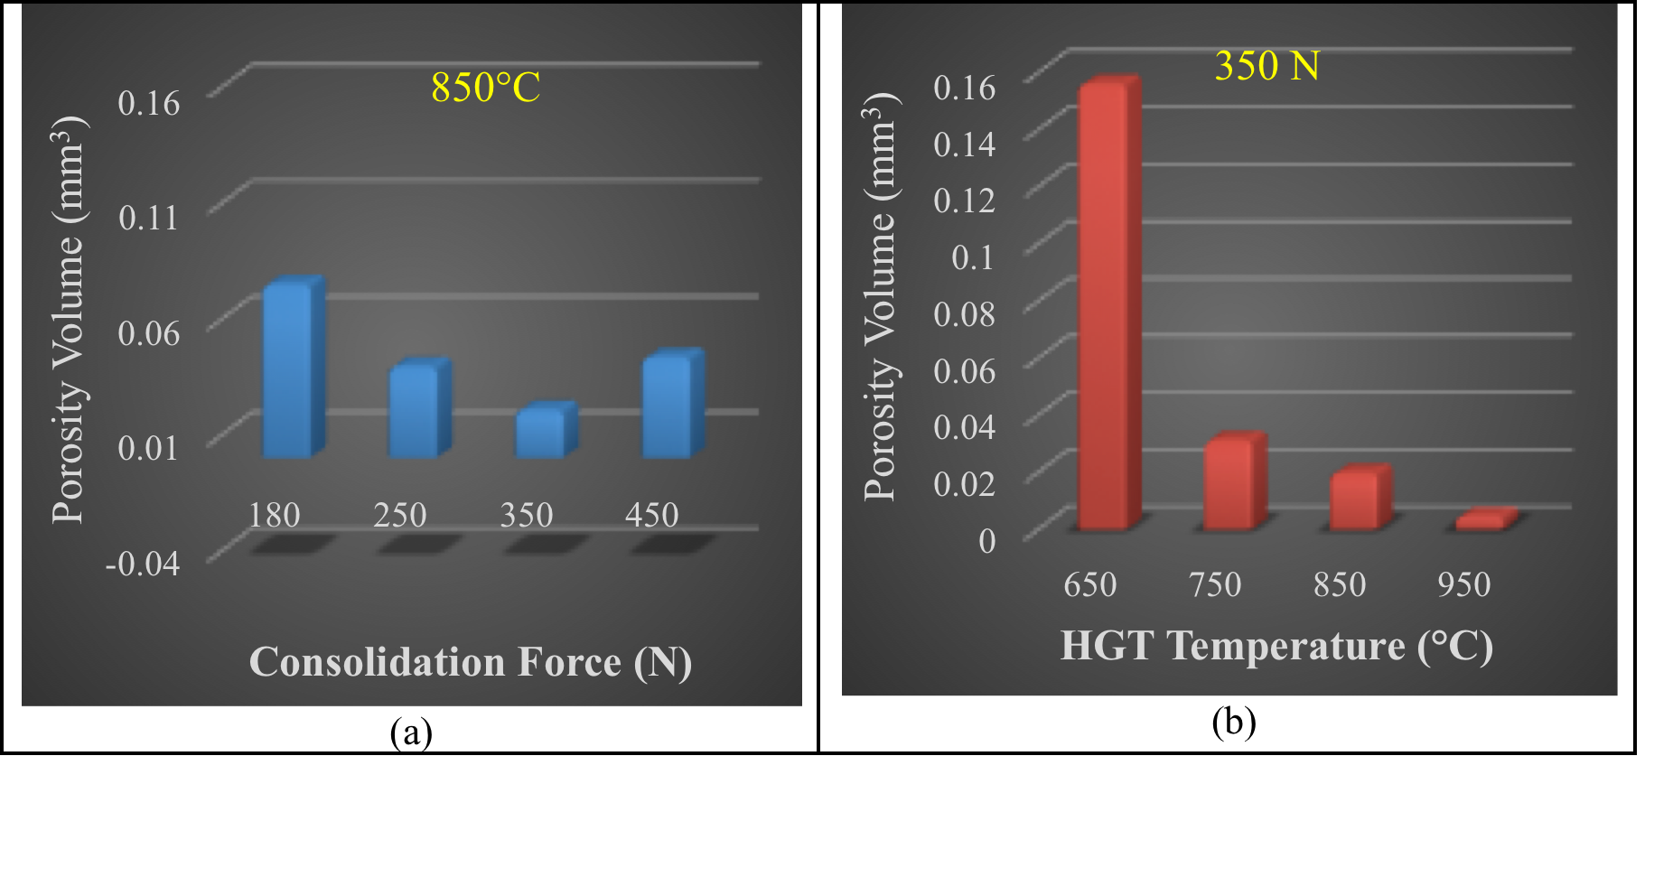
Comparison of total volume of porosity

Slide 29
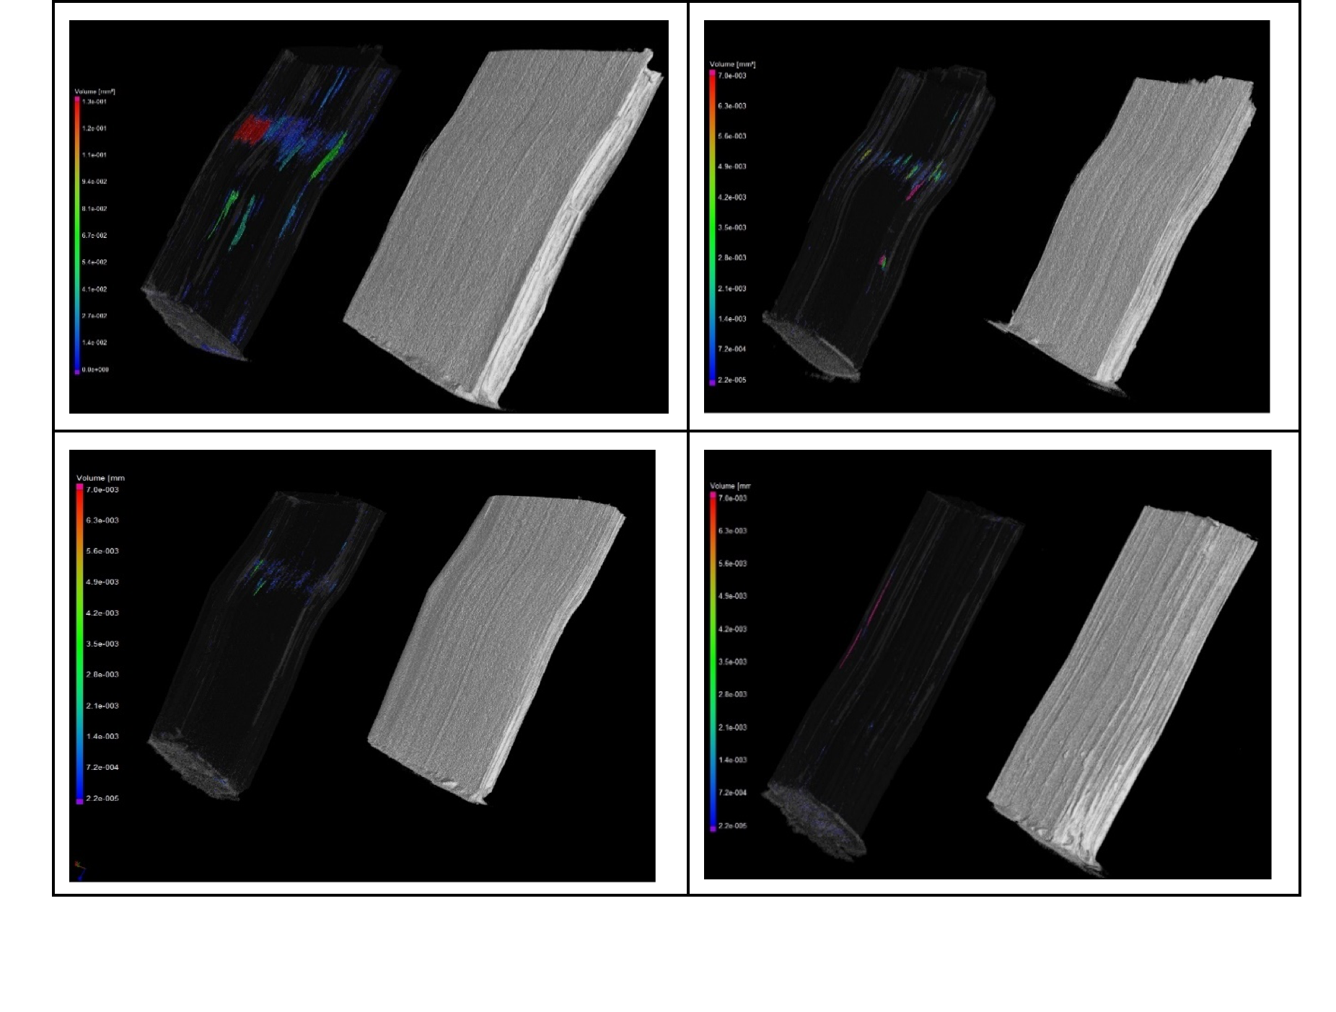
Void development after deformation

Slide 30
Comparison of porosity level between the undeformed and deformed samples

Slide 31
DINGO upgrade with PSI neutron microscope

Slide 32
New scintillation screen to deliver 2.5μm pixel size
Isotope enriched 157Gd2O2S:Tb
Porous Si-membrane
Thinner screen increase light output
First results with 2.5μm pixel size lead to 5μm optical resolution

Slide 33
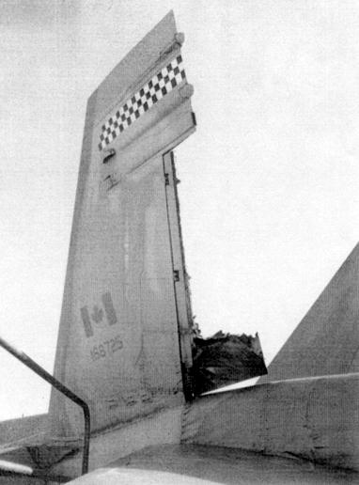
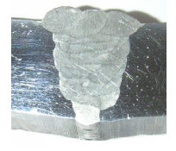
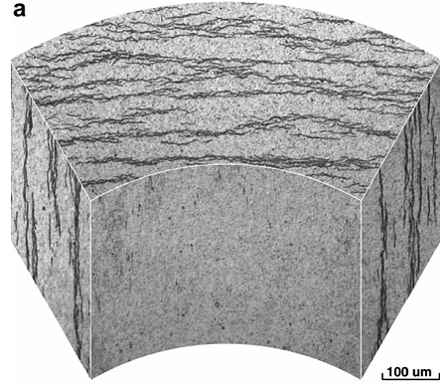
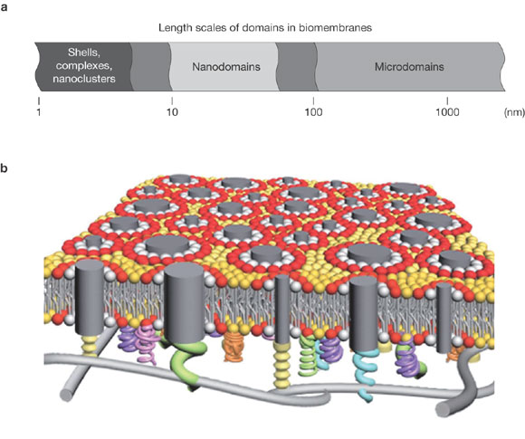
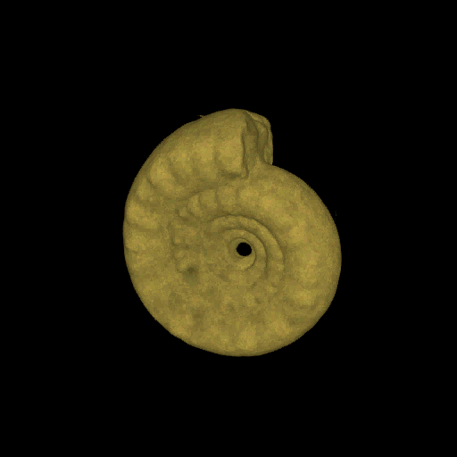
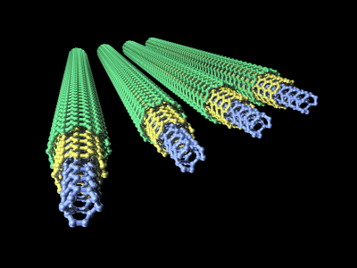
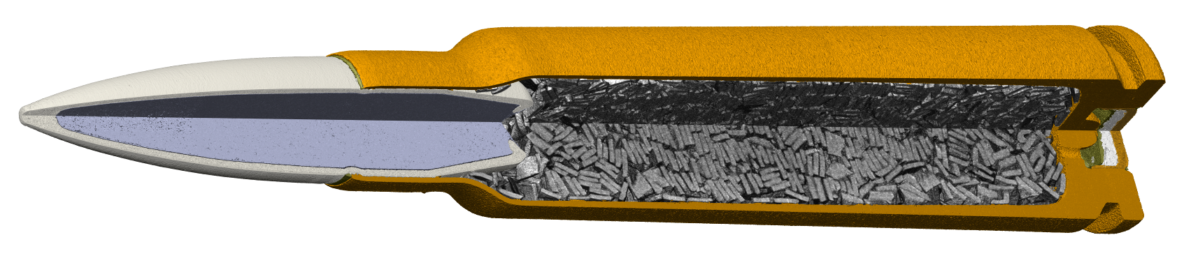
Neutron Microscope
Magnetic imaging
In-situ imaging under extreme conditions
Light element imaging
Bragg edge scanning
Standard neutron imaging
Neutron microscope
Aircraft parts
Nanotubes
Ammonites
Welds
Zr-hydride
Bio-membranes
Cartriges
1m
Resolution
1µm
1nm

Slide 34
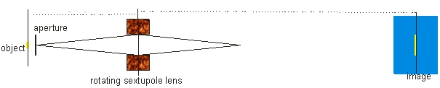
Instrument layout
3-4m
70-150m
Magnification of ~ 20-50

Slide 35
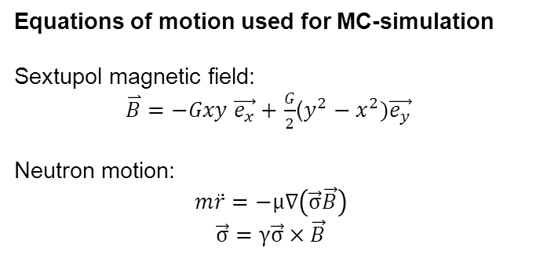
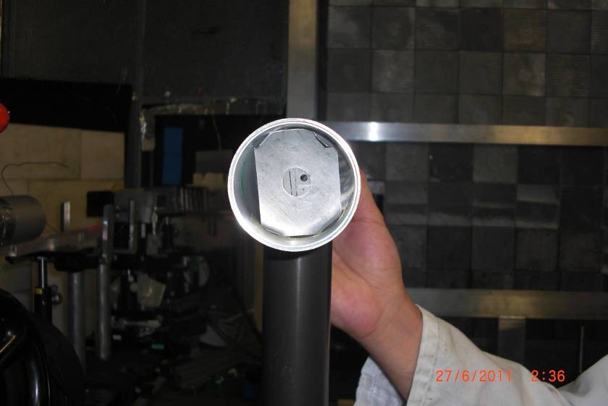
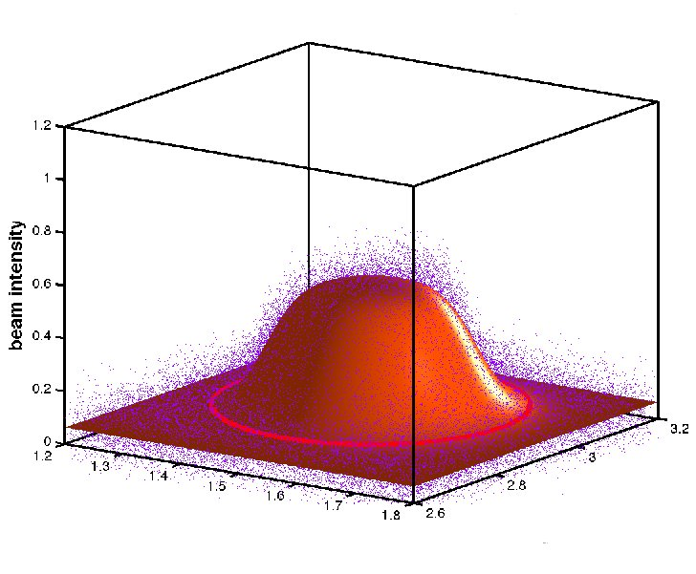





First results
First experiment using VCN SANS setup:
Cd plate with 3 apertures
(being f = 1 mm, f = 2 mm circles and a 0.5 mm wide slit)
Magnification factor 1
Simulated image with high and inhomogeneous neutron beam divergence (VCN)
Simulated image with low and homogeneous neutron beam divergence
Magnification factor 5

Slide 36
Neutron microscope summary
Sextupole lens works as magnifier
Magnification factor 5 proven by experiment
New instrument with 70 – 100 m length on cold source could achieve magnification of 50
100-50nm resolution depends on detector
Potential resolution of 0.2 - 0.5nm limited by the wavelength of cold neutrons

Slide 37

Summary
Thank you!
Please contact us : ulf.garbe@ansto.gov.au

Slide 38

World Conference on Neutron Radiography (WCNR-11)
02-07 September 2018
Maritime Museum Sydney, Australia
Notes:
ANSTO and Sydney looks forward to the Board’s decision so we can make the 2018 meeting a truly memorable and highly successful event which will create a long-lasting legacy for ISNR.

