Slide 1

Diamond-Edge Gaskets for the Ultrahigh Vacuum Systems
Gao-Yu Hsiung
National Synchrotron Radiation Research Center (NSRRC), Hsinchu, Taiwan
E-mail: hsiung@nsrrc.org.tw

Slide 2
Outline
Introduction
Concepts: Diamond-Edge Gasket
Experimental Test
Conclusions

Slide 3
Ultrahigh Vacuum (UHV) System
10⁻¹⁵
10⁻¹²
10⁻⁹
10⁻⁶
10⁻³
1
1013
(mbar)
10⁻¹³
10⁻¹⁰
10⁻⁷
10⁻⁴
0.1
100
101325
(Pa)
UHV
Pressure: P < 1×10⁻⁷ Pa (~ 1×10⁻⁹ mbar)
Leak Rate: Q_{L} < 1×10⁻¹⁰ Pa∙m³/s (~ 1×10⁻⁹ mbar∙l³/s)
All Metal Materials (typically)
Thermal Outgassing Rate after Baking:
q < 1×10⁻⁹ Pa∙m³/(s∙m²) (~1×10⁻¹² mbar∙l/(s∙cm²))
(~ 3.3×10⁷ Molecules/(s∙cm²) )

Slide 4

National Synchrotron Radiation Research Center, Hsinchu, Taiwan
TLS (1.5 GeV, 360 mA) 1993 ~
Administration
& Operation
Administration Offices
User Office
Control room
Guest Hose I
Activity Center
Guest House II
Conference Rooms
Cafeteria
Parking
TPS (3 GeV, 400 mA) 2015 ~
Main Gate

Slide 5
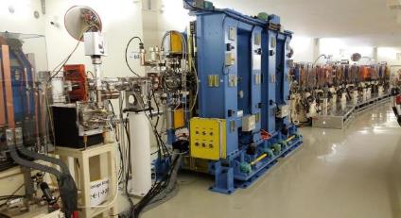
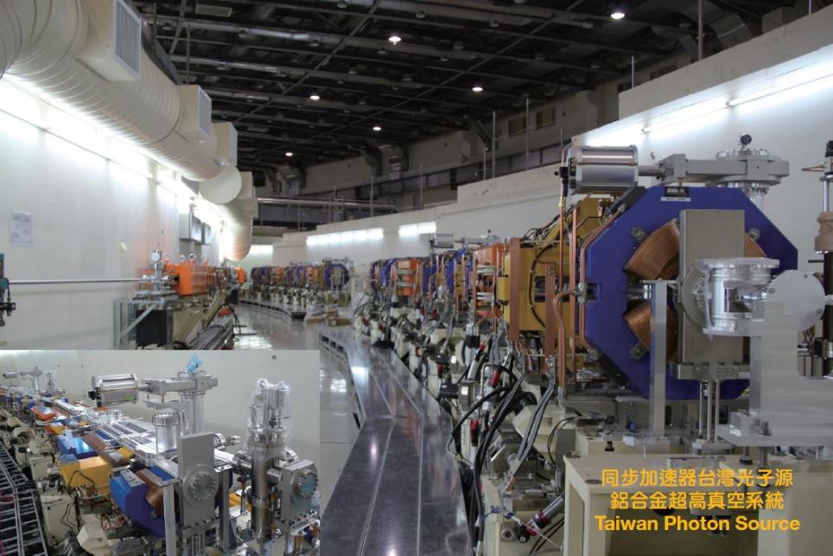
Taiwan Photon Source (TPS)
3 GeV, 500 mA, 1.6 nm∙rad

Slide 6
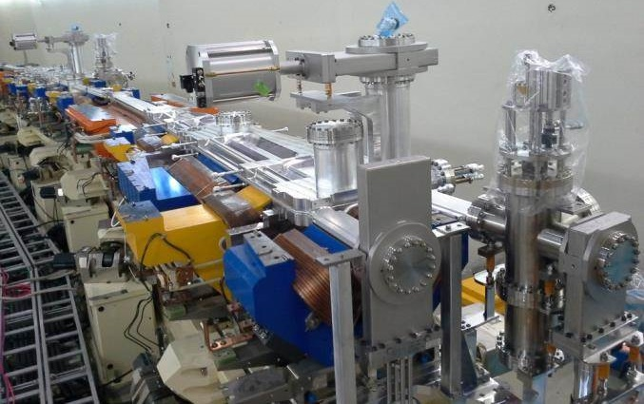
4m-long Aluminum Bending Chamber
4m Aluminum Bending Chamber
Synchrotron Light
Electron Beam

Slide 7
Ultrahigh Vacuum Systems for the Accelerator Light Sources
Extremely low density of the residual gas molecules in the beam ducts: to mitigate the beam loss from nuclear scattering, ion trapping instability. (Ultrahigh Vacuum)
Beam Duct
e – beam (bunch)
Residual Gas Molecules
Beam Loss
(Gas-Scattering)
Ion Trapping Instabilities
(Ions from Residual Gases)
Bremsstrahlung Radiation
(Inelastic Gas-Scattering)

Slide 8
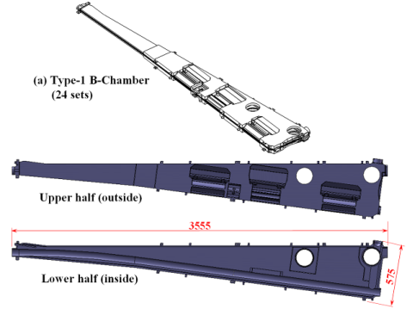
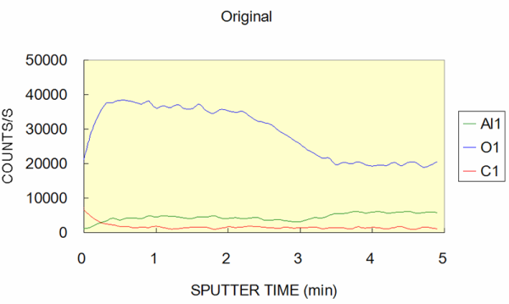
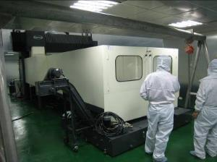
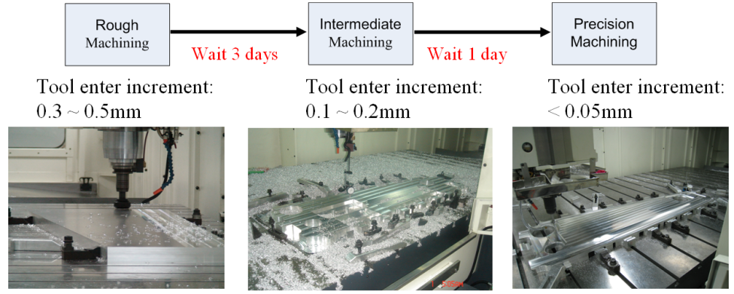
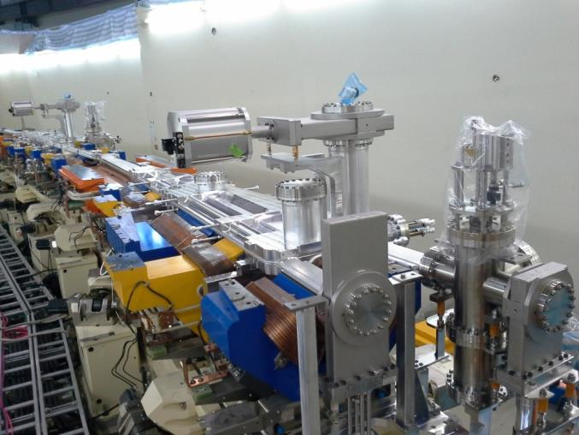
Low-carbon clean surface after Ethanol CNC machining for the TPS Bending Chambers
Oil-Free CNC Machining for the TPS B-chambers (~ 4 m) in Clean Room
< Class 10,000 @0.1μm
Ethanol CNC machining
O
Al
C
Low Carbon
TPS Aluminum B-chamber
Experience from the TPS
CNC Machining Processes (sprayed with pure alcohol)

Slide 9
Thermal Outgassing Rate (Aluminum) q (Ethanol) ~ 1.4×10⁻¹⁴ Torr·l/(s·cm²)
(a)
(b)
♦♦♦ (a) O₃ Water Cleaning
---- (b) Ethanol CNC Machining
xxx (c) Chemical Cleaning
(c)
After Baking :
(c) Chemical cleaning
q₇₂ = 9.5×10⁻¹⁴ Torr·L/s·cm²
(b) Ethanol CNC Machining
q₇₂ = 1.4×10⁻¹⁴ Torr·L/s·cm²
TPS Result
(a) O₃ Water Cleaning
q₇₂ = 4.8×10⁻¹⁵ Torr·L/s·cm²

Slide 10
Smooth Beam Ducts for the Accelerator Light Sources
Very smooth cross section of the beam ducts: to avoid the interaction of the wake field excited via the non-smooth structure such as the steps or the gaps. (Low Impedance)
No Steps
No Gaps
e – beam (bunch)
Beam Duct

Slide 11
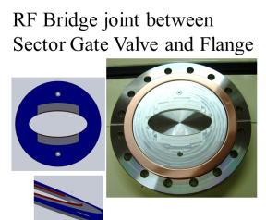
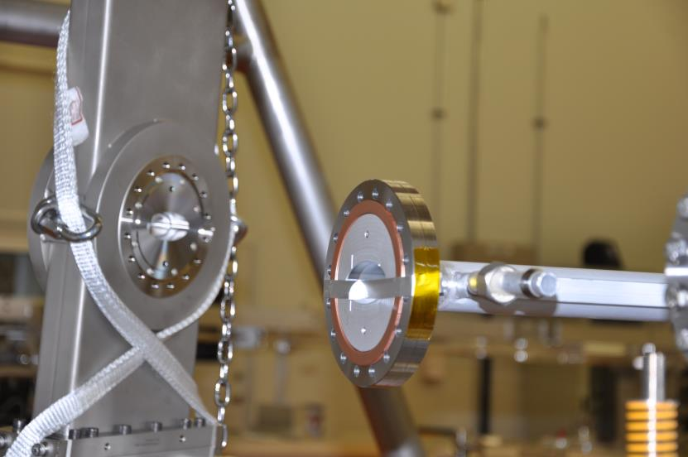
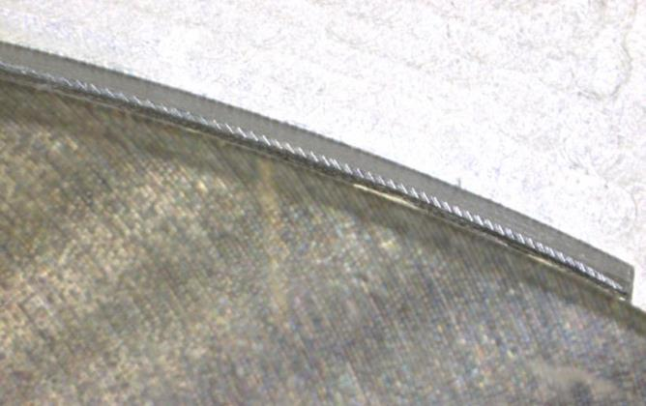
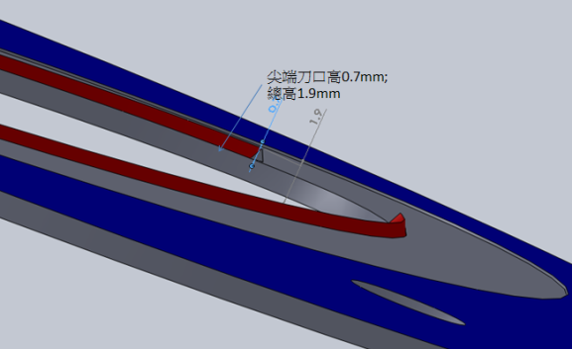
RF-Bridge Aluminum plates between Flanges to mitigate the impedance
Knife Edge (contact bridge)

Slide 12
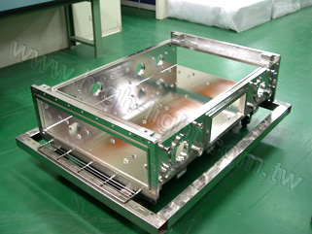
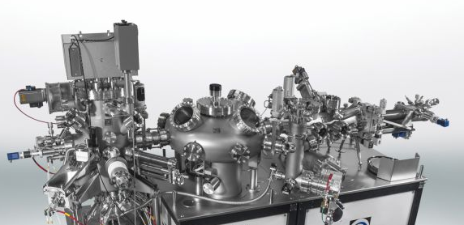
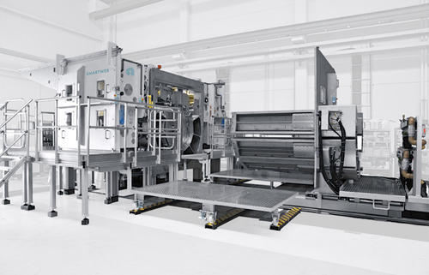
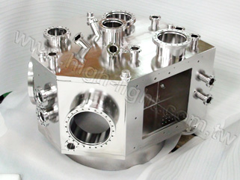

Markets (Aluminum UHV Systems)
Future Accelerator Light Sources (Ultra-low emittance)
  beam ducts with small apertures (I. D. < 20 mm)
Large Flat Panel Displays and Solar Cell Panels
  4 m long large processing chambers
  Rectangular valves & flanges
Research & Processing UHV chambers
  MBE, STM, surface analysis, etc.

Slide 13
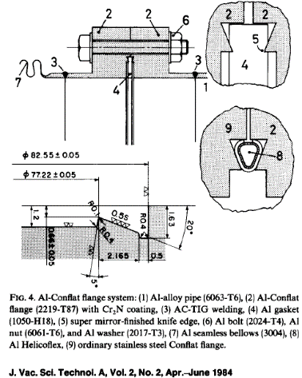
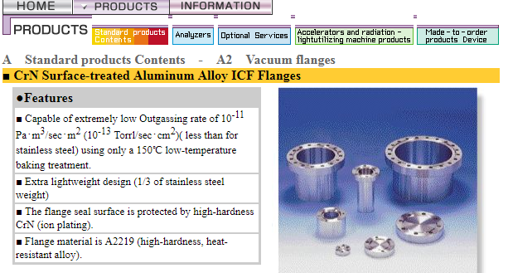
Aluminum Conflat Flanges (Currently)
Mirror Finishing on the surface of the Knife-edge
Hard-coating (CrN, TiN, TiC) on the surface
Drawbacks：
Higher cost
Difficult for repairing
Single supplier

Slide 14
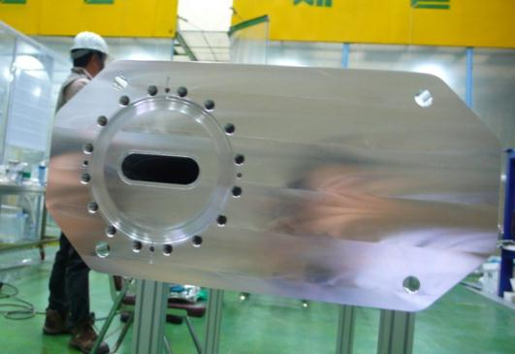
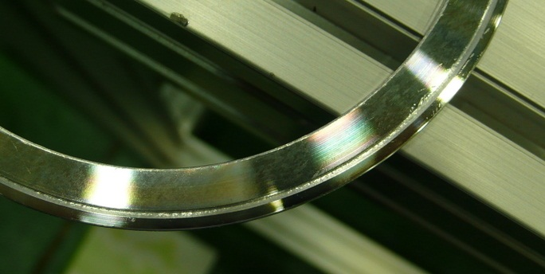
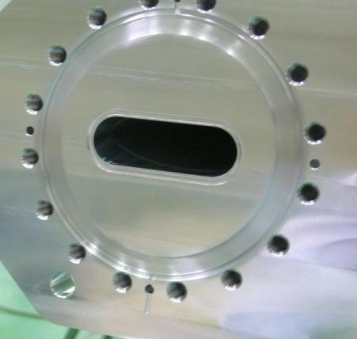
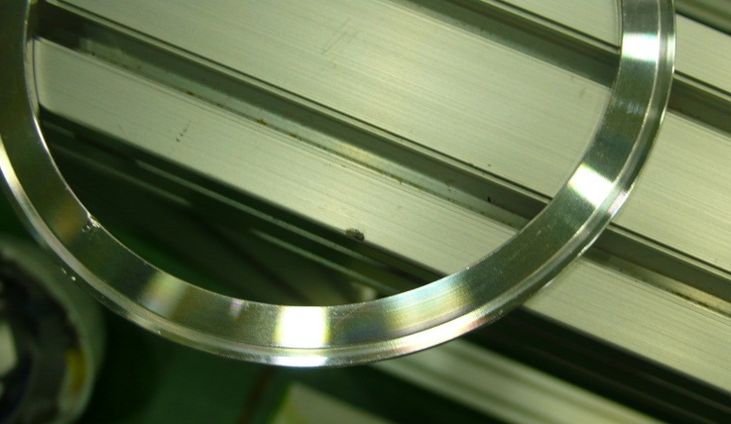
Leakage on the machined aluminum flange
Porous cracks found on the edge-sealing part
Knife edge is difficult to machine
Smooth edge-sealing on Back-side of gasket
Non-smooth surface

Slide 15
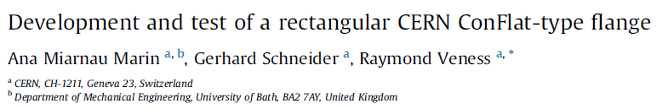
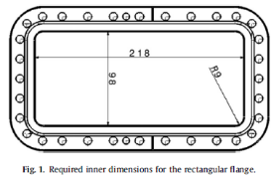
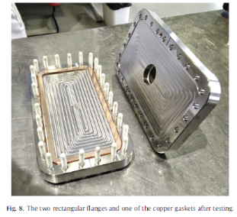
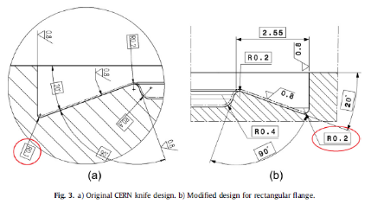
Rectangular Flanges for high-radiation zone (No O-ring seals!)
Drawbacks：
Multi-stages of CNC machining process
Difficult for repairing

Slide 16
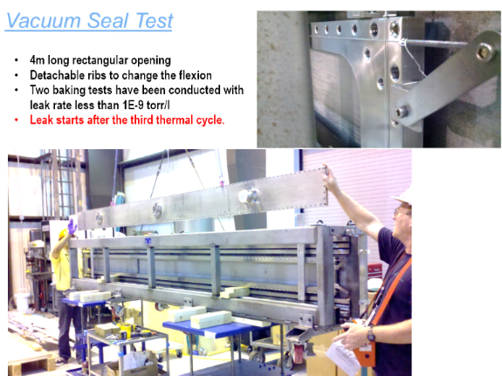
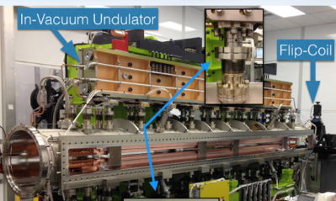
Metal-wire sealing for large flanges
Drawbacks：
Risk of leakage
Difficult for repairing

Slide 17
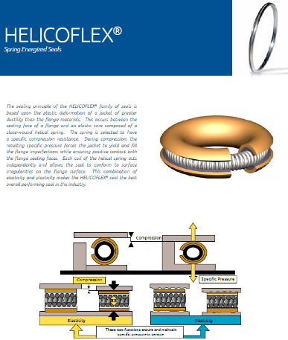
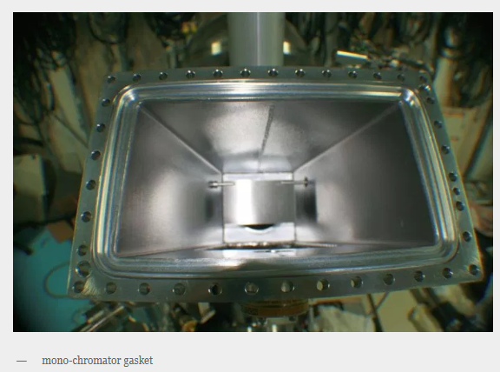
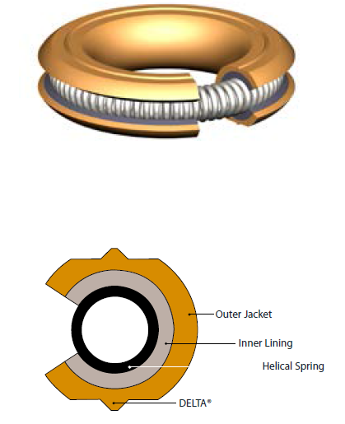
Helicoflex metal gaskets
Drawbacks：
Higher cost
Difficult for repairing
Single supplier
Higher sealing-torques (may damage the aluminum surface)
Delta-type for UHV

Slide 18
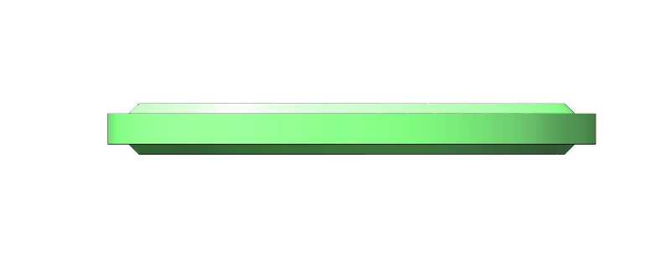
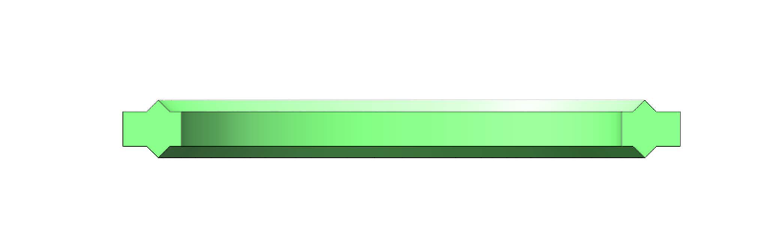
Concept: Diamond Edge (DE-) Gasket
Diamond (Shape) Edge Gasket

Slide 19
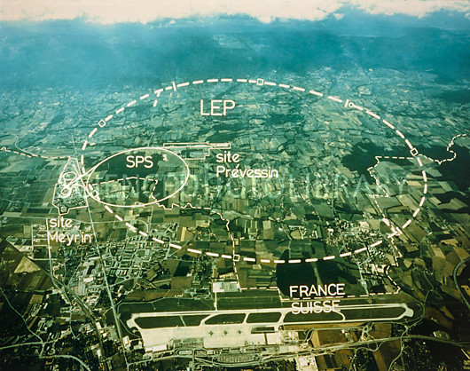
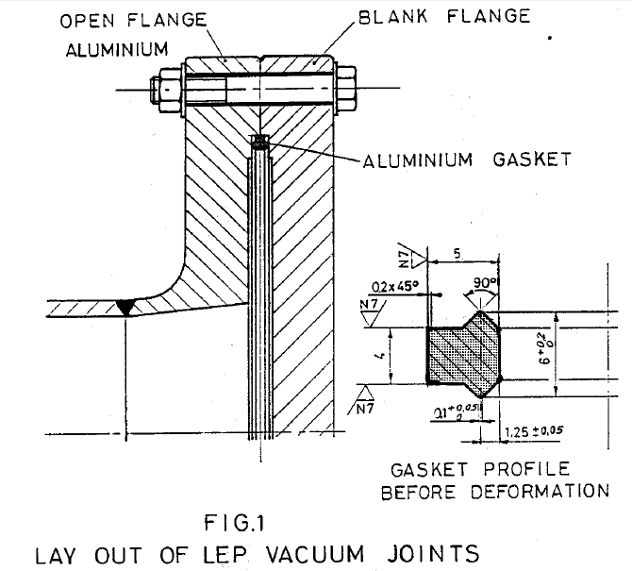
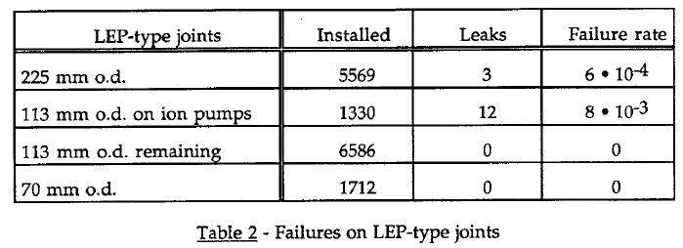
LEP-type joints (Aluminum Flange)
CERN LEP (July 1989 ~ Nov. 2000)
- Large Electron-Positron Collider
√
*Courtesy: W. Unterlerchner, CERN/LEP-VA/89-50

Slide 20
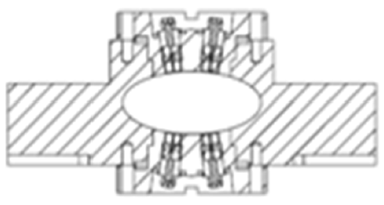
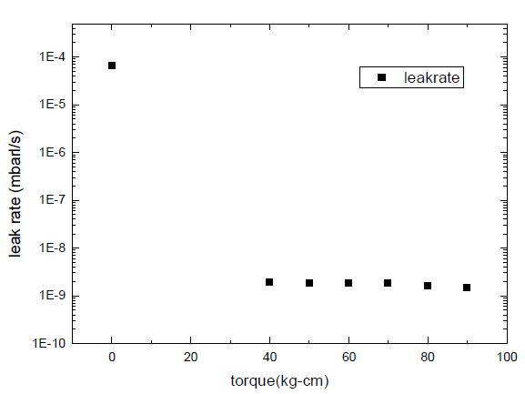
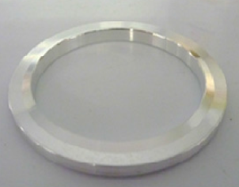
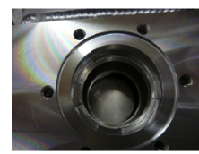
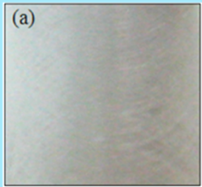
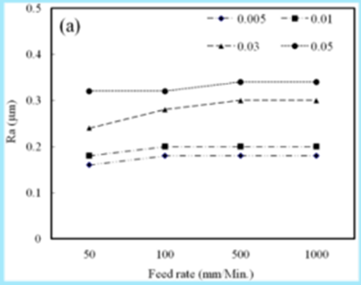
DE-Gaskets for TPS BPM Flanges
(> 340 flanges sealing)
Torque > 40 kg∙cm
(Leak-tight)
Ra < 0.4 μm
*Courtesy: I. T. Huang, Proc. IPAC2012, WEPPD023

Slide 21
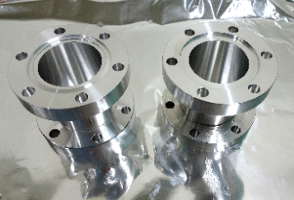
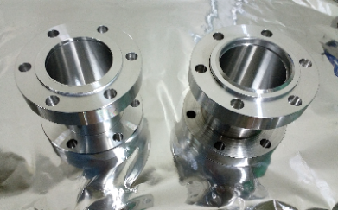
Conversion between the CF & the DEF Aluminum flanges
Conflat Flange
(Knife-edge)
DE Flange
(Flat)
Al Gasket
(Flat)
Al DE-Gasket
(Knife-edge)

Slide 22
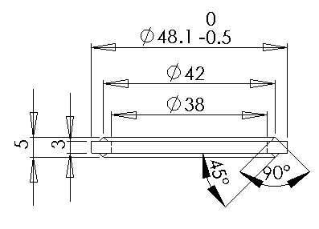
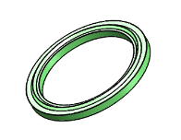

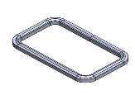
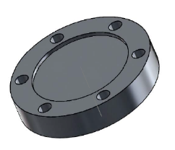
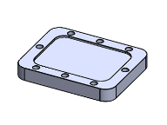
Typical dimension of 35 DEF Gasket
Circular gasket can be made by lathing.
Non-circular gasket must be made by (CNC) milling.

Slide 23


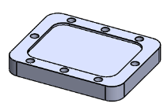
Features of the DE-Gasket
Diamond Edge Gasket
DE-Gasket sitting on DEF (Flat) Flange
Material：Aluminum alloy A1050O
Cross sections: Any shape with smooth closed loop
Machining method：CNC Machining
Vacuum Quality：UHV (P < 1×10⁻⁷ Pa)
Dimension: can be Standardized (Mass Production)

Slide 24




Specifications
A. DE-Gasket：
a: Outer Diameter (long)
b: Outer Diameter (short)
d: Width ( > 3.5 mm)
f: Diameter of Edge
g: Height of Edge ( > 4.5 mm)
B. DEF Flange：
e: Depth of flat surface ( < 2 mm)
Inner dimension of flange, S_{a} & S_{b}, corresponding to a & b: < 0.2 ~ 0.4 mm
C、H、M、S: Standard dimension corresponding to those of CF Flanges

Slide 25

Future Light Sources
8th International Particle Accelerator Conference (IPAC17), May 14-19 (2017), Copenhagen, Denmark

Slide 26

More than 10 projects have launched
Emittance < 500 pm rad
*TPS: 1600 pm rad

Slide 27

Risky RF bridge (spring loading & pumping slots)
Loose Contact …
Arcing (due to Loose Contact)

Slide 28

Non-reliable RF Contact spring
Dropped
Dis-location …
(miss-contact…)

Slide 29

Inner diameter of beam duct: Reduced
LER16 workshop, SOLEIL, 26 October 2016

Slide 30




How to mount the RF-contact parts? Can it be replaced?
Function of DE-gasket with the RF shielding
I.D. 10 mm
UHV sealing performance

Slide 31




Can the flange be made with same aperture of the beam duct?
Same cross section

Slide 32




Directly Machining the flanges on the chambers
CF-Flanges risks:
Deformation from Welding
Knife edge on chamber: difficult for machining and repairing
1
2
2
3
DEF Flanges profits：
Precise CNC machining
Directly machined flanges
No knife-edge damage
Low cost
High reliability
3

Slide 33
Experimental Test
Gauge Calibration System
Measurement of the Outgassing Rate for the Extractor Ion Gauge
Long beam duct with small aperture for the future light sources
DE-Gaskets with non-circular shape
Special DE Gaskets for the Aluminum extruded beam duct

Slide 34


1. Gauge Calibration System
Aluminum
35DE Gasket
Aluminum
(35DEF/35CF Reducer)
Aluminum 3-way Cube chamber
(Ethanol CNC machining)

Slide 35

Assembly and pumping test

Slide 36

Ultimate pressure after baking (150 °C, 24 h)

Slide 37

Pumping down curves & Gauge calibration curves
Gauge Calibration

Slide 38

2. Measurement of the Outgassing Rate for the Extractor Ion Gauge (IG1)
TMP

Slide 39

Thermal Outgassing Rate
(Throughput Method )
P_{IG2}
$$Q=C(P_{IG1}−P_{IG2})$$
P_{IG1}
Q _{Gas flow}
S_{(pump speed)}
C_{(orifice)}
where
C = 0.82 L/s : Conductance of Orifice (3mm)
P_{IG#} (Torr) : Pressure of Gauge IG#
Q : Outgassing Rate of the IG1-chamber
* Total outgassing rate of gauge IG1 after baking (Q):
Q = 0.82 (7.6×10⁻¹⁰ - 2.7×10⁻¹⁰) = 4×10⁻¹⁰ Torr L/s

Slide 40



3. Long beam duct with small aperture for the future light sources
Prepare the Aluminum tubes of 1m and 2m in length (I.D. 10 mm)
Ultra-low outgassing rate: by Oil-free interior surface machining
Ultra-low impedance: by a special design of aluminum diamond-edge gasket sealing; without interior coating
Features: Simplified structure, Simplified manufacturing process, High quality, High reliability, and Low cost
1m AL-Tube (I.D. 10 mm)
Conductance ~ 0.12 l/s
2m AL-Tube (I.D. 10 mm)
Conductance ~ 0.06 l/s
IG2
IG2
IG1
IG1

Slide 41




Preparation of the Aluminum Tube
Before Drilling
After Drilling
I.D. 9.6 mm
I.D. 10 mm
(a)
(d)
(b)
(e)
(c)
Full-penetrated
welding
Select the aluminum Extruded Pipe-(a) with inner diameter (I.D.): 9.6 mm.
CNC-Machining (in Ethanol) for the aluminum Flanges (without knife-edge)-(b) and the Diamond-Edge Gaskets-(c).
TIG-Weld the flanges to the pipe: full-penetrated welding-(d).
Deep-drill the inside part in Ethanol (oil-free) to I.D. = 10 mm through all the tube-(e).

Slide 42


Deep-drill (in Ethanol) the inner surface through the Al tube to obtain an uniform inner diameter of 10 mm
10 mm
9.6 mm
10 mm
(Animation)

Slide 43


Diamond Edge Gasket Sealing

Slide 44


1m AL-Tube Pumping Test
(I.D. 10mm, interior ethanol drilling)
1 m (I.D. = 10 mm)
IG: Extractor Ion Gauge
TMP: Turbo-Molecular Pump

Slide 45


Pumping down curve for 1m AL-Tube
Baking
(150°C, 24h)
IG1
IG2
Q = 5.7×10⁻¹¹ Torr·L/s

Slide 46


1m AL-Tube (I.D. 10mm) after baking q_{D} ~ 7.0×10⁻¹⁴ Torr∙l/s∙cm²
P_{L}(IG1): 6.06E-10
P₀(IG2): 2.12E-10
TMP
Pump

Slide 47

2m AL-Tube Pumping Test
(I.D. 10mm, interior ethanol drilling)
IG2
TMP (300 L/s)
2m AL-Tube (I.D. 10 mm)
Conductance ~ 0.06 l/s
Tandem Turbo-pumps
TMP (70 L/s)
IG1

Slide 48



Pumping down curve for 2m AL-Tube
IG2
IG1 on
Bake
IG1
大TMP
Reset
Pressure before baking：
IG1: 5.2×10⁻⁸ Torr
IG2: 2.9×10⁻¹⁰ Torr
Continuous pumping for 4 months (before baking)

Slide 49


2m AL-Tube (I.D. 10mm) after baking
(1) Baking for 2m AL-Tube
1
2
(2) Overall system uniformly bake out
Pressure after baking
IG1: 1.8×10⁻⁹ Torr
IG2: 6.8×10⁻¹¹ Torr
1.82E-9
6.8E-11
(Ultimate Pressure)

Slide 50


Thermal Outgassing Rate of (a) 1m , (b) 2m AL-Tubes
q < 2 ×10⁻¹³
UHV
(a) 1m Tube
(b) 2m Tube

Slide 51

Summary of the Outgassing Rate for various chambers
---- Throughput Measurement-----
-- Pumping Down --
Criteria of UHV
q < 2×10⁻¹³ Torr·l/(s·cm²)
Stainless Steel chamber
AL tube-1m
Stainless Steel chamber + AL tube
AL tube-2m
|-------- Ethanol Drilling --------|

Slide 52





4. DE-Gaskets with non-circular shape

Slide 53


Aluminum Chamber & Screen Monitor
Aluminum Chambers with DEF Flange
A6061T651 Al-alloy (hard)
CNC Machining (Ethanol) only
Flat (DEF-) Flange (without knife-edge)
Ultrahigh Vacuum (UHV) quality
Can be re-machining (Ethanol)
Al-SM with a build-in water-cooling vessel
Aluminum DE Gaskets
A1050O Al-alloy (soft)
CNC Machining (Ethanol) only
Reused for 3 times vacuum sealing
Ultrahigh Vacuum (UHV) quality

Slide 54



35 DE-Gaskets
Type A DE-Gasket: 45°+ 45°Knife Edge
(Ethanol CNC-machining)
Type B DE-Gasket: 20°+ 70°Knife Edge
(Lathe-machining)

Slide 55




Functions of Screen Monitor
Profile (Shape, Image)
Position (Transverse)
Dimension (Size)
Intensity (Fluorescence)

Slide 56



Installation #1 and baking (150°C, 24h)
IG1
IG2
IG1
IP/NEG
IG2
IG2
Pressure after baking：
IG1 (IMG) = 7.49×10⁻¹¹ Torr (no pump)
IG2 (EIG) = 1.15×10⁻¹⁰ Torr
IG1

Slide 57





Re-Installation #2 (after re-machining SM in Ethanol) & baking (150°C, 24h)
IG1
Re-Install
IG2
Baking
Pressure after baking：7.58×10⁻¹¹ Torr

Slide 58




Re-Installation #3 (after re-machining SM in Ethanol and Ozone Water Cleaning) & baking (150°C, 24h)
Ozone water
Cleaning
IG1
Re-Install
IG2
Baking
Pressure after baking：1.89×10⁻¹⁰ Torr

Slide 59





Reused 3 times for the Rectangular DE-Gasket
Lower Yield of Photon Stimulated Desorption (PSD) that speeds up the commissioning of new accelerator.
(1)
(2)
(3)
DE Gasket (d)
- Reused 3 times
UHV (conductance limited)
7.58×10⁻¹¹ Torr

Slide 60





5. Special DE Gaskets for the Aluminum extruded beam duct
Reducer Tube : Offset 3.5 mm
SR (TLS-19B)
SR
Incident angle: 1.5°
Photon Span = 2.53 mrad
IG2
IG1

Slide 61






Elliptical DE Gasket

Slide 62


Assembly of the Aluminum duct with the special DEF Flanges & DE Gaskets

Slide 63

Assembly of the Test Vacuum System

Slide 64


[NEXT] DE gaskets for the Aluminum Ducts of the Future Light Sources

Slide 65
Conclusions
The innovative design of the aluminum DE-gaskets for the aluminum UHV systems have been developed successfully.
The flanges of the vacuum chambers are flat without the knife-edge that is easily machined with the CNC machine-tools. Then the cross section of the DEF-flanges and gaskets can be designed any non-circular shape, e.g. rectangular, in addition to the circular one.
The precision and the reliability for the aluminum chambers with the DEF-flanges are high, while the manufacturing cost is lower.
The ultimate pressure of the aluminum system after vacuum baking has reached to < 1.0×10⁻⁸ Pa (~ 7.5×10⁻¹¹ Torr). With the oil-free ethanol CNC machining process, all the DE- and DEF- vacuum components can be assembled immediately after machining in the clean room without further chemical cleaning process, which simplifies the manufacturing procedure.
The results of the experiments have successfully proved the UHV qualities of the Diamond-Edge gasket sealing, and been able to extend to wider applications.
Thanks for your attension.

