Slide 1
Modifying the magnetic reversal mechanism of exchange biased Mn_{x}O_{y}/Ni₈₀Fe_{­20} bilayers through additional O⁺ implantation
Ji Zhang ^{a,b,}, Grace L. Causer ^{b,c}, Xinzhi Liu ^{b,d}, Mihail Ionescu ^{b},, Ko-Wei Lin ^{e} Frank Klose ^{f} and Sean Li ª
ª School of Materials Science and Engineering, University of New South Wales, Sydney, Australia
^{b} Australian Nuclear Science and Technology Organisation, Australia
^{c} Institute for Superconducting and Electronic Materials, University of Wollongong, Wollongong, NSW 2500, Australia
^{d} Helmholtz-Zentrum Berlin für Materialien und Energie, Hahn-Meitner-Platz 1, Germany
^{e} Department of Materials Science and Engineering, National Chung Hsing University, Taichung 402, Taiwan
^{f} Guangdong Technion-Israel Institute of Technology, PR China

Slide 2

Exchange bias (EB)
T_{C}
T_{C}
Field cooling
T_{N}
T_{N}
Moment M
Moment M
H_{C1}
H_{C2}
H_{C1}
H_{C2}
Field H
Field H
H_{EB}
Notes:
A brief introduction of EB.
It is a pinning effect arised from FM and AFM interface, induced by field cooling from the a sample below neel and blocking temperature of AFM material.

Slide 3
Why are we still interested in EB?
Applications in real world
Giant magnetoresistance read-heads
Contributing factors to EB
Nanoparticles: Crystal structure, magnetic structure, chemical composition etc.
Thin films: Anisotropy, layer thicknesses, interface roughness etc.
Focus of this study
Potential application in spintronic devices
Method to achieve
Ion beam implantation
Altering the magnetism and chemistry of a particular layer in thin film sample via ion beam implantation
Magnetic spin reversal before and after ion implantation

Slide 4
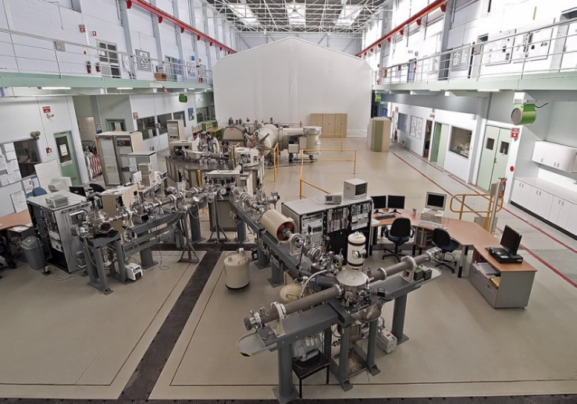

Experimental methods
As-grown thin film
Ta-O / Mn-O(11 nm) / Ni₈₀Fe₂₀ (23 nm) // SiO₂ / Si
Ion beam implantation
8 keV O⁺ ion implantation: fluences of 10¹⁶, 10¹⁷ and 10¹⁸ ions/cm² in ANSTO
Characterisation
TEM,
PPMS-VSM and
PNR
Low Energy Ion Implanter
Polarised Neutron Reflectometer

Slide 5
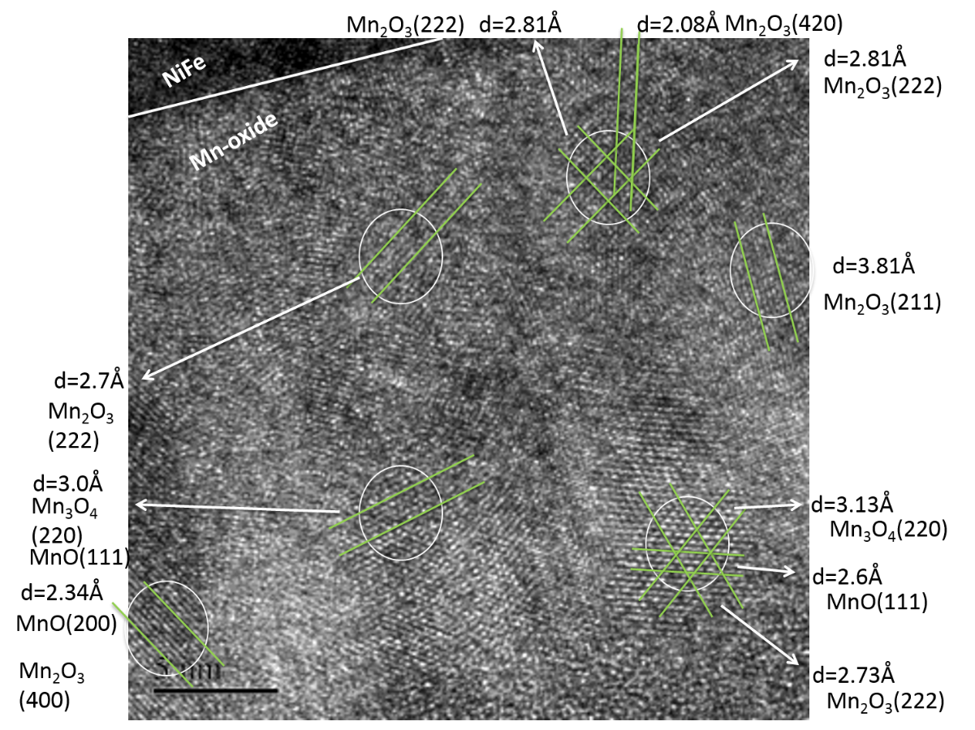
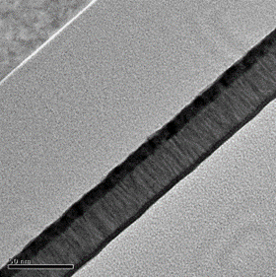
TEM images before and after ion implantation
Si
As-grown
Si
10¹⁷ ions/cm²
SiO₂
SiO₂
NiFe
NiFe
Ta-O
Ta_{x}O_{y}
Mn-O
Carbon coating
Mn_{x}O_{y}
Carbon coating
50 nm
50 nm

Slide 6
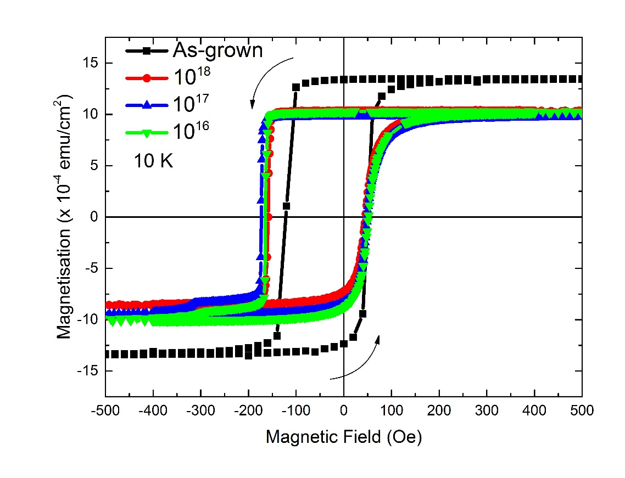
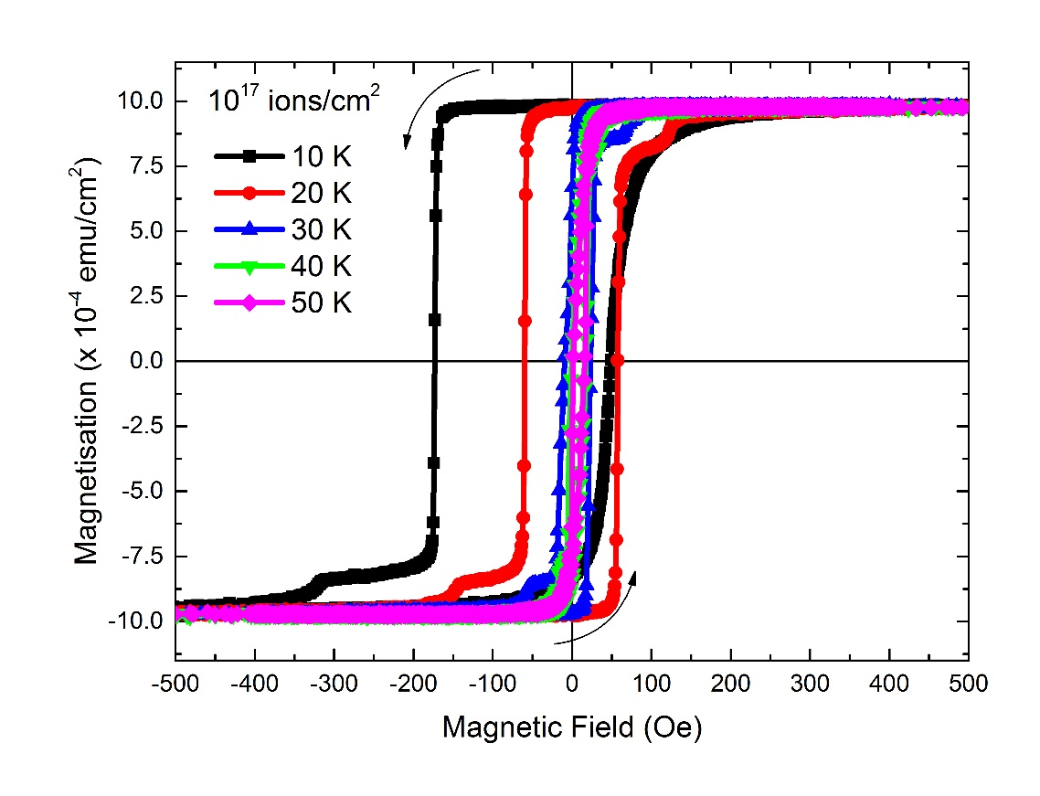
Bulk magnetic properties before and after ion implantation
Notes:
Unit explain, measured sequence explain. HE and HC, detal Ms, step-like

Slide 7
PNR instrument introduction
Non-spin-flip: R⁺⁺, R⁻⁻
Spin-flip: R⁻⁺, R⁺⁻
SLD_{total} = SLD_{total nuc} +/- SLD_{total mag} = (b_{nuc 1} +/- b_{mag 1}) × N₁ + (b_{nuc 2} +/- b_{mag 2}) × N₂ …
Notes:
Explain R++ R --, sample set-up, measuring sequence.

Slide 8
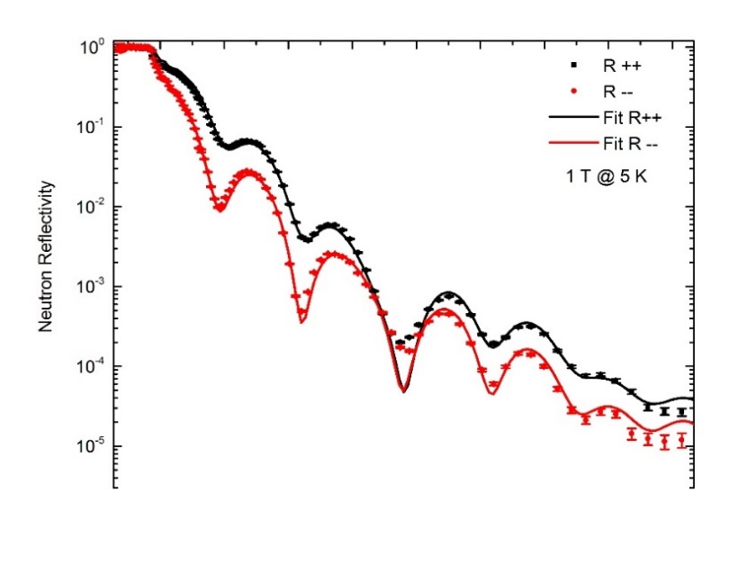
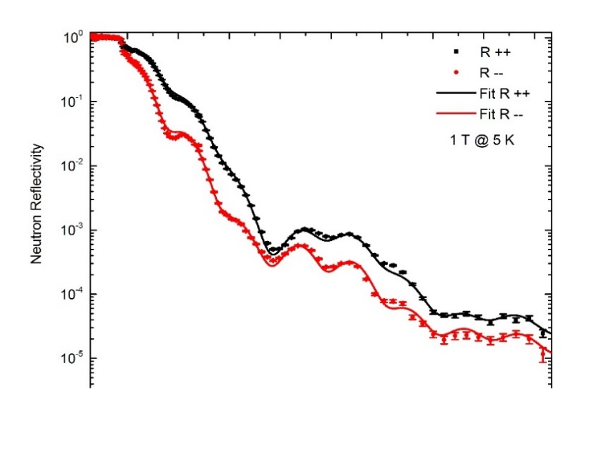
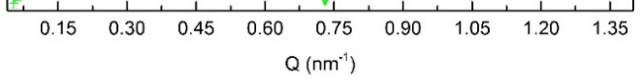
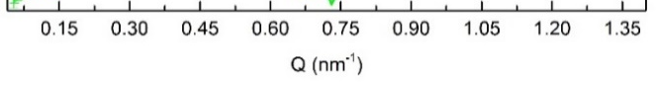
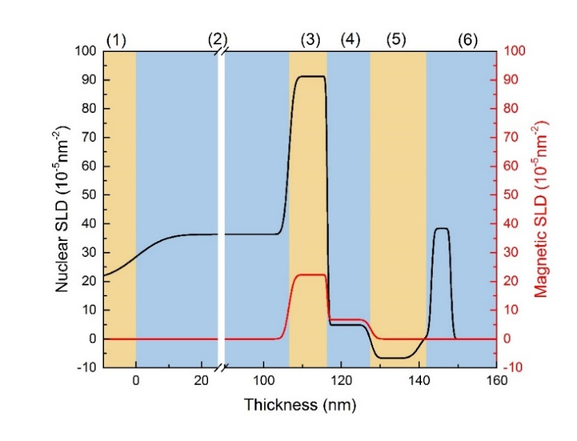
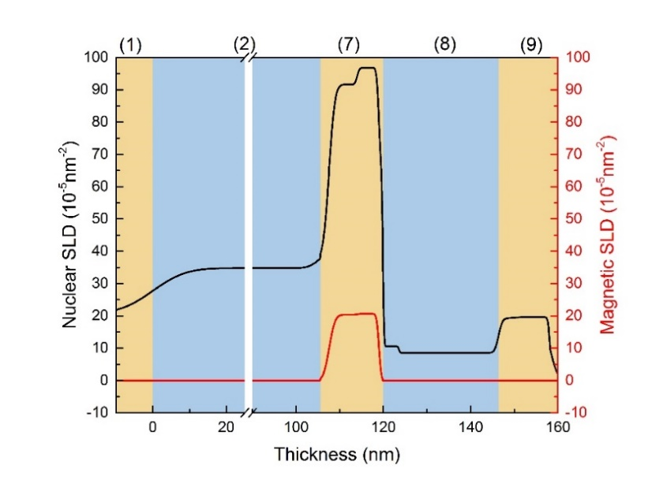
Magnetic depth profile measured by PNR
As-grown
10¹⁷ ions/cm²
Each layer of samples:
(1) Si,
(2) SiO₂,
(3) NiFe,
(4) Mixed Mn-O-NiFe,
(5) Mn-O,
(6) Ta-O,
(7) Mixed NiFe-NiFeOᵪ,
(8) Mn_{x}O_{y},
(9) Mixed Ta-Ta_{a}O_{b}-Mn_{x}O_{y}

Slide 9
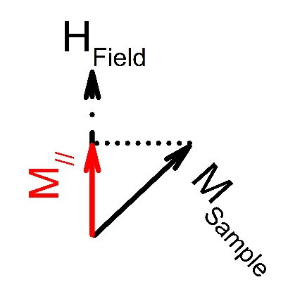
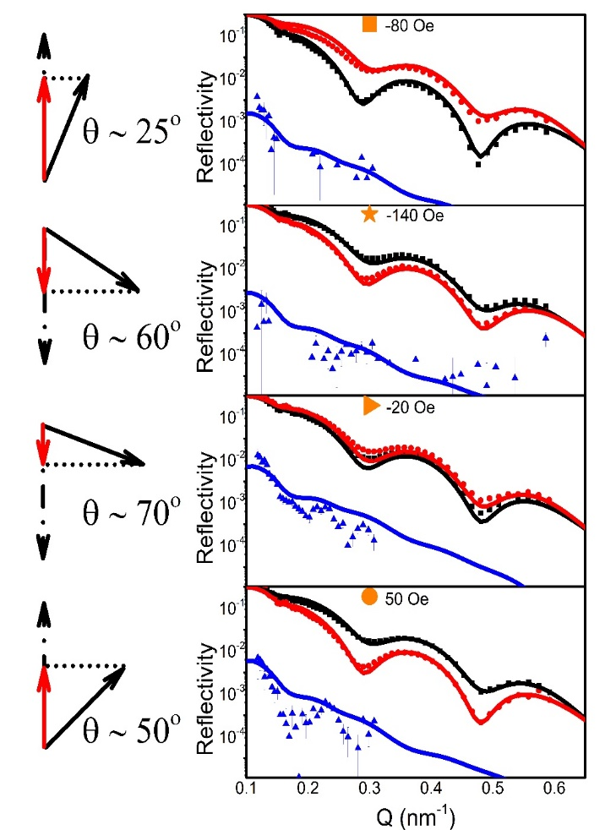
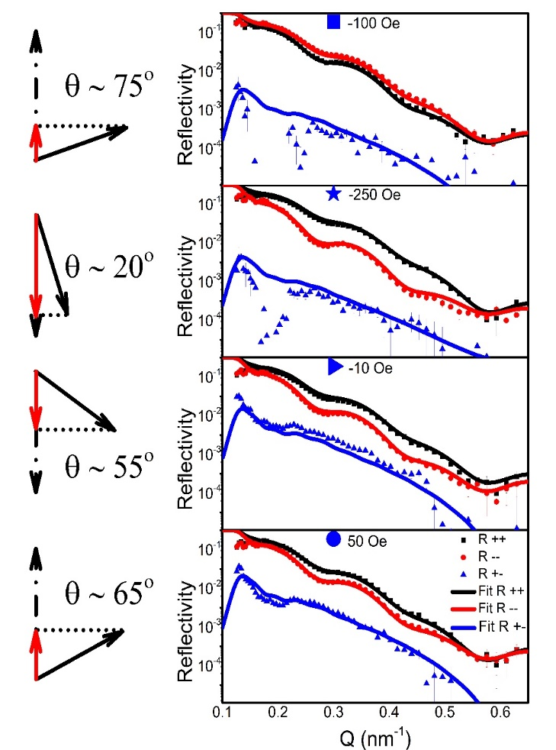
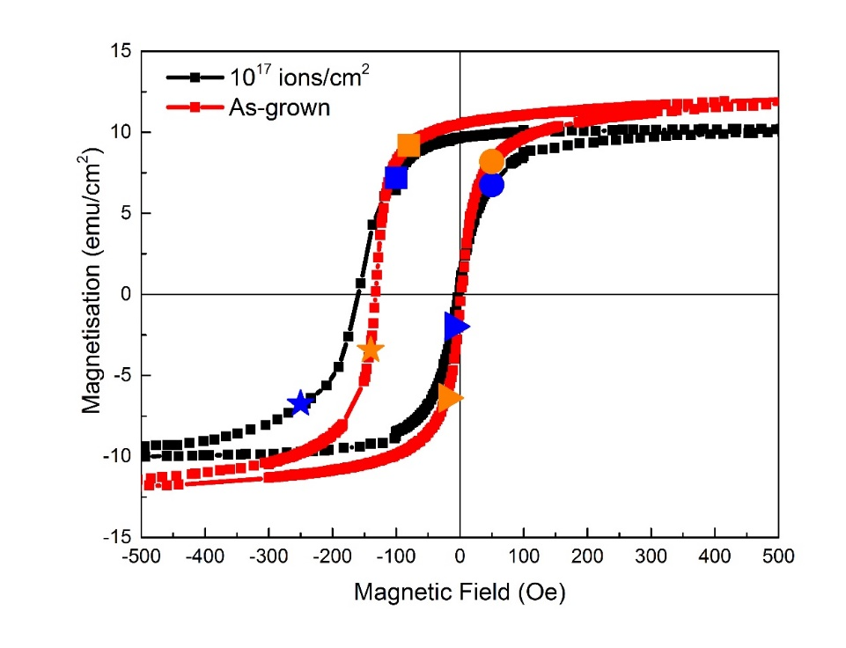
Magnetic reversal measured by PNR
~80% coherent spin rotation
100% coherent spin rotation
θ
As-grown
10¹⁷ ions/cm²
M// = M_{Sample} x sin(θ)
Notes:
Fitting model explain.

Slide 10
Conclusion
Samples were successfully O⁺ ion implanted with 8 keV at 10¹⁶, 10¹⁷ and 10¹⁸ ions/cm² fluences.
Implanted sample shows improved H_{E} and H_{C}.
PNR analyses of sample before and after O⁺ ion implanted shows the chemical and magnetic structures.
During spin reversal, as-grown sample ~80% undergo coherent spin rotation, and ~20% of the spins undergo magnetic domain nucleation and motion
10¹⁷ ions/cm² implanted sample shows fully coherent spin rotation.

Slide 11



Acknowledgements
Funding Supports
Collaborators
Khai-Han and Steve who made the sample

Slide 12
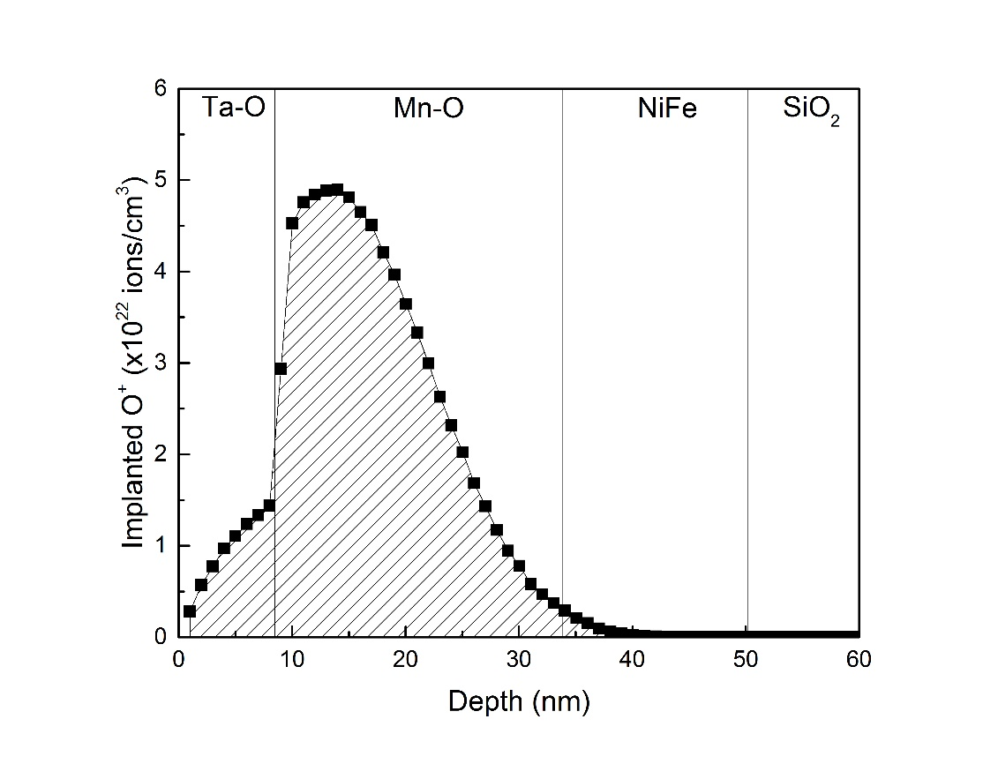
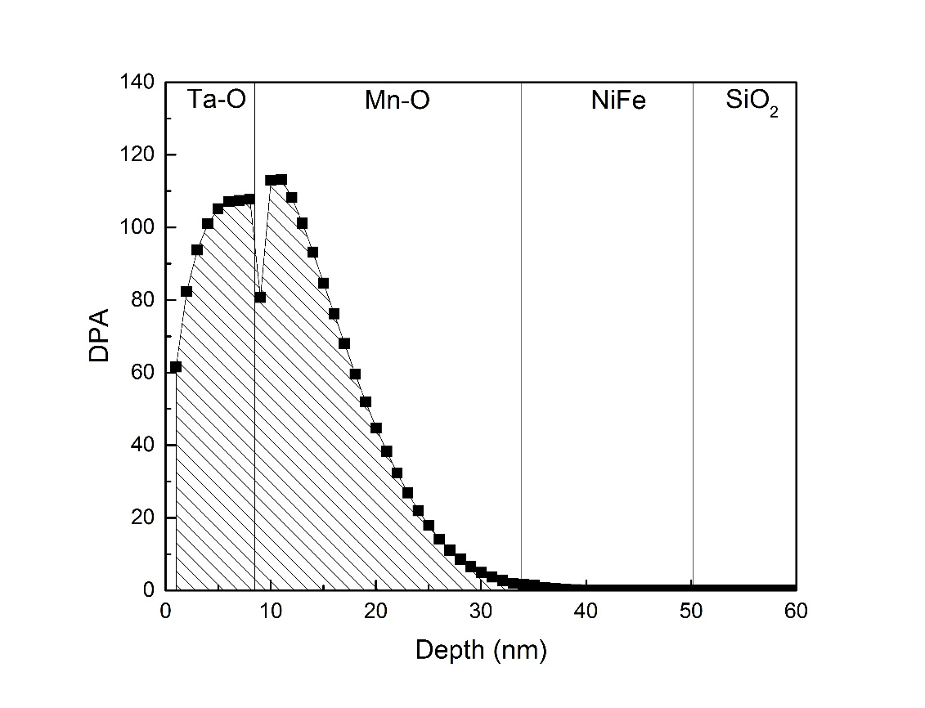
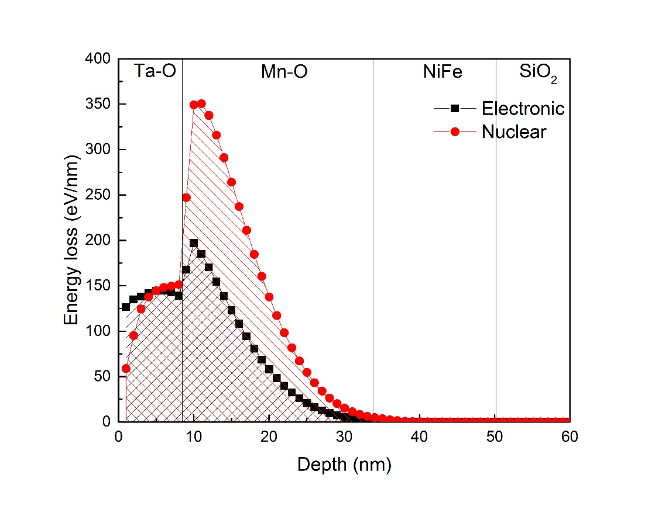
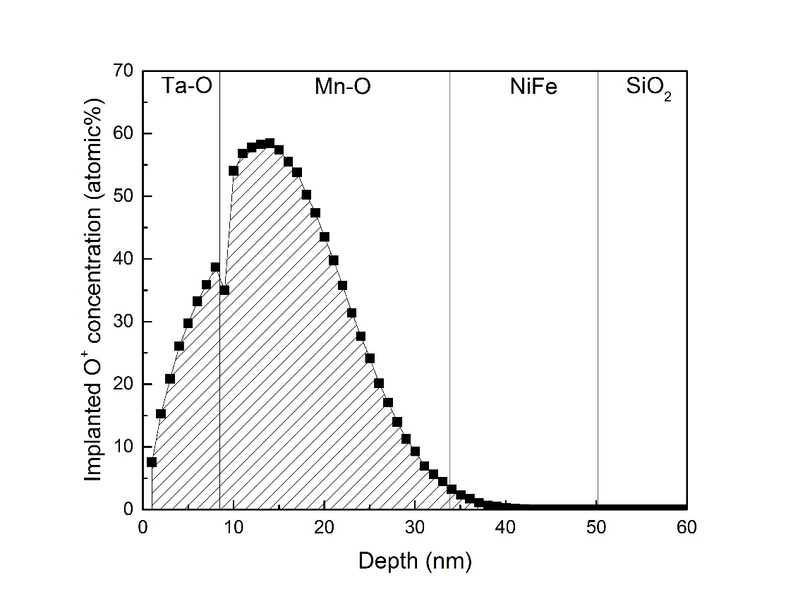
(a)
(b)
(c)
(d)

Slide 13
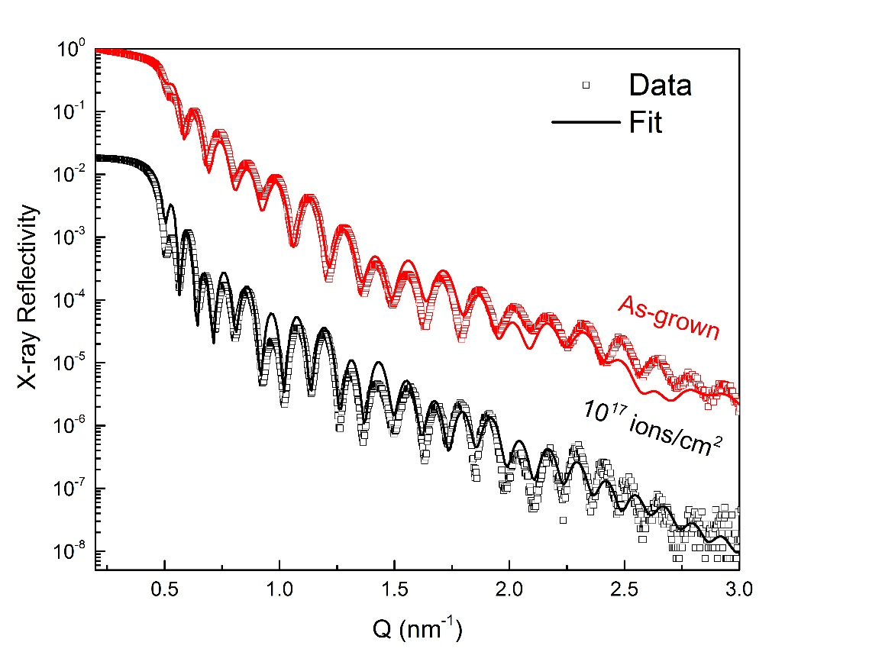
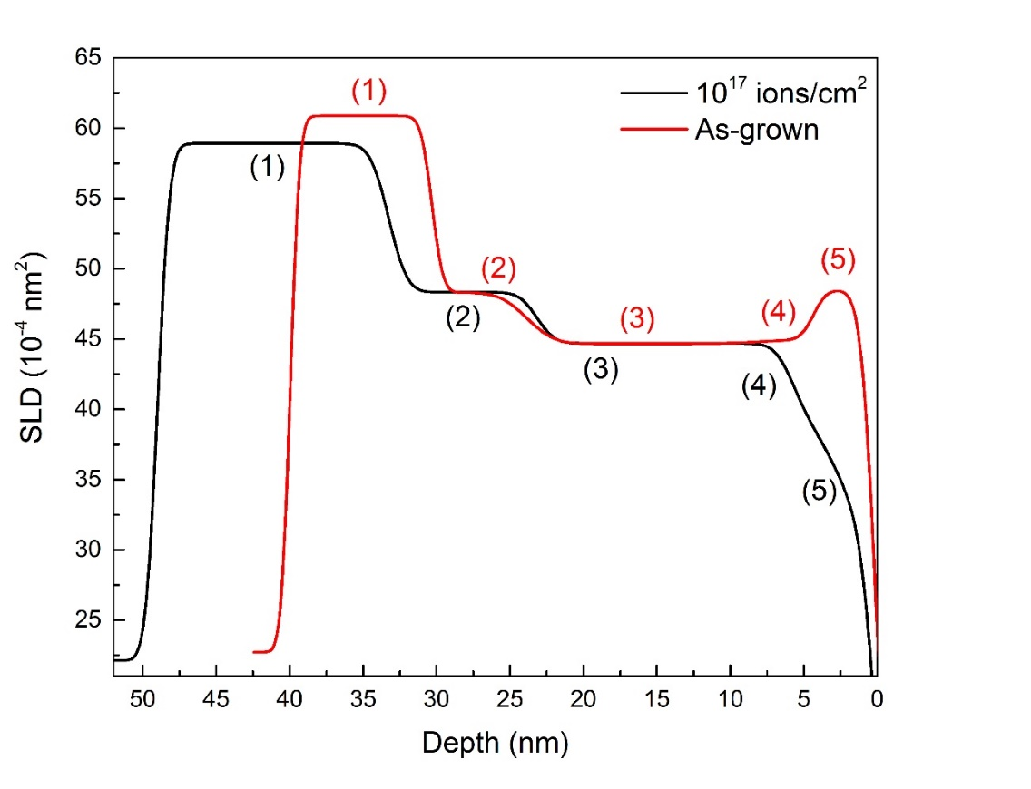
(a)
(b)

Slide 14
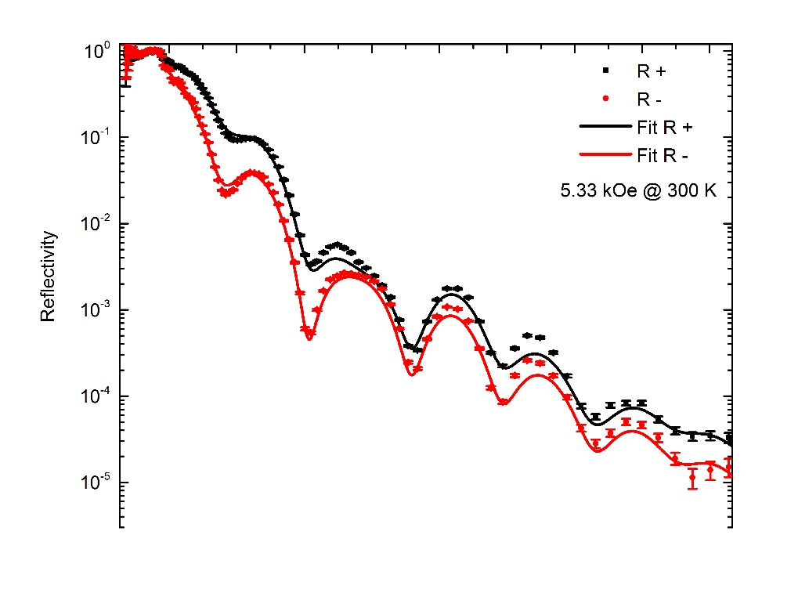
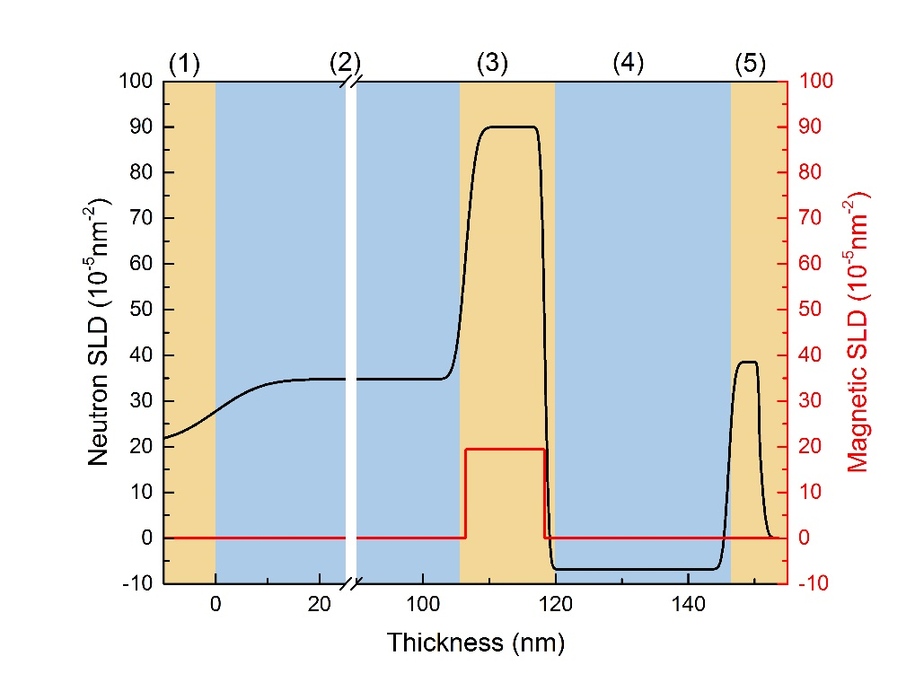
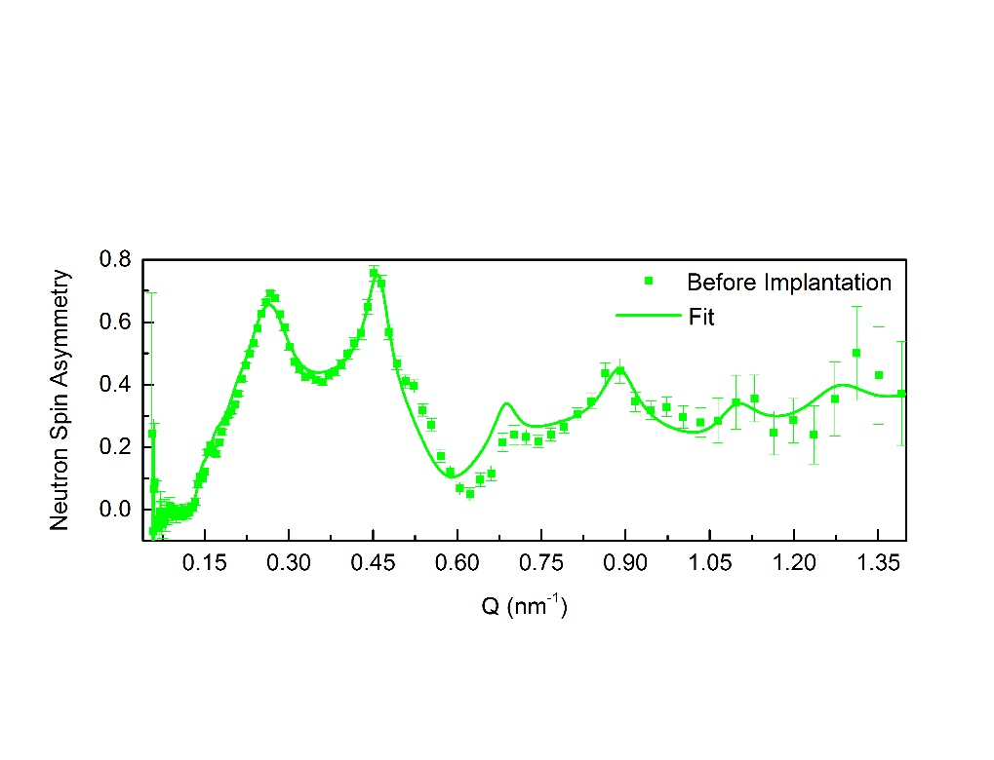
(a)
(b)

