Slide 1




Electronic correlations in graphene
studied using
angle-resolved photoemission
Choongyu Hwang
Department of Physics
Pusan National University
South Korea
Pusan Natl. Univ.
Department of Physics
Max Planck-
POSTECH
Research Initiative
National Research
Foundation of
Korea
Lawrence Berkeley
National Laboratory

Slide 2
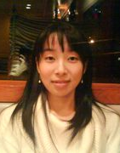
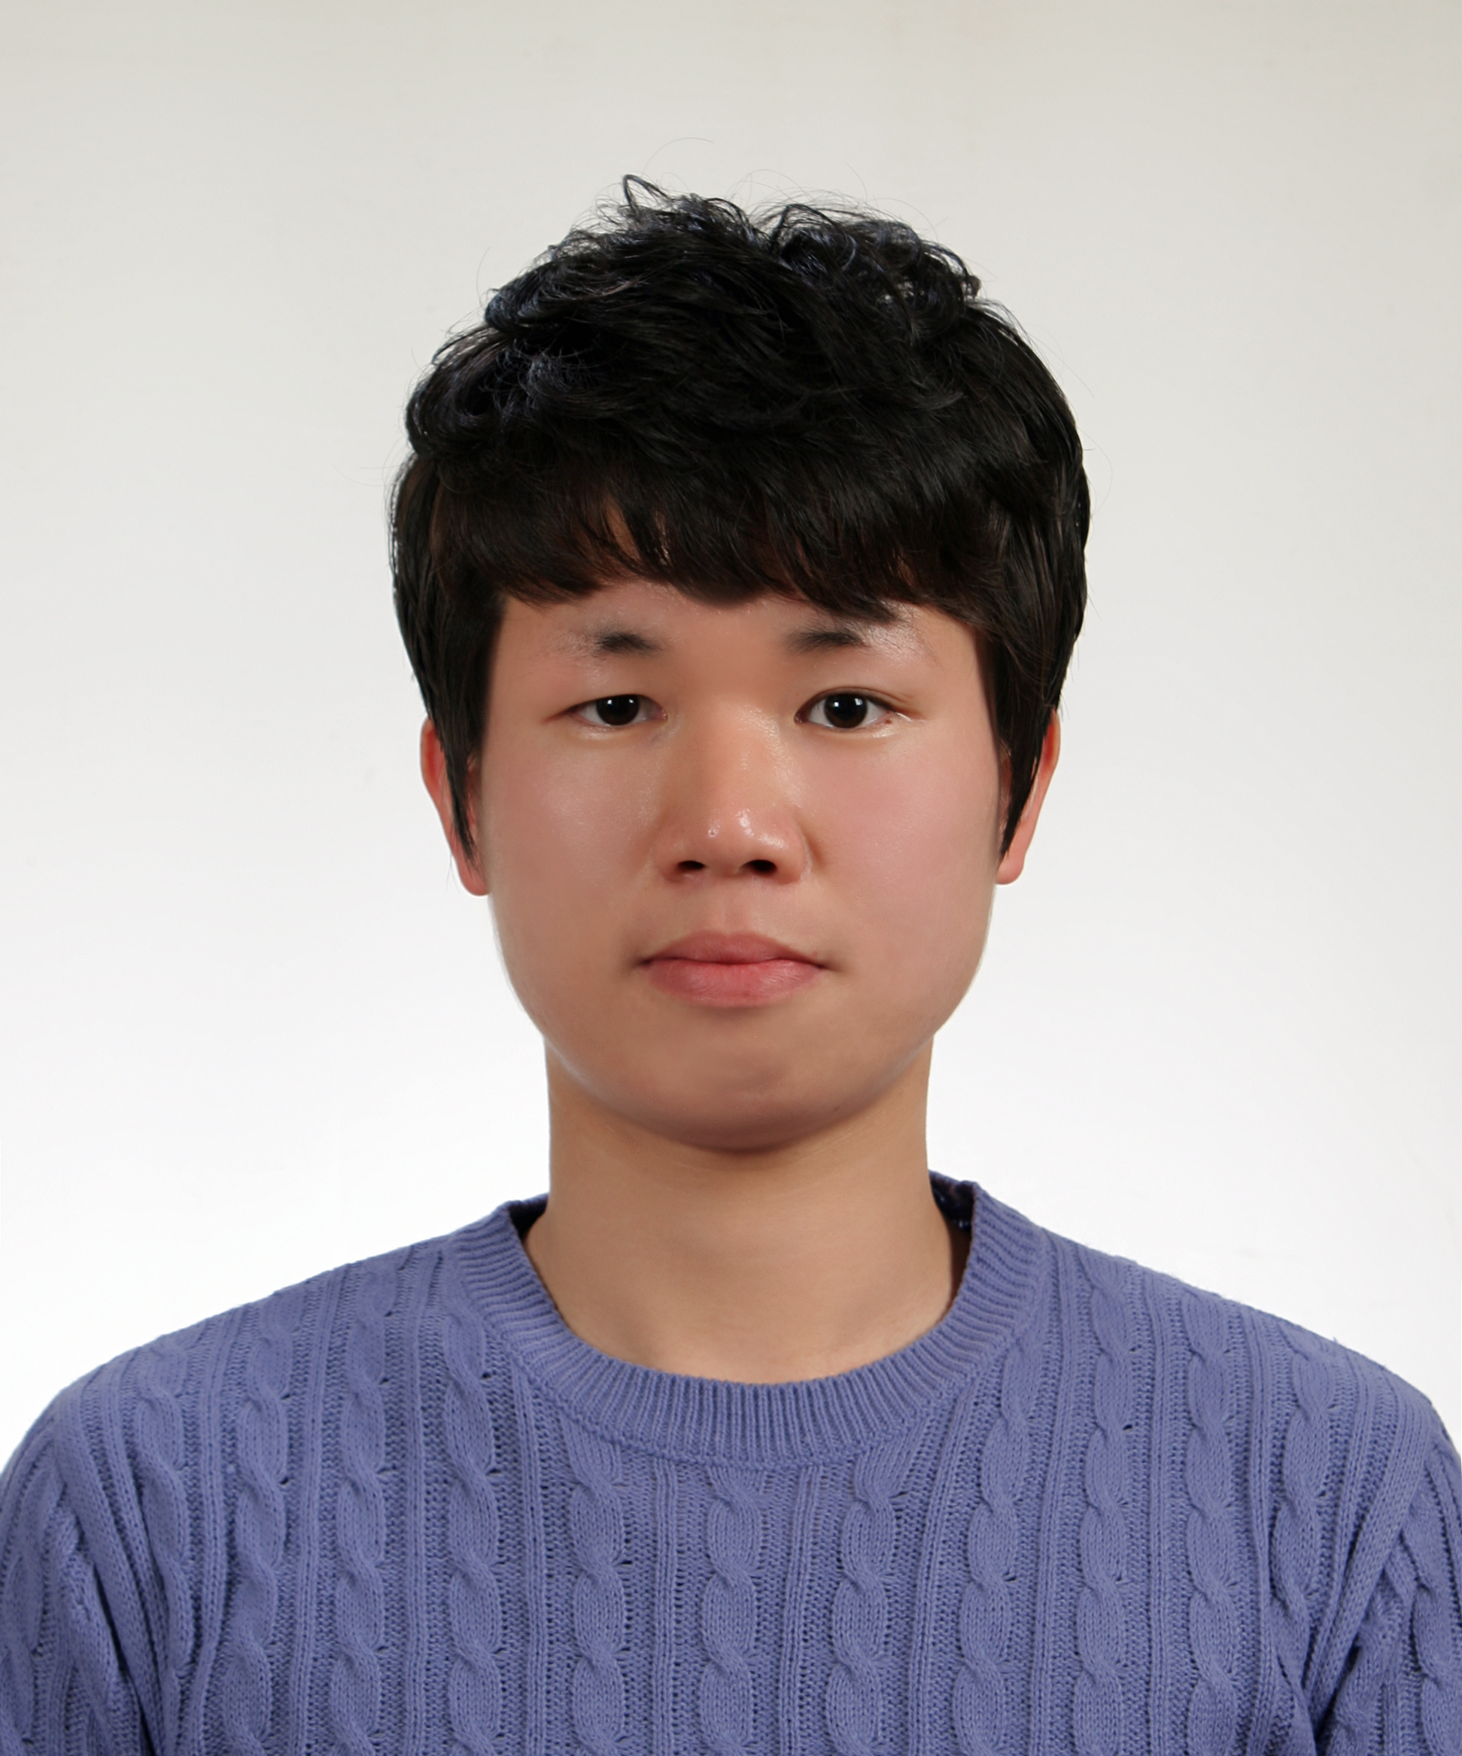
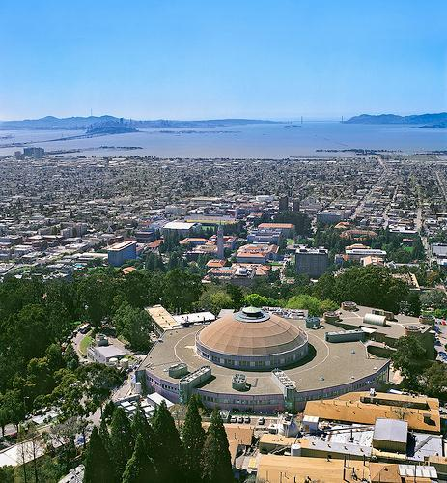
Hwang Research Group
Advanced Light Source
Lawrence Berkeley Natl. Lab. (USA)
Postdoc
Dr. Hyejin Ryu
Graduate student
Jinwoong Hwang
Pusan Natl. Univ.
Department of Physics
Max Planck-
POSTECH
Research Initiative
National Research
Foundation of
Korea
Lawrence Berkeley
National Laboratory

Slide 3



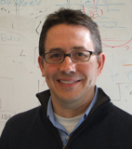
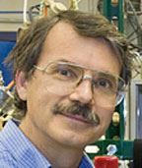
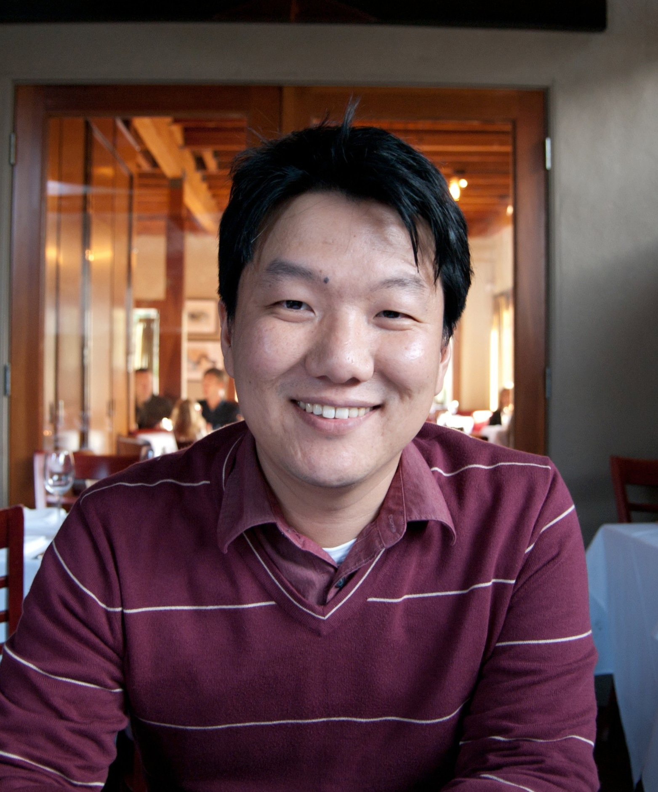


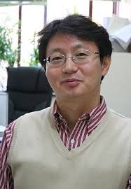
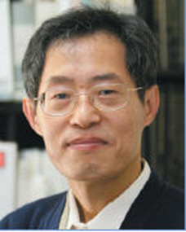
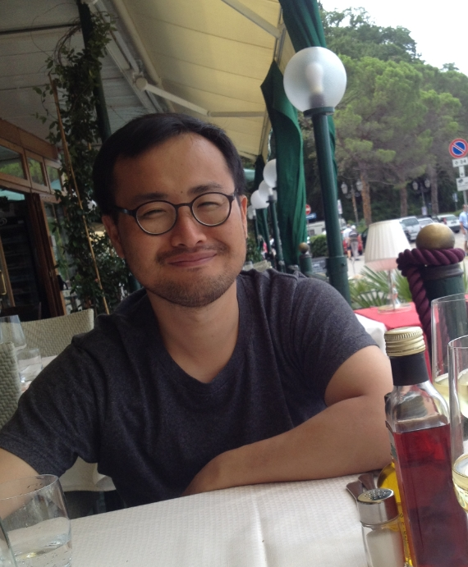

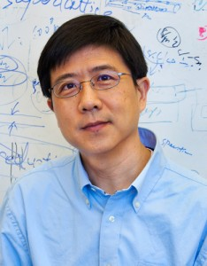

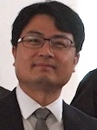

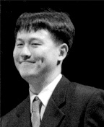
Collaborators
UC Berkeley Collaborators
Postdoc
Dr. Hyejin Ryu
Graduate student
Jinwoong Hwang
A. Lanzara
S. Louie
M. L. Cohen
J. B. Neaton
A. Zettl
ALS Collaborators
POSTECH Collaborators
S. –K. Mo
A. Fedorov
J. Denlinger
J. –H. Park
B. I. Min
K. Kim
LBNL Collaborators
Theoretical Support
R. Dynes
Y. Zhang
A. Ismach
D. –Y. Kim
A. Castro Neto
C. –H. Park
HPSTAR, China
Natl. Univ.
of Singapore
Seoul Natl. Univ.
Notes:
There have been a lot of help from excellent collaborators.
Prof. Alessandra Lanzara has supported all these works and all of our group members have been great help in every part even beyond physics.
With strong emphasis, Prof. Antonio Castro Neto has been wonderful help in understanding complicated physics in graphene. Also there have been great help from beamline scientists at Advance light source and from sample grower at lawrence berkeley national laboratory.
I also appreciate all the help from our collaborators in UC berkeley, Prof. Steven Louie, Prof. Dung-Hai Lee, Prof. Robert Dynes, Prof. Alex Zettl, Prof. Ramamoorthy Ramesh, Prof. Eugene Haller, and their students.

Slide 4
Outline
1. Why do we study electrons?
2. How do we study electrons?
3. Dream about strongly correlated electron phases
in a 2D world: graphene
Role of a substrate: electron-electron interactions
Role of a dopant: spin-spin interactions: Kondo effect
Notes:
First of all, let me introduce outline of my talk.
I will briefly introduce magnetic and electronic properties of graphene that will be followed by brief introduction my main experimental tool, angle-resolved photoemission spectroscopy or ARPES.
Then I will discuss about our recent studies on magnetic ordering and fermi velocity engineering in graphene.

Slide 5
Outline
1. Why do we study electrons?
2. How do we study electrons?
3. Dream about strongly correlated electron phases
in a 2D world: graphene
Role of a substrate: electron-electron interactions
Role of a dopant: spin-spin interactions: Kondo effect
Notes:
First of all, let me introduce outline of my talk.
I will briefly introduce magnetic and electronic properties of graphene that will be followed by brief introduction my main experimental tool, angle-resolved photoemission spectroscopy or ARPES.
Then I will discuss about our recent studies on magnetic ordering and fermi velocity engineering in graphene.

Slide 6
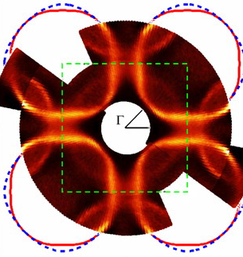
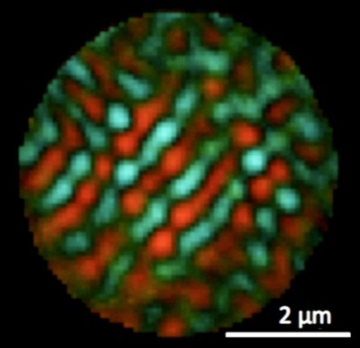
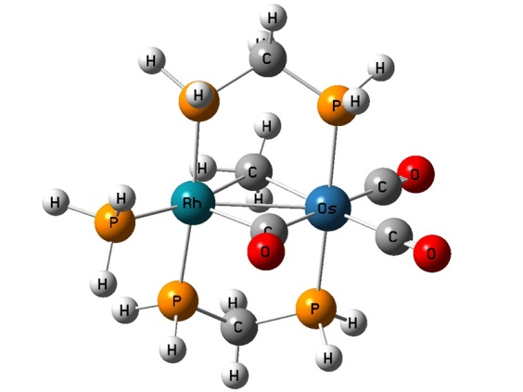
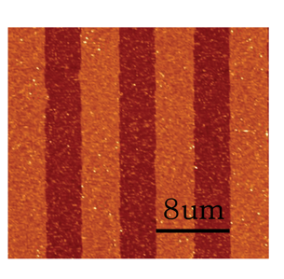
Why do we need to study electrons?
Ultimately, the
electric,
magnetic,
chemical,
mechanical,
optical, thermal, and structural properties of matter depend on the
behavior of electrons and location of atoms.

Slide 7
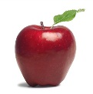
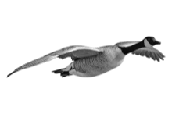
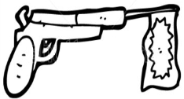
Highly correlated systems
Non-correlated system
Correlated system
Ground state
With external perturbation
The responses are different due to
correlation effects!

Slide 8
Energy scale of importance
Superconducting gap
~ 1 – 100 meV
Optical phonons
~ 40 – 70 meV
Magnons
~ 10 – 40 meV
Pseudogap
~ 30 – 300 meV
Multiphonons and multimagnons
~ 50 – 500 meV
Orbital fluctuations
~ 100 meV – 1.5 eV
Mott gap
~ 1 eV – 3 eV

Slide 9
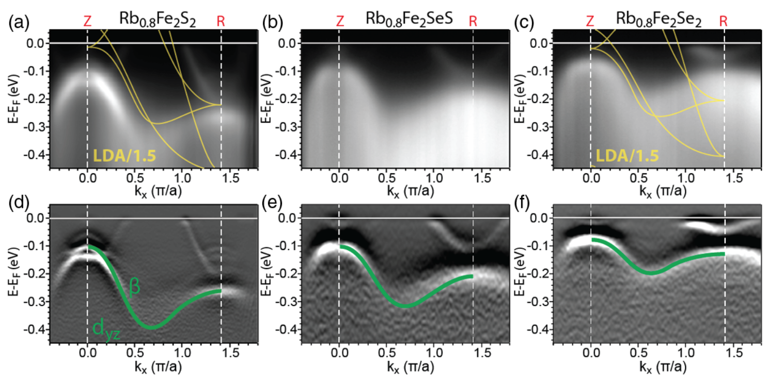
Electron-electron interaction in Fermi liquid
Fermi liquids
Galilean invariance
Rb_{0.8}Fe₂S₂
E–E_{F} (eV)
Rb_{0.8}Fe₂SSe
Rb_{0.8}Fe₂Se₂
k (π/a)
Yi et al., PRL (2011)
Notes:
In order to understand electron-electron interactions, it is important to note the difference between Fermi liquids and Dirac Fermions.
Fermi liquids are described by Galilean invariant theories whose main parameter is effective mass. For Fermi liquids, as electron-electron interactions become stronger, the effective mass becomes heavier so that Fermi velocity is decreasing.
In the same analogy with Fermi liquid, the main parameter of Dirac fermions is velocity which is described by Lorentz invariant theories. Similar to Fermi liquid, velocity is also affected by electron-electron interactions. However, with increasing interactions, the velocity is also increasing in contrast to Fermi liquid.
Base on this theoretical expectation along with the easiness of graphene to modify electron band structure, graphene is viewed as a prototypical two dimensional electron system for Fermi velocity engineering.

Slide 10
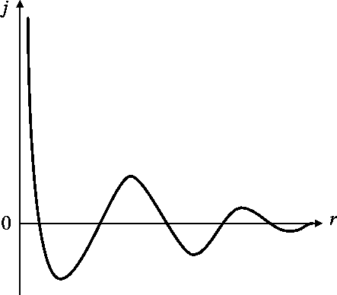
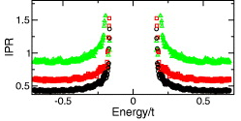
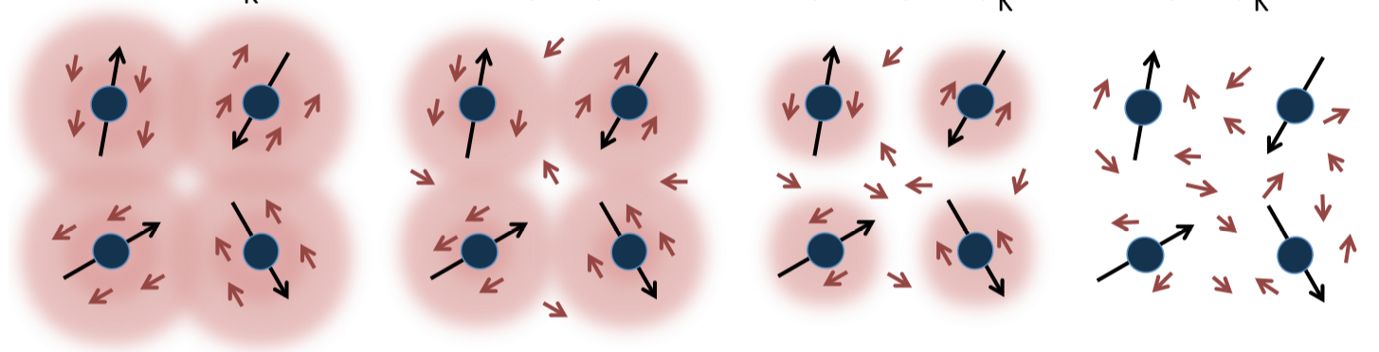
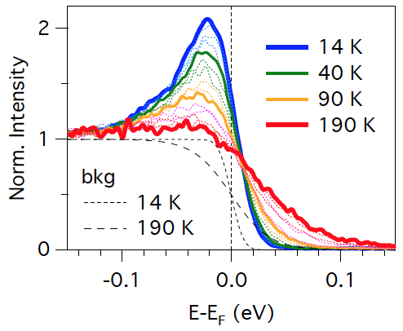
Spin-spin interaction in metallic sea
RKKY interaction
Giant magneto-resistance
FM/AFM oscillation
Magnetic skyrmions
J
r
Rappoport et al., EPL (2011)
Kondo effect
Jang et al., arXiv:1704.08247v1

Slide 11
Outline
1. Why do we study electrons?
2. How do we study electrons?
3. Dream about strongly correlated electron phases
in a 2D world: graphene
Role of a substrate: electron-electron interactions
Role of a dopant: spin-spin interactions: Kondo effect
Notes:
First of all, let me introduce outline of my talk.
I will briefly introduce magnetic and electronic properties of graphene that will be followed by brief introduction my main experimental tool, angle-resolved photoemission spectroscopy or ARPES.
Then I will discuss about our recent studies on magnetic ordering and fermi velocity engineering in graphene.

Slide 12
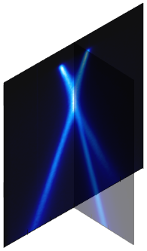
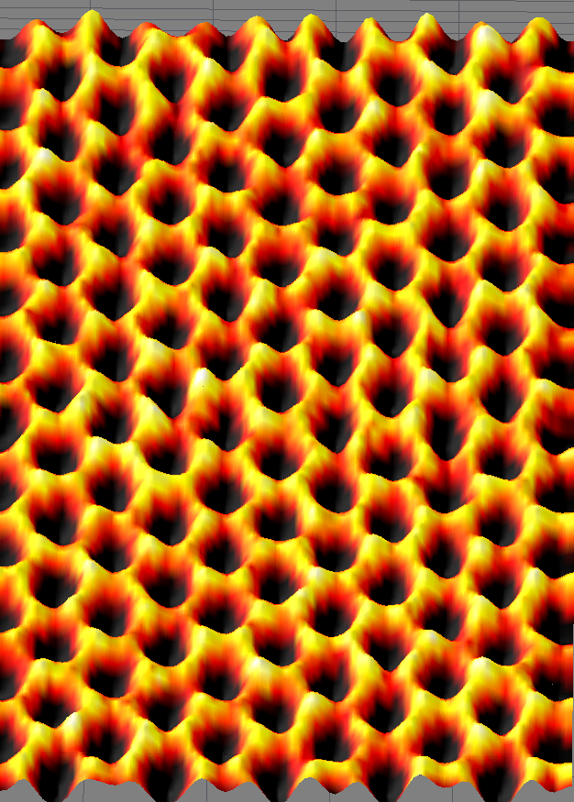
Angle-Resolved PhotoEmission Spectroscopy
E_{F}
Fermi surface
Dispersion and
self energy
Binding Energy
Κ
Γ
Momentum
E_{F}
Photo-electrons
E_{D}
E−E_{D}=−0.8 eV
Notes:
ARPES is photon-in electron-out method which directly shows how electrons are bound within a crystal as a function of momentum and binding energy.
A horizontal cut of this 3-dimensional data give Fermi surface which gives important information on the electronic properties of a system. A vertical cut gives information of energy-momentum dispersion and electron self-energy.

Slide 13

Angle-Resolved PhotoEmission Spectroscopy
A(k,ω) spectral function, M(k) Matrix element, f(ω) Fermi function
Electron band structure
Fermi velocity
Charge carrier concentration
Κ
Γ
Electron self-energy
E_{F}
E_{D}
Quantum phases
Berry’s phase
Sign of hopping integrals
Hwang et al., PRB (2011)
E−E_{D}=−0.8 eV
Notes:
ARPES is photon-in electron-out method which directly shows how electrons are bound within a crystal as a function of momentum and binding energy.
A horizontal cut of this 3-dimensional data give Fermi surface which gives important information on the electronic properties of a system. A vertical cut gives information of energy-momentum dispersion and electron self-energy.

Slide 14
Outline
1. Why do we study electrons?
2. How do we study electrons?
3. Dream about strongly correlated electron phases
in a 2D world: graphene
Role of a substrate: electron-electron interactions
Role of a dopant: spin-spin interactions: Kondo effect
Notes:
First of all, let me introduce outline of my talk.
I will briefly introduce magnetic and electronic properties of graphene that will be followed by brief introduction my main experimental tool, angle-resolved photoemission spectroscopy or ARPES.
Then I will discuss about our recent studies on magnetic ordering and fermi velocity engineering in graphene.

Slide 15
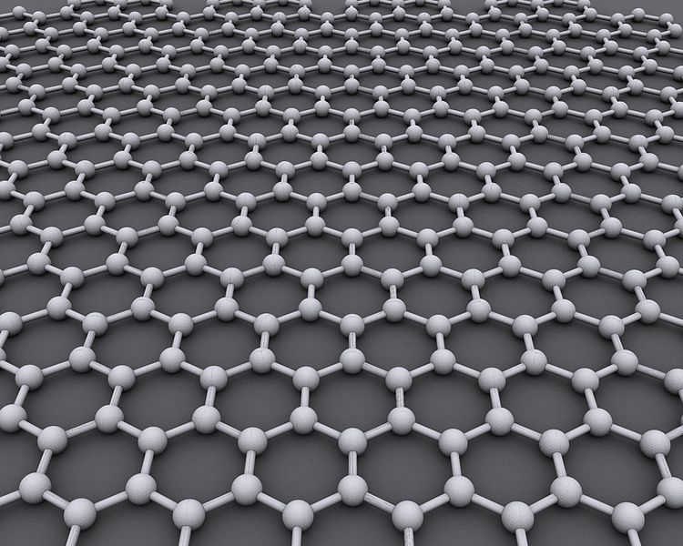
Dream about strongly correlated electron phases
Graphene
Thinnest two-dimensional material
& linear band with chirality
Abnormal quantum Hall effect
ultrahigh conductivity
1 THz transistor
half metallicity,
quantum spin Hall effect
spin valves
etc.
Energy
Playground to explore electronic correlations
predicted in a two-dimensional limit
Mott insulator
Kondo effect
Superconductivity
Magnetism
Exciton condensation
etc.
Momentum

Slide 16
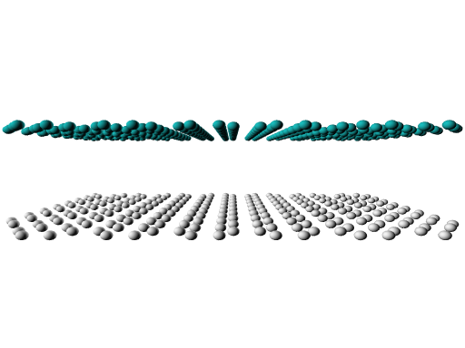
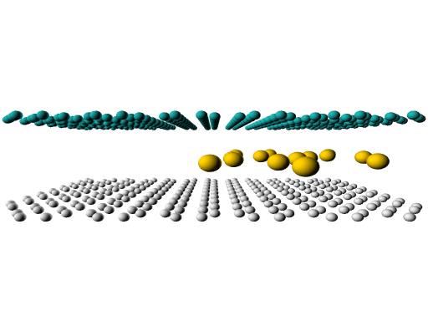
Dream about strongly correlated electron phases
Graphene
A light element, carbon, only with 6 electrons confined in a 2D system
spin-spin
interactions
electron-electron
interactions
Graphene + adsorbates
Graphene + substrate

Slide 17
Electron-electron interactions in Fermi liquids
Fermi liquids
Galilean invariance
Rb_{0.8}Fe₂S₂
E–E_{F} (eV)
Rb_{0.8}Fe₂SSe
Rb_{0.8}Fe₂Se₂
k (π/a)
Yi et al., PRL (2011)
Notes:
In order to understand electron-electron interactions, it is important to note the difference between Fermi liquids and Dirac Fermions.
Fermi liquids are described by Galilean invariant theories whose main parameter is effective mass. For Fermi liquids, as electron-electron interactions become stronger, the effective mass becomes heavier so that Fermi velocity is decreasing.
In the same analogy with Fermi liquid, the main parameter of Dirac fermions is velocity which is described by Lorentz invariant theories. Similar to Fermi liquid, velocity is also affected by electron-electron interactions. However, with increasing interactions, the velocity is also increasing in contrast to Fermi liquid.
Base on this theoretical expectation along with the easiness of graphene to modify electron band structure, graphene is viewed as a prototypical two dimensional electron system for Fermi velocity engineering.

Slide 18
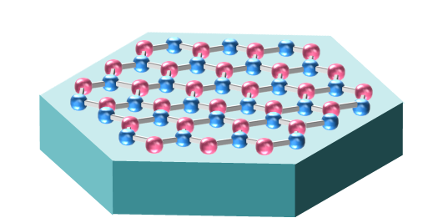
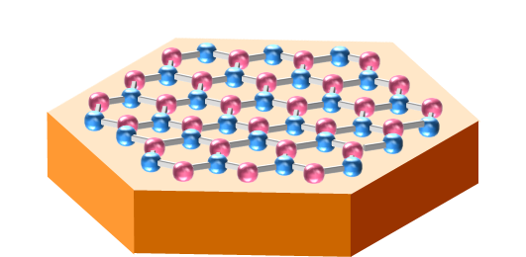
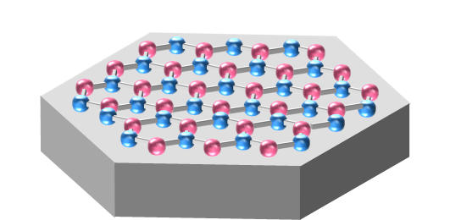
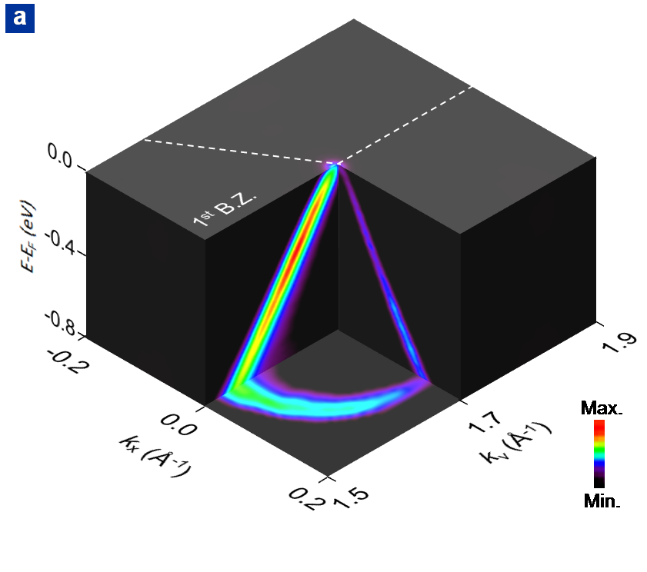
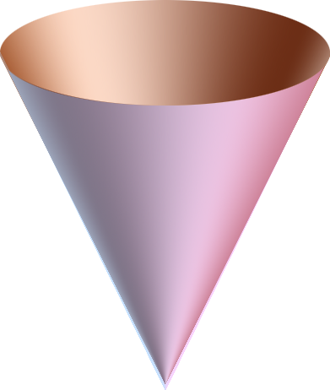

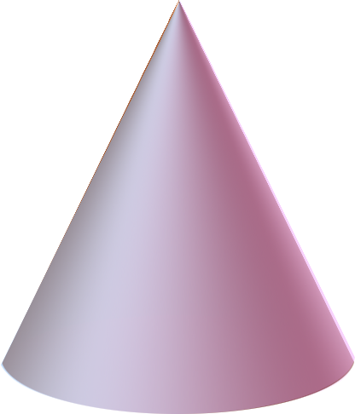

Graphene on dielectric substrates
SiC(0001)
h-BN
Quartz
0.0
0.05 Å⁻¹
Μ
Γ
Κ
− 0.5
E − E_{F} (eV)
−1.0
momentum
Siegel, Hwang et al., PNAS (2011)
Hwang et al., Sci. Rep. (2012)

Slide 19
Fermi liquids vs. Dirac fermions
Non-Fermi liquid behavior
by a dielectric substrate
Dirac Fermions
Lorentz invariance
3
G/Quartz
Increasing curvature
2
v_{F} / v₀
G/BN
G/SiC(0001)
1
LDA
Increasing el-el interactions
0
0
0.5
1.0
1.5
Fine Structure Constant
Hwang et al., Sci. Rep. (2012)
Das Sarma et al., PRB (2007)

Slide 20
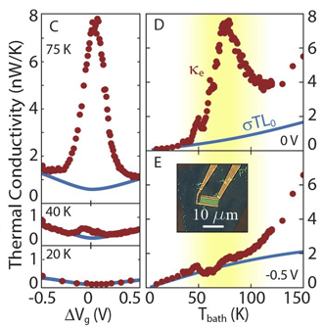
Control parameters of el-el interactions
Possible formation of
strongly coupled Dirac fluids
by temperature
Non-Fermi liquid behavior
by a dielectric substrate
a smart choice of a substrate
+
proper control of temperature
||
strong electronic correlations?
3
G/Quartz
2
v_{F} / v₀
G/BN
G/SiC(0001)
1
LDA
0
0
0.5
1.0
1.5
Fine Structure Constant
Hwang et al., Sci. Rep. (2012)
Crossno et al., Science (2016)

Slide 21
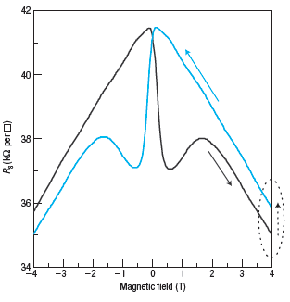
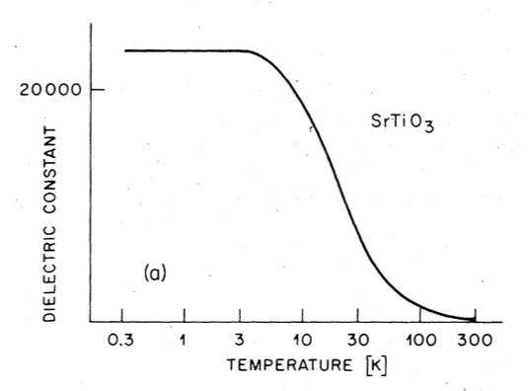
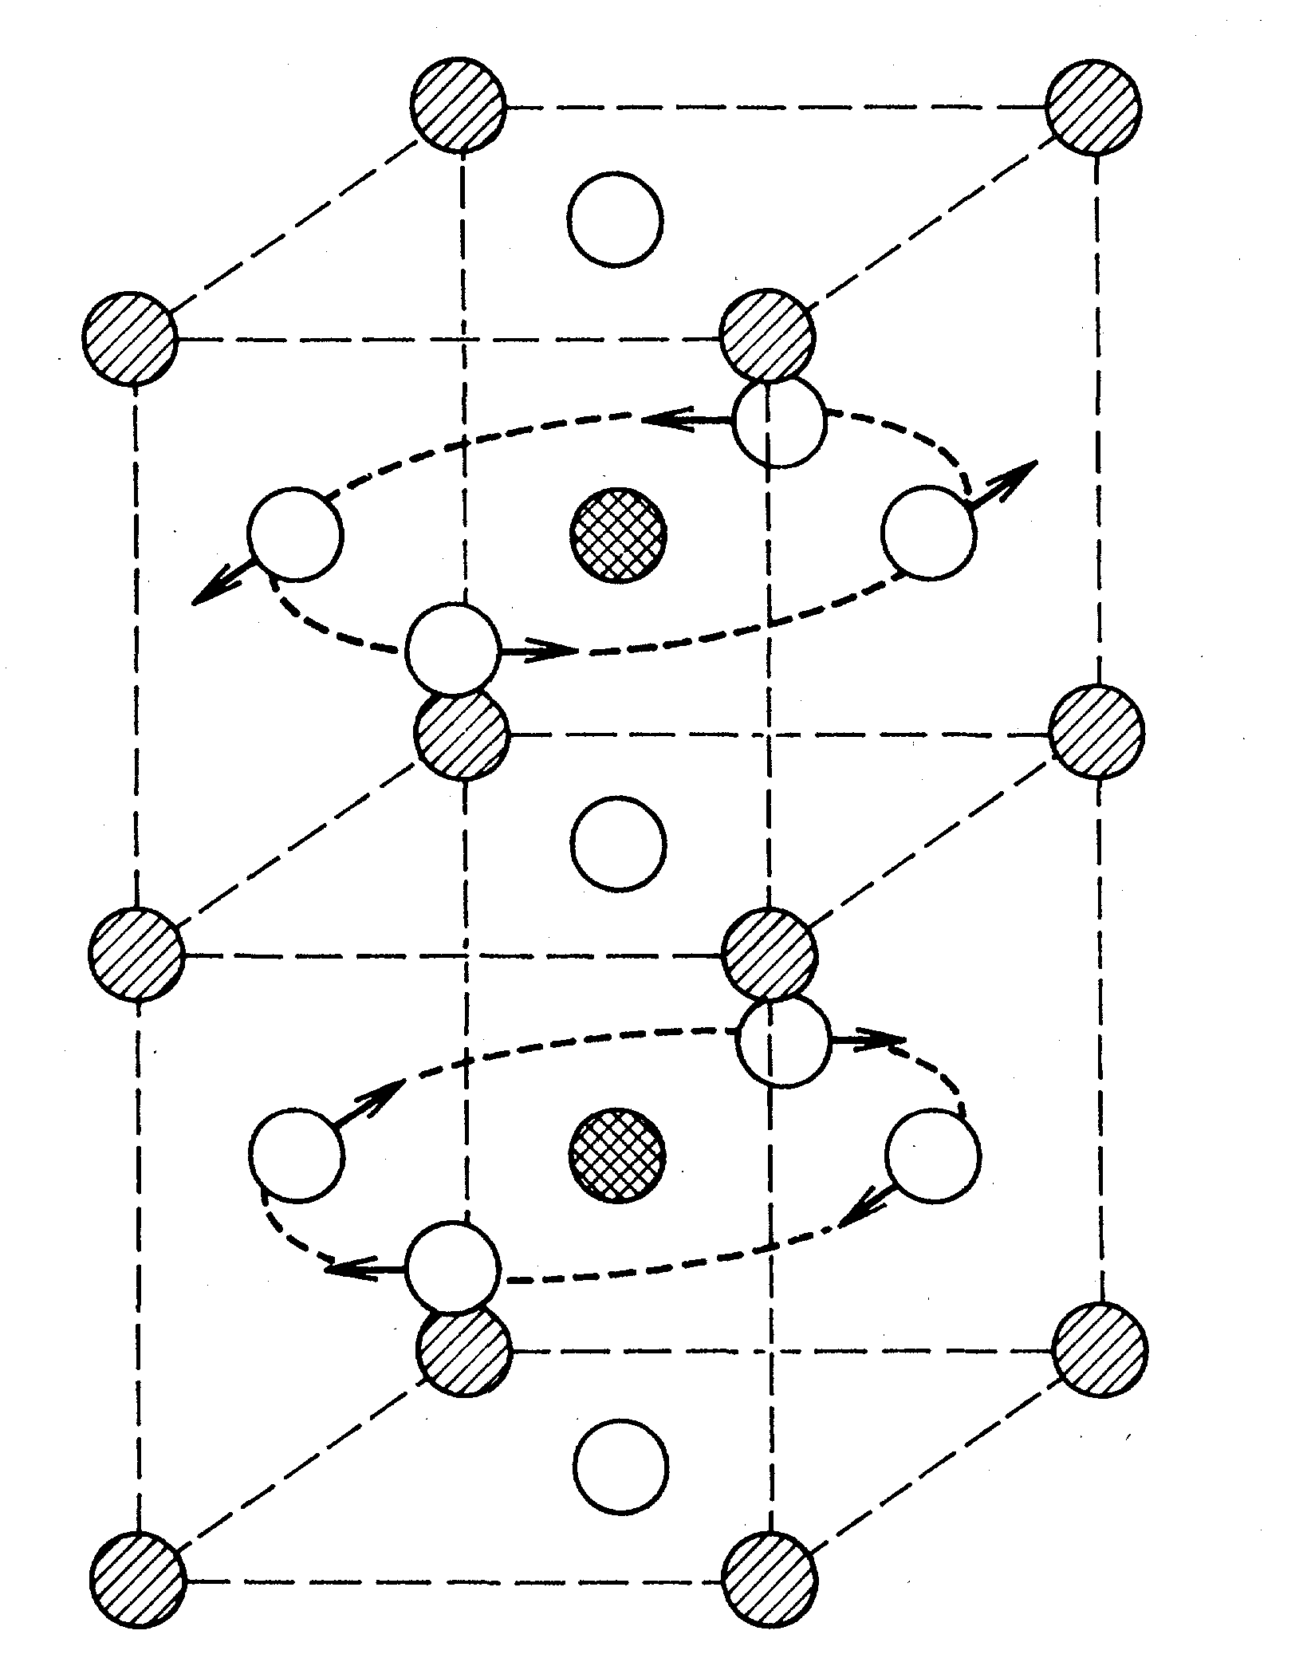
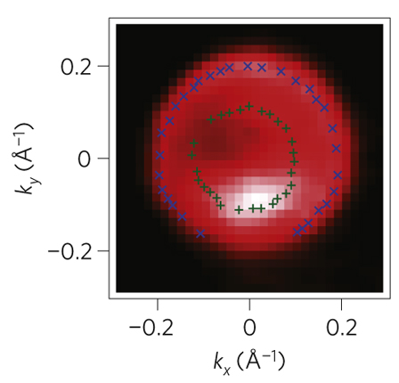
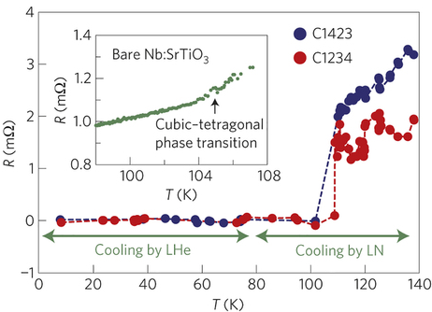
Graphene on SrTiO₃
1. Interesting material
by itself
2. Host material
for exotic properties
SrTiO₃
Dielectric constant ε
15000
SrTiO₃
0.3
1
3
10
30
100
300
Temperature (K)
Muller et al.,
PRB (1979)
LAO/STO
Brinkman et al.,
Nature (2007)
Quantum Paraelectricity
Scott, RMP (1974)
2DEG
Meevasana et al.,
Nat. Mater. (2011)
FeSe/STO
Ge et al., Science (2015)

Slide 22
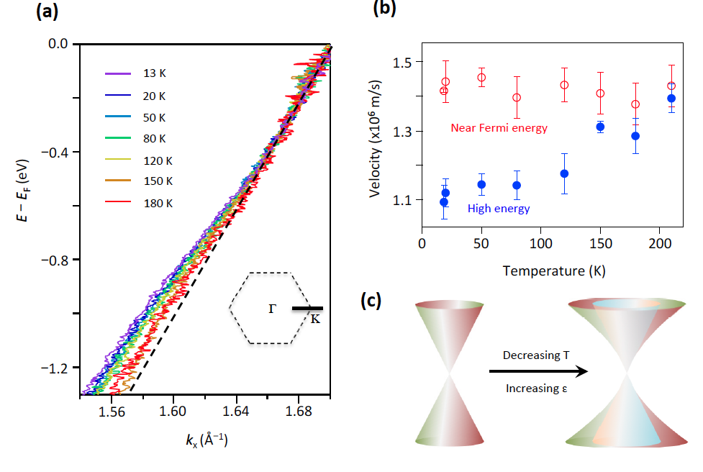
Strong enhancement of el-el interaction
1. Departure from linearity
2. Logarithmic self-energy
0.0
0.4
180 K
180 K
0.4
0.0
180 K
ReΣ (eV)
–1.0
− 0.6
E − E_{F} (eV)
LDA
0.0
0.0
ReΣ (eV)
−0.14
0.02
k-K (Å⁻¹)
13 K
Γ
Κ
Decreasing T
0.2
–2.0
−1.2
–1.7
–0.7
0.3
−0.14
−0.02
0.0
Temperature-controlled
k-K (Å⁻¹)
−0.14
0.02
H. Ryu, C. Hwang et al., Nano Lett. 17, 5914 (2017)
k-K (Å⁻¹)
strong electron-electron interaction

Slide 23
Outline
1. Why do we study electrons?
2. How do we study electrons?
3. Dream about strongly correlated electron phases
in a 2D world: graphene
Role of a substrate: electron-electron interactions
Role of a dopant: spin-spin interactions: Kondo effect
Notes:
First of all, let me introduce outline of my talk.
I will briefly introduce magnetic and electronic properties of graphene that will be followed by brief introduction my main experimental tool, angle-resolved photoemission spectroscopy or ARPES.
Then I will discuss about our recent studies on magnetic ordering and fermi velocity engineering in graphene.

Slide 24
Role of a dopant: Kondo effect
Formation of a resonant-type hybridized many-body ground state
Decreasing temperature
Formation of
many-body
ground state
(Kondo resonance)
Τ > Τ_{K}
Local
magnetic
moment
(4f or 3d electrons)
Τ ≈ Τ_{K}
Screening by
spins of
metallic
background
Τ < Τ_{coh}

Slide 25
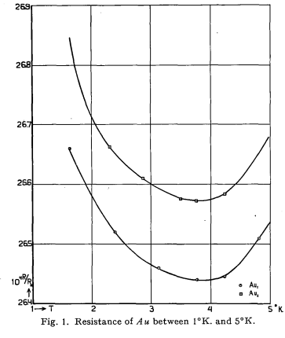
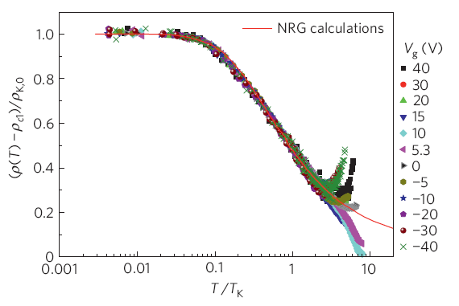
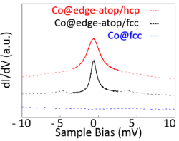
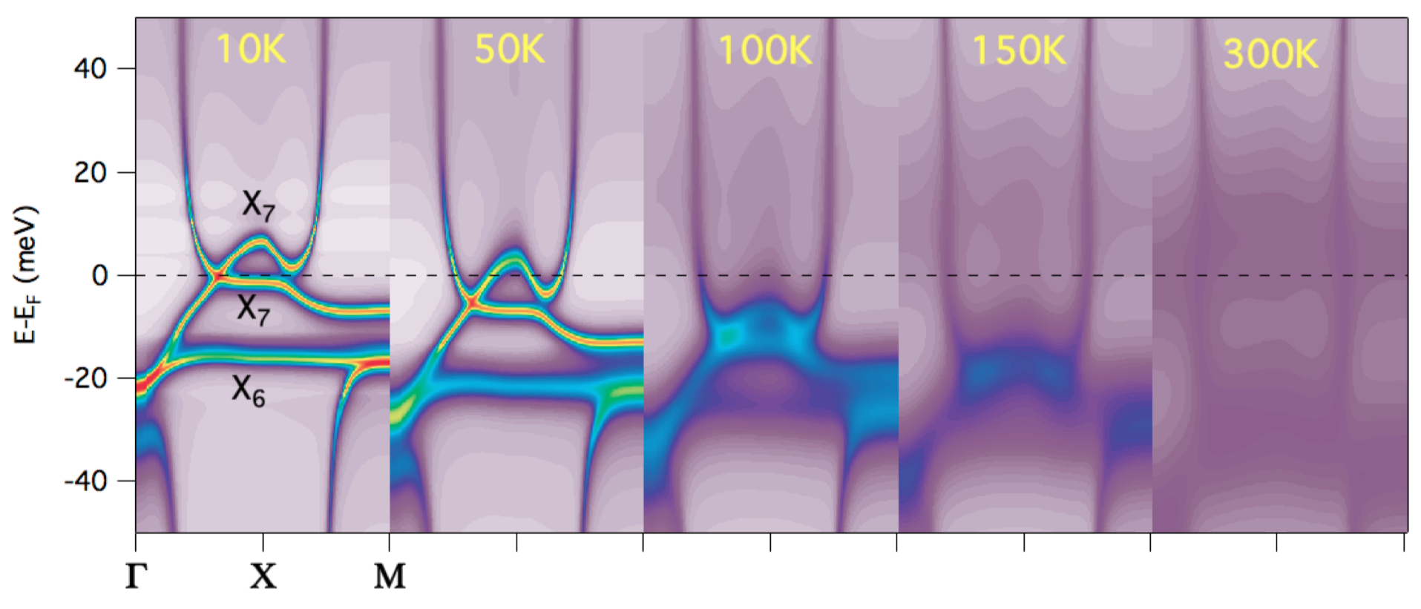
How do we know the Kondo effect?
Transport: increasing ρ
Transport: scaling
Resistance
Temperature
de Boer et al., Physica (1933)
Chen et al., Nature Phys. (2011)
Spectroscopy:
Zero-bias resonance peak
Spectroscopy (ARPES):
T-dependent hybridization
Ren et al., Nano Lett. (2014)
Denlinger et al., arXiv:1312.6637

Slide 26
Graphene: partially decorated with Cerium
0
−1
Energy (eV)
−2
−3
0.0
36 K
0.0
−0.2
0.0
0.2
Momentum (Å⁻¹)
–0.5
Κ
–0.5
–1.0
Γ
–1.0
E – E_{F} (eV)
–1.5
–1.5
–2.0
Max.
Min.
–2.0
E_{photon}= 80 eV
–2.5
–2.5
–0.4
0.0
0.4
–0.4
0.0
0.4
k_{x} (Å^{–1})
k_{x} (Å^{–1})
As-grown
graphene
+
Graphene
with cerium

Slide 27
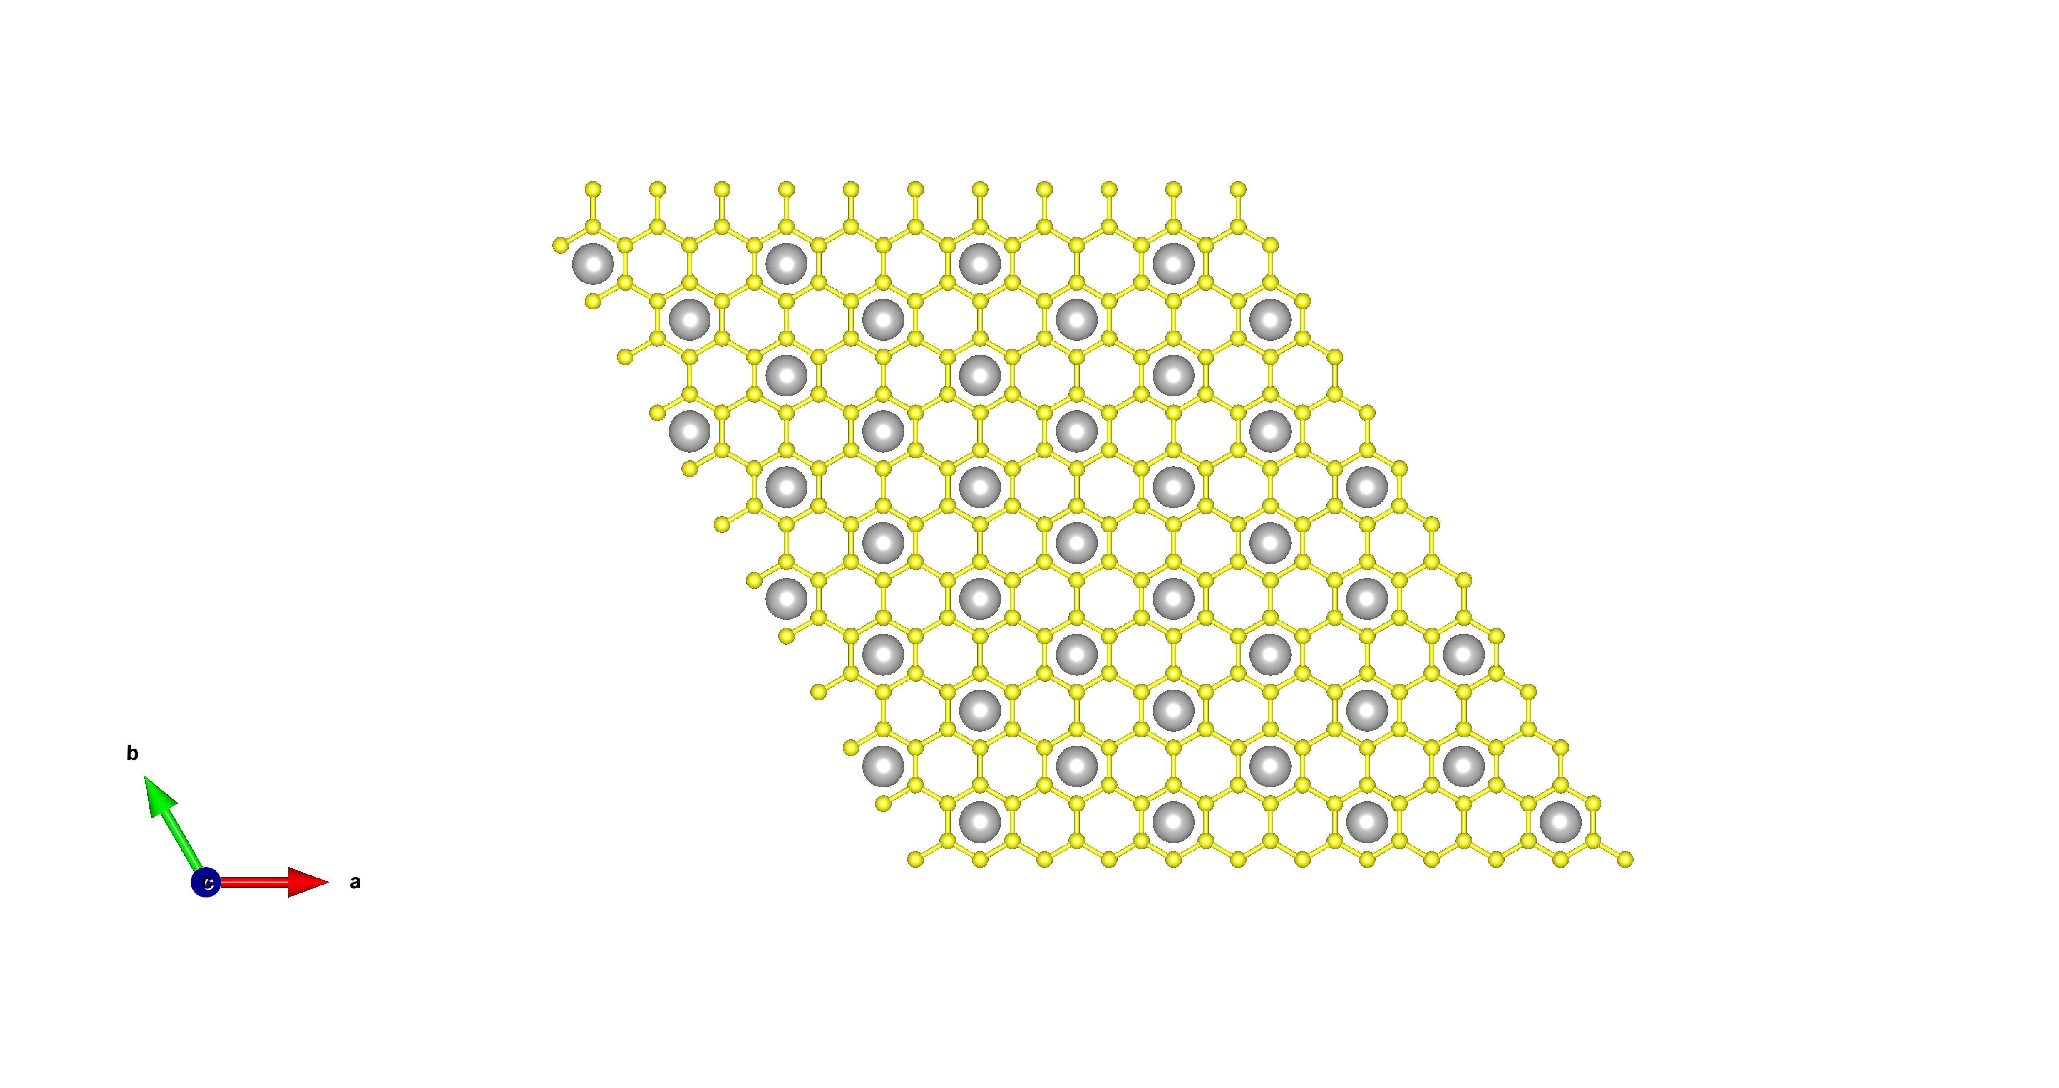
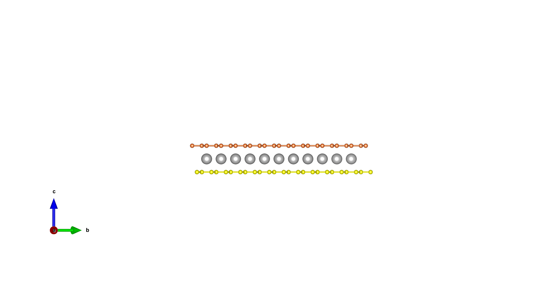
Graphene: partially decorated with Cerium
Top view
Ce 5d
0.0
35 K
DFT+U
–0.5
Graphene
–1.0
E – E_{F} (eV)
As-grown
graphene
–1.5
Tight-binding
–2.0
Side view
Ce 4f
E_{photon}= 120 eV
Graphene
–2.5
Cerium
–0.4
0.0
0.4
Buffer layer
Localized 4f electron from cerium
+
Metallic background from graphene
||
Are they interacting with each other?
k_{x} (Å^{–1})

Slide 28
Energy spectrum close to Fermi energy
J. Hwang, C. Hwang et al., Nano Lett. 18, 3661 (2018)
0.0
Κ
E – E_{F} (eV)
Γ
–1.0
290 K
290 K
–1.0
0.0
1.0
–1.0
0.0
1.0
k_{x} (Å^{–1})
k_{x} (Å^{–1})

Slide 29
Energy spectrum close to Fermi energy
J. Hwang, C. Hwang et al., Nano Lett. 18, 3661 (2018)
0.0
–1.0
210 K
210 K
E – E_{F} (eV)
0.0
Κ
Γ
–1.0
290 K
290 K
–1.0
0.0
1.0
–1.0
0.0
1.0
k_{x} (Å^{–1})
k_{x} (Å^{–1})

Slide 30
Energy spectrum close to Fermi energy
J. Hwang, C. Hwang et al., Nano Lett. 18, 3661 (2018)
0.0
–1.0
110 K
110 K
0.0
E – E_{F} (eV)
–1.0
210 K
210 K
0.0
Κ
Γ
–1.0
290 K
290 K
–1.0
0.0
1.0
–1.0
0.0
1.0
k_{x} (Å^{–1})
k_{x} (Å^{–1})

Slide 31
Energy spectrum close to Fermi energy
J. Hwang, C. Hwang et al., Nano Lett. 18, 3661 (2018)
0.0
–1.0
18 K
18 K
0.0
–1.0
110 K
110 K
E – E_{F} (eV)
0.0
–1.0
210 K
210 K
0.0
Κ
Γ
–1.0
290 K
290 K
–1.0
0.0
1.0
–1.0
0.0
1.0
k_{x} (Å^{–1})
k_{x} (Å^{–1})

Slide 32
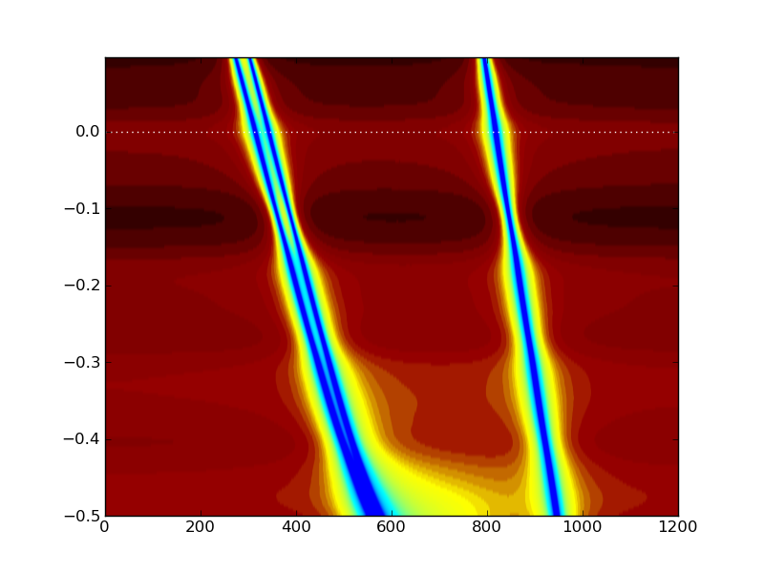
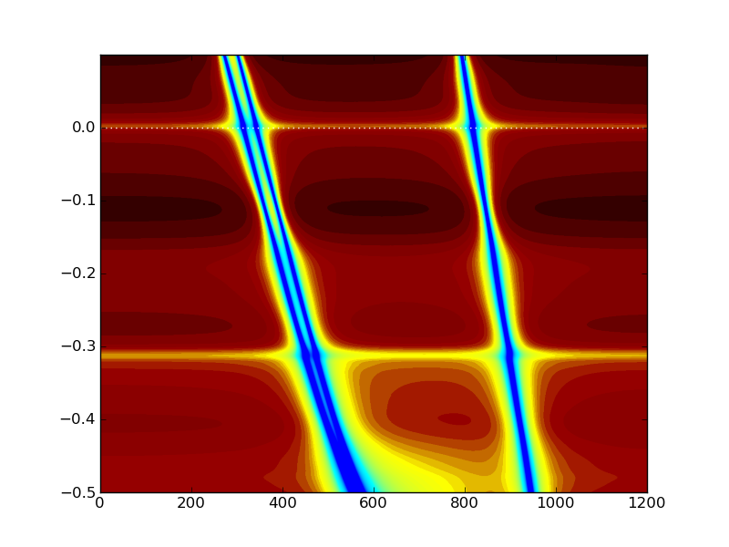
Temperature-dependent spectral change
J. Hwang, C. Hwang et al., Nano Lett. 18, 3661 (2018)
18 K
60 K
110 K
160 K
210 K
260 K
290 K
18 K
60 K
110 K
160 K
210 K
260 K
Spectral Intensity (a. u.)
Subtracted Intensity (a. u.)
Calculations within the Dynamic Mean-Field Theory
300 K
20 K
0.0
–0.6
–0.4
–0.2
0.0
0.2
–0.6
–0.4
–0.2
0.0
0.2
E – E_{F} (eV)
–0.2
E – E_{F} (eV)
E – E_{F} (eV)
Κ
–0.4
Γ
Κ+Μ
Κ
DOS
Κ+Μ
Κ
DOS

Slide 33
Realization of Kondo resonance in a 2D limit
J. Hwang, C. Hwang et al., Nano Lett. 18, 3661 (2018)
Photoemission final states (Kondo resonance)
Kondo peak
Spin-orbit side band
4f₁→4f₀ ionization peak
E_{F}
E_{F}
E_{F}
4f_{7/2}
4f_{7/2}
4f_{7/2}
4f_{5/2}
4f_{5/2}
4f_{5/2}
Calculations within the Dynamic Mean-Field Theory
ħω
300 K
20 K
0.0
Kondo peak
E – E_{F} (eV)
–0.2
Κ
Spin-orbit side band
–0.4
Γ
Κ+Μ
Κ
DOS
Κ+Μ
Κ
DOS

Slide 34
Realization of Kondo resonance in a 2D limit
J. Hwang, C. Hwang et al., Nano Lett. 18, 3661 (2018)
MDC
0.0
36 K
Fit
–0.1
–0.2
kink
E – E_{F} (eV)
–0.3
–0.4
Κ
Kondo effect
Min.
–0.6
Max.
–0.5
Γ
in the sea of 2D Dirac fermions,
Graphene
–0.4
–0.1
–0.4
–0.2
0.0
0.2
k_{x} (Å^{–1})
k_{x} (Å^{–1})
Calculations within the Dynamic Mean-Field Theory
300 K
20 K
0.0
Kondo peak
E – E_{F} (eV)
–0.2
Κ
Spin-orbit side band
–0.4
Γ
Κ+Μ
Κ
DOS
Κ+Μ
Κ
DOS

Slide 35


Summary
Enhanced electronic correlations
Non-Fermi liquid behavior of charge neutral graphene
Decreasing T
T-dependent electronic correlations in graphene
Magnetic correlations
Kondo effect in graphene
A binary compound of graphene and a magnetic impurity
Dream about strongly correlated electron phases?
Smart choice of substrate and adsorbate/dopant
leading to even stronger electronic correlations
Viable route towards superconducting and
magnetic graphene at high temperatures

Slide 38


What do we learn from momentum resolution?
BSCCO
superconducting
A
Intensity
metallic
B
E-E_{F} (eV)
Z.X. Shen et al., PRL (1993)

Slide 39
The future of photoemission
What is missing? Time and Spin
Time resolved photoemission
To study excitation and phase transitions
Spin resolved photoemission
To access spin degrees of freedom

Slide 40



The mystery of high T_{C} superconductivity
- Why do we need these additional resolutions?
1) Is there a Quantum Critical
Point?
2) What is the nature of NFL region?
3) What defines the Pseudogap (PG)
phase?
4) What are the basic excitations?
5) Is SC a consequence of QCP or is
it hiding the QCP?
6) Are PG and SC state competing
states of matter?
Temperature
FL
F
UD
g = Doping
OD
Quantum
Critical
(NFL)
SC
CDW
DDW
SDW
Quantum
Critical
(NFL)
AFM
VB
FL
FM
g_{c}
g
We need time and spin resolutions

Slide 41


Time-resolved ARPES
Pump-Probe, ultrafast ARPES:
Energy conservation
E_{B} = ħω - E_{K} – Φ_{A}

Angle / momentum conservation
k║ √E_{k} sin θ





sample
Time Resolution
A(k, ω, t-t′)
Possibilities:
Quasiparticle lifetimes
Ultrafast phase transitions
Photoelectron intensity
Closing/opening of gaps
Coherent oscillations
…

Slide 42
The power of time + momentum resolution
High-T_{c} superconductors
T_{c}=91 K
T_{c}< 2 K
Zhang, Hwang et al., Nature Comm. 5, 4959 (2014)

Slide 43
The future of photoemission
What is missing? Time and Spin
Time resolved photoemission
To study excitation and phase transitions
Spin resolved photoemission
To access spin degrees of freedom

Slide 44


Spin-ARPES
Spin + time-resolved ARPES
Energy conservation
E_{B} = ħω - E_{K} – Φ_{A}

Angle / momentum conservation
k║ √E_{k} sin θ






sample
Time resolution
A(k, ω, t-t′)
Critical for:
Fundamental magnetism
Magnetic phase transitions
Topological Insulators
Spin resolution
P_{x}, P_{y}, P_{z}
Colossal magnetoresistance
FeAs superconductors
…

Slide 45





Light-spin interactions in topological insulator
y
Spin-resolved Geometry:
y
θ
θ
s-pol
6 eV laser
x
x
45°
45°
p-pol
P_{y}
z
P_{y}
z
e ⁻
e ⁻
β
β
P_{z}
P_{z}
spectrometer
spectrometer
Standard ARPES:
Full Spin Polarization Maps:
Photoelectron spin polarization is fully flipped by rotating photon polarization!
Jozwiak, Hwang et al., Nature Phys. 9, 293 (2013)

Slide 46
Singlet ground states vs PES final states
Singlet ground state
E_{F}
E_{F}
4f_{7/2}
4f_{7/2}
4f_{5/2}
4f_{5/2}
ħω
Photoemission final states
Kondo peak
Spin-orbit side band
4f₁→4f₀ ionization peak
E_{F}
E_{F}
E_{F}
4f_{7/2}
4f_{7/2}
4f_{7/2}
4f_{5/2}
4f_{5/2}
4f_{5/2}

Slide 47
Graphene: partially decorated with Cerium
0
−1
Energy (eV)
−2
−3
0.0
36 K
0.0
−0.2
0.0
0.2
Momentum (Å⁻¹)
–0.5
Κ
–0.5
–1.0
Γ
–1.0
E – E_{F} (eV)
–1.5
–1.5
–2.0
Max.
Min.
–2.0
E_{photon}= 80 eV
–2.5
–2.5
–0.4
0.0
0.4
–0.4
0.0
0.4
k_{x} (Å^{–1})
k_{x} (Å^{–1})
Graphene
with cerium
+
As-grown
graphene

Slide 48
Realization of Kondo resonance in a 2D limit
Hwang et al., Nano Lett. 18, 3661 (2018)
ħω
Photoemission final states (Kondo resonance)
Kondo effect
Kondo peak
Spin-orbit side band
in the sea of 2D Dirac fermions,
Graphene
4f₁→4f₀ ionization peak
E_{F}
E_{F}
E_{F}
4f_{7/2}
4f_{7/2}
4f_{7/2}
4f_{5/2}
4f_{5/2}
4f_{5/2}
Calculations within the Dynamic Mean-Field Theory
300 K
20 K
0.0
Kondo peak
E – E_{F} (eV)
–0.2
Κ
Spin-orbit side band
–0.4
Γ
Κ+Μ
Κ
DOS
Κ+Μ
Κ
DOS

