Slide 1


VASSCAA-9 meeting, Sydney, Australia. August 13th-16th, 2018
Dye Giant Absorption and Light Confinement Effects in Porous Microcavities
M. Oliva-Ramírez, J. Gil-Rostra, Adam C. Simonsen, F. Yubero, A.R. González-Elipe,
Institute of Materials Science of Seville, Spain
yubero@icmse.csic.es
Notes:
Good morning. Thanks for coming to my contribution to this conference.
My name is Francisco Yubero and the title of my talk is
“Dye Giant Absorption and Light Confinement effects in Porous Microcavities”
This work has been done at the Institute of Materials Science of Seville in Spain

Slide 2
VASSCAA-9 meeting, Sydney, Australia. August 13th-16th, 2018
Dye Giant Absorption and Light Confinement Effects in Porous Microcavities
Porous Bragg microcavities as sensing transductors for condensed vapors, transparent fluids and dye solutions
M. Oliva-Ramírez, J. Gil-Rostra, Adam C. Simonsen, F. Yubero, A.R. González-Elipe,
Institute of Materials Science of Seville, Spain
yubero@icmse.csic.es
Notes:
Good morning. Thanks for coming to my contribution to this conference.
My name is Francisco Yubero and the title of my talk is
“Dye Giant Absorption and Light Confinement effects in Porous Microcavities”
This work has been done at the Institute of Materials Science of Seville in Spain

Slide 3

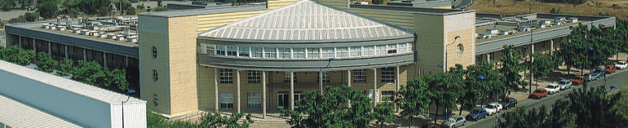
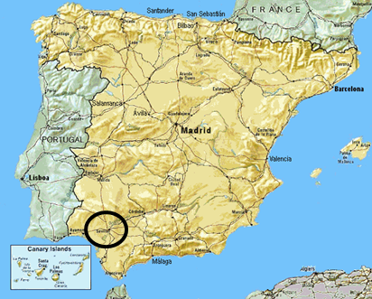
Institute of Materials Science of Seville (CSIC-US), Spain
http://www.icmse.cartuja.csic.es/
Size: (∼45 senior scientists, ∼55 PhD, post-docs, ∼30 technicians, administration)
Research units:
Engineered Ceramics for Extreme Environments
Catalysis for Environment and Energy
Mechanochemistry and Reactivity of Materials
Tailored Nanomaterials and Microstructure
Nanostructured Functional Materials
  Nanotechnology on Surfaces research group
  http://sincaf.icms.us-csic.es/
  (∼7 senior scientists, ∼5 PhD/post-docs)
Applied/fundamental activity on:
Functional thin films (PVD, plasma-CVD)
Sensors (microfluidic, optical, …)
Fuel cells, solar cells,
Photocatalysis, plasma catalysis,
Dichroic mirrors, luminescent films
1D nanostructures, plasma polymers,
Wetting
…

Slide 4
Porous Bragg microcavities as sensing transductors for condensed vapors, transparent fluids and dye solutions
OUTLINE OF THE TALK
  Scientific context
  Birefringent Sculptured Bragg Microcavities (SBM): microstructure and optical response
  Application for vapor monitoring
  Application for liquid monitoring
  Light Confinement Effects in SBM
  Summary

Slide 5
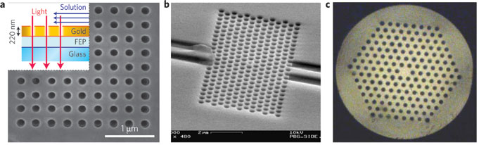
Scientific context: optofluidics & porous thin films
Optofluidics: Integration of photonics and microfluidics
Pores within a thin film: Extremely small detection volumes: femto to nanolitres
Maximize light-analyte interaction (biological/chemical analysis)
Lab-on-a-chip concept
In situ during process reaction (i.e., operando) analysis
Label-free analysis
Liquid analysis: RI
Many possibilities based on 2D structures
Plasmonics
Photonic crystals
PC Fibers
Nano Lett. 8,
2718–2724 (2008)
Opt. Express 15,
4530–4535 (2007)
Opt. Express 14,
8224–8231 (2006)
Challenge:
Exploring the opportunities of porous birefringent multilayer structures as optofluidic sensors within a lab-on-a-chip approach

Slide 6
Scientific context: fluid/vapor optical sensing with porous films
(SiO2 or TiO2)/H3Sb3P2O14 Bragg stacks
Infiltration + swelling
touchless positioning interfaces
  Reflection band position depends on layer(multilayer) thickness and refractive index (RI)
  Individual layer effective RI varies with the amount of condensed vapor and the RI of infiltrated liquid (effective medium theories)
Szendrei et al. Adv. Mater. 27 2015 6341

Slide 7
Scientific context: fluid/vapor optical sensing
(SiO2 or TiO2)/H3Sb3P2O14 Bragg stacks
Beetles Tmesisternus isabellae
Infiltration + swelling
Liu et al. Optics Express 17 (2009) 16184
Sensing/reaction based on color change
Szendrei et al., Adv. Mater. 27 (2015) 6341

Slide 8
Scientific context: optical fluid/vapor sensing
TiO₂ STF (distributed Bragg mirror)
SiO₂/TiO₂ sculptured zig-zag DBM
color based humidity vapor sensing
color based liquid sensing
Hawkeye et al. Adv. Funct. Mater. 21 2011 3652
L. González-García et al. J. Mater. Chem. 20 2010 6408

Slide 9

Bragg microcavity basic sensing architecture
TiO₂
SiO₂
Bragg microcavity (simple photonic structure) is made incorporating a ”defect” in a Bragg reflector
  Resonant peak RP (narrow pass-band within the photonic band gap) appears
  RP position depends on layer(multilayer) refractive index (RI)
  Individual layers with high open porosity (about 50% void fraction)
  Individual layers effective RI varies with RI of infiltrated liquid (effective medium theories)
    RP position monitors RI of infiltrated phase (well-known)

Slide 10
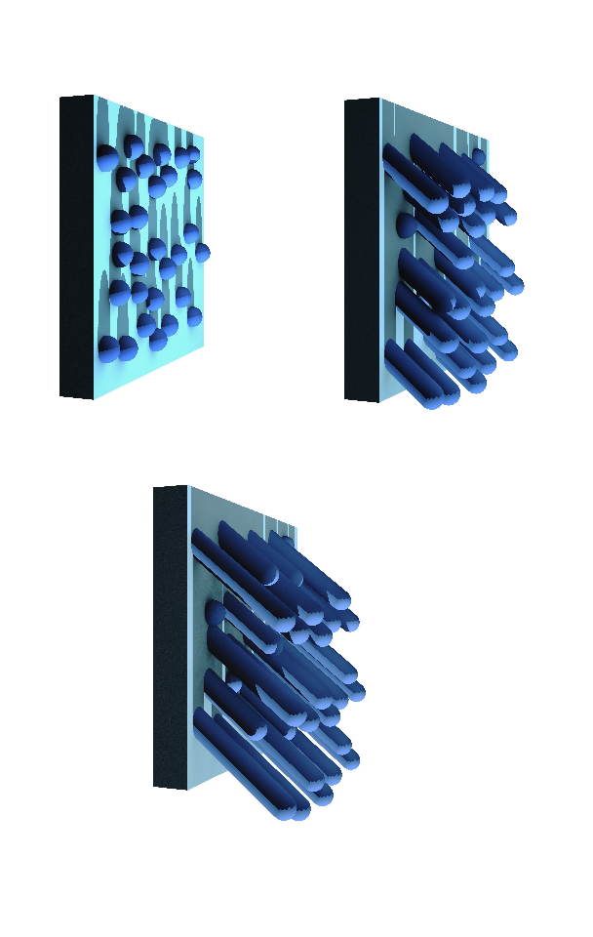
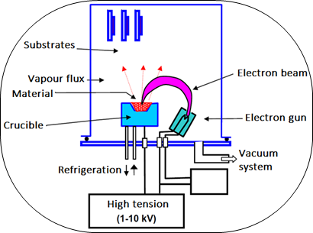
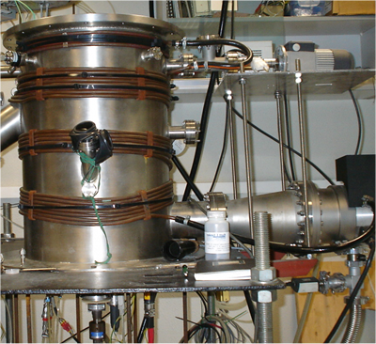
Multilayer preparation:
Technology: PVD-GLAD (EBE)
Materials: TiO₂/SiO₂
Process pressure 2-3x10⁻⁴ mbar
Crucible-substrate distance ∼50 cm
Deposition rate ∼6nm/min
φ
α

Slide 11
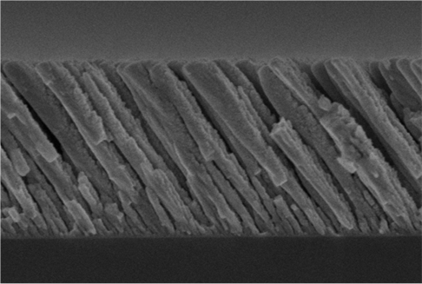
Sample preparation: GLAD-PVD technology
Initial nucleation centers act as “barriers” for the following arriving particles
source
α
Plane of incidence
β
shadowed area
GLAD-PVD film
substrate
0.5 µm
substrate
Shadowing induces porosity at macro (in-between columns), meso, and micro (inside columns) levels and anisotropic growth

Slide 12
Sample preparation: GLAD-PVD technology
Kranenburg 1993
substrate
No-shadowing in the direction perpendicular to the plane of incidence
→ Column bundling may take place (column fan out)

Slide 13

SBM with slanted, zig-zag , vertical architectures
SiO₂
TiO₂
At the surface: Slanted and zig-zag show preferential arrangement of material along the direction perpendicular to the vapor flux
→ bundling phenomena

Slide 14
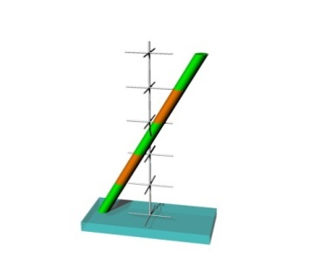
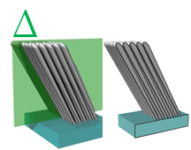
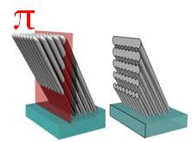
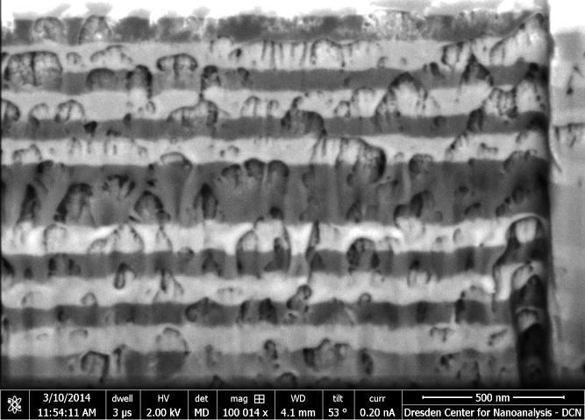
slanted SBM (FIB-SEM)
p
s
Slanted p
Slanted s
500nm
500nm
Within the BM thickness:
Mesoporous extend the whole BM thickness
Self-association of columns (along s direction) even with material change → Fence-bundling

Slide 15
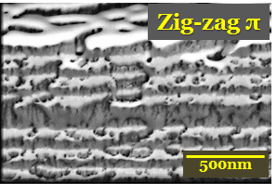
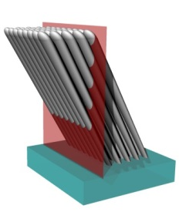
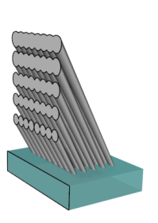




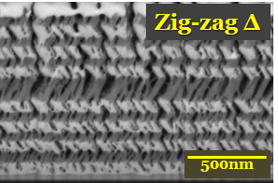
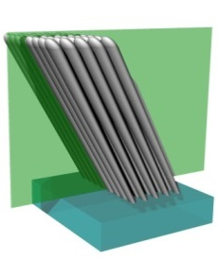
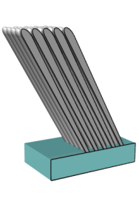

zig-zag SBM (FIB-SEM)
π
s
←Fence-bundling
Δ
p

Slide 16
Sample preparation: GLAD-PVD technology
Two optical axis (p,s) for normal incidence optical analysis
Column bundling modulated by
Process pressure
Initial surface patterning
Temperature
Geometry of deposition
Higher material connectivity (i.e., polarizability, RI) along s than p direction
Anisotropic microstructure ←→ Anisotropic optical performance

Slide 17
Optical response of SBM
Analysis with unpolarized light
BMs with fence-bundling
→ double resonant peak
BMs without fence-bundling
→ single resonant peak

Slide 18
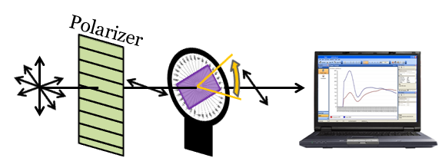
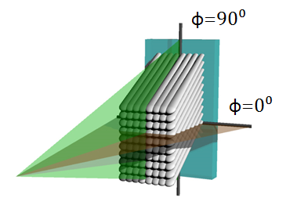
Optical activity of BMs
Analysis with polarized light
ϕ
Fence-bundling induces strong optical polarization activity
ϕ=90⁰ (p)
ϕ=0⁰ (s)
ϕ=0⁰ → fence-bundling
ϕ=90⁰ → ⊥ fence-bundling

Slide 19
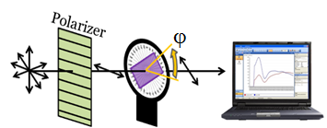
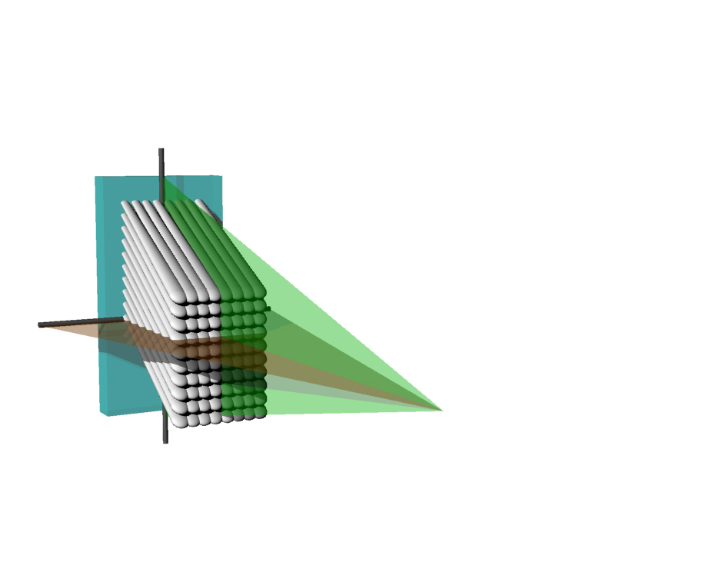



Optical activity of SBMs
Simulated as
uniaxial birefringent BM stack
Fast optical axis (low n)
⊥ fence-bundling
∆n=(n_{e}-n_{o})=n_{⊥b}-n_{b}
TiO₂ ∆n=-0.150
Slow optical axis (high n) fence-bundling
∆n_{calcite} =-0.172
∆n_{quartz} =+0.009
SiO₂ ∆n=-0.043

Slide 20
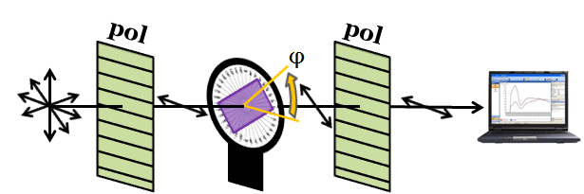
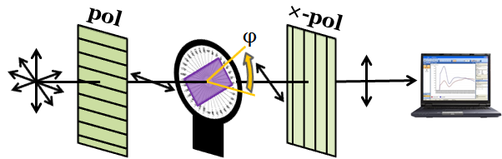
SBMs as optical retarders
Optical retarder
Slanted and zig-zag SBMs act as strong wavelength dependent optical retarders

Slide 21
SBMs as wavelength dependent retarders (empty)
If T_{II} = T_{X} →
SBM behaves as quarter waveplate

Slide 22
Vapor sensing with SBM

Slide 23
Vapor sensing with SBM
Initial peak shift (pore filling) without loss of birefringence
After a while, birefringence start to diminishes

Slide 24
Vapor sensing with SBM
GLAD TiO₂
Gonzalez-Garcia et al.
Nanotechnology 23 (2012) 205701
Hysteresis as in typical isotherms of mesoporous materials

Slide 25
Vapor sensing with SBM
Hysteresis loop as in typical Type IV-V isotherm of mesoporous materials:
  First, monolayer/multilayer adsorption (mainly filling the micropores)
  Then, capillarity condensation in mesopores
Birefringence change (note it varies by a factor 5 !!!) monitors site dependent vapor adsorption

Slide 26
Vapor sensing with SBM
Fill/empty
micropores
Fill/empty
mesopores
Birefringence change monitors site-dependent vapor adsorption (varies by a factor 5)!!!

Slide 27
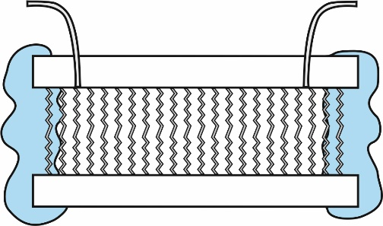
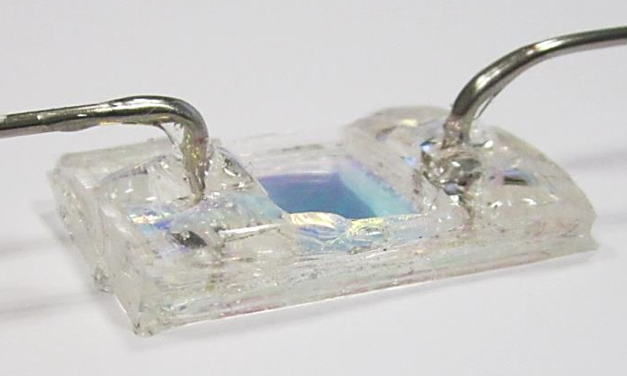
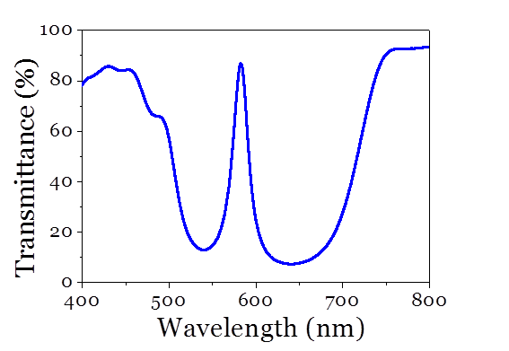
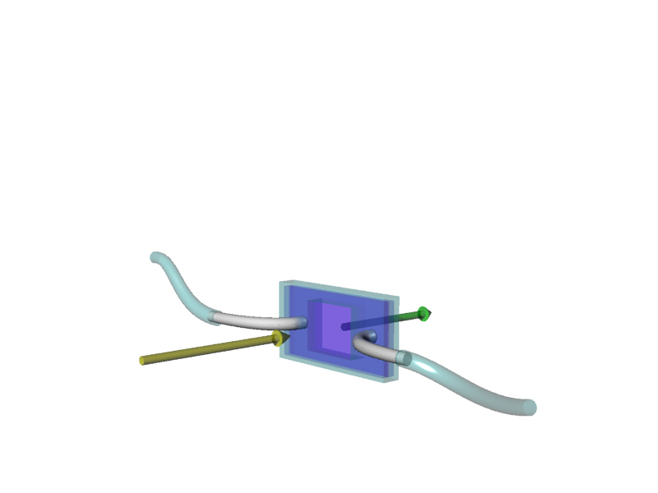

Liquid sensing within a microfluidic device
Flow of liquids through the BM
Lab on a chip
Infiltration is fast, reproducible and robust
Small volumes analyzed (1mm² → ∼1nl)

Slide 28
basic optofluidic response of SBM
Unpolarized light
Vertical SBM
Resonant peak (RP) positions
toluene
Cl-benzene
ethanol
water
air
toluene
Cl-benzene
ethanol
air
water
Linear wavelength dependence of the RP position with the liquid refractive index (∼200nm/RIU)
(i.e., if ΔRP=0.2nm then ΔRI=0.001 )
Oliva-Ramirez et al. ACS Appl. Mater. Interfaces (2013)

Slide 29


Optofluidic modulation of BM polarization optical activity
Optofluidic monitoring of glucose in water in a microfluidic device
No hysteresis effects !!!
The ratio A‖/A× can be used as a calibration curve for optofluidic RI determination of liquids
Sensitivity: if A‖/A× varies 0.5% → RI varies ∼0.0003 RIU (∼0.2 brix units)

Slide 30
Microfluidic liquid sensing with SBM
Glucose alcoholic fermentation:
C₆H₁₂O₆ (glucose 180g) → 2 C₂H₅OH (ethanol 92g) + 2 CO₂ (88g).
n_{D} (@587nm, 25ºC) = 1.333 water, 1.362 ethanol
Fermentation kinetics
Jimenez-Marquez et al.
Sensors and Actuators B 225 (2016) 121

Slide 31



Microfluidic liquid sensing with SBM
Led light source
Photodiodes as sensors
I_{ux}
7
1
5
I_{uu}
4
6
7
3
2
1 microfluidic chip, 2 SBM transductor, 3 polarizing beam splitter, 4 polarized light, 7 photodiodos
Patent claimed: “Sensor, apparatus, and method for determining a concentration of solute in a solution” PCT/ES2016/070764

Slide 32
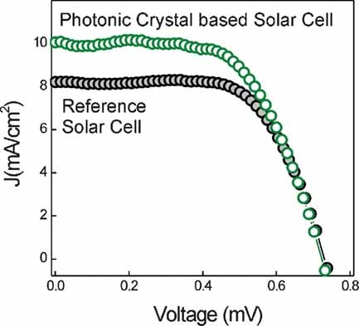
Light confinement effects in SBM
Motivation: to study light trapping in photonic structures due to electric field confinement
1. To enhance luminescence
2. To enhance efficiency in dye-sentitised solar cells
A. Jimenez-Solano et al. Small 11 (2015) 2727)
Colodrero et al. Adv. Mat. 21 (2009) 764
3. To enhance photocatalytic activity
We now focus on:
  Effects of electric field confinement on absorption
The tools needed to make this study
  Porous thin films
  Photonic structure
  Fluidic devices
  Dye solutions
X. Zheng et al. J. Phys. Chem. C 117 (2013) 21263
Notes:
The motivation of this work is in the line of studying light trapping effects in photonic structures due to electric field confinement.
When light propagates in ordered photonic structures, standing waves established, and maxima and minima of the light electric field can be identified at specific locations within the photonic structure
This phenomenon is not new. It is the basis of many research works as these 3 I illustrate here.
1. To enhance the luminescence of dyes incorporated in photonic structures as the one shown here where these authors tune intensity of the luminescence of the dye by placing it at different location within a photonic structure
2. To enhance the efficiency of dye-sentitized solar cells.
3. Or to enhance the photocatalytic activity of 3D inverse opal of titania decorated with dyes
Previous 3 examples show evidences of the light trapping effects in final performance of the developed photonic structure (either luminescence, solar cell efficiency, or photocatalytic activity). Note that previous examples have in common that light absorption has to take place.
In our work we focus on how light absorption of dye solutions infiltrated within porous photonic structures (in particular in the so-called Bragg microcavities) is affected by the electric field localization within the photonic structure.
In the following I am going to introduce the tools we need to make this study:
Basically the porous thin films, photonic structure , the fluidic devices, the dye solutions and the optical characterization set-up

Slide 33
Photonic architecture: Bragg microcavity optical response
TiO₂
SiO₂
Bragg microcavity is a photonic structure with a central layer (defect) in-between two Bragg reflectors
  Resonant peaks RP appears (narrow pass-band within the photonic band gap)
  RP position depends on layer(multilayer) refractive index (RI)
  Number of RP depends on thickness of central layer
  Note that individual layers are very porous (about 50% void fraction)
  Layer effective RI varies with RI of infiltrated liquid (effective medium theories)
Notes:
The photonic structure we have considered in our experiments is a Bragg microcavity with a large central layer (made using TiO2/SiO2 porous layer) .
For those of you that are not familiar with this type of multilayer designs
A Bragg reflector is just a periodic multilayer with alternate layers with refractive index contrast. It shows a photonic band gap (a reflection band)
A Bragg microcavity consist of a central layer (defect) in between two Bragg reflectors. In these conditions and the appropriate layer refractive index and thicknesses, a resonant peak (a narrow pass-band) appears within the Bragg reflector band.
If the thickness of the central layer is increased, several resonant peaks will appear within the reflection band of the Bragg reflectors. We are interested in these particular type of Bragg microcavities to get simultaneously resonant peaks at the absorption and transparent regions of a dye solution.
Note again that the individual layers of this photonic architectures are porous with open porosity and about 50% voids

Slide 34
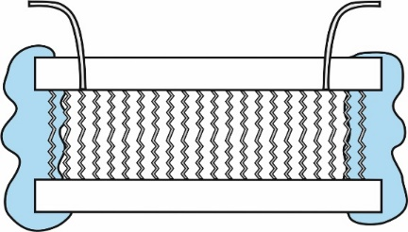
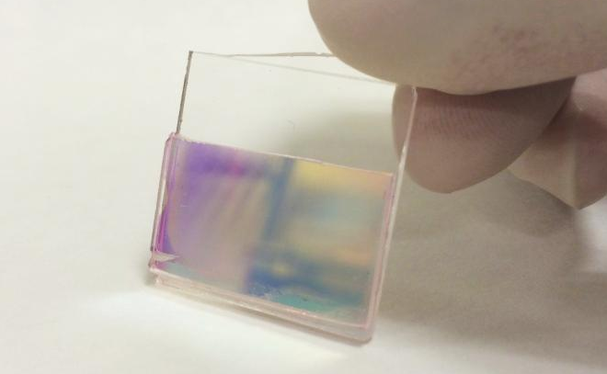

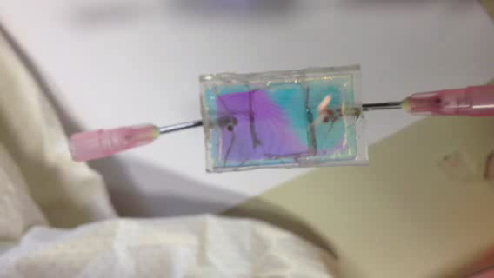

Experimental set-up: microfluidic device including porous BM
BM-Cuvette with Bragg microcavity including slanted architecture
Microfluidic Bragg microcavity including zig-zag architecture
Type 2
Spacers
150μm
BM
Flow of liquids through the BM
Infiltration is fast, reproducible, and robust
Small volumes analyzed (1mm² → ∼1nl)
Lab on a chip
Notes:
And these are our fluidic devices. We encapsulate the zigzag porous multilayer described before within a fluidic device that allow to flow of liquids through its open porosity
The liquid infiltration is fast, and reproducible. The volume analyze is about 1nl (remember thickness of multilayer is about 2 micron
We have also for convenience fabricate a homemade BM-cuvette with our slanted porous BM deposited in the inner side of one of its walls.
We have interrogated optically our fluidic devices with this lab-on-a-chip concept

Slide 35
Why a BM ?
Because there is strong electric field localization at the RP wavelength
Why a porous BM ?
To let liquid flowing through its open pore structure
Why a porous BM with a large defect ?
To allow two resonant peaks RP within the photonic gap so
a RP tuned at the dye absorption (Rhodamine101)
another RP out of the dye absorption
Notes:
Summarizing:
We are using a Bragg microcavity because this photonic structure present strong electric field localization at the resonant peak wavelengths.
We need this microcavity to be porous to allow fluid to circulate through its open porosity
And we need a microcavity with a large defect within the photonic gap to get two resonant peaks within the reflection band of the microcavity, to tune one of them to the absorption of a dye solution (in our case Rhodamine 101 – ethanol solutions) and to leave the other in the transparent region of the solution.

Slide 36
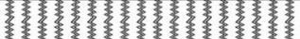
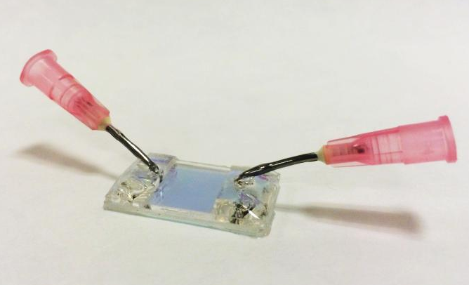
Photonic response of porous Bragg microcavity
Tubes
BM
Type 1
Notes:
How are we going to tune the dye absorption and the resonant peak of the microcavity?.
Two strategies:
1. By tilting the angle of incidence of the light with respect to the surface normal of the fluidic device, we can blue shift the resonant peak positions.
Thus, this trick allows to follow the relative differences in response between the two resonant peaks of our microcavity

Slide 37
Photonic response of porous Bragg microcavity: BM-cuvette
x₃
x₁
Spacers
150μm
BM
Type 2
Notes:
2. The second strategy is to get profit of the thickness inhomogeneity of the slanted microcavity.
By doing analysis at normal incidence at different point of the BM-cuvette , when lower the total thickness of the microcavity are considered , the resonant peaks shift to lower wavelengths

Slide 38

Photonic response of Rh101-dye Et-OH solutions infiltrated within BM
P₂
P₁
P₂
P₁
Notes:
In both cases, the first idea is to scan the position of the lower wavelength resonant peak across the absorption band of the dye solution and to follow the relative evolution of the resonant peak wavelength of the microcavity infiltrated with dye-solutions. And we do that for several dye concentrations
In this figures you can see , first the absorption of the dye-ethanol solution (dotted lines) free (i.e., out of the BM),
Besides, the evolution of the measured transmitted spectra at different spots taken across the BM-cuvette for two dye concentrations. Note that different spots of analysis in the cuvette correspond to microcavities with different total thickness
In the other figure, we can see the wavelength separation of the two resonant peaks for ethanol infiltrated within the microcavity and two dye solutions.
If the infiltrated solution has no absorption (i.e., infiltration of pure ethanol), the separation between the two resonant peaks varies linearly (by changing the total thickness of the BM) , but if the infiltrated liquid has some absorption there is a certain deviation of this linear behavior . The strength of the deviation of this linear response increases with the concentration of the dye solution

Slide 39

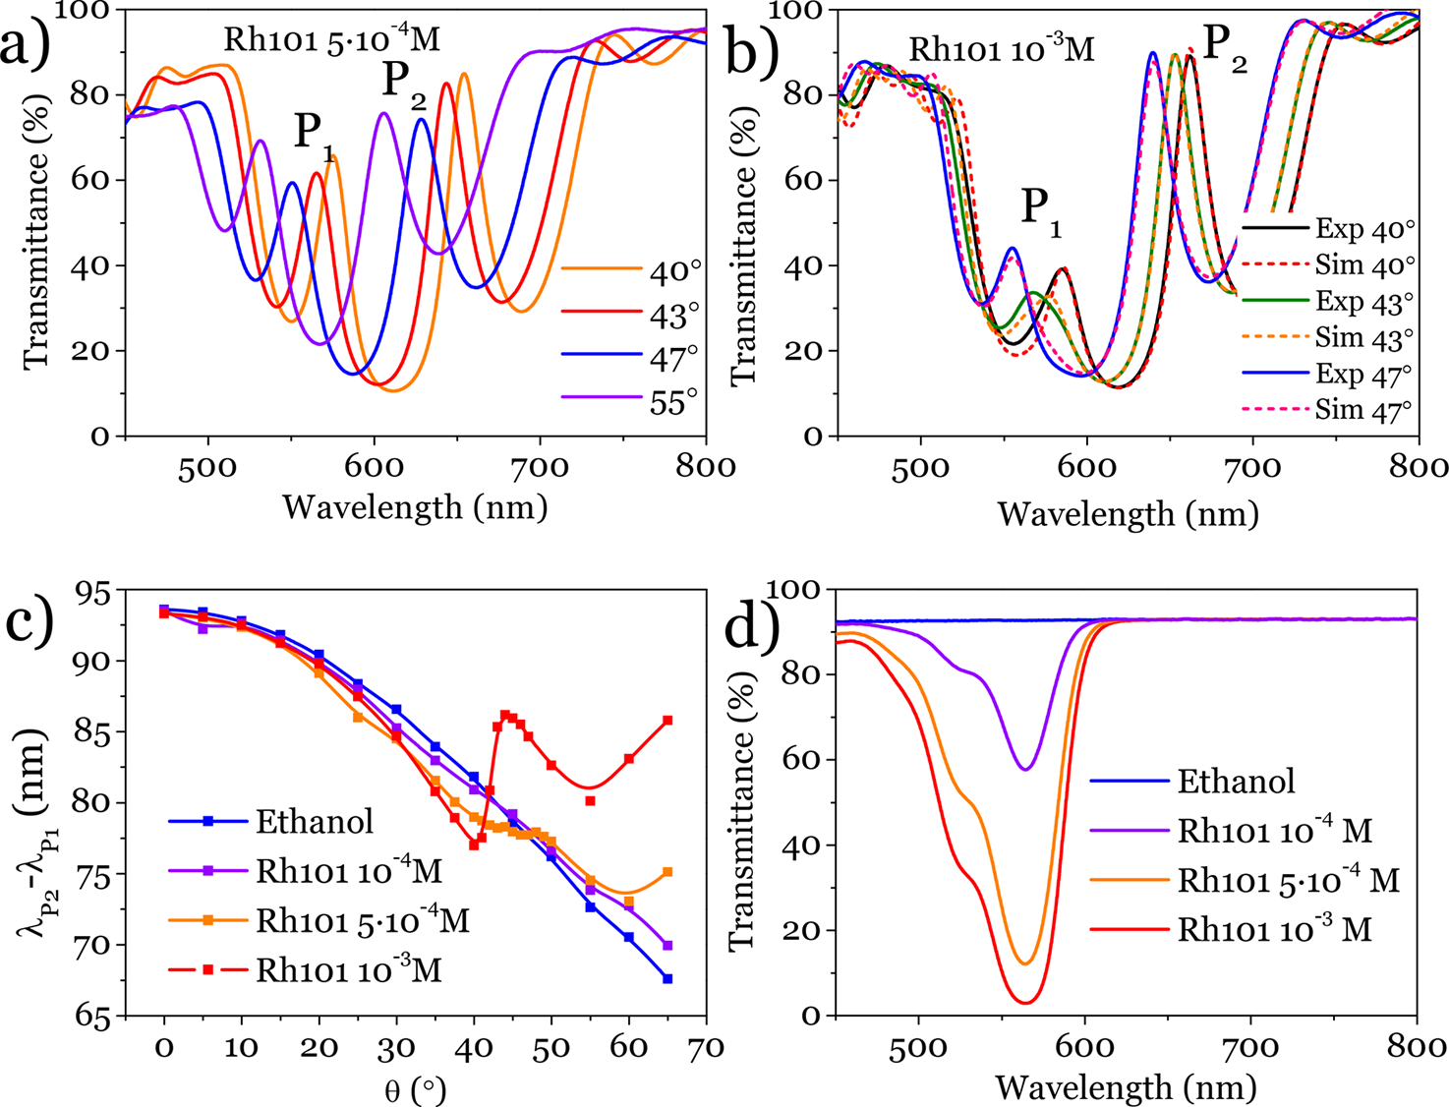

Photonic response of Rh101-dye Et-OH solutions infiltrated within BM
Note dashed lines optical simulations using BM multilayer model, porous EMA layer components, and refractive index and extinction coefficient of solution as fitting parameters
Notes:
In this slide, figures a) and b) we show the corresponding transmission measurements as a function of the tilting angle of the device with respect to incident light beam to tune the absorption of the dye solution with one of the resonant peaks.
In figure c) is shown the comparison of the separation between resonant peaks vs tilting angle of the device for ethanol and three Rh101 dye solutions. Again, we observe a deviation of the behaviour of non-absorbing ethanol when one of the resonant peaks is tuned to the absorption of the dye.
Figure d) shows, for comparison, the absorption of free dye solutions
Note also that in figure b) we include dashed lines with optical simulations of our porous microcavities infiltrated with absorbing solutions

Slide 40
Photonic response of Rh101-dye Et-OH solutions infiltrated within BM
Optical model using WVASE software
Optical simulations using BM multilayer model, porous EMA layer components, and refractive index and extinction coefficient of solution as fitting parameters
Notes:
In this slide I give some details about the optical simulation of the BM infiltrated with absorbing solution
We have evaluated the optical characteristics (refractive index and the absorption coefficient) of the dye solution when infiltrated within the Bragg microcavity
For that we have developed optical model (using WVASE software) that take into account the optical characteristics of our system (transparent anisotropic multilayer porous structure infiltrated with absorbing solutions
And we have compared the results to the optical characteristics of the free dye solution (i.e., out of the Bragg microcavities i.e., in a simple cuvette).

Slide 41
Comparison of photonic response of dye solutions free and infiltrated within BM
When dye-solution infiltrated within BM:
Giant (x20 !!!) dye absorption
Enhanced anomalous dispersion of refractive index
Modified (red shifted) absorption
Notes:
The results of the optical analysis of infiltrated microcavities and free dye solutions are shown in these figures.
Above the refractive index and absorption of free dye solutions . Note the scales of the absorption and the effect of this absorption in the anomalous dispersion of the refractive index (about a change of about 0.001 refractive units for dye solution of 10-3 M.
When the dye-solutions are analysed infiltrated within the microcavity, the effect on the strength of the anomalous dispersion of the refractive index is about 0.03 refractive index units, and there is an increase of about a factor 20 in the absorption coefficient with respect to that of the corresponding free dye solution.
Thus we clearly show that when Rh101-ethanol dye solutions are infiltrated in our cavities, a giant absorption of the dye and an strong enhancement of anomalous dispersion of the refractive index take place.
Besides, we observe a red shift of the absorption of the dye when infiltrated within the microcavity.

Slide 42
Electric field localization/confinement within BM
Notes:
The only explanation for this enhanced anomalous dispersion of the refractive index and giant absorption of the dye solutions is that when the dye solution is infiltrated within the microcavity, absorption takes place in an special environment with strongly localised electric field.

Slide 43
Applications: to enhance sensing (biosensing) capabilities of dye molecules
Note that similar principle applies for enhanced sensitivity of dye molecules nearby plasmonic nanoparticles due to local field enhancement
Design microfluidic devices with photonic crystals with resonant peaks both at dye-absorption and dye-emission wavelengths
Electric field confinement within photonic crystal
absorption
emission
500
600
700
Wavelength (nm)
Notes:
This result is not qualitative different than the enhance sensitivity reported of dye molecules nearby plasmonic nanoparticles (also due to the fact that the absorption takes place in an environment of enhanced localised electric fields nearby the surface of these plasmonic nanoparticles).
The most significant result of the analysis we have performed is not the effect itself but the strength of the effect. A factor 20 enhancement in absorption in a photonic structure had not been reported so far.
A possible application of the observed phenomenon might be to develop microfluidic devices including photonic crystals design to have resonant peaks tuned at both absorption and emission bands, in order to get strong enhanced sensitivity to dye molecules in a similar manner than plasmonic nanoparticles.

Slide 44

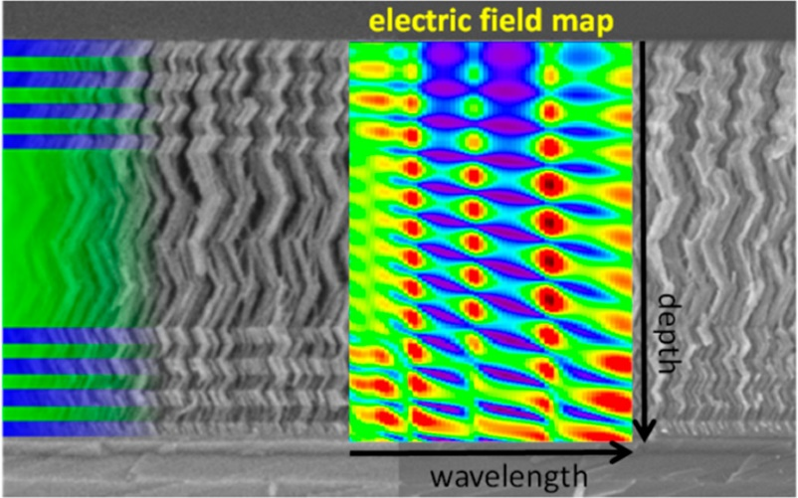
Summary
Lab on a chip
Fence-bundling in SBM has been identified
Optical activity of SBM is modulated by vapour/liquid infiltration
Site dependent adsorption isotherms
Optofluidic monitoring of RI water-glucose solutions probed
Implementation in prototype to follow alcoholic fermentation kinetics
Electric field localization in porous BM show up as giant absorption and enhanced anomalous refractive index dispersion of infiltrated dye-solutions
Thanks for your attention
Oliva-Ramírez et al. Sensors and Actuators B 256 (2018) 590; J. Nanophotonics 11 (2017) 046009; ACS Photonics 5 (2018) 984
Notes:
Thanks

