Slide 1
RF and Impedance induced beam effects
Rohan Dowd
Senior Accelerator Physicist, Australian Synchrotron

Slide 2
Overview
RF systems and longitudinal stability
Beam spectrum and tunes
Wakes and Impedances
Sources of Impedance and Measuring them
Effects of Impedance and their ‘Cures’

Slide 3
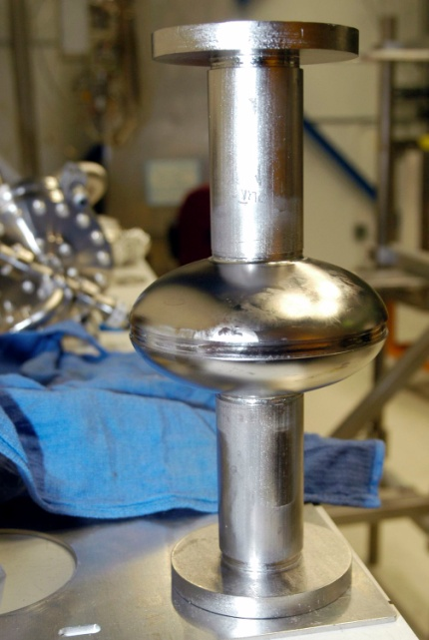
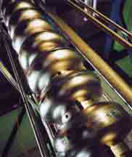
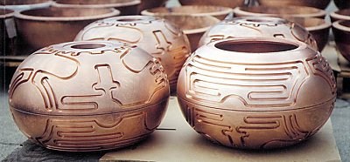
RF systems
Used to accelerate beams or replenish lost energy.
Provide a longitudinal focussing force
Two technologies: Normal Conducting (NC) and Super-Conducting (SC)

Slide 4
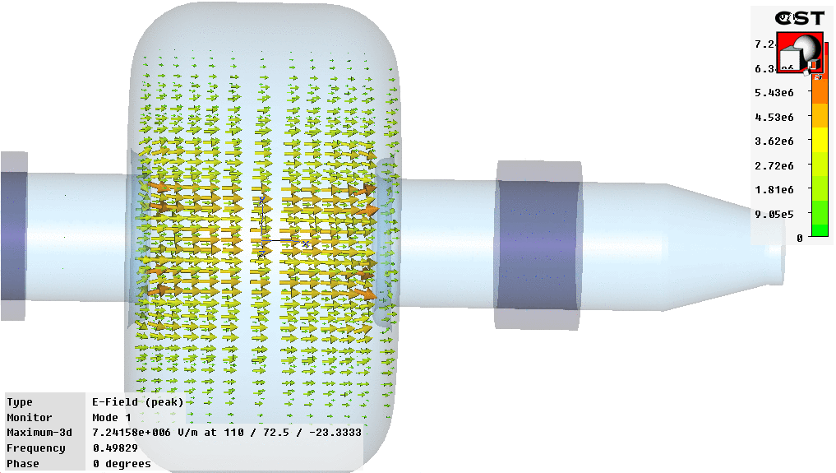
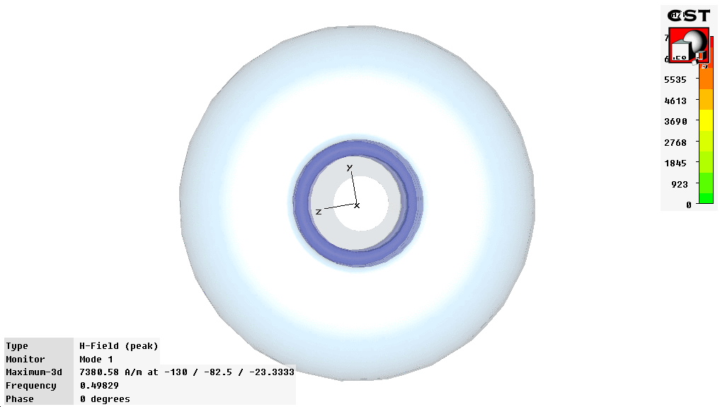
Inside a cavity
Electric Field Peaks along the centre axis, Magnetic field is minimal.
Frequency of oscillation determined by cavity geometry.

Slide 5
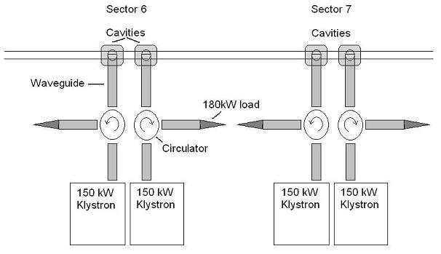
RF System at the Australian Synchrotron
4 independent stations
3MV total voltage - 750 KV per cavity
150 kW per klystron

Slide 6
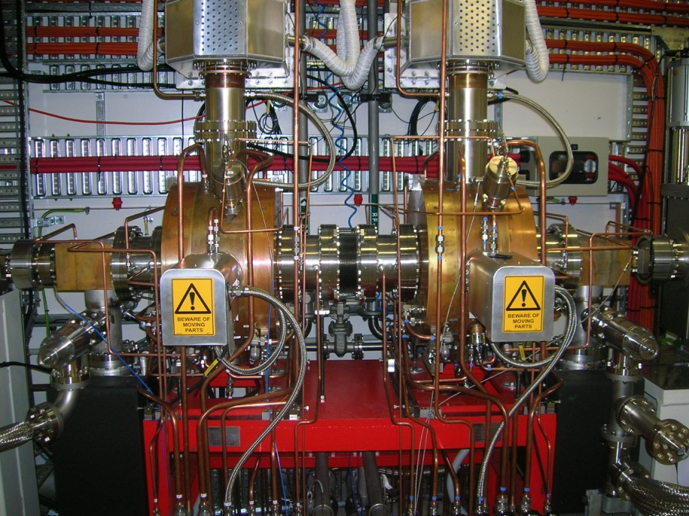
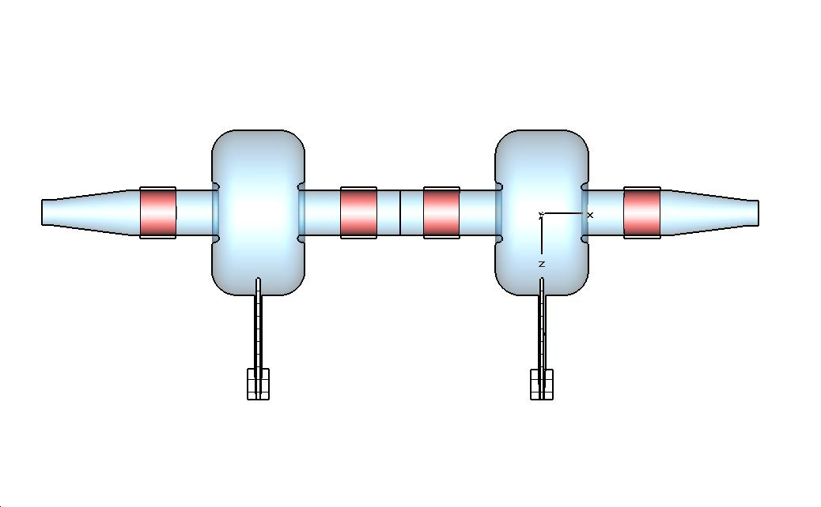
Normal Conducting vs. Super Conducting
4 Copper Cavities
Wall Losses:
P = V²/2R_{s} = 75kW each!
Beam Loading at full current (200 mA) = ~50kW each
Only 40% of RF power goes into the beam
SC cavities could support another ~ 300 mA of beam for same RF power – but now have Cryo costs + other issues.
SC – same voltage, less cavities, more ID straights

Slide 7
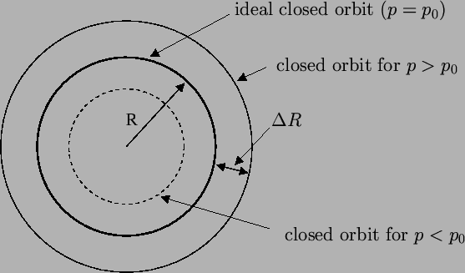
Momentum compaction and flight times
Momentum Compaction
α = (ΔR/R₀)/(Δp/p₀)
Relativistic particles – no velocity change for a change in momentum.
Arrival time depends on path length taken.

Slide 8
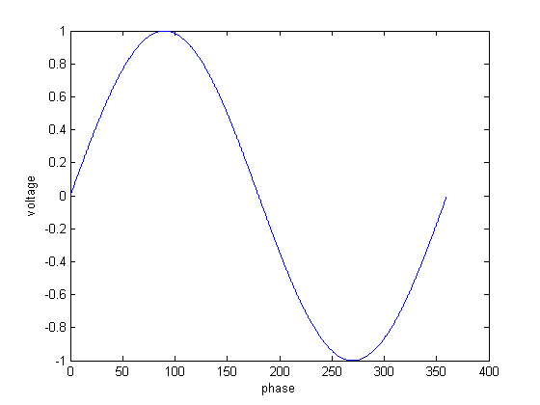
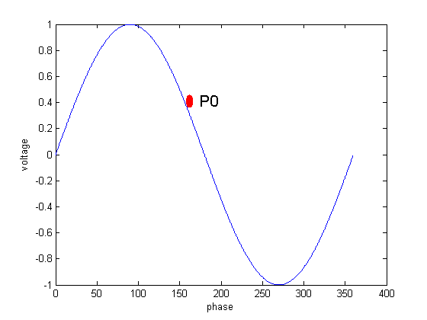
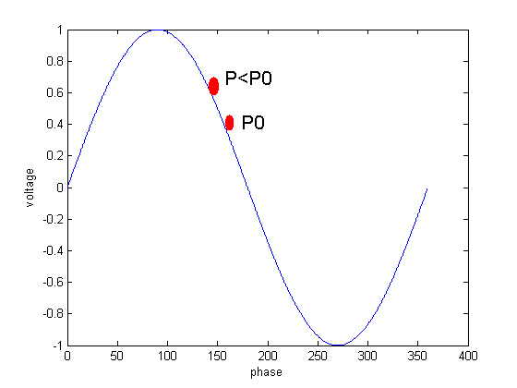
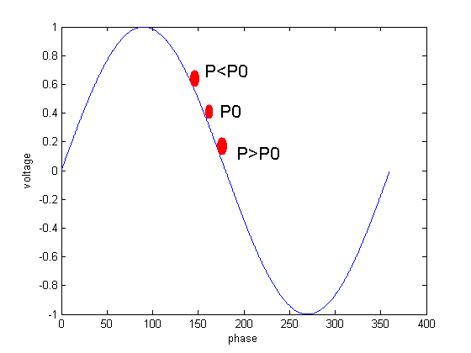
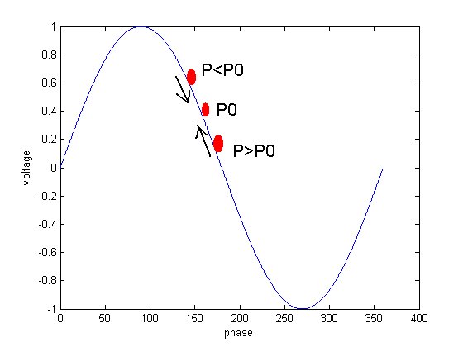
Longitudinal focussing
RF voltage varies sinusoidally with time.
Energy gain = V_{p}.cos(φ)
Flight time = Change in phase
Stability Criteria

Slide 9
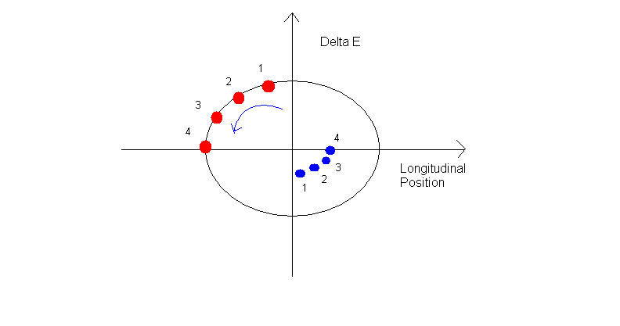
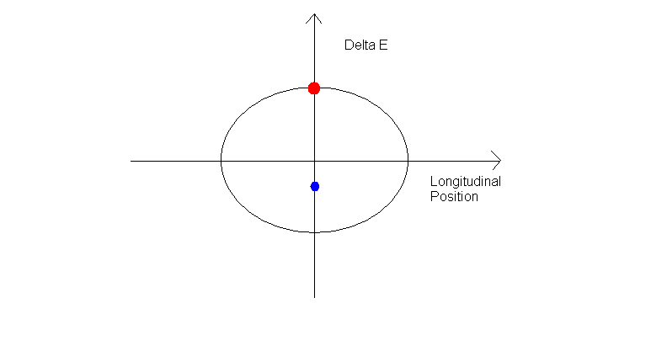
Longitudinal Phase rotation

Slide 10
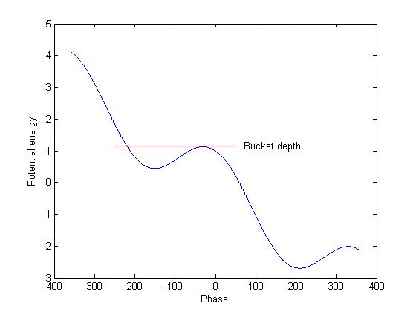
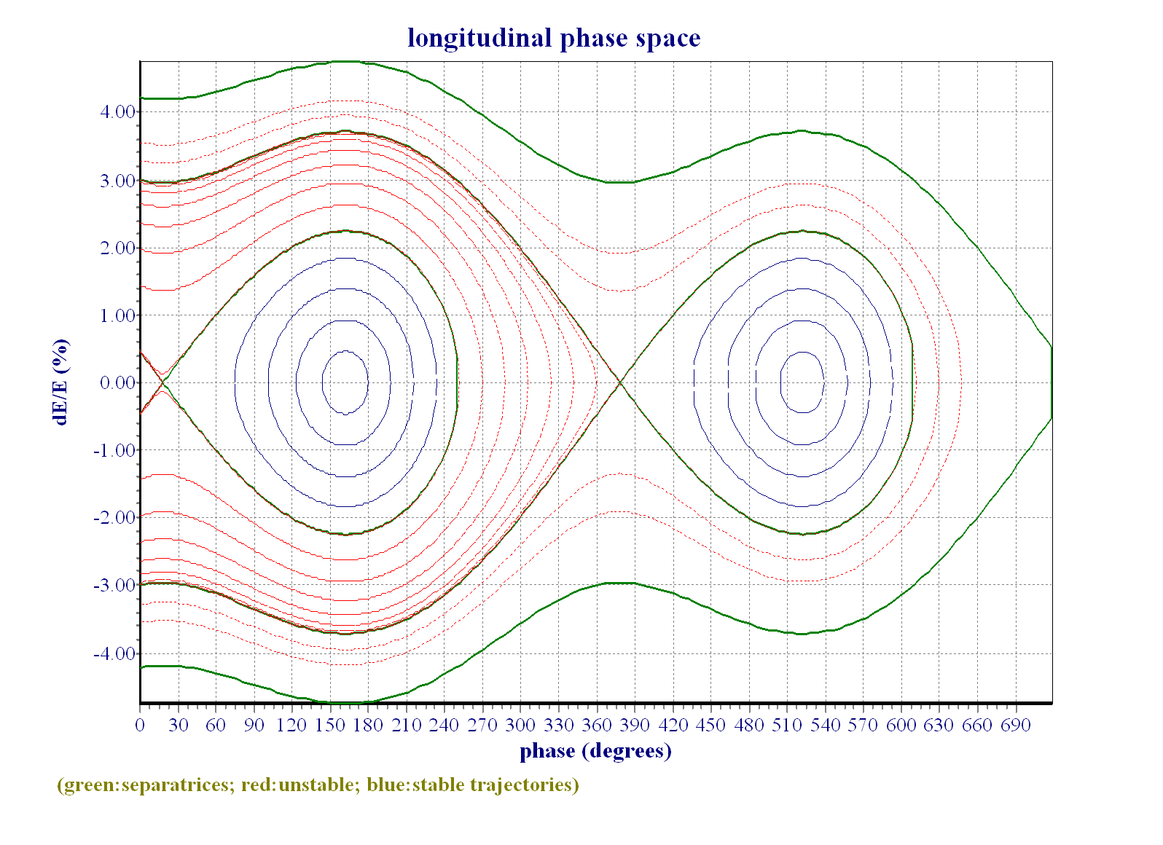
RF Buckets and potential wells
Focussing force leads to a potential well or bucket
Depth of bucket = slope of RF
Cavity phasing is important!

Slide 11
Synchrotron Frequency
Particles in the bunch oscillate in phase space at the synchrotron frequency
Frequency given by:
For Australian Synchrotron at Vrf = 3MV, ν_{s} = 14.4 kHz

Slide 12
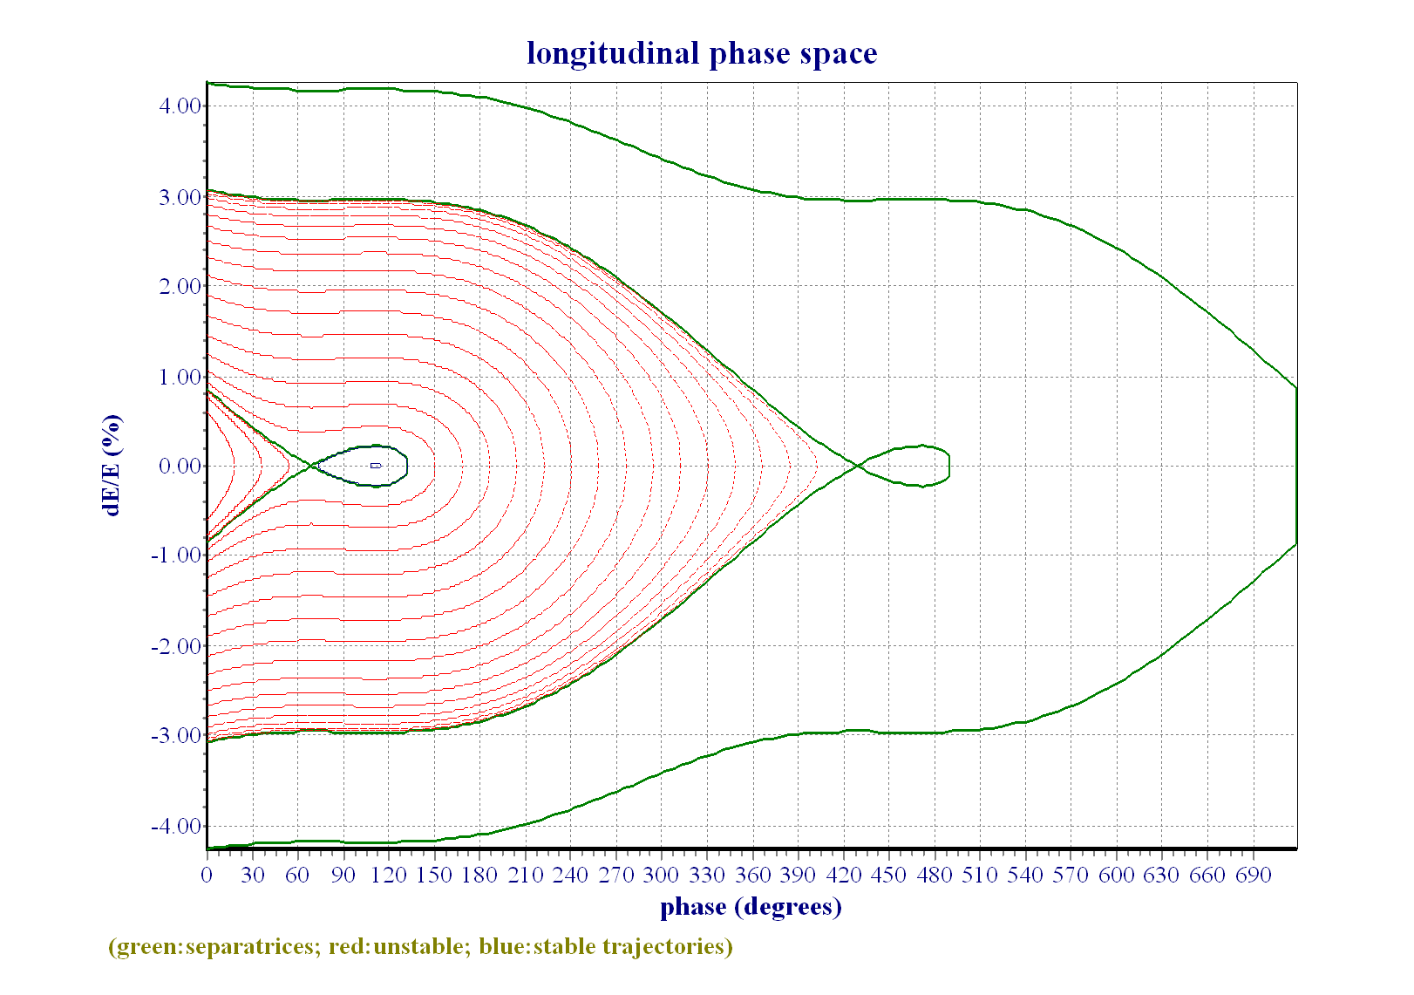
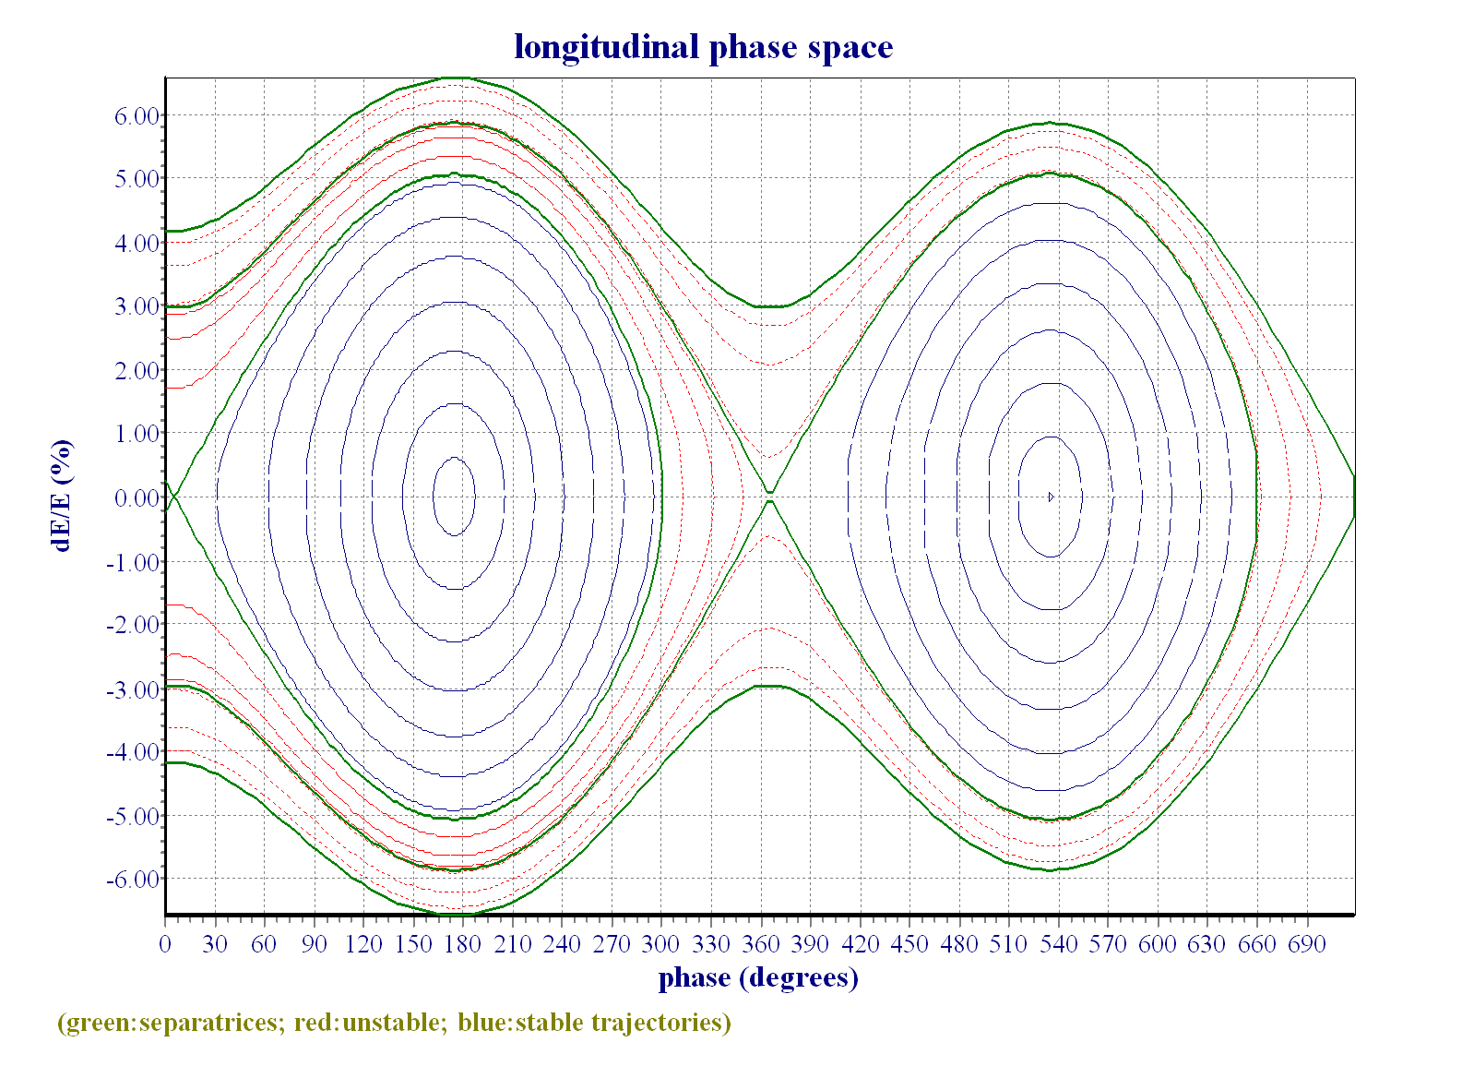
Overvoltage
1000 kV
3000 kV
10000 kV
Energy loss at AS = 931 KeV/turn (no IDs)
‘Only’ need cavity voltage of 931 KV, we have 3000 kV

Slide 13
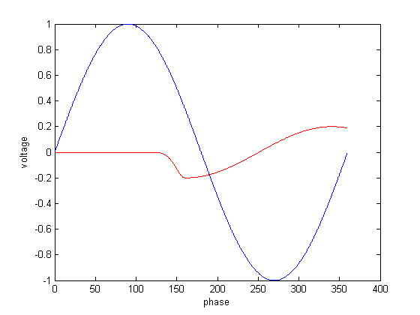
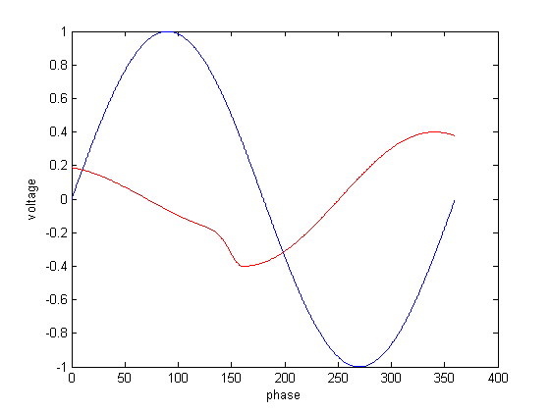
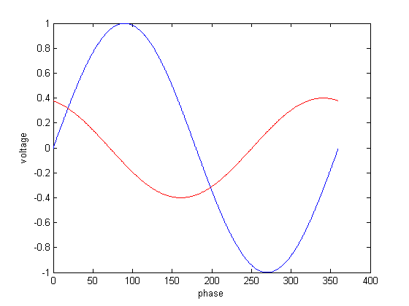
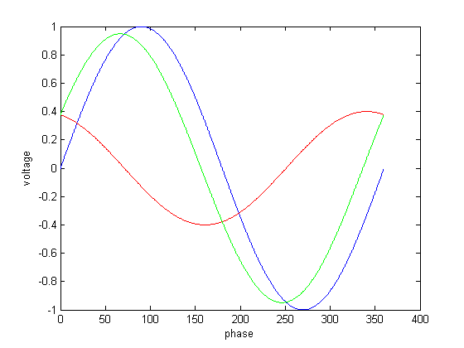
Beam Loading
Beam induces an opposing voltage in the cavity
Need Amplitude and Phase Feedback to compensate

Slide 14
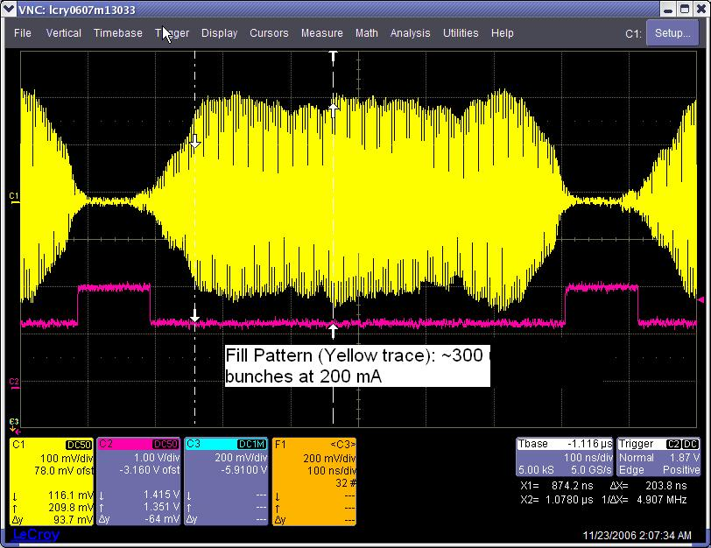
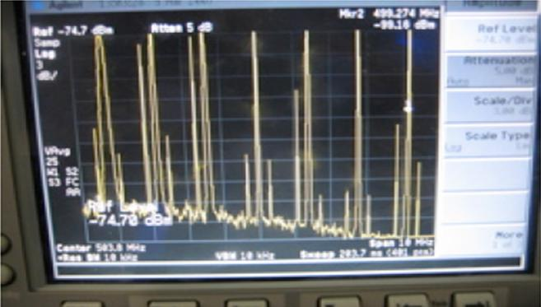
Beam signals in Frequency Space
Time domain monitoring of beam motion is unwieldy → Frequency domain
Beam observed with pickups at fixed points around the ring.
RF signals fed into spectrum analyser.
Beam revolution frequency is the ‘carrier’, coherent beam motion shows up as modulation sidebands

Slide 15
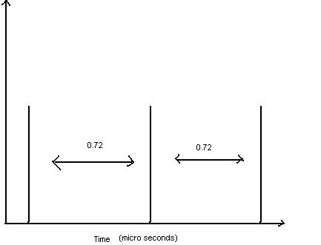
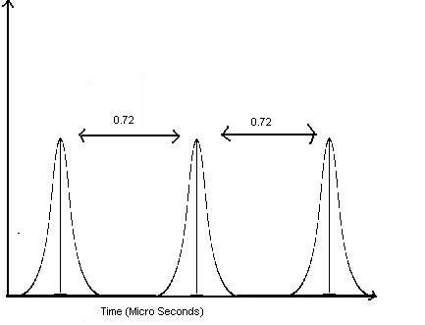
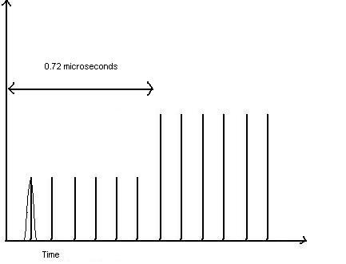
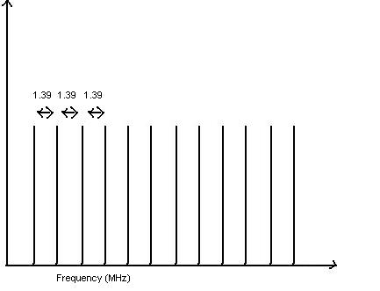
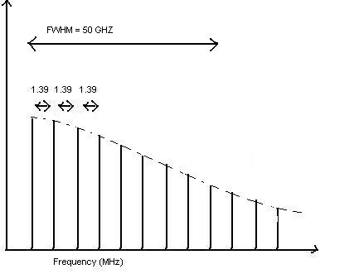
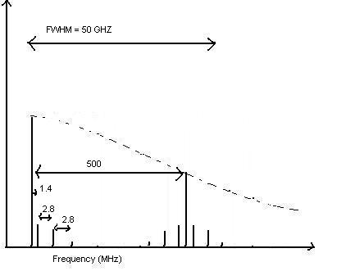
Time Domain → Frequency Domain
Time Domain
Frequency Domain

Slide 16
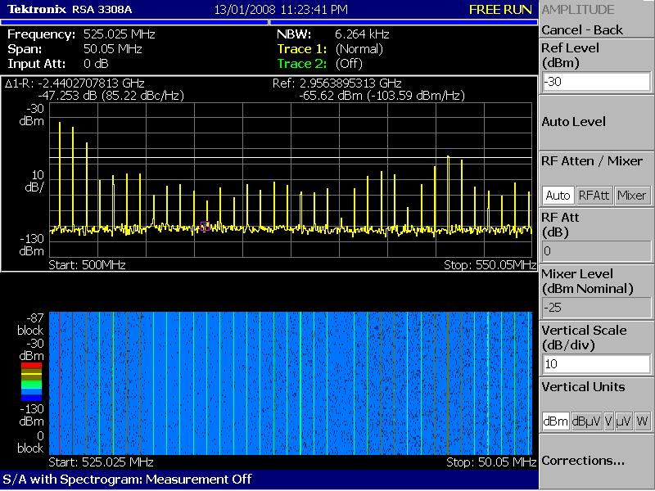
Uneven Fill Pattern

Slide 17
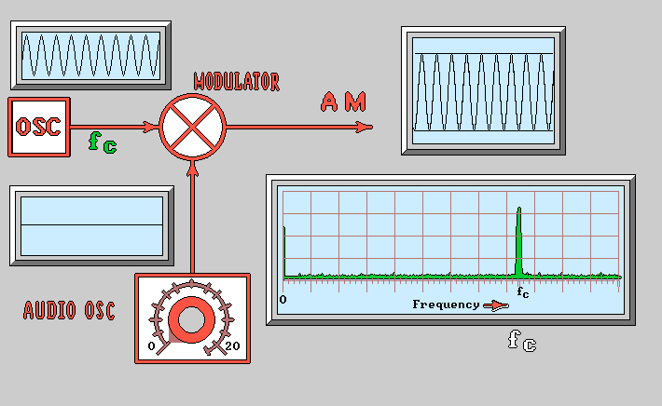
Tune Sidebands
Tunes appear as sidebands on the revolution harmonics.
Different motion causes different types of modulation.
How does this affect the orbit? Can a beamline see it?

Slide 18
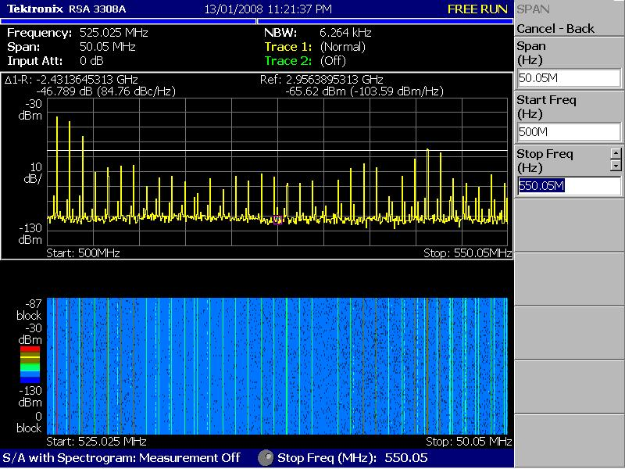
Tune Sidebands

Slide 19
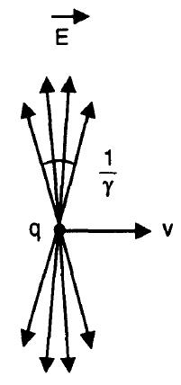
Wakefields and Impedance
Electric fields from a relativistic bunch are flattened into a ‘pancake’ shape
Vacuum chamber walls form image currents.
Discontinuities lead to non-perfect cancellation of fields.

Slide 20
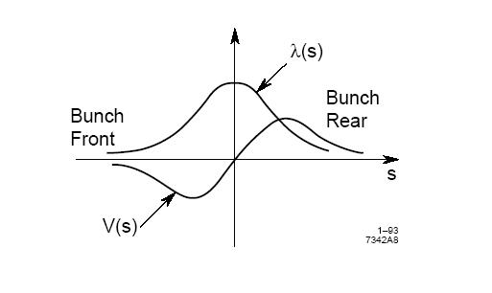
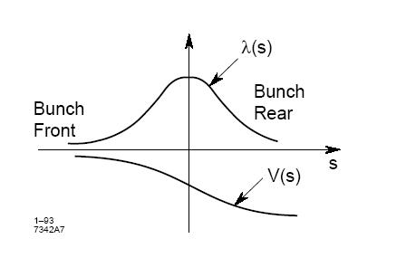
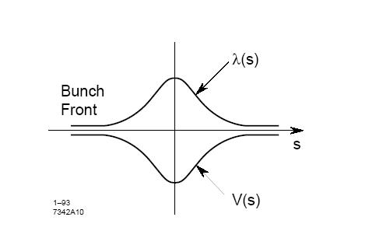
Wakefields and Impedance
Two general types of wake:
Inductive and Resistive
Inductive shifts energy from head of bunch to the tail
Resistive takes energy from whole bunch.

Slide 21
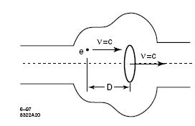
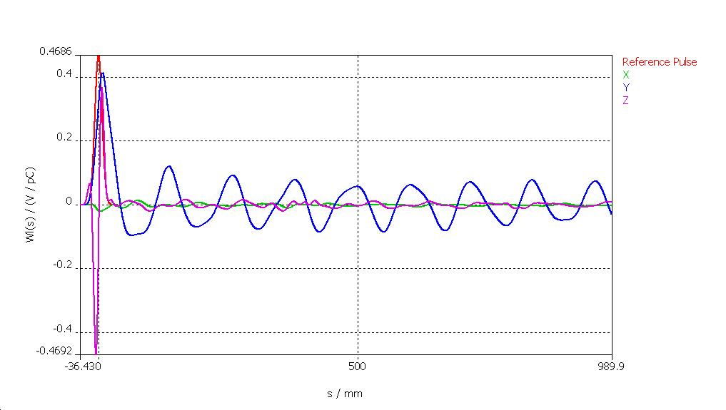
Wakefields and Impedance
Wake Potential: (V/pC)
Transverse wake Potential is in V.pC⁻¹.m⁻¹
Fields are solved numerically in most cases
Wake potential is useful for seeing single bunch effects, what about many turns?

Slide 22
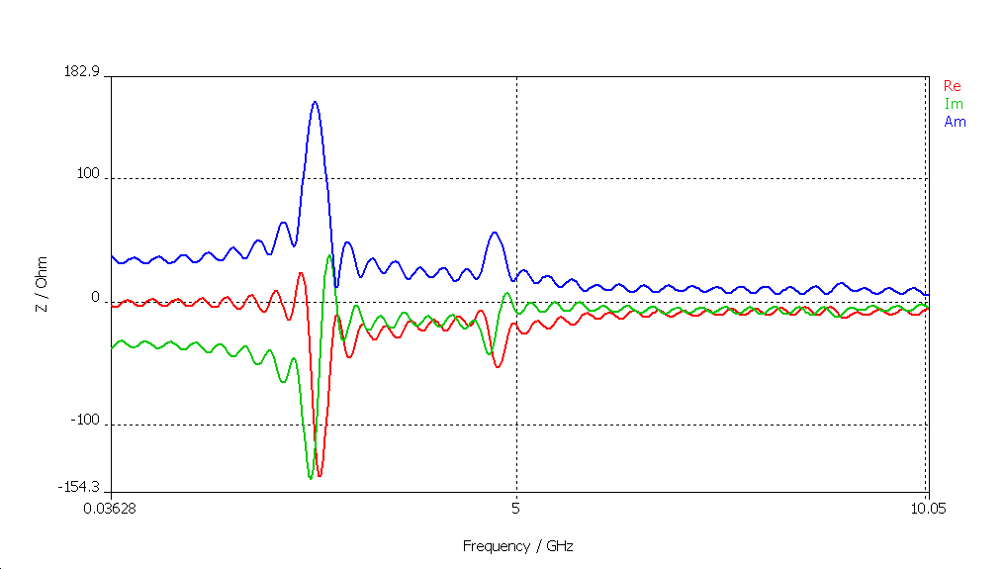
Impedance
DC Resistance: R=V/I AC Impedance: Z(ω) = R+iX
Wakefield Impedance:
Fourier Transform of Wake potential
Shows resonances and high frequency behaviour

Slide 23
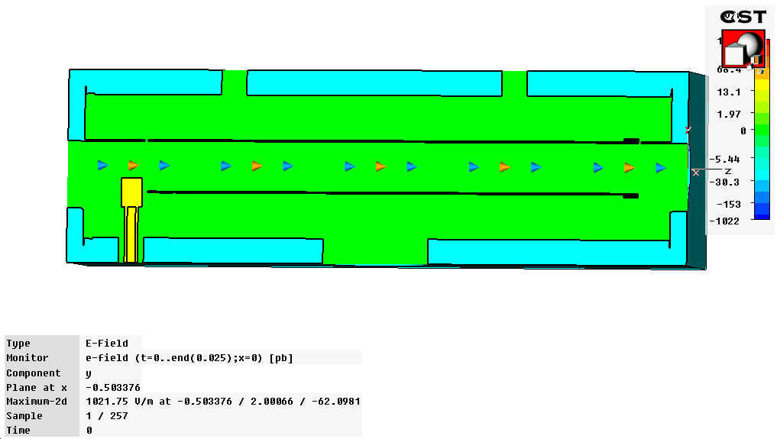
Impedance simulations
Done by solving Maxwells equations in mesh cells
Takes material properties into account
Very computationally intensive

Slide 24
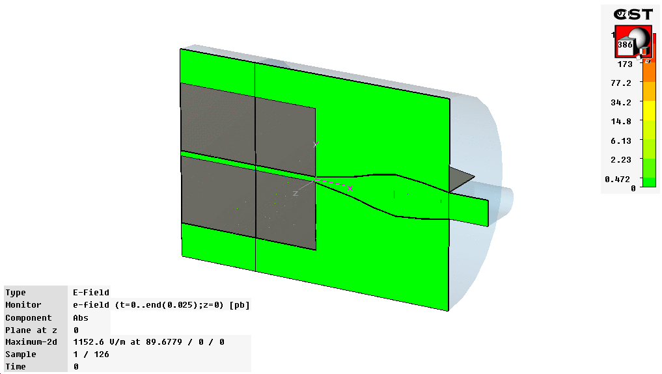
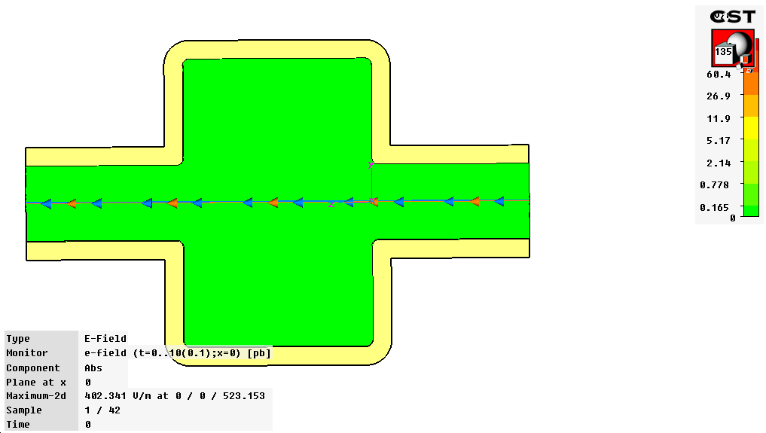
More simulations

Slide 25
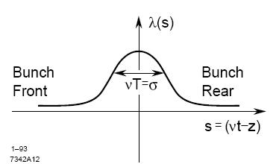
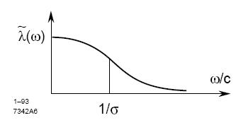
Bunch Power Spectrum
Bunch contains frequencies up to 1/σ
Bunch spectrum, , is FT of charge distribution
Power spectrum :
FT →

Slide 26
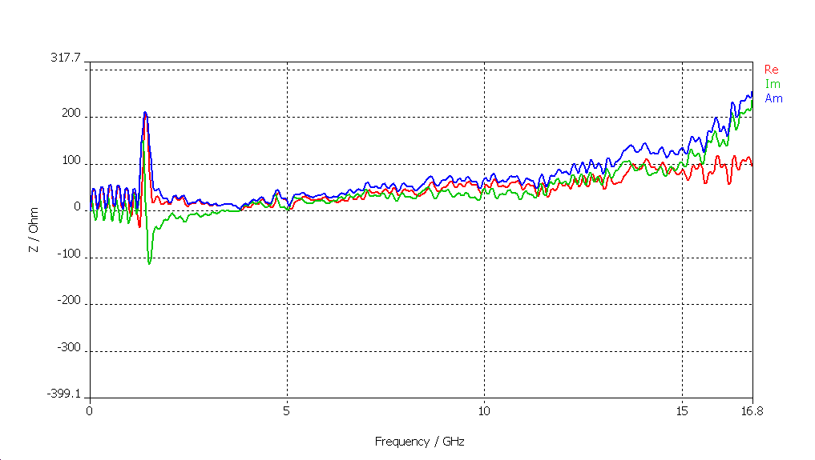
Effective Impedance
The bunch length and fill pattern determine the frequency components of the beam.
Only Impedances at these frequencies will be ‘seen’ by the beam
Effective Impedance:
→
Continuous spectra
Discrete Spectra

Slide 27
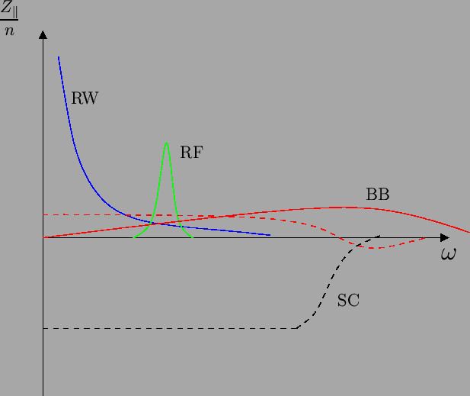
Impedance sources
Two main types – Broadband and narrow band. Also split into longitudinal and transverse components.
Resistive wall – Broadband
Discontinuities – Broadband
Cavities – Narrow Band

Slide 28
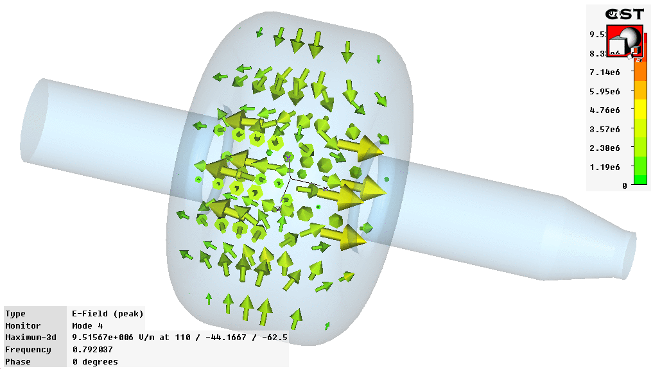

Cavity Higher Order Modes (HOMs)
Cavities have many resonant modes.
Wakefields can excite these higher frequency modes
Some modes will be ‘trapped’ in the cavity

Slide 29

HOM damping
Antenna placed at appropriate locations can ‘siphon off’ much of the energy of a HOM while leaving the main accelerating mode largely untouched

Slide 30
Impedance measurements
Different types of impedance can be measured in different ways.
Longitudinal impedance is best measured through single bunch effects.
  Eg Potential well distortion
Transverse impedance can be seen as deflections and tune shifts

Slide 31


Potential well distortion
Two types, resistive and inductive
Inductive impedance causes energy spread increase - widens bunch profile
Resistive impedance takes energy from the bunch and thus moves the centroid ‘up’ the RF slope – asymmetric bunch profile
Measures total machine impedance

Slide 32

Potential Well Distortion Results
0 IVU chambers 3 IVU chambers
R=800 Ω, L = 25nH R=1600 Ω, L = 110nH
0 IVU Chambers 3 IVU Chambers
R=800 Ω, L = 33nH R=1600 Ω, L = 110nH
1 IVU Chamber 2 IVU Chambers
R=1600 Ω, L = 90nH R=1600 Ω, L = 55nH

Slide 33




Mystery Solved
Before
After

Slide 34

Synchronous phase advance
Provides a measure of the resistive impedance of the machines.
Measure the movement of the bunch up the RF phase as the current increases in the bunch.

Slide 35




Synchrotron Phase advance
Using Phase advance vs. bunch current, can extract loss factor, k_{l}.
For Gaussian bunches

Slide 36


Tune Shift
Transverse wake fields act like quadrupoles because they are offset dependant (V/pC/m)
This effect can be seen by looking for changes in the tune with current
Measures the imaginary component of the transverse impedance

Slide 37

Impedance induced Instabilities
Effects on the individual bunch is not so important unless time resolved imagery is used
However, wakefields (cavity modes, resistive wall) can cause coupling between bunches.
This leads to coupled motion of the bunches in the beam – ‘Collective effects’

Slide 38

Collective Effects
Oscillation modes – similar to linked pendulum, instead of springs we have impedance.
N-1 modes of oscillation for each bunch in the beam. Phase diff = 2π.M/N

Slide 39



Collective instability symptoms
Physical blow up in beam size – emittance growth – lifetime increase

Slide 40
Instability Cures
Design
  Avoid sharp transitions and cavity-like structures in Vacuum components where possible.
  Use tapers and RF shielding.
Chromaticity
  Introduce an energy dependant tune shift into the beam
  As particles undergo synchrotron phase oscillations, their tunes will shift, de-cohering any oscillations that are building up
  A type of ‘passive’ damping
Active feedback
  Measure the bunch oscillations at a pickup
  Hit the bunch with a correction kick at the kickers
  Needs fine tuning to work properly, but can be very effective
Fill Patterns, Tune shifts and other tricks

Slide 41

Chromaticity + Fill pattern
Chromaticity introduces a frequency shift of oscillation with energy.
Head-tail damping occurs
Effective, but reduces dynamic aperture.

Slide 42


Active Feedback
Measure the bunch oscillations at a pickup
Hit the bunch with a correction kick at the kickers
Needs fine tuning to work properly, but can be very effective

Slide 43






The system
Processing
X/Y Kickers
Pickup BPM and Hybrids

Slide 44

Conclusion
RF and Impedance effects directly affect beam stability and can severely limit the performance of accelerators
Proper care must be taken in design of components and often active feedback is required.

Slide 45
Spare slides

Slide 46
Robinson stability criteria
Phase stability with no beam loading: π/2 < φ_{s} < π
Beam loading induces a phase shift in the RF potential, new stability requirement: P_{b} < P_{W}
But this criteria just results in stable oscillations, we want damping…

Slide 47




Robinson Damping
Need to consider bunch centroid.
P > P0 → ω_{r} < ω_{RF}
It will sample cavity impedance at a lower frequency.
If the cavity is detuned in the correct direction, higher energy bunch will dump more energy into cavity.
Motion will be damped.

Slide 48


Robinson Instability

Slide 49


Resistive Wall – Vacuum Chamber
Stainless Steel 216m
Pumping Antechamber
32 mm High
70 mm wide

Slide 50
Chamber Transverse Impedance
Using Gluckstern + Zotter equation,
With,
We get:

Slide 51
Growth Rates
Coupled bunch Growth Rates
Vertical growth rate (200mA) = 1.5 ms
Horizontal growth rate (200mA) = 3.6 ms
Vertical radiation damping = 4.82 ms
Horizontal radiation damping = 3.54 ms

Slide 52
Impedance of IVUs
6 mm Gap IVU:
6.6 mm Gap IVUs:
All three at minimum gap is a 73% increase in the ring transverse impedance!

