Slide 1
AUSSY Synchrotron
Eugene Tan – Scientist
Accelerator Physics and Operations

Slide 2
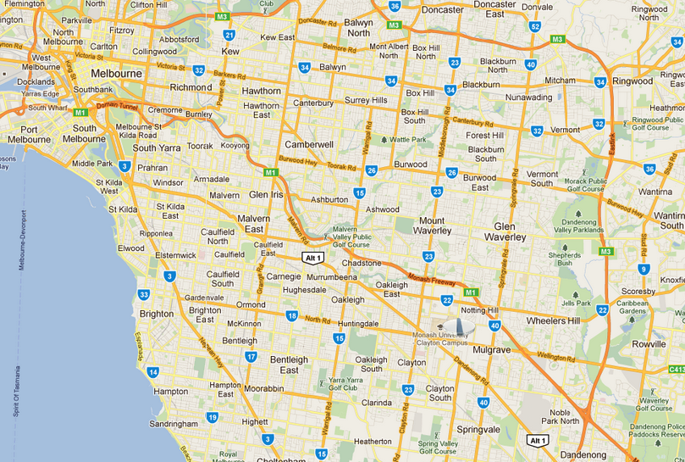
Where is the Australian Synchrotron?

Slide 3
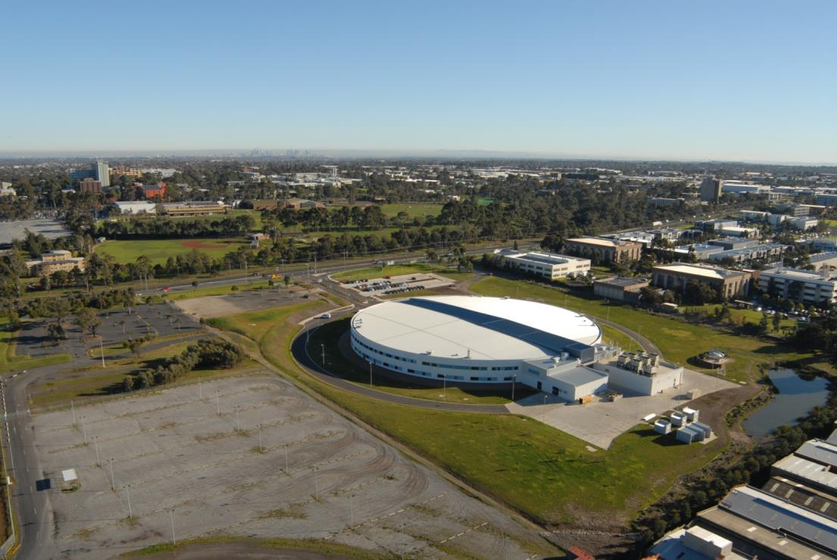
Where is the Australian Synchrotron?

Slide 4
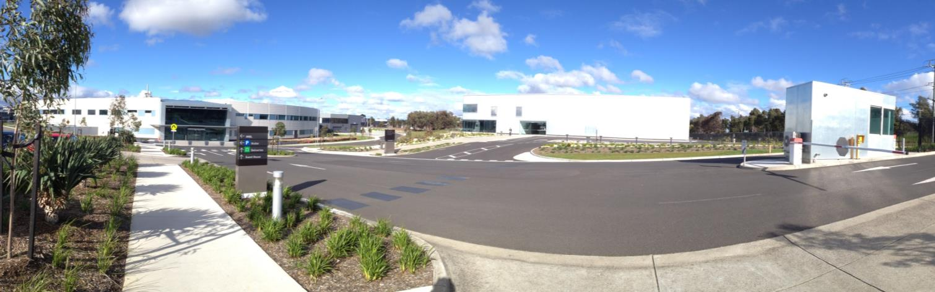
Where is the Australian Synchrotron?

Slide 5
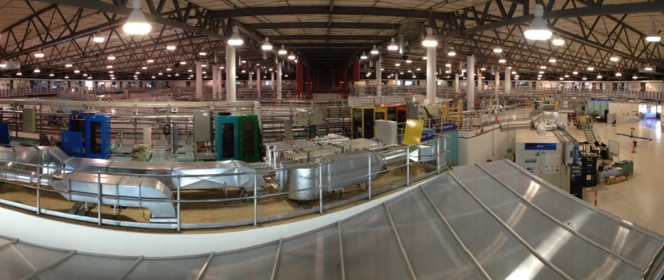
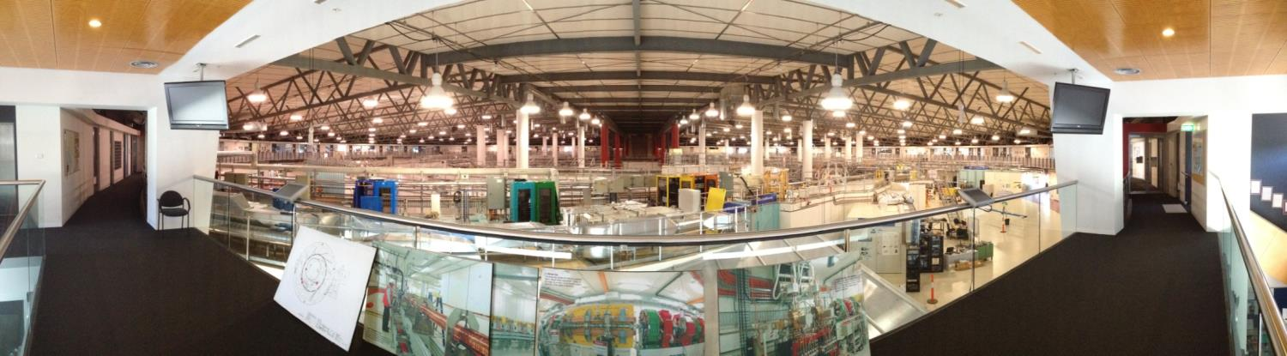
Where is the Australian Synchrotron?

Slide 6
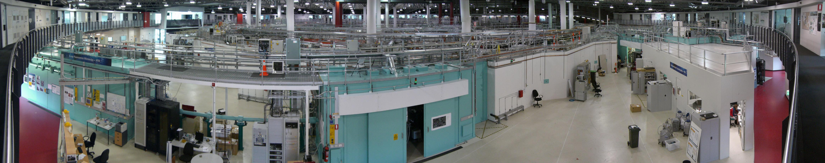

Slide 7
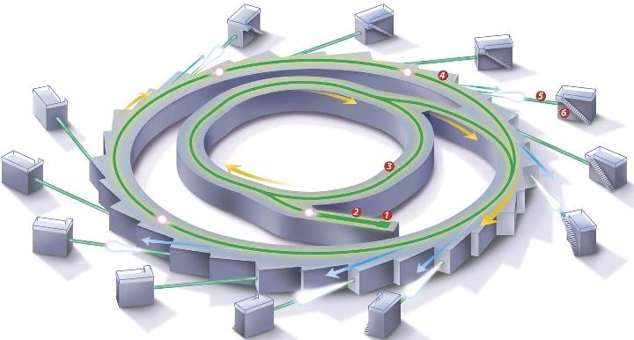

Slide 8
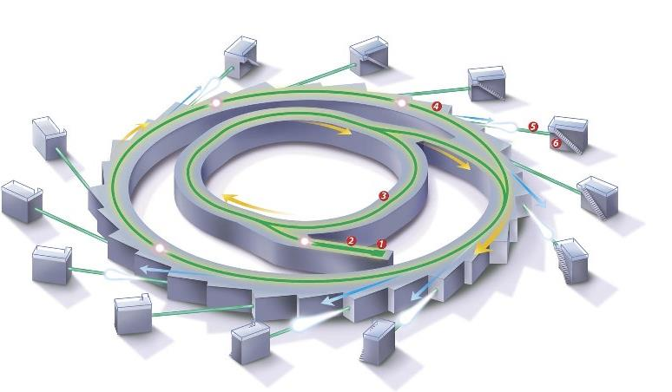
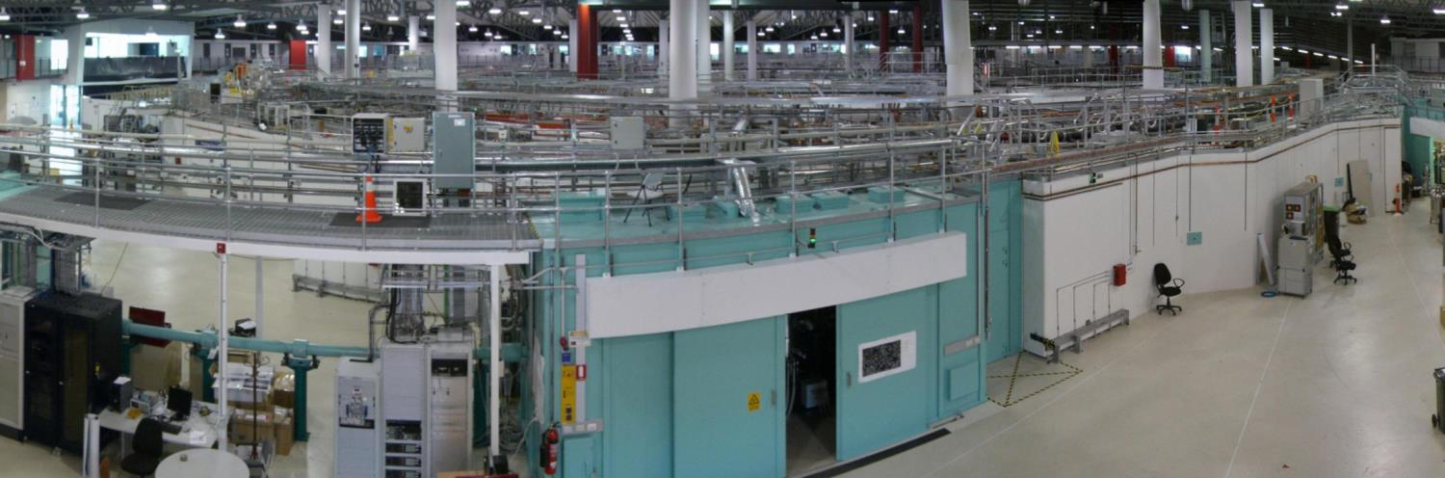

Slide 9
Outline
What is a Synchrotron?
What is Synchrotron Light?
How is Synchrotron Light used?
Experiments using Synchrotron Light

Slide 10
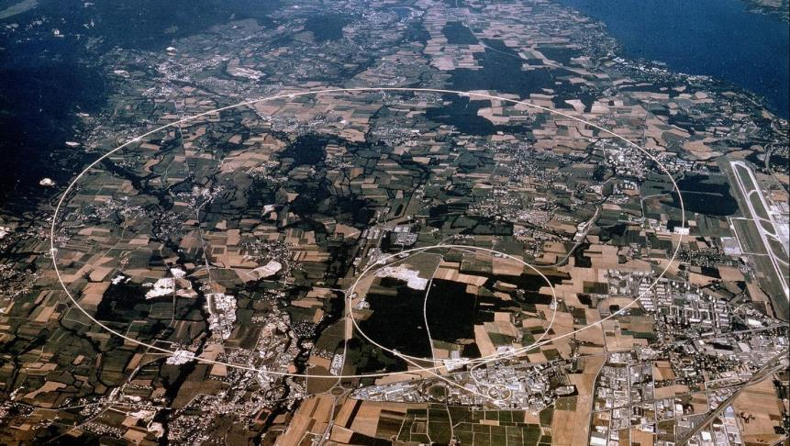
What is a Synchrotron?
Type of machine that Accelerates charged particles – i.e. a Particle Accelerator
  Electrons, protons
  alpha particles (two protons, two neutrons)
  Ions
Uses:
  Particle collider
  Light/photon source
e⁻
n
P⁺
P⁺
n
Be
⁴⁺
²⁺
¹⁺
LHC
Notes:
Accelerate – to change velocity. Go from stop to some speed. So you have added kinetic energy.
Can anyone tell me if we are a collider or a light source.
Before it was realised that synchrotrons could be "light source", synchrotrons were mainly used as particle colliders.
One of the most famous particle collider is the LHC. Who here has heard of the LHC? Can anyone tell me what it stands for? (pop quiz)
CERN - European Organization for Nuclear Research - 2,400 full-time employees, 1,500 part-time employees, and hosts some 10,000 visiting scientists and engineers, representing 608 universities and research facilities and 113 nationalities – Est. 1954

Slide 11
What is a Synchrotron?
Notes:
Accelerate – to change velocity. Go from stop to some speed. So you have added kinetic energy.
Can anyone tell me if we are a collider or a light source.
Before it was realised that synchrotrons could be "light source", synchrotrons were mainly used as particle colliders.
One of the most famous particle collider is the LHC. Who here has heard of the LHC? Can anyone tell me what it stands for? (pop quiz)
CERN - European Organization for Nuclear Research - 2,400 full-time employees, 1,500 part-time employees, and hosts some 10,000 visiting scientists and engineers, representing 608 universities and research facilities and 113 nationalities – Est. 1954

Slide 12
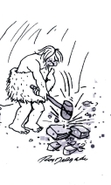
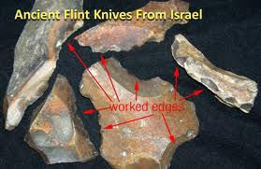
Why Accelerate Particles and Collide them?
Curiosity.
Understanding of how things work.
How can it enrich our lives?
Notes:
Motivation. Why are we doing what we do? Curiosity. We want to understand fundamental nature of the physical universe.

Slide 13
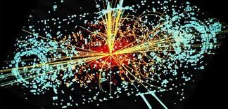
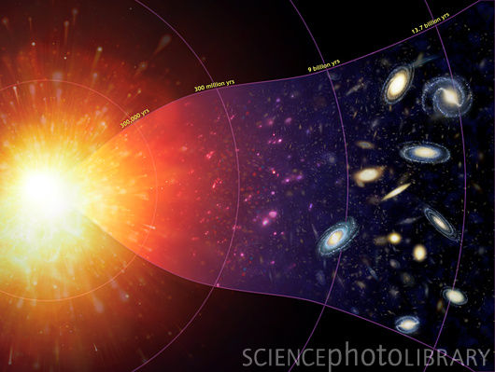
Why Accelerate Particles and Collide them?
Particles/Atoms
Particles/Atoms
Understand how our universe works on a fundamental level
How did matter come into existence?
What happened at the birth of the universe?
https://sciencephoto.com/media/334226/enlarge
Notes:
Have you heard of the Big Bang Theory? An no not the TV series though you get points for knowing about it.

Slide 14
What is a Synchrotron?
Type of machine that Accelerates charged particles – i.e. a Particle Accelerator
  Electrons, protons
  alpha particles (two protons, two neutrons)
  Ions
Uses:
  Particle collider
  Light/photon source
e⁻
n
P⁺
P⁺
n
Be
⁴⁺
²⁺
¹⁺
LHC
Australian Synchrotron
Notes:
Accelerate – to change velocity. Go from stop to some speed. So you have added kinetic energy.
Can anyone tell me if we are a collider or a light source.
Before it was realised that synchrotrons could be "light source", synchrotrons were mainly used as particle colliders.
One of the most famous particle collider is the LHC. Who here has heard of the LHC? Can anyone tell me what it stands for? (pop quiz)
CERN - European Organization for Nuclear Research - 2,400 full-time employees, 1,500 part-time employees, and hosts some 10,000 visiting scientists and engineers, representing 608 universities and research facilities and 113 nationalities – Est. 1954

Slide 15
How does a Particle Accelerator work?
How are charged particles accelerated?
Apply forces!
Lorentz Force:
  Force (F) experienced by a particle of charge q moving with a velocity (v) in an Electric (E) and Magnetic (B) field.
How does this equation apply to the Australian Synchrotron?
Notes:
Lorentz tells you what forces a charged particle will expereince

Slide 16
Elements of the Australian Synchrotron
Electron Gun
Linear Accelerator (Linac)
Booster Synchrotron
Electron Storage Ring
Photon Transport Line
Photon Experiments
4
5
6
3
2
1

Slide 17
Electron Gun (1)

Slide 18
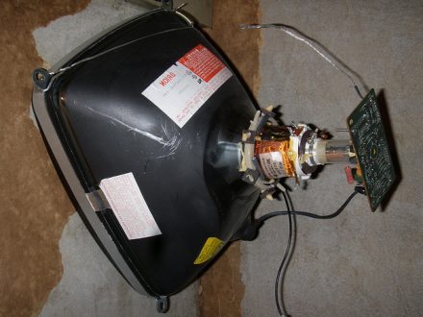
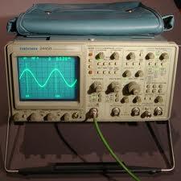
Electron Gun
Source of the electrons
Heated cathode "boils" off electrons
Force parallel to E field.
Force
-90,000 Volts (-90 kV)
0 kV
e⁻
How much energy has been gained?
Anode (+ve)
Cathode (-ve)

Slide 19
Electron Gun
Force
-90,000 Volts (-90 kV)
0 kV
e⁻
d
Energy Gained
ΔK = 1.6×10⁻¹⁹ × 90,000 J
= 90 keV
Notes:
1.44e-14 joules per electron
1e9 electrons typically
Total energy is 1e-6 Joules -> equivalent to dropping a house fly from 1 meter.

Slide 20
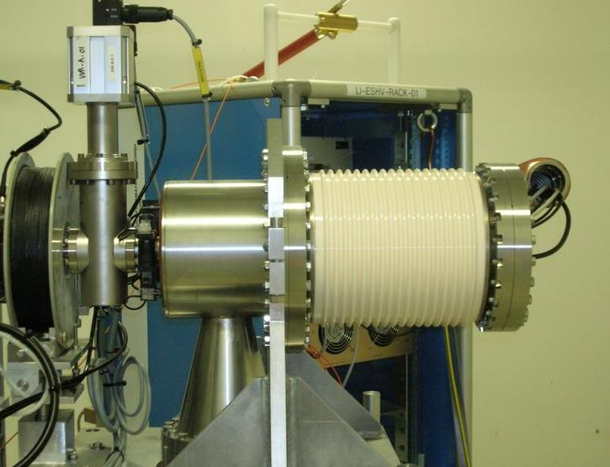
Electron Gun
Energy Gained
ΔK = 90 keV

Slide 21
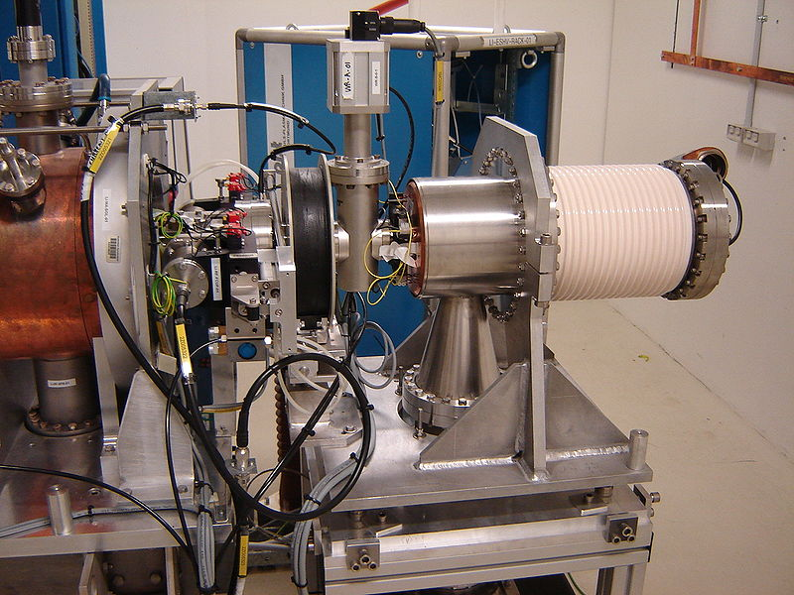

Slide 22
Linear Accelerator (2)
90 keV
90 keV = 90,000 eV

Slide 23
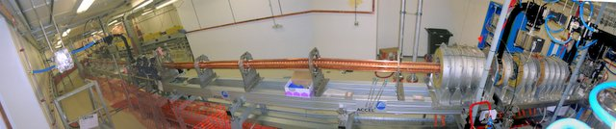
Linear Accelerator
Start with 90 keV (90,000 eV) from the electron gun
Linear accelerator increases it to 100 MeV (100,000,000 eV).
Fires at 1 Hz (once a second).
Arrows showing forces
400keV
300keV
200keV
100keV
+
-
+
-
+
-
+
-
+
-
+
-
+
-
+
-
Bunching Simulation
Accelerating
Bunchers
gun

Slide 24
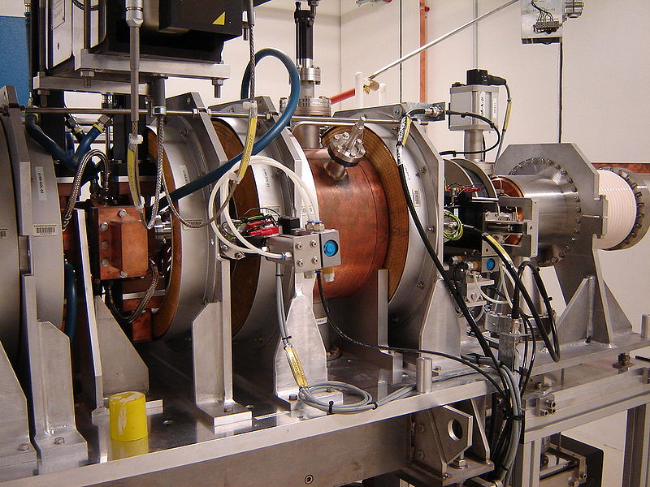

Slide 25
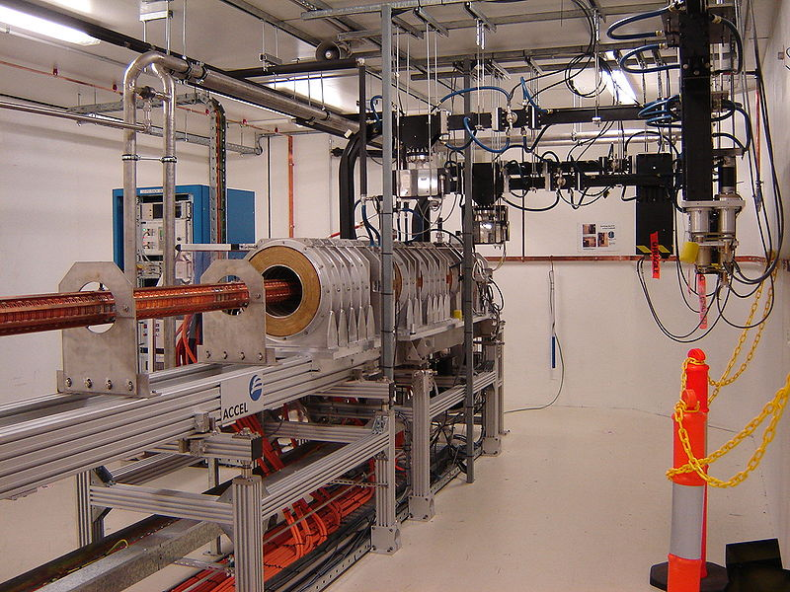

Slide 26
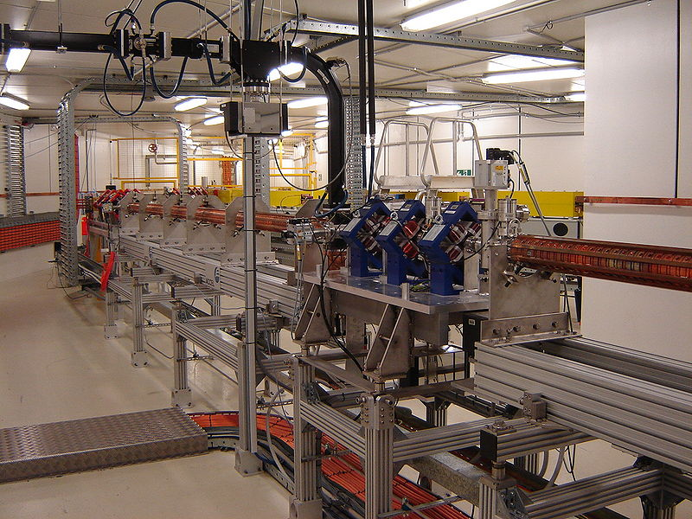

Slide 27
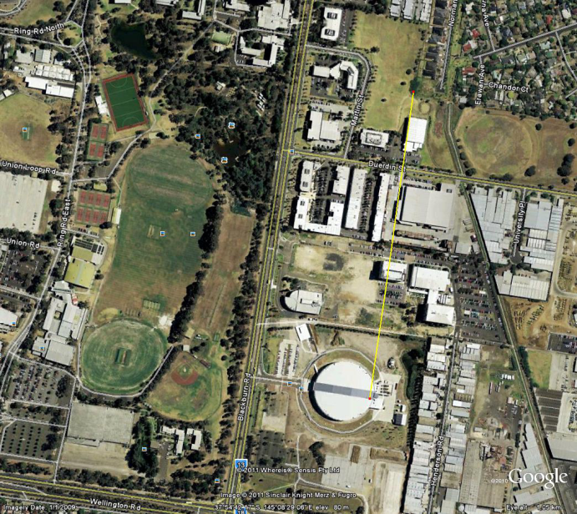
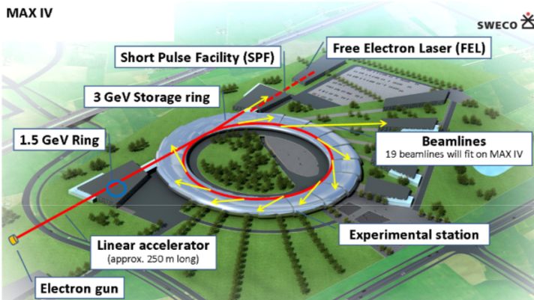
Linear Accelerator
Can we get to energies like 3 GeV (3,000,000,000 eV)?
Yes we can.
But…
Need THIRTY100 MeV linacs in a row (30 x 100 MeV = 3000 MeV).
Each linac is ~20 meters so we would need a 600 meter long linac.

Slide 28
Booster Synchrotron (3)
100 MeV
90 keV
90 keV = 90,000 eV 100 MeV = 100,000,000 eV

Slide 29
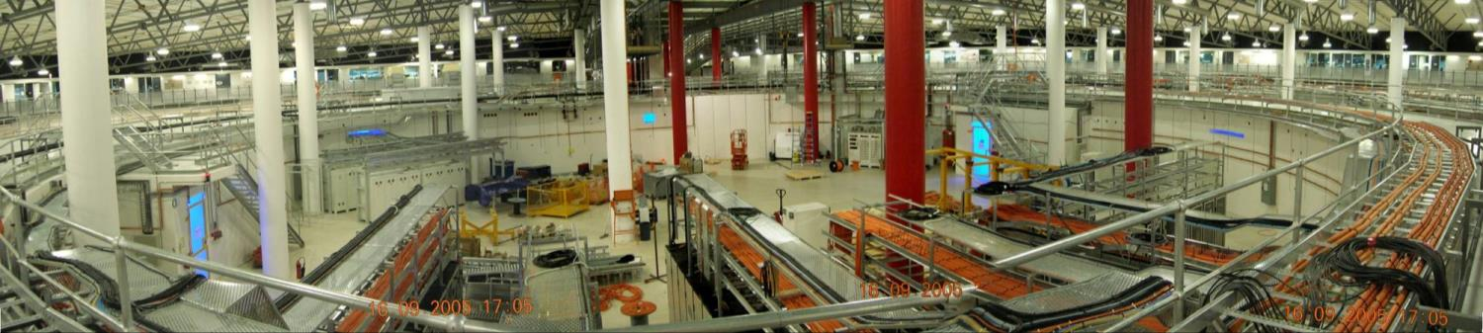
Booster Synchrotron
Alternative to a linear accelerator is a circular accelerator.
Multiple passes through the same electric field.
Increases energy from 100 MeV to 3000 MeV.
100keV
200keV
+
-
-
+
RF Cavity
Notes:
Need to show a picture of what the cavities look like maybe

Slide 30
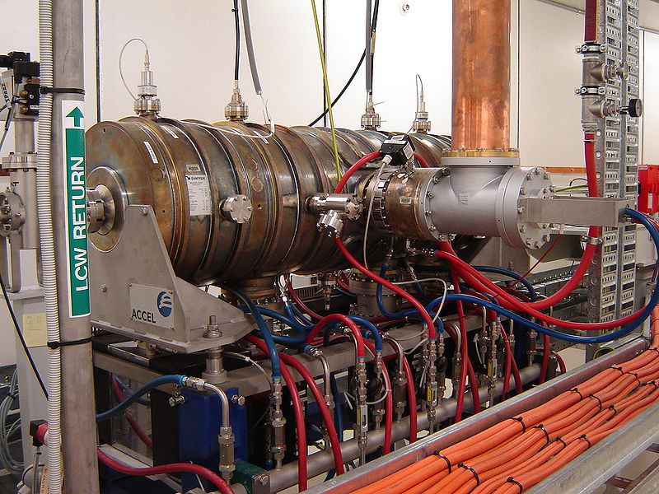
Booster RF Cavities

Slide 31
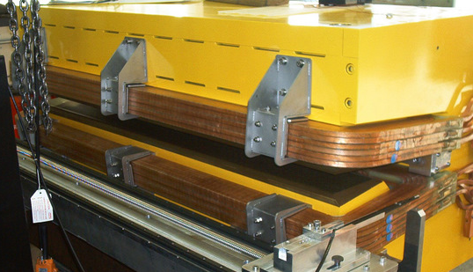
Booster Synchrotron
How to steer it into a circular orbit?
Magnetic fields
Forces are at right angles, "×" symbol
Circular path. No work done by
magnetic fields! F.d = F.0 = 0
Bend Magnet
B field direction into page
r
Force
Centripetal Force equation
Notes:
Does the way the electrons move remind you of anything? Centripetal force, swinging an object in a circle.

Slide 32
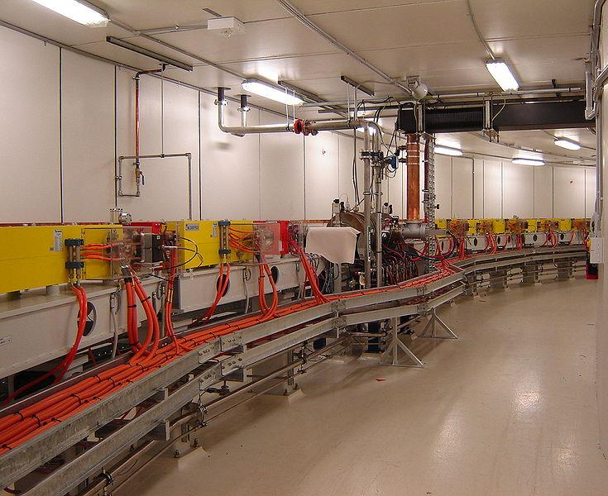
Booster Synchrotron
Notes:
Put it all together and we have the booster ring. RF cavities (like mini linear accelerators).

Slide 33
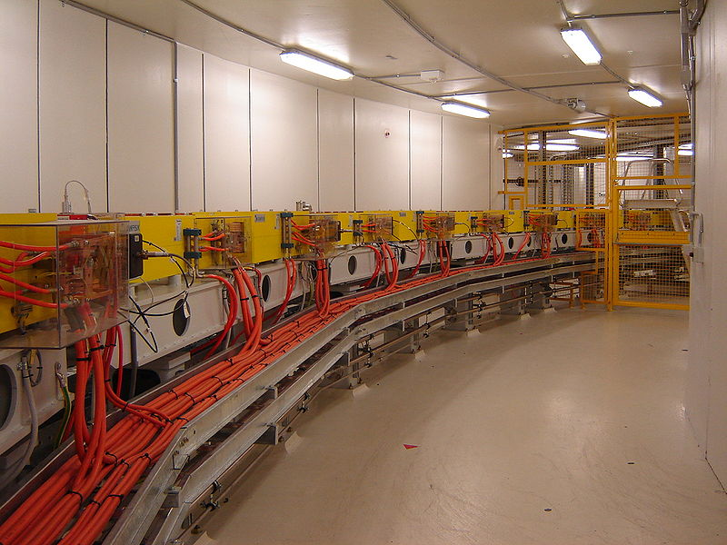

Slide 34
Booster Synchrotron
Electric fields = Acceleration (Increased Energy)
Magnetic fields = Steering

Slide 35
Storage Ring (4)
3 GeV
100 MeV
90 keV
90 keV = 90,000 eV 100 MeV = 100,000,000 eV 3 GeV = 3,000,000,000 eV
Notes:
1e-6 Joules at the Gun, now its 0.033 Joules. Kinetic energy of two raisins dropped from 1 meter.
We talked about colliders and light sources. Are storage ring used in colliders as well? What do you think? Why store electrons if you're going to colloide them? You might wonder why.
If I was an electron the nearest neighbour would be on average 100,000 km away. Earth's circumference is 40,000 km. Its about 1/3 the distance to the moon.

Slide 36
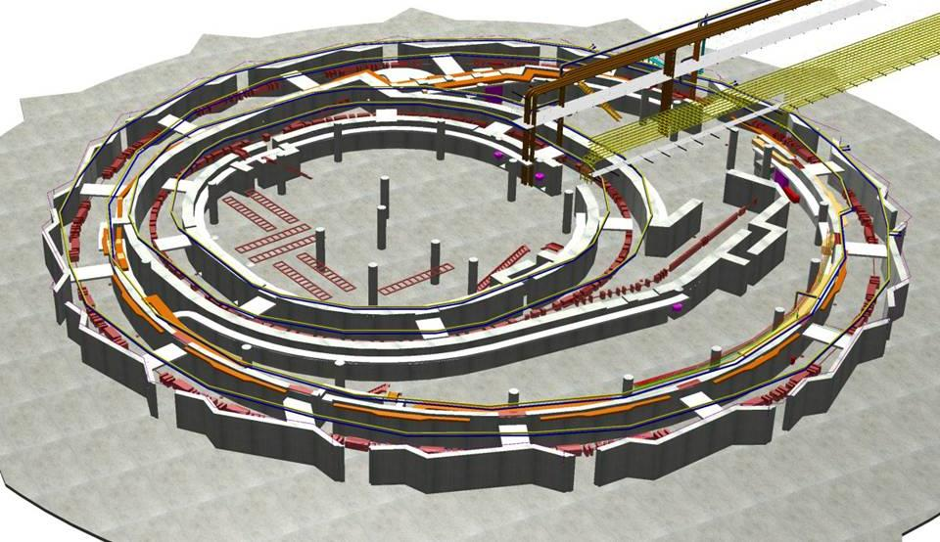
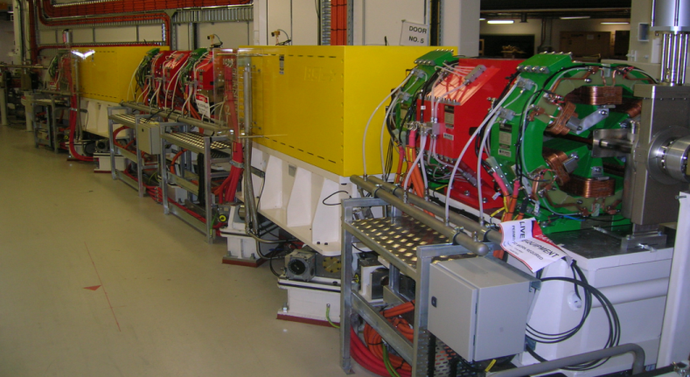
Storage Ring
Store electrons at 3 GeV.
Magnets
3 GeV Storage Ring

Slide 37
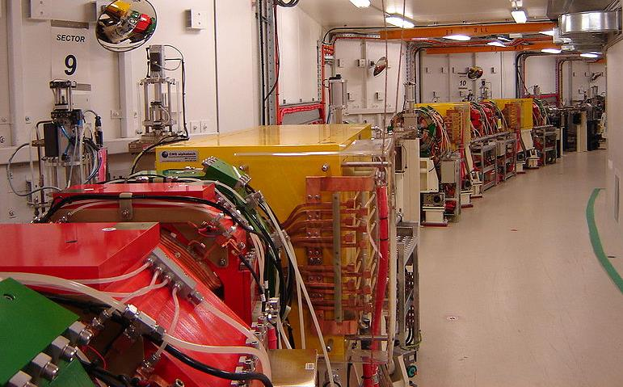

Slide 38
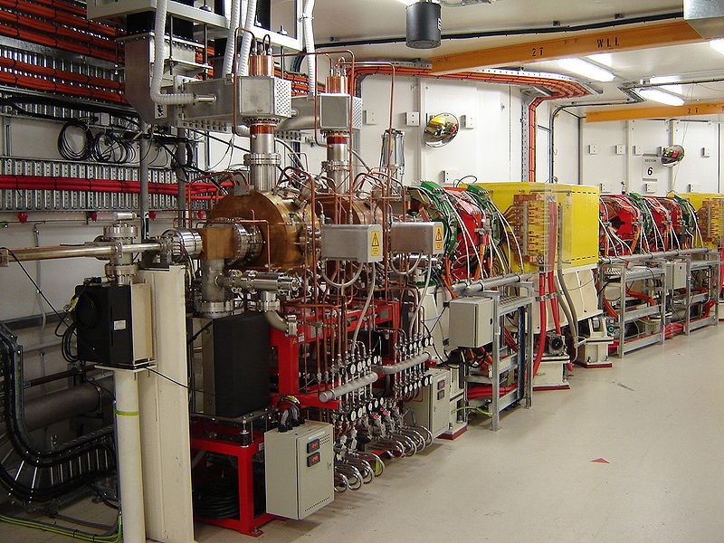
Notes:
Wait, what do these things look like?

Slide 39
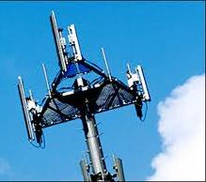
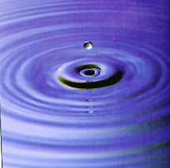
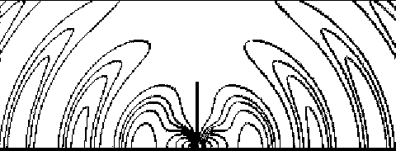
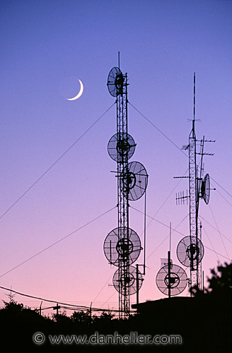
Storage Ring
Do Storage Rings need cavities to generate electric fields to add energy to the electrons?
Yes
Why? Because accelerating charges radiate energy.
Electro-Magnetic Waves

Slide 40
Storage Ring – Electro-Magnetic Radiation
5 MeV to 3 GeV
90 keV
Radiating and loosing energy. Needs cavities to be top up energy.
Electro-Magnetic Radiation emitted in the forward direction, tangential to the direction of motion.

Slide 41
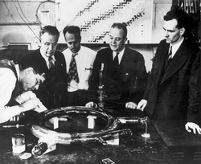
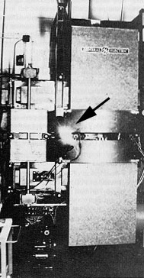
Storage Ring – Electro-Magnetic Radiation
5 MeV to 3 GeV
The General Electric team looking at the vacuum chamber of the 70 MeV synchrotron - the world's second synchrotron
http://journals.iucr.org/s/issues/1998/03/00/hi3494/hi3494fig5.html
Synchrotron light from the 70-MeV electron synchrotron at GE.
http://xdb.lbl.gov/Section2/Sec_2-2.html
Special Relativity can explain why it is a pencil beam!
Commonly called SYNCHROTRON Radiation/Light

Slide 42
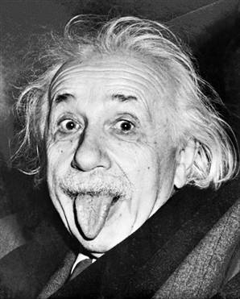
Storage Ring – Electro-Magnetic Radiation
5 MeV to 3 GeV
“Reality is merely an illusion, although a very persistent one”
“The true sign of intelligence is not knowledge but imagination.”
Special Relativity can explain why it is a pencil beam!
Commonly called SYNCHROTRON Radiation/Light

Slide 43
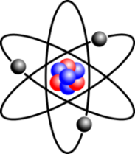
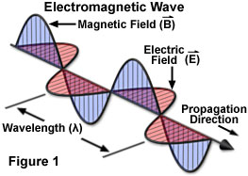
What is a Synchrotron?
- Light/Photon Source
Light/Photons
  Electromagnetic waves.
  Packets of energy transmitted and
  absorbed by atoms.
E = hf = hc/λ
E – Photon Energy
h – Planck’s constant
f – frequency of light
c – speed of light
λ – wavelength of light
http://micro.magnet.fsu.edu/primer/java/electromagnetic/index.html
Notes:
Fundamental form of interaction we experience. It is how we predominantly observe and interact with the physical universe around us.

Slide 44
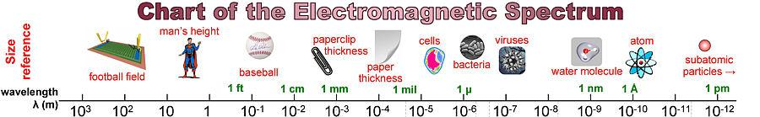
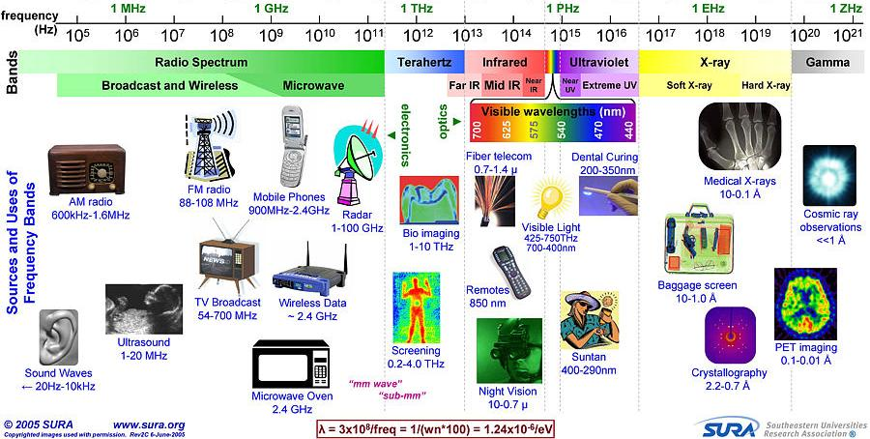
Electromagnetic Radiation

Slide 45
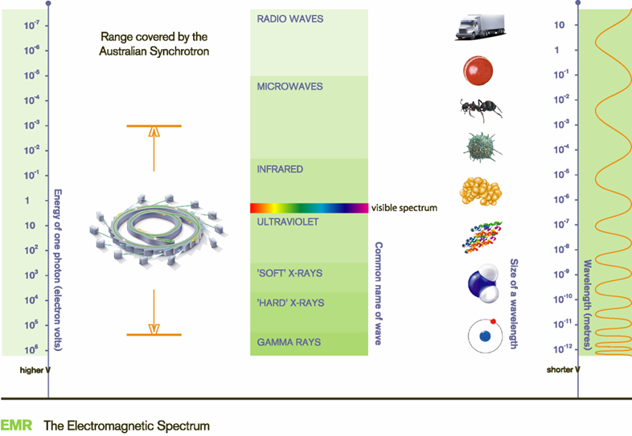
Synchrotron Radiation
A synchrotron dedicated to generating synchrotron radiation is called a Light Source.
What can a Synchrotron Light Source produce?

Slide 46
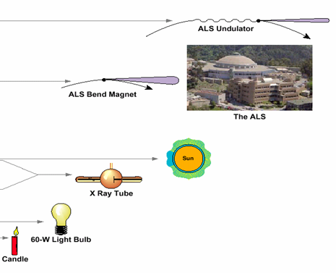
Key Properties of Synchrotron Light
Broad spectrum
  Replace many types of individual sources.
  Select the photon wavelength to suit your particular experiment
Very Bright (Brilliant)
  Faster experiments
  Smaller sample
Collimated / Parallel
  Easier to focus to
  a small spot
  Simplifies analysis
10¹⁹
10¹⁵
Brightness
10¹⁰
10⁶

Slide 47
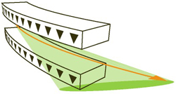

Sources of Synchrotron Radiation
Storage Ring has 28 Bending Magnets
Electron beam (orange line) stays in the ring.
Synchrotron Radiation is extracted.
Special "Insertion Devices" used in straight sections.
Bending Magnet

Slide 48
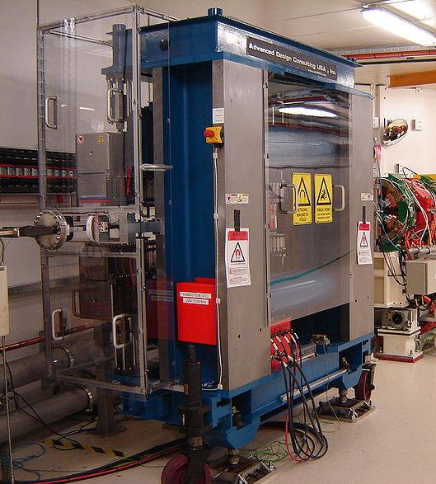
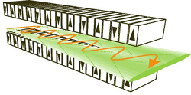
Sources of Synchrotron Radiation
Insertion Devices: Wiggler
Broad spectrum.
Multiple dipoles attached end to end.
Wiggler

Slide 49
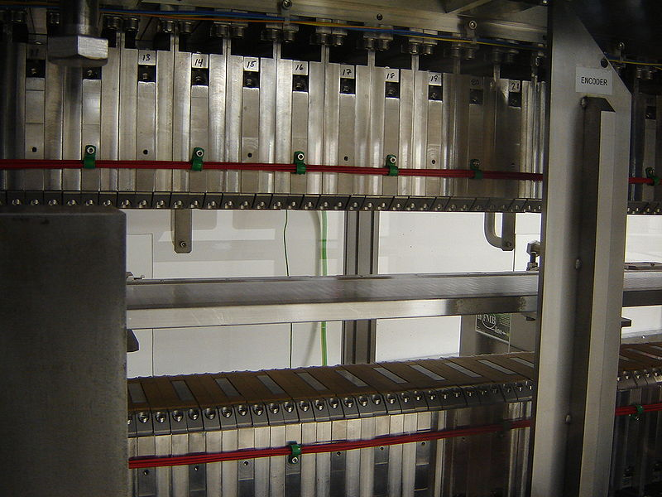
Sources of Synchrotron Radiation
Insertion Devices: Wiggler
Wiggler

Slide 50


Sources of Synchrotron Radiation
Insertion Devices: Undulator
Narrow spectrum.
Concentrated and therefore higher power for a given wavelength.
Undulator

Slide 51

Sources of Synchrotron Radiation
Insertion Devices
Undulator
Wiggler
1000 x
100 x
Bending Magnet
http://pd.chem.ucl.ac.uk/pdnn/inst2/insert.htm

Slide 52
Science of using Synchrotron Light
Electron Gun
Linear Accelerator (Linac)
Booster Synchrotron
Electron Storage Ring
Photon Transport Line
Photon Experiments
4
5
6
3
2
1

Slide 53
Science of using Synchrotron Light (5) and (6)
Notes:
Store electrons to collide. If I was an electron the nearest neighbour would be on average 100,000 km away.

Slide 54
Reminder
B into the screen
1.3 Tesla into the board
electrons
photons
F
r
electrons

Slide 55

Reminder
photons
electrons

Slide 56

Synchrotron Radiation's Interaction with Matter
Surface science
Element analysis
Chemical information
Courtesy SRRC, Taiwan
Structural analysis
Absorption Spectroscopy
Imaging
Notes:
Complex interactions. Looking at various interactions gives us information on the properties of matter that the radiation interacts with.

Slide 57
Current Beamlines and Categories
Crystallography & Diffraction (Structural and Shape information)
1
High-throughput Protein Crystallography
2
Protein Microcrystal & Small Molecule X-ray Diffraction
3
Powder X-ray Diffraction
4
Small and Wide Angle X-ray Scattering
Spectroscopy (Elemental, molecular, inter-molecular information)
5
X-ray Absorption Spectroscopy
6
Soft X-ray Spectroscopy
7
Infrared Spectroscopy
8
Microspectroscopy (submicron-XAS, XANES, & XRF)
Imaging
9
Imaging & Medical Therapy

Slide 58



Crystallography & Diffraction
Understand the arrangement of the atoms, molecules and/or
grains.
Monochromatic photon Beam
?
Analysis

Slide 59
Crystallography & Diffraction
One principal behind diffraction is Bragg's law or Bragg diffraction.
nλ=2d sin θ
θ
d, spacing between crystal layers
d sin θ
=nλ (integer number of λ)
Notes:
3 legged race
In time with each other

Slide 60
Crystallography & Diffraction
One principal behind diffraction is Bragg's law or Bragg diffraction.
1λ=2d sin θ
Strong Signal
θ
d, spacing between crystal layers
d sin θ
Notes:
3 legged race
In time with each other

Slide 61
Crystallography & Diffraction
One principal behind diffraction is Bragg's law or Bragg diffraction.
2λ=2d sin θ
Strong Signal
θ
d, spacing between crystal layers
d sin θ
Notes:
3 legged race
In time with each other

Slide 62
Crystallography & Diffraction
One principal behind diffraction is Bragg's law or Bragg diffraction.
2.4λ=2d sin θ
Weak Signal
θ
d, spacing between crystal layers
d sin θ
Notes:
3 legged race
In time with each other

Slide 63
Crystallography & Diffraction
One principal behind diffraction is Bragg's law or Bragg diffraction.
d=λ/2sin θ
Strong Signal
θ
d, spacing between crystal layers
d sin θ
Notes:
3 legged race
In time with each other

Slide 64


Crystallography & Diffraction
Powder diffraction uses Braggs law to determine crystal
structures.
Powder Diffraction
Notes:
3 legged race
In time with each other

Slide 65

Protein Crystallography
Bending magnet source
Vertically focussing mirror
Final focus Sample Holder
Vertically collimating mirror
Double crystal monochromator
Selects the desired photon energy.
Uses Bragg's Law

Slide 66



Crystallography & Diffraction
Protein Crystallography
Protein's behaviour is dictated by its shape as much as its chemical content.
By modelling virus proteins, medicines can be created to block these proteins.

Slide 67


Spectroscopy
Identifying for elements or molecules in a sample.
Examples of methods:
Absorption spectroscopy (absorbance for chlorophyll)
Photoemission Spectroscopy
(Fluorescence)
Absorption spectroscopy

Slide 68




Spectroscopy
Absorption spectroscopy (absorbance for chlorophyll)
Photoemission Spectroscopy
(Fluorescence)
Absorption spectroscopy

Slide 69
Fluorescence Microscopy
Photon Energy Selection

Slide 70



Fluorescence Microscopy
Selenium
Iron
Zinc
Iron
Manganese
Micronutrient distribution in barley grain.
Enzo Lombi et al.
Uni South Australia
Phosphorus
Se, Fe, and P in selenium-enriched broccoli flower, showing high selenium concentrations in the pollen.
Marian McKenzie, Plant & Food Research (Ltd.).
Food Production Research

Slide 71



Fluorescence Microscopy
Part of the Archimedes “Method of Mechanical Theorems” written down ~ 10th century.
Archimedes palimpsest.
U. Bergmann
et al, SSRL
Cultural
Preservation

Slide 72


Infrared Signature of Collagen Degradation
in Antibody-Induced Arthritis
Microscope image
Infrared “classification map”
Infrared “signature” of
collagen damage in green zone
Stained mouse paw thin section
Monash University
Merrill Rowley (Biochemistry)
Allyson Croxford (Biochemistry)
Don McNaughton (Chemistry)
Senga Whittingham (Autoimmunity Group)
Ian Mackay (Autoimmunity Group)
IR Beamline
Mark Tobin
Ljiljana Puskar
Danielle Martin
Protein structure changes are mapped onto outer regions of cartilage in antibody-induced arthritis (dark green). Changes are not observed in control animals. Has potential to allow study of treatments. CA = Cartilage BO = Bone
Karolinska Institute, Stockholm
Dr. Kutty Selva Nandakumar
Prof. Rikard Holmdahl
Medical

Slide 73
Imaging
Detector
Sample
A ‘diffraction experiment’
An ‘imaging experiment’
Detector

Slide 74


Imaging –Phase contrast of lungs
Phase contrast

Slide 75


Imaging –Phase contrast of lungs
Medical research into improve the health prospects for premature babies
No PEEP
PEEP
http://www.neoresus.org.au/pages/LM1-7-Breathing.php#B_FirstBreaths

Slide 76


Imaging - Tomography
X-ray tomography of rat thigh bone. Non-destructive.

Slide 77

Accelerator Lattice Modelling/Simulation

Slide 78

Electron Beam Instability (Low E Ring configuration)

Slide 79

Low Alpha (coherent synchrotron radiation)

Slide 80

Low Alpha (coherent synchrotron radiation)

Slide 81




Slide 82
Summary
A synchrotron is a type of particle accelerator.
  Some understanding of how a particle accelerator works
The Australian Synchrotron is a Light Source.
  Some understanding of how synchrotron radiation is created.
We are at the forefront of Australian research
  Some understanding of how synchrotron radiation is used.

Slide 84


ACKNOWLEDGMENTS
Mark Boland
Mark Tobin
Martin de Jonge
David Paterson
Chris Glover
Nigel Kirby
Chris Hall
Etc…

Slide 85

Thank You

