Slide 1
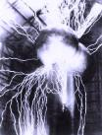

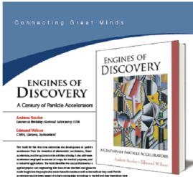
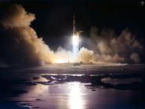
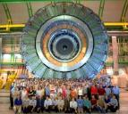
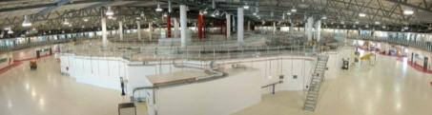
Enabling Science with Accelerators
Jeff Corbett, SLAC
Australian Consortium Accelerator Science
Summer School
January 2016
From DC to AC Acceleration
The Golden Era of Applied Science
Big Science with Accelerators
Synchrotron Light Sources

Slide 2
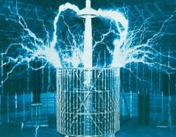
After Fresnel
Hertz
Lorentz
Maxwell
Rontgen
Bohr
Einstein
Schrodinger
Heisenberg
Dirac
and others...
We knew about electromagnetism
electrons
nuclei
Had LOTS of theories how things should behave
And were beginning to have to tools to explore...

Slide 3
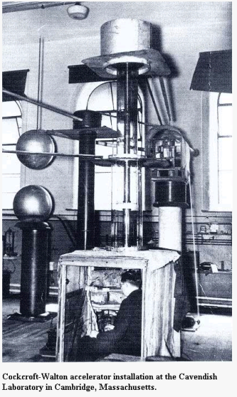
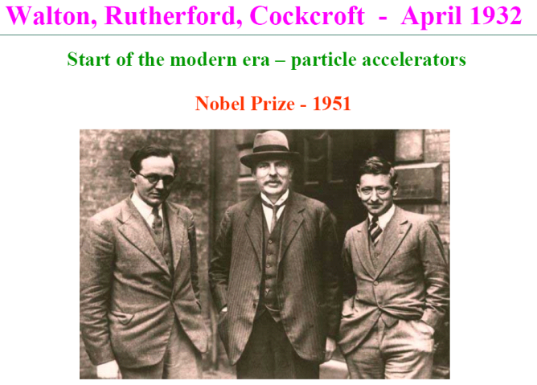
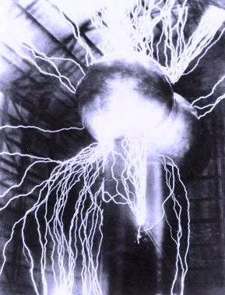
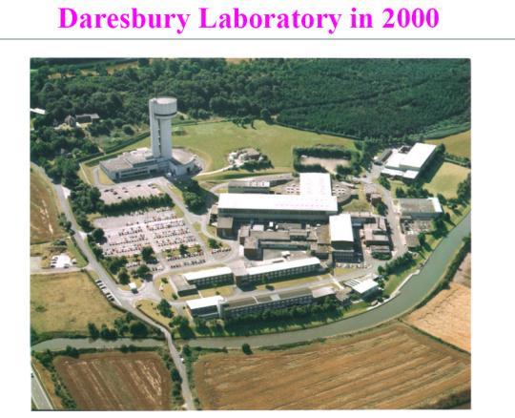
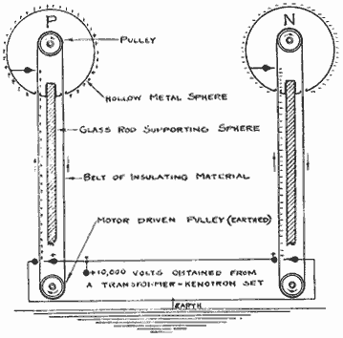
Dawn of a New Age – High Voltage DC Acceleration
α
p
Li
800keV
α
nuclear transmutation!
Van de Graaff <7MV
courtesy M. Poole

Slide 4
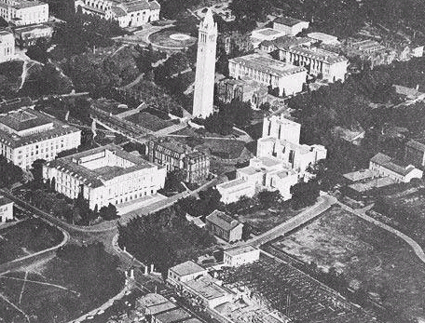
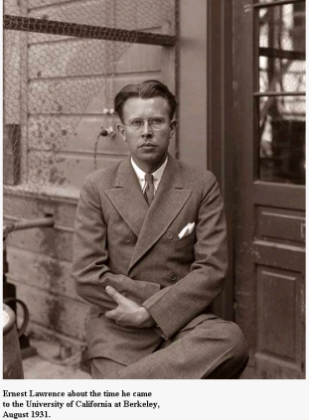
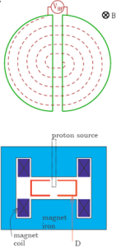
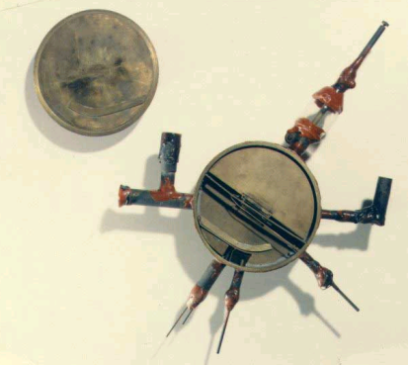
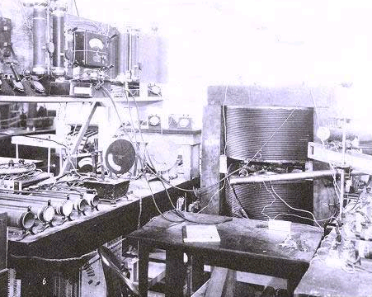
AC Acceleration - The Berkeley Revolution
Ernest Lawrence and the cyclotron

Slide 5
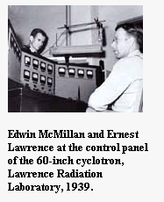
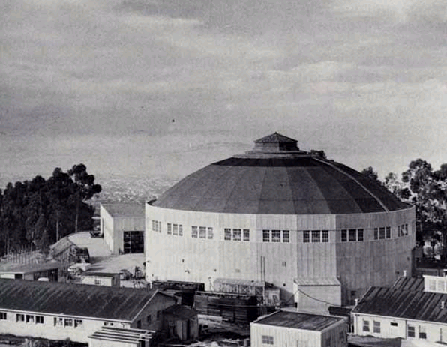
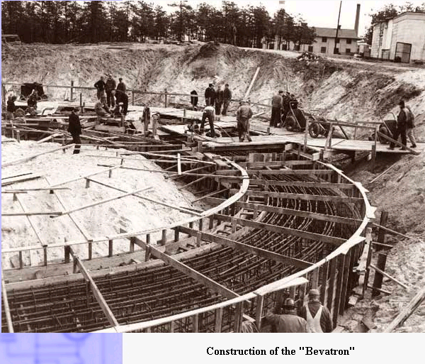
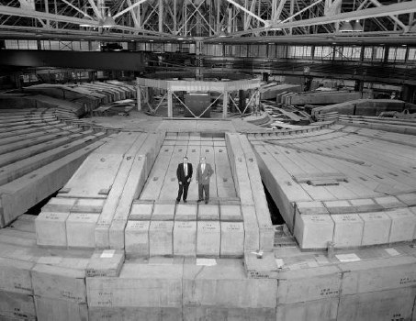
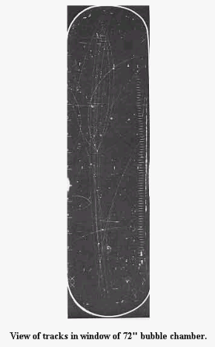
Moving Toward Large-Scale Physics
‘Old Town’ 184 inch cyclotron
(present site of the ALS)
Ed McMillan
phase focusing
Storage Rings!

Slide 6
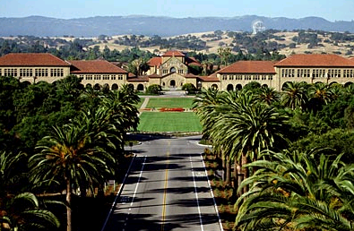
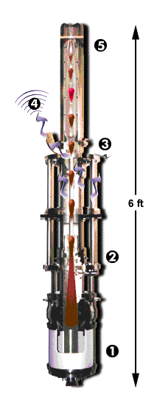
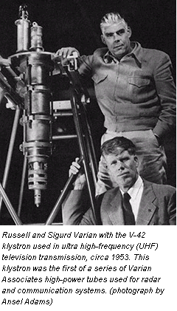
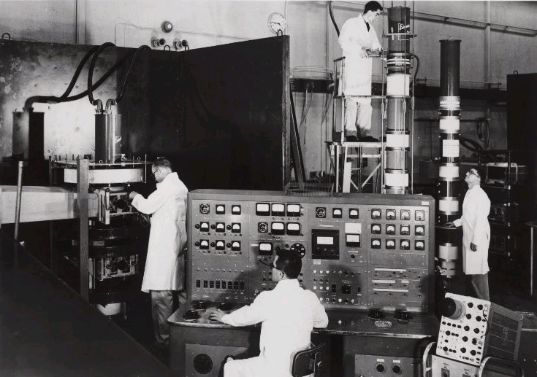
Meanwhile back on the Farm...
electromagnetic
‘whistle’
- Invention of the Klystron (radar) -

Slide 7
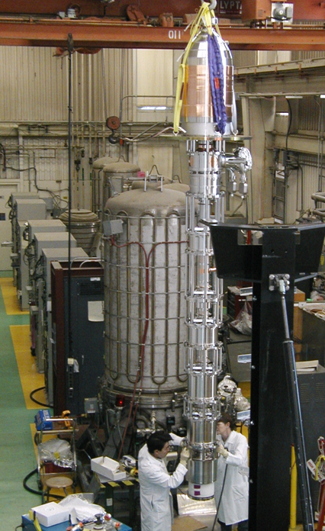
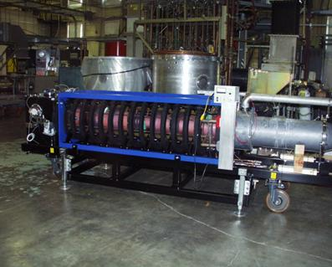
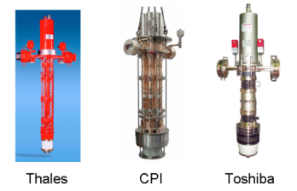
High Power Tubes
1.2 MW at 500MHz

Slide 8
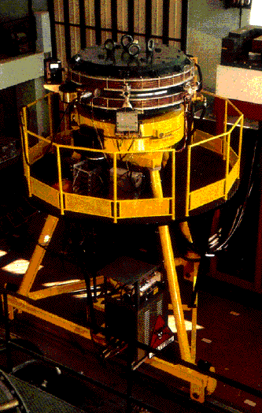
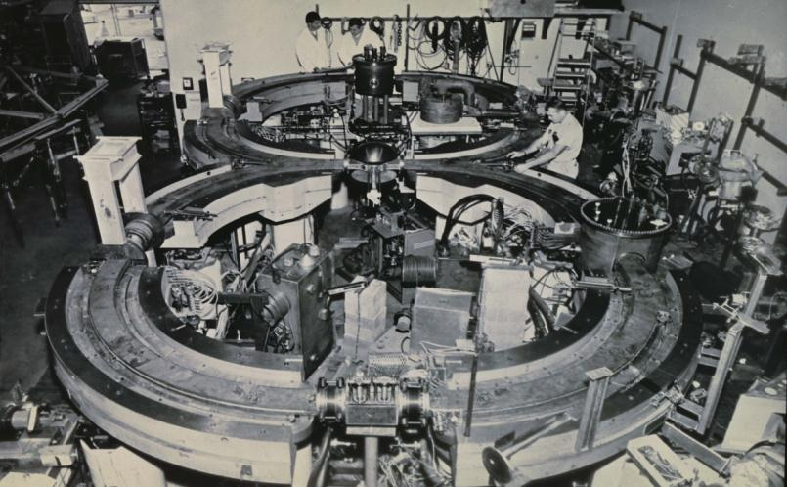
Emergence of Storage Rings
ADA
(Frascati, 1960)
Princeton-Stanford colliding beam storage rings - 1960

Slide 9
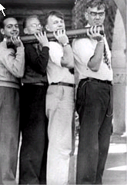
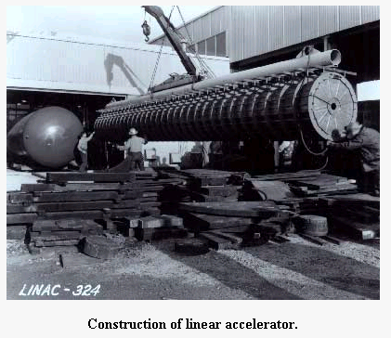
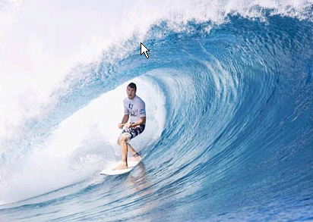
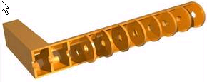
The linear accelerator (linac)
- disk loaded waveguides -
Joel Parkinson

Slide 10
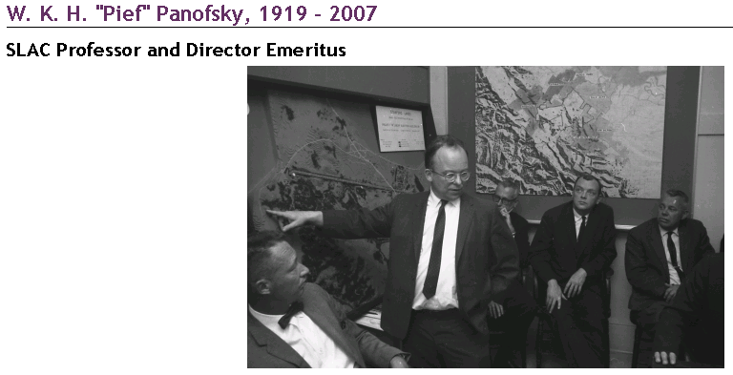
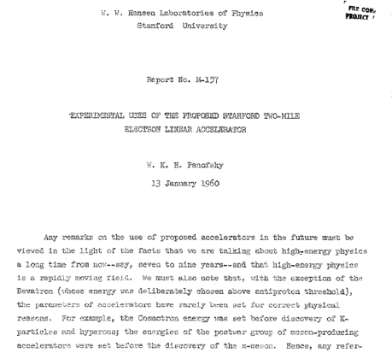
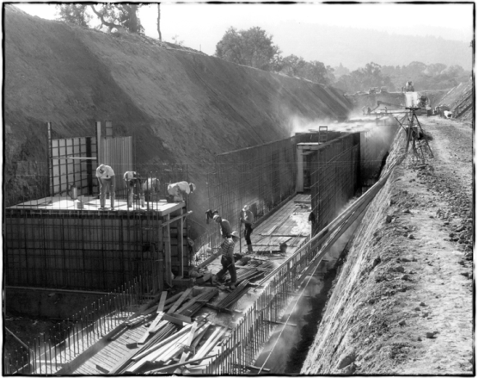
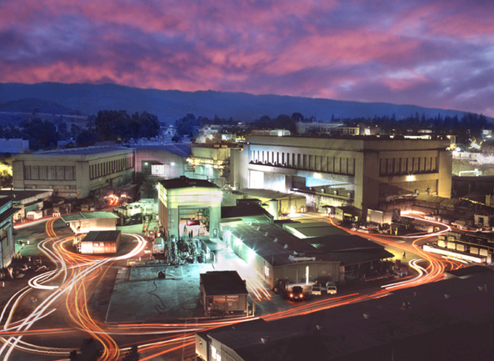
SLAC: Project-M

Slide 11
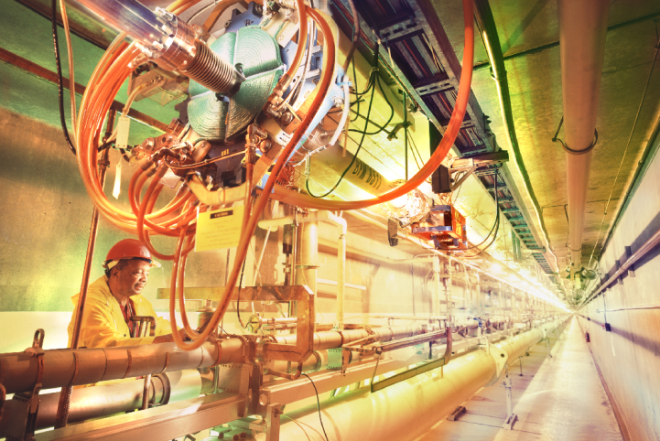
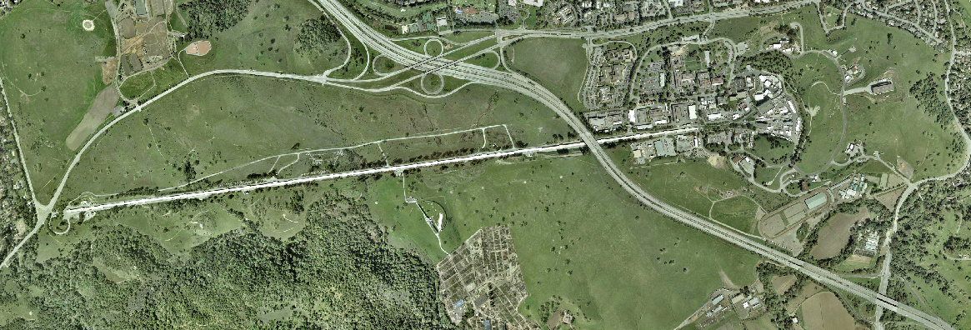
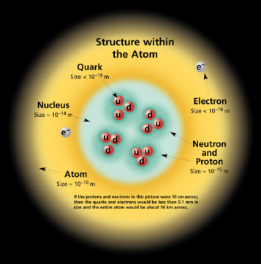
Project-M: the two mile accelerator (1962)
Beam direction (5km)

Slide 12
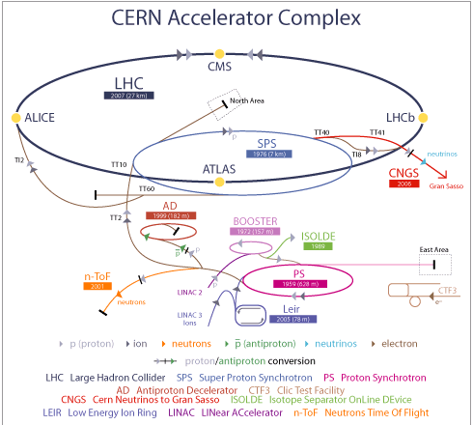
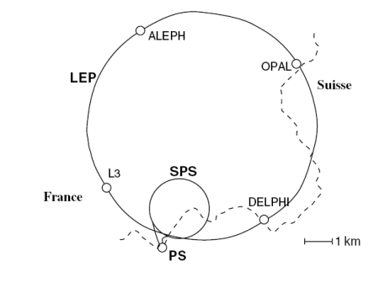

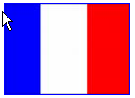
Rapid Developments at CERN (p,p)
27km circumference
Suisse
France

Slide 13
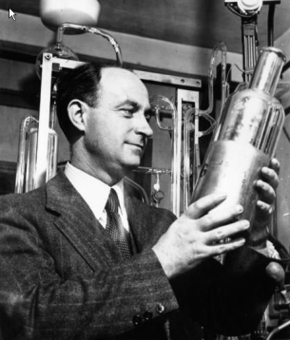
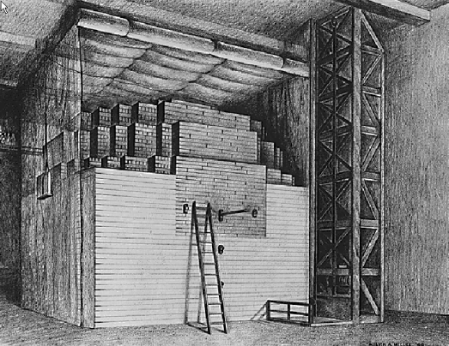
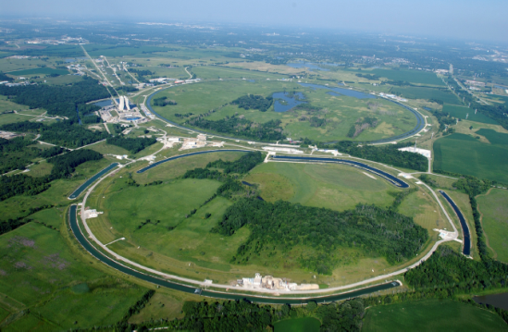
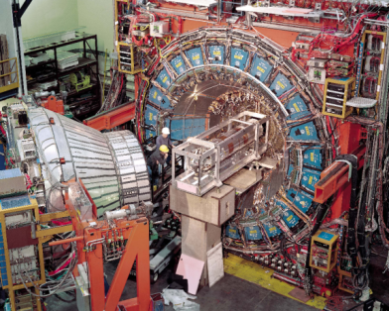
FermiLab in Chicago
University of Chicago
Argonne

Slide 14
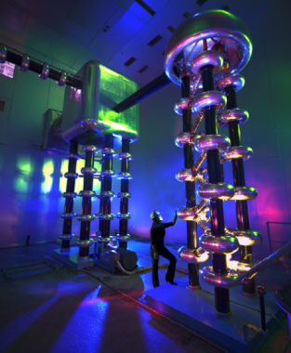
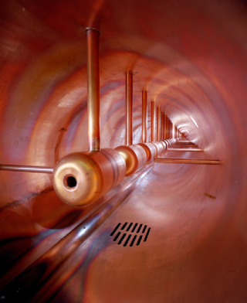



Tevatron Linac, Injector, Main Ring (p-p)

Slide 15



HERA e⁻-p collider and Petra (Petra-III)
6.3 km circumference
27GeV e- 820GeV p

Slide 16




KEK-B (asymmetric collisions)
“Asymmetry of the Universe”
damping wiggler

Slide 17




PEP-II B-Factory

Slide 18




The SNS (Spallation Neutron Source)
Oak Ridge, Tennessee

Slide 19




More Big Neutron Sources
Linac Tank at ISIS
(Rutherford-Appleton Laboratory)
storage ring
Sinq in Paul Scherrer Institute
(Suisse)

Slide 20

Cosmology – Origin and Structure of the Universe

Slide 21





The LHC (Large Hadron Collider)
7 TeV on 7 TeV p - p

Slide 22







Future Accelerator – The International Linear Collider

Slide 23






Klystrons Brought Other Applications
Ionispheric scattering, Trombso, Norway
UHF: 929MHz
VHF: 224MHz
More recently 500MHz

Slide 24


Nuclear Fusion – High Current/Low Voltage Machines

Slide 25






Fusion – The Joint European Torus (JET)

Slide 26




Hadron Therapy – Plan View and Gantry
radiation therapy using strongly interacting particles

Slide 27








Australian Accelerators...
Linac (6MeV/amu)
12MV Van DeGraff
Mass Spectrometry (AMS)
Ion Beam Analysis (IBS)
Secondary Ion Mass Spectrometry (SIMS)
STAR
ANTARES
SIMS

Slide 28

Synchrotron Light Sources
Australian Synchrotron

Slide 29


Layout of the SSRF complex (Shanghai)
Beam Lines
Main Ring
Booster
Linac
Courtesy Z. Zhao

Slide 30




Synchrotron Radiation Emission
radiation emission from a storage ring
radiation in particle system
radiation in lab system
infrared to x-ray spectrum!
(ordinary heat to passage-through-matter)

Slide 31


1/γ and the Critical Frequency
electron
photon
1/γ
observer
δt=10⁻¹⁹ sec!
δt
f_{c}=10¹⁹ Hz!
to 10keV
1/γ
λ=400-700nm (~1 eV)
ω=ω_{c}
visible

Slide 32

Insertion Devices for Radiation Enhancement
bending magnet - a “sweeping searchlight”
wiggler - incoherent superposition
undulator - coherent interference

Slide 33


Light Source Progress: ~50 years
First light - GE synchrotron
Large user facility

Slide 34






Medium Energy Machines (2.5-3 GeV)
CLS
(Canada)
DIAMOND
(UK)
ASP
(Australia)
SOLEIL
(France)
SLS
(Switzerland)
SPEAR3
(USA)

Slide 35





New 3rd Generation Machines
ALBA
(SPAIN)
SSRF
(Shanghai)
SESAME
(JORDAN)
NSLS-II
(USA)
TLS-II
(Taiwan)

Slide 36




Billion Dollar Synchrotrons
ESRF, Grenoble
6 GeV
APS, Chicago
7 GeV
Spring8, Hyogo
8 GeV
MAX-IV, Lund
3 GeV

Slide 37
Survey of Major Light Source Facilities
Courtesy D. Einfeld

Slide 38












Machine Construction
Australia
China
USA

Slide 39

Fully Developed Site - Advanced Photon Source
Center for Nanoscale Materials
Central Lab/Office Bldg.
Guest House
Booster/Injector
Linac
Storage Ring
Experiment Hall
Lab/Office Modules

Slide 40



Building Interiors
Canadian Light Source
Australian Synchrotron tunnel
Shanghai
Shielded
Ratchet Walls

Slide 41






Magnets and Rafts
Dipole
Quadrupole
Sextupole

Slide 42




Modern Support Systems
Courtesy M. Boege
LIGO Supports!
cam mover and hydrostatic level detector (micron res.)

Slide 43

Synchrotron Vacuum Chambers

Slide 44




Chamber Bakeout and Installation

Slide 45



Normal Conducting Cavities – Australian Synchrotron
cavities
rf drive

Slide 46



Normal Conducting Cavities – SPEAR3
water cooling channels
cavity with accessories
complete system
1.2MW Klystron

Slide 47




Superconducting Cavities
Cornell 500MHz system
Canadian Light Source
30kW solid state source
CERN Cavity

Slide 48

Survey and Alignment: ~20micron accuracy
Laser tracker

Slide 49

Ratchet Walls for SR Extraction
Courtesy D. Einfeld

Slide 50




Heat Load bearing surfaces
Thermal stresses
σ_{MAX} = 90.0 MPa

Slide 51

Photon Beam Lines
synchrotron
collimator(s)
mirror(s)
monochromator
experiment
control/analysis

Slide 52


Hutch Construction at Monash

Slide 53

Long Beam Lines !
SPring-8

Slide 54




Beam Line Components - I
Insertion Device
1.2 m toroidal mirror
Front End Mask

Slide 55




Beam Line Components - II
Monochromators
Bragg Crystals
Rocking Curve

Slide 56


X-ray microscopy and Micro-diffraction
Focus spot size to micron level to examine single micron-sized structures
SR requirements:
intensity stability: 10⁻³
position stability: ~1 μm
white or monochromatic light, 100-1000 eV

Slide 57


Macromolecular Crystal Diffraction Patterns
continuous rotation during scan
sensitive to higher frequency noise (~100 Hz)
high mosaicity crystal
SR requirements:
intensity stability: 10⁻³
energy resolution: 10⁻⁴

Slide 58

End Stations

Slide 59

Synchrotron Radiation Science

Slide 60

SR Science Techniques

Slide 61









SR Science at the Australian Synchrotron

Slide 62



Free-Electron Lasers
+ short pulse
+ spatial and transverse coherence
START MIDDLE END

Slide 63






Anatomy of an FEL
compressor
compressor
electron gun
linac #1
linac #2
undulator

Slide 64



FLASH (Hamburg, 40Angstrom)
40 Angstrom, 10 fs, 10 GW

Slide 65


FLASH (cont’d)
Experimental Floor
LASERS, LASERS, LASERS

Slide 66

The X-Ray Free-Electron Laser
-short pulse, coherence, very high power!
FELS
Rings
peak power

Slide 67


Linac Coherent Light Source (LCLS 1, 2)

Slide 68



X-Ray Free-Electron Laser (XFEL )
Main Linac

Slide 69



XFEL Acceleration Section
^{Niobium Accelerating cavity}
^{Cryomodule}

Slide 70


Single-shot Experiments
SAMPLE INJECTOR
detectors
X-fel pulse
X-ray diffraction pattern

Slide 71




Spring8 Compact SASE Source (SCSS)

Slide 72

Soft X-ray FEL Facilities

Slide 73



The Electron-Recirculating Linac (ERL)
CEBAF
Concept
4th Generation
Machine

Slide 74

THANK YOU !
- Enjoy the Program -

