Slide 1
Effect of thiosulfate on the SCC behavior of carbon steel welds exposed to concrete pore water under anoxic conditions
B. Kursten* and R. Gaggiano**
* SCK•CEN, Belgian Nuclear Research Centre, Mol, Belgium
** ONDRAF/NIRAS, Belgian radioactive waste management organization, Brussels, Belgium
bruno.kursten@sckcen.be

Slide 2
Outline
Context / Research significance
Experimental details
Experimental results & discussion
  SSRT tests: interpretation of stress-strain curves
  Analysis fracture surface
Conclusions
Future work

Slide 3
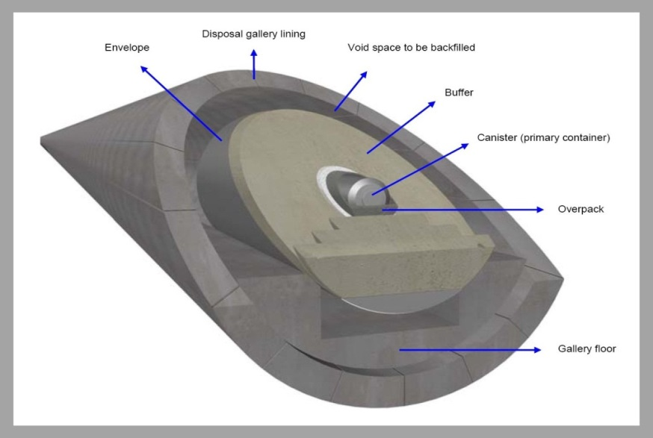
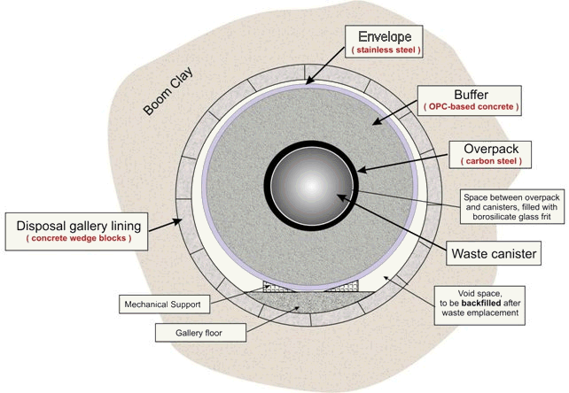
Context / Research significance
The ‘Supercontainer’ design  reference disposal concept in Belgium
Carbon steel overpack (3 cm thick) containing either vitrified HLW canisters or spent fuel assemblies
The overpack is surrounded by a concrete buffer (thickness ~ 70 cm). The concrete buffer contains OPC-based cement
The cylindrical cavity between the overpack and the concrete buffer is filled with a cementitious filler
The concrete buffer is enterily encased in a stainless steel envelope (6 mm thick)

Slide 4
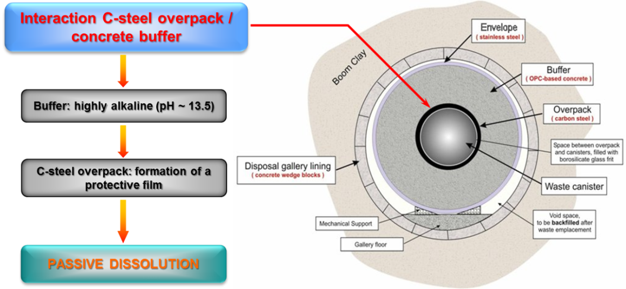
Context / Research significance
Concrete provides a chemically benign environment for C-steel
Contained Environment Concept (CEC)
  to establish and maintain a chemically benign environment around the overpack ( favourable in achieving containment of the radioactivity)
Proving the validity of the ‘exclusion principle’
    Metals protected by passive oxide films can be susceptible to localised breakdown if proper environmental conditions are met
    Accelerated dissolution of underlying metal
    Prove that any form of corrosion other than uniform corrosion cannot occur (i.e. pitting corrosion, crevice corrosion, SCC, HE, …)

Slide 5
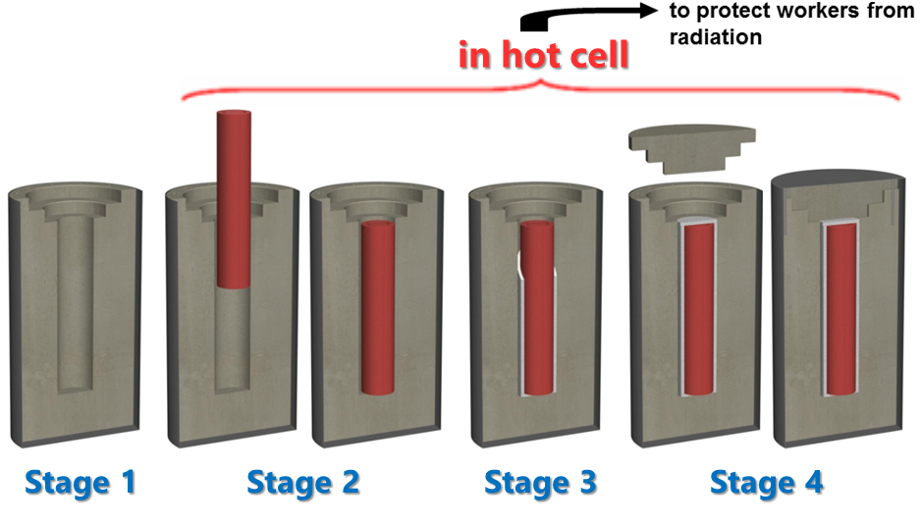
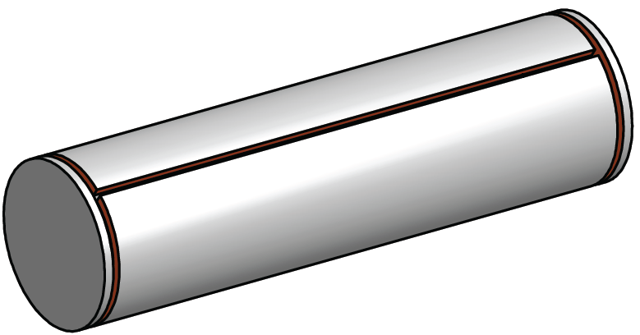
Context / Research significance
Construction of SC  Susceptibility of welds
Welding is being considered as a final closure technique of the C-steel overpack (water tightness)
  Welding  residual stresses  increased susceptibility to SCC
Stage 1: prefabricate phase 1 concrete shell
Stage 2: insert C-steel overpack containing HLW or SF assemblies
Stage 3: fill annular gap around overpack (phase 2 concrete)
Stage 4: place phase 3 concrete end piece and lid
Carbon steel overpack will be welded
  one longitudinal weld (body)
  2 circular welds (base, cover)
  residual stresses
  susceptibility to SCC

Slide 6
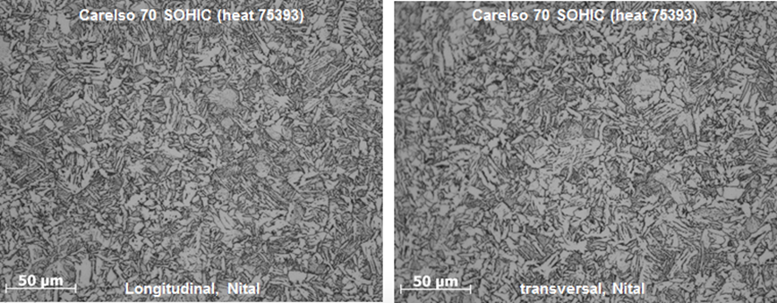
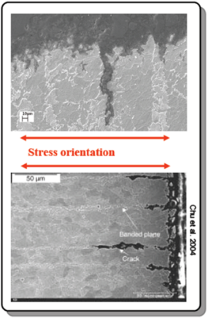
Experimental details
Test material
Reference C-steel grade CarElso 70 SOHIC (P355 QL2)
C | Mn | P | S | Si | Cu | Ni | Cr | Mo | Al | Nb | Zr | V | Ti | Co | B | H | N
0.150 | 0.980 | 0.005 | 0.0005 | 0.324 | 0.043 | 0.050 | 0.082 | 0.009 | 0.034 | 0.006 | 0.001 | 0.001 | 0.001 | 0.005 | 0.0001 | 1.95 | 0.0034
Heat treatment of base metal:
‒ quenching: 920°C × 30 min followed by water-cooling;
‒ tempering: 590°C × 30 min followed by air-cooling;
Very clean homogeneous steel with limited alloying elements
  Free of ferrite/pearlite banding
  CEA study (A. Didot, 2008, PhD Thesis)
    P265 grade carbon steel tested under static load
    revealed presence of transgranular cracks in Base Metal
    caused by galvanic coupling between the ferrite matrix and the array of pearlite bands

Slide 7
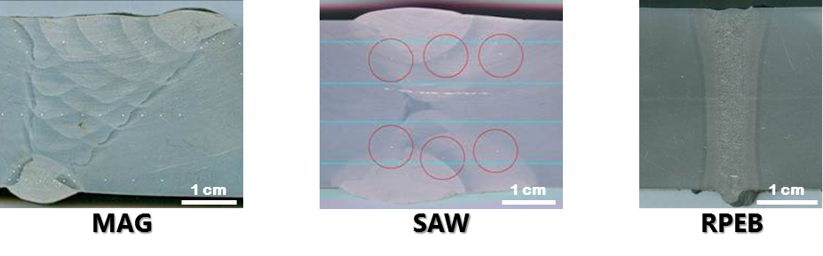
Experimental Details
Welding procedures
Three weld techniques considered for overpack closure
  MIG/MAG
  SAW
  RPEB
Macrostructure of weld zone
 | MAG ⁽¹⁾ | SAW ⁽¹⁾ | RPEB
Groove depth (mm) | 30 | 15 | 30
Shield gas | Ar–18% CO₂ | Ar–18% CO₂ | ‒
Welding current (A) | 220 | 580 | 0.11 ⁽⁴⁾
Voltage (V) | 28 ⁽²⁾ | 30 ⁽²⁾ | 150 000 ⁽⁵⁾
Travel speed (cm/min) | 45 | 35 | 20
Number of weld passes | 21 | 8 ⁽³⁾ | 1
⁽¹⁾ the plates were preheated to 70°C; MAG and SAW welding were carried out with the addition of filler metal; ⁽²⁾ arc voltage; ⁽⁴⁾ beam current; ⁽³⁾ including 2 root passes (MAG); ⁽⁵⁾ accelerating voltage;

Slide 8
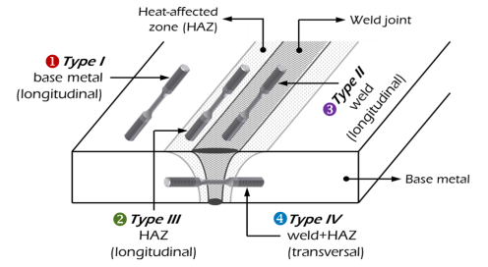
Experimental Details
Sample orientation
4 locations
  in base metal, longitudinal
  in HAZ, longitudinal
  in welded zone, longitudinal
  Through weld & HAZ, transversal

Slide 9
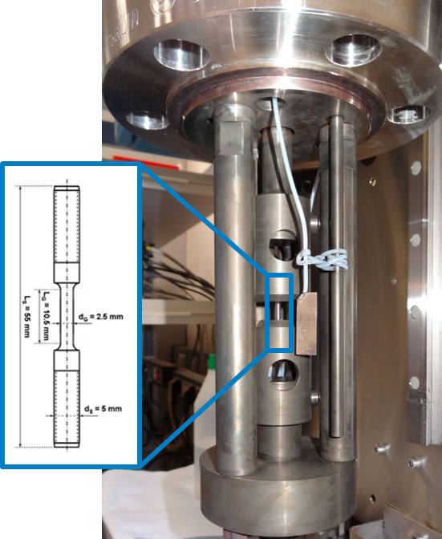
Experimental Details
Slow Strain Rate Testing / Experimental conditions
Slow Strain Rate Testing (SSRT)
  SSRT involves pulling a test specimen at a constant strain rate until failure
  Cylindrical notch-free samples
  Strain rate: 5 ×10⁻⁷ s⁻¹ (÷ 0.3 µm/min)
  Comparison with inert atmosphere (Ar)
  Fractographic analysis (SEM)
Test conditions
  Experiments performed in autoclave
    Stainless steel vessel; 900 mL test solution
    Elevated p (± 6 bar); high T (140°C)
  Ar (reference)
  YCW (Young Cement Water) - ANOXIC
  YCW + S₂O₃²⁻ (60 mg/L – 600 mg/L)
  OCP
 | pH | Na⁺ | K⁺ | SO₄²⁻
Composition (M) | 13.5 | 0.14 | 0.37 | 0.002

Slide 10
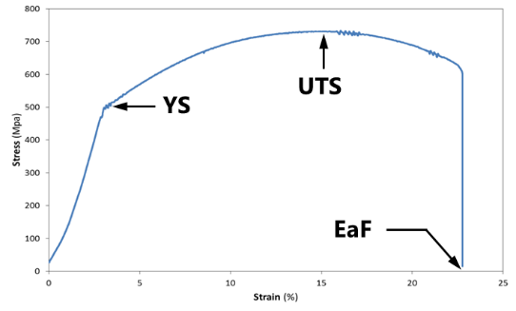
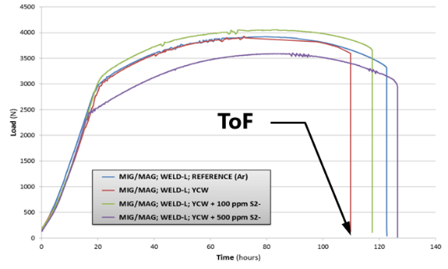
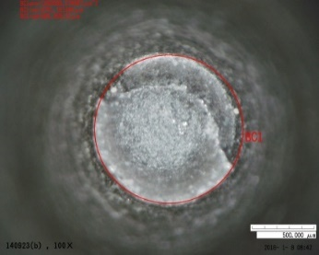
Experimental Details
Mechanical/ductility parameters deduced from SSRT tests
Yield strength (YS)
Ultimate strength (UTS)
Elongation at fracture (EaF)
Time-to-failure (TTF)
Reduction-in-area (RA)
Time-to-failure ratio (TTFR)
Reduction-in-area ratio (RAR)
Stress-strain curve
Load-time curve
Acceptance criteria ¹⁻³
[0,8-1,0] : high resistance to SCC
>0,7 : reasonably high resistance to SCC
<0.5 : high susceptibility to SCC
¹ Henthorne M., Corrosion 72(12), 1488-1518 (2016).
² McIntyre D.R., Kane R.D., Wilhelm S.M., Corrosion 44(12), 920-926 (1988).
³ Pedraza-Basulto G.K., Arizmendi-Morquecho A.M., Miramontes J.A.C., J. Electrochem. Sci. 8, 5421-5437 (2013).

Slide 11
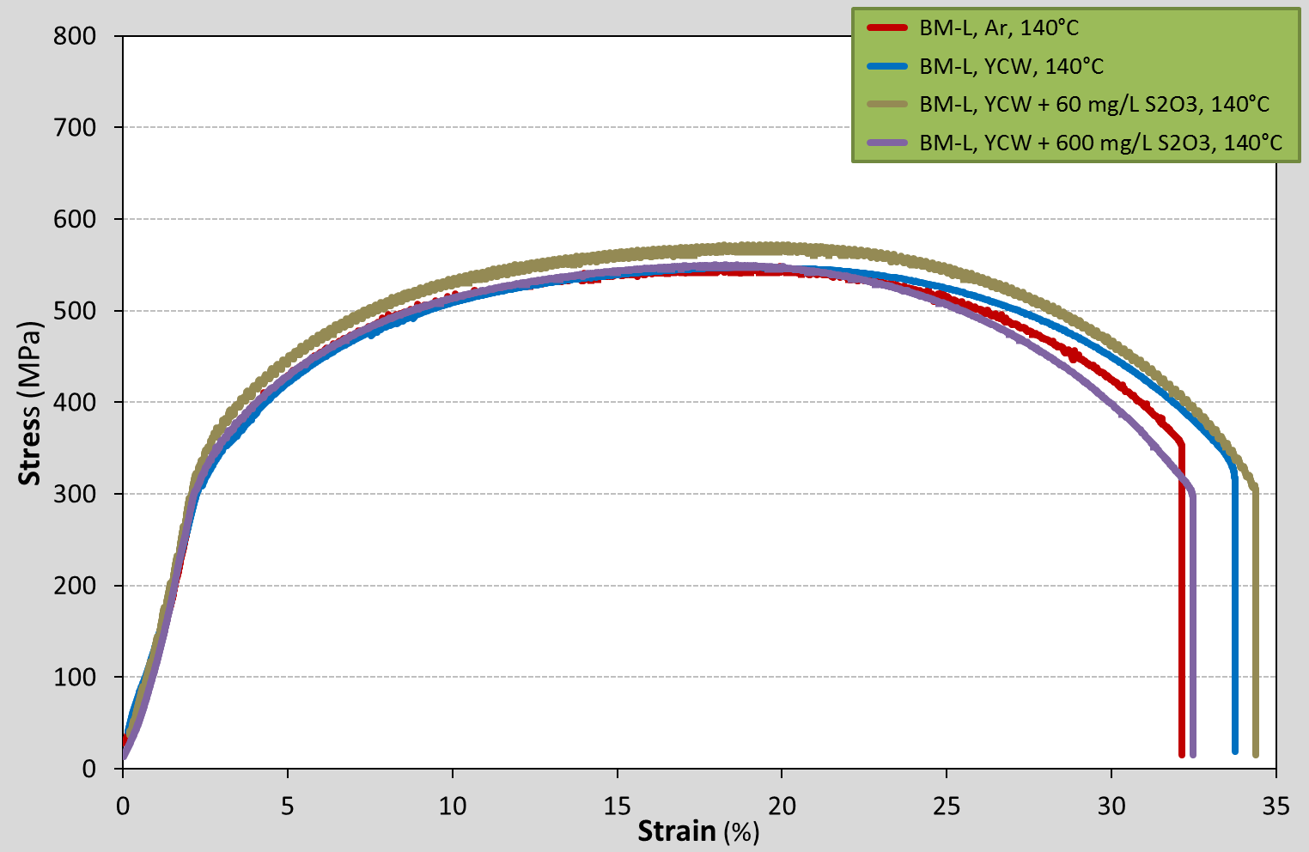
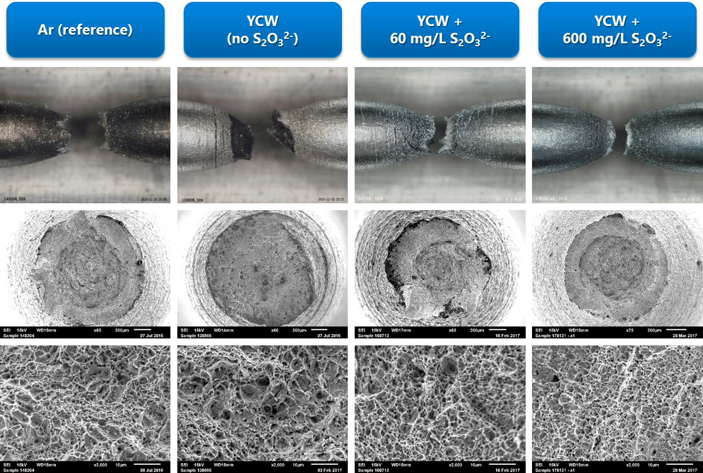
Experimental results
Base Metal
YCW : similar mechanical properties regardless of addition of S₂O₃²⁻
e.g. : strain-to-failure in S₂O₃²⁻ sol. comparable to values in S₂O₃²⁻ free sol. and in Ar
EaF : failure strains varied between [32.1 – 34.4%]
Ductility parameters (TTFR, RAR) ~1,0 : immunity to SCC
Morphology of fracture surface: ductile dimples  mechanical fracture

Slide 12
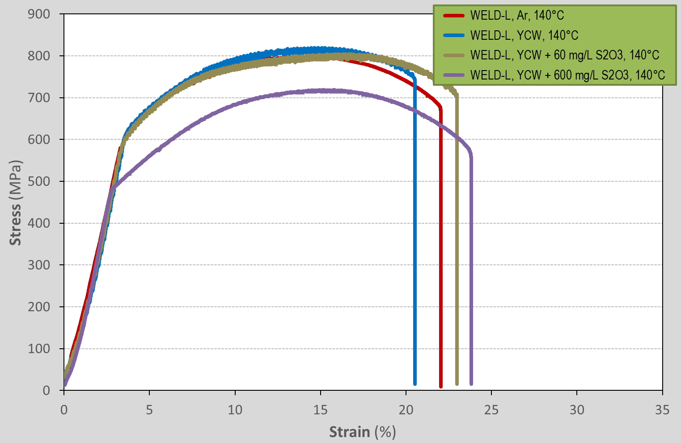
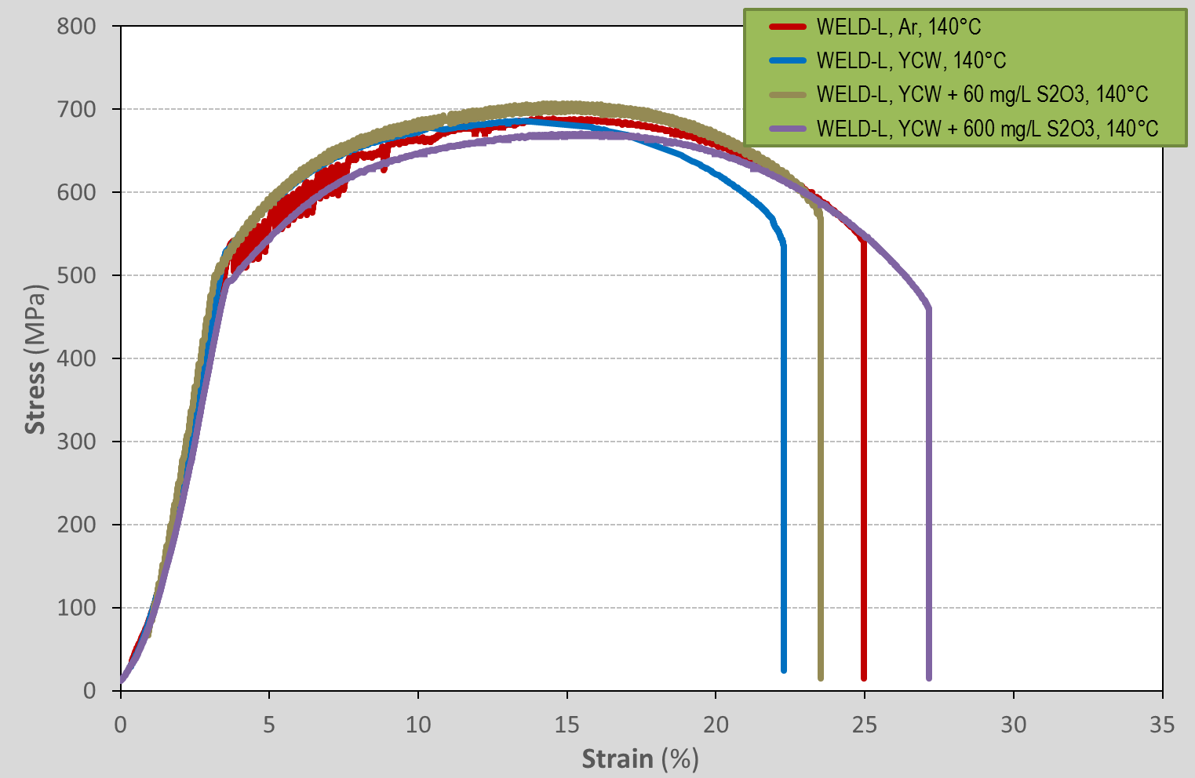
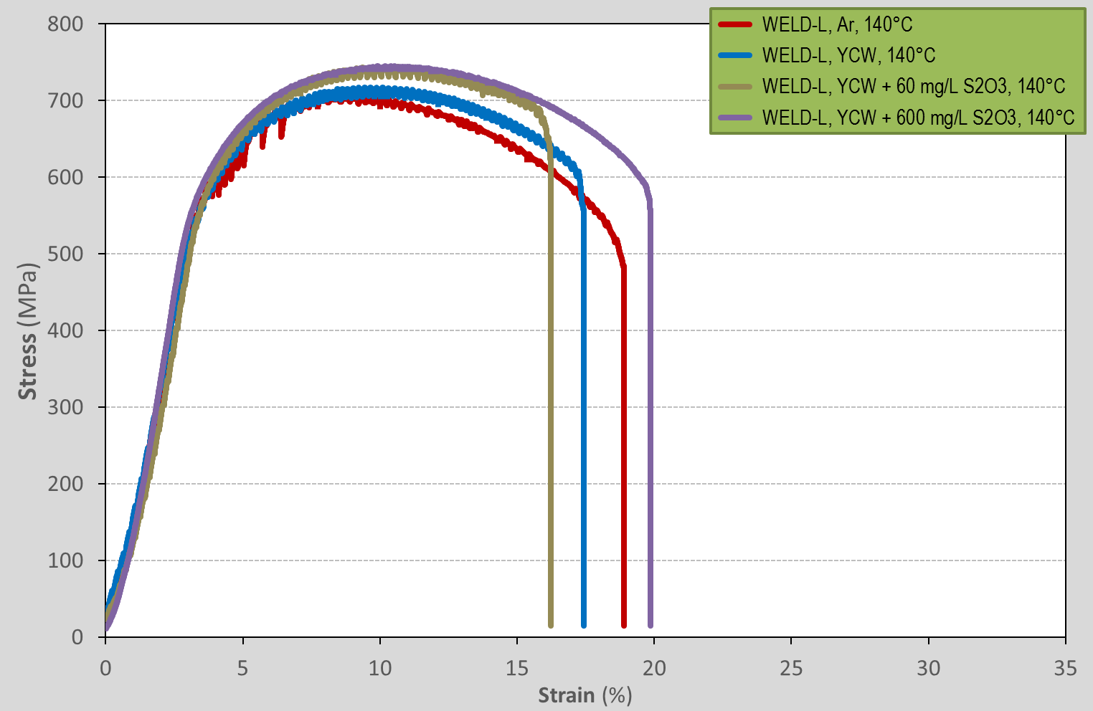
Experimental results
WELD-L / Parameters from SSRT
MIG/MAG
SAW
RPEB
Features similar to those of the BM : Stress/strain behaviour  ductile material
YS, UTS : higher compared to the BM
EaF : smaller compared to the BM (20.5-24%: MAG; 22-27%: SAW; 16-20%: RPEB)
Ductility parameters (TTFR, RAR) ≥ 0,80 : high resistance to SCC
Morphology of fracture surface: ductile dimples  mechanical fracture

Slide 13
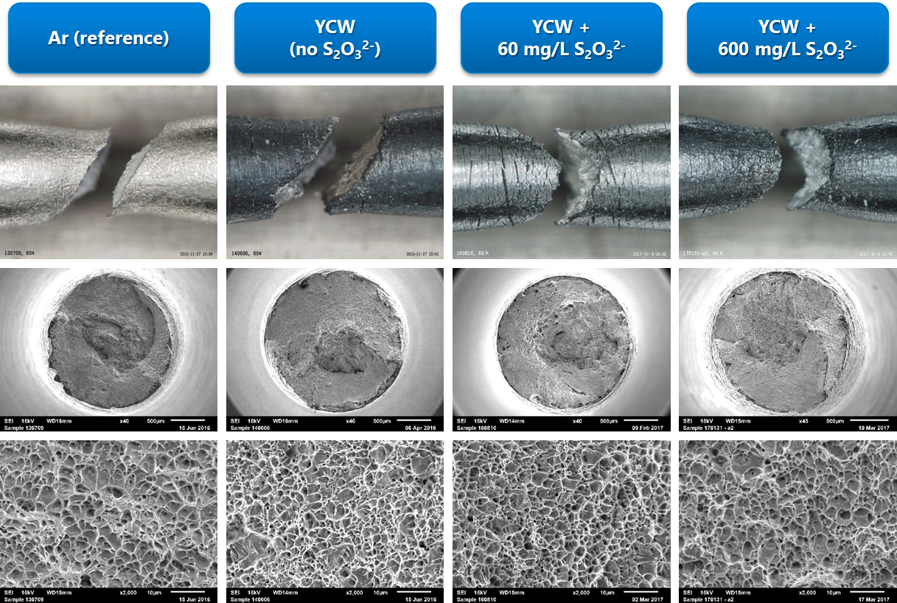
Experimental results
WELD-L (MIG/MAG) / Surface analyses of fracture surface

Slide 14
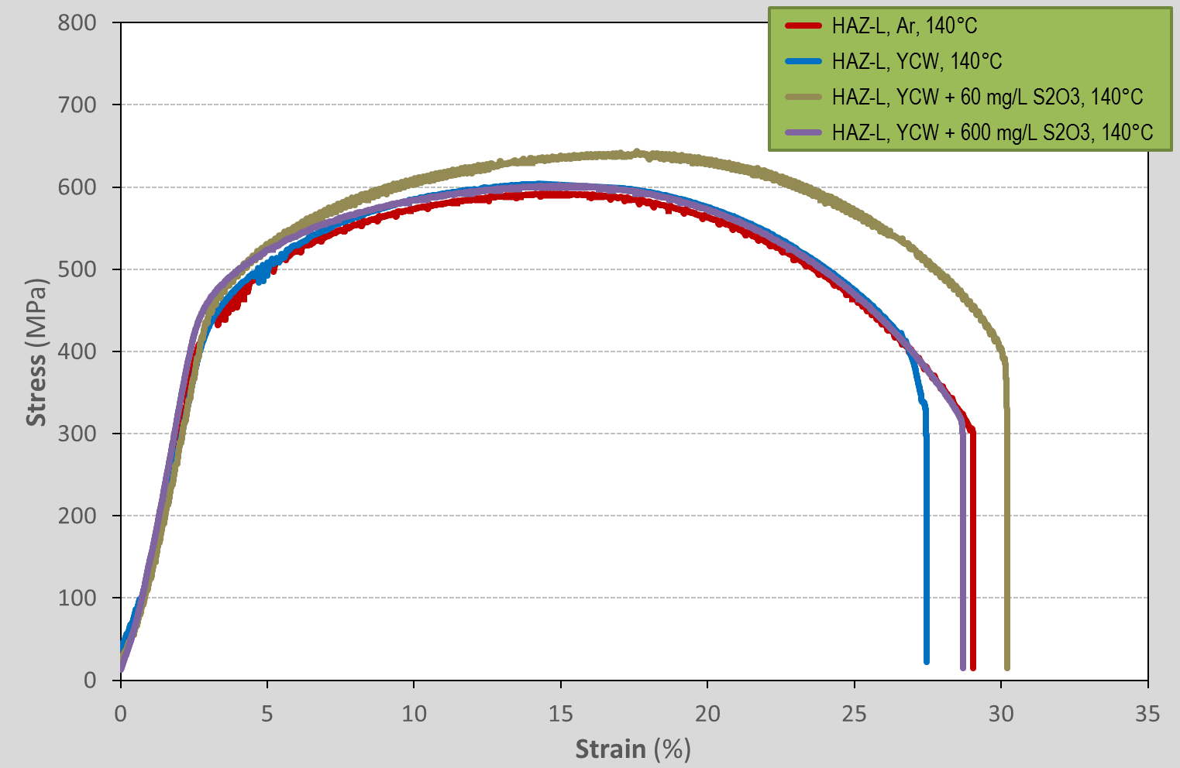
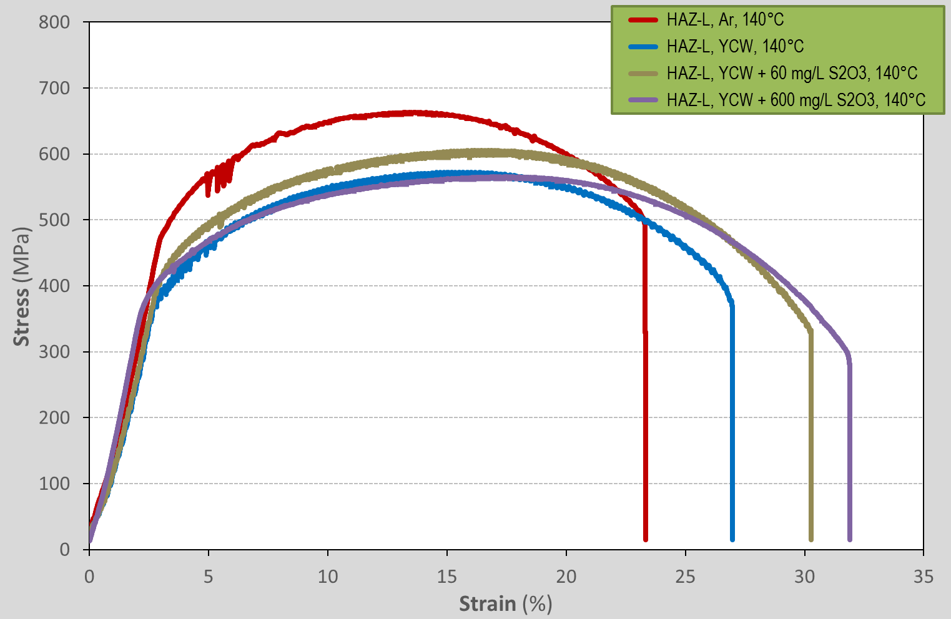
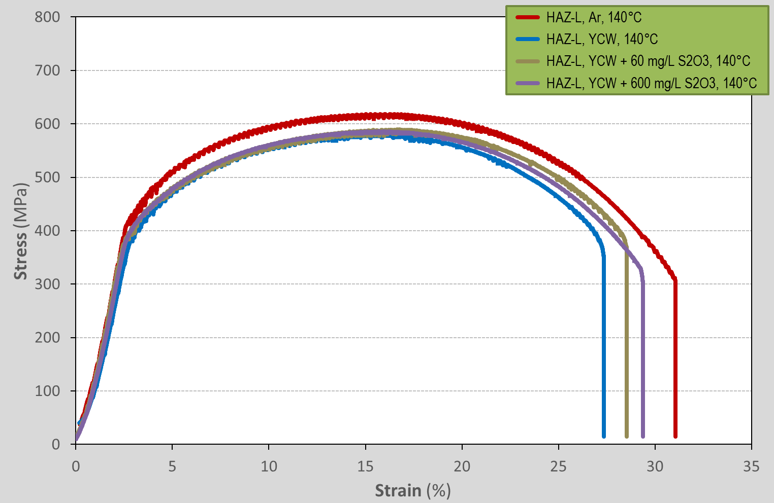
Experimental results
HAZ-L / Parameters from SSRT
MIG/MAG
SAW
RPEB
Features similar to those of the BM : Stress/strain beh.  ductile material
YS, UTS : slightly higher compared to the BM
EaF : slightly smaller compared to the BM
Ductility parameters (TTFR, RAR) ≥ 0,80 : high resistance to SCC
Morphology of fracture surface: ductile dimples  mechanical fracture

Slide 15
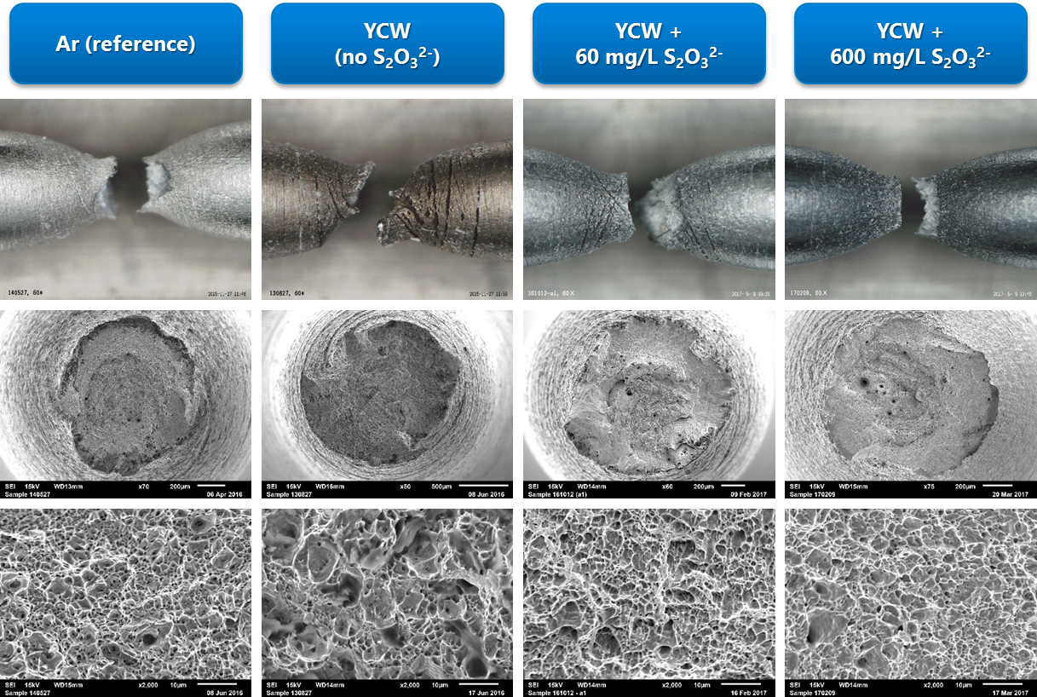
Experimental results
HAZ-L (MIG/MAG / Surface analyses of fracture surface

Slide 16
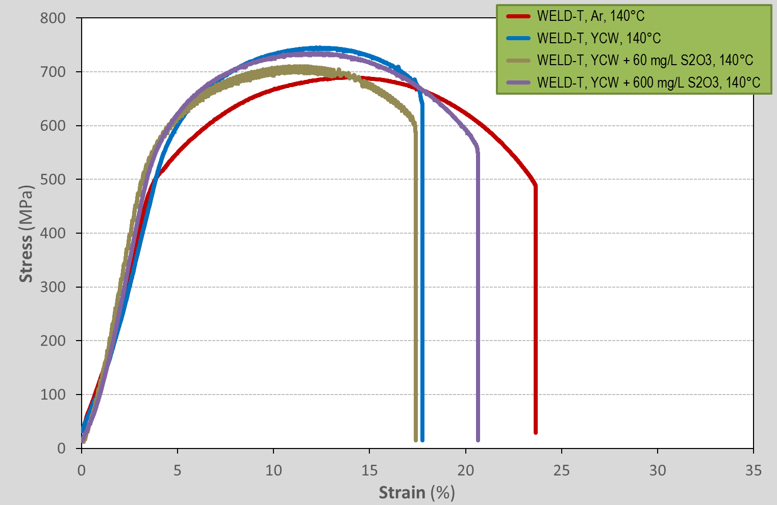
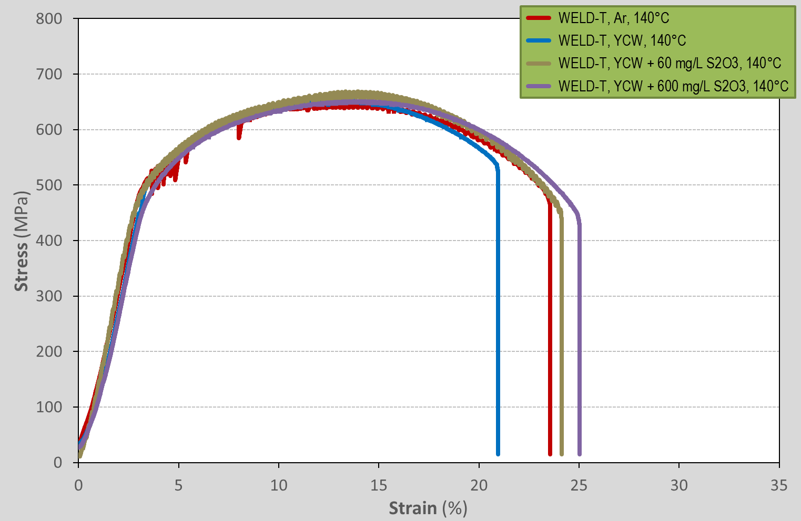
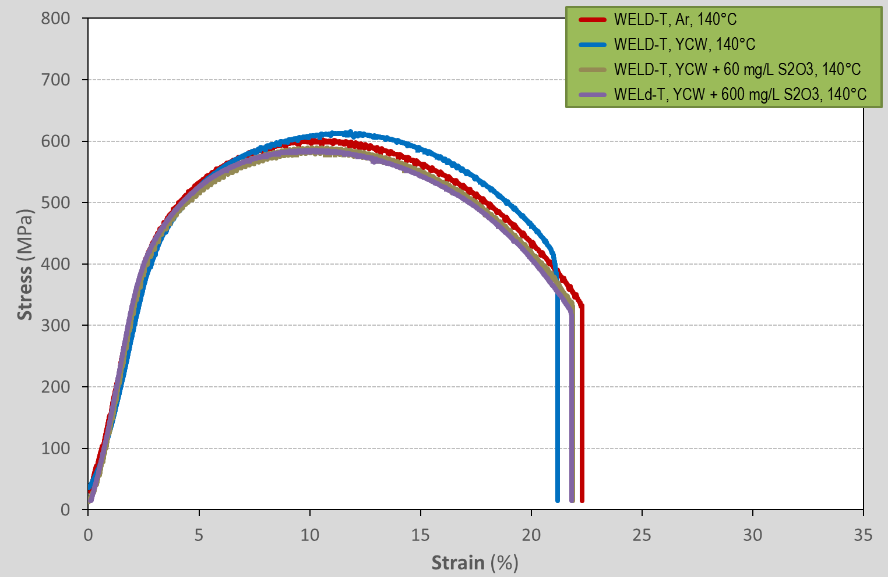
Experimental results
WELD-T / Parameters from SSRT
MIG/MAG
SAW
RPEB
Features similar to those of the BM : Stress/strain behaviour  ductile material
YS, UTS : higher compared to the BM
EaF : smaller compared to the BM (17.4-23.5%: MAG; 21-25%: SAW; 21-22.6%: RPEB)
Ductility parameters (TTFR, RAR) ≥ 0,75 : high resistance to SCC
Morphology of fracture surface: ductile dimples  mechanical fracture

Slide 17
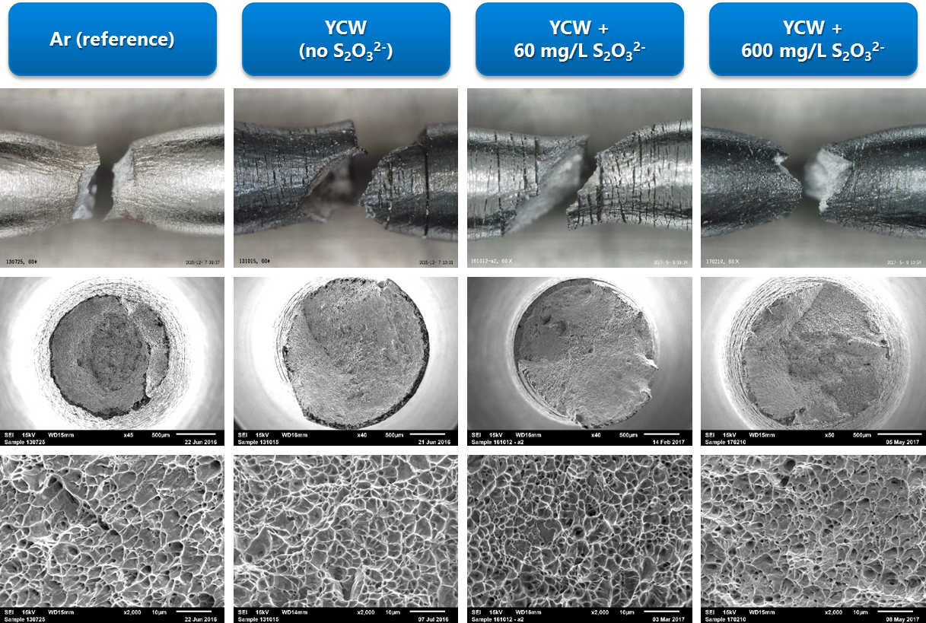
Experimental results
WELD-T (MIG/MAG / Surface analyses of fracture surface

Slide 18
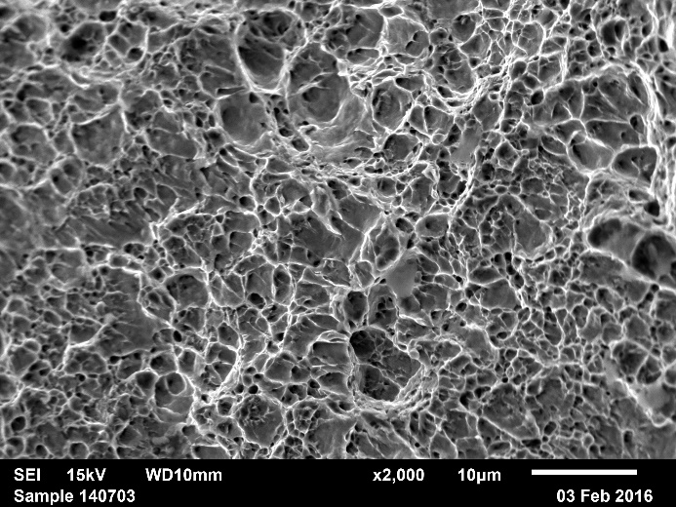
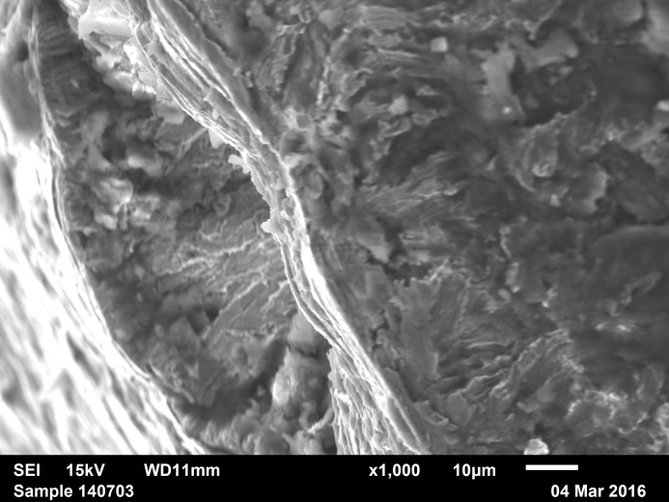
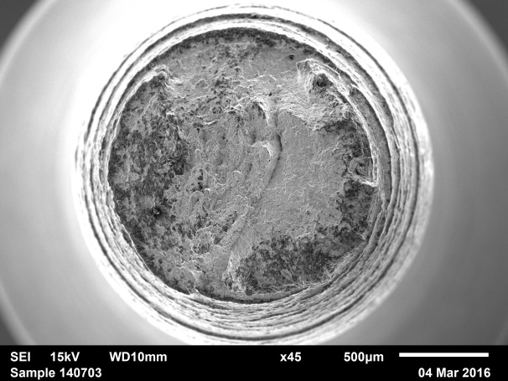
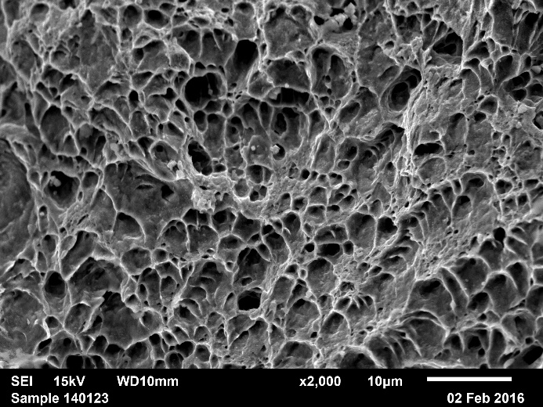
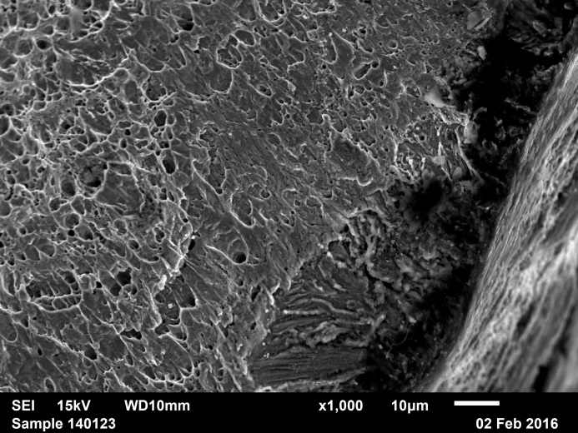
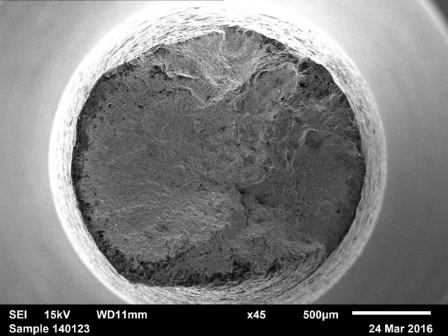
Experimental results
Tearing along periphery of fracture surface  SCC ?
SAW, HAZ-L, YCW
SAW, WELD-L, YCW

Slide 19
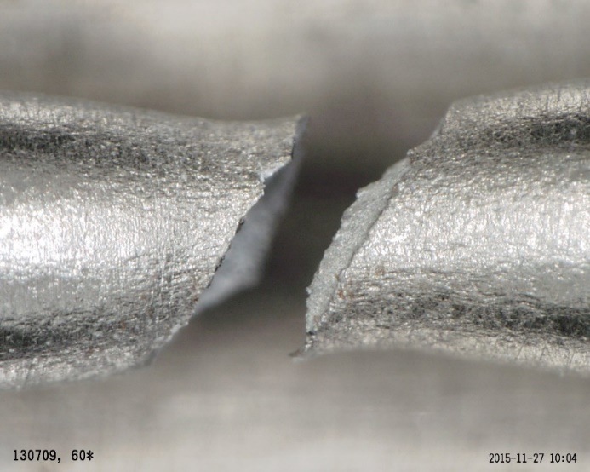
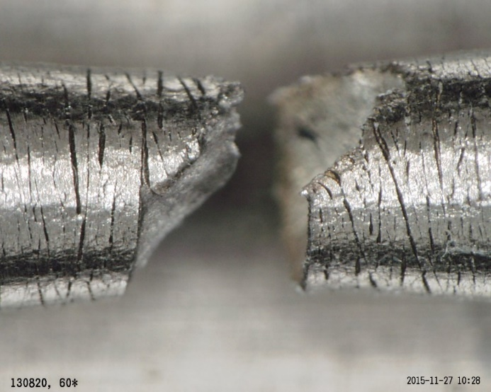
Experimental results
Tearing along periphery of fracture surface  SCC ?
Lateral view of some specimens showed evidence of secondary cracking
Secondary cracks only observed in the necked-down section of the specimen immediately adjacent to the fracture
Secondary cracks are small (100 µm wide, max.) and shallow (~50 um deep)
Samples tested in Ar (reference)
Some researchers ⁴ claim this type of secondary cracks to be the result of an artefact caused during the preparation of the specimens (circumferential machining marks left on the specimen surface)
⁴ McIntyre D., Dash C., Case R., CORROSION/2013, paper no. 2259 (2013).

Slide 20
Conclusions
Addition of thiosulphate ions has no discernible effect on
  Mechanical parameters (YS, UTS, EaF, TTF, RA)
  Ductility parameters (TTFR, RAR)
  Morphology fracture surface
Observation of tearing along the periphery of fracture surface
  Secondary cracks are believed to be the result of an artefact caused during the fabrication of the samples (circumferential machining marks)

Slide 21
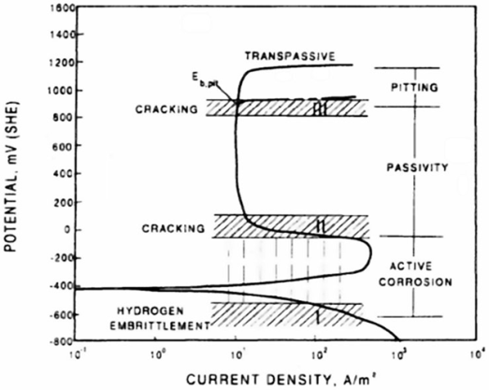
Outlook
Synergistic effects Cl⁻ / S²⁻ / S₂O₃²⁻
SSRT at applied potential
  Negative potentials representative for anoxic conditions  H₂ production

Slide 22
Thanks To …
Technical assistance
  Pieter Schroeders
  Sabrina Lunardi
  Wim Verwimp
Co-author
  Roberto Gaggiano, ONDRAF/NIRAS (Belgium)
The author(s) gratefully acknowledge the financial support of this work by ONDRAF/NIRAS, the Belgian national radioactive waste management organization
And, The audience for listening •••

Slide 23
Copyright © 2017 - SCK•CEN
PLEASE NOTE!
This presentation contains data, information and formats for dedicated use only and may not be communicated, copied, reproduced, distributed or cited without the explicit written permission of SCK•CEN.
If this explicit written permission has been obtained, please reference the author, followed by ‘by courtesy of SCK•CEN’.
Any infringement to this rule is illegal and entitles to claim damages from the infringer, without prejudice to any other right in case of granting a patent or registration in the field of intellectual property.
SCK•CEN
Studiecentrum voor Kernenergie
Centre d'Etude de l'Energie Nucléaire
Belgian Nuclear Research Centre
Stichting van Openbaar Nut
Fondation d'Utilité Publique
Foundation of Public Utility
Registered Office: Avenue Herrmann-Debrouxlaan 40 – BE-1160 BRUSSELS
Operational Office: Boeretang 200 – BE-2400 MOL

