Slide 1
Alkali tin silicate glass as a wasteform for the immobilisation of plutonium
Amber R. Mason, Neil C. Hyatt and Martin C. Stennett
The Scientific Basis for Nuclear Waste Management Symposium 2017
Sydney, Australia
@AmberRose1605 @ISL_Sheffield

Slide 2
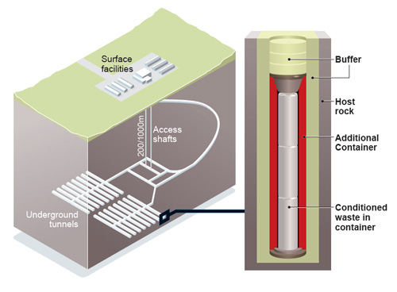
Introduction
Upon completion of fuel reprocessing in the UK, 140t of PuO₂ stockpile will be stored as zero value asset at Sellafield
UK government policy – either reuse in MOx or immoblilisation and disposal in geological disposal facility (GDF).
Dual track strategy also suggested¹ since some material unsuitable for recycle
Develop wasteforms to immobilise this waste stream for over 100000 yrs
1. Hyatt, N. C. (2017). Plutonium management policy in the United Kingdom: The need for a dual track strategy. Energy Policy, 101, 303–309

Slide 3
Alkali tin silicate glass
Alkali Tin Silicate (ATS) glass – type of borosilicate glass developed in the US for immobilization of wPu²
Increased alkali elements to increase Pu waste loading
Sn added to improve chemical durability
Objectives
Determine solubility of CeO₂ as function of melt temperature
Determine solubility of CeO₂ in presence of Fe(0) reduction
Determine feasibility of batchwise HIP (Hot Isostatic Pressing) processing
Note: melt temperature <1300ºC to limit melter corrosion
Reagent | Al₂O₃ | B₂O₃ | CeO₂ | K₂O | Li₂O | Na₂O | SiO₂ | SnO | TiO₂ | ZrO₂
wt% | 1.73 | 10.05 | 6.37 | 7.50 | 10.15 | 15.34 | 39.31 | 2.51 | 1.84 | 5.20
mol% | 1.06 | 9.00 | 2.31 | 4.97 | 21.20 | 15.43 | 40.80 | 1.16 | 1.44 | 2.63
2. Bates, J. K. et al. (1996). Glass as a waste form for the immobilisation of plutonium. Mat. Res. Soc. Symp. Proc., 412, 57–64.

Slide 4
Wasteform Optimisation
Techniques
- XRD
- SEM with EDX
- XAS
Fabrication
Characterisation
Dissolution tests
Reagent type
Oxide, carbonate, chloride etc.
Hydrated?
Synthesis route
Cold uniaxial press
Hot isostatic press
Glass melting
(stirring?)
Optimisation
Final Characterisation
Radiation stability tests
Synthesis Parameters
Temperature
Time
Sintering atmosphere
Excess reagents
Notes:
Add according to percentage batch mass – Dark amber colour associated with Ce 3+

Slide 5
ATS Glass Matrix
Synthesis Temp. (ºC) | mol% CeO₂
 | 2.5 mol% | 5 mol% |  | 10 mol%
 |  | No Fe | Fe
1100
1200
1300
✓
✓
✓
✓
✓
✓
✓
Notes:
Add according to percentage batch mass – Dark amber colour associated with Ce 3+

Slide 6
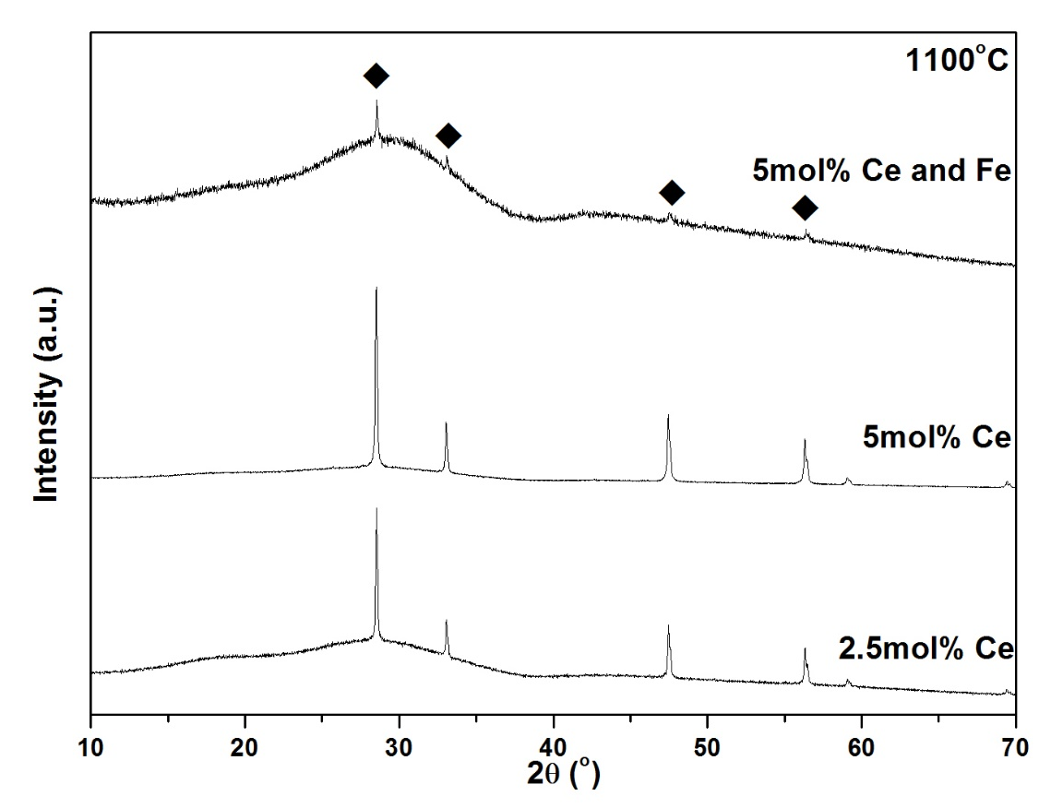
Xray Diffraction Results I
u-CeO₂

Slide 7
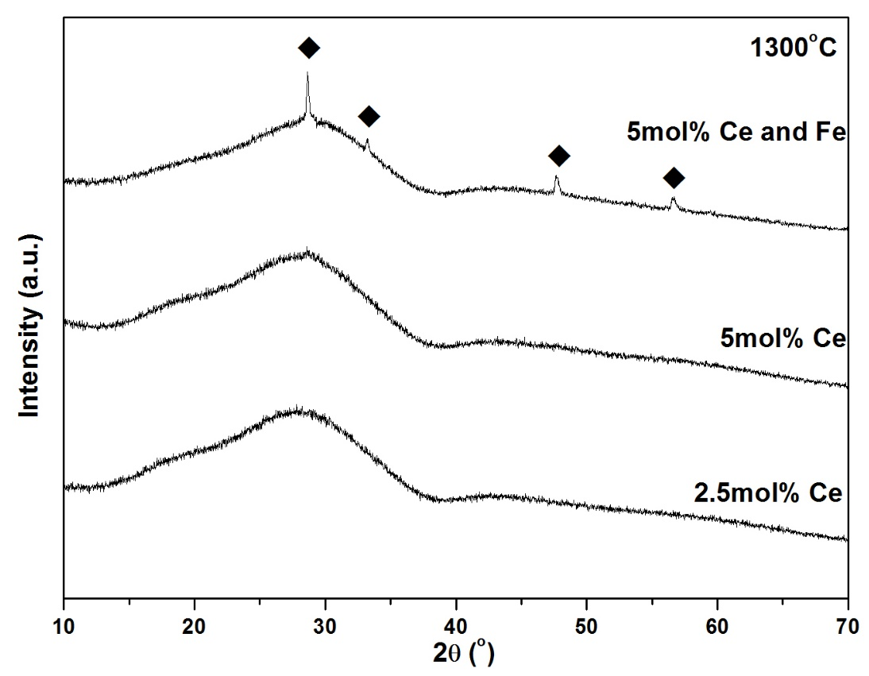
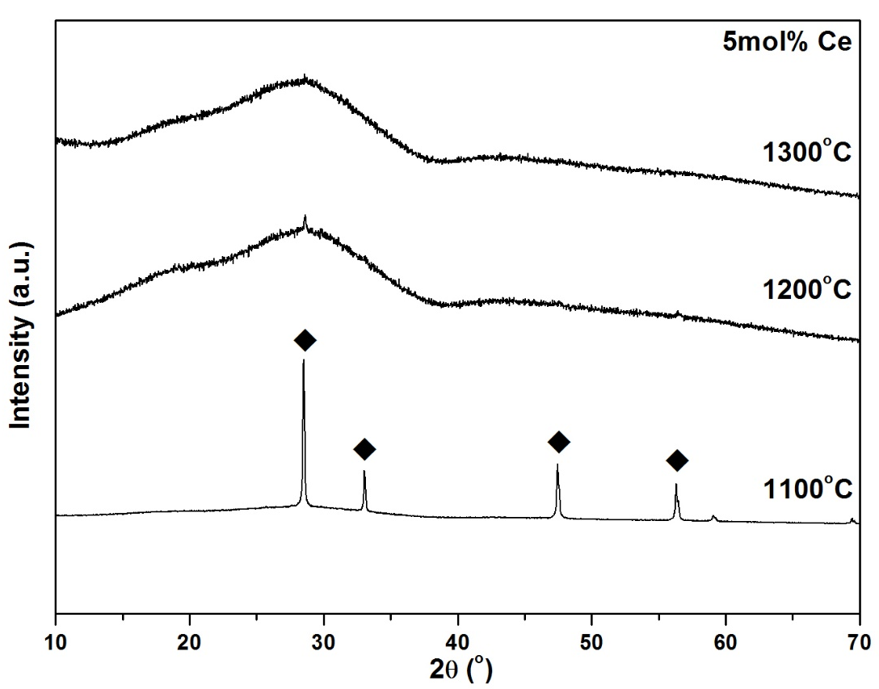
Xray Diffraction Results II
u-CeO₂

Slide 8
ATS Glass - SEM
100µm
1100ºC 5 mol% CeO₂ & Fe(0)
Si
Al
10µm
Ce
Na

Slide 9
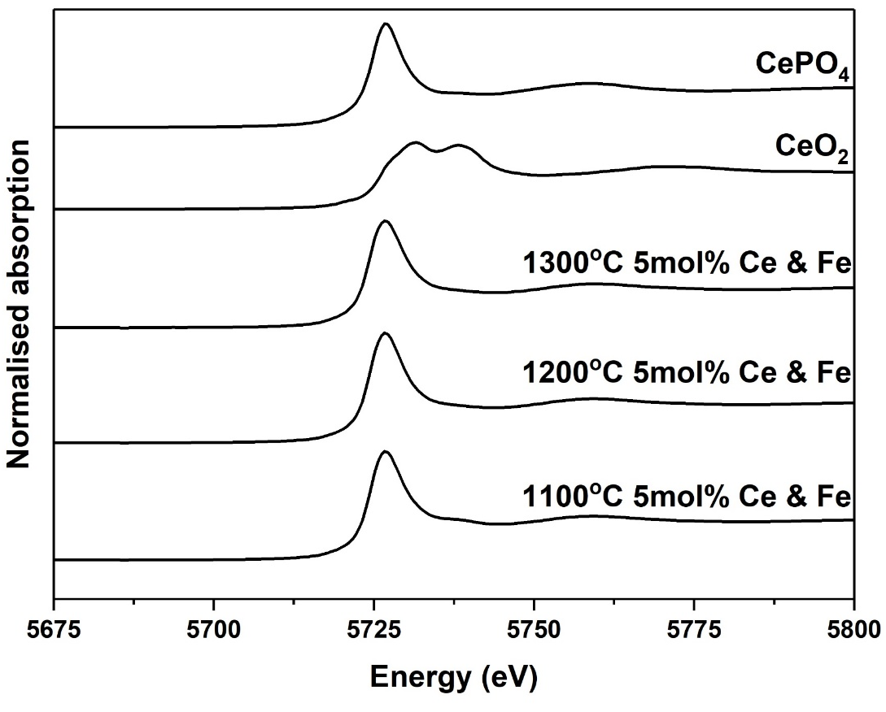
ATS Glass - XANES
Measured Ce L₃ edge (5723eV) at BM26 ESRF, Grenoble
Ce³⁺=21(±1)%
Ce³⁺=100 (±1)%
Ce³⁺=62(±2)%
Ce³⁺=100 (±1)%
Ce³⁺=70(±1)%
Ce³⁺=100 (±1)%
Linear combination fitting⁴ used to determine the percentage of Ce³⁺ in each sample.

Slide 10
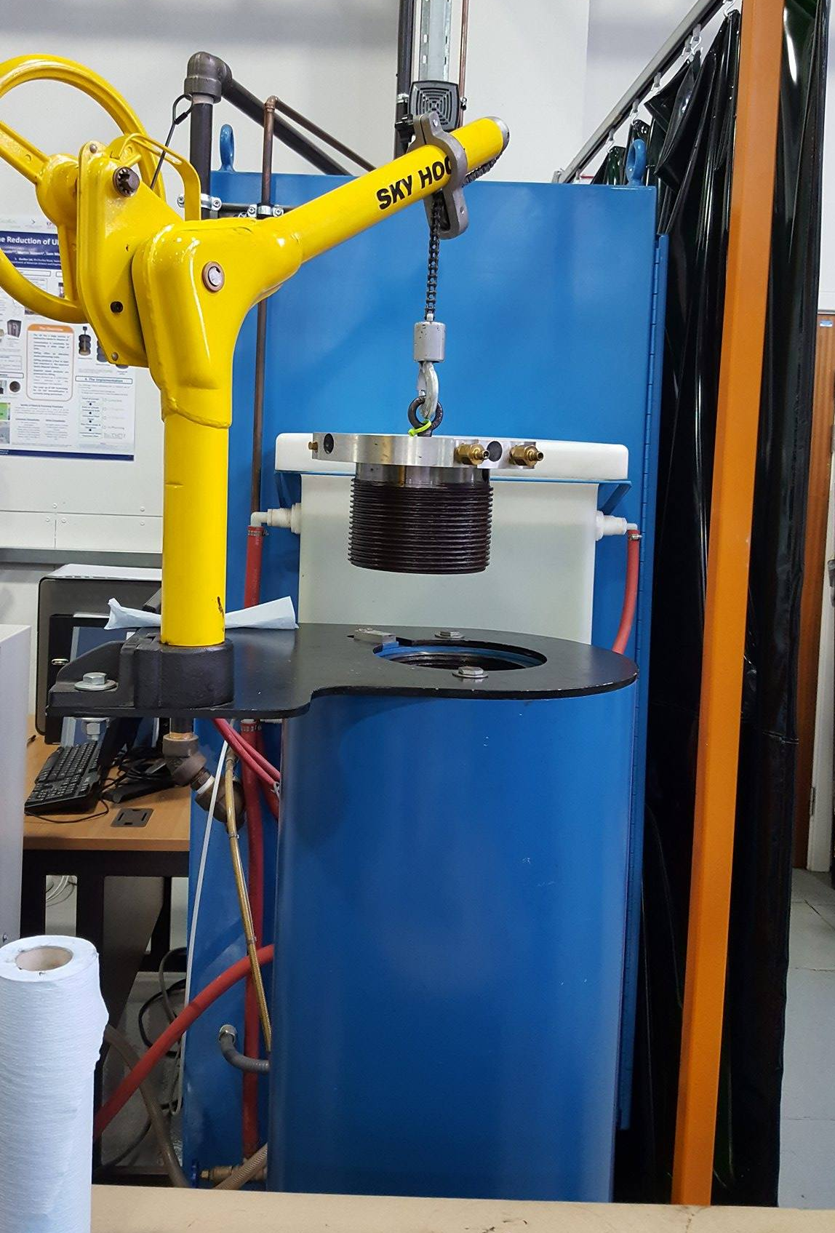
Hot Isostatic Pressing (HIP)
HIP production of glass wasteforms not well established
Potential advantages
Batchwise process – accountancy, safeguards, criticality, and security
Processing in sealed container so no-off gas requirements
Scalable and adaptable to different an variable waste feed
Initial study: ATS glass frit mixed with waste surrogate (CeO₂)
Scale: 30ml stainless steel can
BEFORE
AFTER
Notes:
Describe HIPing

Slide 11
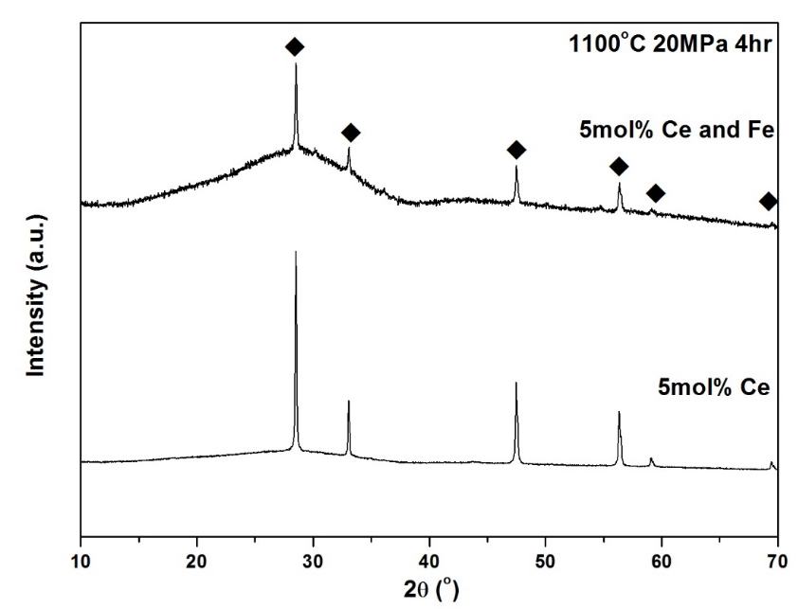
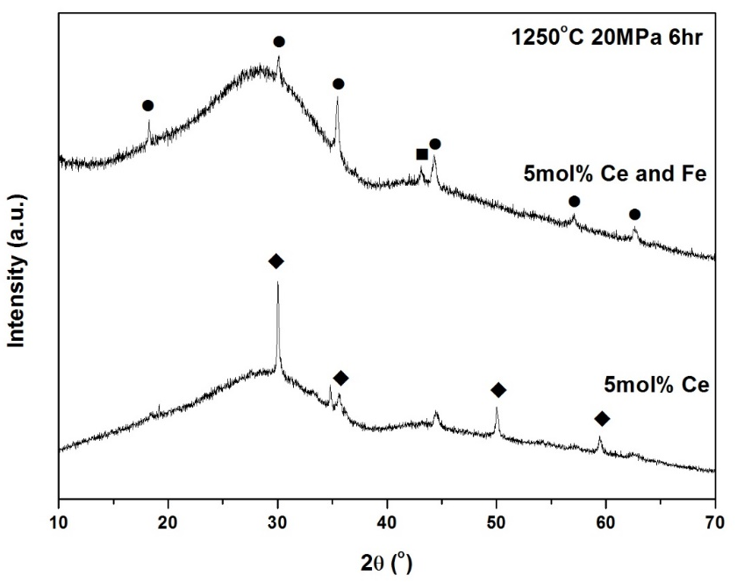
u-CeO₂ l- Fe₃O₄ n- Fe
ATS Glass HIP Matrix
Two HIP runs completed so far
Must consider effects of SS can on redox potential of melt
HIP Run | 5 mol% CeO₂
 | No Fe | Fe
1100ºC 20MPa 4hr dwell
1250ºC 20MPa 6hr dwell
Notes:
Most successful as this is free from Ce

Slide 12
ATS Glass HIP 1 and 2 - SEM
100µm
1100ºC 20MPa 5 mol% CeO₂
Ce
Na
Ce
Al
Zr
10 µm

Slide 13
ATS Glass HIP 3 and 4 - SEM
20µm
1250ºC 20MPa 5 mol% CeO₂ & Fe(0)
Fe
Na
Al
Si
3µm
Notes:
Both cans displayed similar quantities of Fe present.

Slide 14
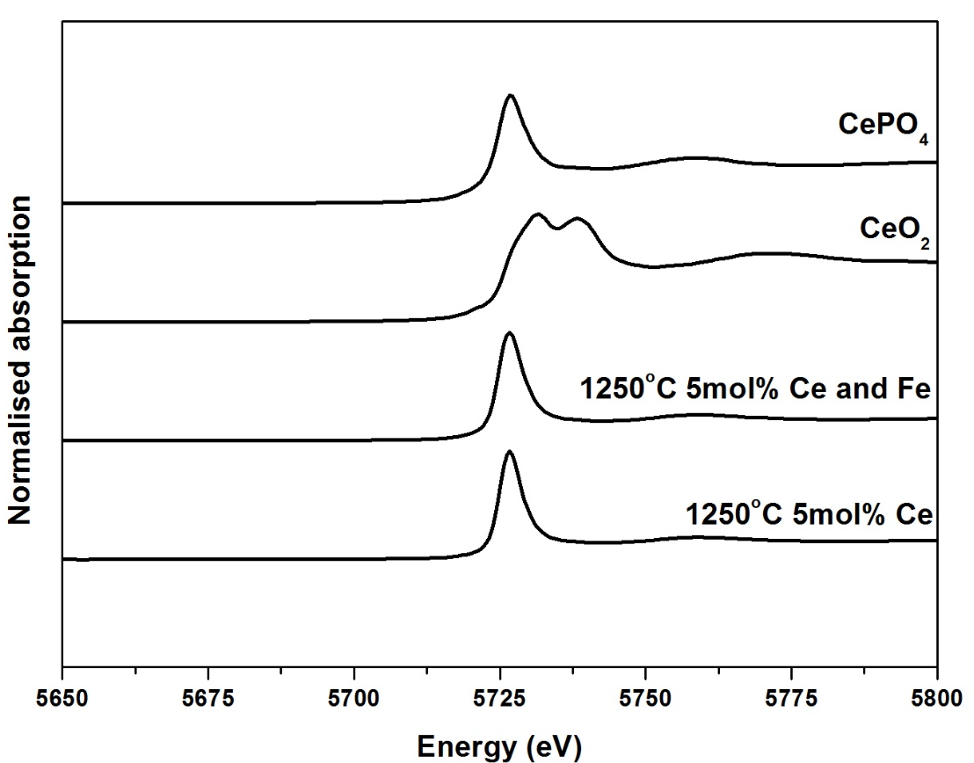
ATS Glass HIP - XANES
Measured Ce L₃ edge (5723eV) at BM26 ESRF, Grenoble
1100ºC 20MPa 4hr
1250ºC 20MPa 6hr
Ce³⁺=100(±1)%
Ce³⁺=100(±1)%
Ce³⁺=71(±4)%
Ce³⁺=100(±1)%
Linear combination fitting⁴ used to determine the percentage of Ce³⁺ in each sample.

Slide 15
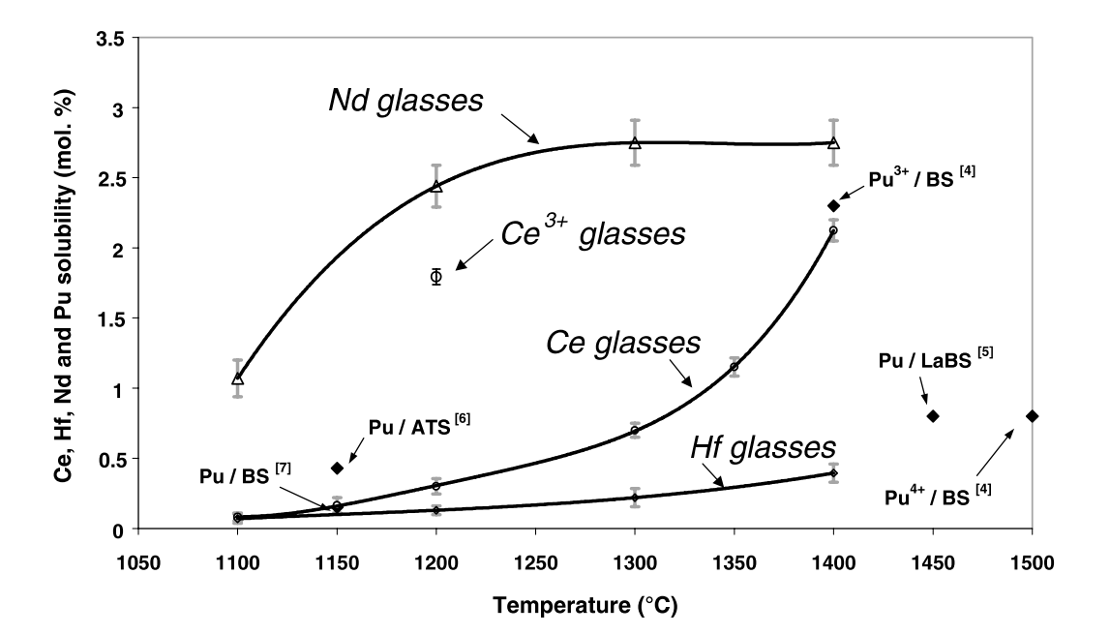
Conclusions
Ce solubility is associated with reduction of Ce⁴⁺ to Ce³⁺
CeO₂ solubility up to 5 mol% at 1300ºC
Equimolar addition of Fe(0), CeO₂ solubility at 5 mol% at 1100ºC
HIP processing of ATS glasses demonstrated to be feasible
Results promising for application:
Reduction in melt temperature advantageous
Increase in CeO2 solubility implies higher waste loading possible
HIP offers batch processing technology
5. C. Lopez et al., Solubility of actinide surrogates in nuclear glasses. Journal of Nuclear Materials. 312, 76–80 (2003).

Slide 16
Future Work
Refine addition of Fe and Ce to optimise waste loading in ATS HIP cans.
Fit EXAFS data to give information about the coordination environment of Ce and Fe.
Dissolution testing using PCT B method to investigate the durability of ATS glass.
Ion irradiation of samples at Inter University Accelerator Centre, New Delhi – further characterisation of samples.
Use U as Pu surrogate to investigate solubility in ATS glass
Continue work with zirconolite ceramics for PhD project
Notes:
Image: http://www.antenchem.com/UpFiles/EN2014/7/24/2014072456846485.gif

Slide 17
Thank you for listening
Acknowledgements
Thank you to my supervisors for their patience and guidance and everyone at the ISL for training and assistance, particularly Dr. Laura Gardner, Steph Thornber, Dan Bailey, Dr. Florent Tocino and Jack Clarke.
This research was performed at the MIDAS Facility, at the University of Sheffield, which was established with support from the Department of Energy and Climate Change.
Any questions?

