Slide 1
Comparison of calculated and measured radionuclide inventory of a Zircaloy-4 cladding tube plenum section
M. Herm¹, E. González-Robles¹, N. Müller¹, K. Dardenne¹, J. Rothe¹, D. Schild¹, R. Dagan², and V. Metz¹
¹ Karlsruhe Institute of Technology, Institute for Nuclear Waste Disposal, P.O. Box 3640, 76021 Karlsruhe, Germany
² Karlsruhe Institute of Technology, Institute for Neutron Physics and Reactor Technology, P.O. Box 3640, 76021 Karlsruhe, Germany
Materials Research Society
Scientific Basis for Nuclear Waste Management XLI
29th October – 3rd November 2017
Sydney (NSW, Australia)

Slide 2
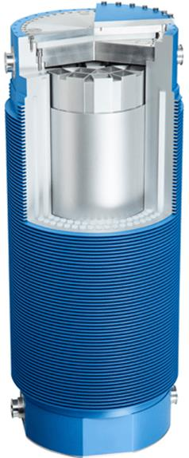
Introduction
Extended dry interim storage of spent nuclear fuel in many countries.
Integrity of cladding important for handling of fuel assemblies after 50 to 100 years of dry interim storage.
Integrity of cladding is affected by:
creep of fuel rod during reactor operation (elongation).
oxidation (reduction of Zircaloy wall thickness).
hydrogen uptake.
pellet-cladding-interaction.
He accumulation due to α-decay.
corrosion with (volatile) fission products at cladding/fuel interface.
interim storage cask

Slide 3
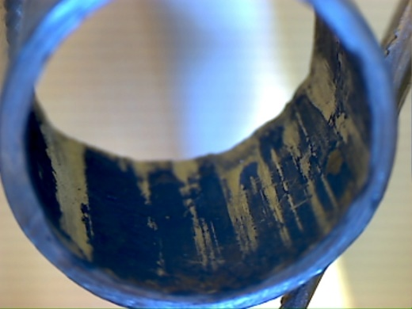
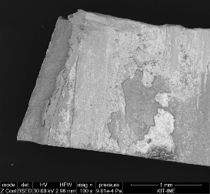
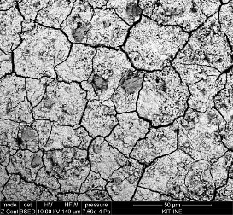
Objectives
Determination of radionuclide inventory of plenum Zircaloy-4 samples.
Comparison of experimentally obtained radionuclide inventories with theoretically predicted inventories.
Prerequisite work for studies with Zircaloy-4 cladding in contact with pellets.

Slide 4
Materials and irradiation characteristics
Zircaloy-4 cladding sampled from plenum of fuel rod segment SBS1108–N0204.
irradiated in the Swiss Gösgen PWR (1985–1989).
1226 effective full power days.
average burn-up: 50.4 GWd/t_{HM}.
average linear power: 260 W/cm.
stored gas tight until 2012.
upper end-plug
75 mm

Slide 5
Experimental and analytical methods
Acidic digestion of six Zircaloy-4 subsamples in flask or autoclave.
α-spectroscopy: ^{235,238}U, ²³⁷Np, ^{238,239,240,242}Pu, ^{241,243}Am, ^{243,244}Cm.
γ-spectroscopy: ²⁴¹Am, ^{134,137}Cs, ¹²⁵Sb.
LSC: ²⁴¹Pu, ¹⁴C, ⁵⁵Fe.
HR-ICP-MS: ^{235,238}U, ²³⁷Np, ^{238,239,240,241,242}Pu, ^{241,243}Am, ²⁴⁴Cm.
Separation methods:
Extraction chromatography.
Liquid-liquid extraction.
Extraction of ¹⁴C by conversion into ¹⁴CO₂ and absorption in NaOH.

Slide 6
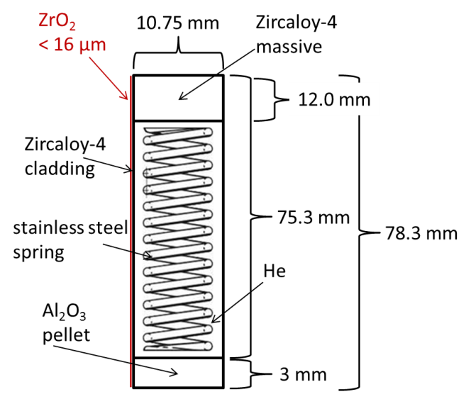
Inventory calculations
Calculation of the radionuclide inventory of the irradiated plenum Zircaloy-4 cladding.
MCNP 2.7 code simulates neutron flux and CINDER module for burn-up and activation calculation.
Geometrical shape, irradiation characteristics, and position in fuel assembly and nuclear reactor taken into account.
Use of nominal material composition data of Zircaloy-4 for calculation.

Slide 7
Simulation of PWR Gösgen fuel assembly
Burn-up conditions of the fuel rods adapted in such a way that the given boundary conditions of 50.4 GWd/t_{HM} and irradiation time of 1226 days by ~260 W/cm will be kept.
green fuel pins: investigated fuel segments (symmetry)
yellow fuel pins: generating power and thus flux without burn-up
guide tubes: filled with water (control rods extracted)
dark blue: water of primary circuit

Slide 8
Results: inventory calculations
Calculation of plenum Zircaloy-4 cladding radionuclide inventory based on:
minor actinides/fission products: U traces in Zircaloy-4 (3.5 ppm).
activation products: precursor elements present in Zircaloy-4 (e.g. ¹⁴N, ⁵⁴Fe, ¹²⁴Sn).
activation products | experimental ≈ calculated
minor actinides | experimental > calculated
non-volatile fission products | experimental > calculated
volatile fission products | experimental >> calculated
 | ¹⁴C [Bq/g] | ⁵⁵Fe [Bq/g] | ¹²⁵Sb [Bq/g]
experimental | 3.7(±0.4)×10⁴ | 1.5(±0.1)×10⁵ | 2.4(±0.2)×10⁵
calculated | 3.5×10⁴ | 1.3×10⁵ | 2.6×10⁵
ratio (E/C) | 1.06 ± 0.11 | 1.15 ± 0.12 | 0.92 ± 0.09

Slide 9
Results: minor actinides (MA)
Ratios between experimental and calculated inventories in good agreement for minor actinides (MA) except for ²⁴⁰Pu.
Factor of 57 ± 9 between experimental and calculated values except for ²⁴⁰Pu. → excess inventory of MA due to fission of U adherences on inner Zircaloy-4 surface, not taken into account in calculations (see E. González-Robles).
Calculated ²⁴⁰Pu inventory lower compared to other MA. → problem with ²⁴⁰Pu cross-section???
 | ²³⁹Pu [Bq/g] | ²⁴²Pu [Bq/g] | ²⁴¹Am [Bq/g] | ²⁴³Am [Bq/g] | ²⁴⁴Cm [Bq/g] | ²⁴⁰Pu [Bq/g]
experimental | 1.2(±0.1)×10⁴ | 2.3(±0.2)×10² | 1.7(±0.2)×10⁵ | 3.3(±0.3)×10³ | 3.1(±0.3)×10⁵ | 2.2(±0.2)×10⁴
calculated | 2.4×10² | 4.1×10⁰ | 3.6×10³ | 4.9×10¹ | 4.7×10³ | 2.2×10²
ratio (E/C) | 50 ± 5 | 56 ± 6 | 47 ± 5 | 67 ± 7 | 66 ± 7 | 100 ± 10

Slide 10
Results: fission products
Experimental ¹⁵⁴Eu inventory exceeds calculated by a factor of about 56 ± 6. → E/C ratio similar to MA: 57 ± 9.
Experimental ¹³⁷Cs inventory exceeds calculated by a factor of about 114 ± 11. → E/C ratio similar to MA and ¹⁵⁴Eu expected if ¹³⁷Cs is only due to fission of U present in plenum.
Excess Cs in plenum due to migration of Cs released from fuel pellets during reactor operation to the plenum (T_{pellets} > T_{plenum}).
 | ¹⁵⁴Eu [Bq/g] | ¹³⁷Cs [Bq/g]
experimental | 3.5(±0.3)×10⁴ | 3.3(±0.3)×10⁶
calculated | 6.3×10² | 2.9×10⁴
ratio (E/C) | 56 ± 6 | 114 ± 11

Slide 11
Summary, conclusions and outlook
Good agreement between experimental and calculated inventory for activation products.
Experimental inventory exceeds calculated values of about 57 ± 9 for MA and non-volatile fission products due to nuclear fuel/U remnants in plenum.
Three sources of volatile fission product Cs in plenum:
fission of U impurity present in Zircaloy (max. 3.5 ppm U).
fission of nuclear fuel/U remnants on the inner surface of the plenum.
Cs volatilized from fuel pellets during reactor operation.
Results of ²⁴⁰Pu inventory calculation indicate an isolated problem of the ²⁴⁰Pu cross-section (scattering and absorption) that will be further investigated.

Slide 12
Acknowledgements
E. Bohnert (KIT)
M. Böttle (KIT)
M. Fuss (KIT)
F. Geyer (KIT)
T. Kisely (KIT)
E. Soballa (KIT)
C. Walschburger (KIT)
Thank you for your attention!

