Slide 1
Influence of rapid cooling rates for HIP on mechanical and corrosion properties of UNS S32205
Arnulf Hörtnagl¹, Paul Gümpel¹, Michael Hamentgen², Beat Hofer³
Institute for Materials System Technology Thurgau at the University of Applied Sciences Konstanz (1)
Powder Metallurgy, Saar Pulvermetall GmbH, Saarwellingen (2)
Hofer Werkstoff Marketing Beratung (3)

Slide 2
- Duplex stainless steel UNS S32205 - Effects of cooling rate - Influence of Process-Temperature - Experimental - Results - Conclusion and discussion
Outline

Slide 3
Duplex stainless steel UNS S32205

Slide 4
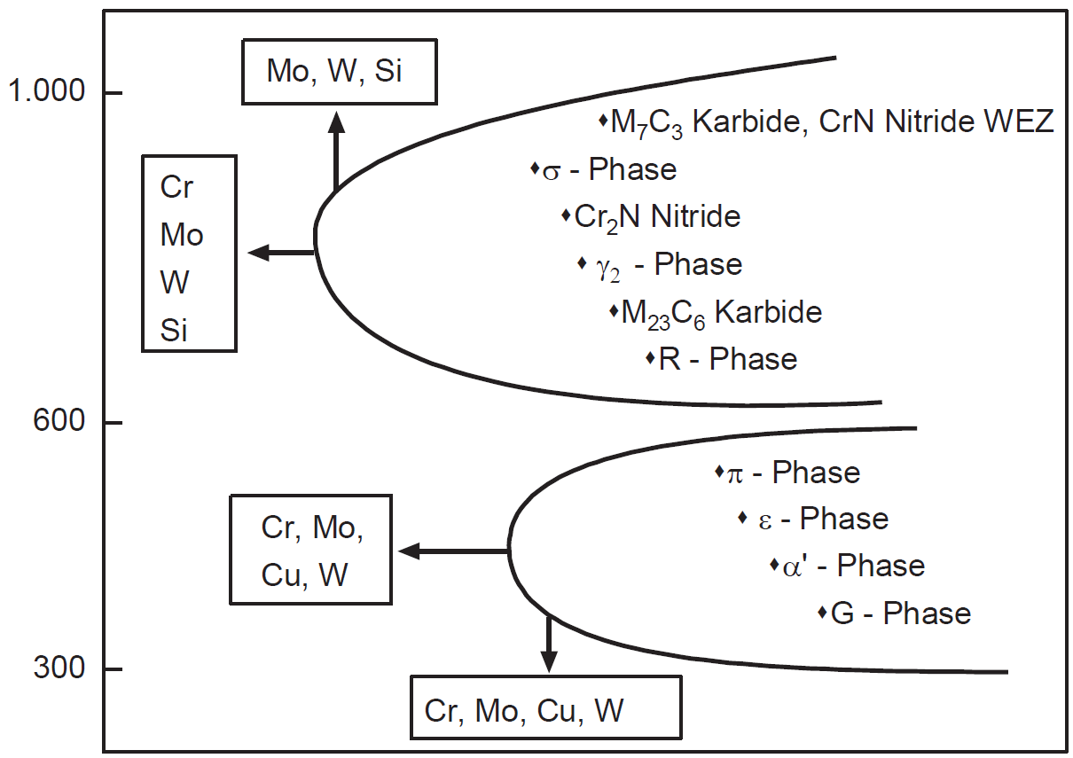
according ASTM S32205 Composition in wt. pct. Carbon 0.030 max Chromium 22.0-23.0 Nickel 4.5-6.5 Molybdenum 3.0-3.5 Nitrogen 0.14-0.20 Phosphorus 0.035 max Manganese 2.00 max Sulfur 0.020 max Silicon 1.00 max Iron Balance
Duplex stainless steel UNS S32205
temperature →
Temperature-Precipitation diagram of duplex stainless steel UNS S32205 – influence of alloying constituents;
Source: J. Charles; Duplex Stainless Steels 1991
time →

Slide 5
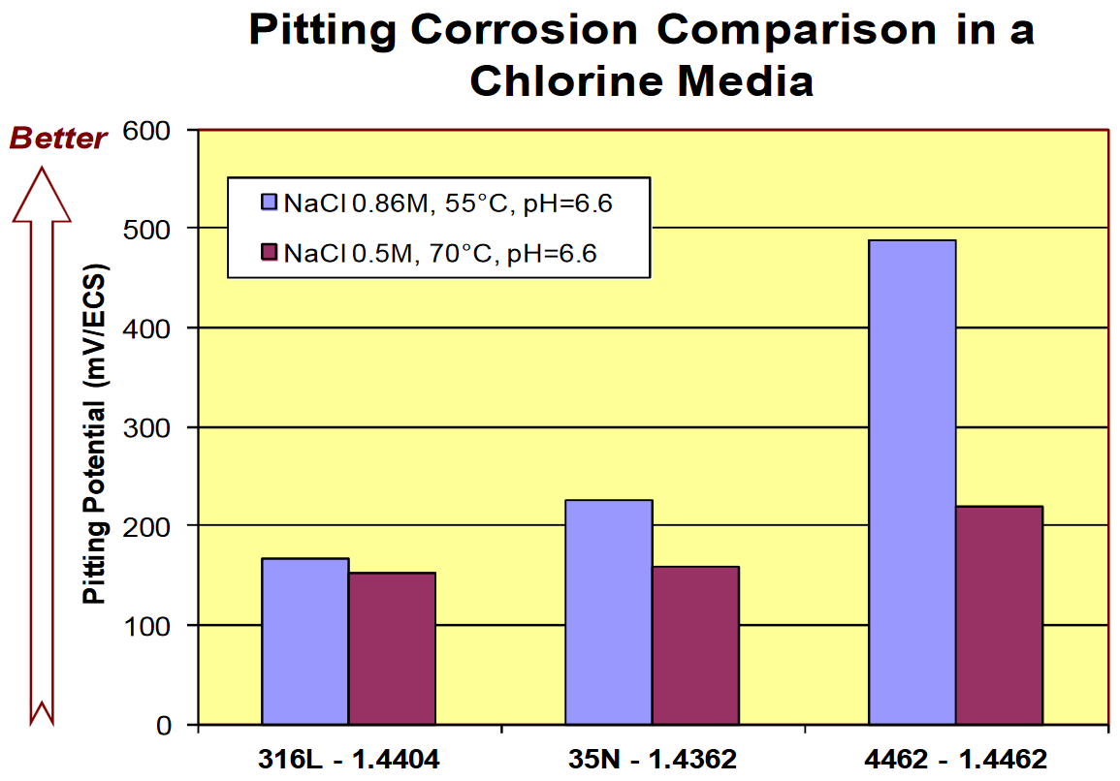
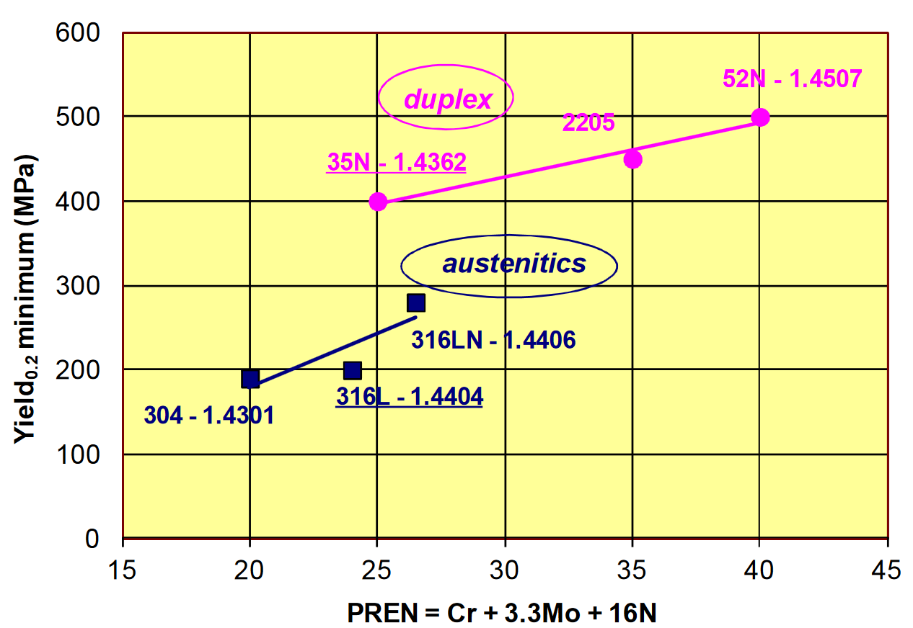
Duplex stainless steel: - mixed microstructure - austenite / ferrite ratio usually 50/50 mix to 40/60 - twice the strength compared to austenitc stainless steels - improved resistance to localized corrosion - lean duplex: PREN > 25 - standard duplex: ≈ 22% Cr PREN > 32 - super duplex: PREN > 40 - hyper duplex: PREN > 48
Duplex stainless steel UNS S32205
Properties
Density 7.80 g/cm³
Specific heat 460 J/Kg K
Young´s modulus 19.5 x 10⁴ MPa
Melting range 1420 – 1465 °C
0.2 % proof stress > 450 MPa
Tensile strength 650 – 880 MPa
Hardness < 293 HB
PREN 30.9 – 38.0

Slide 6
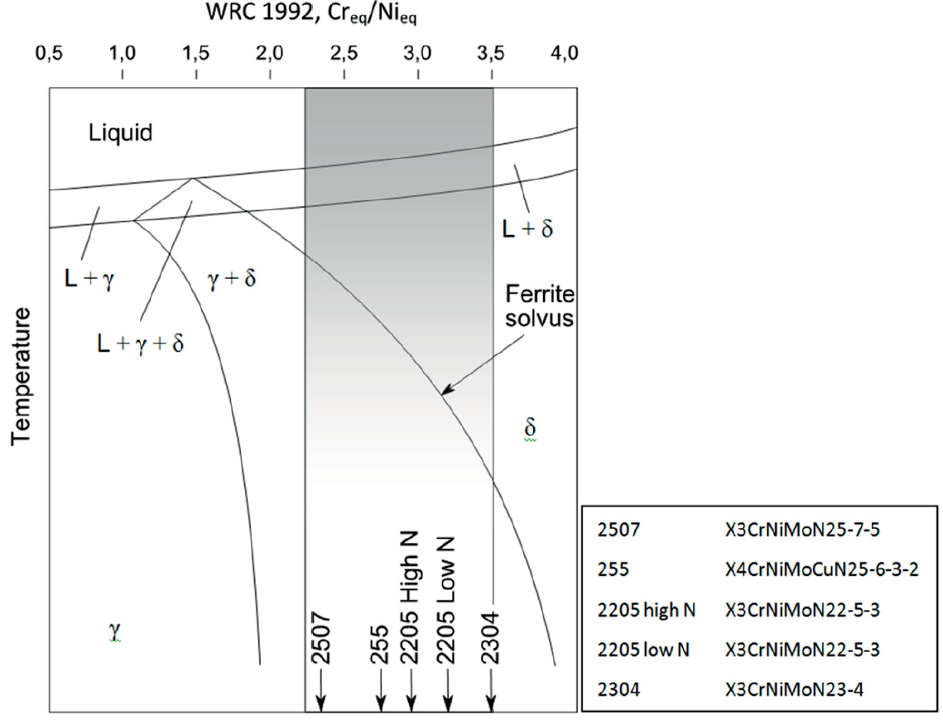
Chromium equivalent Cr_{eq} = % Cr + 1.4% Mo C + 0.5% Nb + 1.5% Si + 2% Ti Cr_{eq} = 27.65 Nickel equivalent Ni_{eq} = % Ni + % Co + 0.5% Mn + 0.3% Cu + 30% N + 30% C Ni_{eq} = 9.76 Cr_{eq} / Ni_{eq} = 2.83
Duplex stainless steel UNS S32205
Alloy |  | Chemical Composition
UNS | DIN EN | C | Cr | Ni | Mo | Mn | N | Si | Cu
S32205 | 1.4462 | 0.03 | 22.40 | 5.21 | 3.4 | 1.23 | 0.10 | 0.30 | 0.11
Cr_{eq}/Ni_{eq}
Vertical section of an Fe-Cr-Ni phase diagram at 60% Fe
Source: J.C.Lippold, D.J. Kotecki; ISBN: 0-471-47379-0
Temperature →
2507
2550
2205 high N
2205 low N
2507
2550
2304
2205 high N
2205 low N
2304

Slide 7
Aims - add value - reduce cost - lead time - increase safety - specify requirements
Norsok M-630 Standard / Duplex stainless steel UNS S32205
What is NORSOK?
Industry Initiative for the Competitive Standing of the Norwegian Offshore Sector
Norwegian Oil Industry Association
Federation of Norwegian Engineering Industries
Standards
M630 – Material Data Sheets for Piping
M650 – Qualification of Manufacturers of „Special Materials“
- Duplex Stainless Steels
- High Alloyed Austentic Stainless Steels
- Nickel Base Alloys (Castings)
- Titanium and Alloys (Castings)

Slide 8
Norsok M-630 Standard / Duplex stainless steel UNS S32205
Requirements according Norsok M-630 Standard
Tensile Testing
Rp_{0.2} > 450 MPa
R_{m} > 620 MPa
A5 > 25 %
Hardness
maximum 28 HRC or 271 HB or 290 HV10
Impact Testing
according ASTM A 370 at -46°C
minimum 45 J / single 35 J
Micrographic Examation
according ASTM E 562
35-55 % ferrite content

Slide 9
Effect of cooling rate

Slide 10
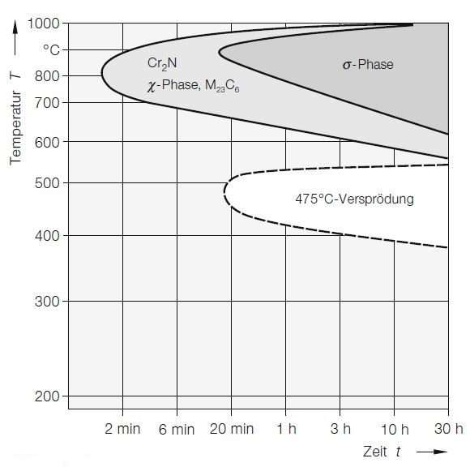
Effect of cooling rate
Cr₂N
χ-phase
σ – phase
carbides
temperature →
475°C -embrittlement
time →
Time-Temperature-Transformation diagram for various preciptitates appearing in duplex stainless steel UNS S32205; source: M. Sorg; NACE-2015-5611

Slide 11
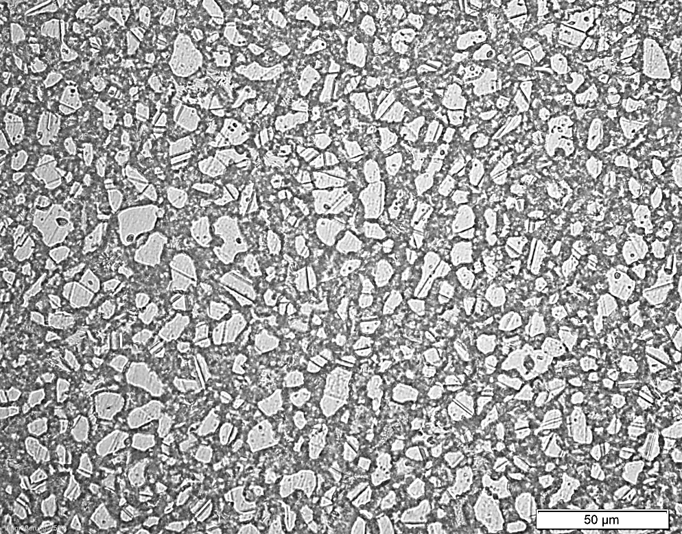
Approx. Cooling rate 1000°C-700°C: 1.7 K/min over all: 0.2 K/min χ-phase area 120-180 min 475°C – embrittlement more than 10 h
Effect of cooling rate
Cr₂N
χ-phase
σ – phase
carbides
temperature →
475°C -embrittlement
TTT diagramm UNS S32205;
scoure: M. Sorg; NACE-2015-5611
time →
Approx. 46.0 % Austenite
32.5 % Ferrite
21.5 % intermetallic phases

Slide 12
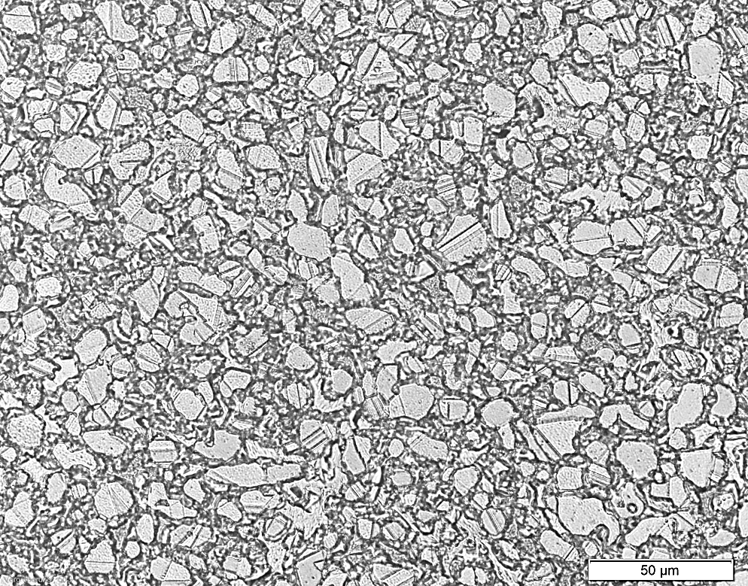
Approx. Cooling rate 1000°C-700°C: 5 K/min over all: 0.25 K/min χ-phase area 30-60 min 475°C – embrittlement more than 4 h
Effect of cooling rate
Cr₂N
χ-phase
σ – phase
carbides
temperature →
475°C -embrittlement
TTT diagramm UNS S32205;
scoure: M. Sorg; NACE-2015-5611
time →
Approx. 47.5 % Austenite
41.0 % Ferrite
11.5 % intermetallic phases

Slide 13
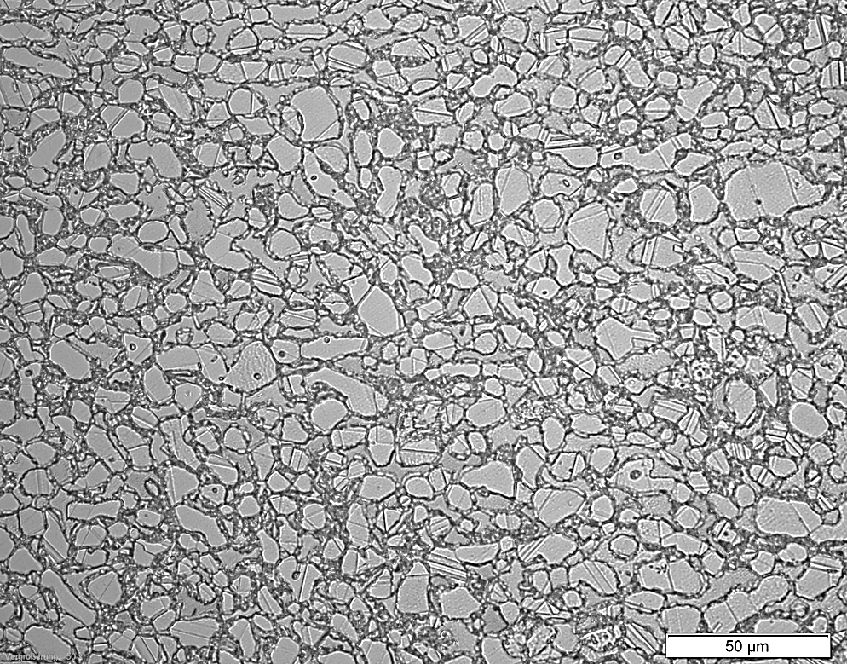
Approx. Cooling rate 1000°C-700°C: 10 K/min over all: 0.35 K/min χ-phase area 20-30 min 475°C – embrittlement more than 4 h
Effect of cooling rate
Cr₂N
χ-phase
σ – phase
carbides
temperature →
475°C -embrittlement
TTT diagramm UNS S32205;
scoure: M. Sorg; NACE-2015-5611
time →
Approx. 49.0 % Austenite
43.5 % Ferrite
7.5 % intermetallic phases

Slide 14
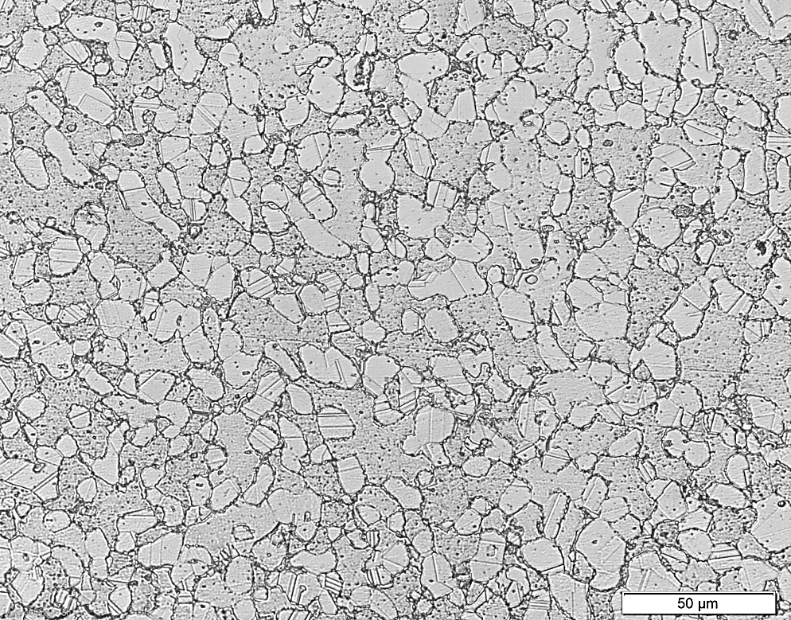
Approx. Cooling rate 1000°C-700°C: 20 K/min over all: 0.5 K/min χ-phase area 10-15 min 475°C – embrittlement approx. 1h
Effect of cooling rate
Cr₂N
χ-phase
σ – phase
carbides
temperature →
475°C -embrittlement
TTT diagramm UNS S32205;
scoure: M. Sorg; NACE-2015-5611
time →
Approx. 50.5 % Austenite
46.5 % Ferrite
3.0 % intermetallic phases

Slide 15
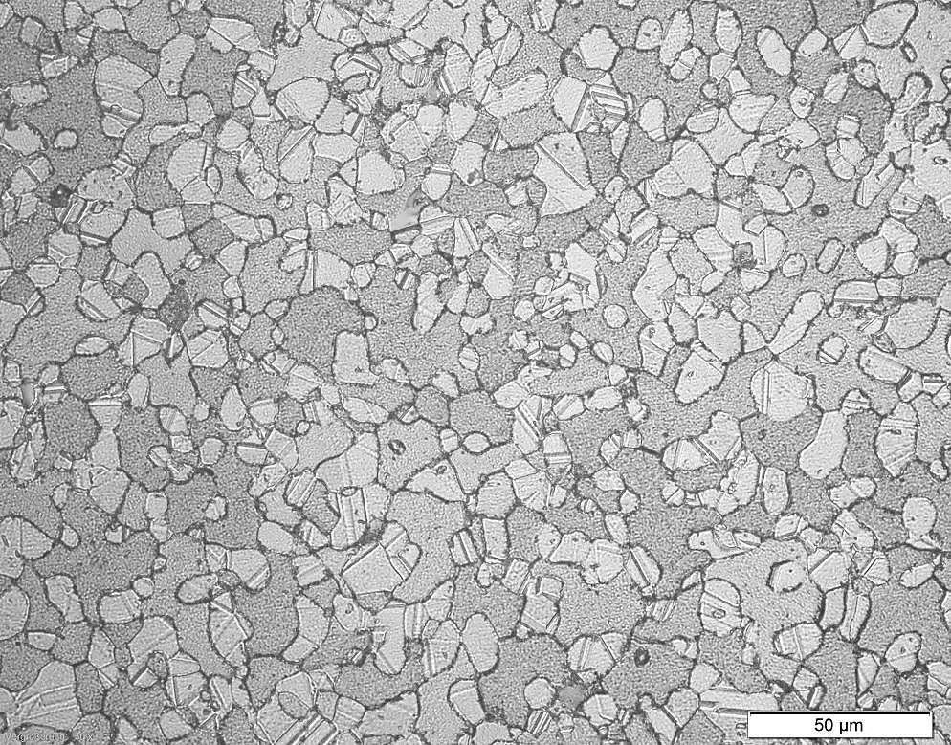
Apporx. Cooling rate 1000°C-700°C: 50 K/min over all: 3.5 K/min χ-phase area 5-10 min 475°C – embrittlement 10-20 min
Effect of cooling rate
Cr₂N
χ-phase
σ – phase
carbides
temperature →
475°C -embrittlement
TTT diagramm UNS S32205;
scoure: M. Sorg; NACE-2015-5611
time →
Approx. 51.5 % Austenite
47.0 % Ferrite
1.5 % intermetallic phases

Slide 16
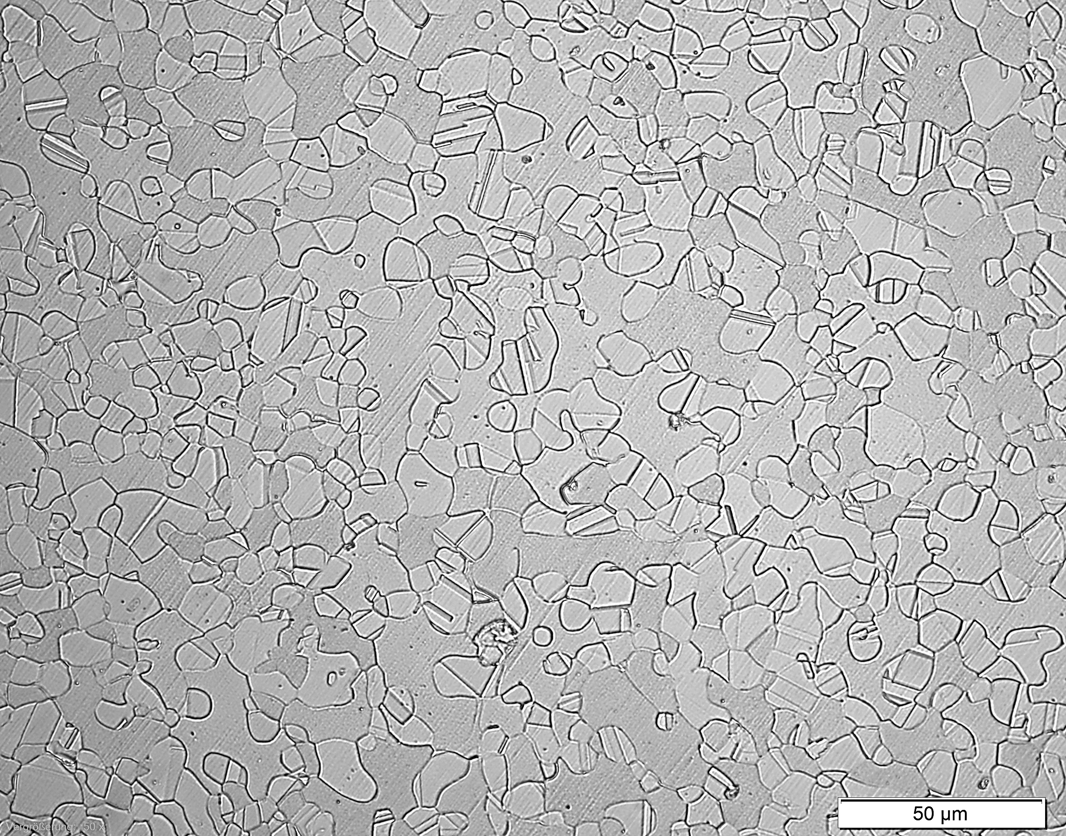
Approx. Cooling rate 1000°C-700°C: 60 K/min over all: 15-20 K/min χ-phase area 2-5 min 475°C – embrittlement not reached
Effect of cooling rate
Cr₂N
χ-phase
σ – phase
carbides
temperature →
475°C -embrittlement
TTT diagramm UNS S32205;
sources: M. Sorg; NACE-2015-5611
time →
Approx. 52.1 % Austenite
47.7 % Ferrite
0.2 % intermetallic phases

Slide 17
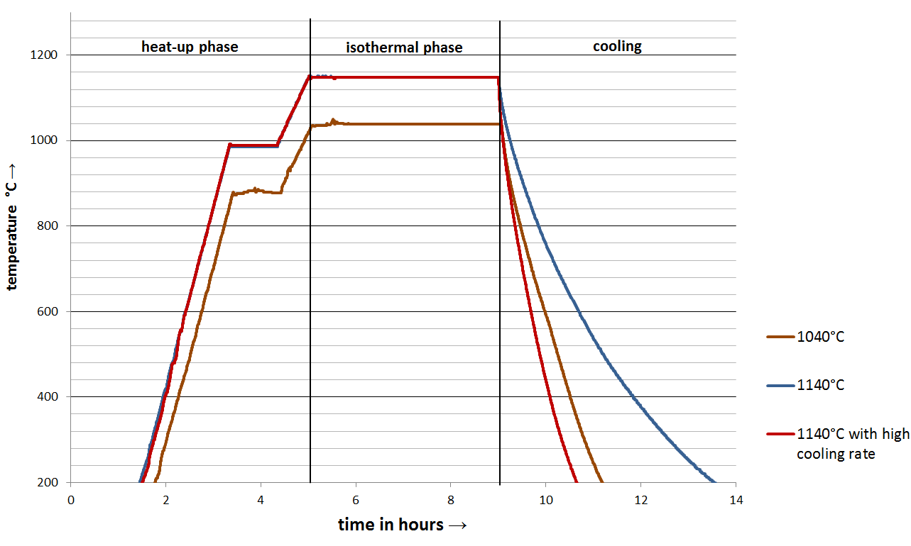
- increase the cooling rate - reduce the process temperature
Effect of cooling rate
Temperature profile
Cr₂N
χ-phase
σ – phase
carbides
temperature →
475°C -embrittlement
time →
TTT diagramm UNS S32205;
scoure: M. Sorg; NACE-2015-5611

Slide 18
Influence of Process Temperature

Slide 19
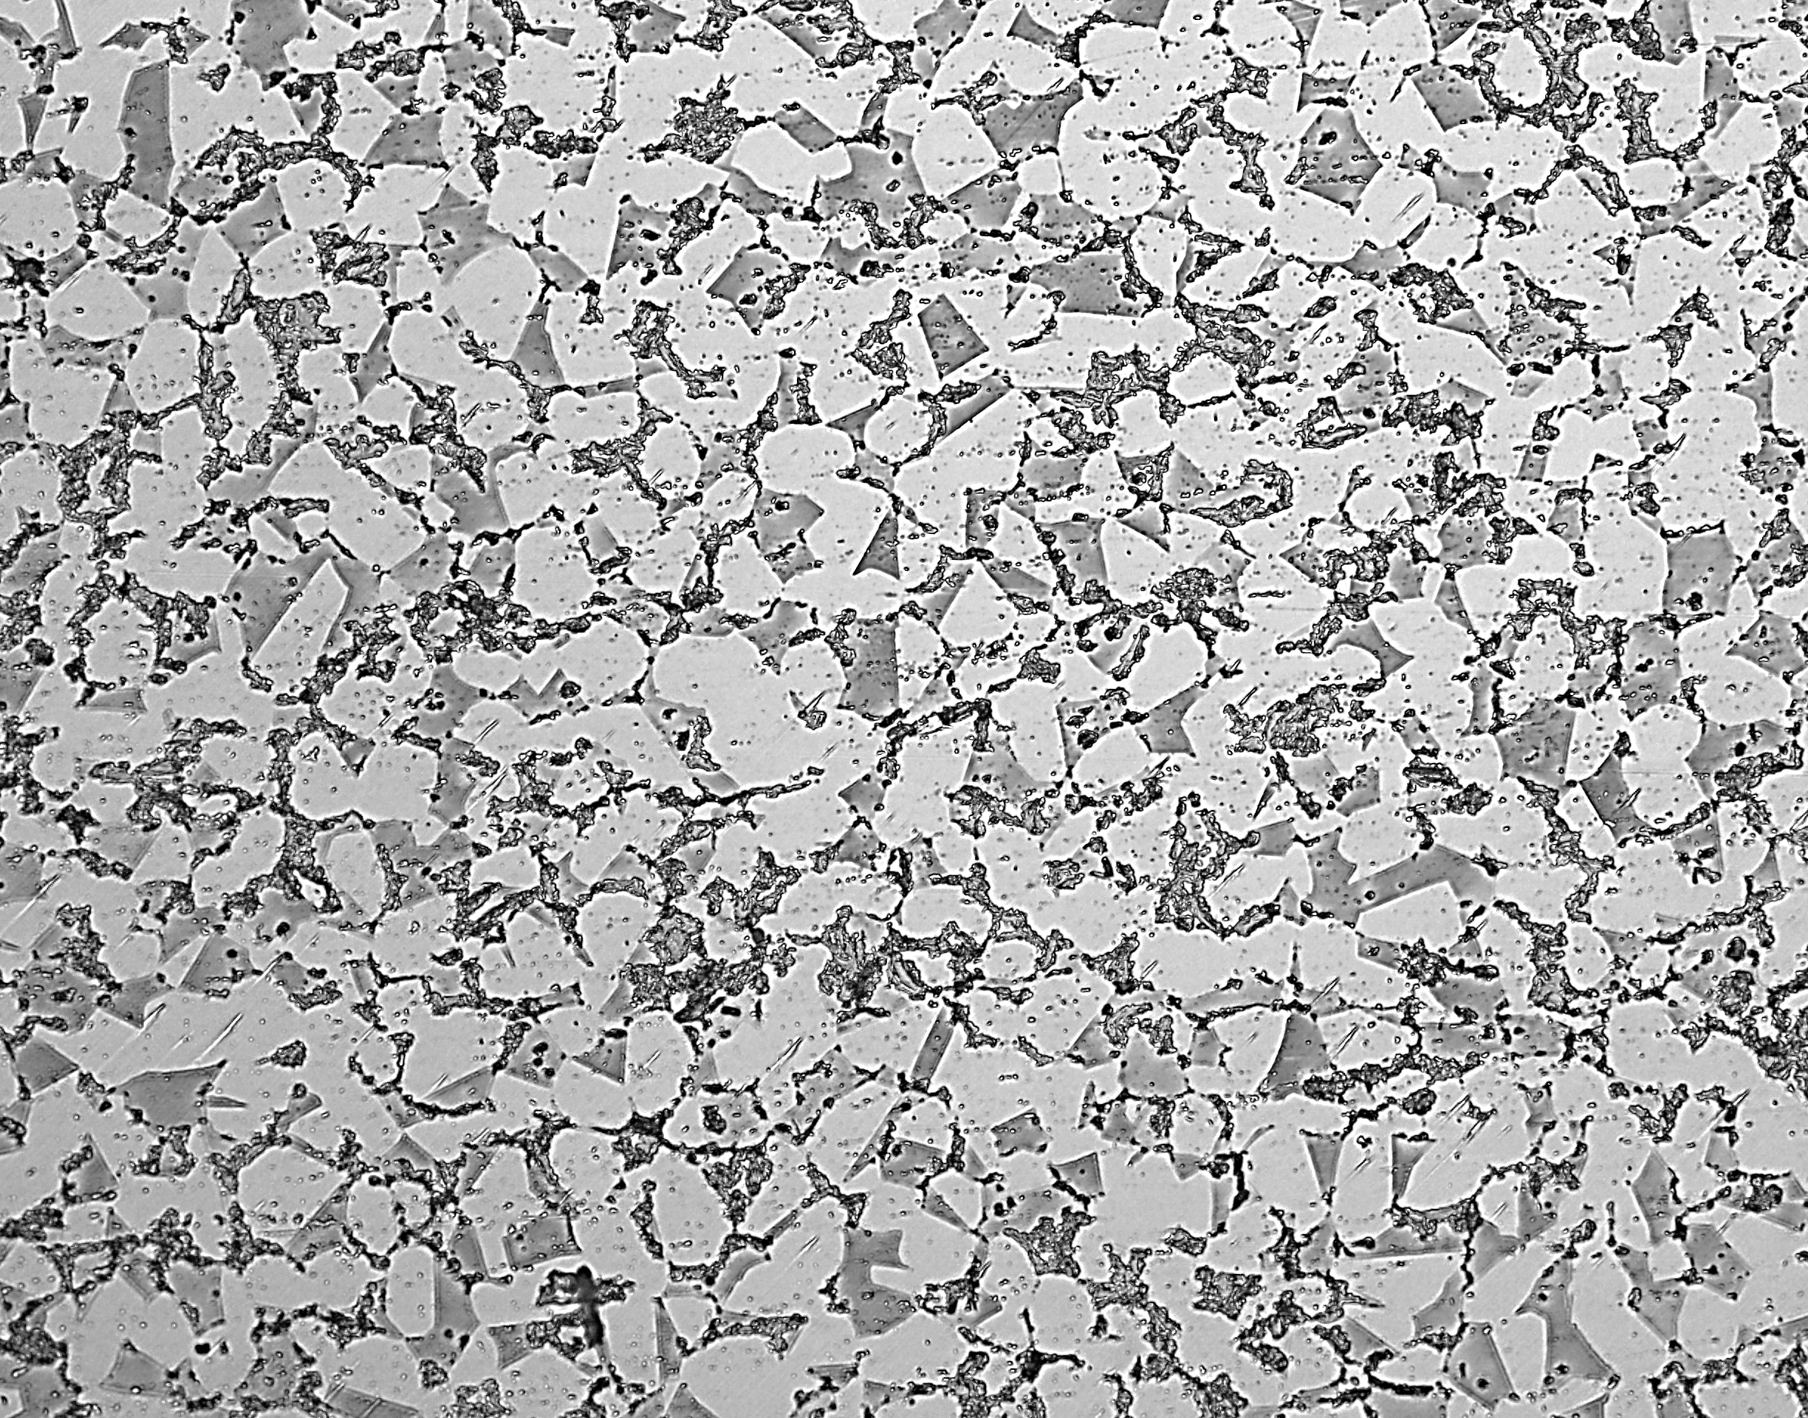
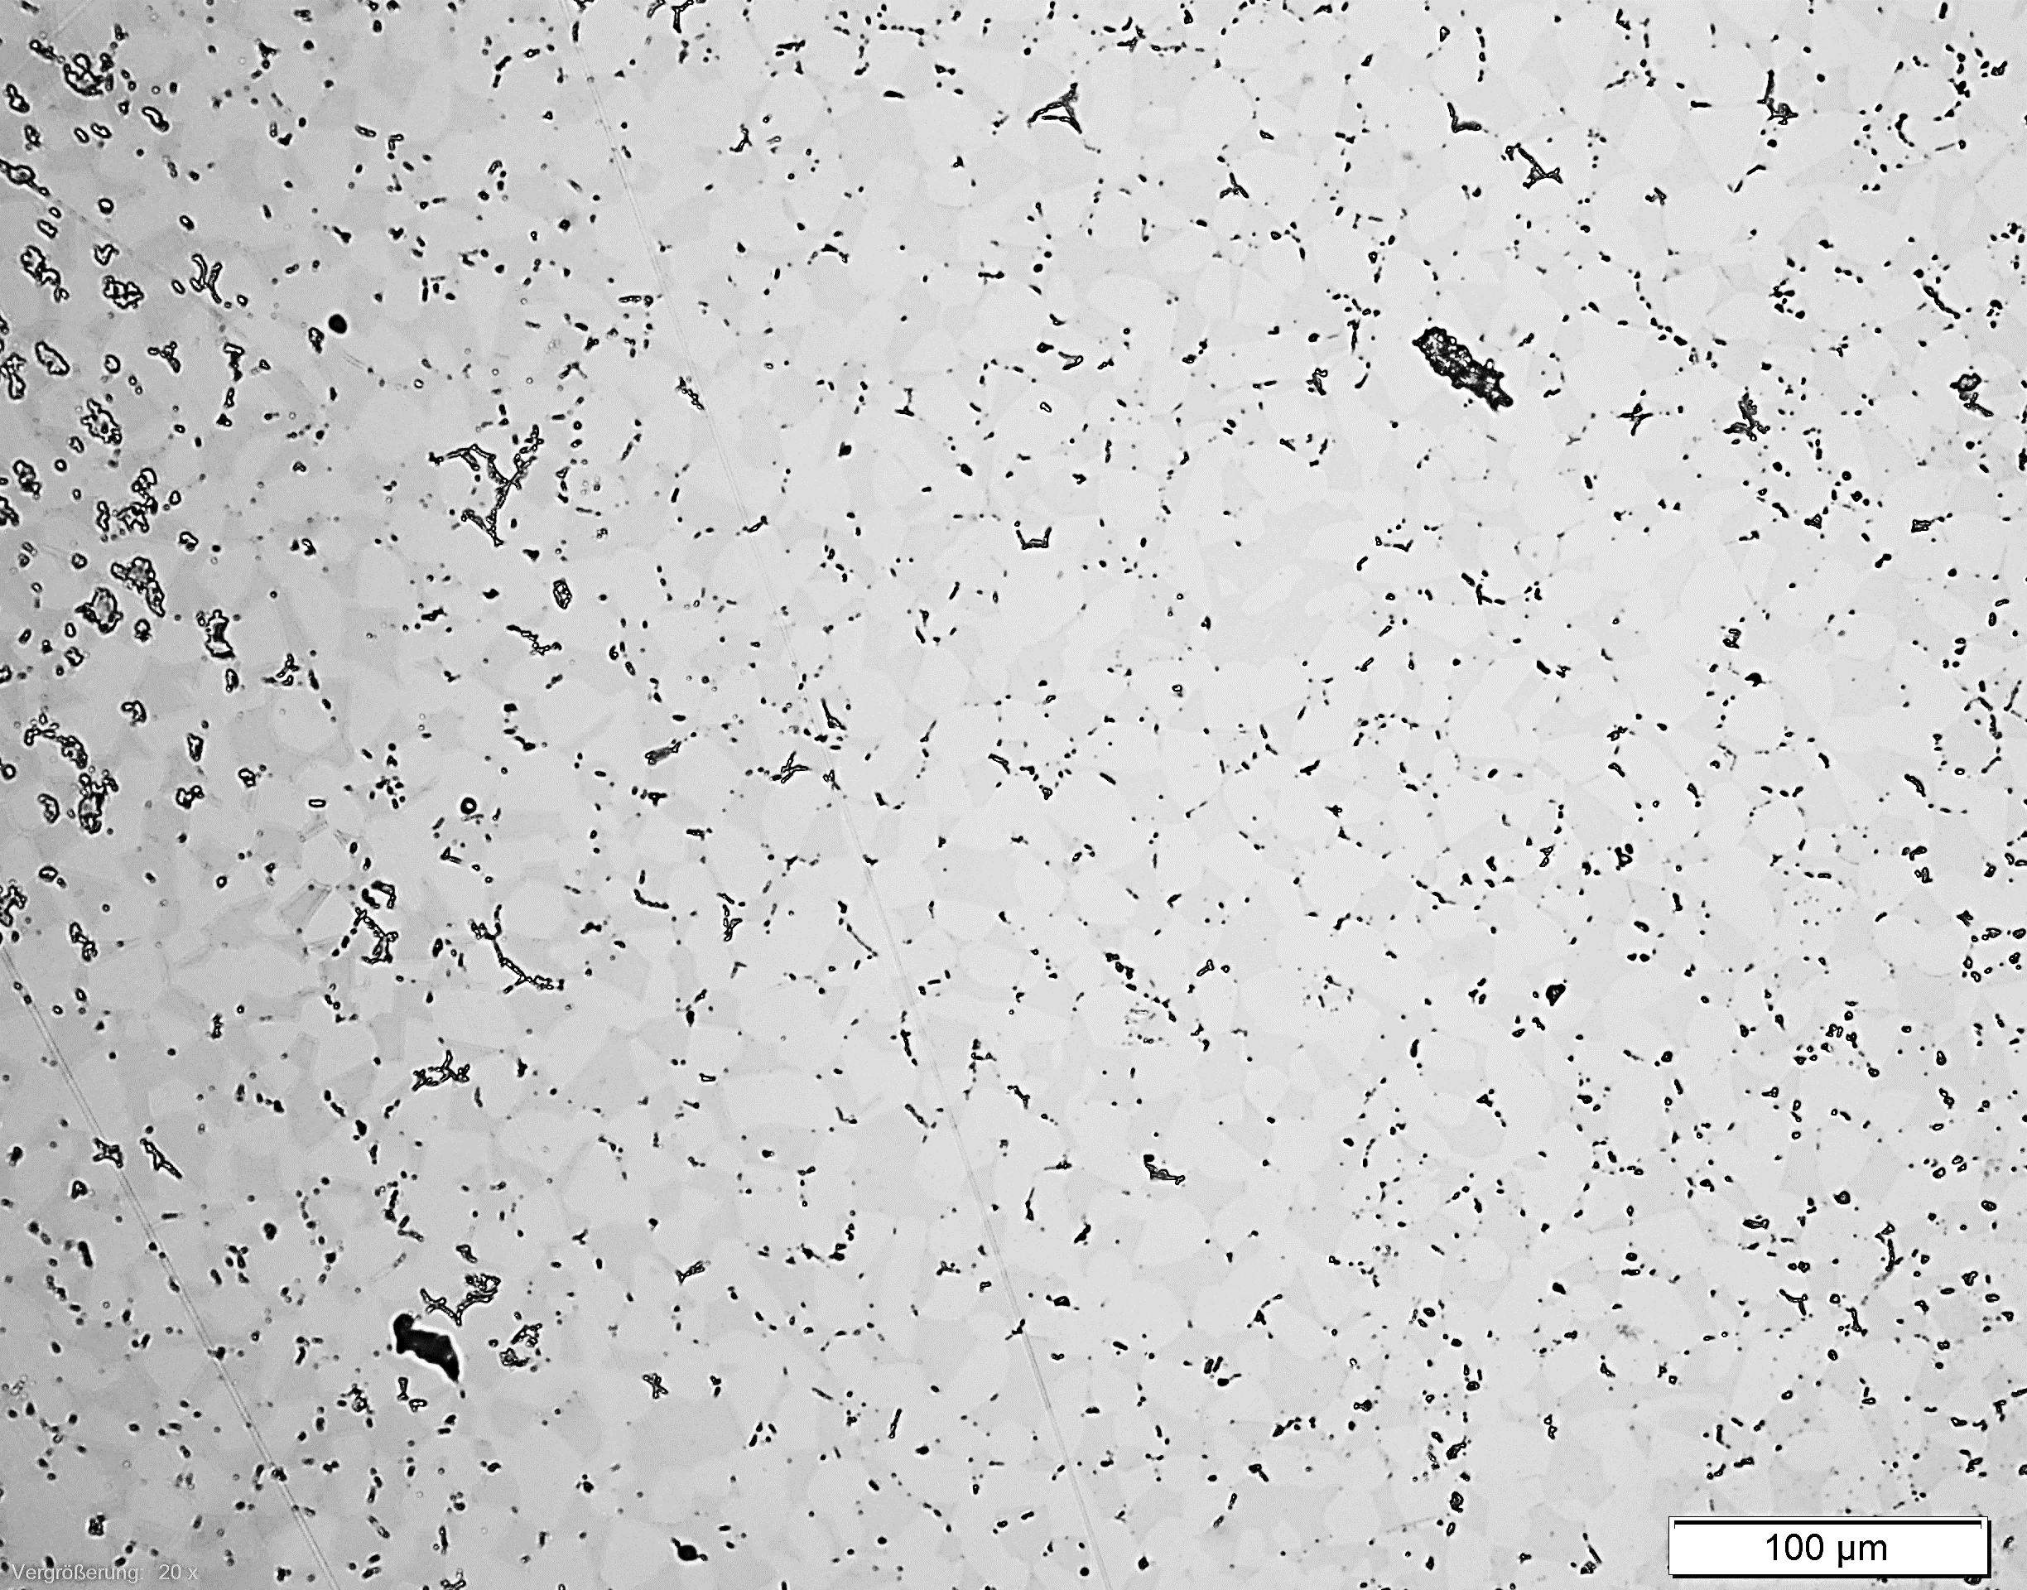
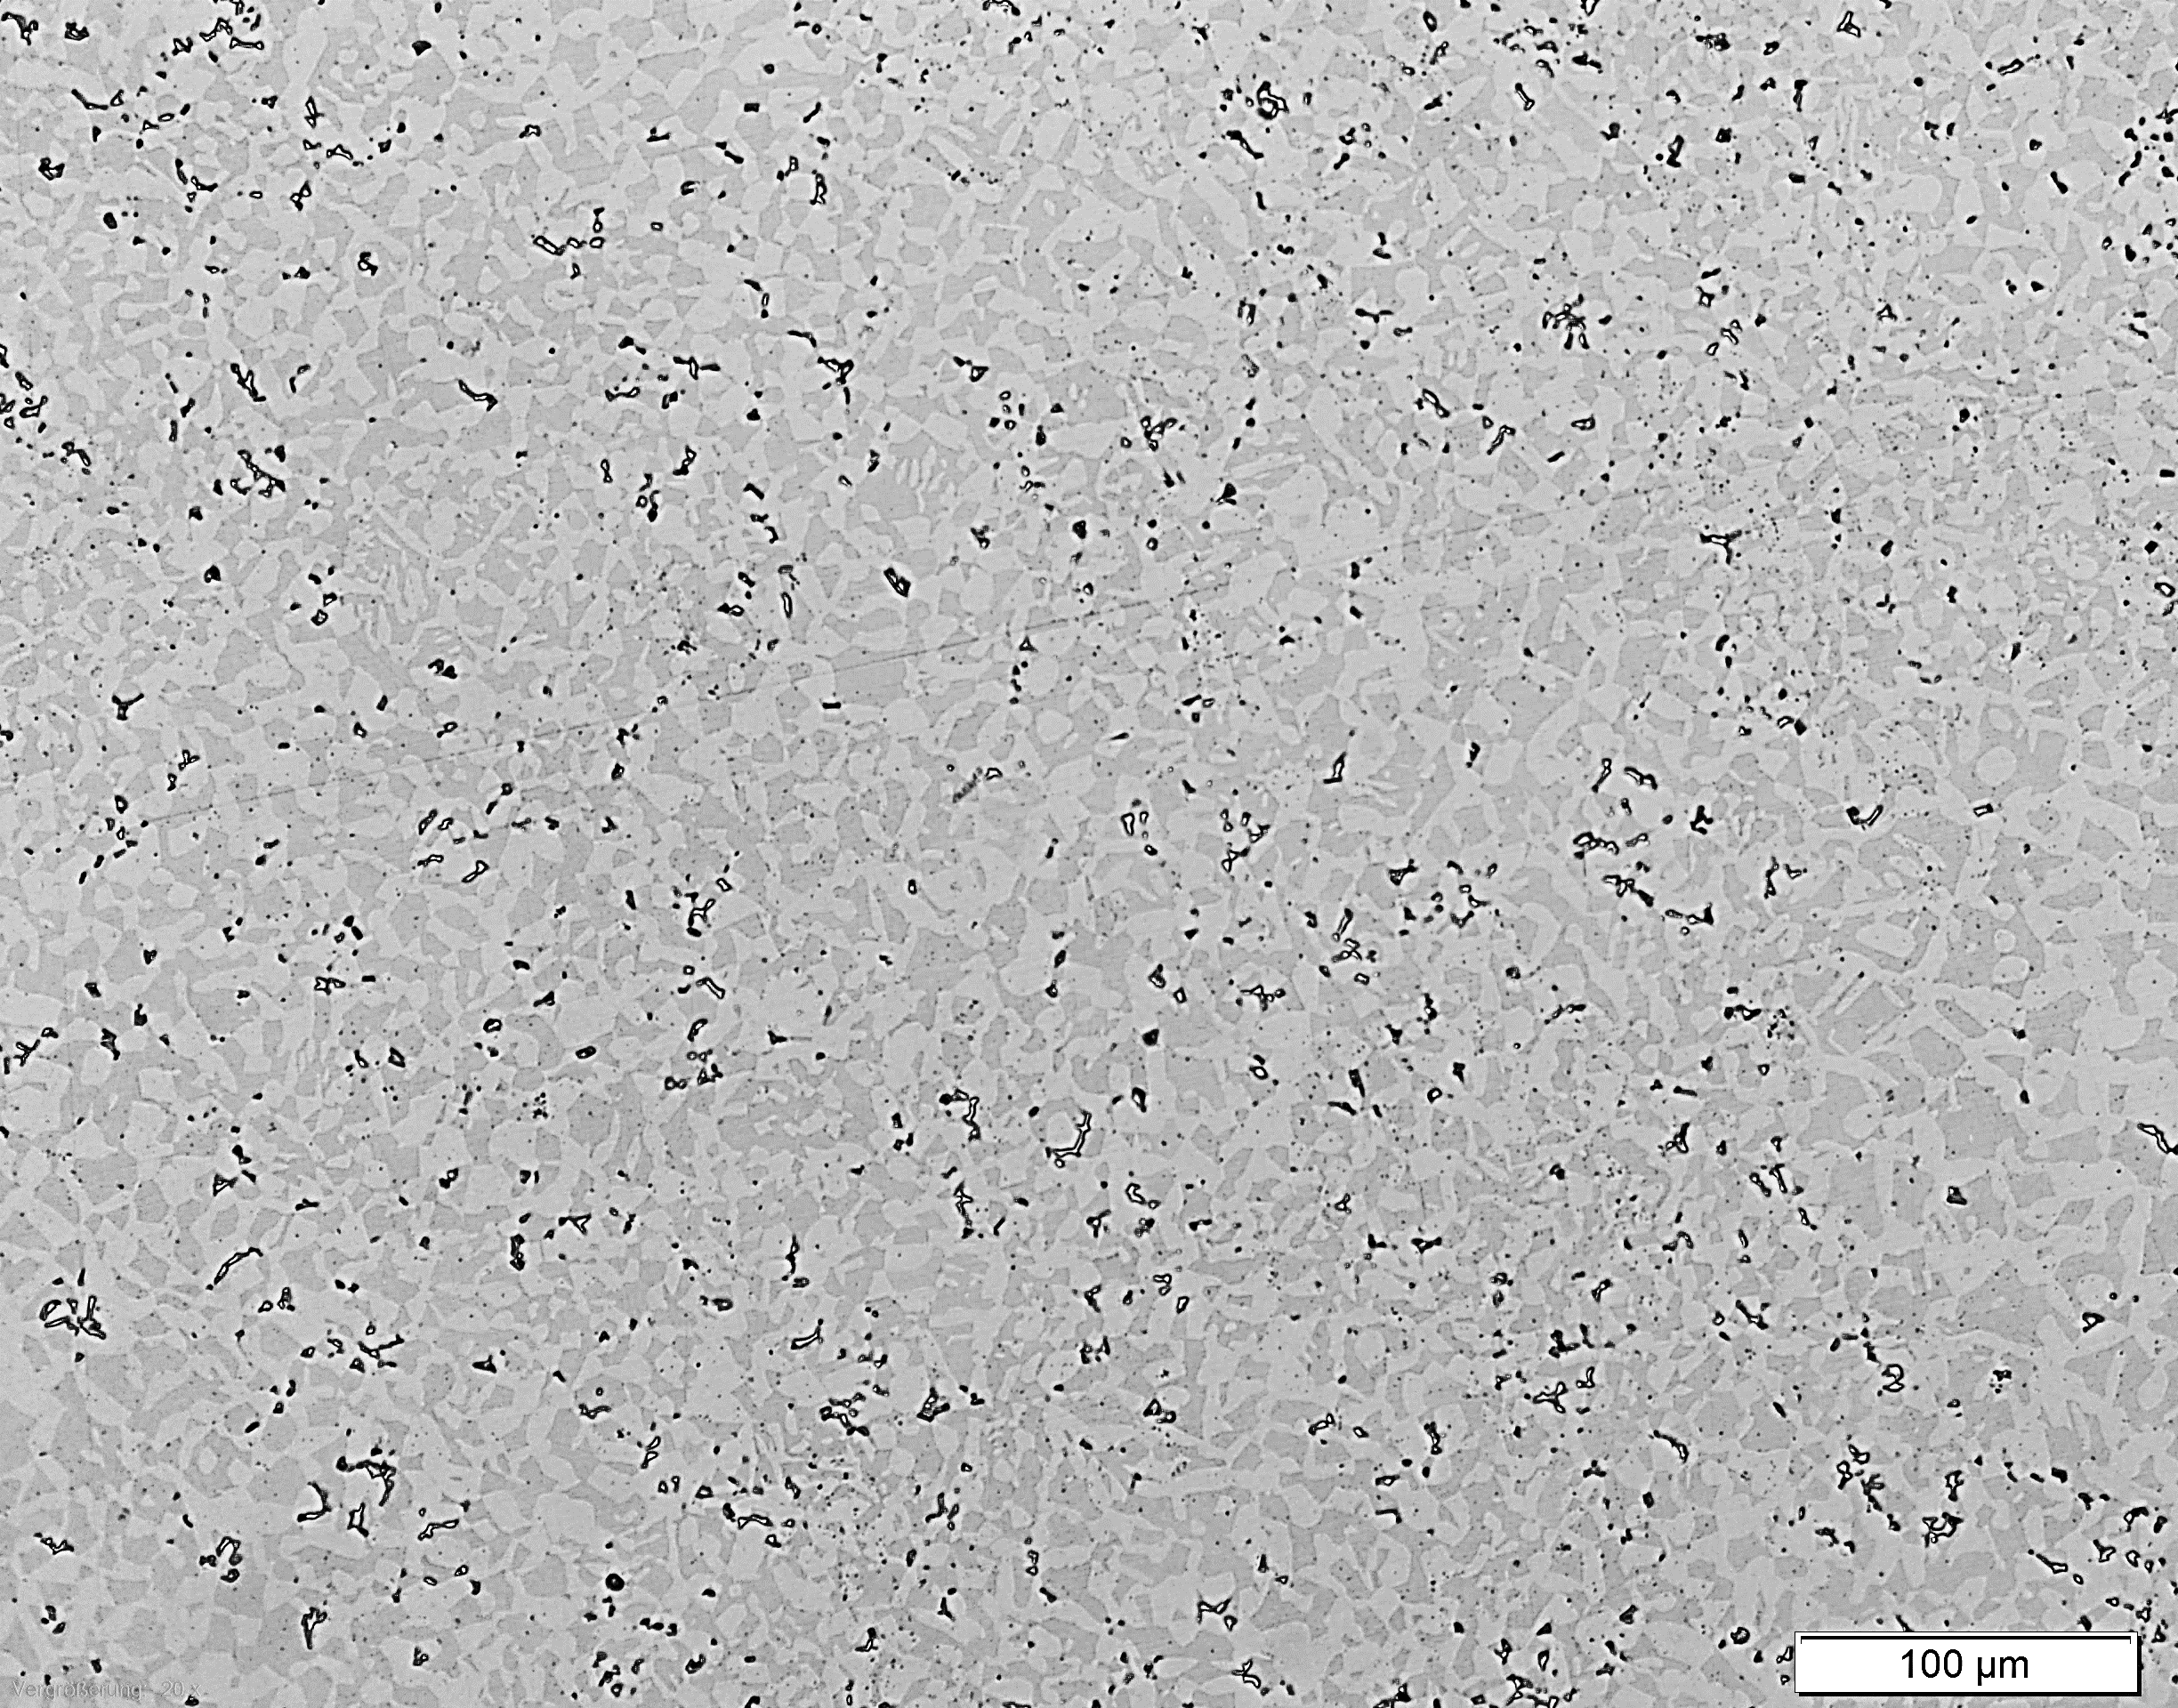
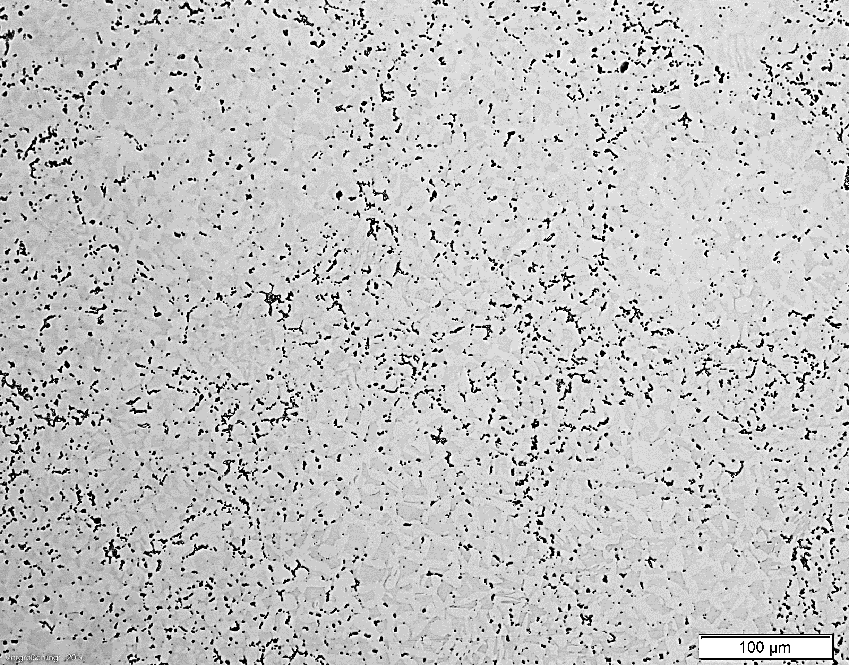
comparison of process temperatures → 1200°C → 1140°C → 1100°C → 1040°C without heat treatment approx. cooling rate critical temp.: 10 K/min over all: 1 – 2 K/min
Influence of HIP-Temperature
1200°C : Ferrite 47% / Austenite 47.5 % / intermetallic phases 5.5 %
1140°C : Ferrite 47% / Austenite 51.5 % / intermetallic phases 1.5 %
1100°C : Ferrite 47.5% / Austenite 50.5 % / intermetallic phases 2 %
1040°C : Ferrite 47.5% / Austenite 50 % / intermetallic phases 2.5 %
Notes:
PPB – PriorParticalBoundary

Slide 20
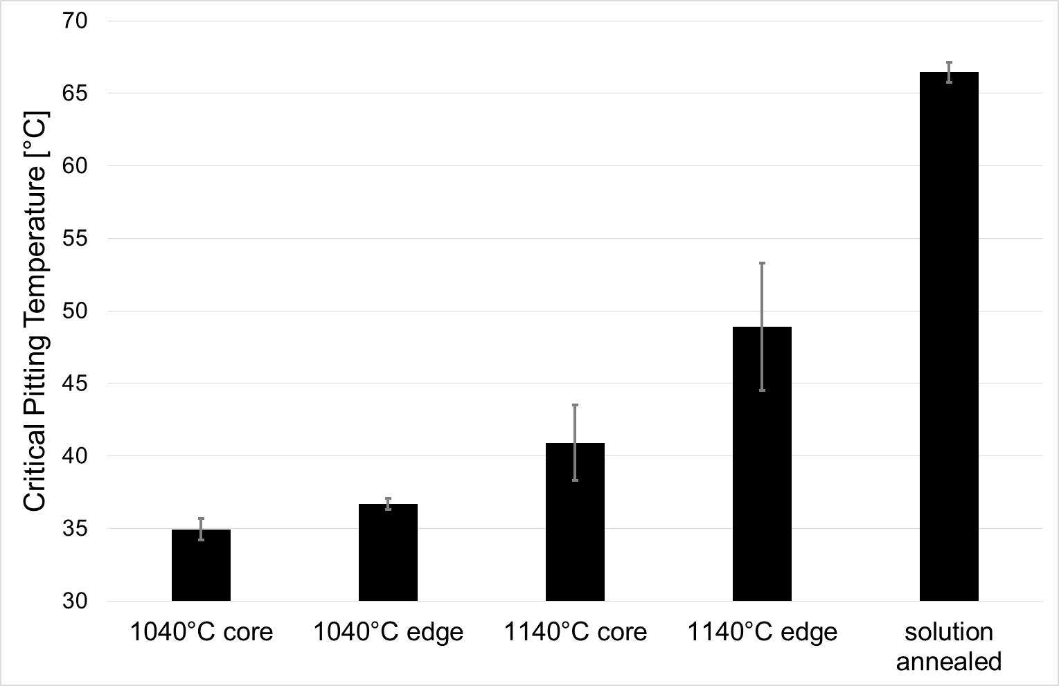
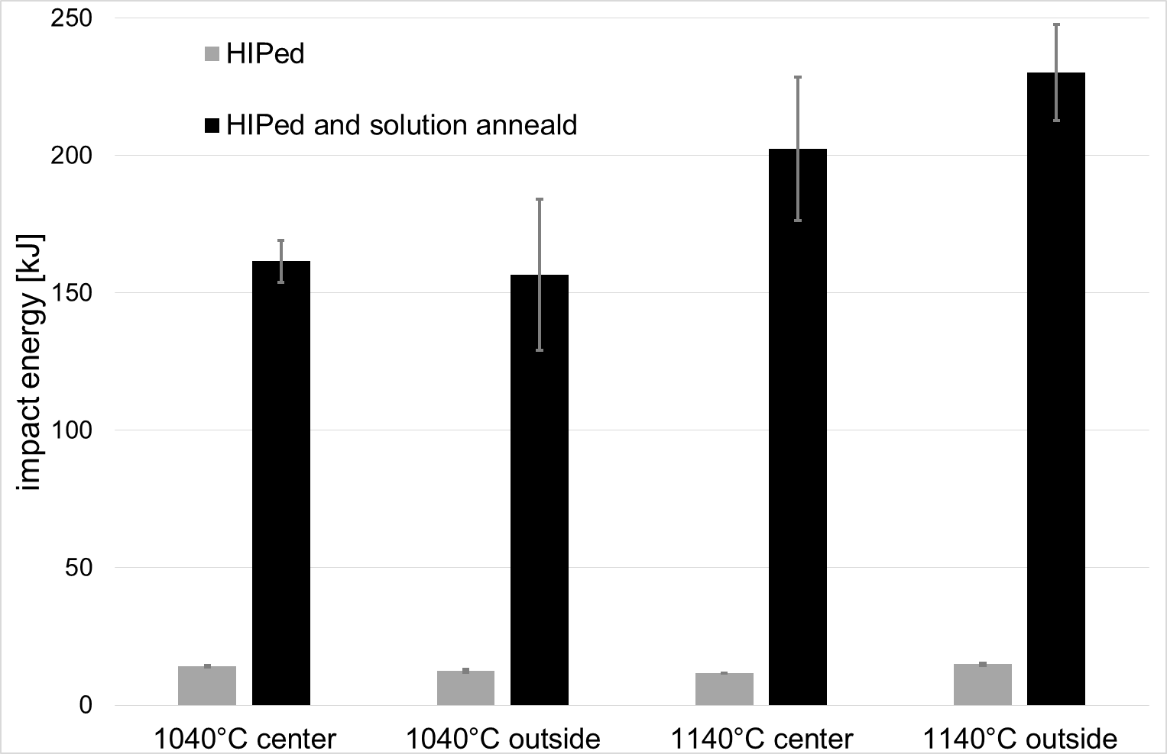
comparison of process temperatures → 1200°C → 1140°C → 1100°C → 1040°C without heat treatment part dimensions 200 x 200 x 400 mm³ approx. cooling rate critical temp.: 10 K/min over all: 1 – 2 K/min
Influence of HIP-Temperature
Impact energy UNS S32205;
sources: M. Sorg; NACE-2015-5611
CPT UNS S32205;
sources: M. Sorg; NACE-2015-5611

Slide 21
Experimental

Slide 22
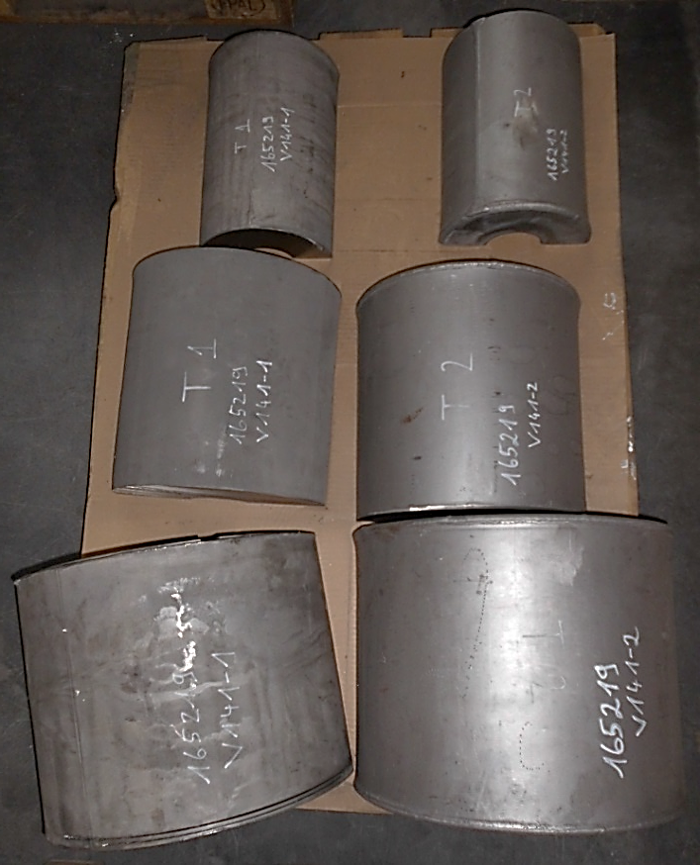
Goal evaluate benefits of fast cooling in industrial HIP facilities Process parameters HIP-Temperature 1140°C for 4 h realized cooling rate approx. 15-20°C / min approx. 1. 000 kg
Experimental Setup
experimental component
HIP-Samples
one-half
conventional heat treatment
one-half
rapid cooling
(HIP facility)

Slide 23
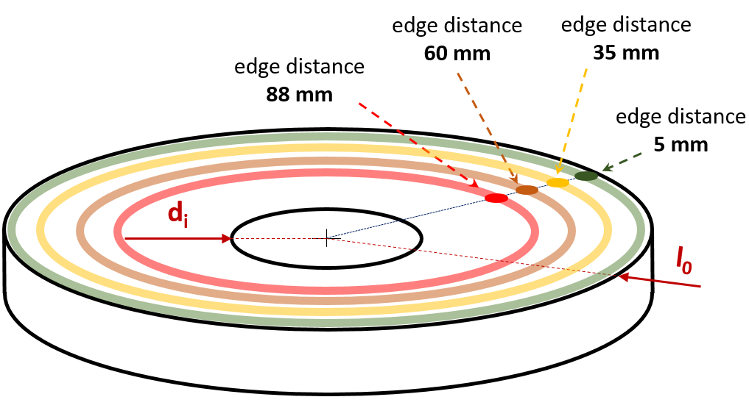
Investigated wall thickness / edge distance 10 mm / 5 mm 70 mm / 35 mm 120 mm / 60 mm 175 mm / 88 mm
Experimental Setup
sample conditions
standard heat treatment with water quenching
Jominy (ASTM A255-10 / DIN EN ISO 642) modified test setup
no heat treatment after HIP
HIP with rapid cooling (approx. 40-60 K/min)

Slide 24
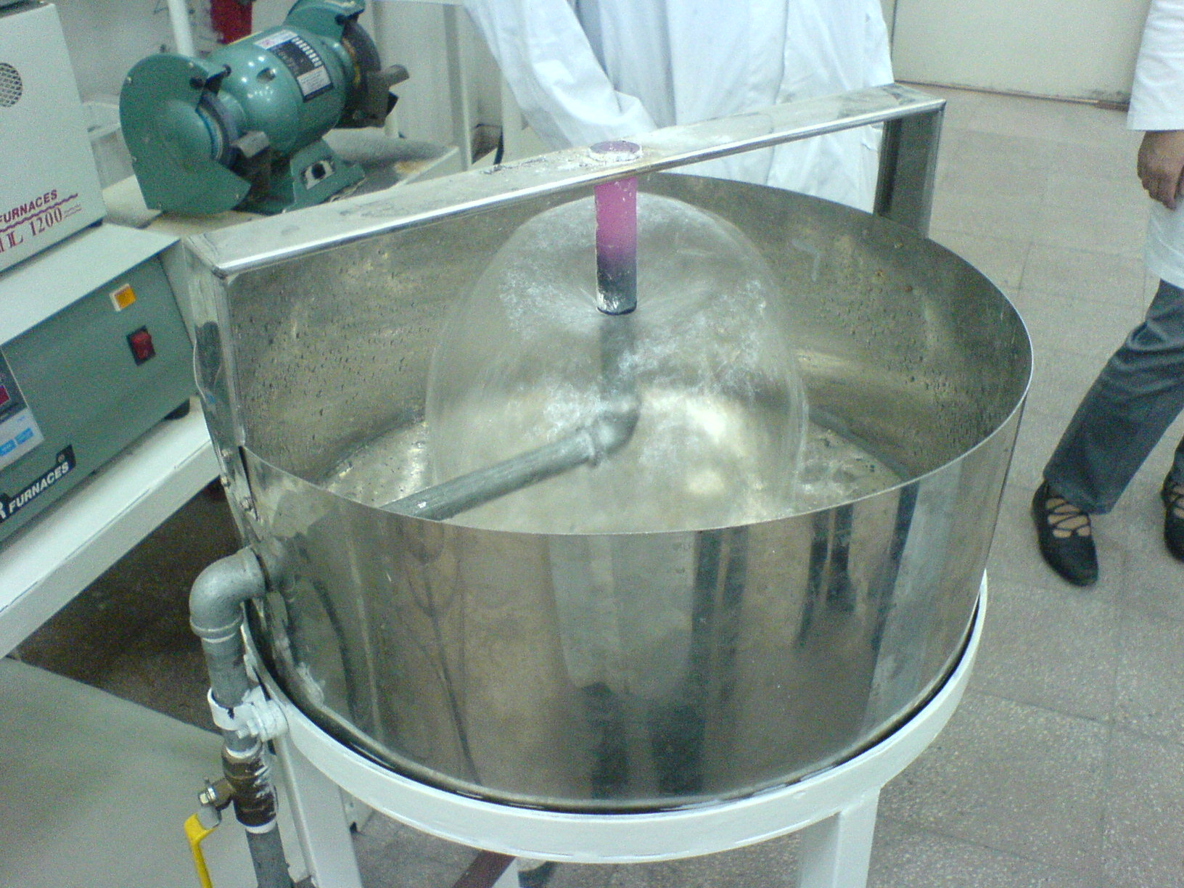
Goal develop and prove a new and cost efficient test method to illustrate the influence of cooling parameters and wall thickness for HIP products
Jominy (ASTM A255-10 / DIN EN ISO 642) modified test setup
Jominy End Quench Test ASTM A 255 is used to measure hardenability of steels
hardenability is a measure of the capacity of a steel to be hardened in depth when quenched form its austenitizing temperature (usually 800°C to 900°C)
specimen cylinder 100mm in length and 25mm in diameter
cooling rate decreases form the quenched end to the air cooled end: different cooling rates are generated
wall thickness cannot depict by the usual experimental setup
Image source:
http://www.wirebiters.com/george-jominy-end-quench-test/ Nov. 2017

Slide 25
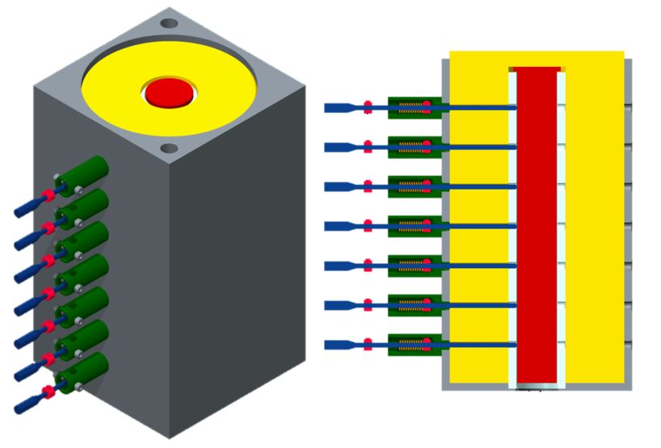
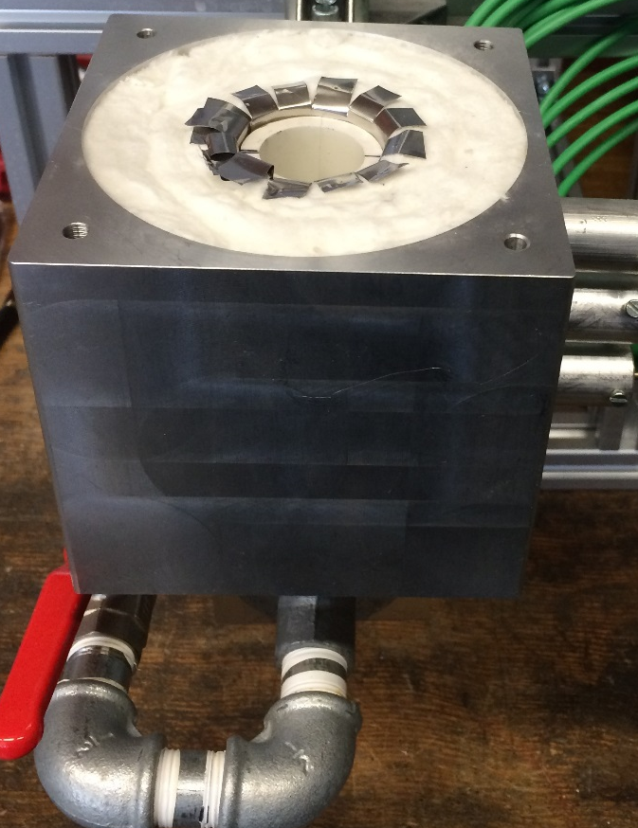
Modification increasing sample length form 100 mm to 200 mm add an isolation add several thermocouples drape in an aluminum casting
Jominy (ASTM A255-10 / DIN EN ISO 642) modified test setup
specimen
isolation
ceramic tube
thermocouple
aluminum casting
water jet

Slide 26
Results

Slide 27
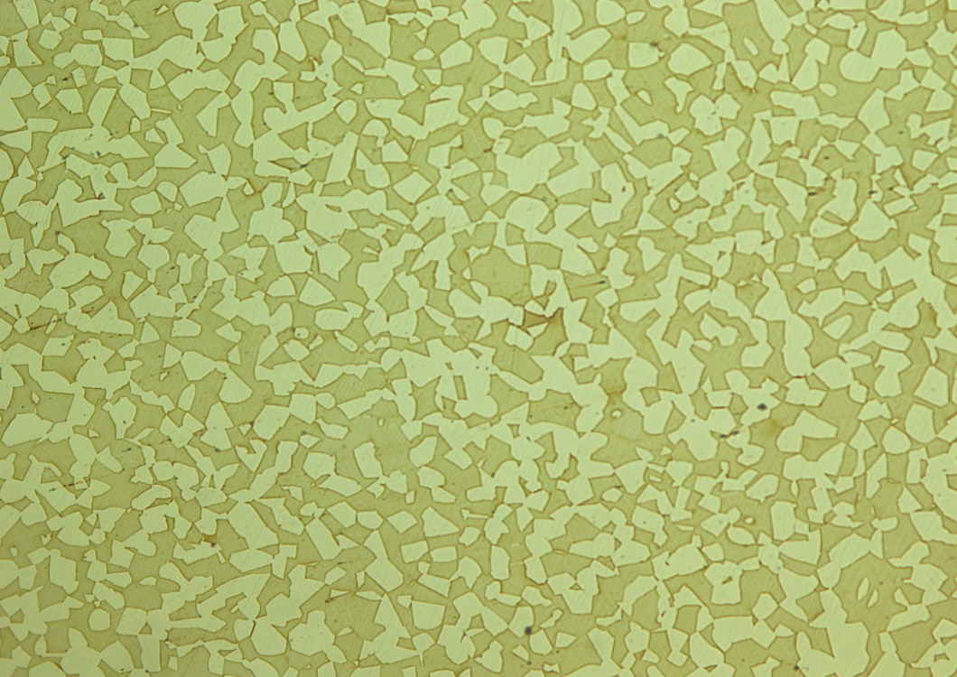
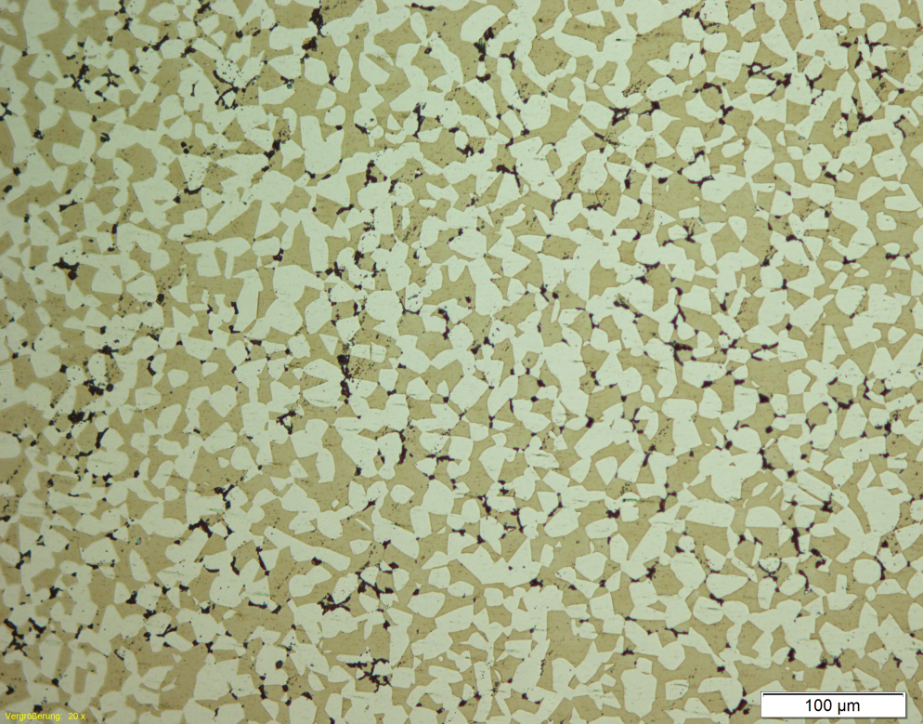
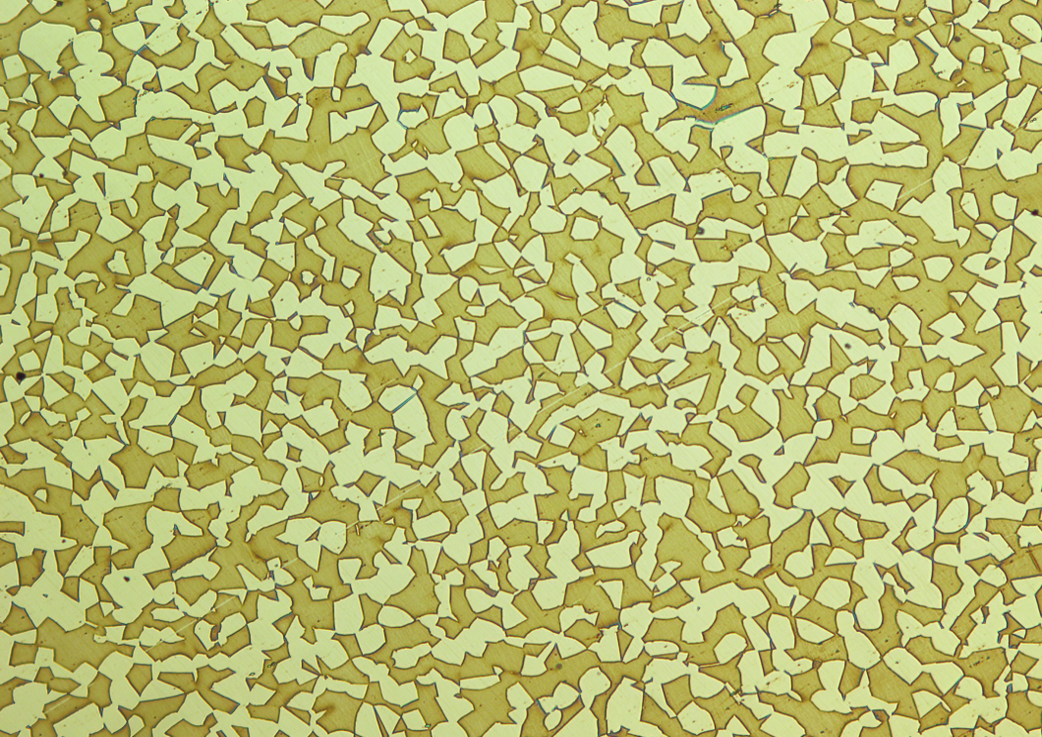
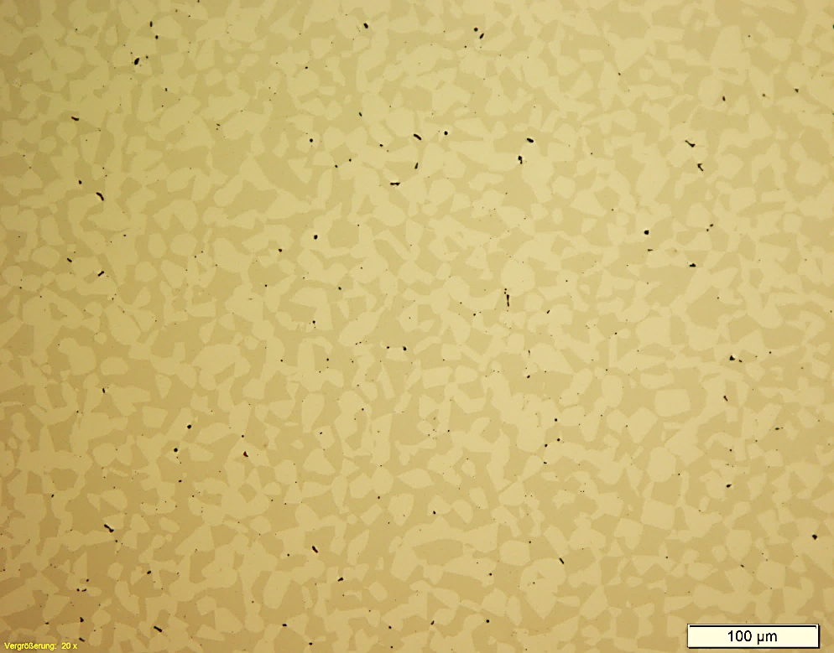
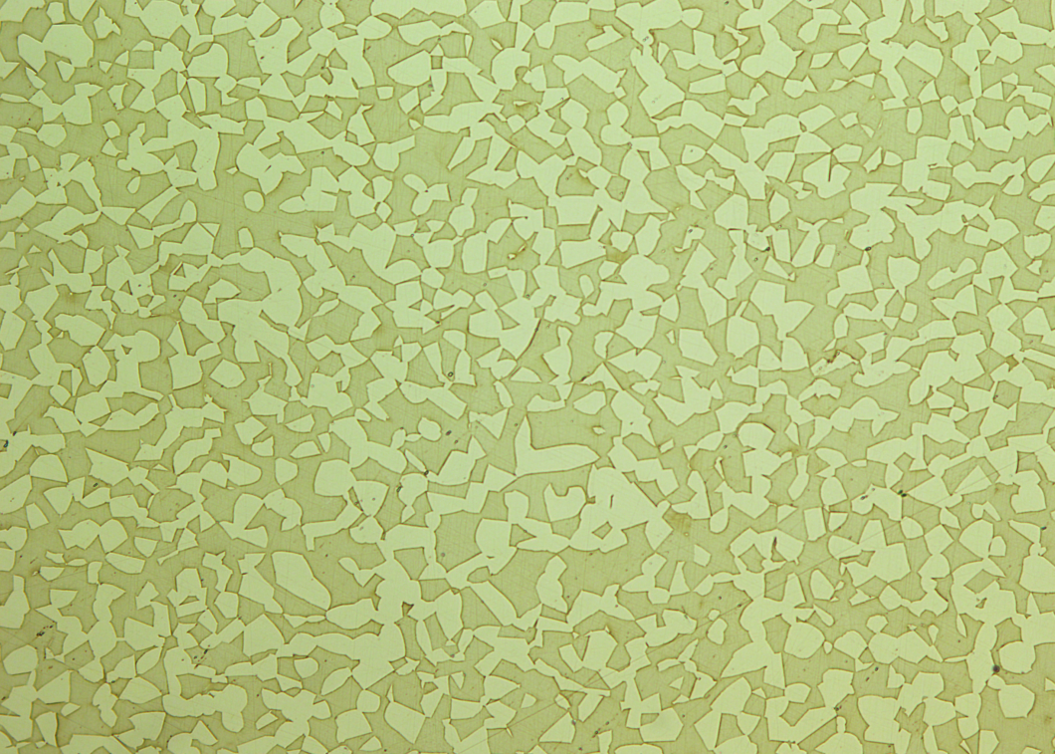
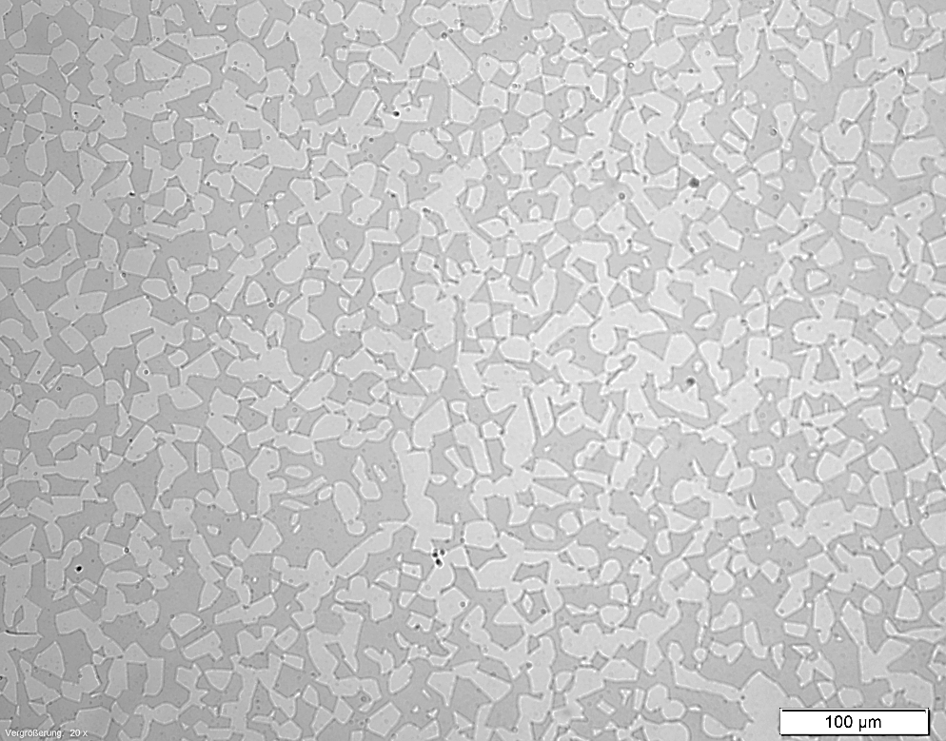
Microstructure
modified Jominy
test setup
standard heat treatment
water quenching
HIP-Process
with rapid cooling
edge distance
170 mm
65 mm
5 mm

Slide 28
Austenite/Ferrite ratio

Slide 29
Austenite/Ferrite ratio

Slide 30
Corrosion resistance

Slide 31
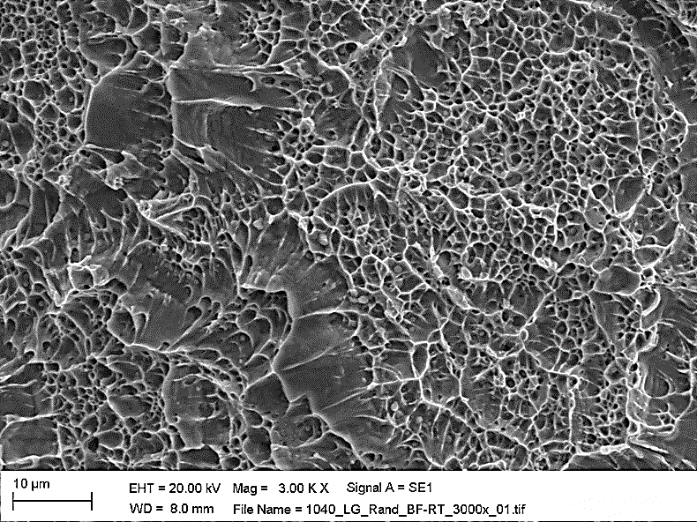
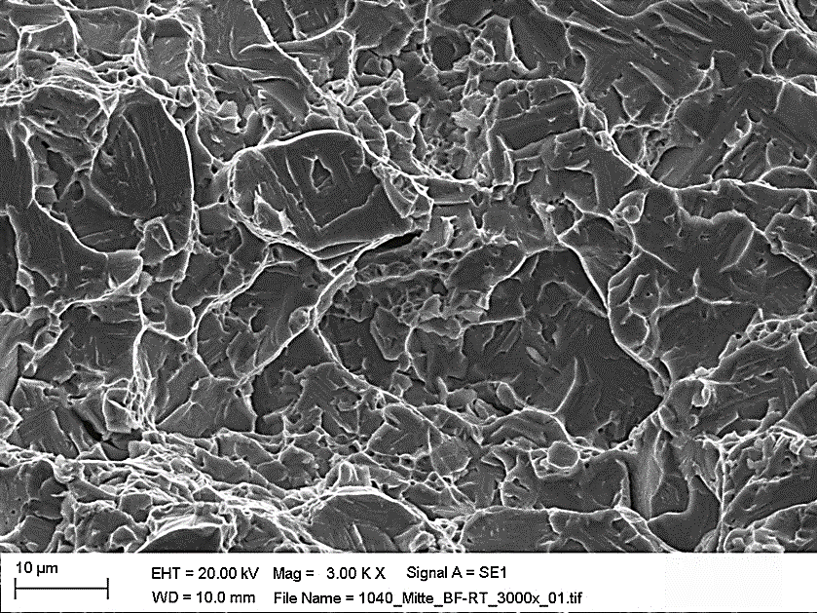
Impact energy / toughness
ductile fracture
brittle fracture

Slide 32
Mechanical properties
Hardness
Yield strength
max. 271 HB
according to NORSOK M-630 Standard
min. 450 MPa
according to NORSOK M-630 Standard

Slide 33
Conclusion & Discussion

Slide 34
Conclusion of results
The results of corrosion measurements do not illustrate a significant effect of heat treatment or wall thickness / edge distance
A small amount of intermetallic phases shows no significant reduction of corrosion resistance
Demands and requirements of the NORSOK Standard will be achieved by fast cooling after HIP-Process only for thin-walled components (up to approx. 70mm)
Notch impact energy is affected very strong by a small amount of intermetallic phases / precipitations
The fracture surface of non heat treatment specimens shows brittle characteristics due to precipitations

Slide 35
UNS S2205
High cooling rate / Quenching
Example calculation
UNS S2205 1.000 kg
specific heat capacity approx. 0.5 KJ/kg K
temperature difference 350 K (1000°C to 650°C)
specific heat 175 MJ
to prevent intermetallic phases 120 seconds (175 K/min)
cooling power 1.45 MW
1.45 kW/kg
Cr₂N
χ-phase
σ – phase
carbides
temperature →
475°C -embrittlement
time →
TTT diagram UNS S32205;
source: M. Sorg; NACE-2015-5611

Slide 36
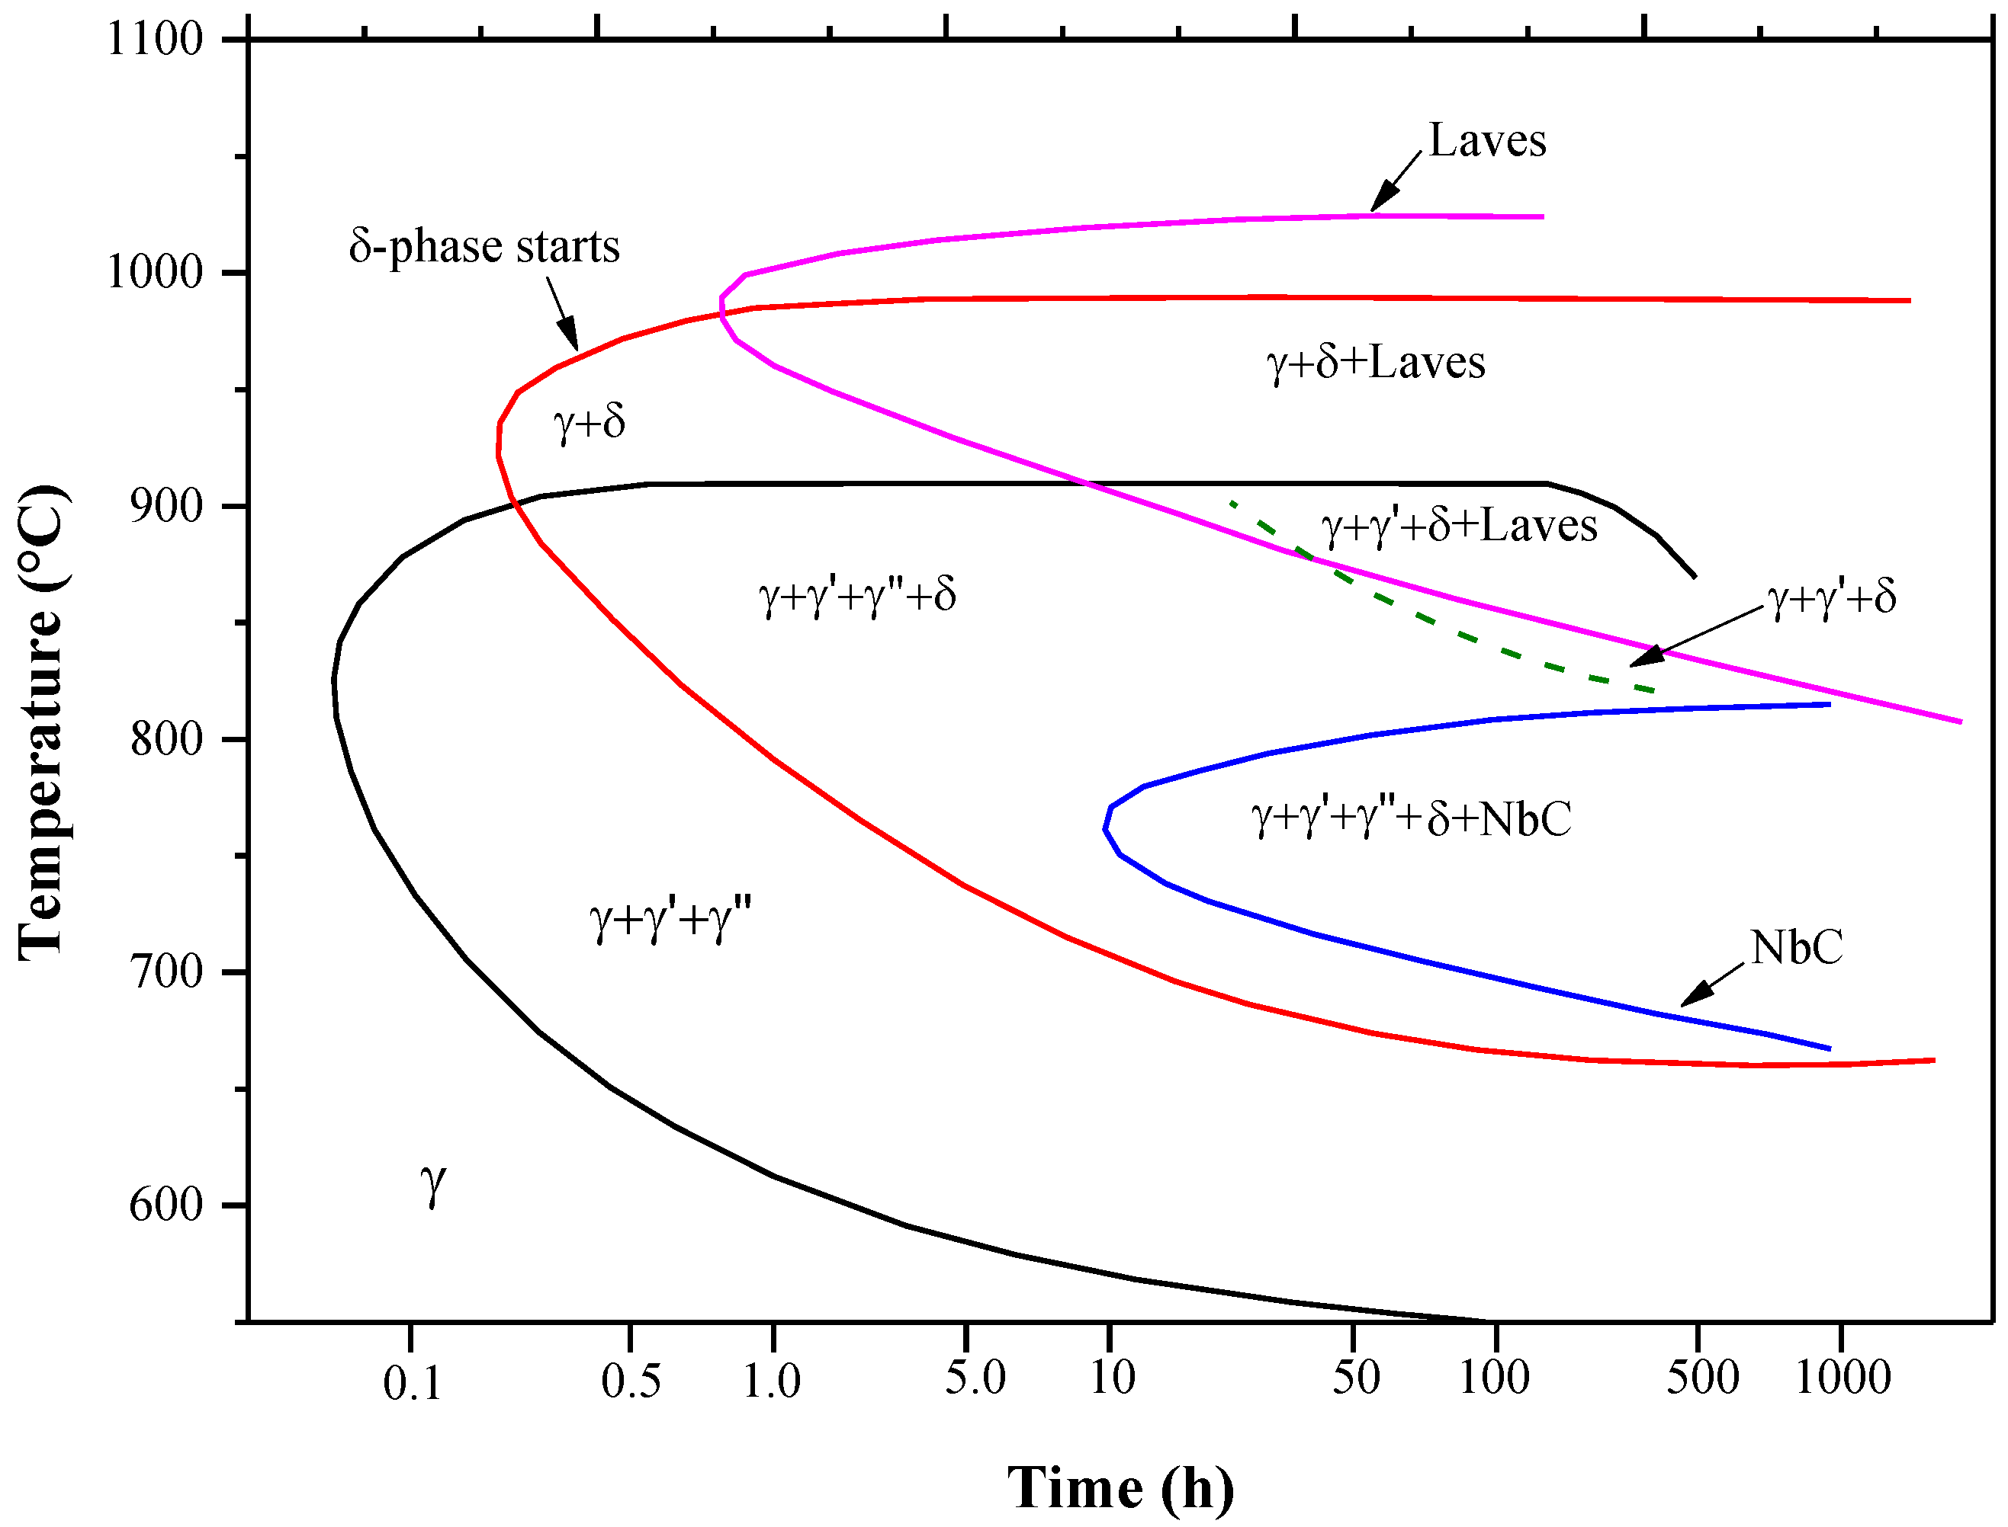
UNS N07718 INCONEL 718 ... usually smaller components ... lower critical temperature difference to cross ... approx. 6 minutes to avoid intermetallic phases
High cooling rate / Quenching
temperature in °C →
time in h →
TTT diagram IN718
source: A. Mostafa et. al; metals 2017 – 7, 196; 7060196

Slide 37
UNS N07718 INCONEL 718
High cooling rate / Quenching
Example Calculation:
UNS N07718 1.000 kg
specific heat capacity approx. 0.435 KJ/kg K
temperature difference 300 K (1050°C to 750°C)
specific heat 130.5 MJ
to prevent intermetallic phases 360 seconds (50 K/min)
cooling power 0.36 MW / 360 KW
0.36 kW/kg
temperature in °C →
time in h →
TTT diagram IN718
source: A. Mostafa et. al; metals 2017 – 7, 196; 7060196

Slide 38
Conclusion
Process temperature and wall thickness is influencing
Ferrite/Austenite ratio
Grain size
corrosion resistance
mechanical properties, in particular: toughness
Rapid cooling rates
cannot replace conventional heat treatment to prevent intermetallic phases for thick-walled components made of UNS S32205
Help to accelerate the HIP-Process in industrial scale
Parts can be removed faster form your HIP-unite
Increasing the economic efficiency of the HIP-process / HIP-facility
help to control cooling rates
can be used for “small parts” or less sensitive materials

Slide 39
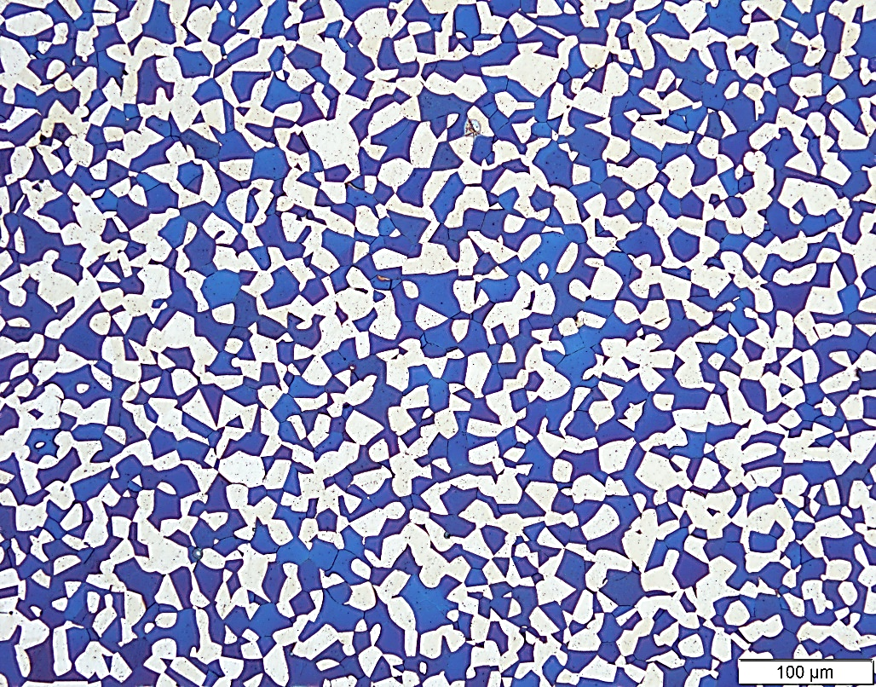
Thanks for your attention!
UNS S32205 - HIP-Temperature 1140°C / Beraha II etching

