Slide 1
Wear of PM HIP metal matrix composites – influence of carbide type
Notes:
Sandvik är en högteknologisk verkstadskoncern med avancerade produkter och en världsledande position inom utvalda områden.

Slide 2
Wear of PM HIP metal matrix composites – influence of carbide type
Tomas Berglund Josefin Hall
Technical Marketing Researcher Sandvik Powder Solutions Dalarna University

Slide 3
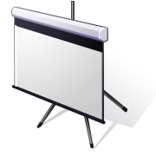
Presentation Outline
Introduction
Applications
Materials
Experimental
Material and manufacturing
Tribological testing
Results
Microstructure
Tribological characteristics
Field tested components
Conclusions

Slide 4
Introduction
Wear resistant metal matrix composites
Composed of a ductile matrix and hard particles to improve wear resistance
MMCs containing tungsten carbide are often used as overlays in the mining industry
HIP-cladding is an attractive alternative to e.g. laser cladding, HVOF and PTAW overlays
Several forms of tungsten carbide is in the overlays
Properties are primarily controlled by:
Carbide type
Matrix composition
Carbide size and amount
Consolidation parameters

Slide 5
Presentation Outline
Introduction
Applications
Materials
Experimental
Material and manufacturing
Tribological testing
Results
Microstructure
Tribological characteristics
Field tested components
Conclusions

Slide 6
Experimental
Materials
Consolidated at 1150ºC, 1000bar for 2 hours
All materials have the same Ni-base matrix alloy
The same powder sizes are used for all materials.
50 vol.% of tungsten carbide
Fused crushed carbide (W₂C/WC), F50
Fused spherical carbide (W₂C/WC), FSP50
Macrocrystaline WC, MC50

Slide 7
Experimental
 | Low stress | High stress
Base procedure | ASTM G65 A mod. | ASTM B611
Abrasive media | Silica sand #50-70 | 30# Al2O3
HV abrasive | 1100 HV | 2200 HV
Slurry | N/A | 80% abrasive 20% H20
Wheel material | Rubber | AISI 1020 Steel
Wheel RPM | 212 | 100±5 rpm
Sand flow rate | 375 g/min
Force | 130N | 200 N
No revolutions | 6000 | 1000
Sliding distance | 4309 meters | 518-530 meter
Material testing
Abrasion testing
Low stress abrasion testing, dry sand rubber wheel (ASTM G65)
High stress abrasion testing, wet sand steel wheel (ASTM B611)
Scratch testing
Quartz stylus
Testing was performed to study carbide damage during abrasion
Hardness testing
Macro, matrix, carbide
Field tested parts

Slide 8
Presentation Outline
Introduction
Applications
Materials
Experimental
Material and manufacturing
Tribological testing
Results
Microstructure
Tribological characteristics
Field tested components
Conclusions

Slide 9
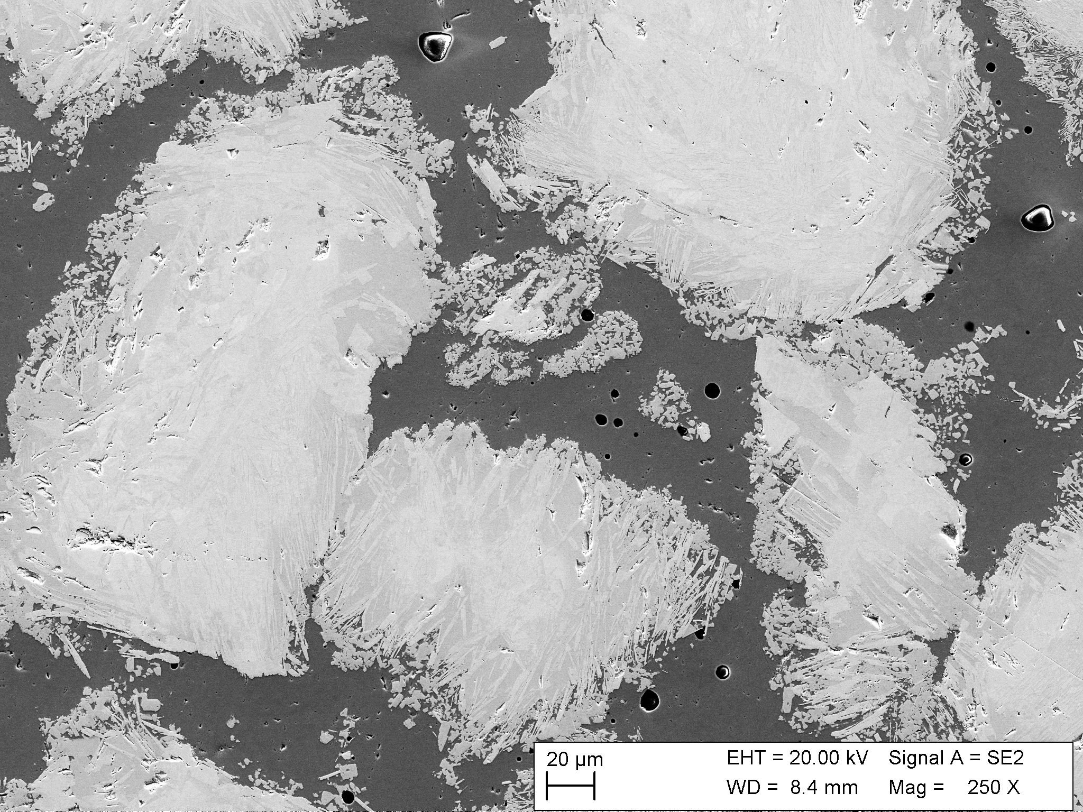
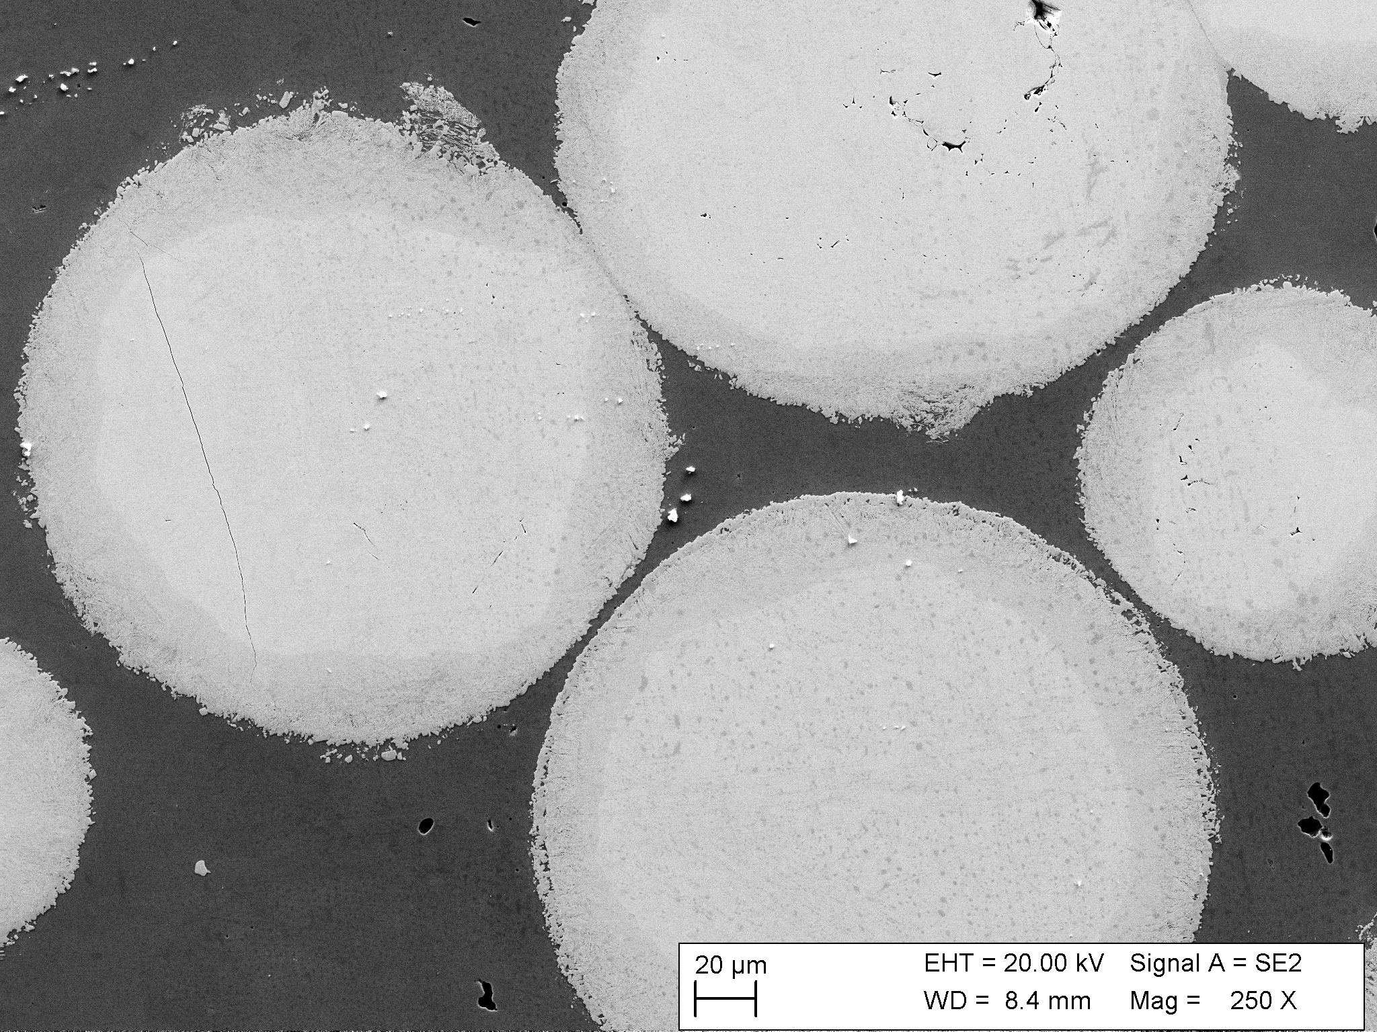
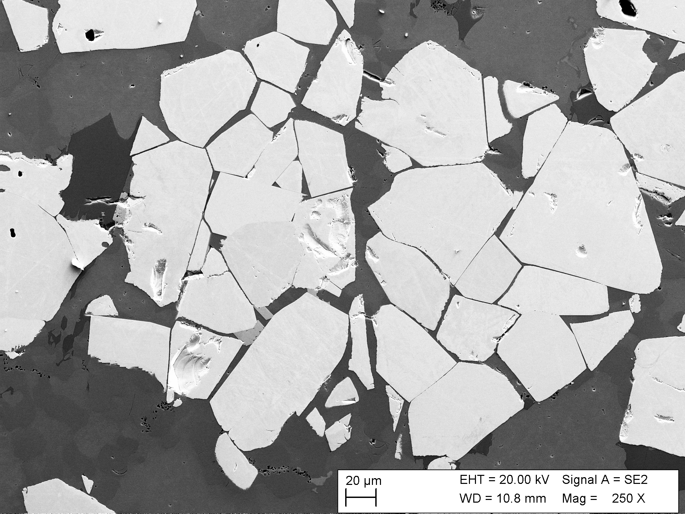
Results
Microstructure
F50 has the highest degree of carbide dissolution followed by FSP50 and MC50
The fused carbides have no to little cracking
The MC carbides have a significant amount of cracking
For all material there are a small amount of secondary phases in the matrix between the primary carbides

Slide 10
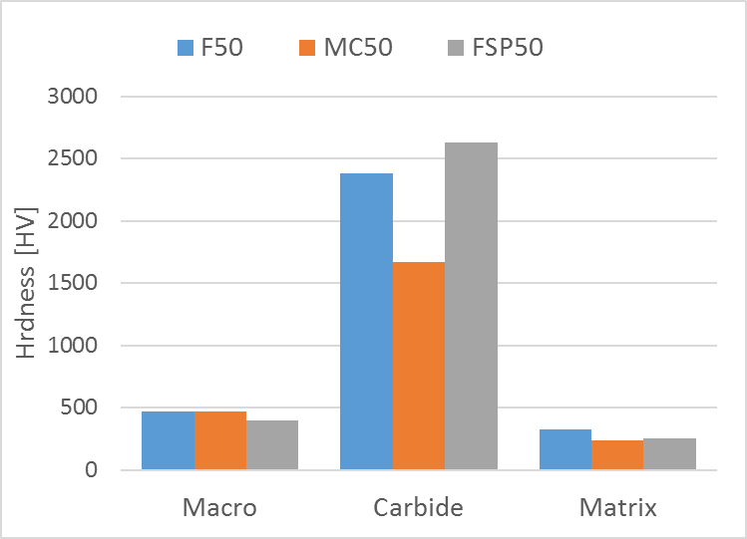
Results
Hardness
Macro hardness of MC50 is slightly lower compared to the F50 and FSP50
The fused spherical carbide is the hardest followed by fused crushed and macrocrystalline
The matrix in F50 has the highest hardness
Carbide dissolution increases alloying content of matrix
Solid solution strengthening by W as well as carbide precipitation
Figure . Macro hardness of material and micro hardness of carbides and matrix.

Slide 11
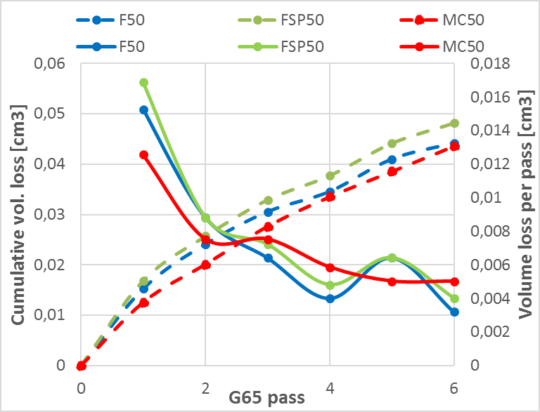
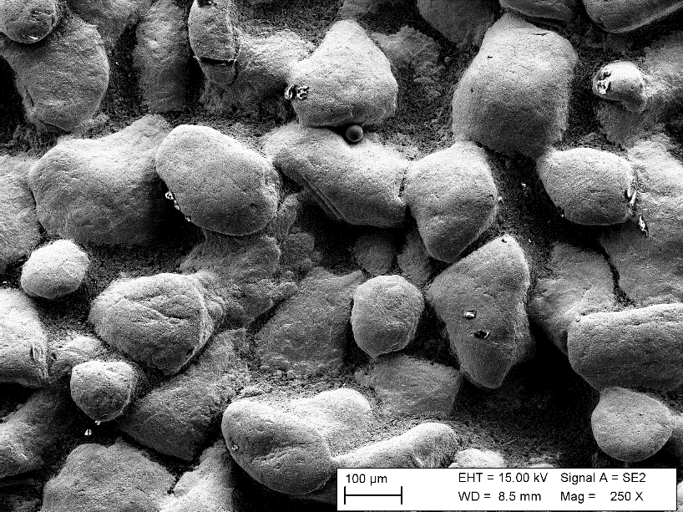
Results
Low stress abrasion testing
Low stress abrasion is often done in 1 or 2 passes (ASTM G65)
Wear doesn’t stabilize until pass 4 to 6
Just matrix being worn away in the first passes
Initially the wear resistance of F50 is lower and MC50 higher
Carbide dissolution increases mean free path
After pass 4 the performance of the material is similar.
Even after 6 passes the majority of the wear is in the matrix between carbides

Slide 12
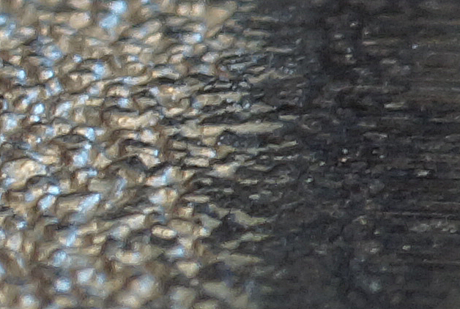
Results
Low stress abrasion testing
Low stress abrasion is often done in 1 or 2 passes (ASTM G65)
Wear doesn’t stabilize until pass 4 to 6
Just matrix being worn away in the first passes
Initially the wear resistance of F50 is lower and MC50 higher
Carbide dissolution increases mean free path
After pass 4 the performance of the material is similar.
Even after 6 passes the majority of the wear is in the matrix between carbides

Slide 13
Results
Low stress abrasion testing
Low stress abrasion is often done in 1 or 2 passes (ASTM G65)
Wear doesn’t stabilize until pass 4 to 6
Just matrix being worn away in the first passes
Initially the wear resistance of F50 is lower and MC50 higher
Carbide dissolution increases mean free path
After pass 4 the performance of the material is similar.
Even after 6 passes the majority of the wear is in the matrix between carbides

Slide 14
Results
High stress abrasion testing
Much higher wear compared to low stress abrasion testing
MC50 performs significantly worse than the other two materials
Lower hardness carbide
Significant higher amount of carbide damage in MC50

Slide 15
Results
Scratch testing
The fused carbide show very little signs of bulk cracking
Damage to the fused carbide is predominantly at the edges in or close to the dissolved region
The macrocrystalline carbide displays a tendency to bulk cracking
Also indicated in hardness testing

Slide 16
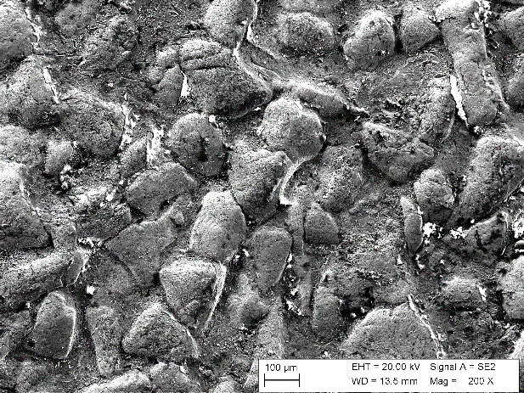
Results
Field tested part - Slurry
Large similarities to low stress abrasive wear
Slurry flowing over the surface
Matrix worn away between carbide
Rounded carbides indicates mild wear
Some carbide damage
Cracking, micro chipping and abrasion

Slide 17
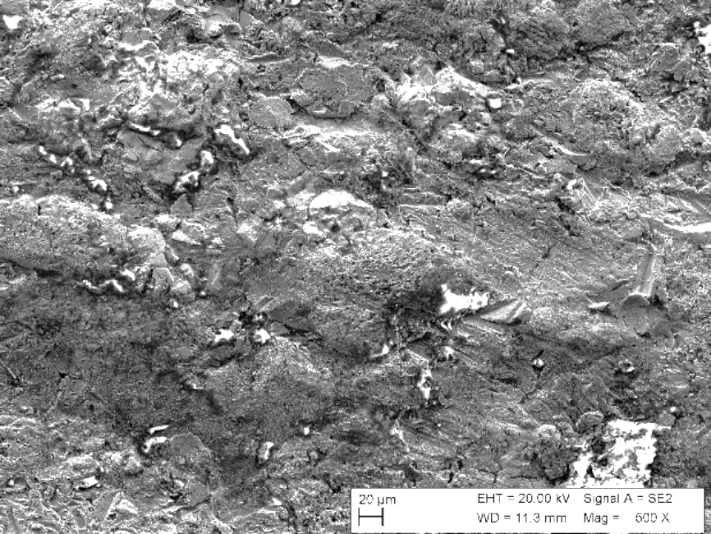
Results
Field tested part - Crushing
Similarities to high stress abrasion but more carbide damage
Surface topography is relatively flat compared to pump part
Carbide damage and abrasion
Embedded particles in the surface

Slide 18
Presentation Outline
Introduction
Applications
Materials
Experimental
Material and manufacturing
Tribological testing
Results
Microstructure
Tribological characteristics
Field tested components
Conclusions

Slide 19
Summary and Conclusions
Angular fused tungsten carbide exhibit a higher degree of carbide dissolution compared to spherical fused carbide when HIPed at the same conditions
Macrocrystalline carbide exhibits significantly lower degree of carbide dissolution compared to the fused carbides
Lower carbide dissolution result in better wear resistance in the early stages of wear during low stress abrasion testing using silica sand
There is a good correlation between carbide hardness and wear resistance in high stress abrasion testing using Al₂O₃ particles
Higher degree of carbide dissolution increases the hardness of the matrix
The wear mechanism in the slurry part is more similar to low stress abrasion
The wear mechanism in the crusher part is more towards high stress abrasion

Slide 20
Summary and Conclusions
Angular fused tungsten carbide exhibit a higher degree of carbide dissolution compared to spherical fused carbide when HIPed at the same conditions
Macrocrystalline carbide exhibits significantly lower degree of carbide dissolution compared to the fused carbides
Lower carbide dissolution result in better wear resistance in the early stages of wear during low stress abrasion testing using silica sand
There is a good correlation between carbide hardness and wear resistance in high stress abrasion testing using Al₂O₃ particles
Higher degree of carbide dissolution increases the hardness of the matrix
The wear mechanism in the slurry part is more similar to low stress abrasion
The wear mechanism in the crusher part is more towards high stress abrasion

Slide 21
Summary and Conclusions
Angular fused tungsten carbide exhibit a higher degree of carbide dissolution compared to spherical fused carbide when HIPed at the same conditions
Macrocrystalline carbide exhibits significantly lower degree of carbide dissolution compared to the fused carbides
Lower carbide dissolution result in better wear resistance in the early stages of wear during low stress abrasion testing using silica sand
There is a good correlation between carbide hardness and wear resistance in high stress abrasion testing using Al₂O₃ particles
Higher degree of carbide dissolution increases the hardness of the matrix
The wear mechanism in the slurry part is more similar to low stress abrasion
The wear mechanism in the crusher part is more towards high stress abrasion

Slide 22
Summary and Conclusions
Angular fused tungsten carbide exhibit a higher degree of carbide dissolution compared to spherical fused carbide when HIPed at the same conditions
Macrocrystalline carbide exhibits significantly lower degree of carbide dissolution compared to the fused carbides
Lower carbide dissolution result in better wear resistance in the early stages of wear during low stress abrasion testing using silica sand
There is a good correlation between carbide hardness and wear resistance in high stress abrasion testing using Al₂O₃ particles
Higher degree of carbide dissolution increases the hardness of the matrix
The wear mechanism in the slurry part is more similar to low stress abrasion
The wear mechanism in the crusher part is more towards high stress abrasion

Slide 23
Summary and Conclusions
Angular fused tungsten carbide exhibit a higher degree of carbide dissolution compared to spherical fused carbide when HIPed at the same conditions
Macrocrystalline carbide exhibits significantly lower degree of carbide dissolution compared to the fused carbides
Lower carbide dissolution result in better wear resistance in the early stages of wear during low stress abrasion testing using silica sand
There is a good correlation between carbide hardness and wear resistance in high stress abrasion testing using Al₂O₃ particles
Higher degree of carbide dissolution increases the hardness of the matrix
The wear mechanism in the slurry part is more similar to low stress abrasion
The wear mechanism in the crusher part is more towards high stress abrasion

Slide 24
Summary and Conclusions
Angular fused tungsten carbide exhibit a higher degree of carbide dissolution compared to spherical fused carbide when HIPed at the same conditions
Macrocrystalline carbide exhibits significantly lower degree of carbide dissolution compared to the fused carbides
Lower carbide dissolution result in better wear resistance in the early stages of wear during low stress abrasion testing using silica sand
There is a good correlation between carbide hardness and wear resistance in high stress abrasion testing using Al₂O₃ particles
Higher degree of carbide dissolution increases the hardness of the matrix
The wear mechanism in the slurry part is similar to low stress abrasion
The wear mechanism in the crusher part is more towards high stress abrasion

Slide 25
Summary and Conclusions
Angular fused tungsten carbide exhibit a higher degree of carbide dissolution compared to spherical fused carbide when HIPed at the same conditions
Macrocrystalline carbide exhibits significantly lower degree of carbide dissolution compared to the fused carbides
Lower carbide dissolution result in better wear resistance in the early stages of wear during low stress abrasion testing using silica sand
There is a good correlation between carbide hardness and wear resistance in high stress abrasion testing using Al₂O₃ particles
Higher degree of carbide dissolution increases the hardness of the matrix
The wear mechanism in the slurry part is more similar to low stress abrasion
The wear mechanism in the crusher part is similar to high stress abrasion

Slide 26
Thank You for Your attention!
Tomas Berglund Sandvik Powder Solutions AB Sandvik Materials Technology Phone: +46 26 65408 Mailto:tomas.berglund@sandvik.com
Josefin Hall Researcher Dalarna University Mailto: joh@du.se

