Slide 1
Tailoring HIP equipment and protocols for the unique features of MIM
R.M. Conaway and Hugh M.B. Davis II
Isostatic Forging International, Ltd
Columbus, Ohio

Slide 2
When to Strive for high density or pore free MIM
To improve properties, especially fatigue strength
To improve surface (mostly appearance)
To proof a part to be free of internal voids
When the customer insists

Slide 3
Unique Combination of Features of MIM
Large in number
Small in mass
High in value per unit mass
Amiable to rapid heating and cooling
Key properties often crucially dependent on microstructure (e.g., grain size) and porosity level.
Exhibit “HIP-readiness” fine grain size, porosity closed to the surface.

Slide 4
Toll HIP of MIM: Disadvantages-
The HIP parameters are generally not optimized for a specific MIM product range.
Contamination from other materials/customers, in a shared load, is possible.
Logistics are complicated by the necessary packing, shipping, handling, delay
Possible loss of predicable pricing for HIP as a result diminishment of shared/unused capacity.
Possible loss of capacity as a result of HIP processors turning attention to larger volume customers.

Slide 5
Toll (sub-contract) HIP of MIM

Slide 6
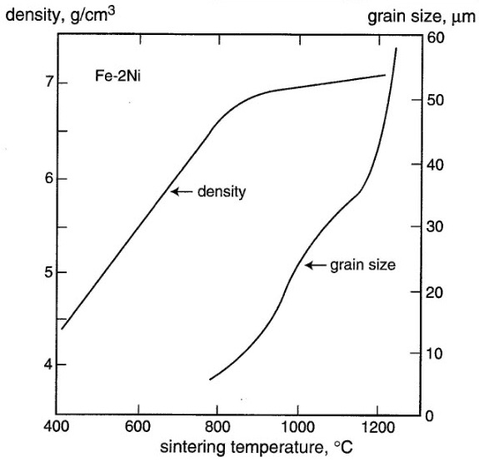
Effect of Sintering temperature (Rand German)

Slide 7
Advantages of HIP for Increased Density
Less concern for porosity (just needs to be closed)
Possible shorter sinter cycle
Possible lower temperature
Possible feed stock adjustment (lower cost?)

Slide 8
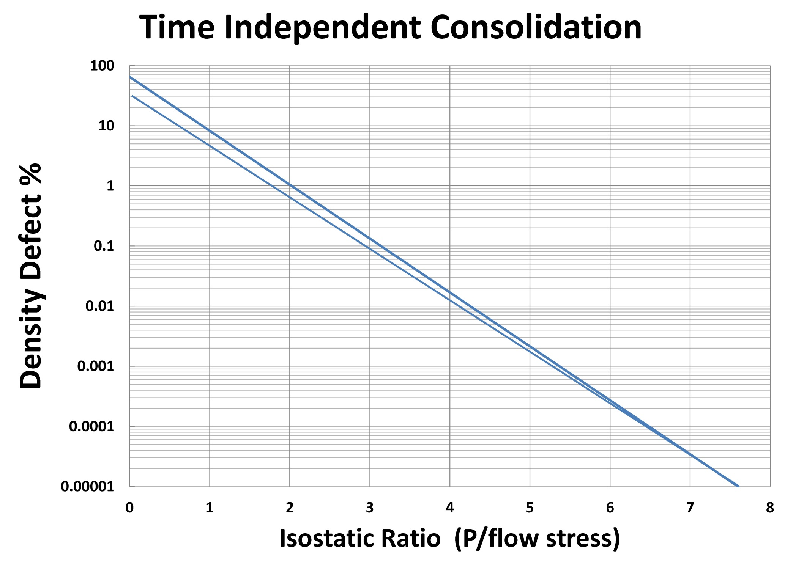
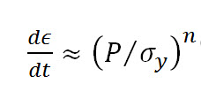

Slide 9
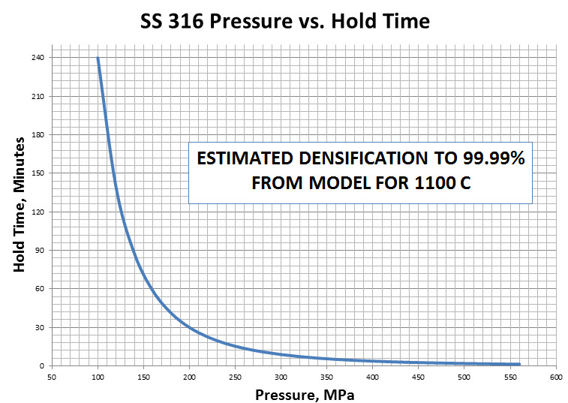
The IFI HIP Process Model

Slide 10
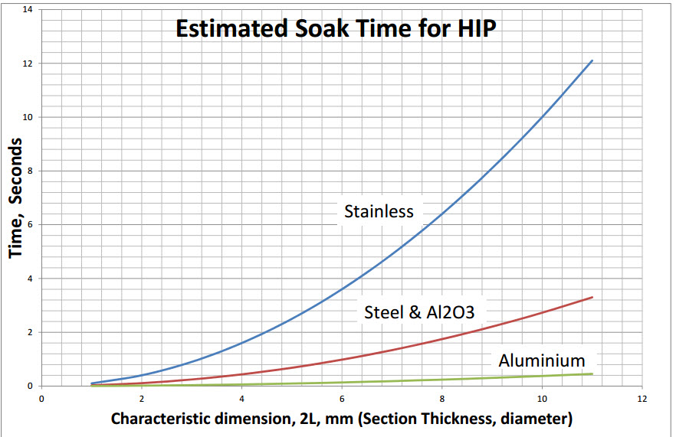

Slide 11
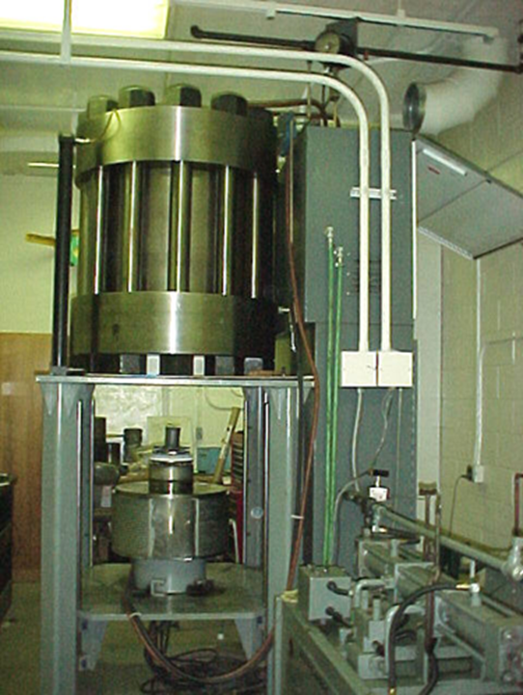
Purpose Built Quick HIP at Michigan Tech
500 MPa
1400 C
Chamber: 150mm dia by 200 mm
15 minute cycle time

Slide 12
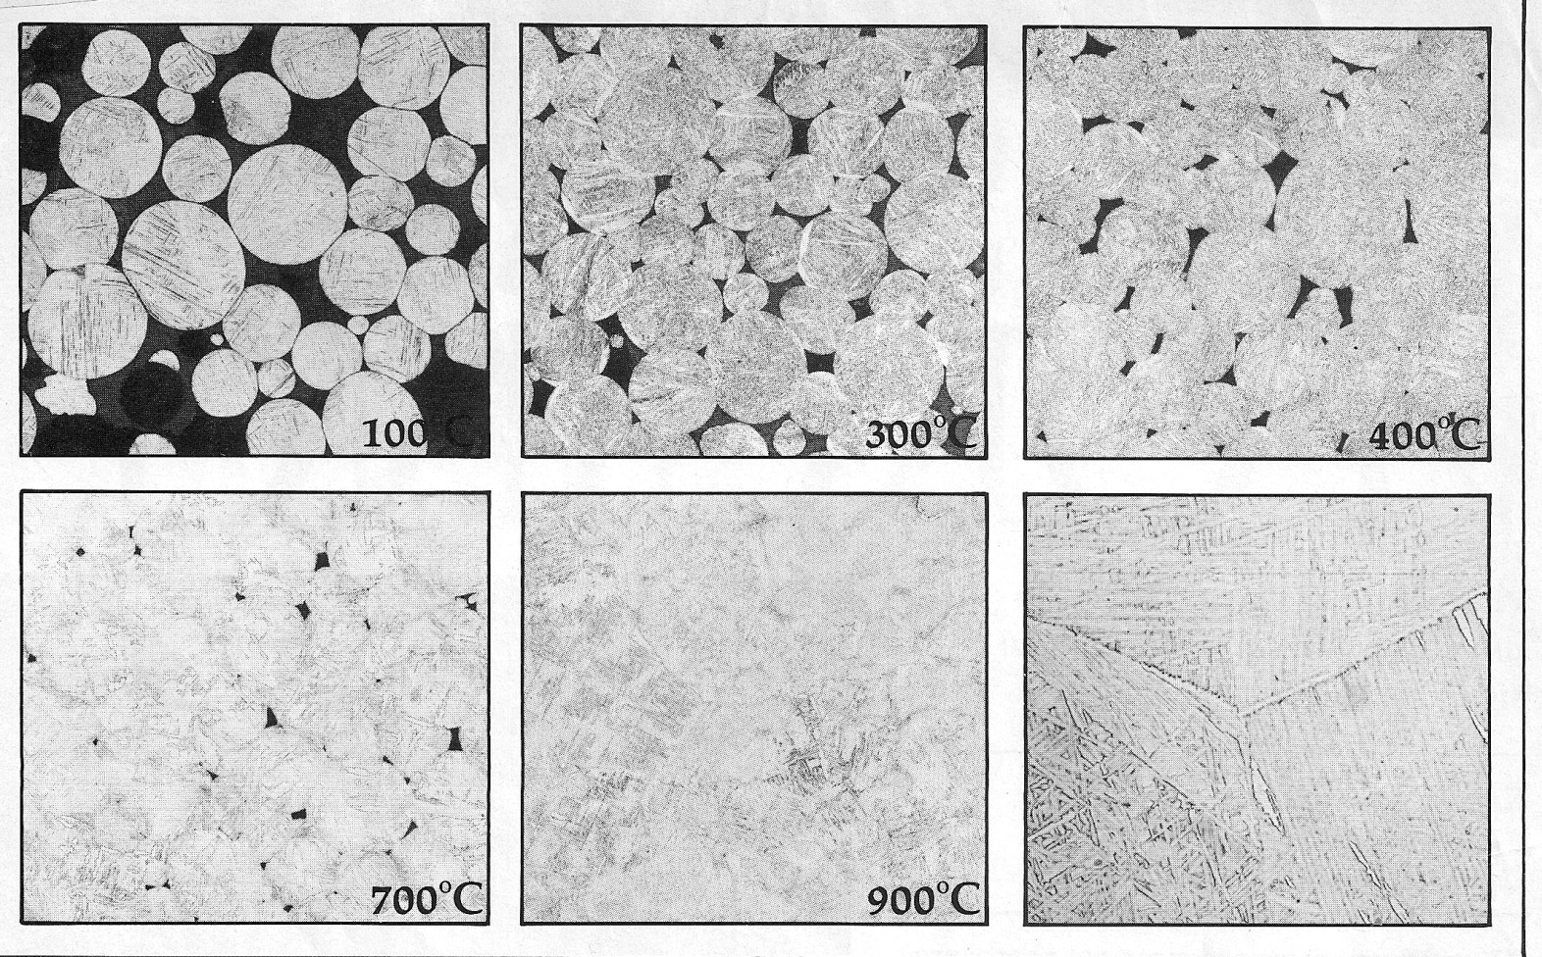
Quick HIP of Titanium 6-4
HIP at 500 MPa, 15 seconds hold

Slide 13
Effect of Variations in Sinter and HIP Parameters
- Lin, German Study
Mechanical Properties of Fully Densified Injection Molded Carbonyl Iron Powder
S.T. Lin and R.M. German,
Met. Trans. A, V.21A, Sept. 1990, pp. 2531-2538
Carbonyl Iron Powder, Wax-based binder
Powder loading = 62.5 vol.% (93.5 wt.%)
Cumulative particle size
10% - 2.5 µm
50% - 4.0 µm
90% - 9.5 µm
Sinter and HIP Conditions
Vacuum Sinter at 1200°C for 1 hour @ 0.05 Pa ρ = 7.30 (92.6%)
HIP Cycle #1: 805°C - 200 MPa – 1 hr ρ = 7.78 (98.9%)
HIP Cycle #2: 805°C - >400 MPa – <10 min ρ = 7.83 (99.5%)

Slide 14
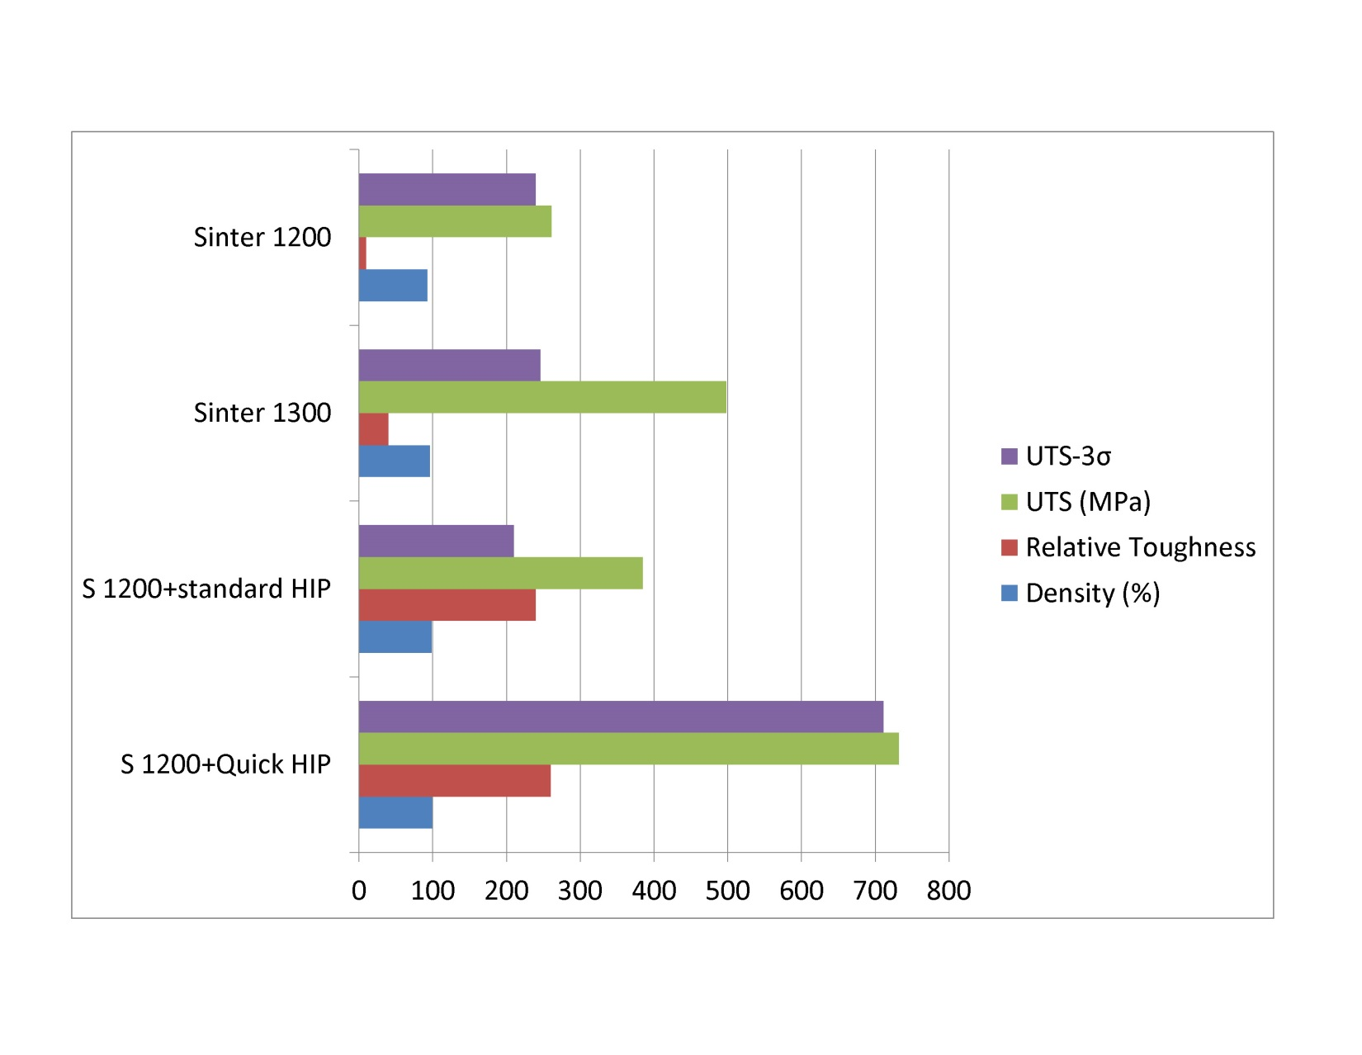
Quick HIP of Carbonyl Iron
Graphical Display

Slide 15
News Flash: High Pressure and Quenching
HIP effects other than consolidation:
it slows down time!
Session 30
11am Wednesday
Dr. Stephen Mashl Paper

Slide 16
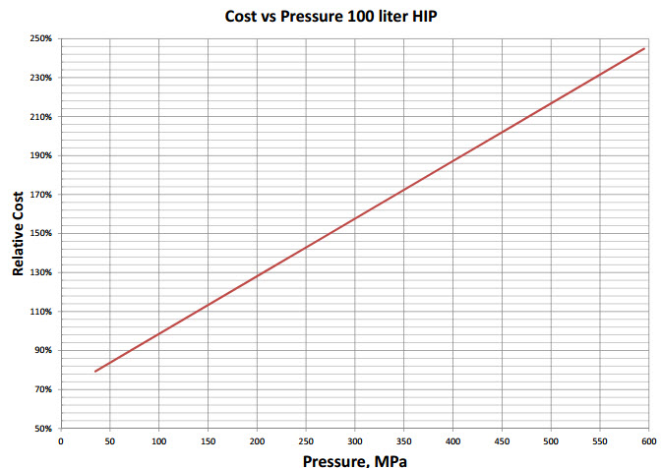
The IFI HIP Cost Model

Slide 17
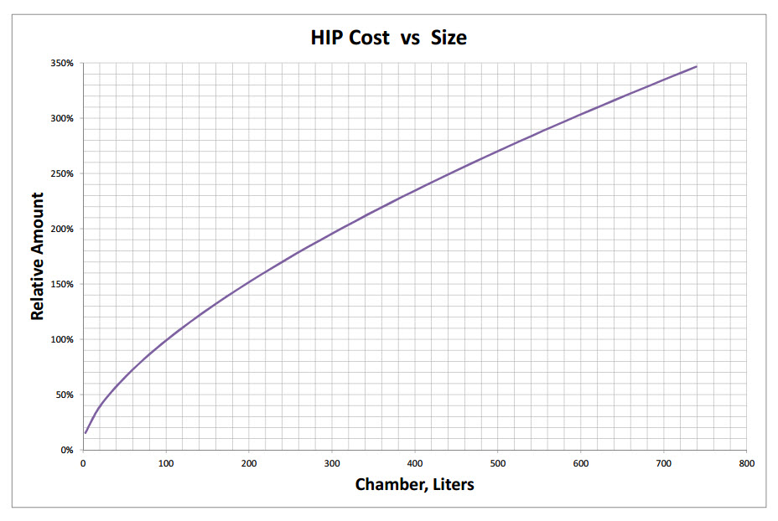
The IFI HIP Cost Model

Slide 18
The IFI HIP Process Model

Slide 19
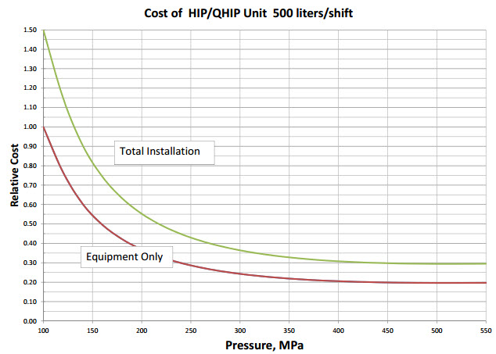
Mapping Process into Cost Model

Slide 20
Advantages of Quick HIP
Equipment 5 to 50 times faster than conventional HIP and therefore:
Chamber size 5 to 50 times smaller
Much lower capital cost
Feasible for use within MIM production facilitates:
Profoundly better logistics
Profoundly better process control
No need to “share” a HIP load with others

Slide 21
A Production Application Model
The HIP cycle can be optimized:
For the material
The geometry of the part
Handling
(share setters, jigging, baskets with other MIM steps)
The volume of material to be processed
Quality, logistics, and economic concerns
And when parts are small:
-almost always mandates in-house Quick/Rapid HIP

Slide 22
Costs Associated with HIP of MIM
Typical Toll HIP: $5 to $10 per Kg -(plus a minimum per lot charge)
Loading/Unloading $0.10 to $1.00 per Kg
Running (Gas, Power, wear) $0.20 to $1.00 per Kg
Amortization of investment: mostly for accountants to conjure most properly:
Toll HIP-who knows (if anybody)
In-house $50 to $200 per shift.

Slide 23
Tailored HIP of MIM
- Closing Summary
HIP of MIM is being used when Zero Porosity is needed on an increasing basis. . Now being done mostly on a Toll basis at outside processors.
Fast HIP cycles have been shown to be clearly feasible, making the promise of small , fast in-house HIP units
The IFI tailored HIP approach has been proven in production for a casting application.
HIP pressure Quenching is being developed that may add a new dimension to the benefits of higher pressure HIP.
Stay tuned (Mashl-session 30)
Costs of in –house HIP can be quantified for an application.

Slide 24
Thanks and see you on the Road
Thank You
conaway@hot-isostatic.com
rconaway@isostatic.com
ifiusa@hotmail.com

Slide 25
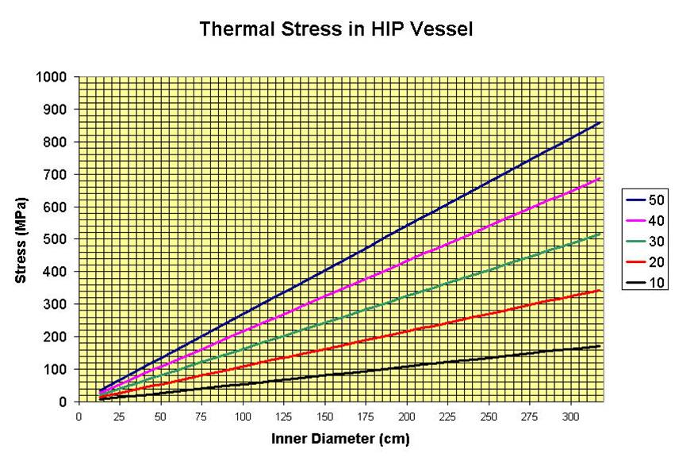

Slide 26
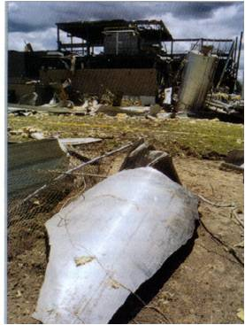

Slide 27
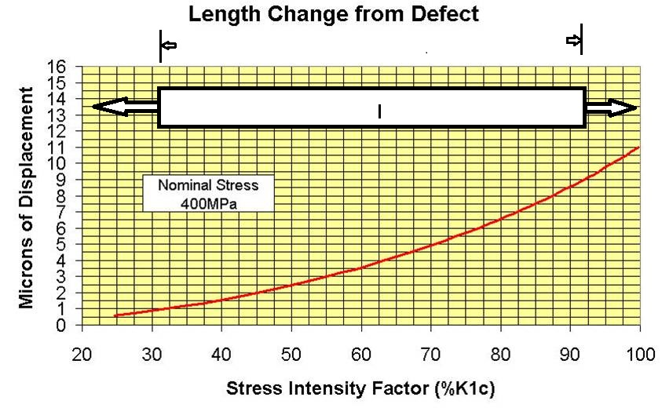

Slide 29
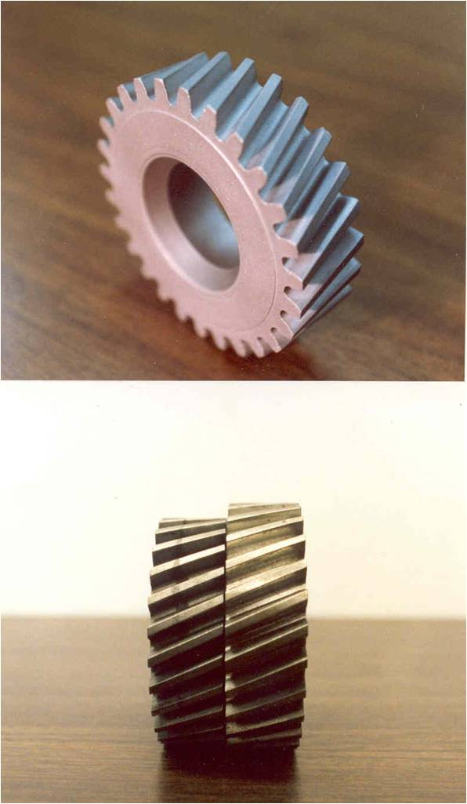

Slide 30
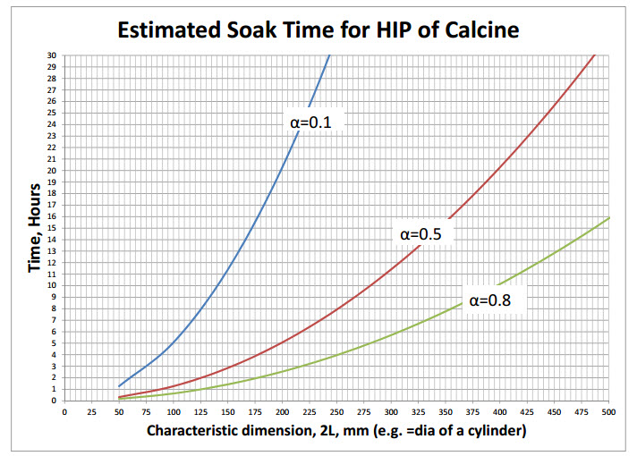

Slide 31
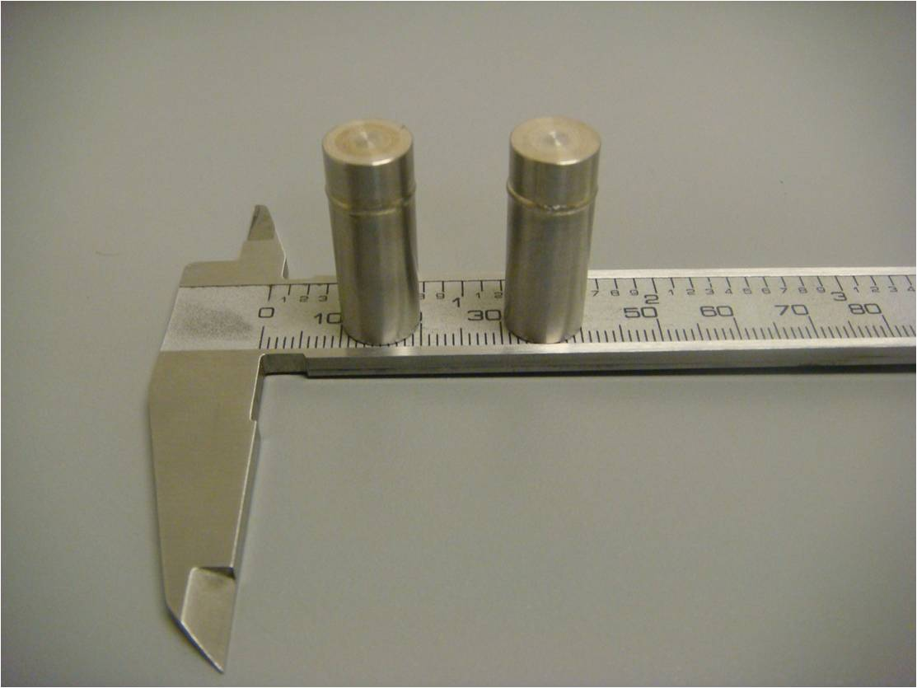

Slide 32
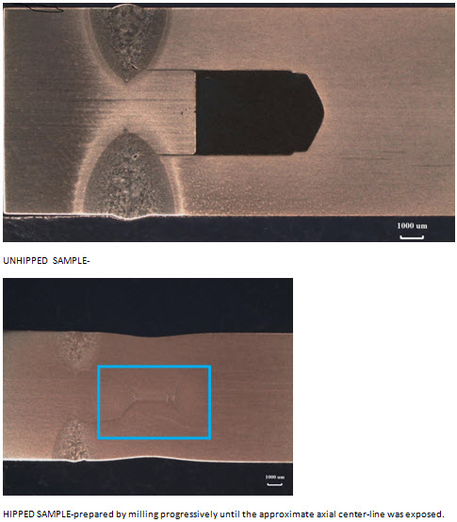

Slide 33
