Slide 1
TeraPi – A 3.5 meter diameter hot zone unit enables HIPing of large components
Dr. Anders Eklund and Mr. Magnus Ahlfors
Quintus Technologies AB
e-mail: anders.eklund@quintusteam.com

Slide 2
Quintus TeraPi
General Design Requirements & Goals
ASME design
Designed for greater than 98%+ uptime
Designed for half of today’s installation time
Manufacturing time not to exceed 24 months
Maximum temperature deviation of +/- 10C
Minimum calculated fatigue life of 10,000 cycles…30+ years
Total load weight of about 75 tons
Cycle time not to exceed 24 hours
Conventional technology!!

Slide 3
Quintus TeraPi
Competitive Game Changers
Large diameters, over 3.0 meters (3.14 m = 123” ID)
Running cost below 1.00 SEK/kg
Possible to modularize for easy manufacturing and installation
  No overhead crane
  No pit
High degree of automation for easy handling of the loads
New frame construction with multiple frames
New furnace construction for handling large volumes of hot gas
The solutions make the foundation easier
The solutions minimize Argon risk
The solutions have noise protected pump unit
Separate floors for operation and maintenance
ASME approval

Slide 4
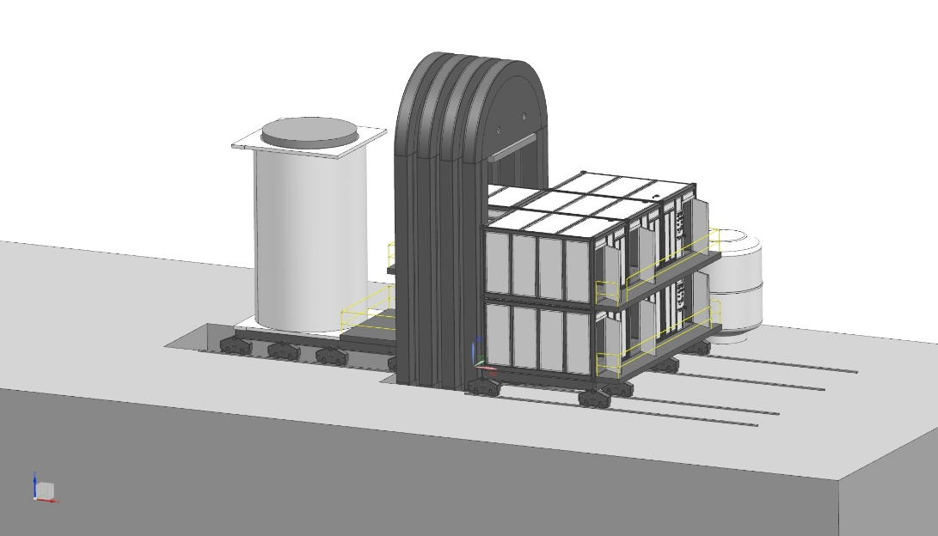
Quintus TeraPi
QIH - TeraPi
HZ Ø 3,14m x H 5m
Pressure 1050 bar
Temp 1250°C

Slide 5
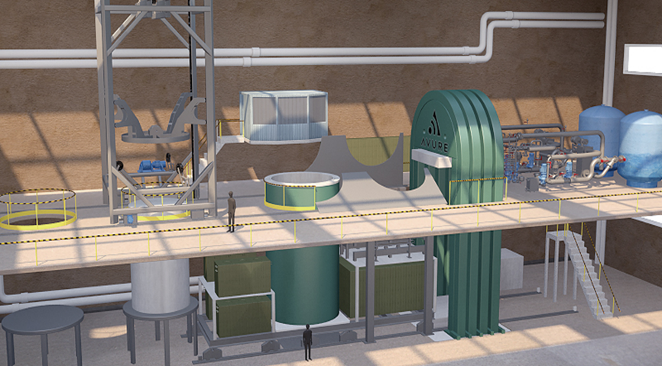
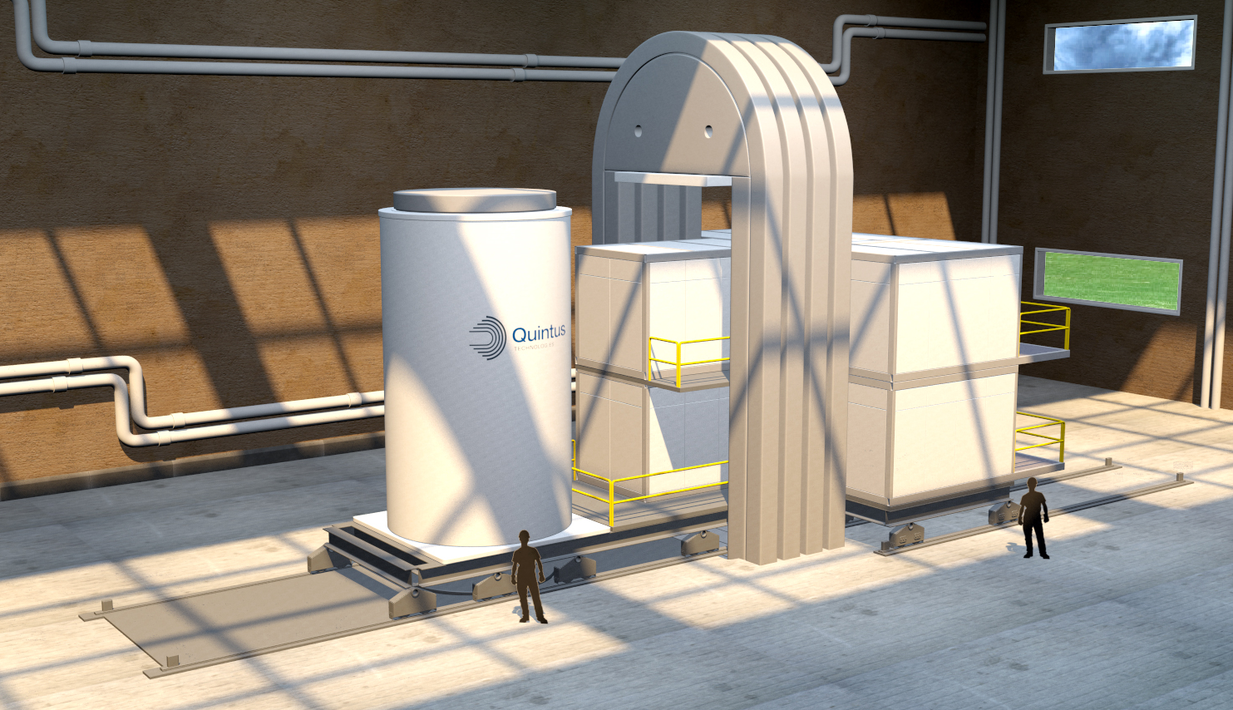
Quintus TeraPi
Background
Novel HIP 2011
  Develop a new frame concept in order to pass the current 2 meter
  Develop a new cylinder concept in order to pass the current 2 meter HIP diameter boundary (hot zone),
  Develop a new furnace concept in order to pass the current 2 meter
  The target is to achieve a process cost below 1 € / kg
  Outcome would be TeraPi
Presented at PM2012 Yokohama
Updated modularized design 2015
Bottom loading 2016

Slide 6
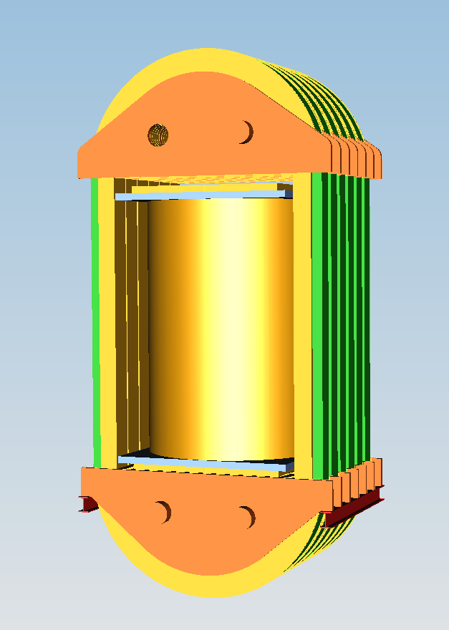
Quintus TeraPi
Project: Novel HIP – Frame
Frame for cylinder up to
Ø10m, height ~8 m
Pressure 1000 bar
Total weight frame: 8 000 ton
New light frame solution
Transportable pieces
To be winded at site
To be assembled at site
Forging sizes available

Slide 7
Quintus TeraPi
Background
Novel HIP 2011
  Develop a new frame concept in order to pass the current 2 meter
  Develop a new cylinder concept in order to pass the current 2 meter HIP diameter boundary (hot zone),
  Develop a new furnace concept in order to pass the current 2 meter
  The target is to achieve a process cost below 1 € / kg
  Outcome TeraPi
Presented at PM2012 Yokohama
Updated modularized design 2015
Bottom loading 2016

Slide 8
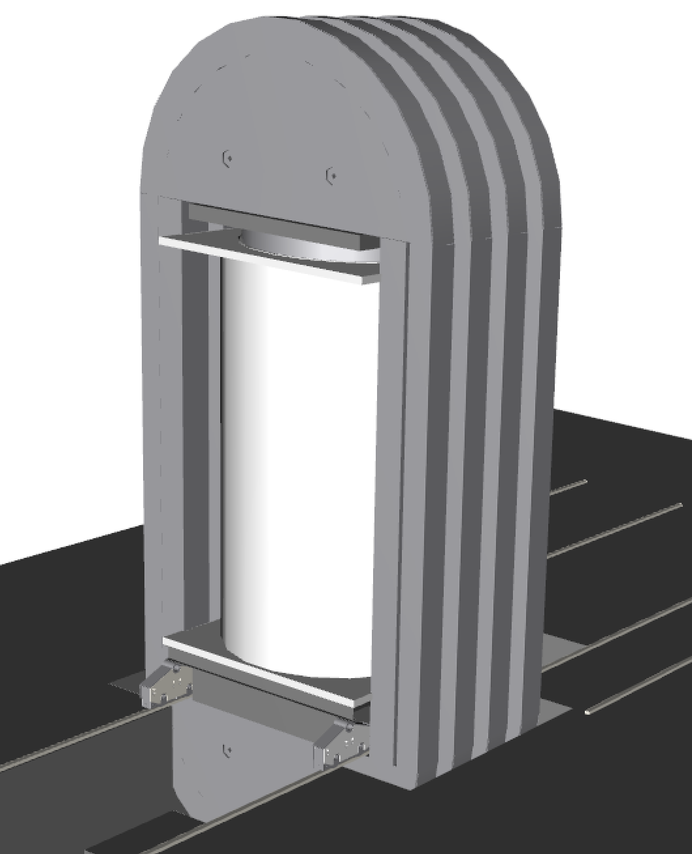
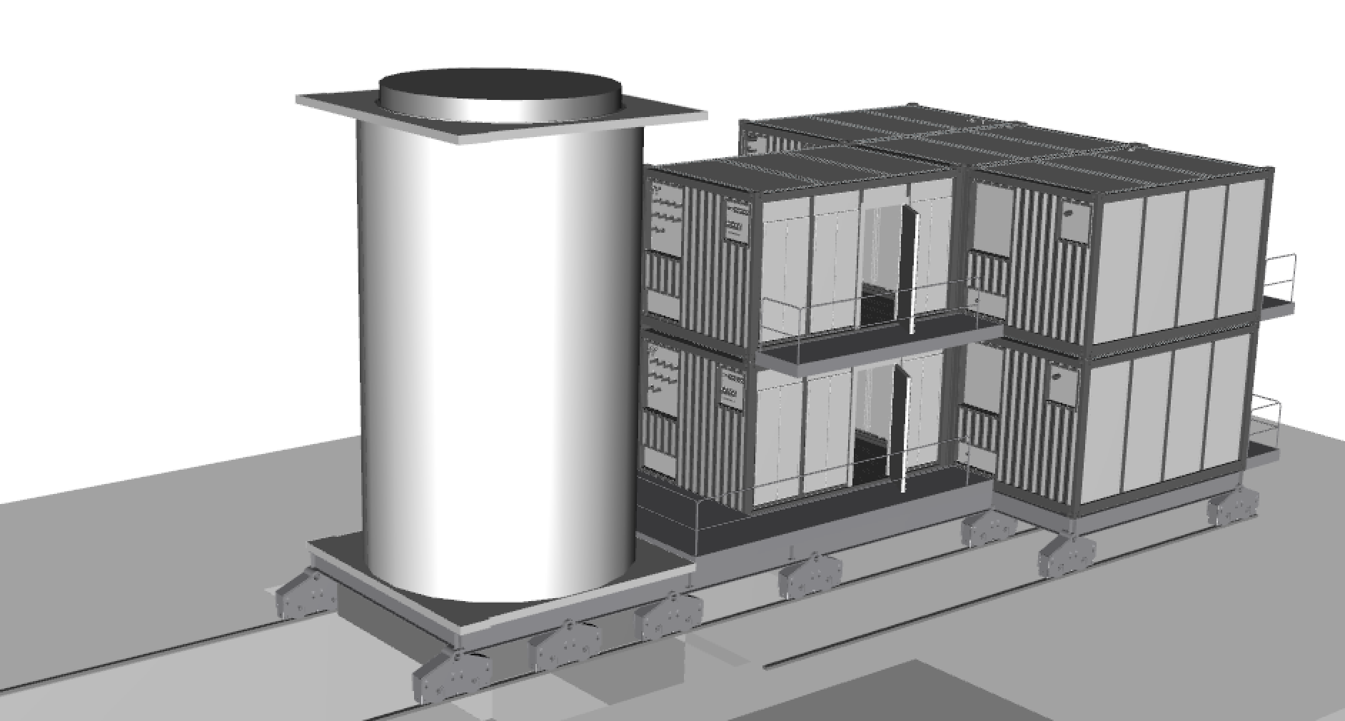
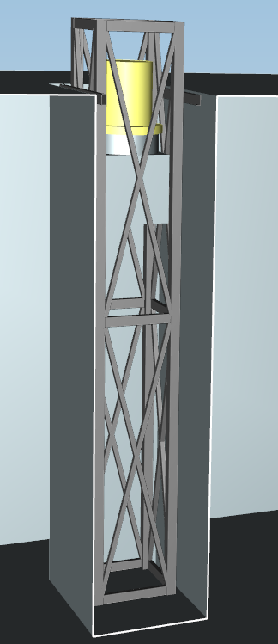
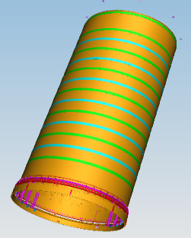
Quintus TeraPi
Concept Engineering
  Moving cylinder
  Cylinder carrier
  Bottom or top loading
  Lower closure
Furnace 1250°C
  Temp accuracy
  Circulation fan
  Load plate
System modules
  Power feeds
  Argon gas compressor
Lifting manipulator
  Position accuracy
  Lifting load

Slide 9
Quintus TeraPi
Modular System
New modular way to build up the site
Press built up at base floor
  Easy to raise the frames, each 250ton
  All the heavy work at base floor
Cylinder one module
  Rail on the floor for modules carrier

Slide 10
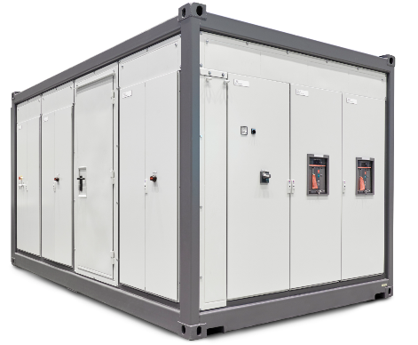
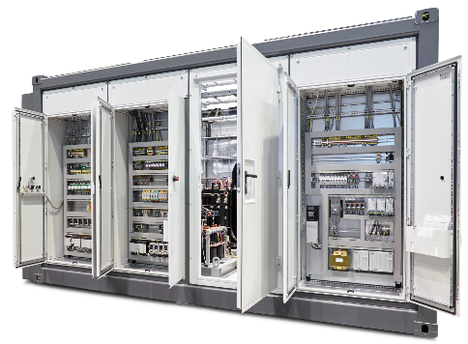
Quintus TeraPi
Modular System
Gas compressor, Furnace power supply
  Premade, installed and tested
  Including water, electrical
  Control functions installed
  Enclosed and sound insulated
Together with the cylinder
  One integrated unit

Slide 11
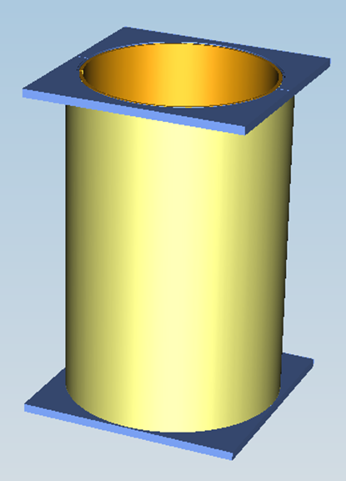
Quintus TeraPi
Pressure vessel
Wire wounded frame
Pressure 1050 bar
Total weight frame: 4 x 250 ton
Transportable pieces
To be assembled at site
Wire wounded cylinder
Pressure 1050 bar
Total weight cylinder: 300 ton

Slide 12
Quintus TeraPi
Scope of Supply
QIH TeraPi
Hot Zone Ø 3,14m x 5m
Pressure 1050bar
Temp 1250°C
Pay load 50-75 ton
Weight frame: 4 x 250ton
Weight cylinder: 300ton
Height 12 m
Pit 9 m
Modules 11 x 20 ton

Slide 13
Quintus TeraPi
Engineering of TeraPi – two steps
Concept Engineering
Verification of design concept
Including third party assessment
Lead time 6 months
Detailed design
Detailed design of press
Including third party assessment
Lead time 12 month

Slide 14
Quintus TeraPi
Manufacturing of TeraPi
Pressure Vessel
Cylinder winding in Västerås
  Winding time 8 weeks (2-sh)
Frame (x4) winding in Quintus Workshop.
  Winding time 4 x 6 weeks (2-sh)
Closures assembled in Quintus Workshop
Erection and Pressure test at customer site
Furnace
Assembly in Quintus Workshop
System modules (x8)
Manufacturing & Commissioning at suppliers
Assembly of Modules & carrier at site
Cylinder carrier
Commissioning in Quintus Workshop
Lifting manipulator
Erection & Commissioning at site

Slide 15
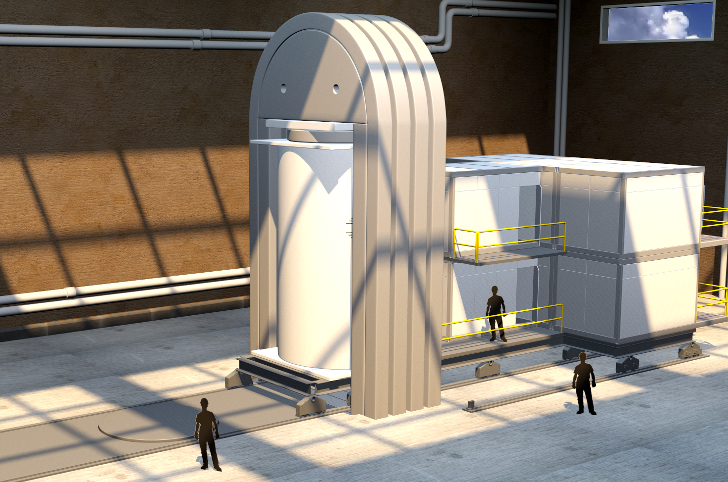
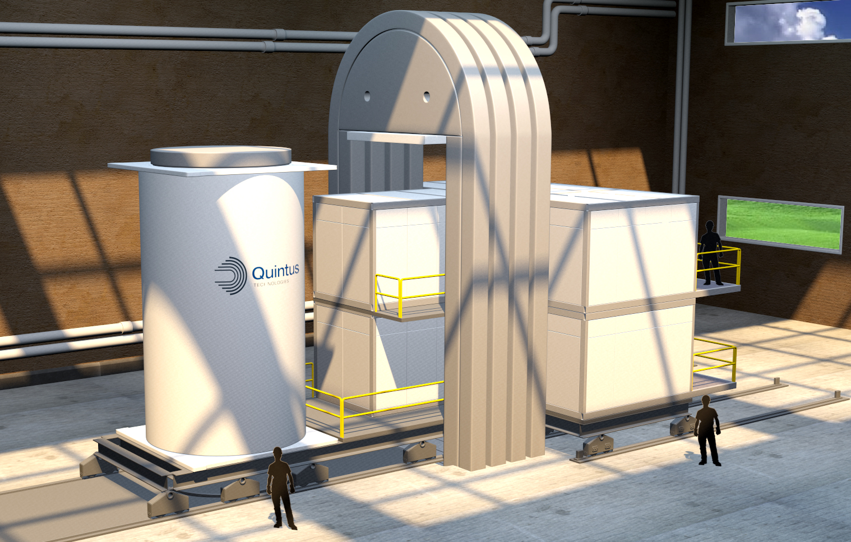
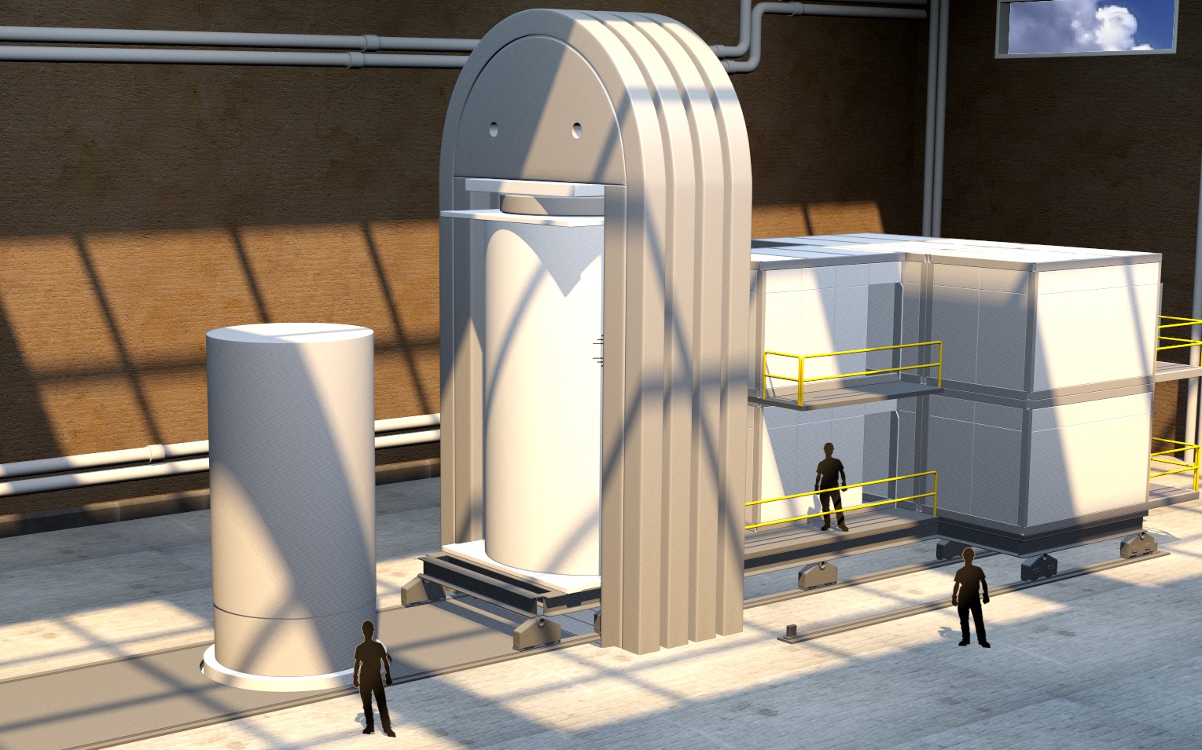
Quintus TeraPi
Automation
Loading
  Press cylinder move horizontal on rails
  Frame fix position
  Bottom loading
  Vertical lifting manipulator
3
2
1

Slide 16
Quintus Tera-HIP
Scope of Supply
QIH-T140
Hot Zone Ø 3,55m x 4,0m
Pressure 1050bar
Temp 1250°C
Pay load 50-75 ton
Weight frame: 4 x 270ton
Weight cylinder: 320ton
Height 13m
Pit 8m
Modules 11 x 20ton

Slide 17
Quintus Tera-HIP
Scope of Supply
QIH-Tera4me
Hot Zone Ø 4,0m x 4,0m
Pressure 1000bar
Temp 1250°C
Pay load 50-75 ton
Weight frame: 4 x 290ton
Weight cylinder: 350ton
Height 13m
Pit 8m
Modules 11 x 20ton

Slide 18
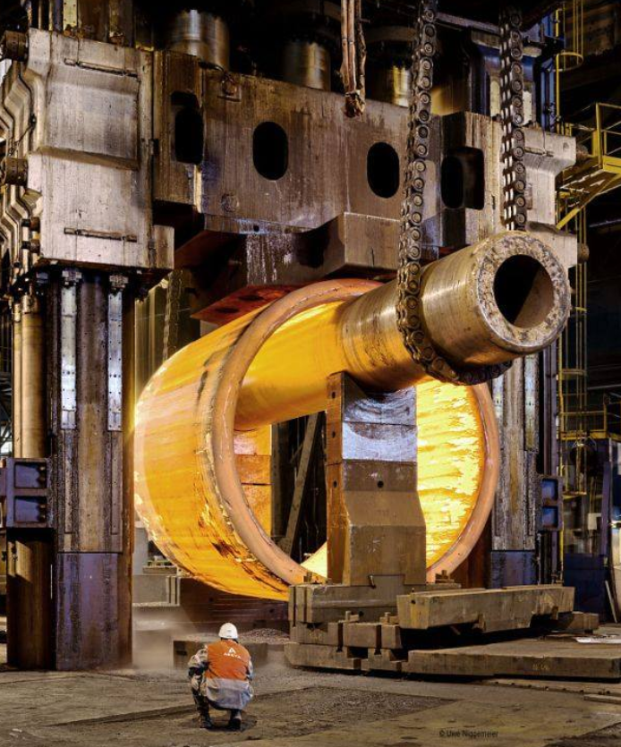
Quintus Tera-HIP
Scope of Supply
QIH-T140 Ø 3,55m x 4,0m – 1000bar
Cylinder SA723 ID 4,0m x 6,6m,

Slide 19
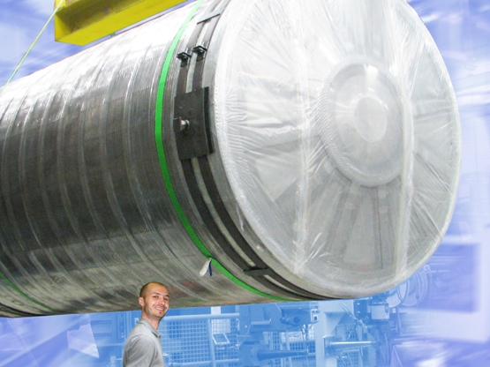
Quintus Tera HIP
Furnace
Furnace for HIP’s up to
Ø3,5m, height ~8 m
Temperature 1250°C
Temp and gas flow calculations
From Ø 0,3m ➔ Ø 4m hot zon

Slide 20
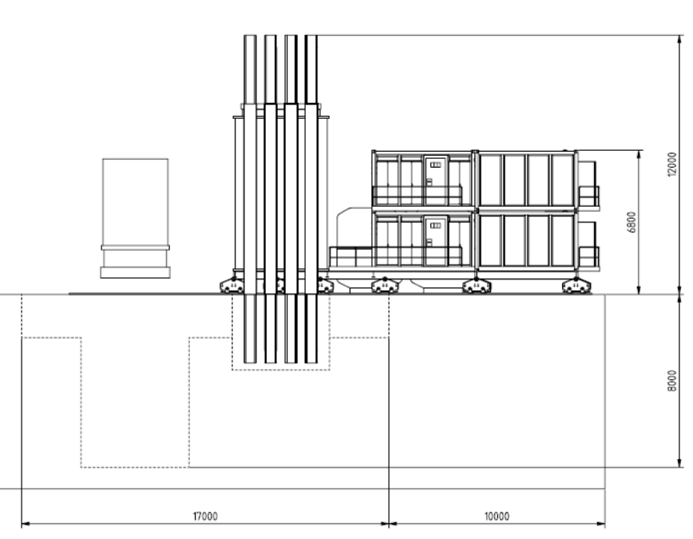
Quintus Tera-HIP
Lay-out
QIH-T140 Ø 3,55m x 4,0m – 1000bar
Cylinder on floor
Height 13m
Pit 8 m
QIH-T140 Ø 3,55m x 4,0m – 1000bar
Frame on floor
Height 17 m
Pit 4 m
13 m
8 m
17 m
13 m

Slide 21
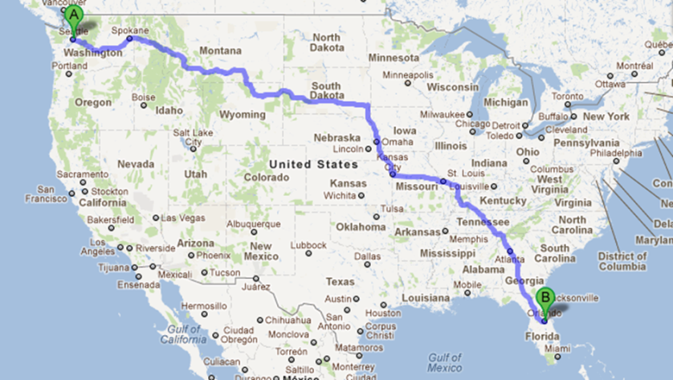
Quintus TeraPi
Some interesting facts
Total load weight of about 75 tons, 38m³
Cycle time not to exceed 24 hours
Maximum temperature deviation of +/- 15°C
Wire
  Each frame = 50 tons (4 frames)
  Cylinder = 158 tons
  Wire = 14.3 m/kg
  Totaling: 5100 km of wire
  Distance from Seattle, WA to Orlando, FL
  Elongation ~ 0.3% meaning = about 16 km

Slide 22
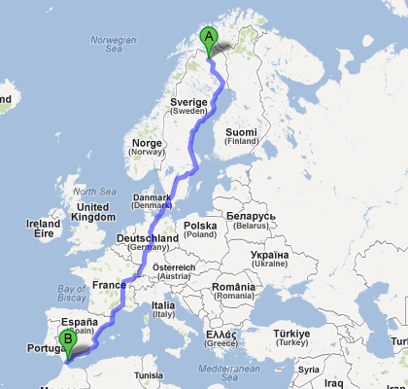
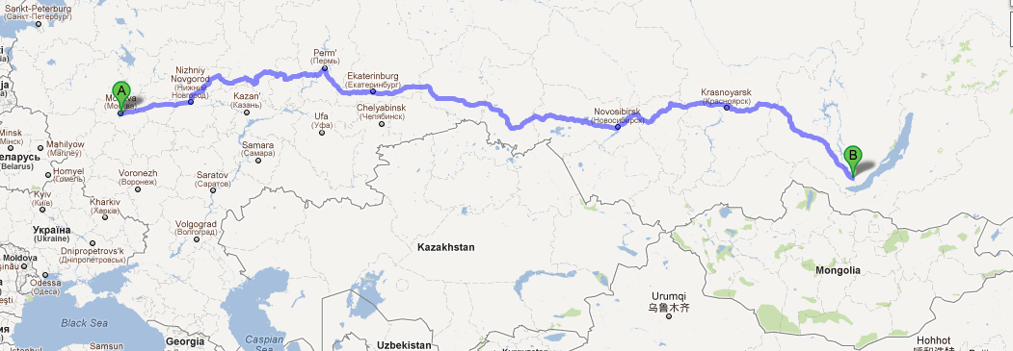
Quintus TeraPi
Some interesting facts
Wire:
Each frame = 50 tons (4 frames)
Cylinder weight = 158 tons
Wire = 14.3 m/kg
Totaling: 5100 km of wire
- Distance from Seattle, WA to Orlando, FL
- Kiruna to Gibraltar
- Moscow to Irkutsk
Elongation ~ 0.3% meaning = about 16 km

Slide 23

Quintus TeraPi
QIH 3,14 x 5,0 – 1050 – 1250M URC

Slide 24
Quintus TeraPi
Concepts Conclusion
  The solutions:
  Make the foundation easier
  Shorten the installation lead time
  Include prefabricated modules
  Include automation
  Minimize argon risk
  Provide noise protected pump unit
  Separate floors for maintenance and operations
  ASME approval
  Low operating costs

Slide 25
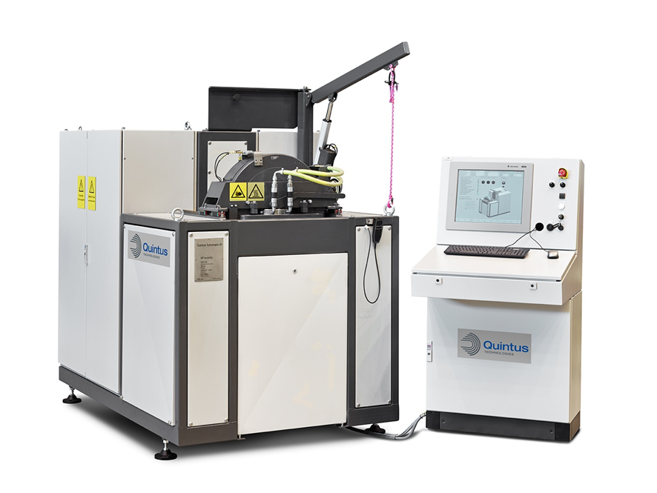
Quintus Technologies
Thank you for your attention!
How can we help?

Slide 26
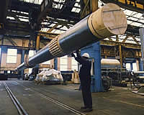
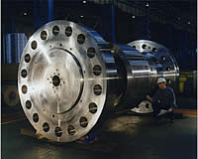
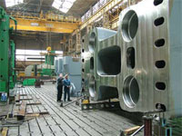
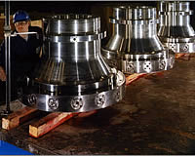
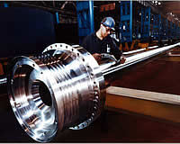
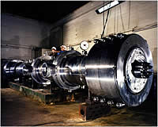
What does Powder do for all of us?
Powder opens new markets:
  Cuts end customer lead time & cost
  Increases quality and execution
  New markets for existing HIPs
  New Markets for very large HIPs

Slide 27
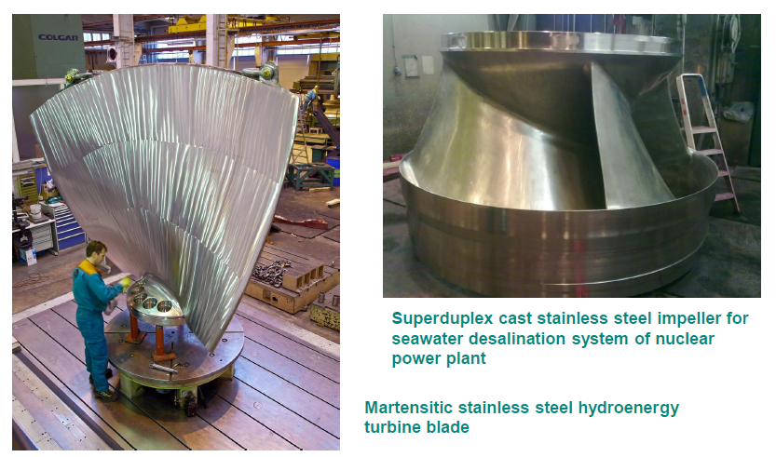
Objects for TeraPi
HIPed impellers for desalting and hydro power production
Superduplex cast stainless steel impeller for seawater desalination system
Martensitic stainless steel hydro energy
turbine blade

Slide 28
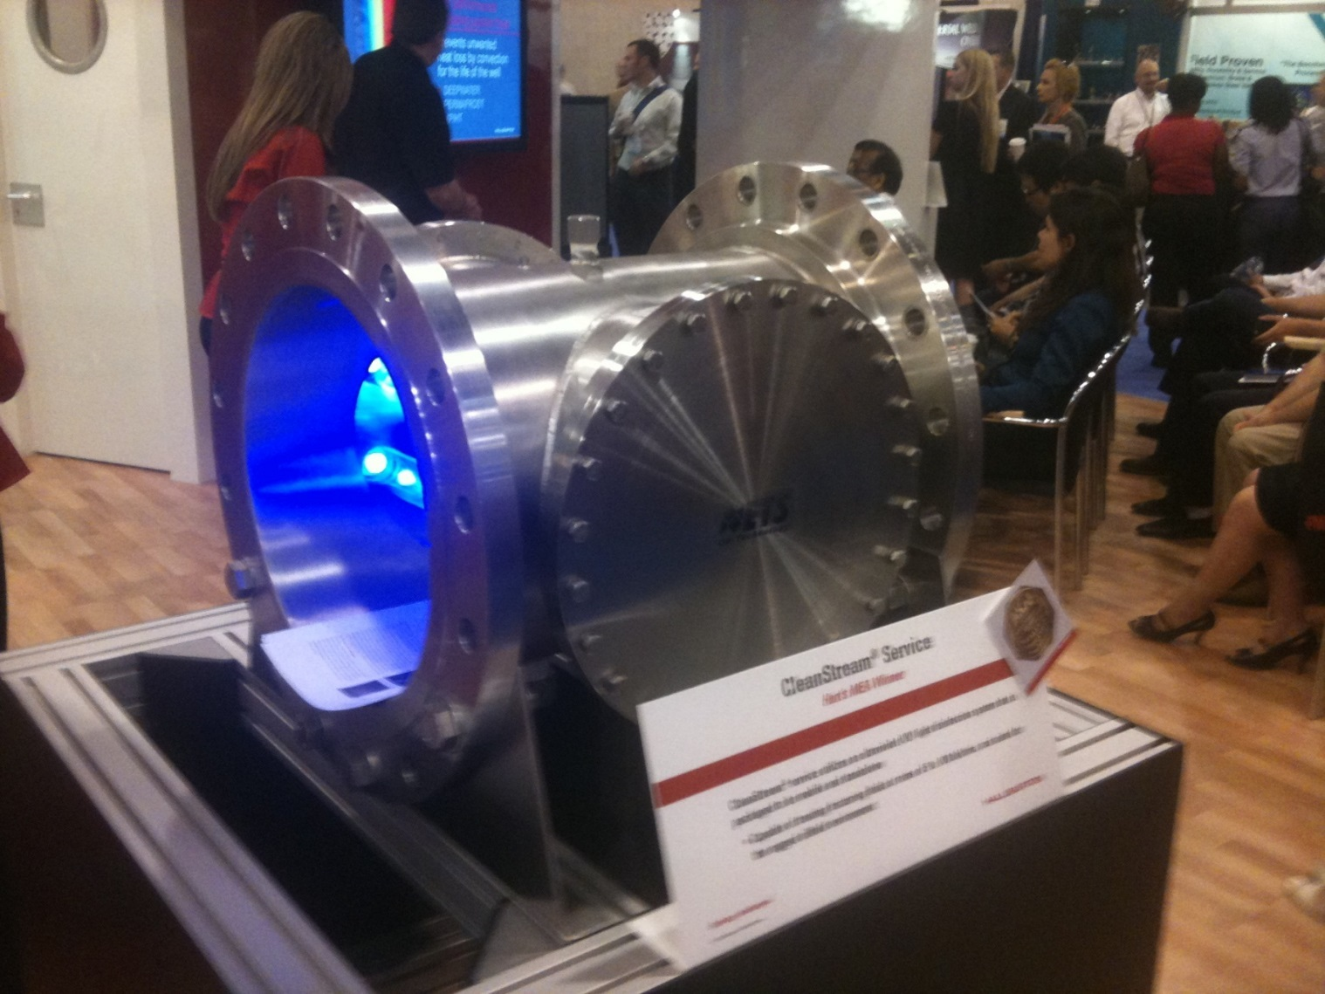
Remove Welds in Current Large Pipe Flange Designs

Slide 29
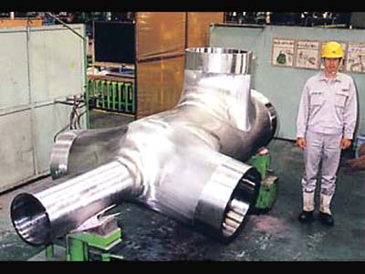
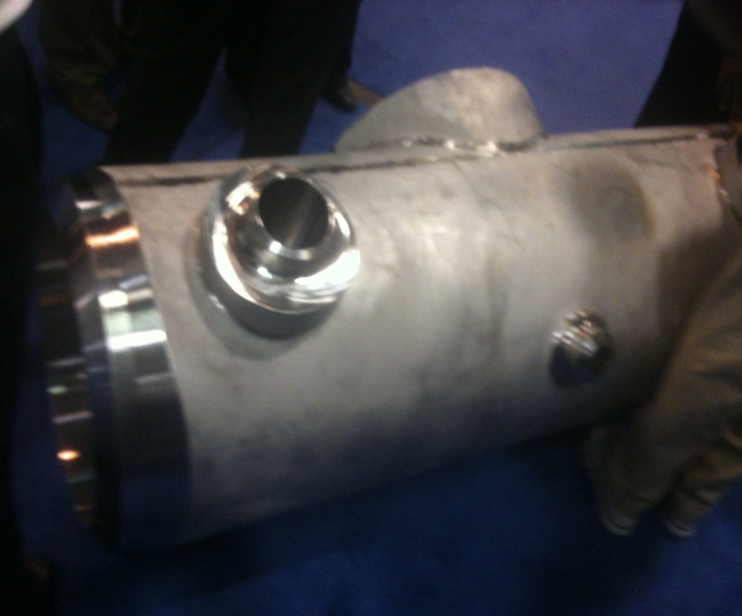
PM/HIP Offshore Deep Sea Manifolds

Slide 30
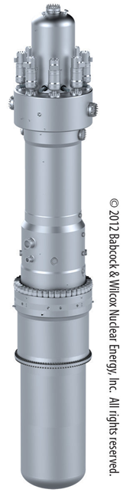
Nuclear Power Plant Components
Standing about 75 feet tall with a girth of about 14 feet, Babcock & Wilcox's new modular nuclear reactor would generate about one-sixth of the electricity a larger reactor produces. But it would be safer, partly because it would be buried in a containment building 140 feet underground. And it would cost a fraction of the price of a new large reactor.

Slide 31
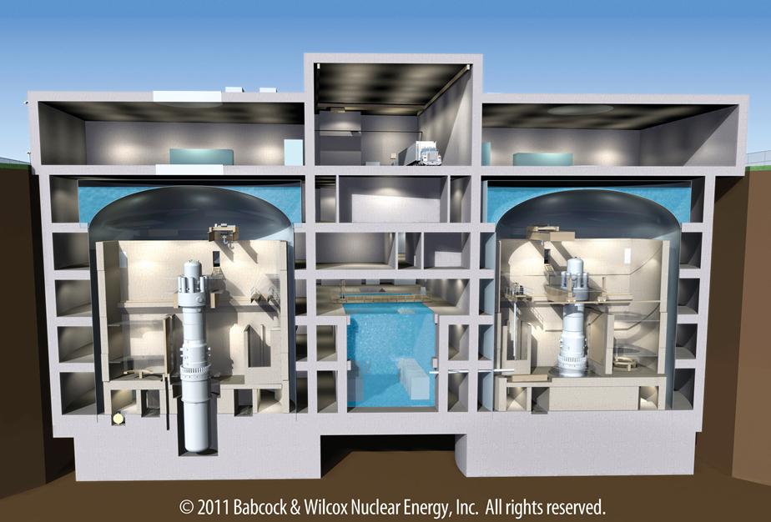
Nuclear Power Plants
New Small Modular Reactor Designs
Cutaway of an underground nuclear containment building housing two small reactors designed by Babcock & Wilcox. FirstEnergy is studying the feasibility of deploying such reactors in the future. Note the semi-tractor trailer at the top center of the drawing. Westinghouse and Holtec also offer “passively safe” light water reactor designs.

Slide 32
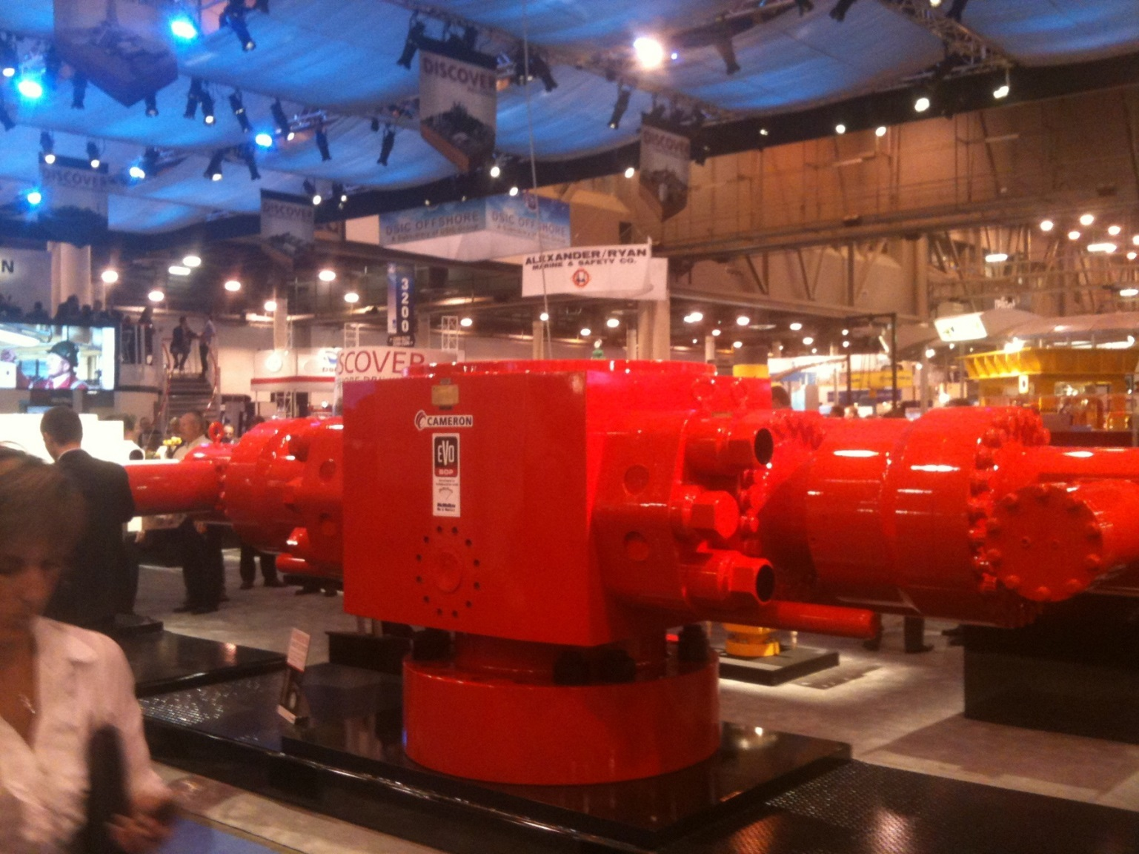
Power Plant Components

Slide 33
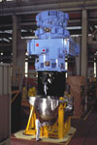
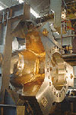
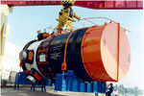
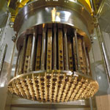
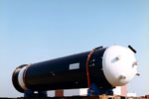
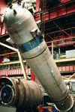
Power Plant Components
Reactor coolant pumps
Reactor vessels
Pressurizers

Slide 34
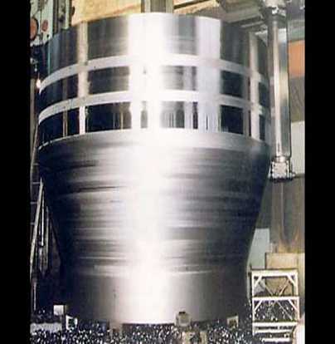
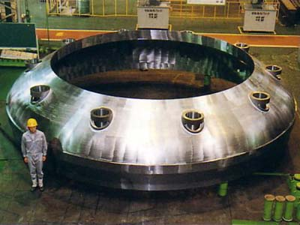
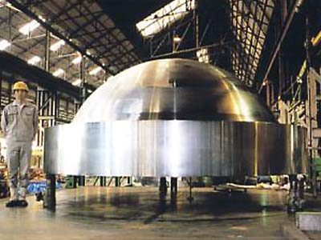
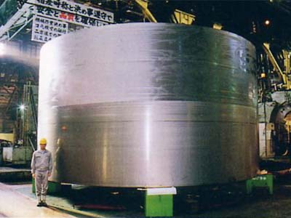
Forged Parts
Steam Generator
Cone Shell
Dimension: | 189” od X 130” H
(mm)
Weight: | 44 ton
Material: | ASME SA508, CL.3EQ.
Reactor Pressure Vessel |  |  | Reactor Pressure Vessel |  |  | Reactor Pressure Vessel
Core Region Shell |  |  | Bottom Petal |  |  | Integrated Type Closure Head
Dimension: | 295” od X 156” H |  | Dimension: | 300” od X 63” H |  | Dimension: | 158” od X 67” H
(mm) |  |  | (mm) |  |  | (mm)
Weight: | 127 ton |  | Weight: | 80 ton |  | Weight: | 38 ton
Material: | ASME SA508, CL.3EQ. |  | Material: | ASME SA508, CL.3EQ. |  | Material: | ASME SA508, CL.3EQ.

