Slide 1
EPSI – The company – US & EU
Engineered Pressure Systems International N.V.
Controlled uniform load cooling in production scale HIP equipment
Maxime Pauwels, Engineered Pressure Systems International NV
HIP’17 Sydney – Australia
7/12/2017

Slide 2
EPSI – The company – US & EU
Engineered Pressure Systems International N.V.
EPSI International
Temse
Belgium
Saar Pulvermetall
Saarwellingen
Germany
EPSI Incorporated
Haverhill
MA, USA

Slide 3
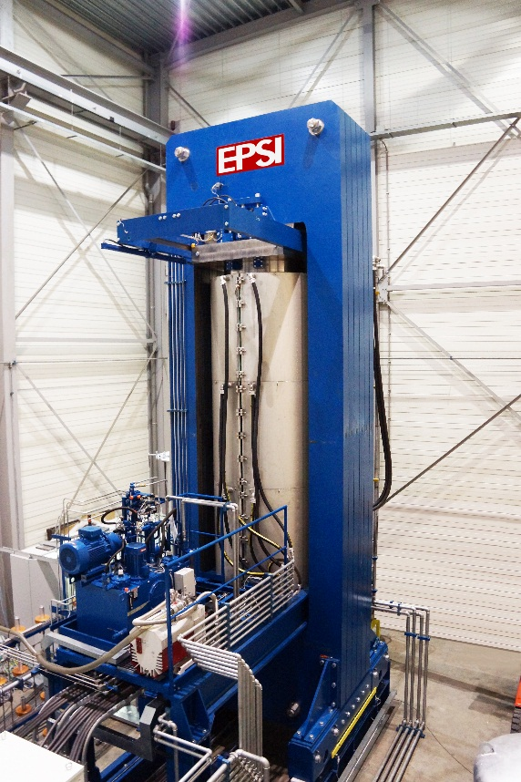
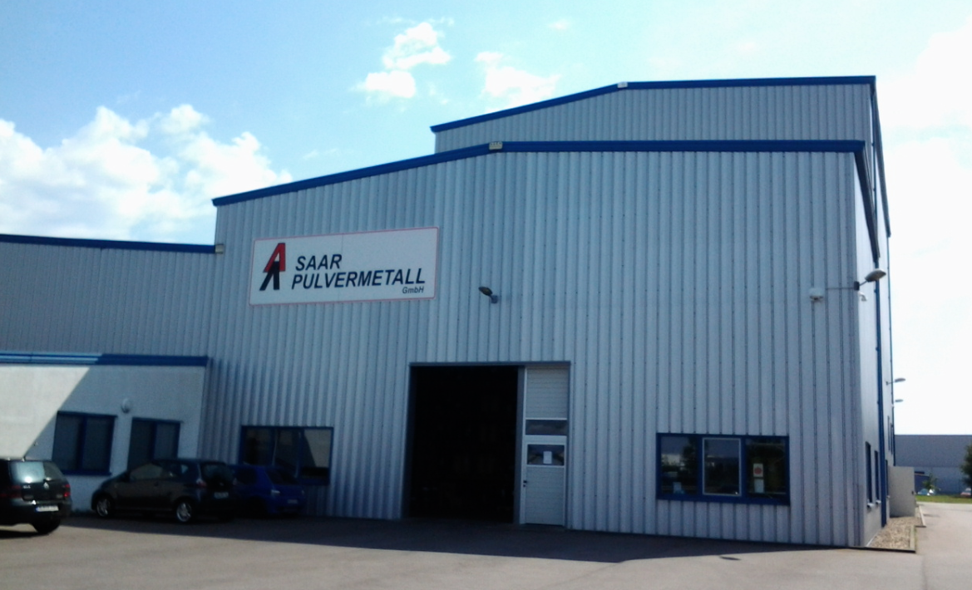
EPSI – The company – US & EU
Engineered Pressure Systems International N.V.
Useful inner dimensions: 850 mm diameter and 2500mm length
6 separate radial heating zone
Pressure up to 140 MPa
HIP140-850*2500M

Slide 4
EPSI – The company – US &EU
Engineered Pressure Systems International N.V.
Thermal build up
Control thermo element
Heating zone 1
Redundant element
Heating zone 2
Control thermo element
Redundant element
10 loading elements can also be used to steer the HIP
Control thermo element
Heating zone 3
Redundant element
Control thermo element
Heating zone 4
Redundant element
Heating zone 5
Control thermo element
Redundant element
Control thermo element
Heating zone 6
Redundant element
2 Bottom heating elements with control thermo element and redundant element
Bottom heating

Slide 5
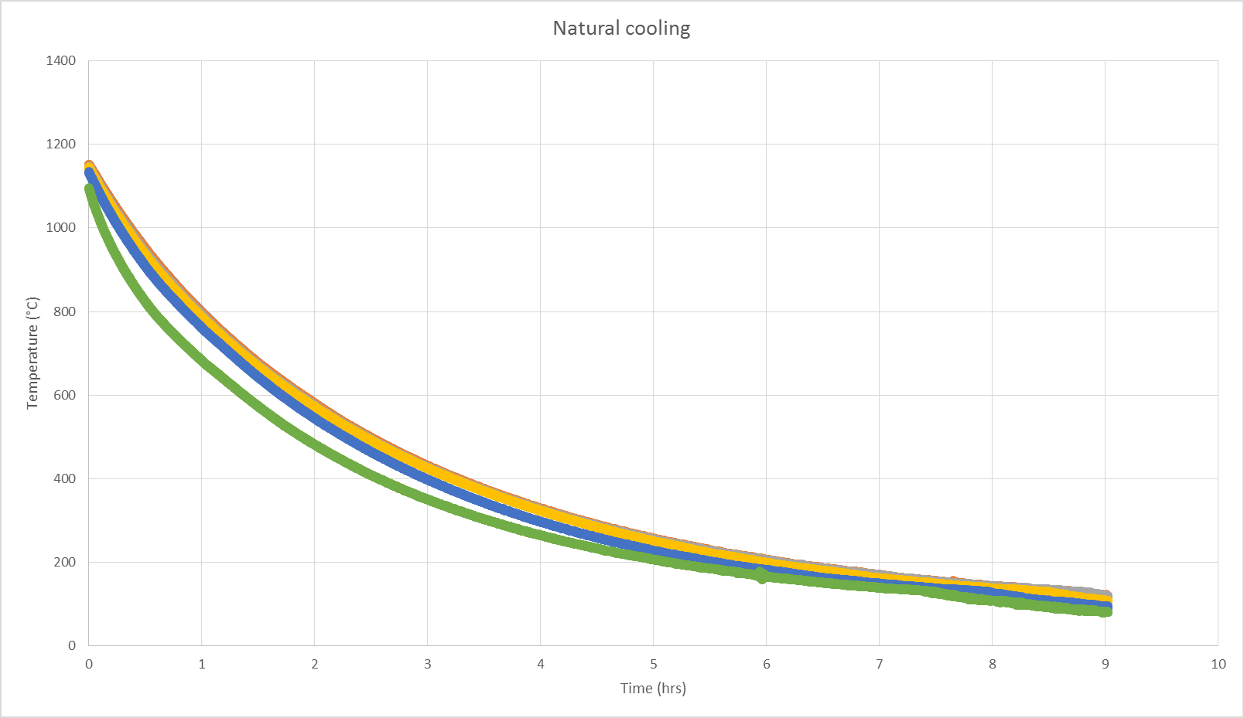
EPSI – The company – US & EU
Engineered Pressure Systems International N.V.
Natural cooling
Temperature difference of +-120 °C possible!

Slide 6
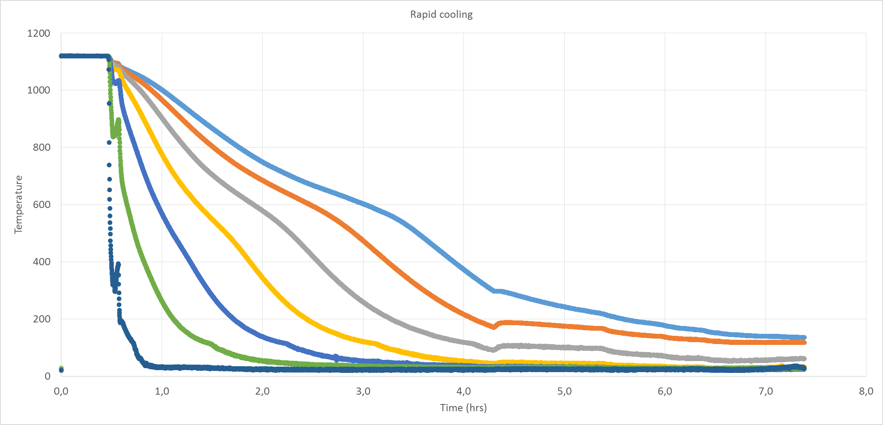
EPSI – The company – US & EU
Engineered Pressure Systems International N.V.
Rapid cooling
Cooling speed augmented
BUT large temperature differences!

Slide 7
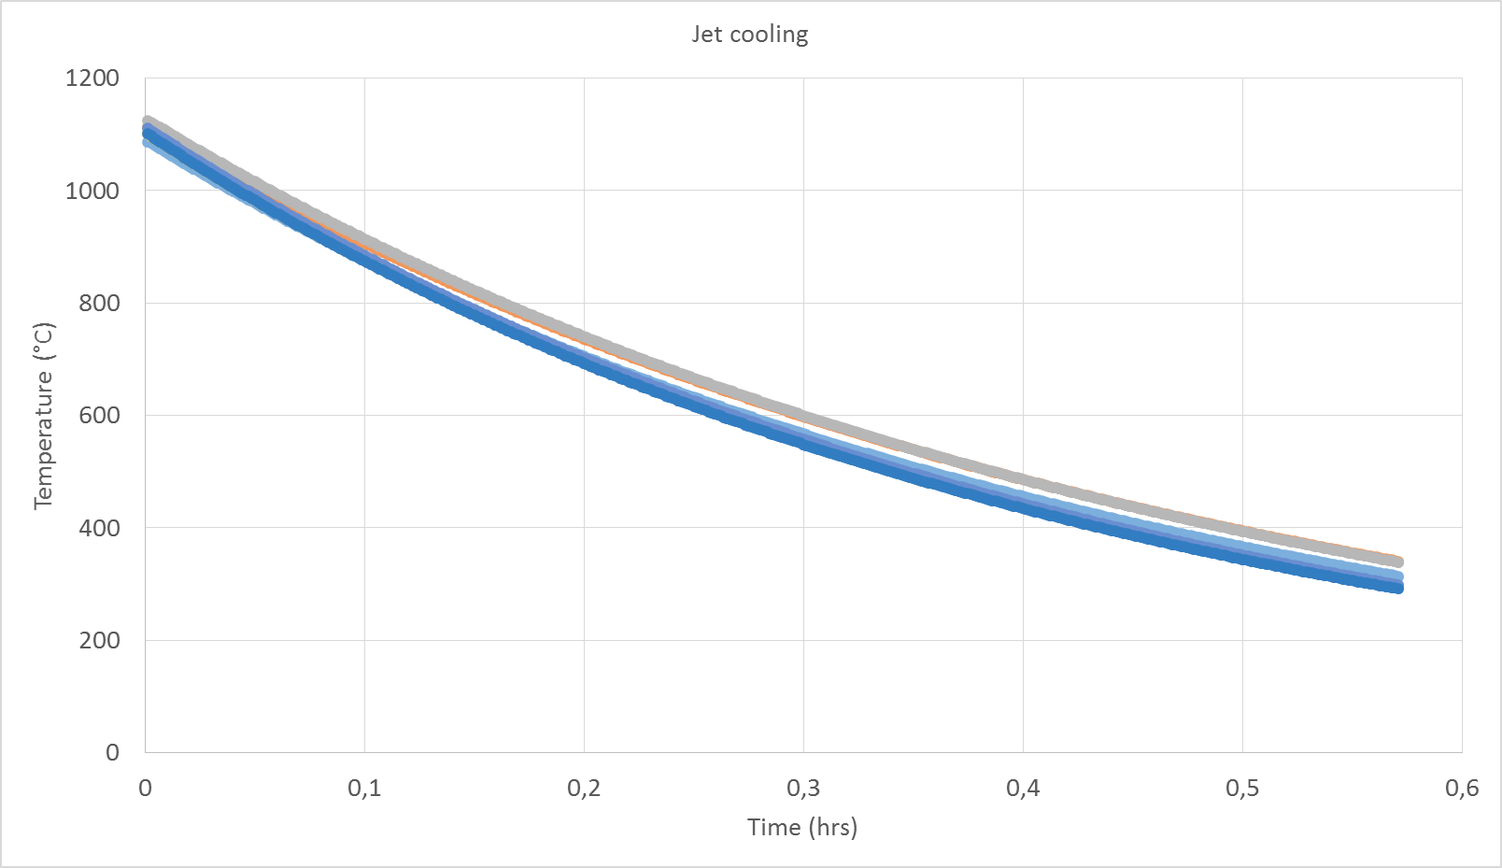
EPSI – The company – US & EU
Engineered Pressure Systems International N.V.
Jet cooling

Slide 8
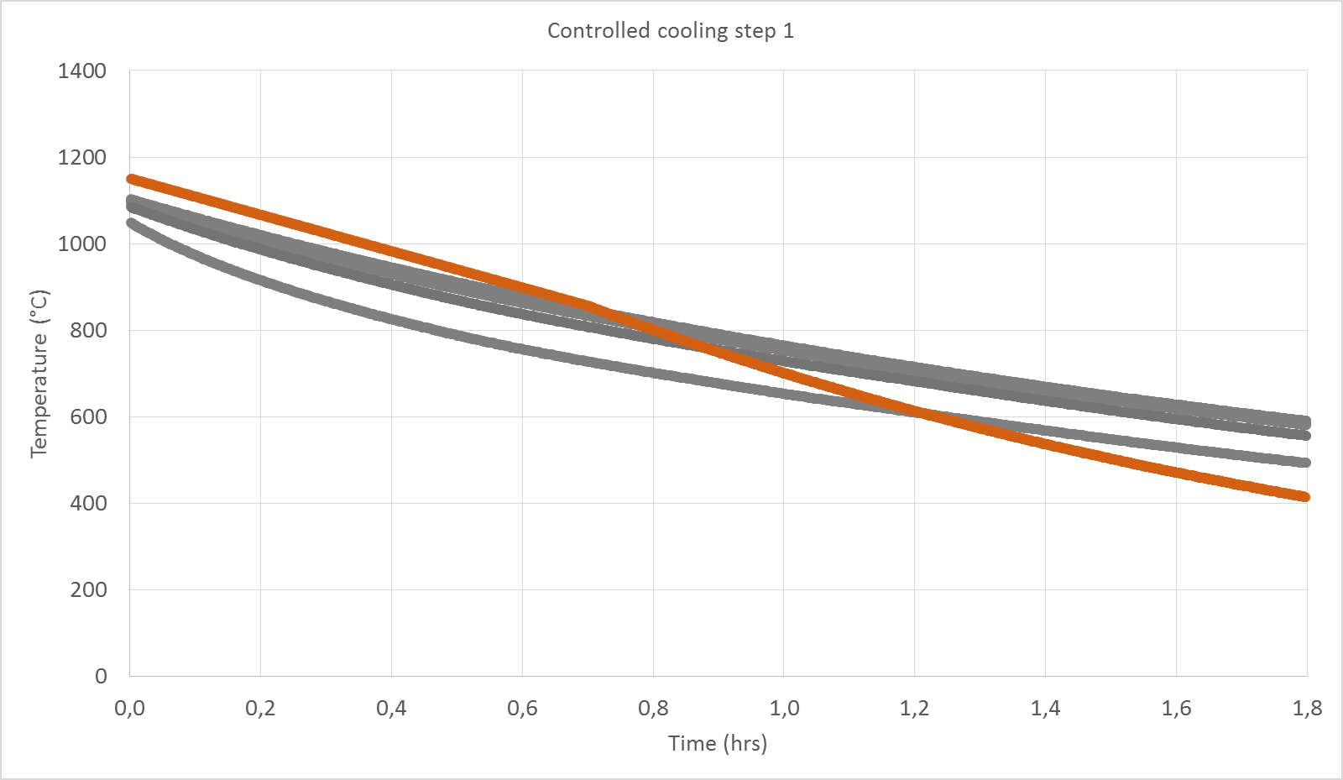
EPSI – The company – US & EU
Engineered Pressure Systems International N.V.
Controlled cooling 1

Slide 9
EPSI – The company – US & EU
Engineered Pressure Systems International N.V.
Controlled cooling 2

Slide 10
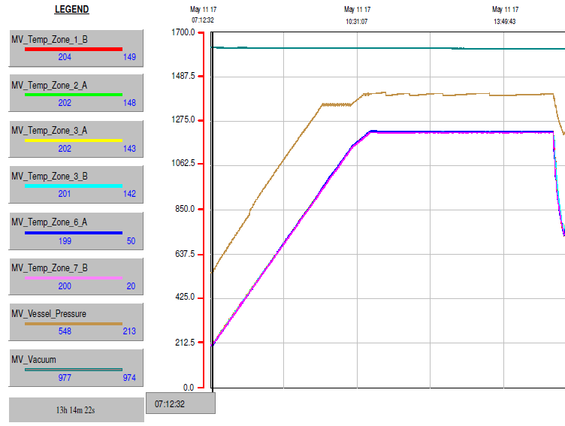
Engineered Pressure Systems International N.V.
Jet cooling results with 2800 kg load
1216 °C +/- 6°C
1216°C
800°C
Temperature accuracy during jet cooling +- 6 °C
With all TCs
416 K in 9‘ = 46 K/Minute

Slide 11
Engineered Pressure Systems International N.V.
Heating and cooling – energy calculation

Slide 12
Engineered Pressure Systems International N.V.
Many thanks for your attention

