Slide 1
Small Modular Reactor Vessel Manufacture/Fabrication Using PM-HIP and Electron Beam Welding Technologies
David Gandy and Craig Stover (Electric Power Research Institute)
Keith Bridger, Steve Lawler, and Matt Cusworth (Nuclear-AMRC)
Victor Samarov and Charlie Barre (Synertech-PM)
Potential Nuclear Components

Slide 2
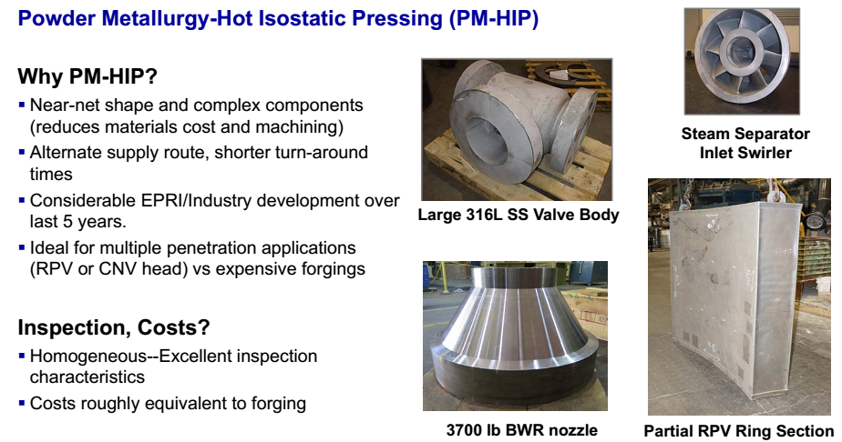

Slide 3
Project Objectives
Three key objectives were identified for this project. These include:
Develop and demonstrate advanced manufacturing and fabrication technologies to rapidly accelerate the deployment of SMRs
Develop/demonstrate new methods for manufacture/fabrication of a Reactor Pressure Vessel (RPV) which could lead to production of a vessel in under 12 months.
Eliminate 40% of the costs of production of an SMR RPV, while reducing the overall schedule by up to 18 months.

Slide 4
Manufacture of the key components for the reactor vessel includes both conventional forging and PM-HIP. The breakdown of the key A508 low alloy steel components are as follows:
PM-HIP (A508, Grade 3, Class 1)
Lower reactor head
Upper reactor head
Steam plenum
Steam plenum access ports/covers
Upper transition shell (in four sections)
Forgings (SA508, Grade 3, Class 1)
Lower transition shell
Upper flange
Lower flange
PZR (pressurizer) shell

Slide 5
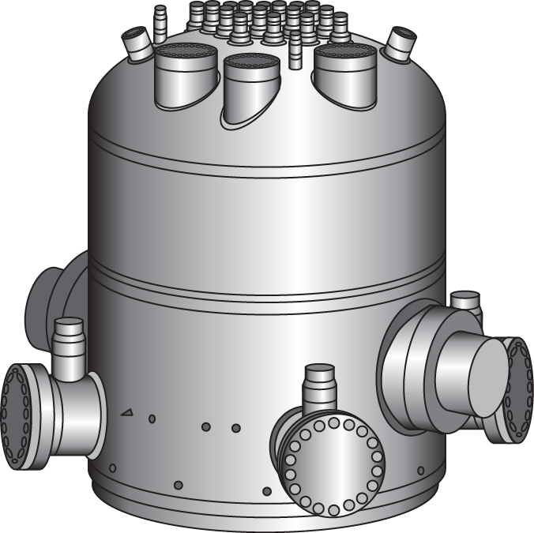
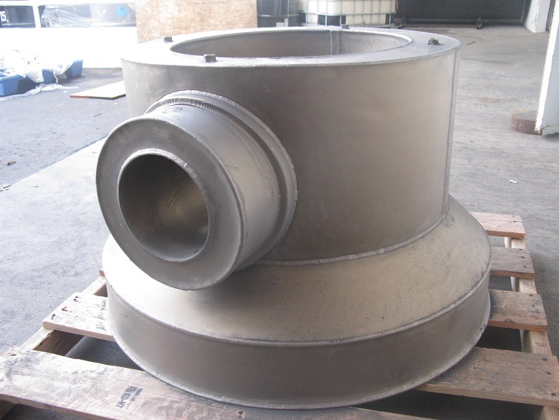

Slide 6
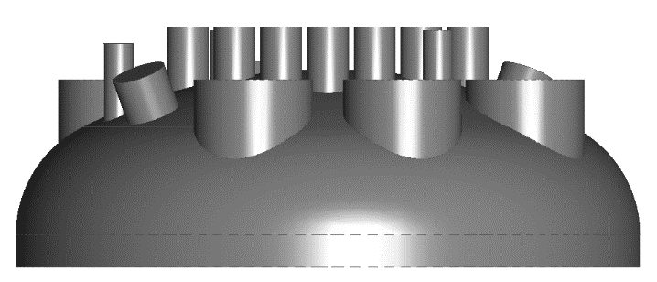

Slide 7
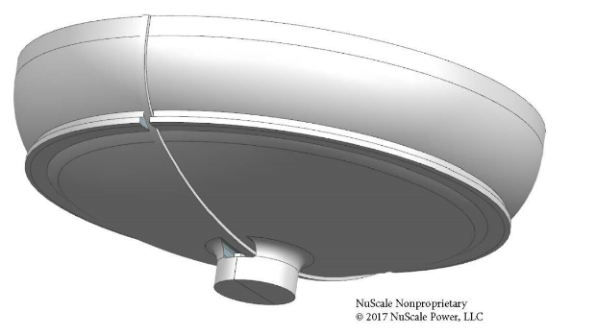

Slide 8
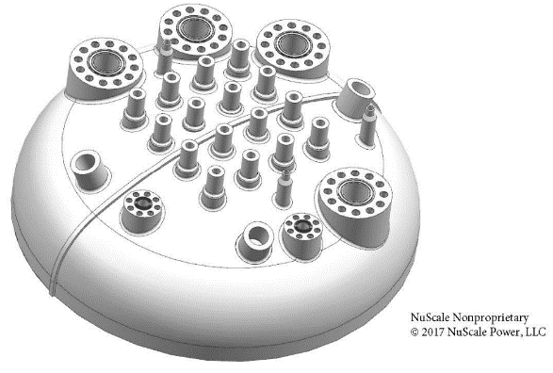

Slide 9
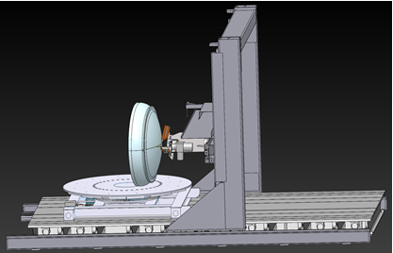

Slide 10
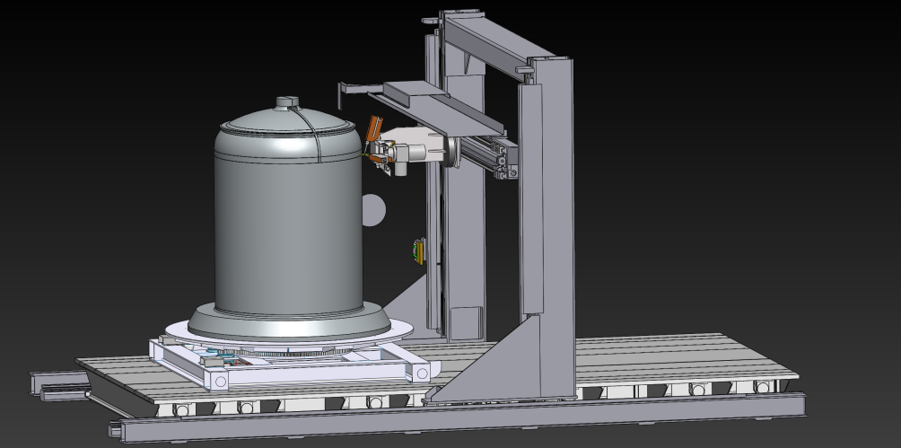

Slide 11
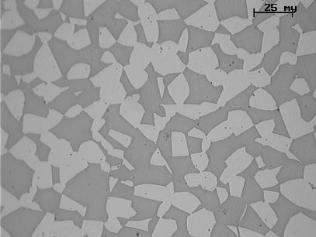
ATLAS
Uniform Microstructure (Duplex 2205)
Forged Bar (Longitudinal)
PM/HIP
Courtesy Carpenter

Slide 12
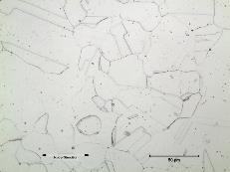
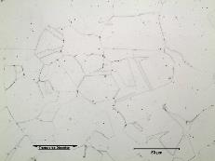
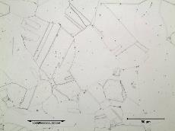
ATLAS
Isotropic Mechanical Properties
Charpy Impact = >195 ft-lbs (hammer stopper)
ASTM Grain Size = 6-7
Photo’s from 3 different orientations.
Courtesy EPRI

Slide 13
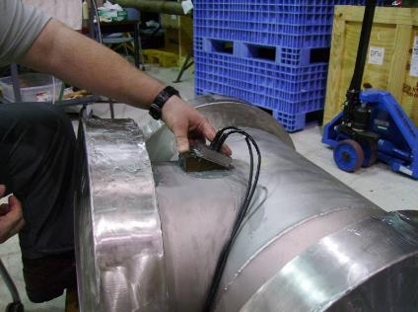
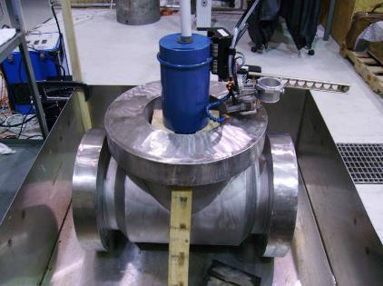
ATLAS
Superior Ultrasonic Inspectability
Manual and Automated UT Scans Performed
Courtesy EPRI

Slide 14
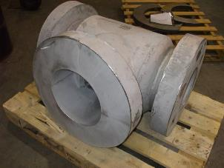
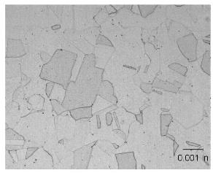
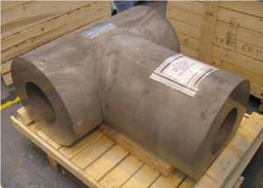
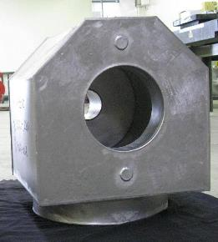
ATLAS
PM/HIP 316L ASME Code Approval
Courtesy Rolls-Royce
Good tensile/yield properties
Good toughness: >122 ft-lbs (165 Joules)
No Porosity, homogenous microstructures
Good Fatigue properties
Inspection, near forging quality
ASME Code Case N-834
Sect III-Approved Sept 2013
Courtesy EPRI
Notes:
4 heats of materials (components) were manufactured and included in the large data package submitted to ASME along with the Code case.
The Code Case is presently out to Section III members as a letter ballot

Slide 15
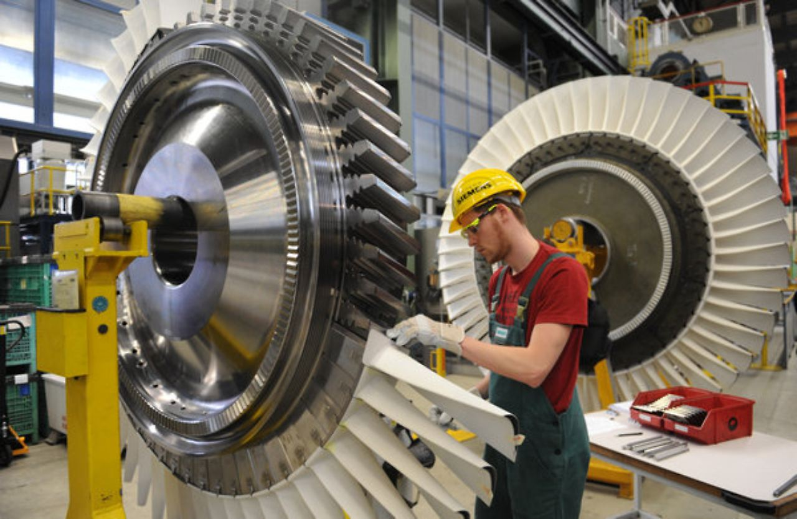
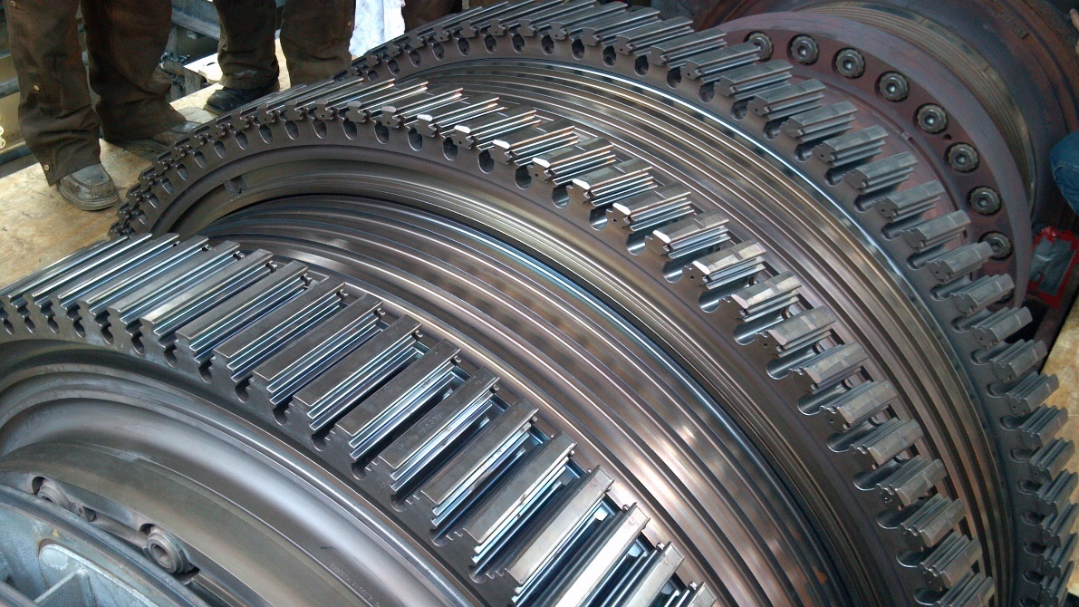
Gas Turbine Discs
Courtesy of Siemens

Slide 16
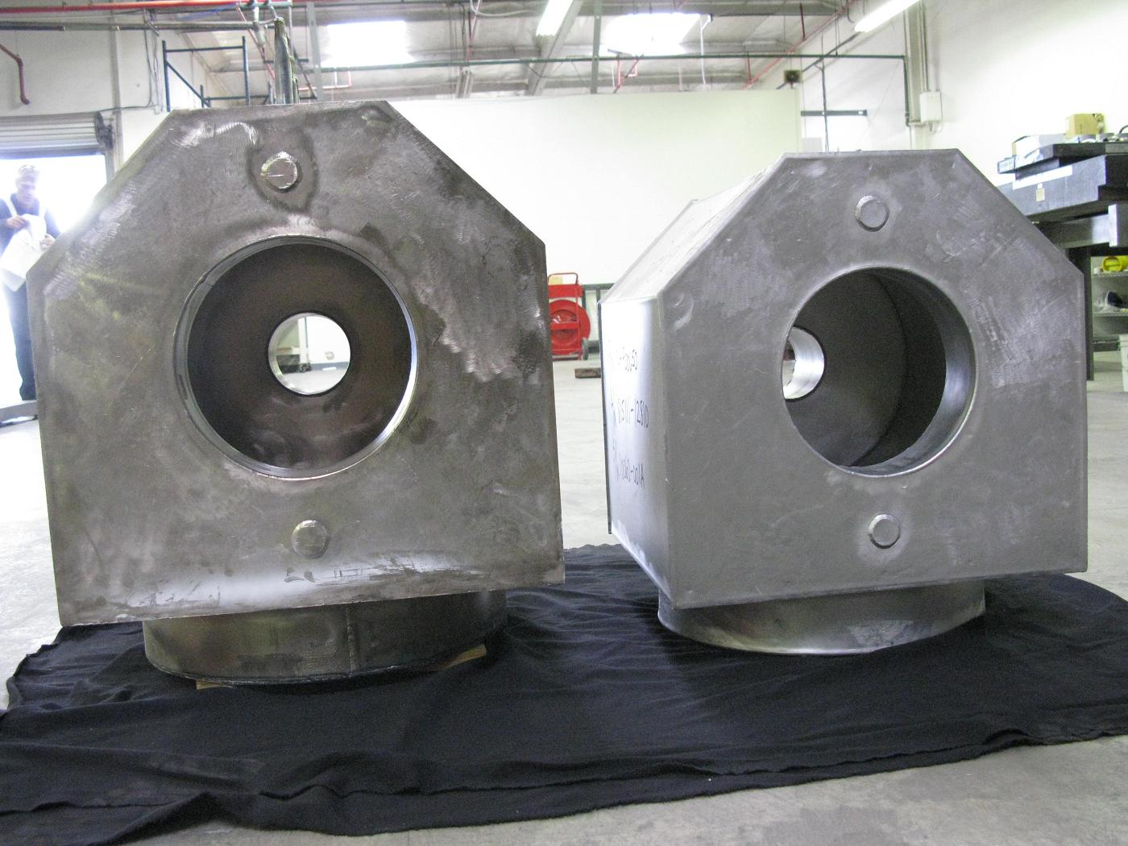
Shrinkage during HIP
before HIP
after HIP

Slide 17
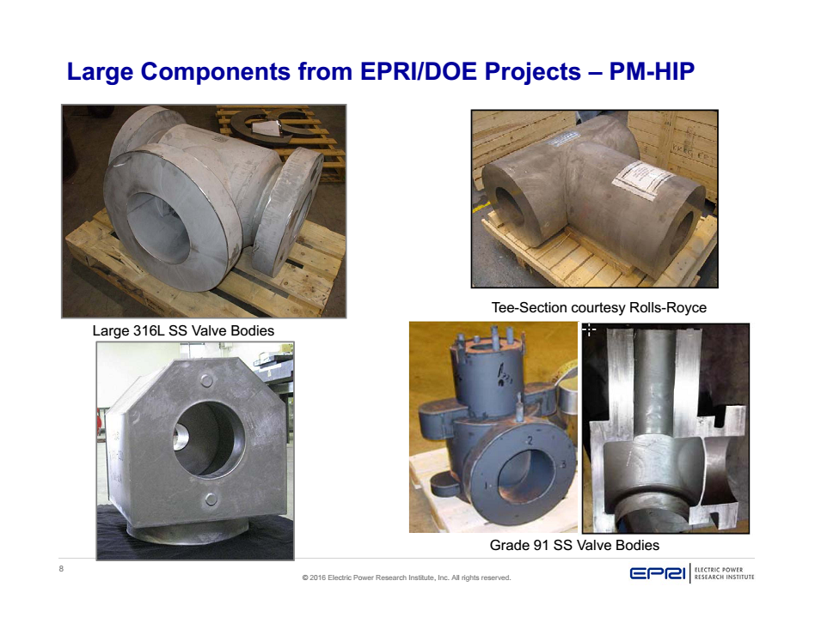

Slide 18
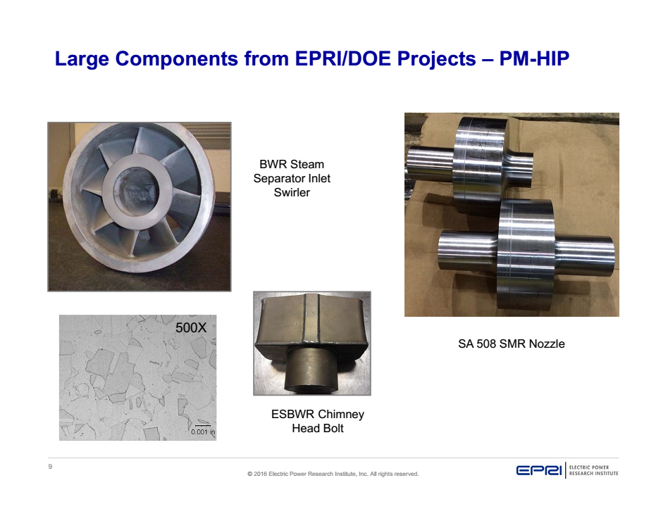

Slide 19
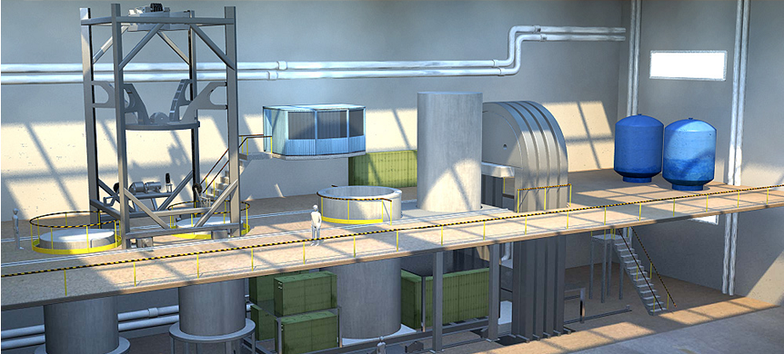
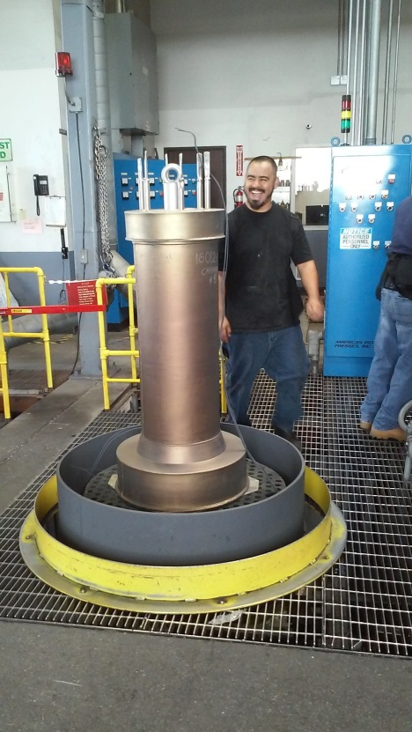
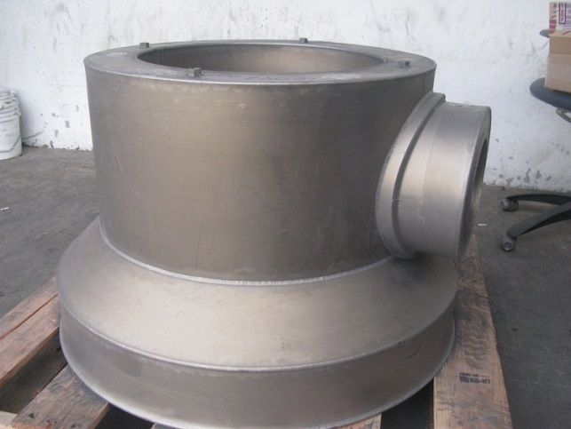
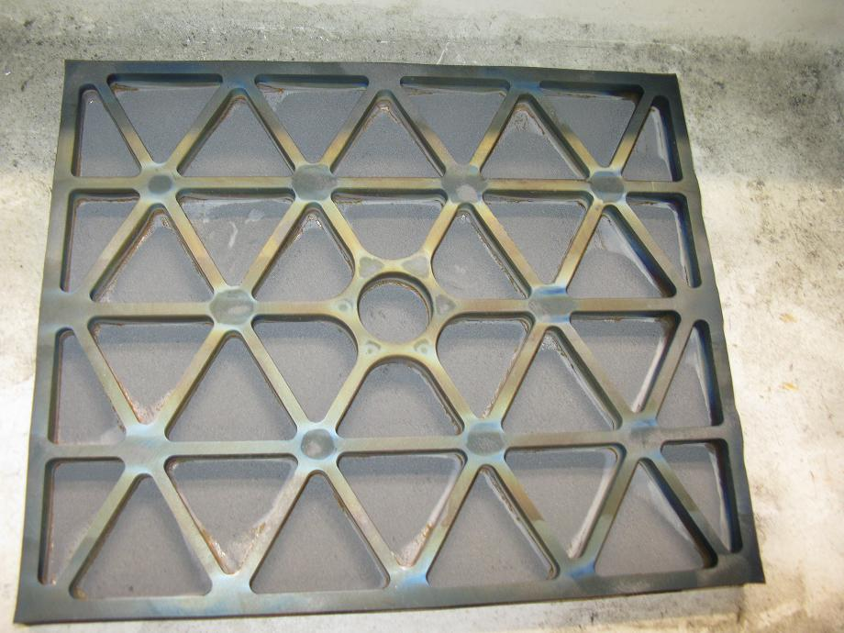
Requirements to the HIP cycle and Equipment for the ATLAS PM HIPED parts

Slide 20
Temperature Uniformity of in the HIP furnace at the ramp stage beginning with 100-200C
Temperature uniformity of +/- 25F measured on the external and internal surface of the parts at the dwell stage of HIP cycle
HIP cycle duration, assuming a 4 hour dwell, within 24 hours up to 1200C, 1000 bars
Design of the major components of the PCS incorporating damage tolerance (crack arrest, load shifting),
Inspectability, including UT of the major components of the PCS
Possibility of periodical disassembling and visual and NDT inspection of the major tension stressed parts to reveal cracks, if any, and enable to replace them

Slide 21
CONCLUSIONS
HIP is becoming a cost efficient and winning alternative to machining of the forgings to the final complex shape and provides for large components for Nuclear Power Plants:
Material affordability;
Decrease of “buy- to fly” ratio 2-3 times for complex shapes;
Properties as wrought or better, shape- as cast or better;
Efficient Non-destructive inspection ;
Capability for re-design of critical components to their best performance;

