Slide 1
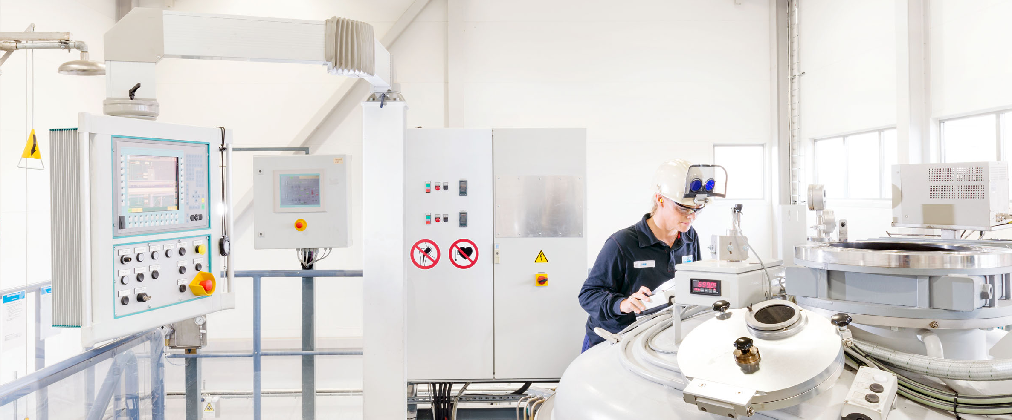
Overview of properties, features and developments of pm hip 316L and 316LN

Slide 2
Overview of properties, features and developments of pm hip 316L and 316LN
Martin Östlund (presenter)
R&D, Powder Technology
Sandvik Materials Technology
martin.ostlund@sandvik.com
Tomas Berglund
Technical Marketing
Sandvik Powder Solutions
tomas.berglund@sandvik.com

Slide 3
Overview of properties, features and developments of pm hip 316L and 316LN
Agenda
Introduction
Microstructure
  Features
  Non Metallic Inclusions
Mechanical properties
  General properties
  Enhanced yield strength
  Impact toughness
  Creep strength
Summary

Slide 4
introduction
Pm hip 316L & 316LN
316L one of the most commonly used stainless steel alloy
PM HIP 316L/LN manufactured by Sandvik Powder Solutions since the 1980’s
  Large manufacturing experience regarding processing parameters and properties
Recent ASME section III code case approval for PM HIP 316L [1]
  Comprehensive technical report by EPRI regarding properties and performance [4]
  Issues regarding reduced impact toughness at cryogenic temperatures raised [15]
[1] ASME Boiler and Pressure Vessel Code Case N-834
[4] D. Gandy, Technical Report 1025491, Electric Power Research Institute (EPRI), 2012.
[15] D. Cédat et. al. Advanced mechanical properties of P/M 316L stainless steel material, Presentation at Euro PM2012, September 16-19 (2012) Basel, Switzerland.

Slide 5
Overview of properties, features and developments of pm hip 316L and 316LN
Agenda
Introduction
Microstructure
  General features
  Non Metallic Inclusions
Mechanical properties
  General properties
  Enhanced yield strength
  Impact toughness
  Creep strength
Summary

Slide 6
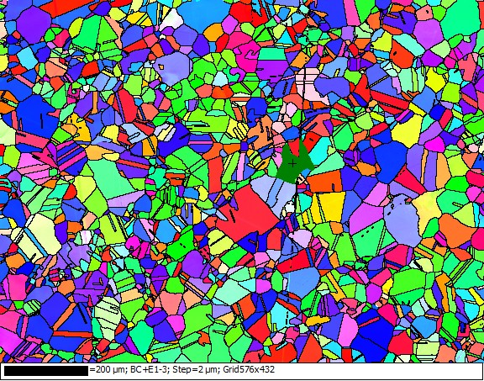
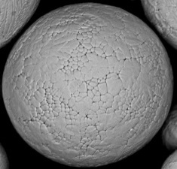
microstructure
General features of Pm hip 316L & 316LN
Isotropic microstructure
No segregation of compositional elements
High cleanness
→ Great ultrasonic inspectability
PM ingot
Max 500 μm

Slide 7
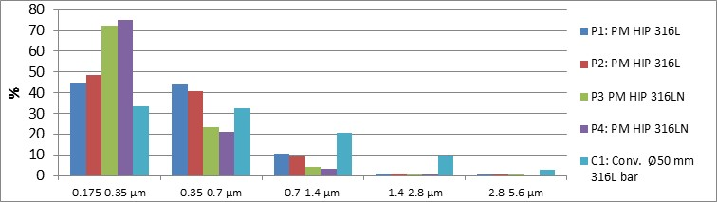
microstructure
non-metallic inclusions
Absolute majority of inclusions are spheroidal and well below 2.8 µm in size
  Relative amount of inclusions per size range (equivalent circle diameter) in figure below

Slide 8
microstructure
non-metallic inclusions
Inclusions predominately constituted by oxides
  Bulk oxides
  Surface oxides
    Referred to as PPB (prior particle boundary) oxides in the HIPed microstructure and can affect ductility and toughness adversely
    Not perceived as an issue for PM HIP 316L/LN
Inclusion number density can affect grain size by pinning grain boundaries

Slide 9
Overview of properties, features and developments of pm hip 316L and 316LN
Agenda
Introduction
Microstructure
  General features
  Non Metallic Inclusions
Mechanical properties
  General properties
  Enhanced yield strength
  Impact toughness
  Creep strength
Summary

Slide 10
Mechanical properties
General properties
Average mechanical properties ± standard deviation for different PM HIP 316L components with wall thicknesses ranging from 60 to 600 mm and weight from 10 kg to > 3000 kg.
A general feature in PM HIP materials is a higher yield strength compared to it’s conventionally manufactured counterpart

Slide 11
Mechanical properties
Yield strength – Irvine and pickering
Irvine et. al. derived an empirical relationship between compositional and microstructural parameters and yield strength for austenitic stainless steels shown as Eq. 1 [6,7].
On the next slide, yield strength for different PM HIP316L/LN batches and conventionally manufactured 316L/LN material as well as predicted yield strength acc. to Irvine and Pickering (eq. 1.) can be seen.
Rp0.2 (MPa) = 15.4[4.4+23(C)+1.3(Si)+0.24(Cr)+0.94(Mo)+1.2(V)+0.29(W)+2.6(Nb)+ 1.7(Ti)+0.82(Al)+32(N)+0.16(delta ferrite)+0.46d^{-0,5}]. (1)
[6] F. B. Pickering, Int. Met. Rev. 21 (1976) 227-277.
[7] K. J. Irvine, Et al. J. Iron Steel Inst. 207 (1969) 1017.

Slide 12
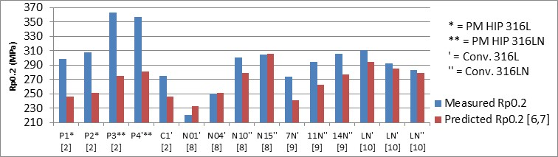
Mechanical properties
Yield strength – Irvine and pickering
Yield strength for different PM HIP316L/LN batches and conventionally manufactured 316L/LN material as well as predicted yield strength acc. to Irvine and Pickering (eq. 1).
[2] T. Berglund, M. Östlund, L. Larsson, Proceedings of Euro PM2015 Congress (2015).
[8] D. W. Kim, W-S Ryu, J. H. Hong, Journal of Materials Science 33 (1998) 675-679.
[9] J. G. Kumar, M. Chowdary et. al., Nuclear Eng. and Design 240 (2010) 1363-1370.
[10] M. Nyström, J-O. Nilsson, Internal Sandvik R&D technical report, T9600472, 1996.

Slide 13
Mechanical properties
Yield strength – Irvine and pickering
Yield strength for different PM HIP316L/LN batches and conventionally manufactured 316L/LN material as well as predicted yield strength acc. to Irvine and Pickering (eq. 1).
[2] T. Berglund, M. Östlund, L. Larsson, Proceedings of Euro PM2015 Congress (2015).
[8] D. W. Kim, W-S Ryu, J. H. Hong, Journal of Materials Science 33 (1998) 675-679.
[9] J. G. Kumar, M. Chowdary et. al., Nuclear Eng. and Design 240 (2010) 1363-1370.
[10] M. Nyström, J-O. Nilsson, Internal Sandvik R&D technical report, T9600472, 1996.

Slide 14
Mechanical properties
Yield strength – Irvine and pickering
Irvine and Pickering predict yield strength relatively accurate for conventionally manufactured 316L/LN
Irvine and Pickering consistently underestimate yield strength significantly in PM HIP 316L/LN.
  Strengthening mechanism aside from composition, grain size and delta ferrite in PM HIP 316L/LN that does not exist in conventionally manufactured 316L/LN?
Strengthening contribution from grain size, N and C acc. To Irvine and Pickering was subtracted from the measured yield strength
  The theoretical yield strength, Rp0.2-n, normalized with regard to these parameters should be obtained.

Slide 15
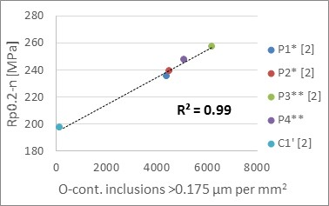
Mechanical properties
Yield strength – Irvine and pickering
The theoretical yield strength Rp0.2-n normalized with regard to grain size, N and C content correlates well to the amount of oxygen containing inclusions >0.175 µm
  Large number of small oxides possible strengthening mechanism in PM HIP 316L/LN?

Slide 16
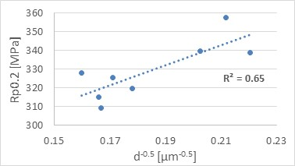

Mechanical properties
[11] E. Hall, Proceedings of the Physical Society, Section B 64 (1951) 747.
[12] N. Petch, J. Iron Steel Inst. 174 (1953) 25.
Yield strength – Hall-Petch
Eight PM HIP 316LN of similar composition were analyzed with regard to grain size (EBSD), non-metallic inclusions (Automated SEM-EDS) and tensile properties.
  A linear relationship between grain size and yield strength should exist according to the Hall-Petch relationship in eq. 2 [11, 12]
Relative poor correlation obtained!
$$σ_{y}=σ_{0}+\frac{k_{y}}{\sqrt{d}}$$
(2)

Slide 17
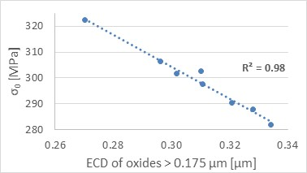
Mechanical properties
Yield strength – Hall-Petch
The calculated grain size contribution to yield strength was subtracted from the measured yield strength for each sample to obtain the intrinsic yield strength/internal friction stress, σ₀ (i.e. yield strength at infinitely large grain size).
  Good correlation between σ₀ and average oxide size (Equivalent Circle Diameter)
  Indication of strengthening effect from oxides?

Slide 18
Mechanical properties
Yield strength improvement from oxides?
Indicative results of strengthening from large numbers of small oxides in PM HIP 316L/LN
  Comparison with conventional counterparts utilizing Irvine and Pickering's formula
  Comparison between different PM HIP samples utilizing the Hall-Petch relationship.
A possible explanation for this feature could be that the relatively large amounts of small oxygen containing inclusions could act as small precipitates impeding dislocation movements during tensile strain, i. e. Orowan strengthening.
By reducing the oxygen content by ~50% in PM HIP 316LN, the yield strength is reduced by 6-7 % [14]
  This large reduction in yield strength cannot be motivated by either Irvine and Pickering's formula or the Hall-Petch relationship
[14] A. Lind, J. Sundström et. al., Fusion Eng. and Des.75–79 (2005) 979–983.

Slide 19
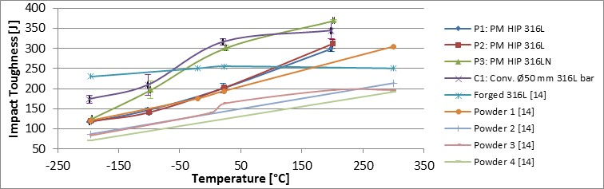
Mechanical properties
Impact toughness
[15]
[15]
[15]
[15]
[15] D. Cédat et. al. Advanced mechanical properties of P/M 316L stainless steel material, Presentation at Euro PM2012, September 16-19 (2012) Basel, Switzerland.

Slide 20
Mechanical properties
Impact toughness
Impact toughness generally improves with lower oxygen content
  Impact toughness at room temperature increased from 225 to 400 J when oxygen was reduced from 238 to 22 ppm in PM HIP 316L [16]
  Impact toughness at -196°C increased from 93 J to 243 J when oxygen was reduced from 100 ppm to 22 ppm in PM HIP 316LN [17]
Oxygen content is however not a conclusive indicator on hoe the materials will perform regarding impact toughness
  Depends on occurrence of bulk and surface oxides as well as size and number of oxides
  Depends on processing parameters
[16] A. Angré. A. Strondl, Proc. Of the 11th Int. Conf. on HIP (2014) 162-168.
[17] J. Sundström, Swerea Kimab (Corr. and Metals Research inst.), IM-2005-509 (2005).

Slide 21
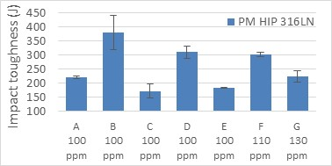
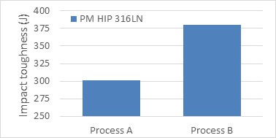
Mechanical properties
Impact toughness
Processing parameters
Different samples with similar oxygen contents
Different processing parameters on the same powder batch

Slide 22
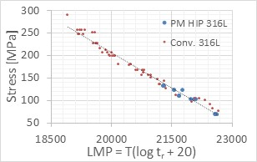
Mechanical properties
Creep strength
Creep testing of PM HIP 316L indicates similar creep strength as conventionally manufactured 316L

Slide 23
Overview of properties, features and developments of pm hip 316L and 316LN
Agenda
Introduction
Microstructure
  General features
  Non Metallic Inclusions
Mechanical properties
  General properties
  Enhanced yield strength
  Impact toughness
  Creep strength
Summary

Slide 24
summary
Pm hip 316L and 316LN
Homogeneous and isotropic microstructure with high cleanness
Non-metallic inclusions are small, spheroidal and relatively evenly distributed
Oxygen containing inclusions can seemingly affect mechanical properties
  Positively in the case of yield strength
  Negatively in some cases for impact toughness
The total oxygen content in PM HIP 316L/LN can on a broader scale indicate impact toughness levels, but results of this study shows that it is not a meticulous parameter for this.
  Excellent impact toughness can be achieved at moderate oxygen levels if processed properly

