Slide 1
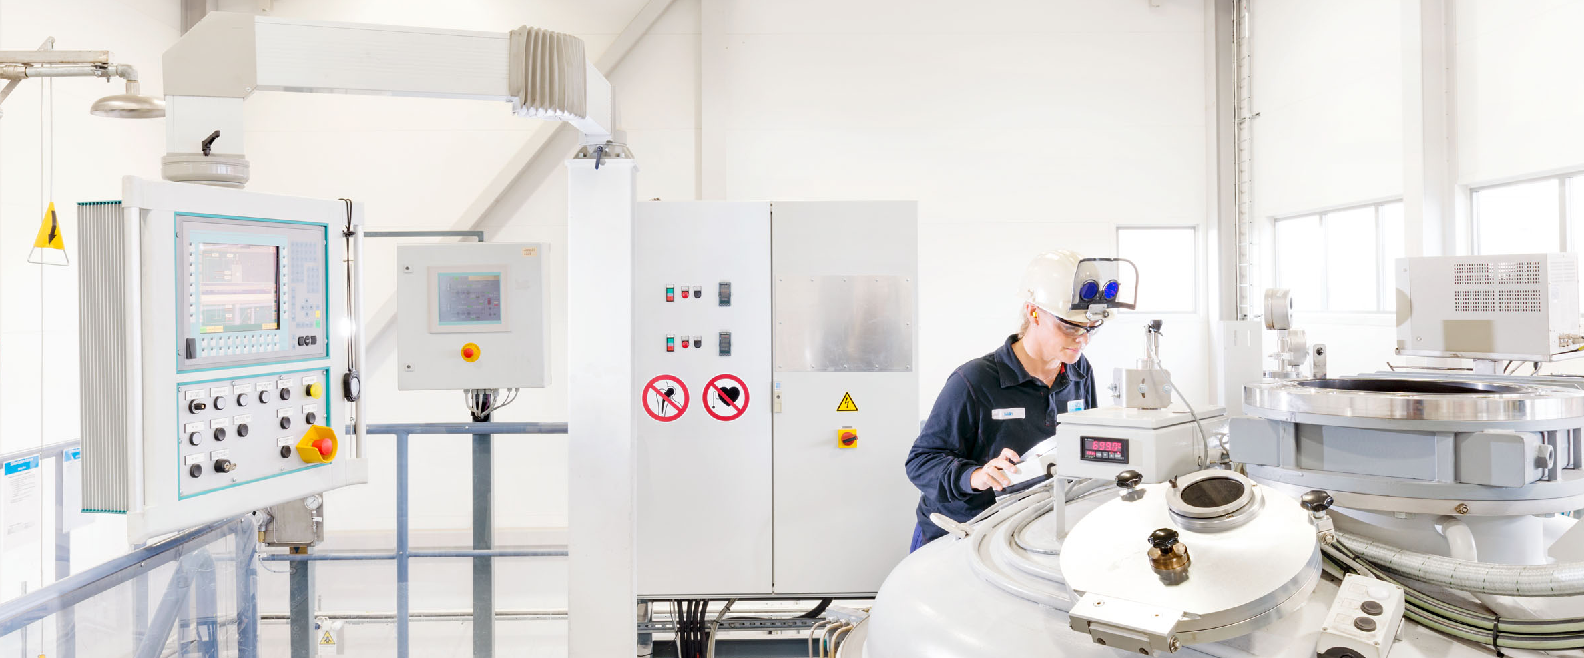
Effect of processing parameters on intermetallic phase content and impact toughness for super duplex alloy pm hip sandvik saf 2507^{tm}

Slide 2
Effect of processing parameters on intermetallic phase content and impact toughness for super duplex alloy pm hip sandvik saf 2507^{tm}
Martin Östlund (presenter)
R&D, Powder Technology
Sandvik Materials Technology
martin.ostlund@sandvik.com
Linn Larsson
R&D, Powder Technology
Sandvik Materials Technology
linn.larsson@sandvik.com
Tomas Berglund
Technical Marketing
Sandvik Powder Solutions
tomas.berglund@sandvik.com

Slide 3
Effect of processing parameters on intermetallic phase content and impact toughness for super duplex alloy pm hip sandvik saf 2507^{tm}
Agenda
Introduction
Experimental
  Sample manufacturing
  Microstructure characterization
  Impact and corrosion testing
Results
  Impact toughness
  Microstructure
  Corrosion properties
Discussion
Conclusions

Slide 4
introduction
[1] L. Larsson, M. Bjurström, Properties of PM HIPed SAF 2507 super duplex stainless steel, Proceedings or Euro PM2012 Conference (2012).
[2] J. O. Nilsson, Overview Super duplex stainless steels, Mat. Sc. Tech. 8 (1992) 685-699
Pm hip sandvik saf 2507^{tm}
Sandvik SAF 2507™ is a super duplex stainless steel characterized by excellent resistance to stress corrosion cracking, pitting and crevice corrosion, general corrosion and high strength
Increasing water depths (increasing pressures) and process temperatures in PM HIP applications for the oil and gas sector results in designs with increased wall thickness.
  A limiting factor when it comes to increased wall thickness is the formation of brittle intermetallic phase during water quenching following heat treatment.
  The intermetallic phases nucleate and grow primarily in ferrite grain boundaries and ferrite/austenite phase boundaries in the approximate temperature interval 600 - 1000°C [1, 2]
  Even smaller amounts of intermetallic phase content may affect the impact toughness adversely.
This study was conducted to investigate if a coarser microstructure (i. e. reduced grain and phase boundary area) obtained by higher HIP temperature could result in lower amounts of intermetallic phase along with improved impact toughness

Slide 5
Effect of processing parameters on intermetallic phase content and impact toughness for super duplex alloy pm hip sandvik saf 2507^{tm}
Agenda
Introduction
Experimental
  Sample manufacturing
  Microstructure characterization
  Impact and corrosion testing
Results
  Impact toughness
  Microstructure
  Corrosion properties
Discussion
Conclusions

Slide 6

Experimental
Sample manufacturing
Two mild steel capsules with dimensions Ø133x250 mm and two with dimensions Ø236x250 mm were filled with Sandvik SAF 2507$™$ powder and HIPed according to the table below.
Chemical composition of the Sandvik SAF 2507™ powder

Slide 7
experimental
Sample manufacturing
The HIPed capsules were tested with regard to Argon content to verify that no capsule leakages occurred during HIP
The HIPed materials were solution annealed to obtain the correct phase balance at holding times adjusted to conform with the different capsule sizes
  All HIPed capsules were water quenched following the solution annealing

Slide 8
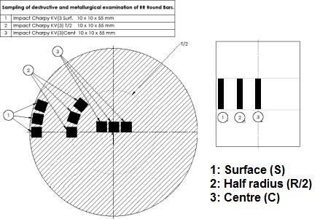
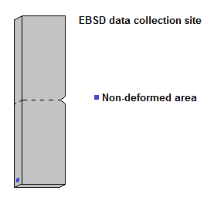
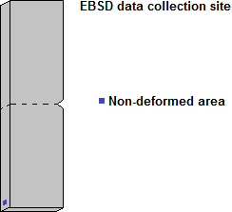
experimental
Sample manufacturing
Three Charpy V-notch impact test bars were prepared from each of the HIPed and heat treated capsules at surface, half radius and center position.
Microstructural characterization was performed on ruptured impact test bars

Slide 9
experimental
Microstructure characterization
EBSD data collection at 500x magnification on 1 site per sample
  FCC, BCC and σ-phase contents
  Grain size disregarding sigma 3 twins
    Area weighted equivalent circle diameter
    Linear intercept
Austenite spacing and intermetallic phase contents were also measured using image analysis at 500x magnification on 20 sites per sample
  Samples polished and etched in Murakami´s etchant
EBSD data collection details

Slide 10
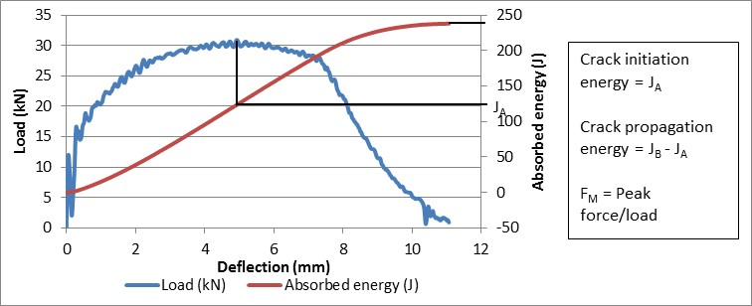
experimental
Impact and Corrosion testing
Instrumented impact testing at -46°C was conducted per ASTM 2298
  Includes load vs. Deflection curves in which the theoretical crack initiation and propagation energies can be derived.
The CPT (Critical Pitting Corrosion Temperature) was measured per ASTM G150 on non-deformed parts of tested impact test bars
J_{B}

Slide 11
Effect of processing parameters on intermetallic phase content and impact toughness for super duplex alloy pm hip sandvik saf 2507^{tm}
Agenda
Introduction
Experimental
  Sample manufacturing
  Microstructure characterization
  Impact and corrosion testing
Results
  Impact toughness
  Microstructure
  Corrosion properties
Discussion
Conclusions

Slide 12
Results
Impact toughness

Slide 13
Results
Impact toughness
Load vs. Deflection curves reveals fully ductile fracture in some samples while other display a ductile-brittle fracture
  1150°C HIP results in fully ductile fracture in all Ø120 mm samples and the surface Ø216 mm sample
  1250°C HIP shows exclusively ductile-brittle fracture for all samples

Slide 14
results
Impact toughness
The observation of fully ductile vs ductile-brittle fracture can also be observed on the fracture surfaces.
  Samples with a
  ductile-brittle fracture
  exhibits a partially ductile
  dimple type of fracture
  and partially cleavage
  fracture in what appears
  to be grain and/or phase
  boundaries
  Samples with fully ductile
  fracture exhibits a fully
  ductile dimple type fracture surface

Slide 15
results
microstructure
Significant difference in grain size and austenite spacing between samples HIPed at 1150°C and 1250°C
  Generally slightly
  larger grain size in
  FCC compared to BCC
  Higher intermetallic
  phase content in center
  of Ø210 mm capsules
  HIPed at 1250°C vs.
  1150°C
    Although overlapping
    standard deviations

Slide 16
results
microstructure
It appears as if the material HIPed at 1250°C generally contains lower amounts of sigma phase

Slide 17
results
Corrosion testing
The average CPT from the ASTM G150 corrosion testing is detailed in the table below.
  Similar values are obtained for all samples.
  The results are in line with previous results from both PM HIP SAF 2507 and conventionally produced SAF 2507 (80-90°C) [1,2].
[1] L. Larsson, M. Bjurström, Properties of PM HIPed SAF 2507 super duplex stainless steel, Proceedings or Euro PM2012 Conference (2012).
[2] J. O. Nilsson, Overview Super duplex stainless steels, Mat. Sc. Tech. 8 (1992) 685-699

Slide 18
Effect of processing parameters on intermetallic phase content and impact toughness for super duplex alloy pm hip sandvik saf 2507^{tm}
Agenda
Introduction
Experimental
  Sample manufacturing
  Microstructure characterization
  Impact and corrosion testing
Results
  Impact toughness
  Microstructure
  Corrosion properties
Discussion
Conclusions

Slide 19
Discussion
Intermetallic phase content
The results of this study indicate that a lower amount of intermetallic phase is formed in PM HIP SAF 2507 when produced with higher HIP temperature.
  Likely explanation is the coarser microstructure
Uncertainties in the measurement of intermetallic phase contents
  EBSD
    Only one field of view per sample
    Large step size might underestimate σ-phase as non-indexed points
    Only measured σ-phase, i.e. any χ-phase present is left out
  Image analysis
    Can be over estimated due to etching effects

Slide 20
discussion
Impact toughness
No significant difference in impact toughness between samples even though lower intermetallic phase contents is indicated in samples produced with higher HIP temperature
  Can be explained by the difference in fracture mode for samples produced with different HIP temperatures
    Higher HIP temperature results in ductile-brittle fracture even in cases where no intermetallic phases are present
  The ductile-brittle fracture of samples HIPed at higher temperature is shown as partial cleavage fracture
    Mechanism for cleavage fracture not fully understood, but seems to be caused by the coarser microstructure

Slide 21
Effect of processing parameters on intermetallic phase content and impact toughness for super duplex alloy pm hip sandvik saf 2507^{tm}
Agenda
Introduction
Experimental
  Sample manufacturing
  Microstructure characterization
  Impact and corrosion testing
Results
  Impact toughness
  Microstructure
  Corrosion properties
Discussion
Conclusions

Slide 22
Conclusions
Pm hip sandvik saf 2507^{tm} produced with different hip-temperatures
Lower intermetallic phase content is indicated for PM HIP SAF 2507 HIPed at 1250°C compared to 1150°C
  A probable explanation for this is the coarser microstructure, i.e. reduced grain and phase boundary area, which results in fewer locations for nucleation and growth of intermetallic phase
No significant difference in impact toughness is obtained for PM HIP SAF 2507 HIPed at 1250°C compared to 1150°C
  A probable explanation for this is the difference in fracture mode for samples produced with different HIP temperatures.
  The coarse microstructure itself seem to generate lower impact toughness regardless of intermetallic phase content.

