Slide 1
High Pressure Heat Treatment - Phase Transformation Under Isostatic Pressure in HIP
Magnus Ahlfors
Applications engineer Isostatic pressing
magnus.ahlfors@quintusteam.com

Slide 2
Project
Joint member project within the Powder Metallurgy Member Research Consortia at Swerea KIMAB, Sweden
Participating companies:
Quintus Technologies AB Magnus Ahlfors, Stefan Sehlstedt
AB Sandvik Materials Technology Linn Larsson, Martin Östlund
Höganäs AB Dimitris Chasoglou

Slide 3
Outline
Purpose and aim
Background
Experiments
Results
Discussion and conclusions

Slide 4
Purpose and aim
Purpose: Rapid quench HIP furnaces enables heat treatment in the HIP
Heat treatment and quenching performed under high external pressure
Very little data on thermodynamics under pressure found in literature e.g. TTT, CCT etc.
Is conventional heat treat recipes transferable to HIP:ing?
Aim: Investigate whether a typical HIP pressure of 1700 bar is enough to shift the austenite to pearlite phase transformation towards longer times and quantify the effect

Slide 5
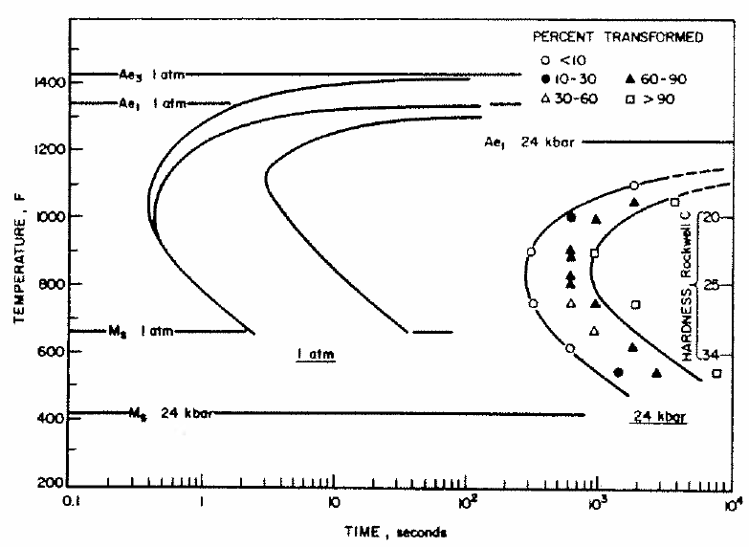
Background
Studies form 1960s-70s on the influance of extreme pressures on phase transformation kinteics in Fe-C system
Nilan, Hilliard, Radcliff, Fujita
Theory on reduction of transformation
Lower carbon diffusivity at elevated pressures
A. Weddeling has used URQ HIP to study the influence of high pressure quenching on microstructure
Results suggest that the bainite formed during quenching under HIP pressure is not only formed later in time but also at lower temperatures
Densifying and Hardening of Martensitic Steel Powders in HIP Units Providing High Cooling Rates, EuroPM2015

Slide 6
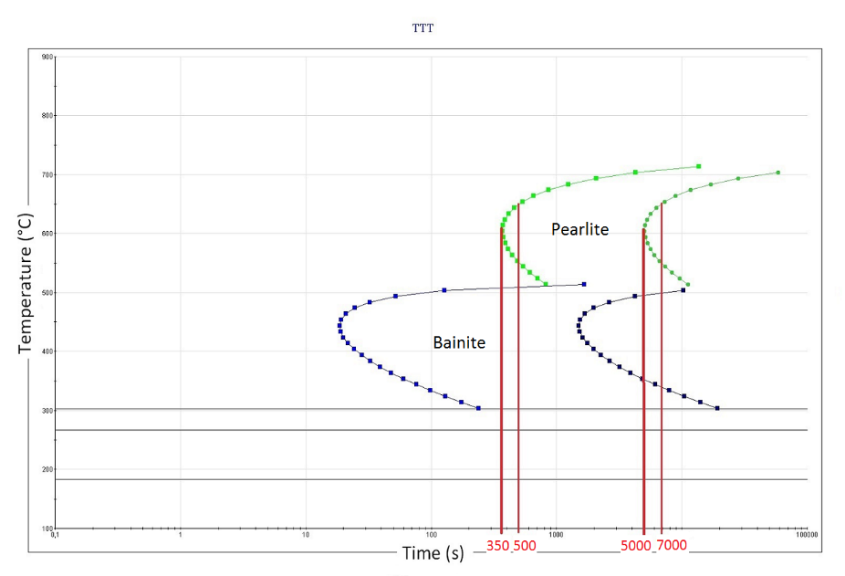
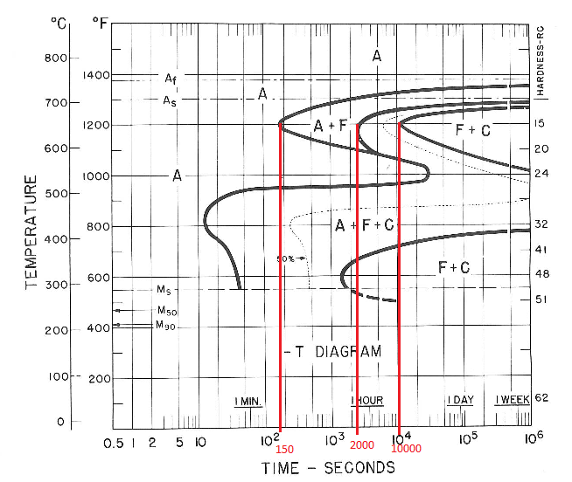
Materials selection
4340 (SS2541)
A wellknown quench and temper steel
Data existing in litterature
Sufficient time to perlite start
Chemical composition
Elements [%] | C | Mn | Si | Cr | Ni | Mo | Cu | Fe
4340 | 0.37 | 0.74 | 0.26 | 1.45 | 1.50 | 0.19 | 0.16 | bal.

Slide 7
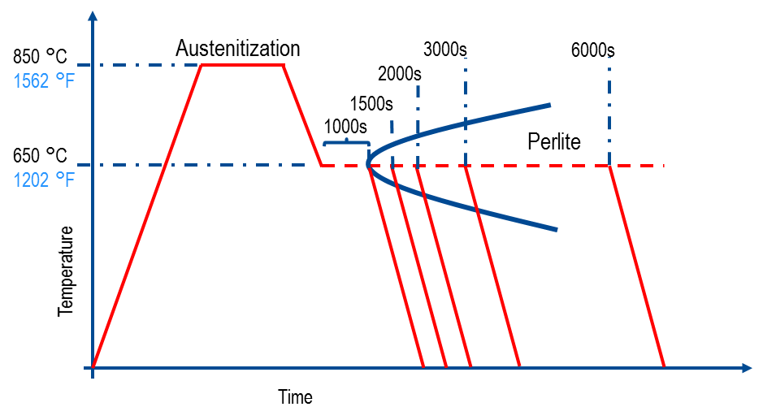
Experimental procedure and parameter selection
TTT diagram experimental approach for a high and a low pressure
Austenize at 850 °C for >20 minutes
Rapid quench to 650°C (park in front of the perlite nose)
Five different hold times (1000s, 1500s, 2000s, 3000s, 6000s)
One low and one high pressure (100 and 1700 bar)
1700 bar = maxiumum possible pressure
100 bar = minimum possible pressure
Microstructure analysis and hardness measurment
Schematic of test procedure

Slide 8
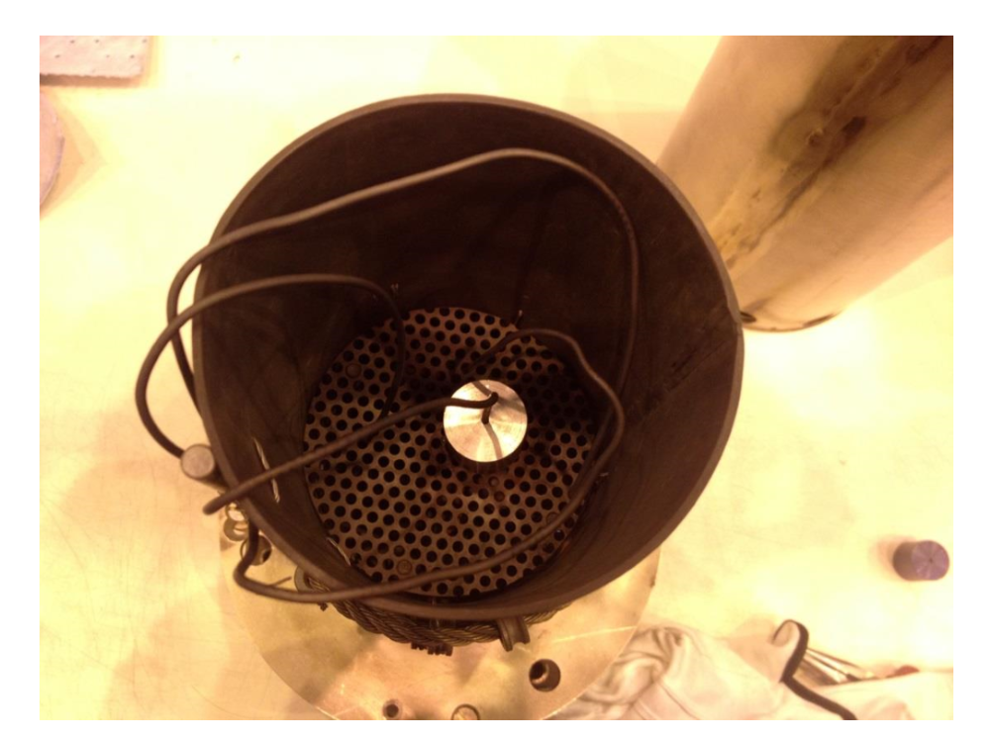
Experimental procedure
Test set-up:
Cylindrical rod specimens: 25 x 25 mm (1” x 1”)
Drilled hole to center of specimen
Thermocouples in gas in hot zone
Thermocouple in center of specimen
Set-up in HIP furnace
Test speciemen
Thermocouples

Slide 9
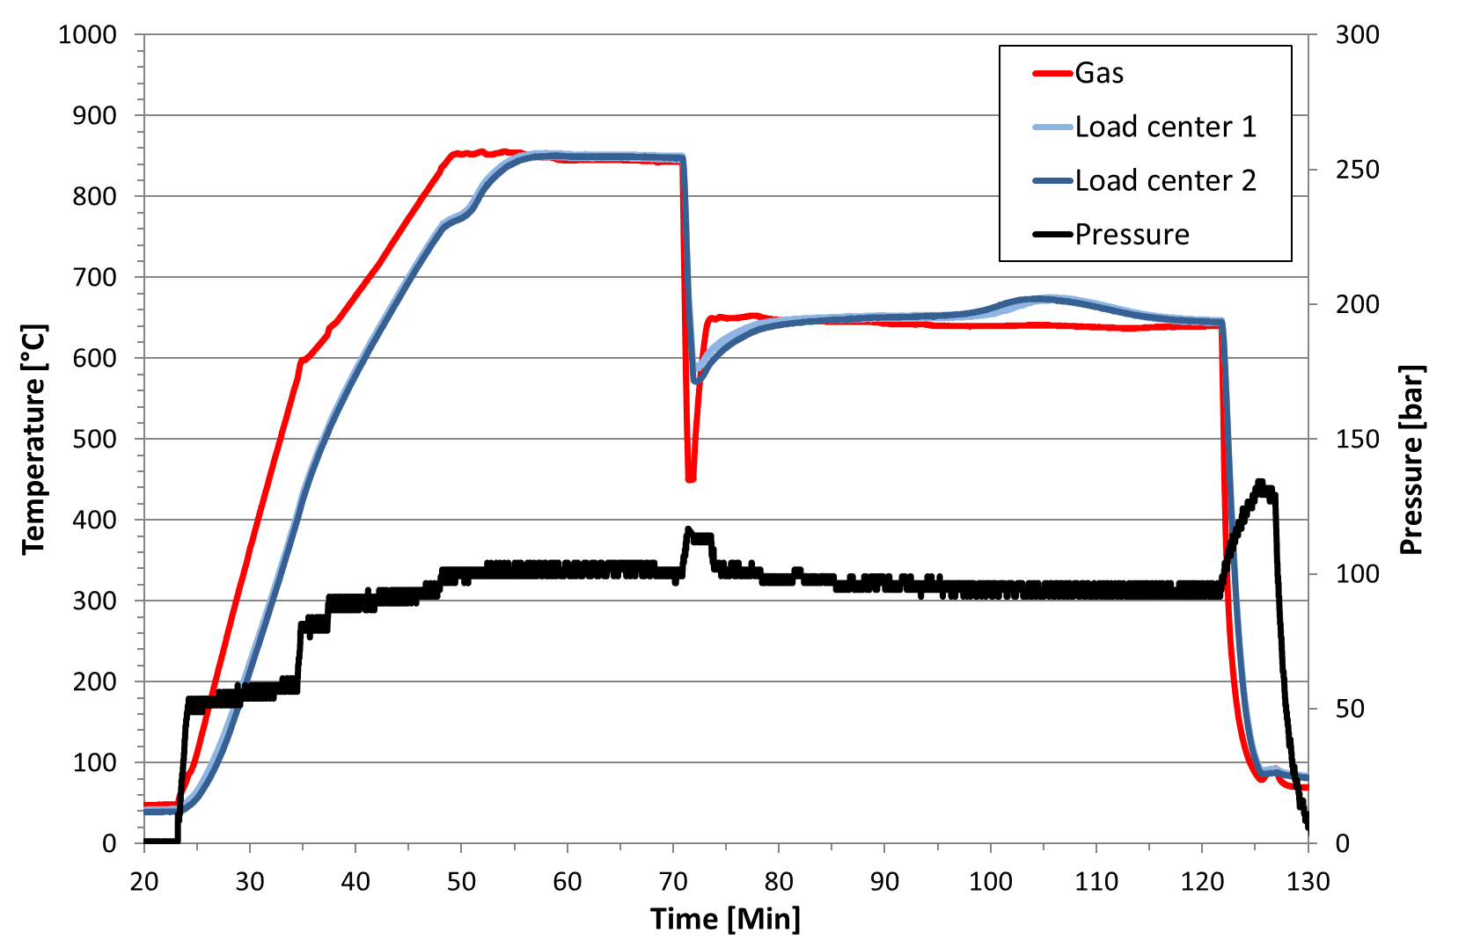
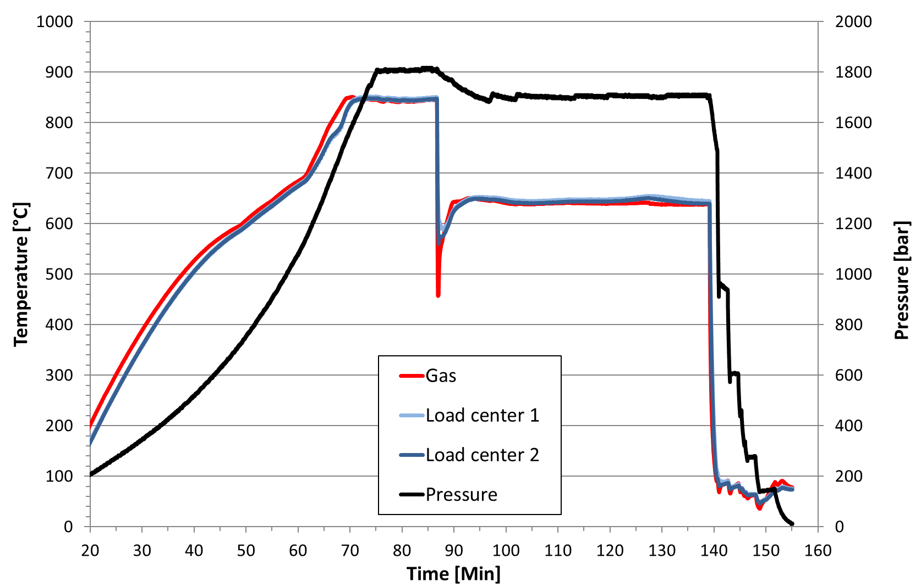
Results from HIP cycles
HIP log curve for 3000 s, 100 bar
HIP log curve for 3000 s, 1700 bar
Perlite transformation
- Exoterm reaction

Slide 10
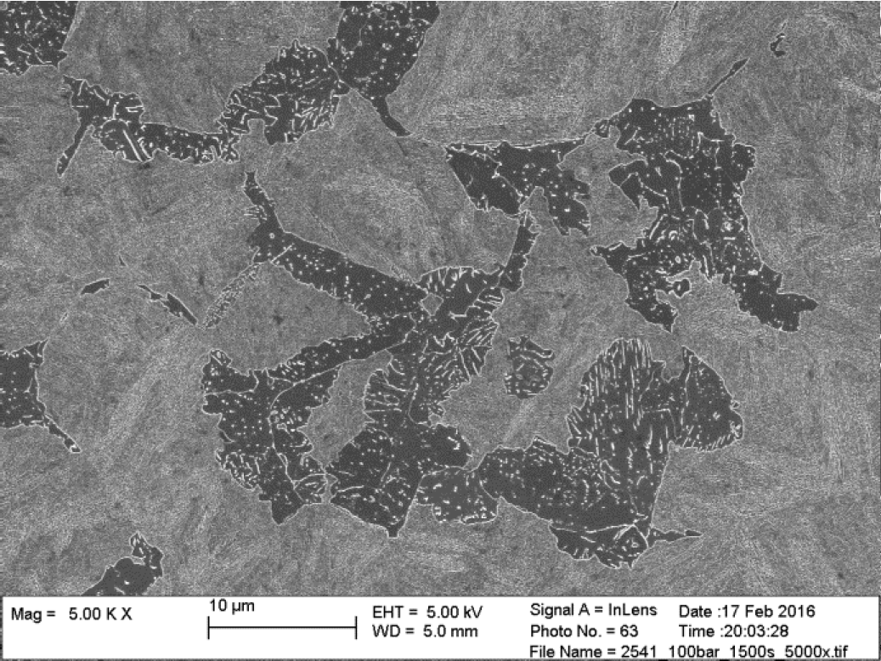
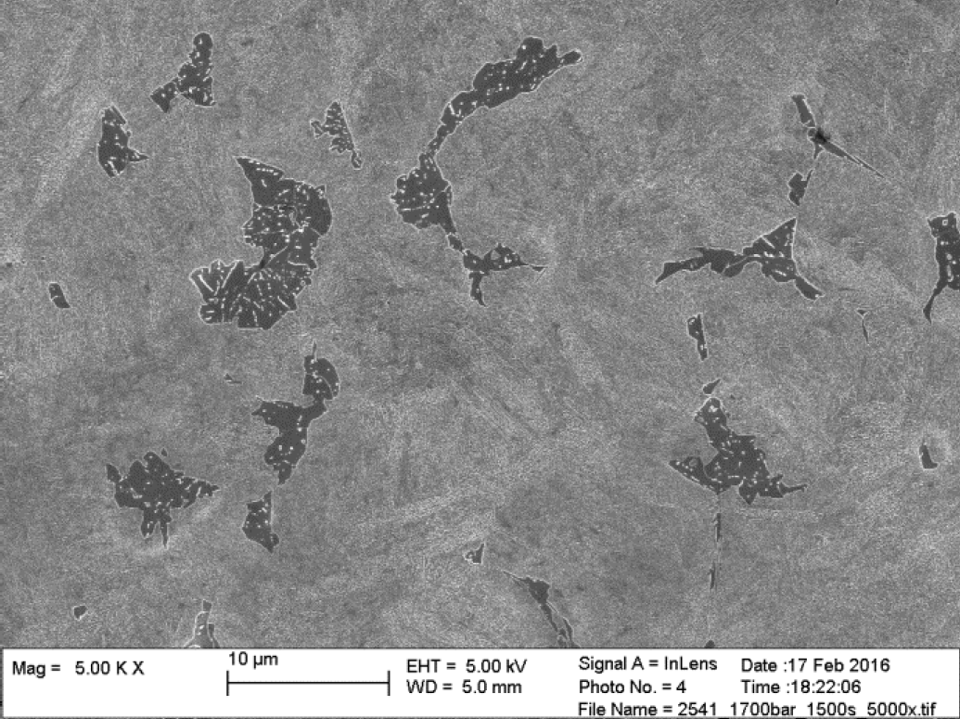
Results of microscopy and hardness measurements
1500 sec isotherm @100 bar
19 % pearlite
Hardness: 536 HV
1500 sec isotherm @1700 bar
10 % pearlite
Hardness: 572 HV
Martensite
Pearlite
Martensite
Pearlite

Slide 11
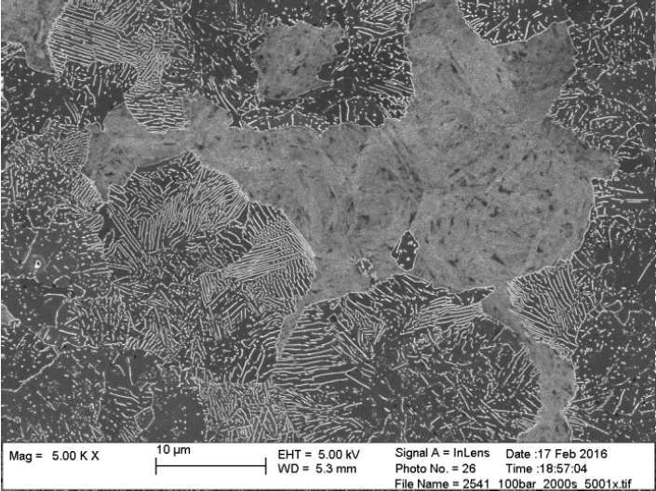
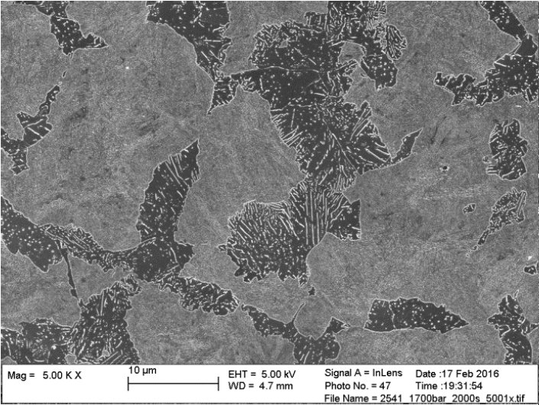
Results of microscopy and hardness measurements
2000 sec isotherm @100 bar
70 % pearlite
Hardness: 344 HV
2000 sec isotherm @1700 bar
26 % pearlite
Hardness: 497 HV
Martensite
Martensite
Pearlite
Pearlite

Slide 12
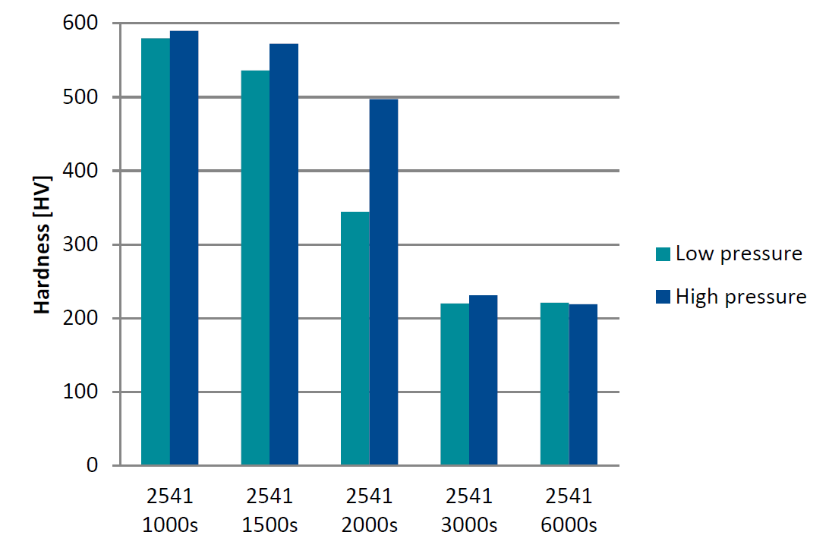
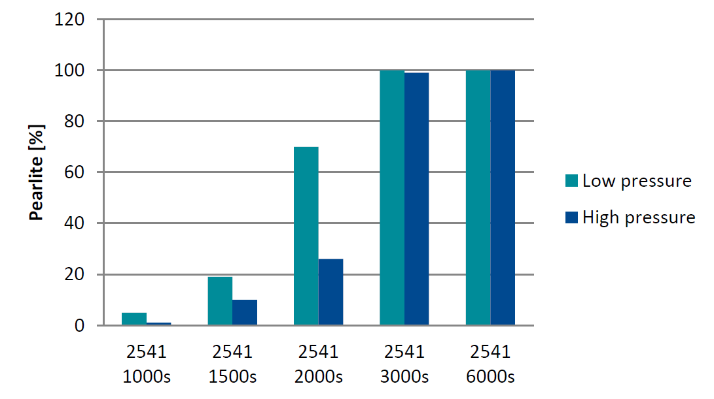
Microscopy and hardness summary
1000 seconds is too short hold time
Virtually 0 % perlite and similar hardness for both pressures
3000 and 6000 seconds are too long hold times
Virtually 100 % perlite and similar hardness for both pressures

Slide 13
Conclusions
All phase fraction evaluation results indicate that HIP pressure pushes austenite – pearlite transformation towards longer times
All hardness measurement results indicate that HIP pressure pushes austenite – pearlite transformation towards longer times
100 and 1700 bar compared, not atmospheric pressure!

Slide 14
Benefits
Automatically increased hardenability when quenching under pressure
Possibility to:
Use less alloying elements
Quench thicker sections
Use slower cooling for the same hardening response

Slide 15
High pressure heat treatment – unexplored field
CCT and TTT diagrams, heat treatment recipes etc.
all for atmospheric pressure
Only Fe-C system investigated in this study
What is the pressure influence on other common materials?
Al, Ti, Ni-base, CoCr etc.
What other effects can pressure have on conventional heat treatment?
Unexplored and interesting field where research is needed!

Slide 16
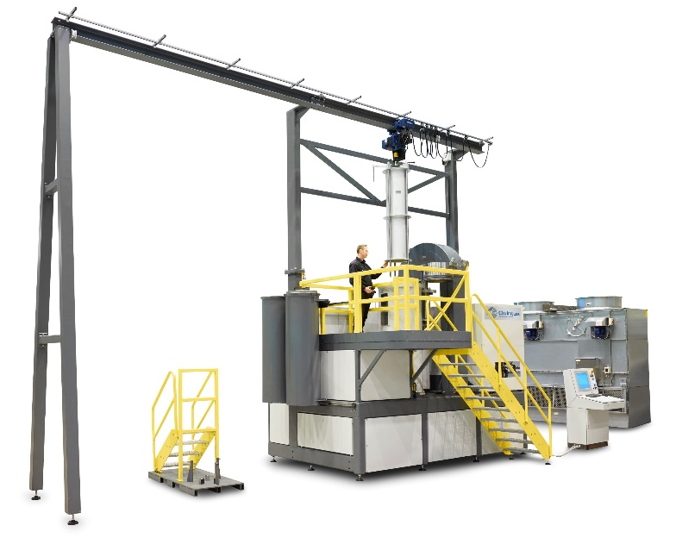
Thank you for your attention!
Magnus Ahlfors
Applications Engineer
Magnus.Ahlfors@quintusteam.com

