Slide 1
HIP technology enables ceramic manufacturers to control material properties and increase productivity
Dr. Anders Eklund and Mr. Magnus Ahlfors
Quintus Technologies AB

Slide 2
Synopsis
Hot Isostatic Pressing (HIP)
  Applications and use
Ceramics
  Properties
  Manufacturing
Summary and conclusions

Slide 3
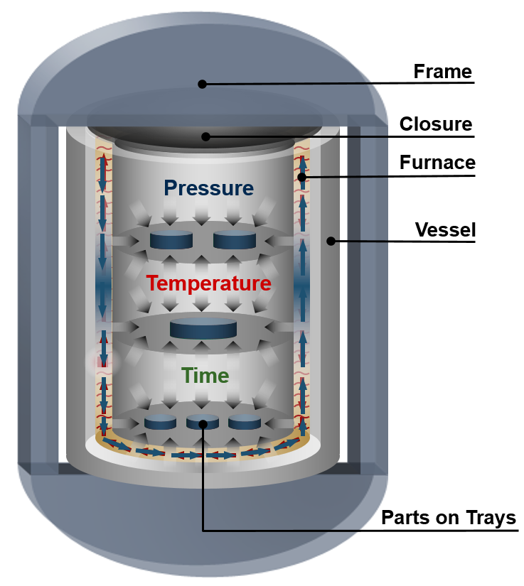
Hot Isostatic Pressing
Definition: “Applying a pressure, distinctly higher than the yield strength of the material at the HIP temperature”
Main applications:
  Pore elimination of solids
  Consolidation of powder
  Diffusion bonding E.g. Steel/Cu, Ti/SS etc.
Mechanisms:
  Mechanical deformation
  Creep
  Diffusion

Slide 4
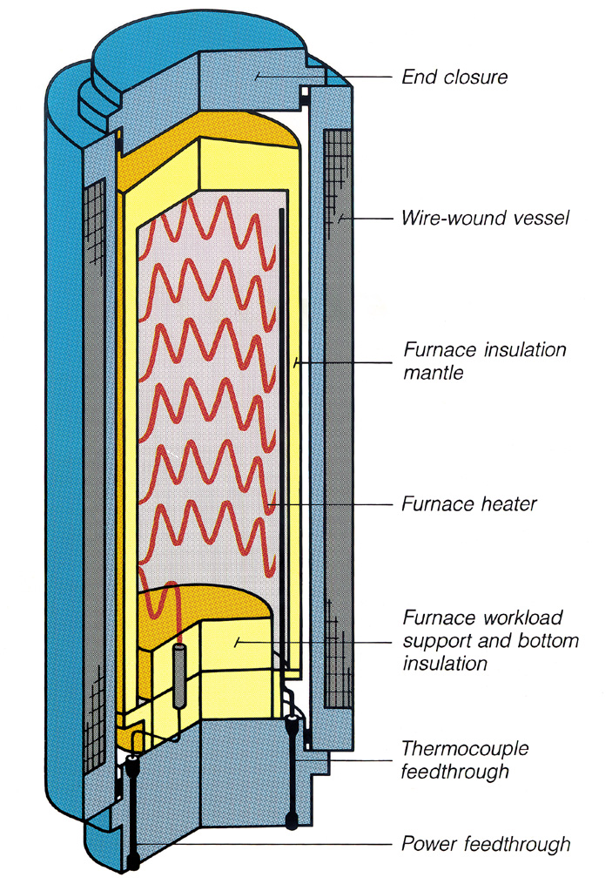
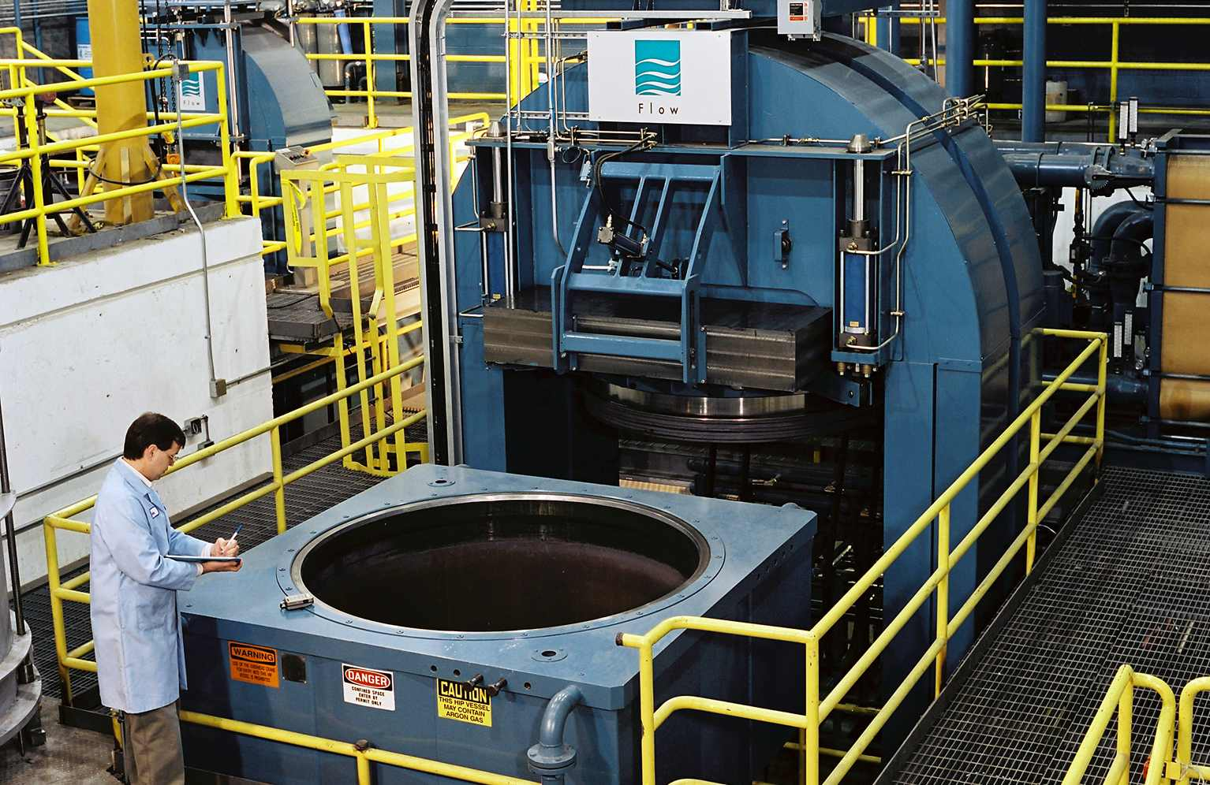
Hot Isostatic Presses
A combination of temperature and pressure heal internal voids in metal and ceramic materials to substantially improve strength

Slide 5
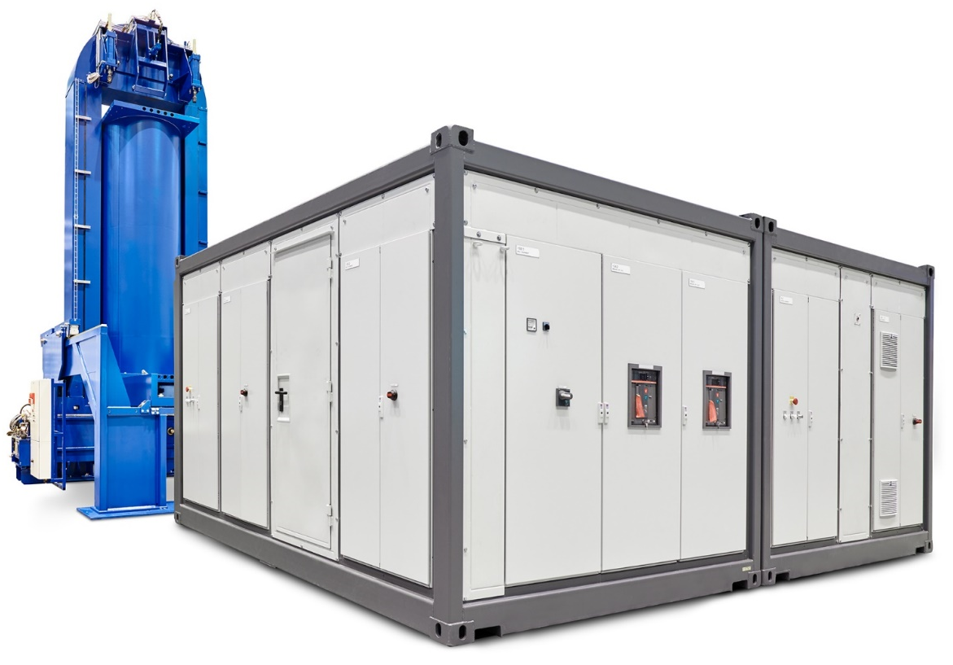
What signifies Quintus systems
Safest pressure vessel on the market
Highest productivity on the market
Highest Quality on the market
Fastest installation from order to production

Slide 6
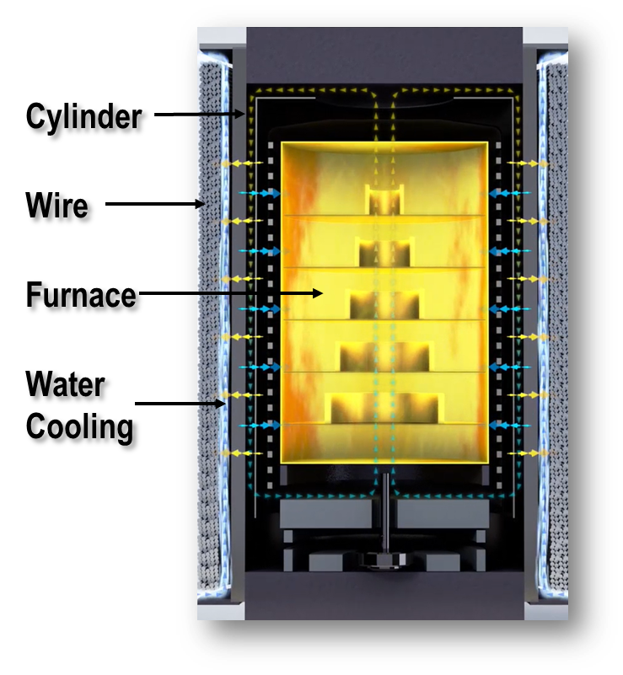
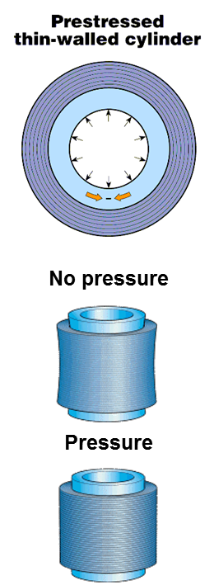
Wire wounded pressure vessel enables fast cooling
The pressure vessel is a thin walled forged cylinder, pre stressed with high strength steel wire
Wire winding enables the possibility to withhold extreme pressure to a comparably low weight.
With wire winding the need for frequent safety related inspections is drastically reduced.
Through controlled water cooling of the thin walled unmatched cycle times are achieved.
Superior furnace insulation concept keep power losses to a minimum.
Wire winding gives maximum safety and enables unmatched performance!
Notes:
The high cooling rates we can achive is thanks to our pressure vessel design with a thin forged cylinder which is wire wounded. We have the cooling water between the cylinder and wire thus very close to the hot zone so we use the pressure vessel like a heat exchanger.

Slide 7
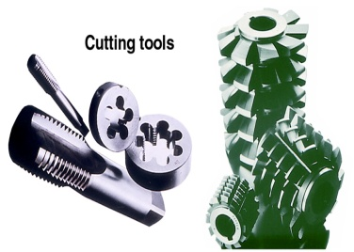
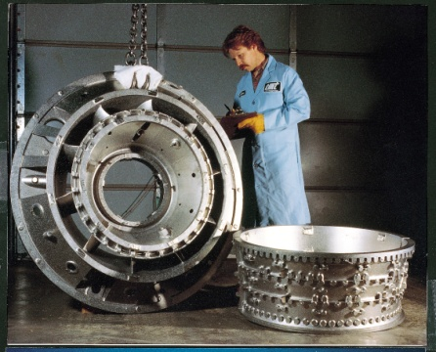
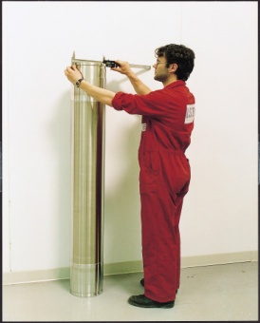
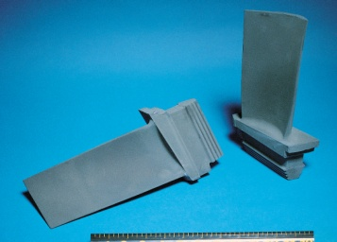
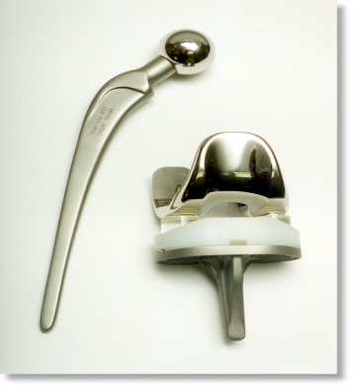
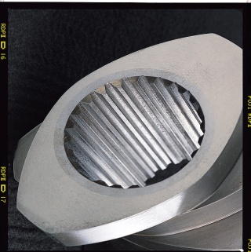
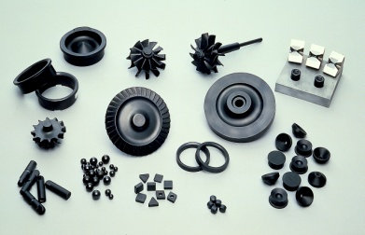
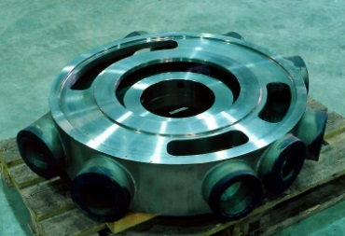
Typical HIP Applications - General
P/M Tool Steel
Aerospace castings (SA and Ti)
Aluminium castings (Densal with Bodycote)
Body implant castings (Ti and Co-Cr-Mo)
Body implant ceramics (Alumina and Zirkonia)
Advanced engineering ceramics
Armour ceramics
Composite P/M materials
Near net shape (NNS) alloy steel products
Super alloy billets and NNS P/M products
Diffusion bonding of dissimilar materials
Sputtering targets
Metal matrix diamond tools
Metal matrix composites
HIP brazing
Carbon/Carbon HIP impregnation
etc., etc., ……

Slide 8
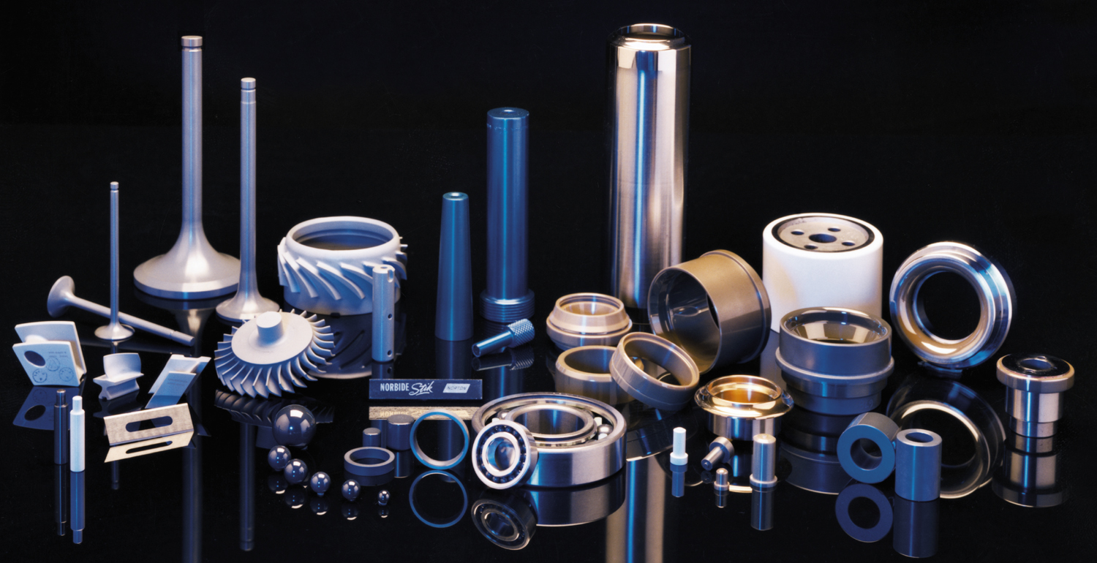
Typical HIP Applications - Ceramics
Silicon Nitrides/Carbides/Oxides
Silicon Nitride

Slide 9
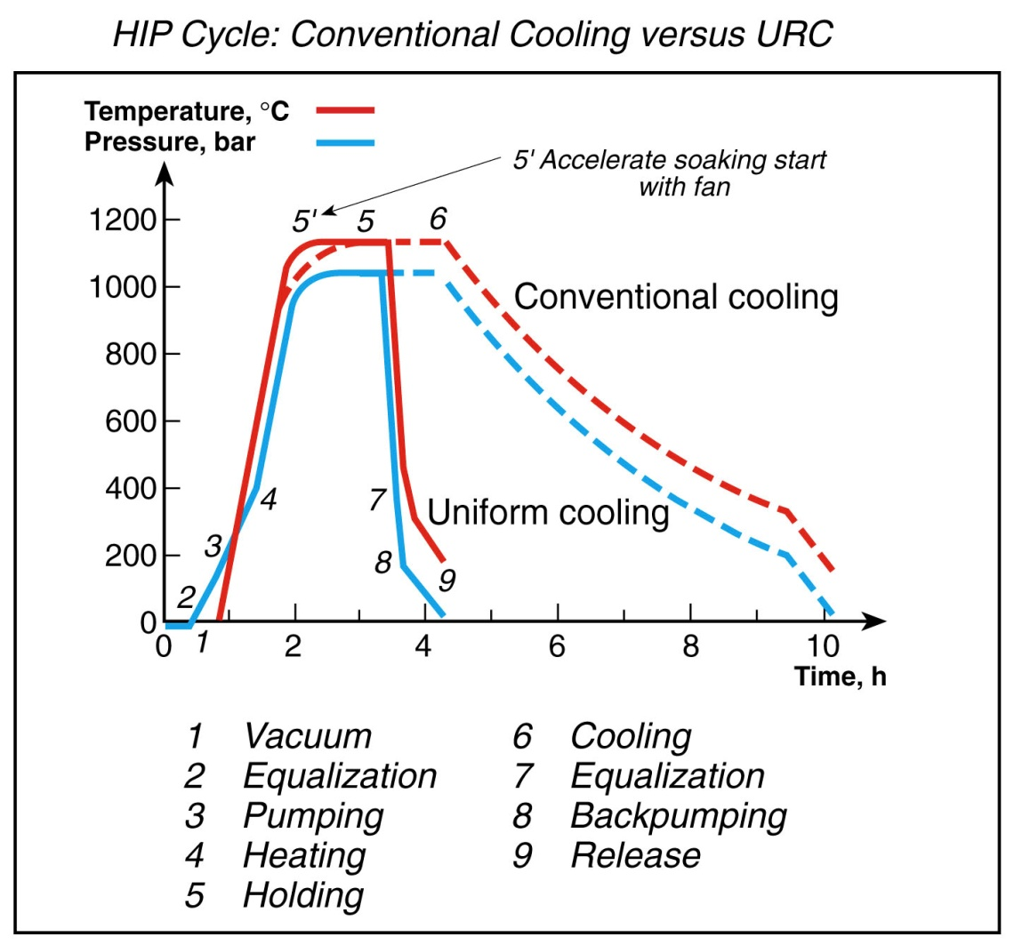
Uniform Rapid Cooling (URC®)
A wire wound thin walled cylinder is the only way to achieve rapid cool performance with control.
Quintus is the sole supplier of the patented URC® solution.
Cooling is fast enough for heat treatment of the load.
Up to 100% faster turn around time is achieved

Slide 10
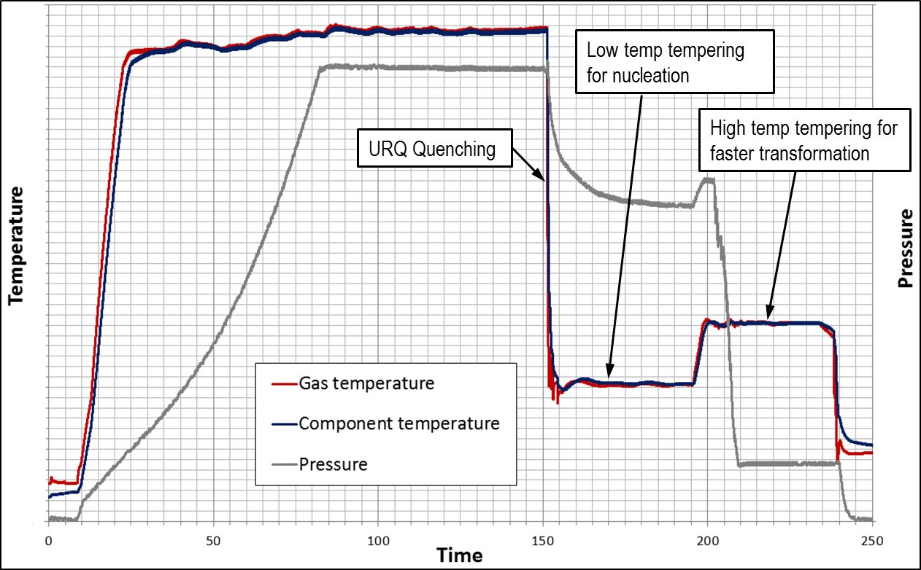
Uniform Rapid Quenching (URQ®)
URQ enables HIP quenching
  URQ ≈ 300-3000C/min (572 – 5432 F/min)
Unrestricted control of temperature and pressure
Control the physical properties in the material
With a URQ HIP you have the ultimate heat treatment machine!
Notes:
A couple of years ago we took this invention a step further with the URQ furnace with very high cooling rates with the purpose to be able to combine HIP+heat treatment enabelöing for example martensitic ahrdening or age ahrening etc. inside the HIP

Slide 11
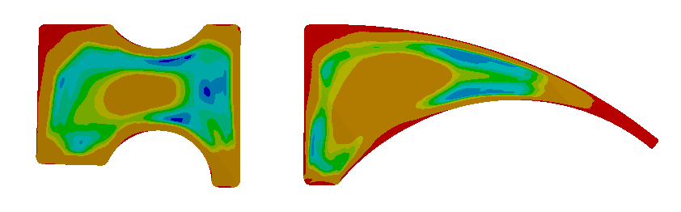

Uniform Rapid Quenching (URQ®)
With Quintus latest developments quenching can be achieved directly in the HIP
Cooling rates up to 2000 C/min can be achieved with a continued high pressure
With Quenching directly in the HIP there will be:
  low thermal gradients ➔ low thermal stresses
  low risk of distortion and cracking
Programmable temperature distribution with good accuracy during the cooling phase
The ultimate Heat treatment machine (HPHT)
Thermal stresses salt bath (60s)
158MPa
Thermal stresses URQ (60s)
50MPa

Slide 12
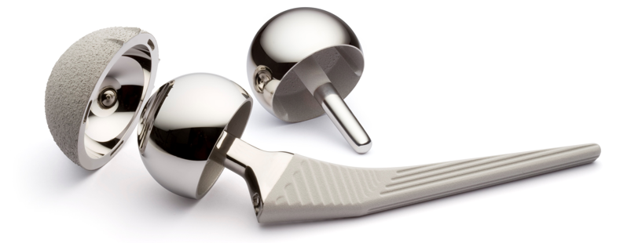
Advantages of Hot Isostatic Pressing
100% of theoretical density
Superior material properties
  Fatigue
  Ductility
Reduced scatter in material properties
  Predictive component life
  Low weight design
Decreased scrap loss

Slide 13
Ceramics – Properties and Manufacturing
YSZ
Yttria Stabilized Zirconia has a number of Applications:
For its hardness and chemical inertness (e.g., tooth crowns).
As a refractory (e.g., in jet engines).
As a thermal barrier coating in gas turbines
As an electro ceramic due to its ion-conducting properties
Used in the production of a solid oxide fuel cell (SOFC).
For its hardness and optical properties in monocrystalline form it is used as jewelry.
As a material for non-metallic knife blades
In water-based pastes for do-it-yourself ceramics and cements.
YSZ doped with rare-earth materials can act as a luminescent material.
Historically used for glowing rods in Nernst lamps.
As a high precision alignment sleeve for optical fiber connector ferrules.

Slide 14
Ceramics – Properties and Manufacturing
Example: YSZ for Dental Implants
Elements (%) | ZrO₂ (+HfO₂) | Y₂O₃ | Al₂O₃ | SiO₂ | Fe₂O₃ | Na₂O | Density (g/cm3) | Hardness (HV)
5YSZ | Balance | 4.95-5.25 | 0.15-0.35 | < 0.02 | < 0.01 | < 0.04 | 6.05 | > 1250

Slide 15
Density Changes in Metal and Ceramic Powders

Slide 16
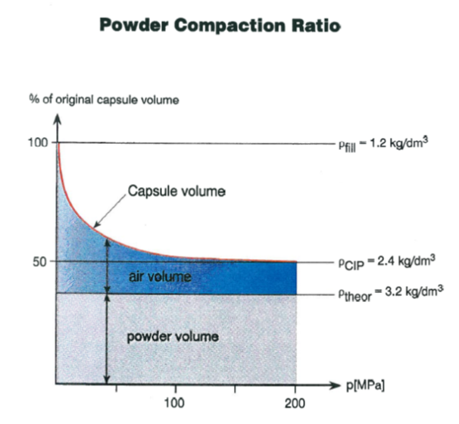
Illustration of the Entrapped Air in a Ceramic Powder

Slide 17

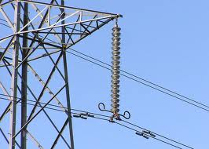
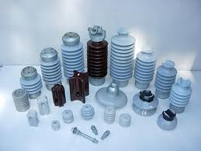
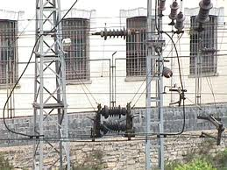
Insulators
It is a kind of mains material which is used on overhead lines for,
Carrying conductors
Cutting off the connection between soil and other conductors
Porcelain Insulator

Slide 18
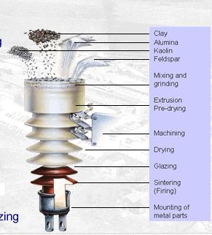
Insulator Production Process
Clay
Quartz
Kaolin
Feldspar
Mixing and Milling
Extrusion and Pre-drying
Shaping
Drying
Glazing
Sintering (Firing)
Metal assembly

Slide 19
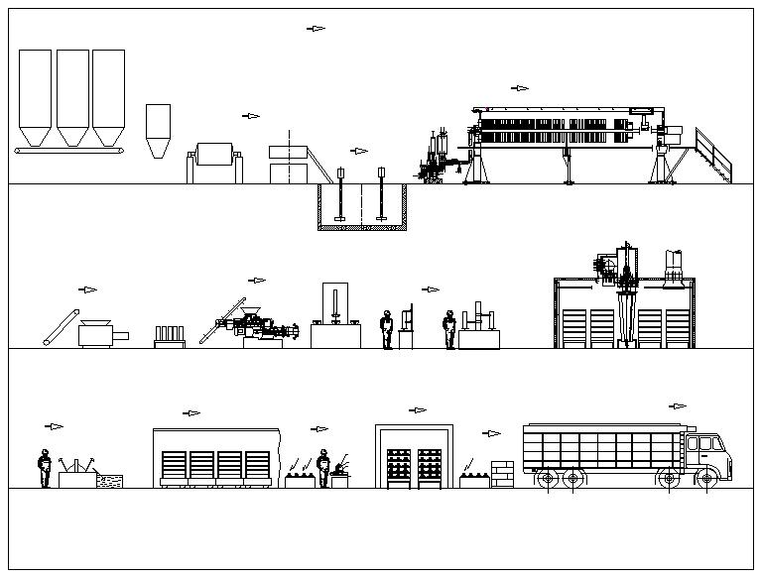
Work-Flow Diagram for Insulators
Raw Material
Filter Press
Mill
Sieve
Pool
Computer
Controlled
Drier
Homog. Press
Pug-Mill
C/HIP
Shaping
?
Metal
Assy.
Cement
Curing
Glazing
Firing
Packaging
Transportation

Slide 20
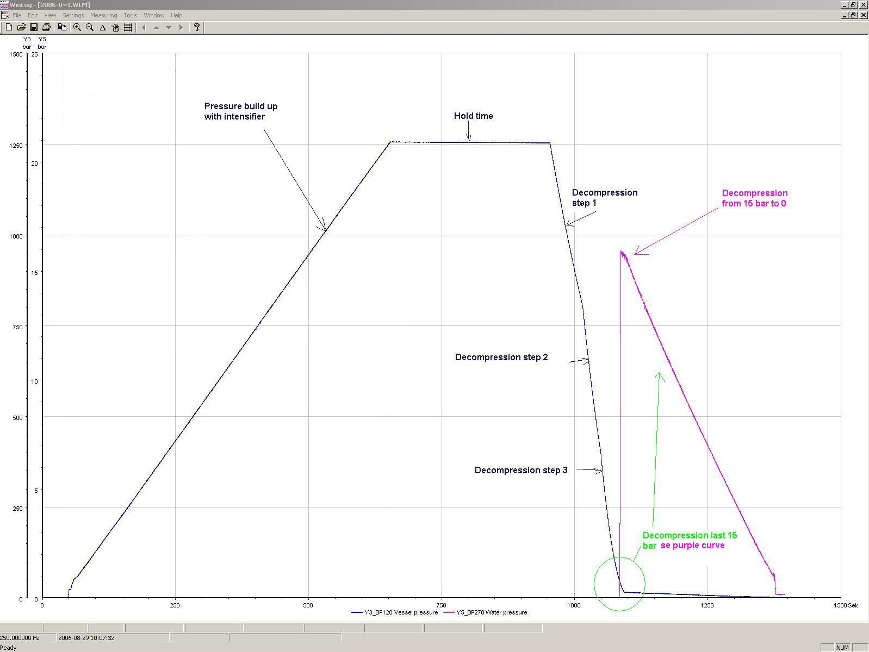
Cycle Programmable Decompression Rates Very Accurate Feed-back Control Decompression 200-15 (Optional) and 15-0 bar
1-20 min in one or more segments

Slide 21
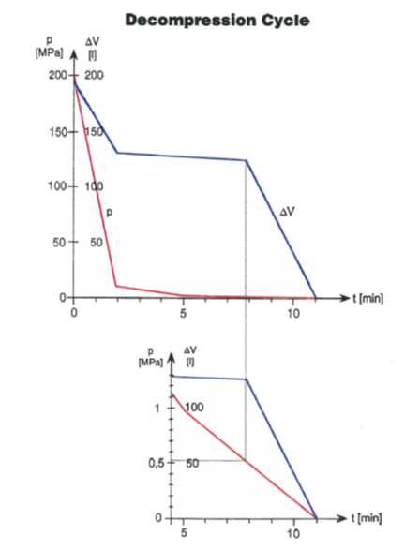
Fine Decompression Cycles

Slide 22
Summary and Conclusion
HIP technology provides manufacturers with
  Control of Material Properties.
  Increased Productivity with URC
Combining HIP and Heat Treatment
  Gives shorter lead times (no NDT)
  Better material properties
  Process cost savings (lowering scrap rate)
  Investement cost savings

Slide 23
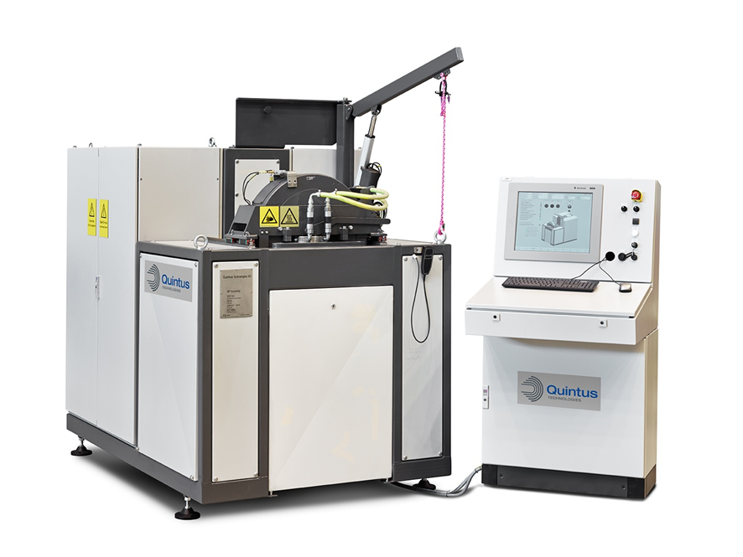
Quintus Technologies
Thank you for your attention!
How can we help?

