Slide 1
HIP for AM - Optimized material properties by HIP
Dr. Anders Eklund and Mr. Magnus Ahlfors
Quintus Technologies AB

Slide 2
HIP for AM material

Slide 3
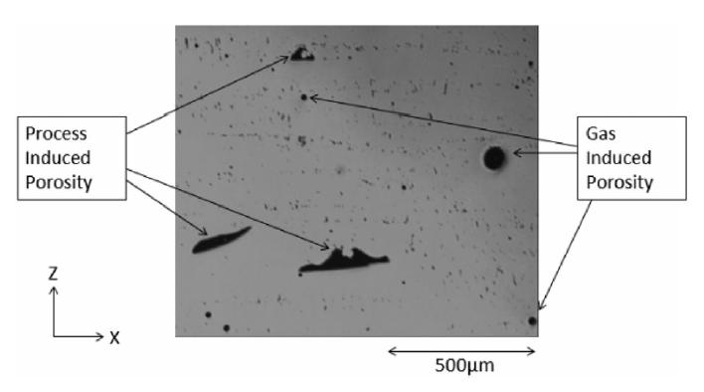
As-printed material
Internal defects as-printed
  Lack-of-fusion porosity
  Gas porosity etc.
  Amount depends on
    Material, powder, printing parameters etc.
Internal defects means
  Stress concentrations
  Crack initiation points
Negative influence on
  Fatigue
  Ductility
  Fracture toughness

Slide 4
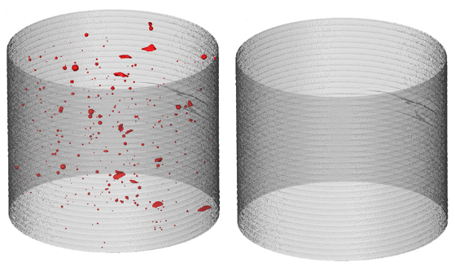
HIPing of AM parts
As-built
After HIP
HIP only eliminates internal, isolated defects =>
  Surface defects are not eliminated
  Porosity acts as stress concentrations and crack initiation points
Requirement: Gas tight surface
  Not a problem for PBF
HIP gives ~100% relative density =>
  Improved ductility and fracture toughness
  Much improved fatigue properties
  Lower scattering in properties
  Better machined surfaces
Strength is mostly controlled by microstructure and not defects
Ref: Porosity regrowth during heat treatment of hot isostatically pressed additively manufactured titanium components, S. Tammas-Williams et al, Scripta Materialia 122 (2016) 72–76

Slide 5
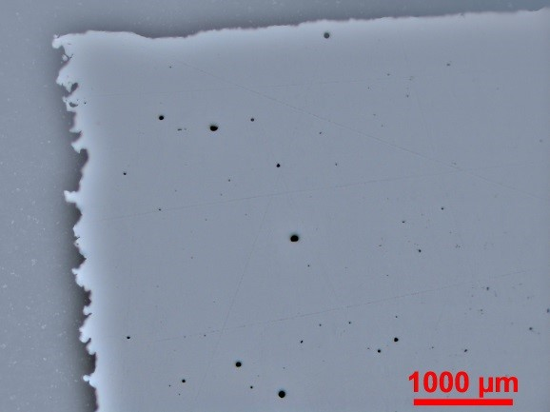
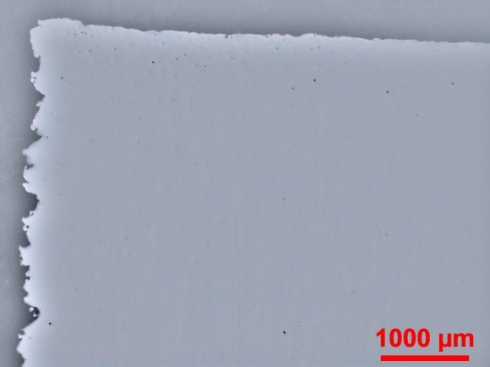
HIP improves fatigue properties of AM Material
Powder bed fusion gives relatively high as-printed densities
  HIP still have a large effect on the fatigue properties
As-built
After HIP
Pores

Slide 6
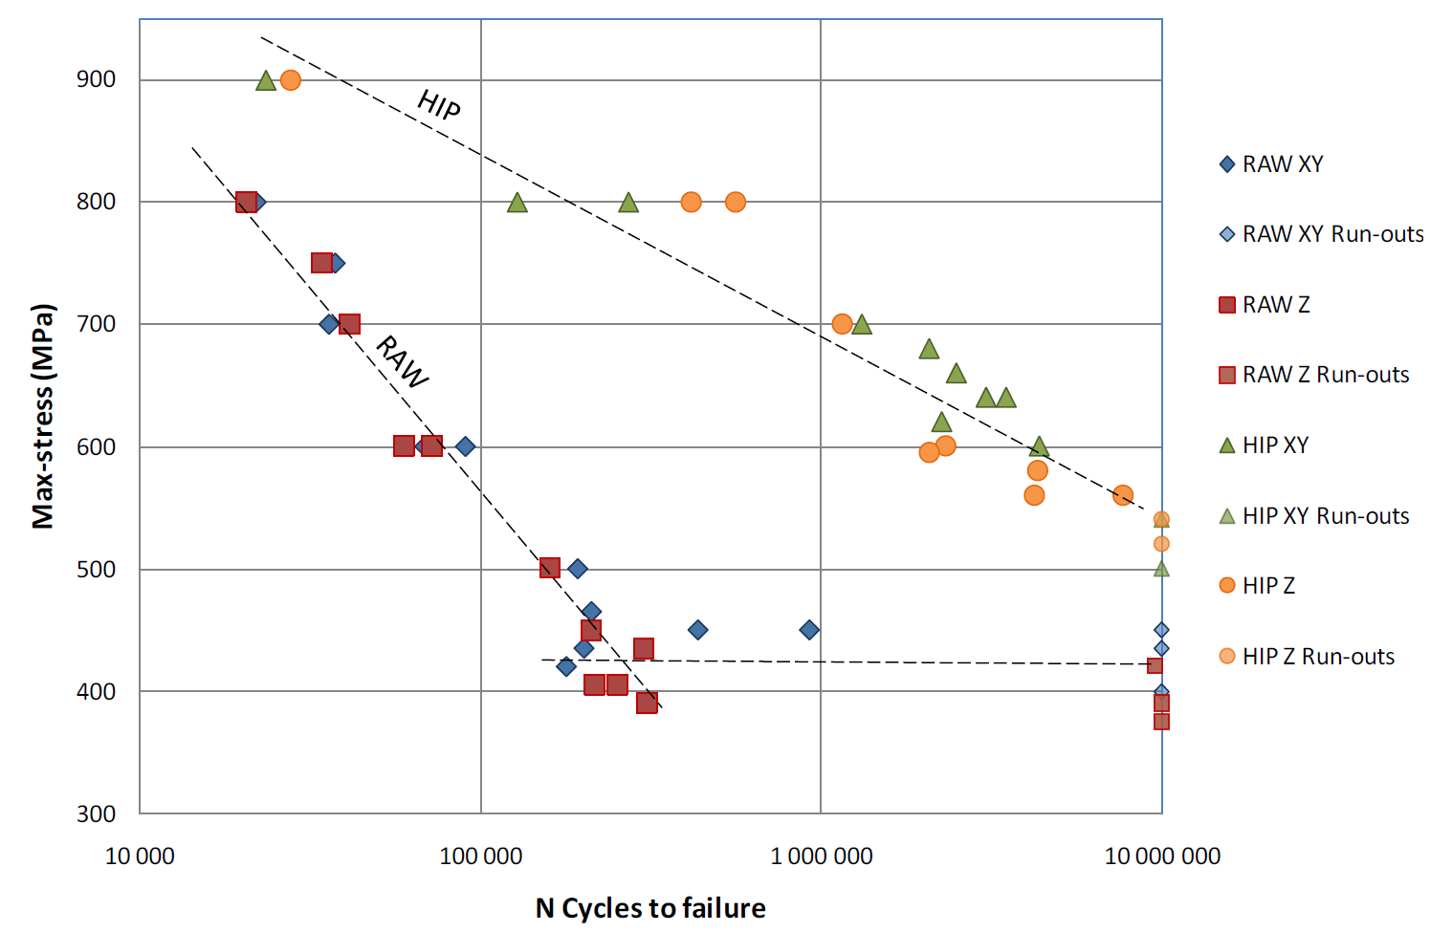
HIP improves fatigue properties of AM Material
EBM Ti-6Al-4V
SLM Ti-6Al-4V
HIPed
HIPed
Pores
As-printed
As-printed
Courtesy of Arcam
Ref: The mechanical performance of structures manufactured by Selective Laser Melting: Damage initiation and propagation, Stefan Leuders, University of Paderborn, Germany, AMPM2014, MPIF, USA

Slide 7
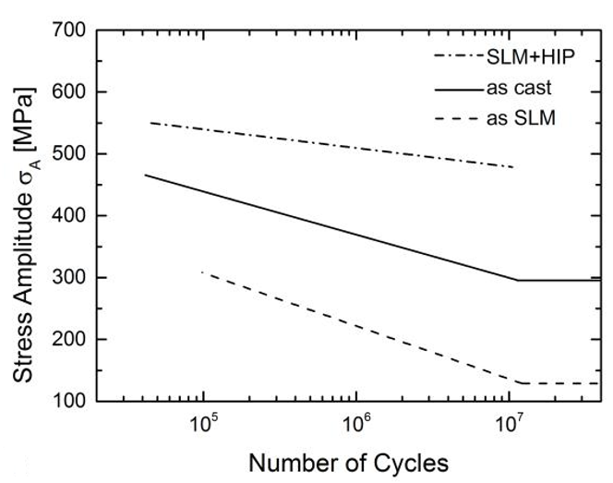
HIP improves fatigue properties of AM Material
SLM CoCr F75
As-printed
HIP:ed
Ref: Effect of Subsequent Hot Isostatic Pressing on Mechanical Properties of ASTM F75 Alloy Produced by SLM, J. Haan et al, Powder Metallurgy, v. 58, n. 3, p. 161–165, jul. 2015.

Slide 8
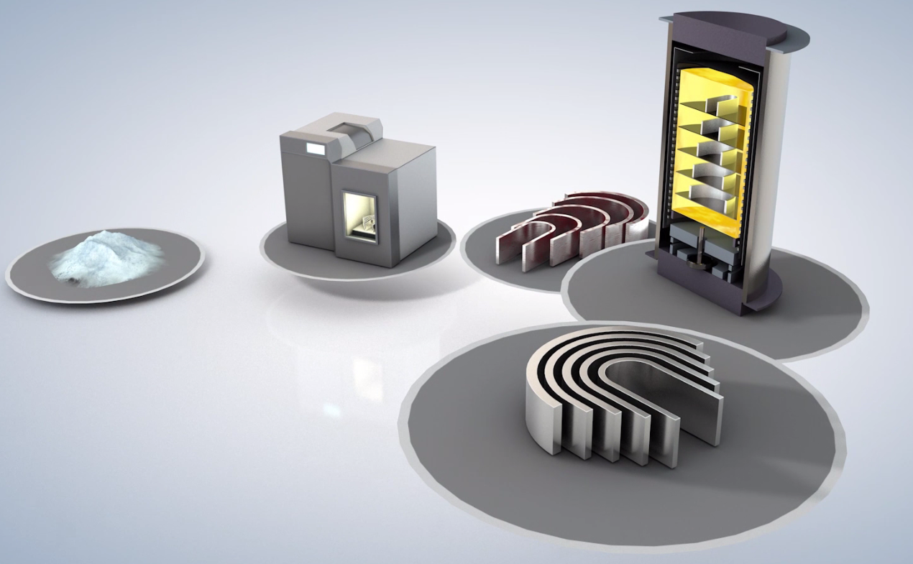
Quintus High Pressure Heat Treatment

Slide 9
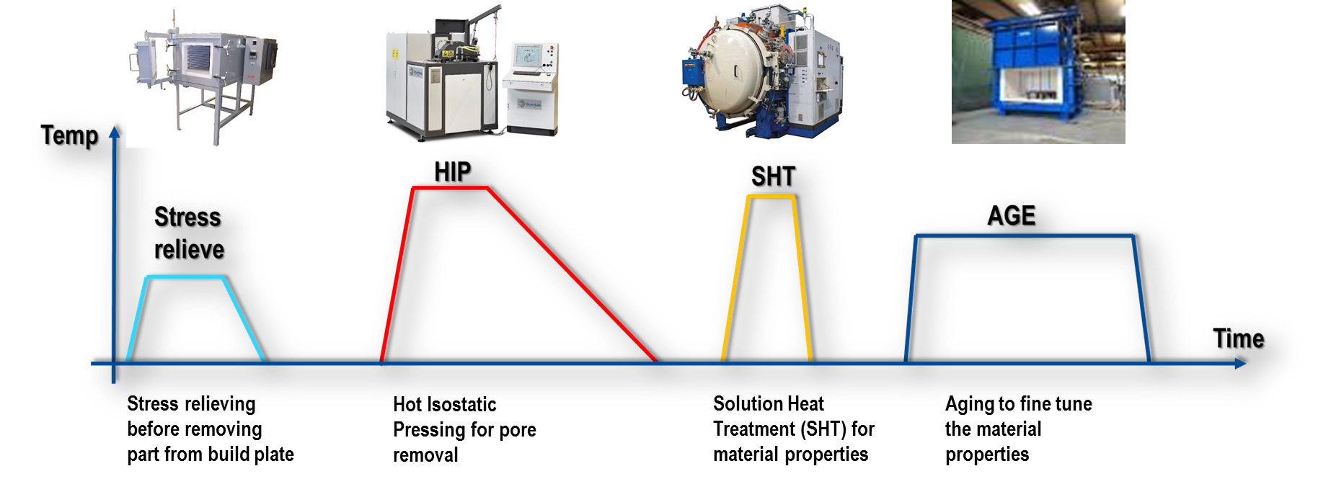
Conventional post process of an AM part
Conventional post process of AM
Stress relieving for removal of part from build plate
Hot Isostatic Pressing for defect elemination
Solutionize and quench
Ageing/tempering for mechanical properties

Slide 10
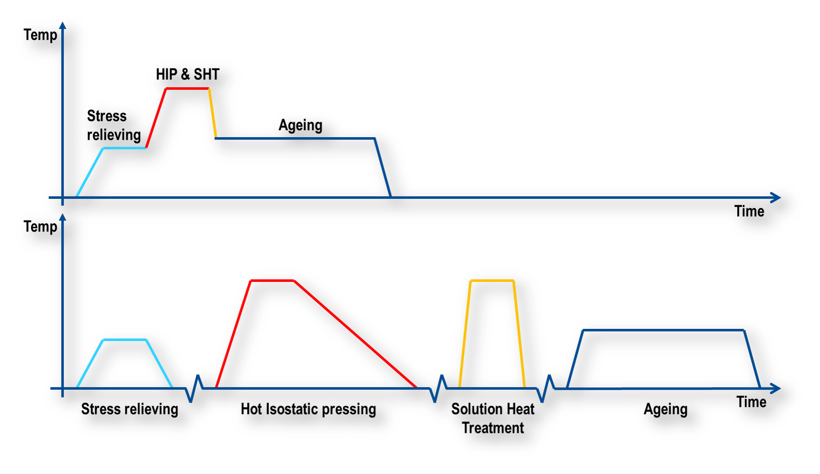
High Pressure Heat Treatment (HPHT)
Savings in:
Lead time
Energy consumption
Cost
Resources
Capital investment
Possibility to combine HIP and Heat Treatment, which gives:
  Reduced downtime & leadtime
  Excellent process controll
  Improved Quality control
  Less time at elevated temperature
Cooling rates in excess of 500°C / min

Slide 11
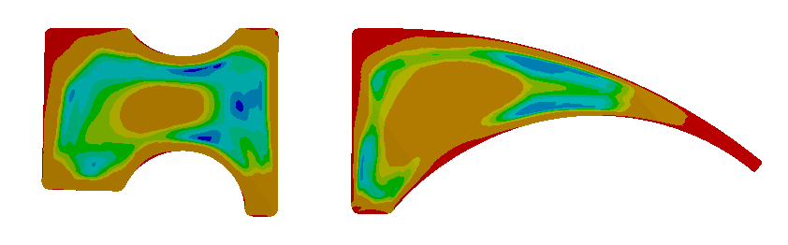

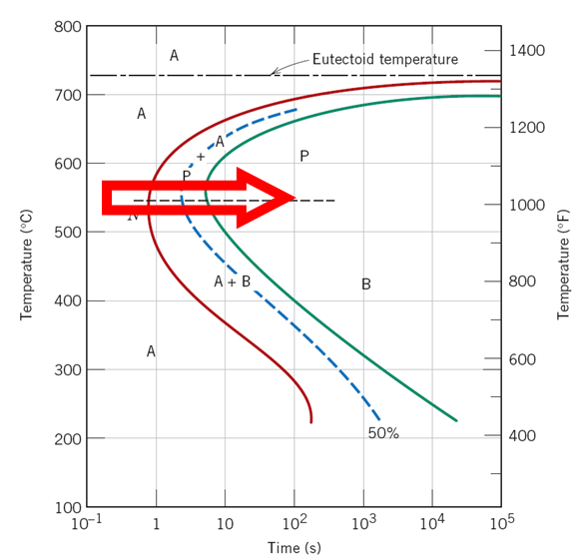
Benefits of HPHT
Thermal stresses salt bath (60s)
High density gas:
  High heat transfer between the gas and component surfaces, α > 1000 W/m²°K (176 Btu/h.ft².°F)
  Continuous cooling of the medium from the same high temperature as the component with a controllable temperature distribution
  Low thermal gradients ➔ Low thermal stresses ➔ Low risk of cracks or distortion
The high pressure remains during quenching
  Slower phase transformation kinetics in the Fe-C system
  Delays perlite transformation ➔ lower cooling rate needed
  Increased hardenability
158MPa
Thermal stresses URQ (60s)
50MPa

Slide 12
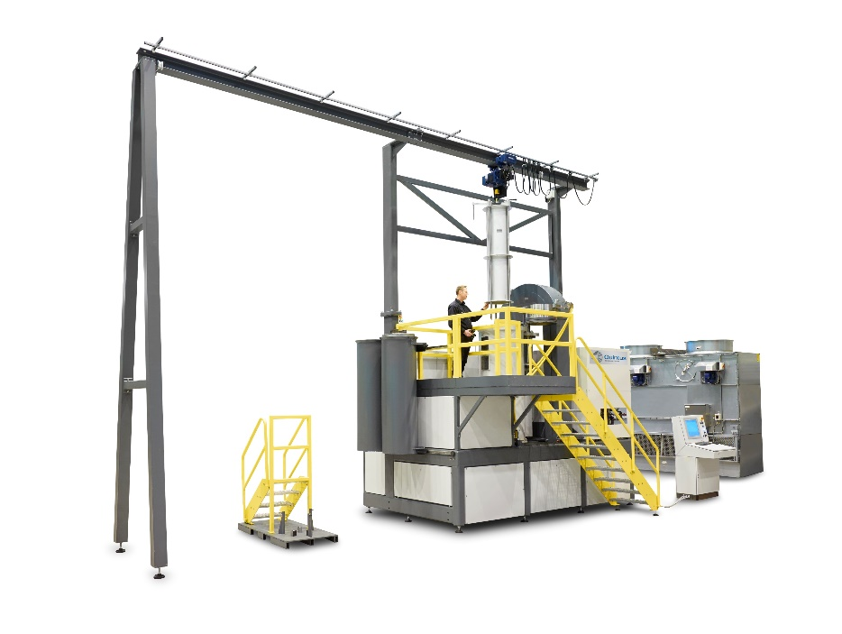
URC & URQ - Estimated Cooling Rates
Quintus Press Types | Hot Zone Dim., DxH | Cooling Rate [°C/min] between 1200 → 650°C
QIH15L M URC (URQ) | 0.186 x 0.5m (0.175 x 0.300) | ~ 180 ( >1400 )
QIH32 M URC (URQ) | 0.300 x 0.89m (0.285 x 0.500) | ~ 130 ( >1200 )
QIH48 M URC (URQ) | 0.375 x 1.2m (0.315 x 0.6m) | ~ 90 ( >1300 )

Slide 13
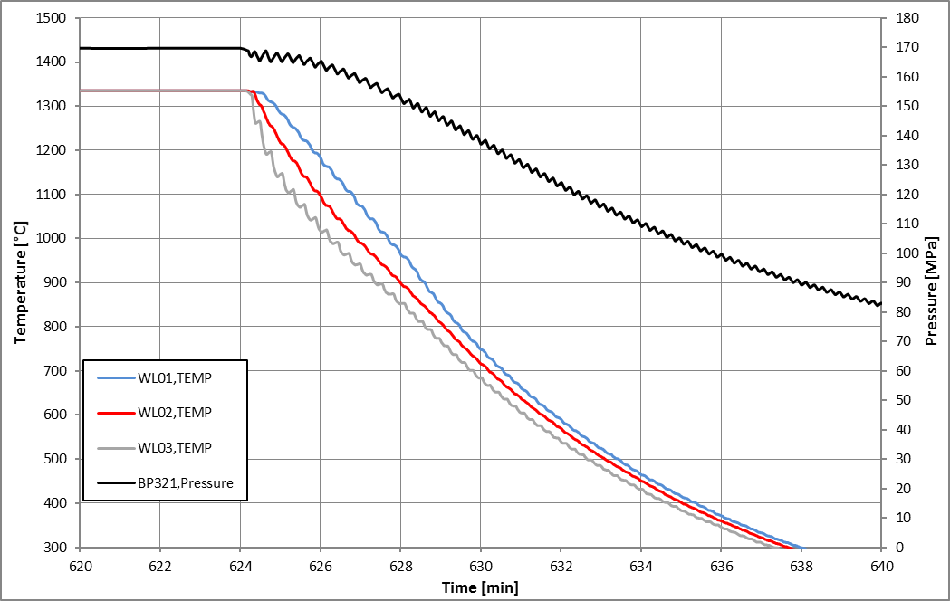
Example: Combined HIP + Heat Treatment CoCr F75
Post processing recommendations by Arcam
Minimum 58 °C/min (136 °F/min) cooling rate to avoid carbide precipitation
This cooling rate is easily achievable in a Quintus Compact HIP with URC
(2192 °F)
(14.5 ksi)
Cooling rate 100 °C/min
(2228 °F)
(0.01 – 0.013 psi)
(2228 °F)
(1400 °F)

Slide 14
Optimized HIP parameters for EBM Ti64
A study by Quintus and Arcam

Slide 15
HIP of EBM Ti-6Al-4V – Reduction of strength
Fatigue properties, ductility and property scatter is improved
  But, a decrease in yield strength can often be seen after HIP
A study by Quintus and Arcam was made to investigate this
Tensile data for SLM Ti-6Al-4V
Ref: The mechanical performance of structures manufactured by Selective Laser Melting: Damage initiation and propagation, Stefan Leuders, University of Paderborn, Germany, AMPM2014, MPIF, USA

Slide 16
HIP of EBM Ti-6Al-4V - Why reduction in strength?
The vey high solidification rates in the EBM/SLM process gives:
  Very fine microstructure as-printed
  High yield strength in the as-printed condition
Any elevated temperature heat treatment, like HIP, gives a coarser microstructure
  Decrease in yield strength

Slide 17
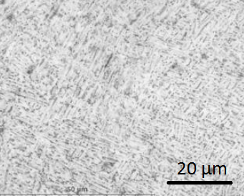
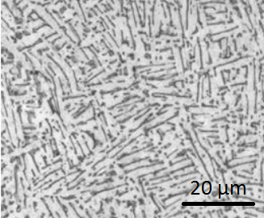
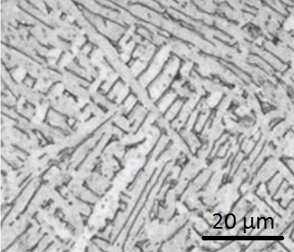
HIP of EBM Ti-6Al-4V - Why reduction in strength?
The newer EBM machines generates even finer microstructures
Q10 EBM machine in 2015
S12 EBM machine in 2009
As-printed
As-printed
HIPed
HIP

Slide 18
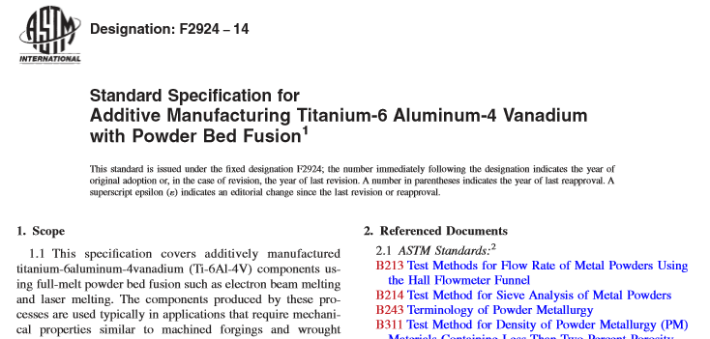
HIP of EBM Ti-6Al-4V - Typical practice today
ASTM F2924-14: 895 to 955 °C, min 100 MPa, min 2 h
Typical HIP parameters for AM Ti-6Al-4V: 920 °C, 100 MPa, 2 h
  Developed for cast Ti-6Al-4V long time ago

Slide 19
HIP of EBM Ti-6Al-4V - Test matrix
Lower HIP temperature to avoid coarsening of the fine microstructure
Increase HIP pressure to compensate for the lower temperature
  100 % densification is still a requirement
Test | Temperature [°C] | Pressure [MPa] | Hold time [hours] | Cooling rate [C/min]
1 | 920 | 100 | 2 | 30
2 | 920 | 100 | 2 | 1500
3 | 880 | 100 | 2 | 30
4 | 840 | 100 | 2 | 30
5 | 800 | 100 | 2 | 30
6 | 800 | 200 | 2 | 30

Slide 20
HIP of EBM Ti-6Al-4V – Results
800 °C, 200 MPa, 2 h gives 100 % density and the highest yield strength
  800 °C, 100 MPa, 2 h did NOT give 100% density

Slide 21
HIP of EBM Ti64 - Conclusions
The yield strength of HIP EBM Ti64 was increased by a simple optimization of the HIP parameters
  800 °C, 200 MPa, 2 h seems to give the best overall material properties
AM is something different from the conventional manufacturing processes
  Standards/specifications taken from e.g. the casting industry might not be optimal for AM

Slide 22
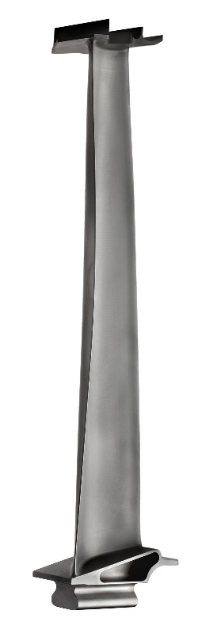
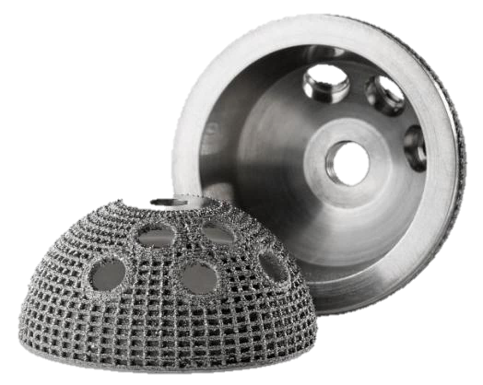
Optimized printing parameters for HIP
A study by Quintus and Arcam Part 2

Slide 23
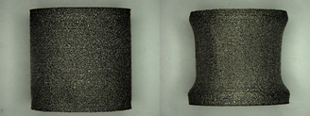
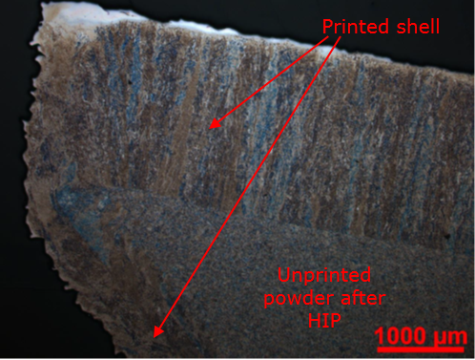
Printing for HIP - Theory
Before HIP
After HIP
HIP will give 100% dense material independent of starting density
  As long as gas tight surface is present
Why print to > 99.5% density before HIP?
Gas tight surrounding shell
Loose powder or less dense printed powder

Slide 24
Printing for HIP - Theory
A test was made to print with a larger line off-set (LO) than standard
  Up to 0.4 mm instead of the standard 0.2 mm line off-set
Line Off-set

Slide 25
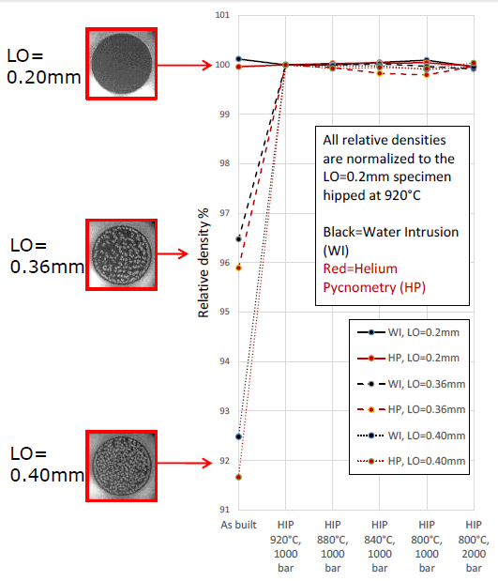
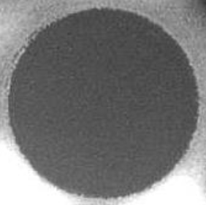
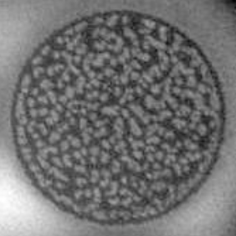
Printing for HIP - Results
With the standard 0.2 mm line off-set the porosity is virtually zero
With 0.4 mm line off-set the amount of porosity is around 8 %!
Porosity analyzed with LayerQam
LO=0.2 mm
LO=0.4 mm

Slide 26
Printing for HIP - Mechanical properties
The porous build (LO=0.4 mm) has the highest strength but low ductility
  HIP restores the ductility
How can the strength of the porous built material be higher than standard?

Slide 27
Printing for HIP - Mechanical properties
How can the strength of the porous built material be higher than standard?
A line off-set of 0.4 mm generates a smaller melt pool and less remelting of the layers =>
Even finer microstructure and less aluminum evaporation during printing =>
Higher strength!

Slide 28
Optimized HIP parameters for EBM Ti-6Al-4V

Slide 29
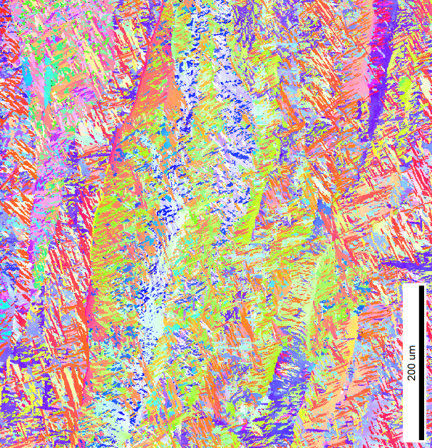
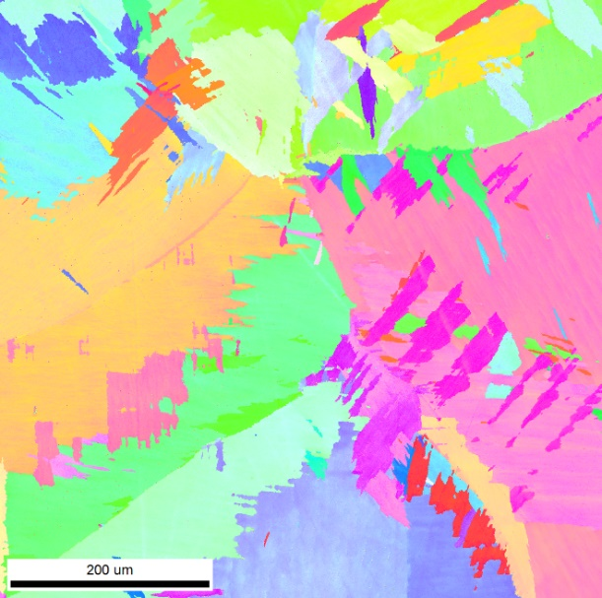
HIP above β-transus temperature HIP for Ti-6Al-4V
Ongoing work at ORNL
A lot of variations in AM on final microstructure and material properties
Possibility to erase these variations with above β-transus HIP (e.g.1050 °C)?
  Big interest from industry
As-printed columnar structure
After HIP equiaxed structure

Slide 30
HIP and fast cooling of EBM Ti 6-4
Example
Experiment to break down the columnar grain structure of EBM Ti 6-4 with URQ
Three different cycles were evaluated
  PT1 – Temp lower than β-transus and rapid quench
  PT2 – Temp higher than β-transus and natural cooling
  PT3 – Temp higher than β-transus and rapid quench
URQ® HIP cycle
p=1000 bar
Collaborative project with Oak Ridge National Labs

Slide 31
HIP and fast cooling of EBM Ti 6-4
As built
920 °C, rapid cool
1120 °C, slow cooling
1120 °C, rapid quench
Notes:
Enter speaker notes here.

Slide 32
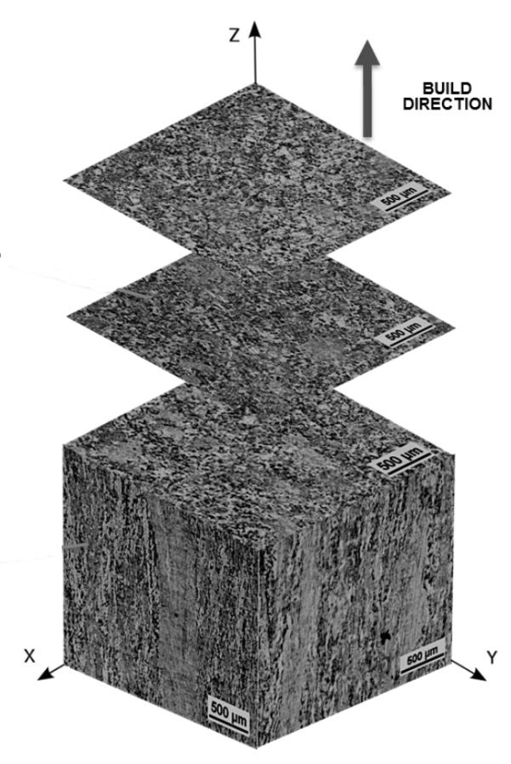
HIP and fast cooling of EBM Ti 6-4
Combining HIP and quenching to break up columnar grain structure for EBM Ti-6Al-4V
Courtesy of Oak Ridge National Laboratory
Notes:
Enter speaker notes here.

Slide 33
HIP and fast cooling of EBM Ti 6-4
Combining HIP and quenching to break up columnar grain structure for EBM Ti-6Al-4V
Courtesy of Oak Ridge National Laboratory
Notes:
Enter speaker notes here.

Slide 34
HIP and fast cooling of EBM Ti 6-4
Combining HIP and quenching to break up columnar grain structure for EBM Ti-6Al-4V
Courtesy of Oak Ridge National Laboratory
Notes:
Enter speaker notes here.

Slide 35
Summary and Conclusions
Fatigue is greatly improved by HIP
  EBM and SLM deposited powder gives same results after HIPing
The yield strength of HIP EBM Ti-6Al-4V was increased by a simple optimization of the HIP parameters
  800 °C, 200 MPa, 2 h seems to give the best overall material properties
AM is something different from the conventional manufacturing processes
  Standards/specifications taken from e.g. the casting industry might not be optimal for AM
If the parts/material are to be HIPed the printing process can be adjusted for this
  No need to print to >99.5 % density
  Printing with a larger line off-set also makes the printing process faster!
With optimized printing parameters for HIP and optimized HIP parameters for AM, the highest strength can be achieved
  Think HIP from the beginning!!

Slide 36

Thank you!
Thank you for your attention!
How can we help you?
Dr. Anders Eklund
Business Analyst – AMD
+46-(0)705-327215
anders.eklund@quintusteam.com

