Slide 1
Mirror, mirror in the vacuum tank an MX2 optics upgrade
Daniel Eriksson, MX

Slide 2
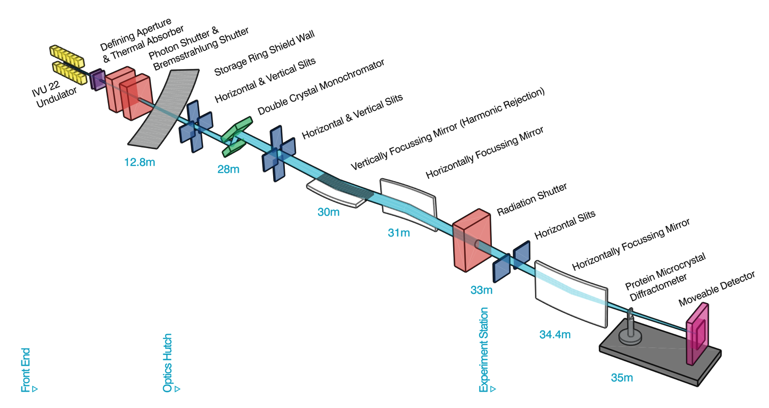
Why mirrors?
Notes:
- Conditioning and and focusing
- Grazing incidence optics

Slide 3
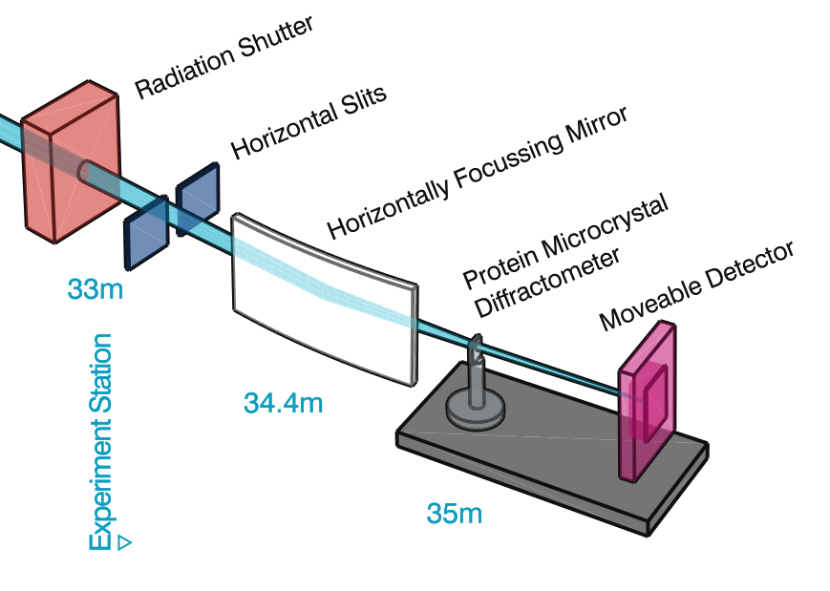
What mirror?
Microfocussing
Notes:
- Three in series
- Last one before sample
- Bimorph
- Laminated
- [prop to show bend]

Slide 4
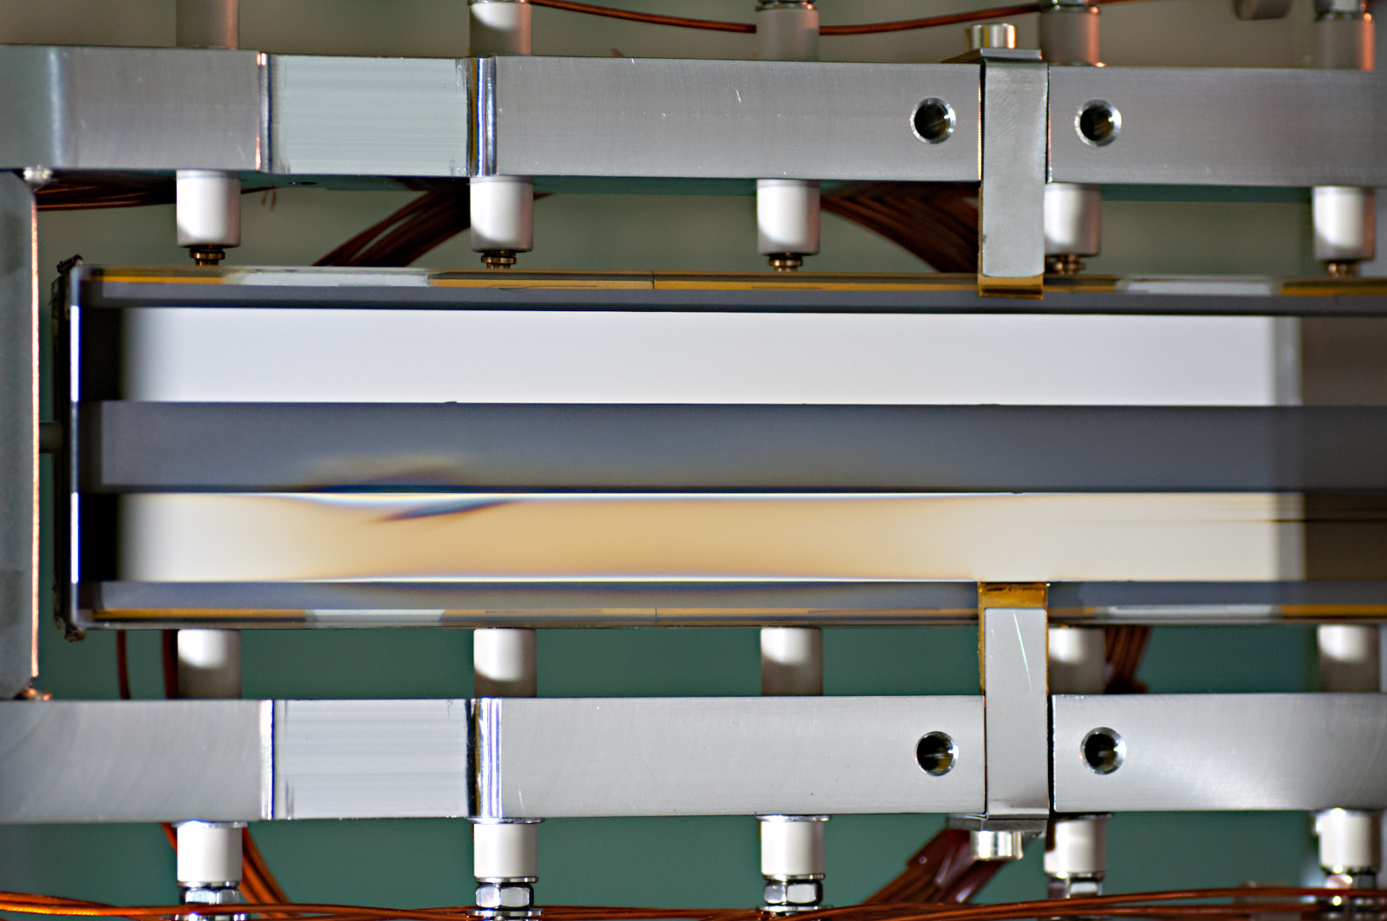
So why that mirror?
Notes:
- Delaminating
- Bimorph issues

Slide 5
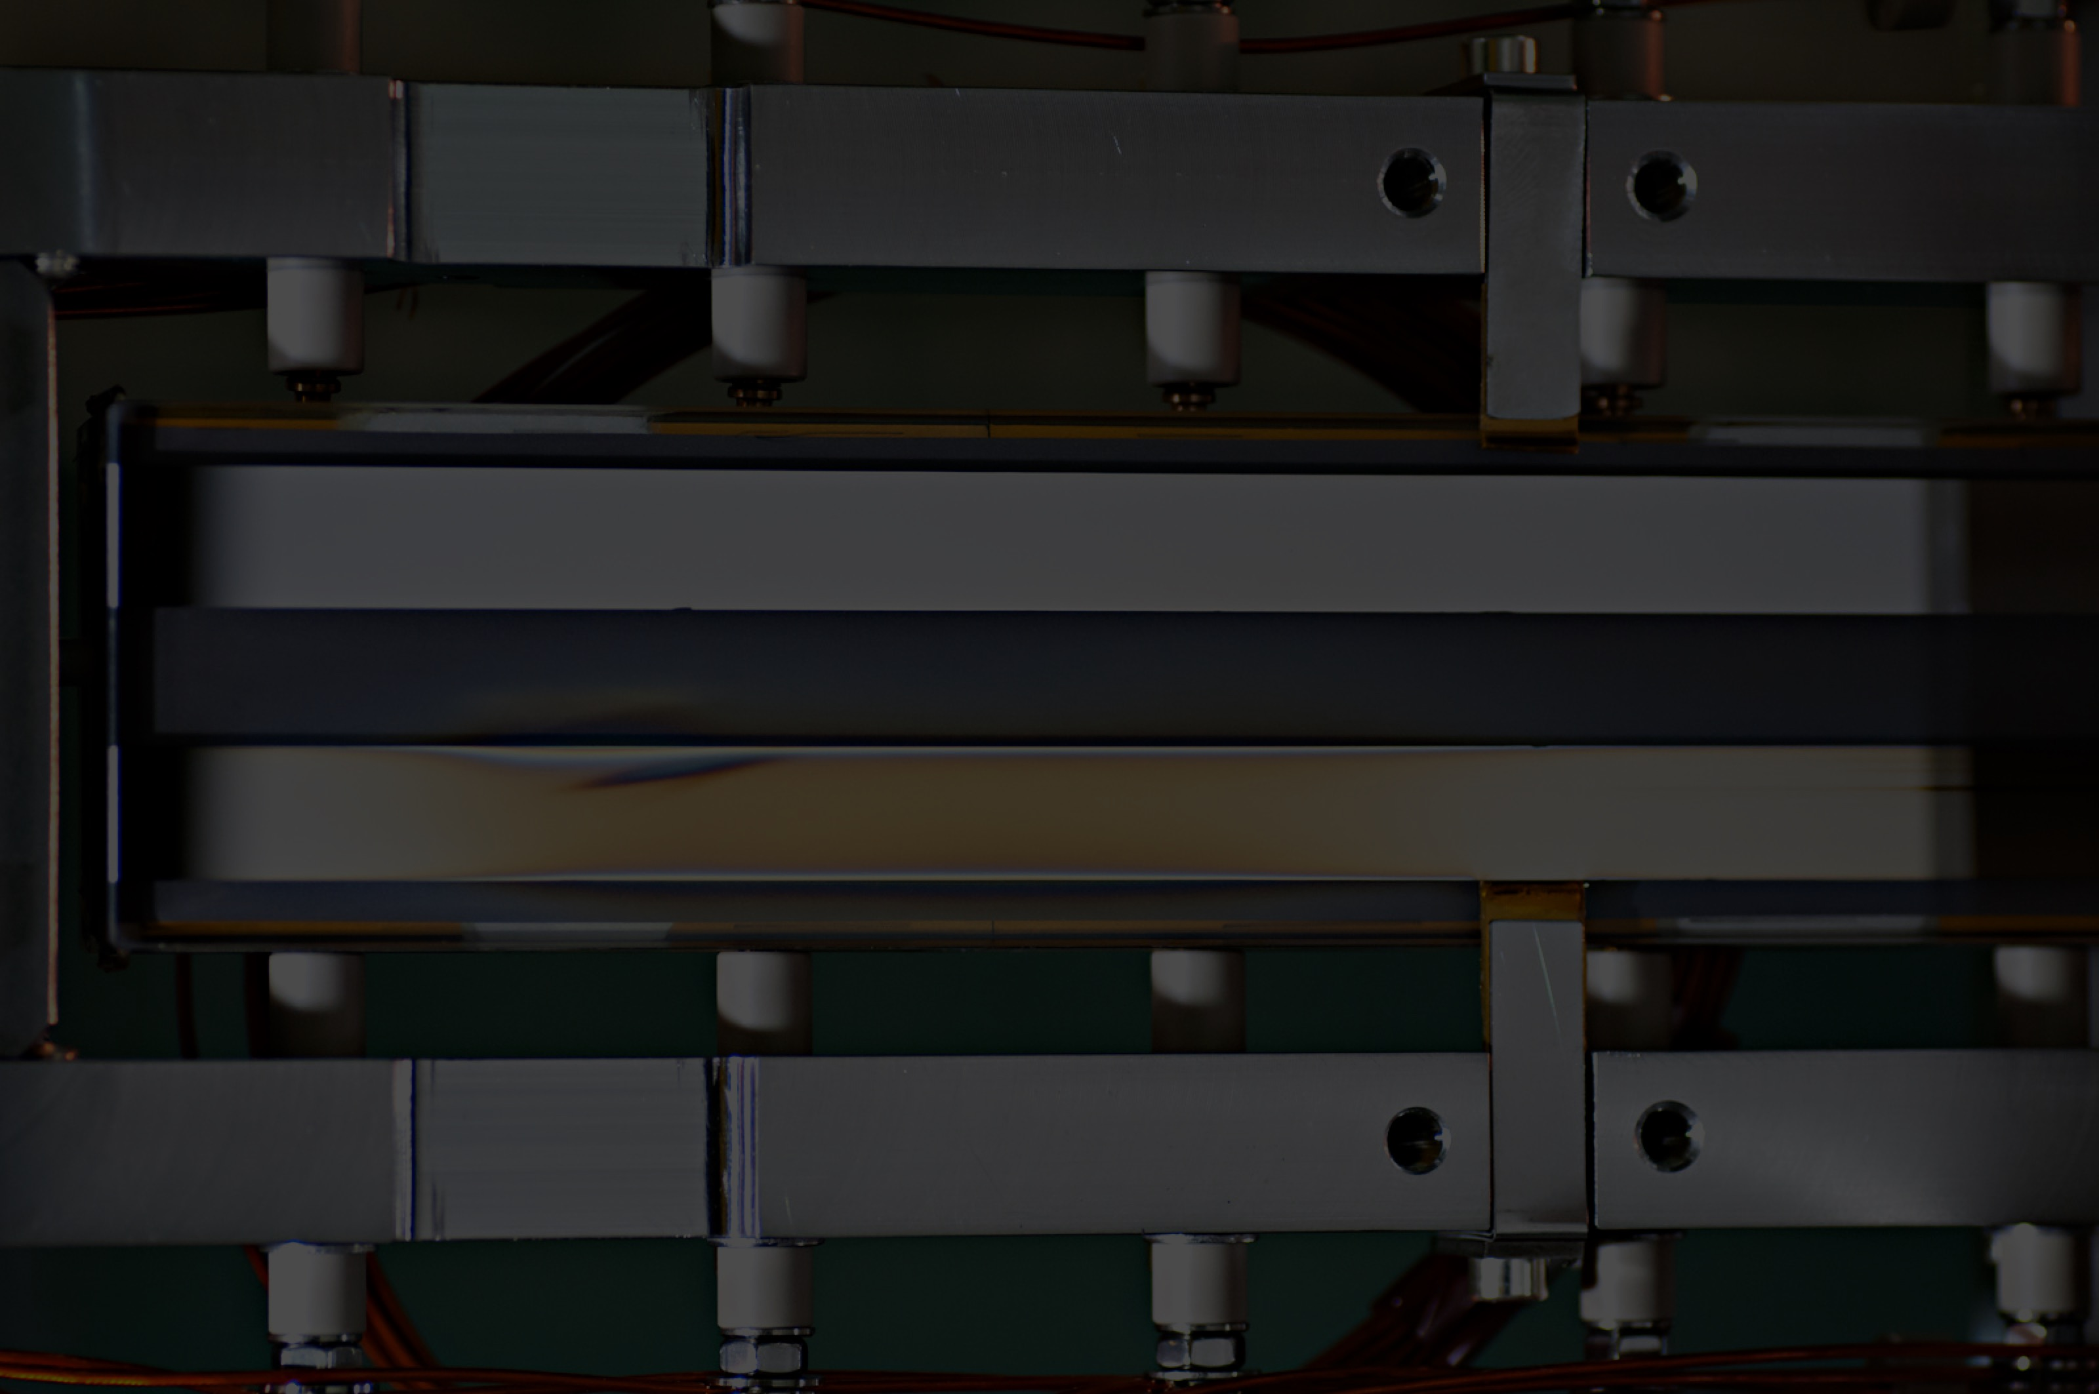
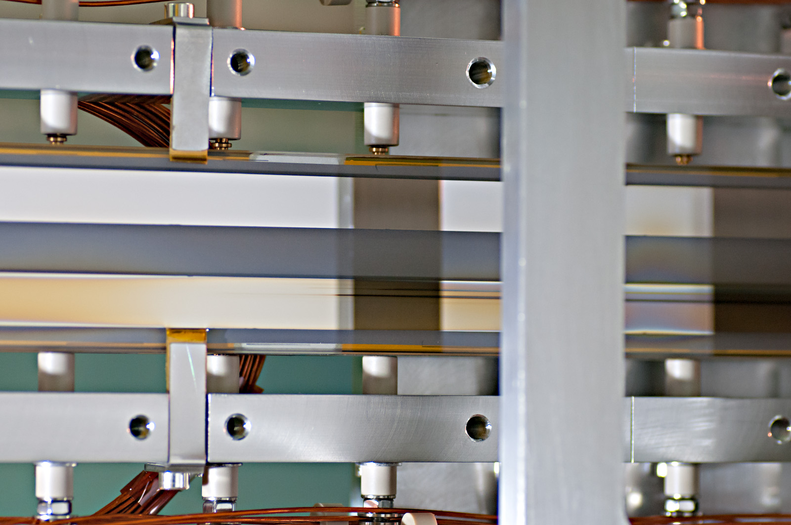
So why that mirror?
Notes:
- Delaminating
- Bimorph issues

Slide 6
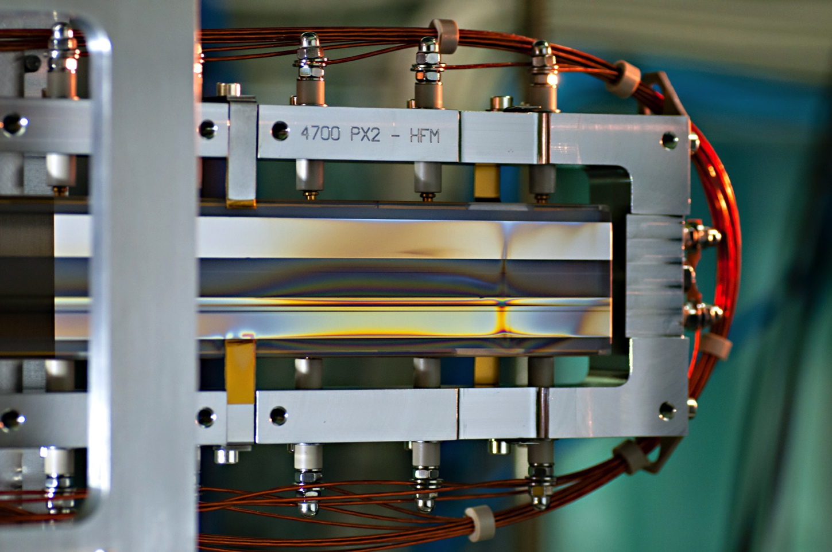
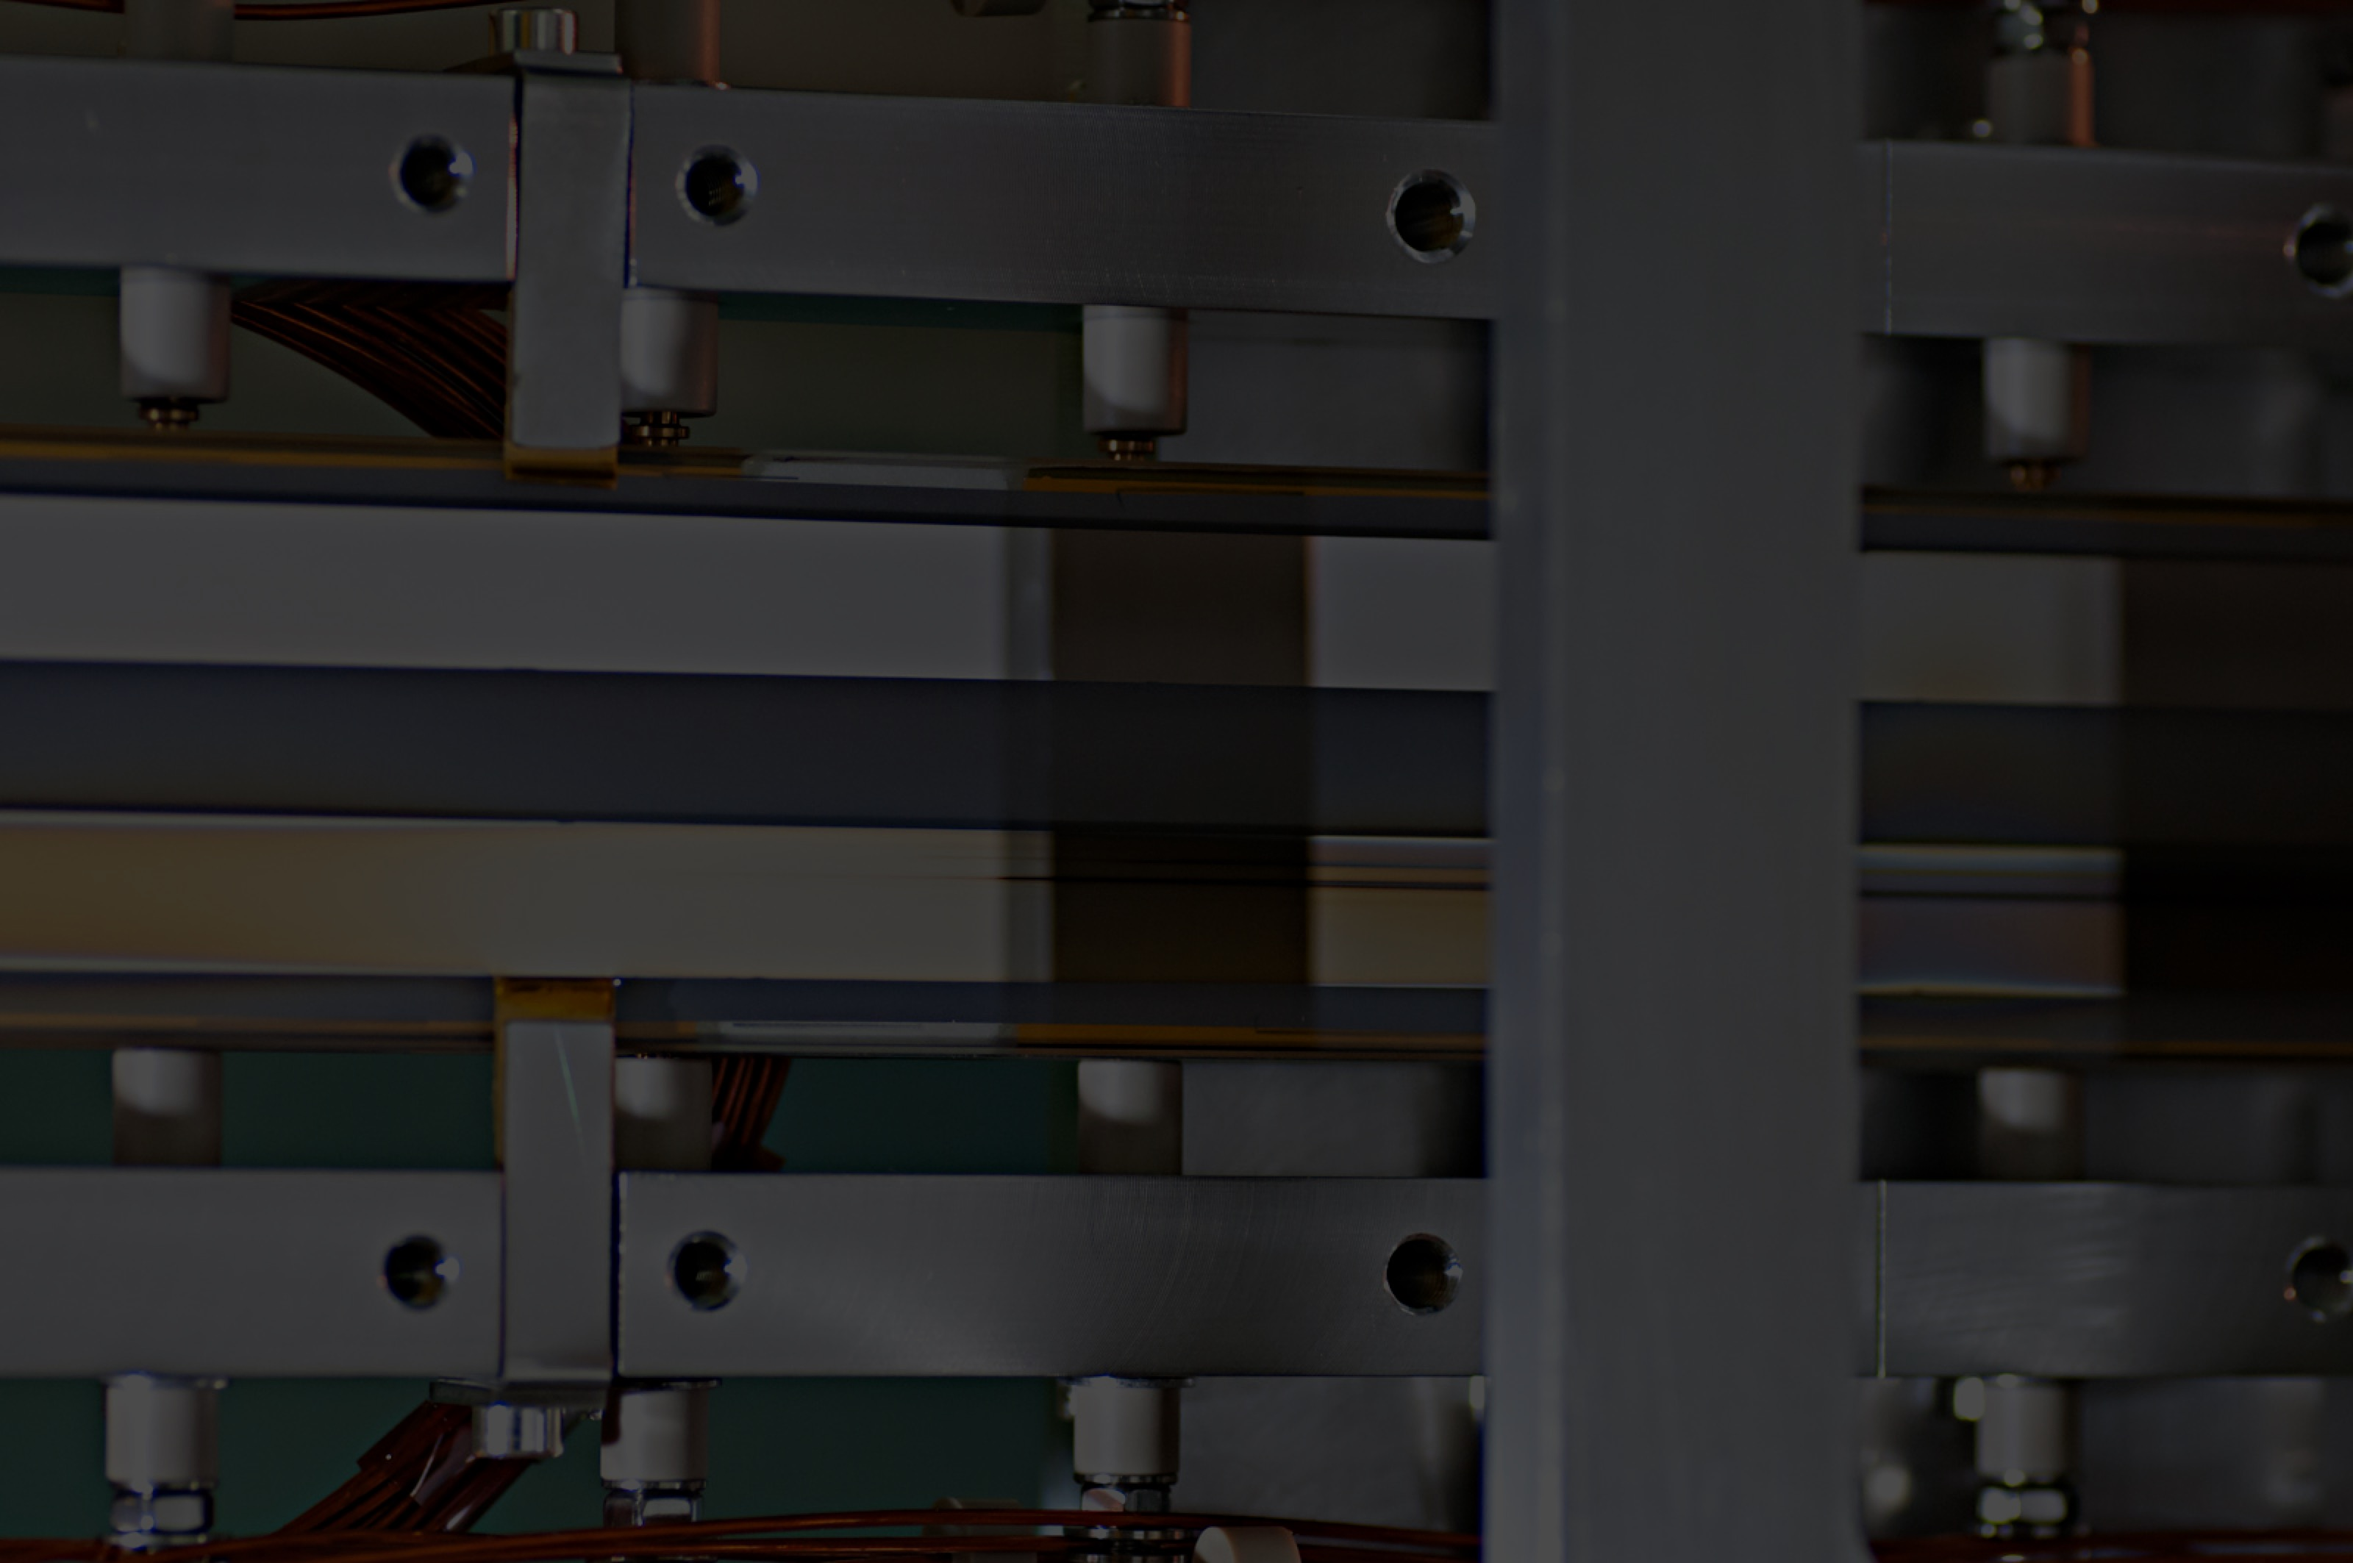
So why that mirror?
Notes:
- Delaminating
- Bimorph issues

Slide 7
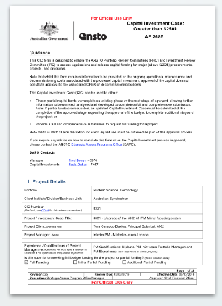
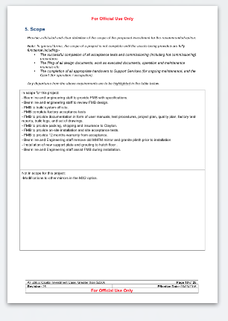
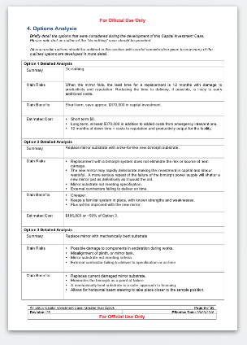
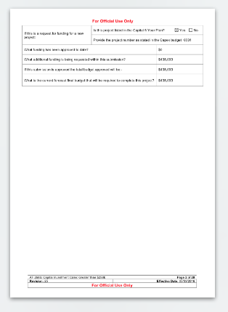
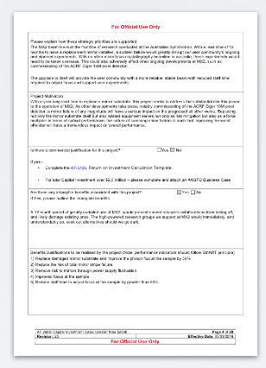
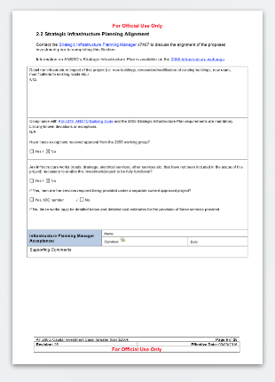
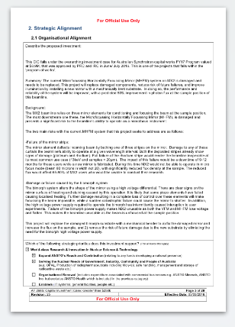
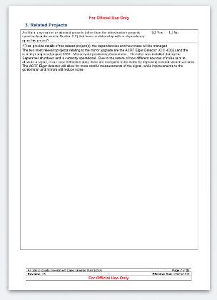
Is it fixable?
Notes:
- Replace mirror
- Replace bimorph
- [prop to show bend]

Slide 8
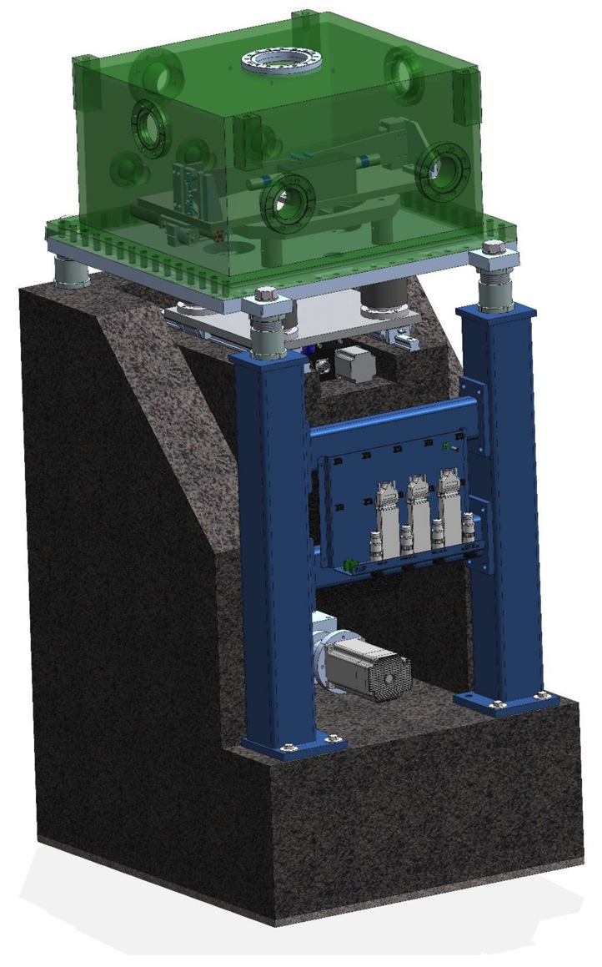
So, straightforward then?
- One year leadtime
- Hard vacuum environment
- Installation in May 2018
- Commissioning in June 2018

Slide 9
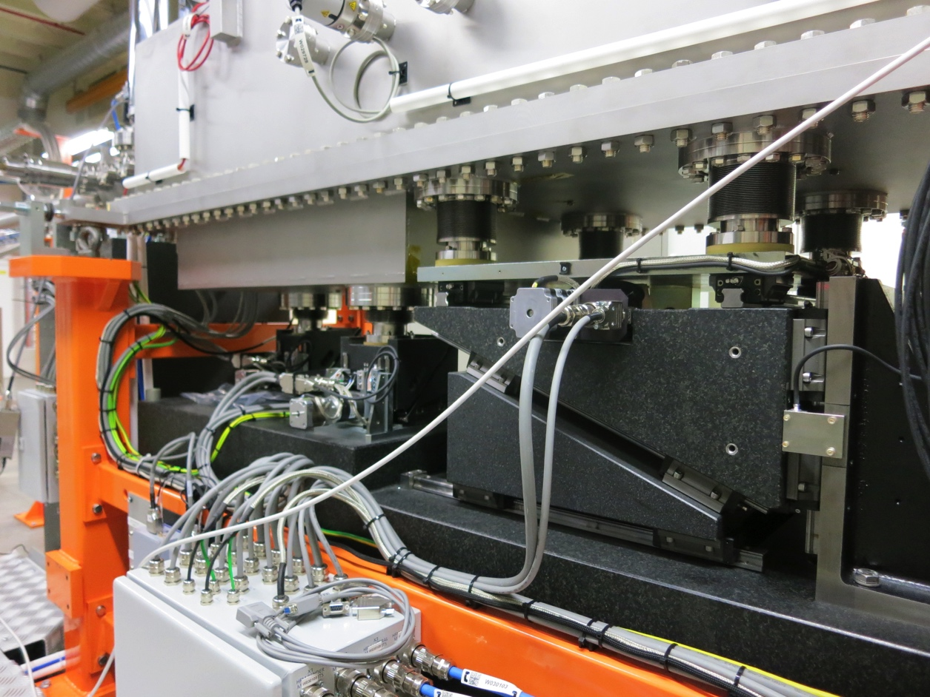
Expected outcomes?
- Risk mitigation
- Performance increase
- Reduce staff workload

Slide 10
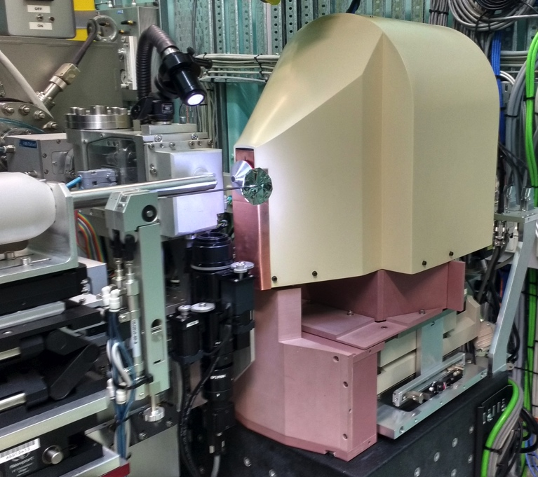
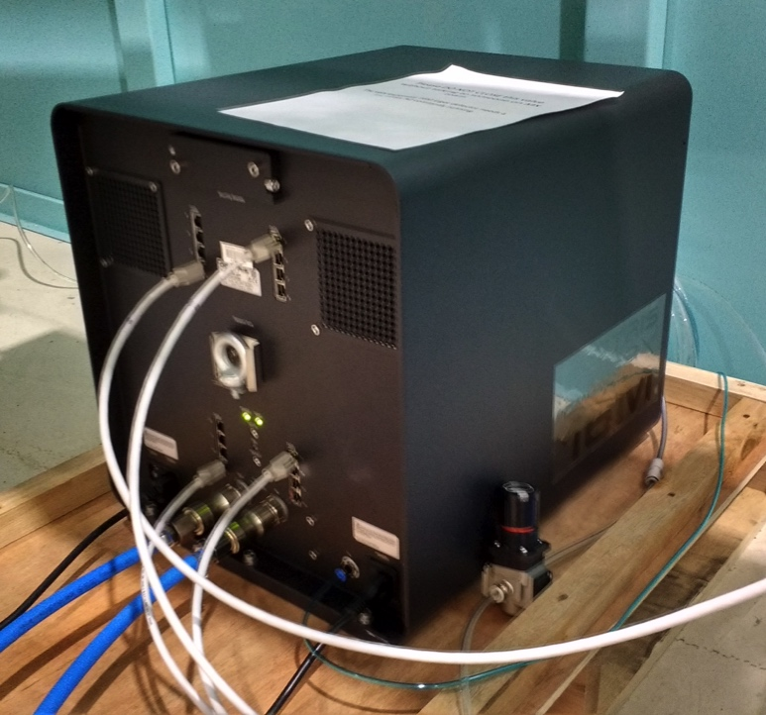
Anything else to worry about?
- New goni reduces noise
- New detector improves signal

Slide 11
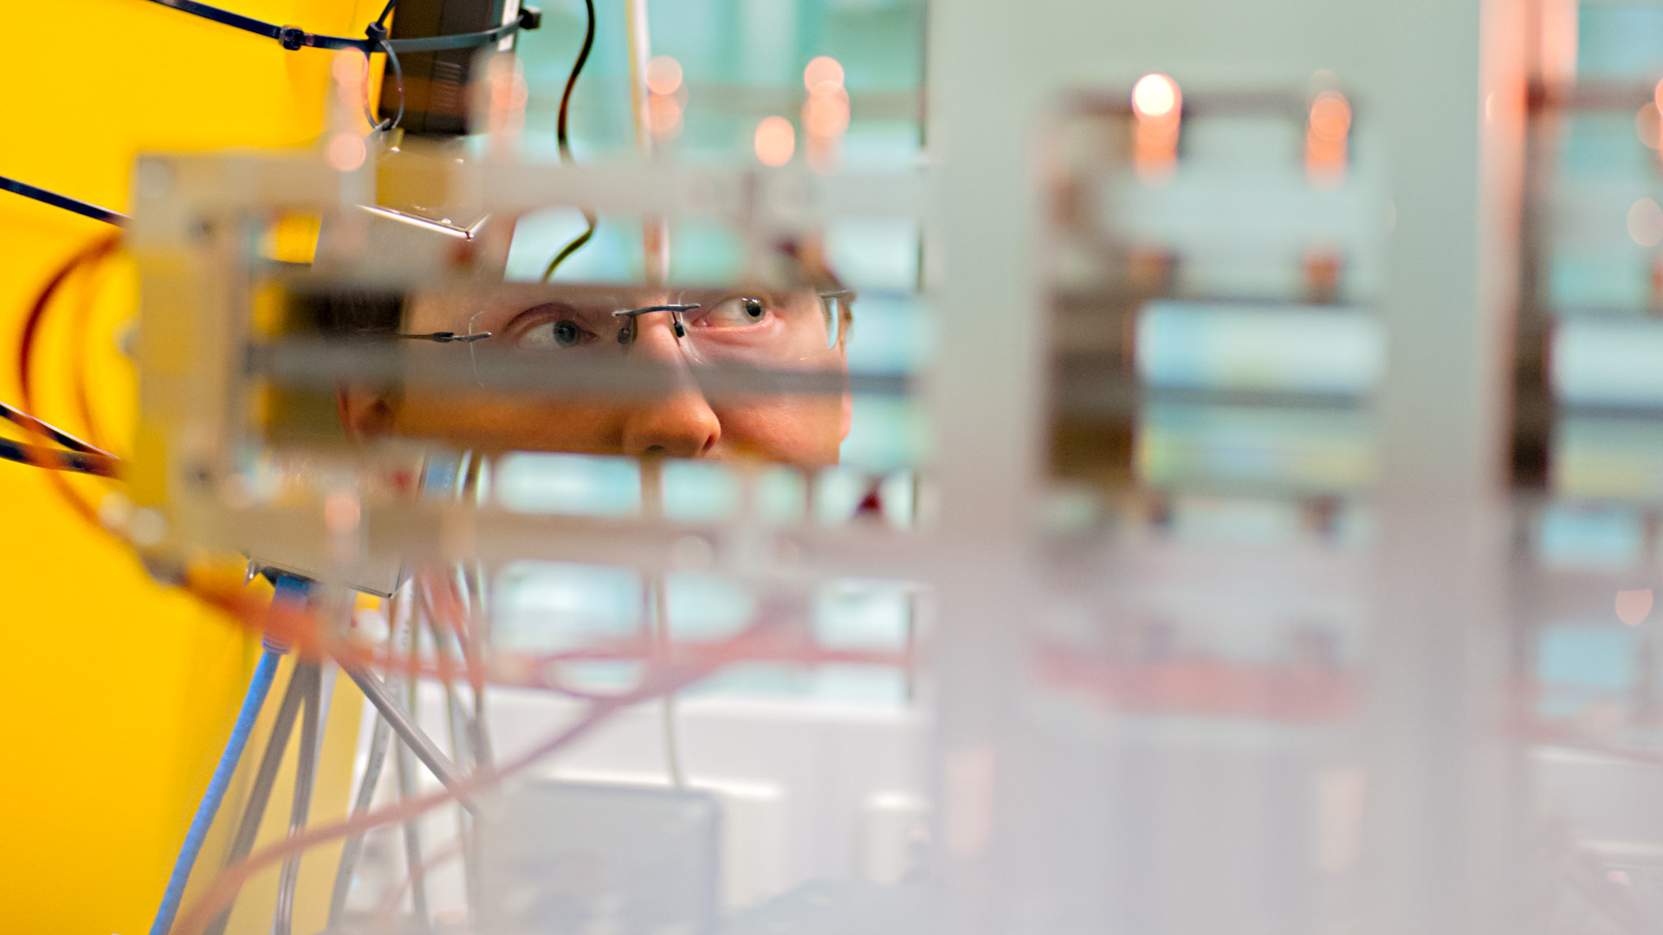
So, to summarize…
Replaces an ageing, damaged, complicated, and failure prone system with a simpler and safer one.

Slide 12
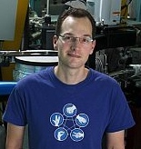
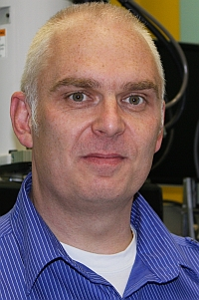
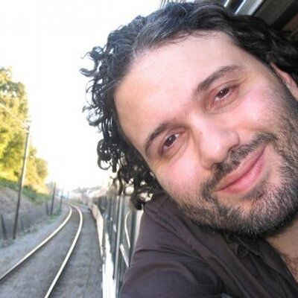
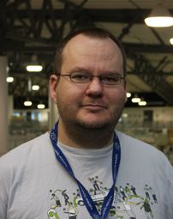
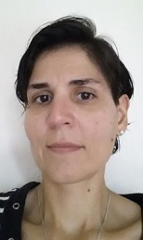
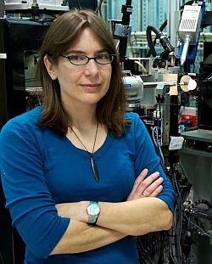
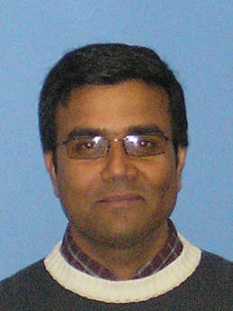
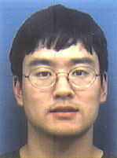
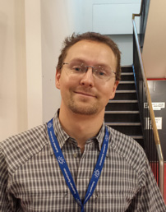
Acknowledgements
Tom Caradoc-Davies
Alan Riboldi Tunnicliffe
David Aragao
Jason Price
Sofia Macedo
Rachel Williamson
Santosh Panjikar
Jun Aishima
Daniel Eriksson

