Slide 1
The Australian Synchrotron and industry
Dr Robert Acres
Industry support and outreach scientist

Slide 2
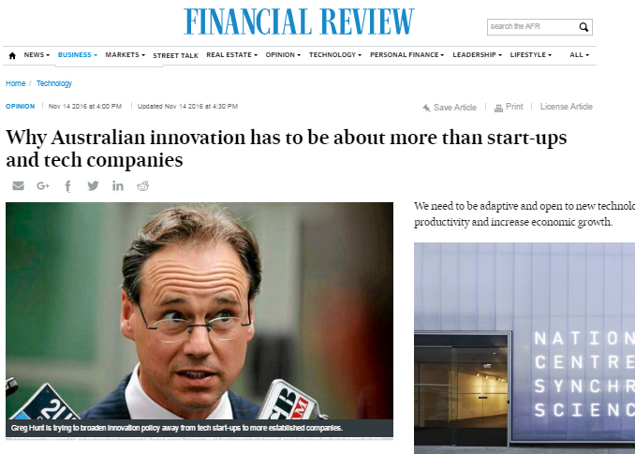
What is innovation?
‘When we talk about "innovation", what exactly do we mean? Put simply, it's about challenging the norm and doing things differently. It's not only coming up with new products and services, but improving on what we already do and make.’
-- Hon. Greg Hunt MP, Minister for industry, innovation and science

Slide 3
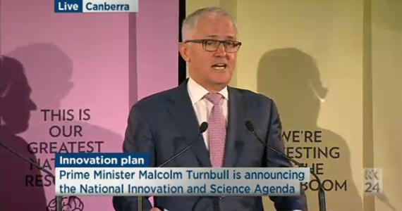
Collaboration between researchers and industry central to government policy
‘Increasing collaboration between businesses, universities and the research sector is absolutely critical for our businesses to remain competitive. To commercialise an idea, a great invention, a great innovation, a great piece of research and then grow it into new sources of revenue, new jobs, new opportunities and new industries.’
-- Hon. Malcolm Turnbull, Prime Minister

Slide 4
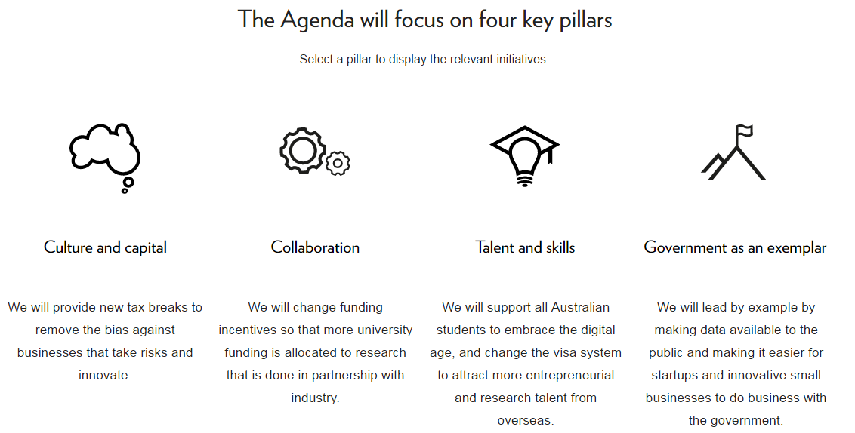
The national innovation & science agenda
http://www.innovation.gov.au/page/agenda

Slide 5
… and is important to our funding
The Australian Government’s National Innovation and Science Agenda included a $520m commitment to fund the Australian Synchrotron’s operations for 10-years

Slide 6
Easy, rapid, supported, great value synchrotron access
Merit program:
Competitive process based on scientific merit
Three cycles per year
Emphasis on publishing in peer reviewed journals
Industry partnerships now a consideration, where national benefit can be demonstrated
Commercial program:
Faster access
Genuine confidentiality
Fee for service
Support for data analysis and reporting
Dedicated Industry Engagement Team

Slide 7
Industry engagement team to support you
Our expert team will assist you at all stages of the process
Pre-experiment advice
Experiment setup and measurements
Data interpretation
Contact:
industryinfo@synchrotron.org.au
Kerry Hayes
Group leader – industry engagement
Kerry.Hayes@synchrotron.org.au
Dr Robert Acres
Industry support and outreach scientist
Robert.Acres@synchrotron.org.au
Dr David Cookson
Industry support and outreach scientist
David.Cookson@synchrotron.org.au

