Slide 1
Characterisation of scale products formed on the heat-exchanger surfaces in the Bayer process
November 20th, 2014
Lina Shi
Dr. Nobuyuki Kawashima
Dr. Ning Xu
Dr. Jun Li
Prof. Andrea Gerson

Slide 2
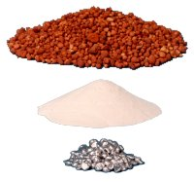
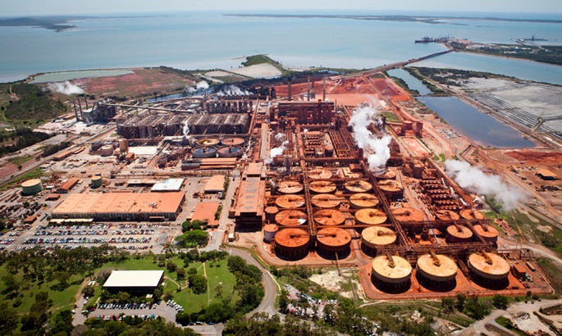
Bayer Process — background
Australia has been the global leader of alumina production and the 5th largest aluminium producer for the last decade
  invented by Karl Josef
  Bayer in 1887
Bauxite
ore
Gibbsite
(Al(OH)3)
Alumina
Bayer Process
Notes:
First of all, let me get you acquainted with Bayer process. Bayer process is applied for the refining of alumina (Al₂O₃) from bauxite ore.
It was invented and patented by Karl Josef Bayer and now has become the cornerstone of the alumina refining industry worldwide.
This is an airscape of a Bayer plant in Australia.

Slide 3
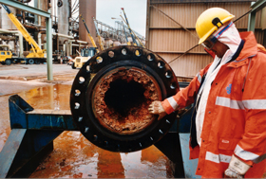
Bayer Process — Scale
Incomplete desilication
the presence of titanium
Notes:
“Scale” means the unwanted deposits inside processing equipment as you can see from the pictures. That comes from the high silica content and titanate content in bauxite ore. It forms in almost every part of an alumina refinery. It forms inside tanks, pipes, heat exchangers, digesters, filters – any working part of a refinery exposed to caustic Bayer solution.

Slide 4
Bayer Process — background
Scaling — a major technical problem
Equipment downtime
Scaling in heat transfer & evaporation equipment
Reduced volume capacity
and heat-transfer efficiency
Lost production
De-scaling operations
and OH&S issues
Notes:
The scale has a number of negative effects. It costs the Australian alumina industry hundreds of millions of dollars a year in the form of equipment downtime, reduced volume capacity and heat-transfer efficiency, lost production, de-scaling operations and OH&S issues associated with human entry into tanks.
While the industry has developed ways of coping with scale, it has yet to come up with a practical and economical means of prevention.

Slide 5
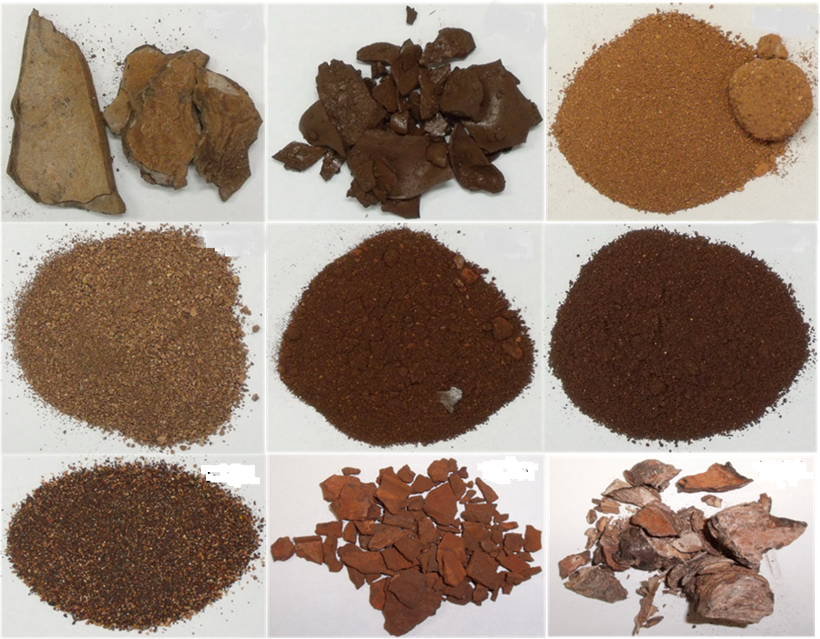
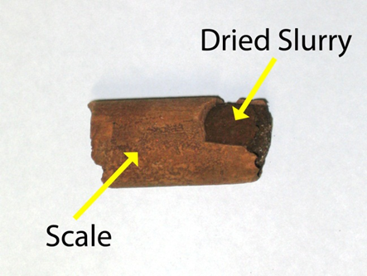
Bayer Process — background
Scaling — a major technical problem
Scale
XRD
EDS
XANES
Sodium Aluminosilicate & Titanate
Less thermodynamically stable phases more stable species
  Amorphous Zeolite Sodalite Cancrinite
Same At% of Al and Si in sodium aluminosilicate
Notes:
These are the scale samples scraped from the inside wall of the equipment across a number of alumina refineries.
In spite of numerous related laboratory studies, an insufficient amount of data has been published regarding the characterisation of these industrial scales, which can provide vital information regarding the mechanism of scale growth and then the means of scale inhibition.
In this study, various characterisation techniques were applied to the selected scale samples removed from the inside wall of plant equipment, including XRD, EDS and XANES. The XANES data were obtained here in Australian Synchrotron. Sodium aluminosilicate and titanate are two main components of the industrial scale samples. And he former is our main objective in this study.
There are different types of sodium aluminosilicate in scale samples. Less thermodynamically stable phases tend to precipitate first and transform to more stable species.

Slide 6
Sample list
Industrial Scale samples across a number of alumina refineries | Quantity of depth resolved samples
Scale A
Heater, 200°C. Collected from the inner wall of heat exchanger tube after installing new tubes and running for 2 weeks. The thickness of the scale was approximately 2 mm on the tube wall. | 12
Scale B | 14
Collected on from the end caps of heater (194°C)
Scale C | 7
Slurry heater, 148°C.
Notes:
These are the details for the 3 selected industrial scale samples in this study. They are from different part of the equipment, where the temperature and the slurry composition are also different.
The depth resolved sub-samples were collected for each sample used in XANES study.

Slide 7
XRD-Quantitative Phase Analysis
 | Scale A | Scale B | Scale C
Cancrinite (Na₆Ca₂(Al₆Si₆O₂₄)(CO₃)₂·2H₂O | 65 ± 4 | 12 ± 2 | 25 ± 3
Sodalite (Na₈(Al₆Si₆O₂₄)(OH)₂) |  |  | 8 ± 2
Boehmite (AlO(OH)) | 2 ± 1 | 8 ± 2 | 1 ± 1
Nacrite Al₂Si₂O₅(OH)₄ |  | 1 ± 1
Perovskite (CaTiO₃) | 6 ± 2 | 13 ± 2
Hematite (Fe₂O₃) | 2 ± 1 | 6 ± 2 | 1 ± 1
Quartz (SiO₂) |  |  | 5 ± 2
Amorphous | 25 ± 3 | 61 ± 4 | 54 ± 4
Notes:
This is the quantitative analysis of the three scale samples. As mentioned before, cancrinite is the most stable sodium aluminosilicate at high temperature. As a result, all the three samples have a fairly high content of cancrinite. In the mean time, they are all found to contain a high percent of amorphous phase. This led to the aim of using XANES in this study.

Slide 8
The aim of using XANES
To identify the large amorphous components in scale samples obtained from XRD.
To characterise and compare the scale sample at different depth from the wall
Notes:
First, it’s to identify the large amorphous components in scale samples obtained from XRD. Second, it’s to characterise and compare the scale sample at different depth from the wall

Slide 9
Experimental Methodology for XANES
XANES spectra at Al K-edge have been collected on the Soft X-ray Spectroscopy beamline at the Australian Synchrotron.
X-ray absorption spectra were recorded in partial electron yield (PEY) detection mode in the photon energy range 1535-1630 eV (Al) with 0.1 eV steps and 0.5 s integration time, using a microchannel plate detector.
Notes:
XANES spectra at Al K-edge have been collected on the Soft X-ray Spectroscopy beamline at the Australian Synchrotron, operating at 3 GeV and with a beam current at 200 mA.
X-ray absorption spectra were recorded in partial electron yield (PEY) detection mode with 0.1 eV steps and 0.5 s integration time, using a microchannel plate detector.

Slide 10
Standard Samples for XANES
Name | Stoichiometries | Source
Diaspore | AlOOH | Purchased from e-bay and tested by XRD
Gibbsite | Al(OH)₃ | KB-30, Alcoa World Alumina- Australia
Corundum | Al₂O₃ | Sigma-Aldrich, -100 mesh, 99 % pure
Sodium aluminate | NaAlO₂ | Riedel-de Häen
Nordstrandite | Al(OH)₃ | Synthesised, (Peskleway et al. 2005)
Kaolinite | Al₂Si₂O₅(OH)₄ | Unimin Limited Australia
Boehmite | AlO(OH) | Synthesised, (Dash et al. 2007)
Sodalite | Na₈Al₆Si₆O₂₄(OH)₂ | Synthesised, (Zheng 1997)
Cancrinite | Na₈Al₆Si₆O₂₄(CO₃)_{1.44}H_{0.88}(H₂O)₂ | Synthesised, (Zheng 1997)
Notes:
These are the 9 standard Al-containing samples. The last three were used in the following linear fitting.

Slide 11
Standard samples - Al
Tetrahedral
Three dimensional framework of corner linked AlO₄ tetrahedra
Octahedral
Distorted octahedral structure

Slide 12
Scale A (Heater, 200°C)

Slide 13
Scale A-Quantitative Comparison
Linear Fitting
XRD Results
Phase | Weight %
Cancrinite | 65 ± 4
Hematite | 1 ± 1
Boehmite | 2 ± 1
Perovskite | 6 ± 2
Amorphous | 25 ± 3
EDS Results (At%)
Element | Na | Al | Si | S | Ca | Fe
bright contrast phase | 26 | 33 | 33 | 5 | 2 | 2
dark contrast phase | 50 | 22 | 21 | 3 | 2 | 3
Notes:
QPA did not indicate the presence of sodalite.
This suggests that the amorphous phase in Scale A may mainly consist of poorly crystallised sodalite.

Slide 14
Scale B (Heater ,194°C)
Linear Fitting
XRD Results
Phase | Weight %
Cancrinite | 12 ± 2
Hematite | 6 ± 2
Boehmite | 8 ± 2
Perovskite | 13 ± 2
Nacrite | 1 ± 1
Amorphous | 61 ± 4
EDS Results
Element | Na | Al | Si | P | S | Ca | Ti | Fe
bright contrast layer | 7 | 7 | 2 | 3 | - | 5 | 37 | 10
dark contrast layer | 23 | 33 | 30 | - | 3 | 2 | 1 | 9
Notes:
The ratio of cancrinite to sodalite obtained from the linear combination fitting of Al K-edge spectra is 3.0, while no sodalite was detected by XRD analysis. The ratio of cancrinite to boehmite is 11.0 (from the linear fitting of the average data) and 1.5 (from XRD) respectively.
The above comparison suggests that the amorphous phase in Scale B contains a large proportion of poorly crystallised sodalite/cancrinite.

Slide 15
Scale C- (Slurry heater, 148°C)
XRD Results
Phase | Weight %
Quartz | 5 ± 2
Hematite | 1 ± 1
Cancrinite | 25 ± 3
Boehmite | 1 ± 1
Sodalite | 8 ± 2
Amorphous | 54 ± 2
EDS Results
Area | Na | Al | Si | S | Cl | K | Fe
2 | 25 | 36 | 37 | - | - | - | 3
3 | 26 | 34 | 37 | - | - | - | 3
4 | 53 | 22 | 24 | - | - | - | 2
5 | 33 | 31 | 33 | 1 | 1 | 1 | 2
6 | 25 | 35 | 36 | 1 | 1 | 1 | 2
7 | 24 | 35 | 37 | 1 | 0.4 | 1 | 2
Linear fitting

Slide 16
Summary
No significant trend in the concentration of any particular phase was found as the depth changes.
The amorphous component in all these three scale samples has been demonstrated to contain a large proportion of poorly crystallised sodalite. Scale B may also contain some poorly crystallised cancrinite in amorphous component.
The conclusion is not exclusive and there might be other phases in the amorphous that have not been confirmed.

Slide 17
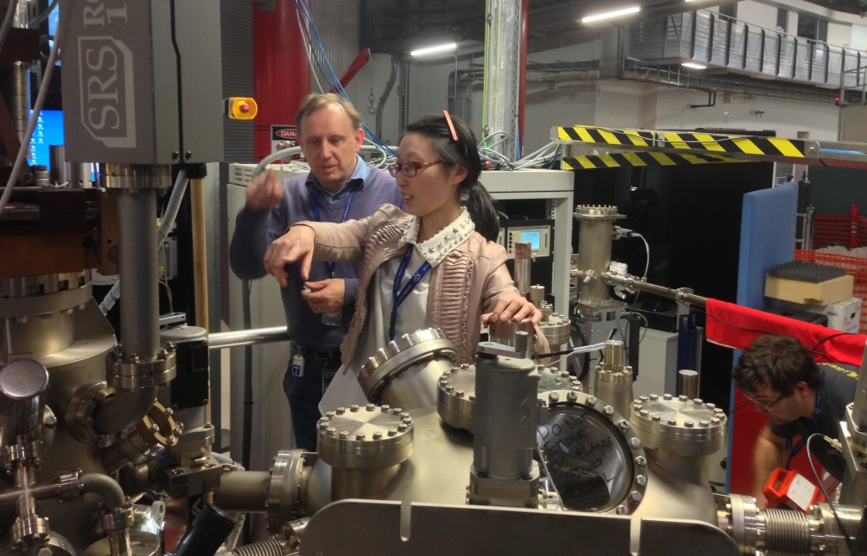
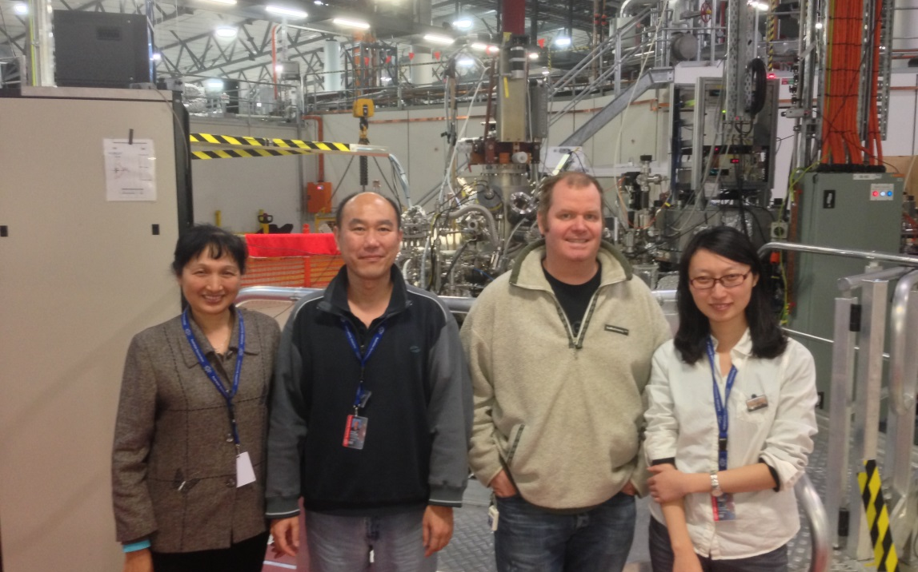
Acknowledgement
Beamline Team - Soft x-ray spectroscopy
Dr Bruce Cowie
Dr Lars Thomsen
Dr Anton Tadich

Slide 18
Thank you

