Slide 1
AS motion architecture EtherCat extension
ATF IC-CoP 2022
Nader Afshar
Controls Systems group ANSTO, Australian Synchrotron

Slide 2
We need to extend
Drivers
Address motion controller supply issues, Improve “vendor entrapment”
Support safety motion applications
New development path for the future
Constraints
in-house development, maintenance
hardware dependencies
skill dependencies
Strategy
Minimal change to the existing Software Stack
Keep Hardware Interfacing standard (wiring and connectors)
Limit the spread of configurations and tuning
Various H/W suppliers
EtherCat fieldbus makes sense as a technology… arguably!

Slide 3
EtherCat for controls
Master/Motion controller
Cyclic Synchronous Position/Velocity
Master controls trajectory
Open or closed loop at slave or master
More capability than cascade controls
Slave/Motor 1 position
Slave/Motor Position
Slave/Motor Position 1
Slave/Motor 2 Position
Slave/Motor Drive
Slave/Motor Position 2
500uSec Bus Clock rate (Servo time)

Slide 4
Options
Pmac master
Linux master (Acontis, EtherLab)
Beckhoff ecosystem​ (TwinCat)
ACS ecosystem
1. Pmac master concept evaluation:
Basic Applications
EtherCat motion components from various of suppliers
H/W configuration abstracted at pmac level
Capacity limits

Slide 5
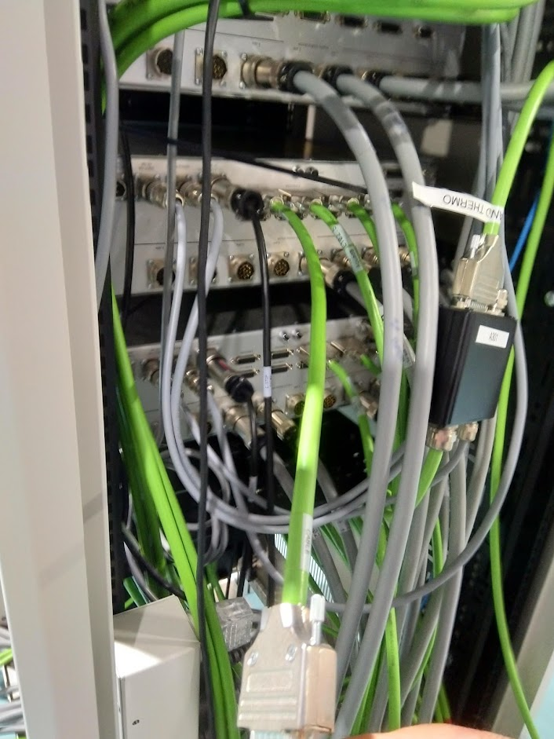
Architecture
~80 Turbo Pmacs, ~200 Power Pmacs
~1600 axes
One IOC per controller
One host for up to 8 IOCs

Slide 6
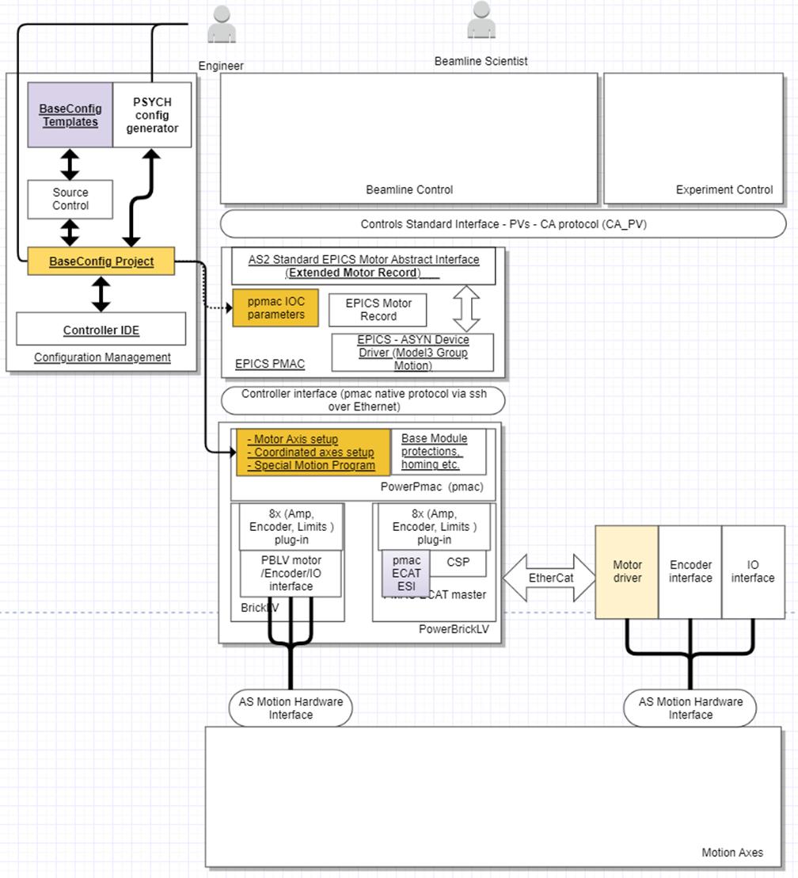
Standard Architecture
Same software stack
Same configuration process
Application data contained in standard templates

Slide 7
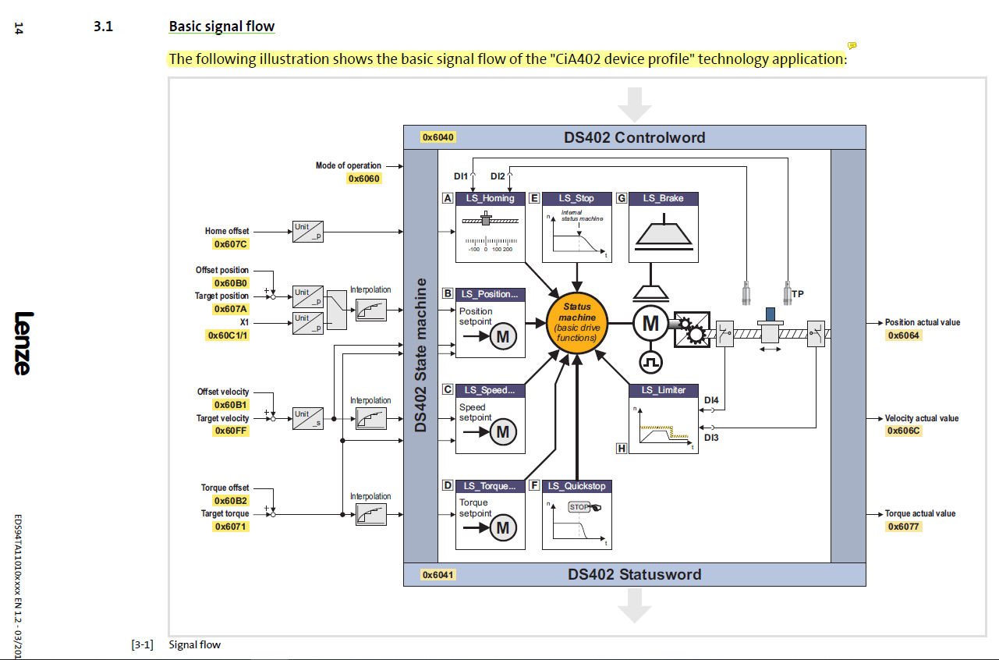
CiA402
DS402
CAN Profile for Motion controls

Slide 8
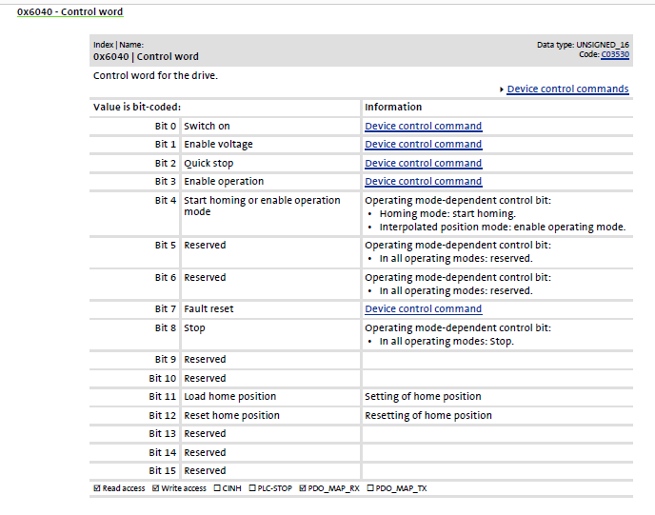
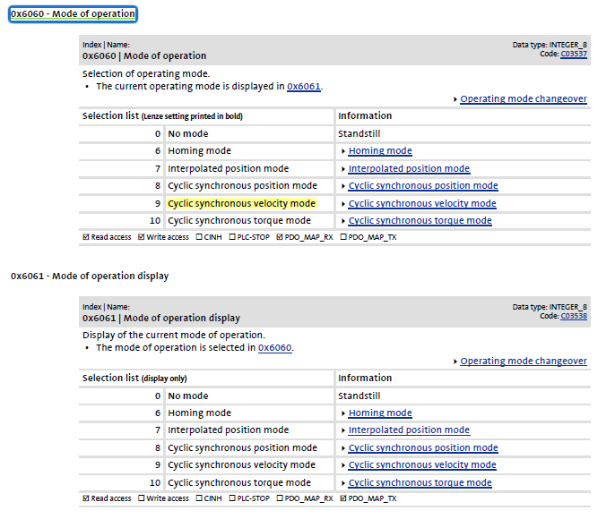

Slide 9
Test setup
PowerBrickLV_IMS_AS4 as master at 2kHz servo update rate:
1x Beckhoff EL7047 stepper, non-CiA402 (CAN in Automation), CSP (Cyclic synchronous position mode)
1x Beckhoff EL4134 4 channel analog output
2x OMRON R88D-1SN servo motors, using CiA402, in CSP mode
3 steppers, 1 servo and 1 external pulse-direction motors directly

Slide 10
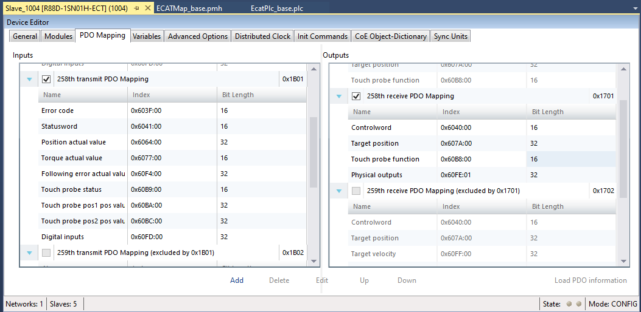
Power

Slide 11
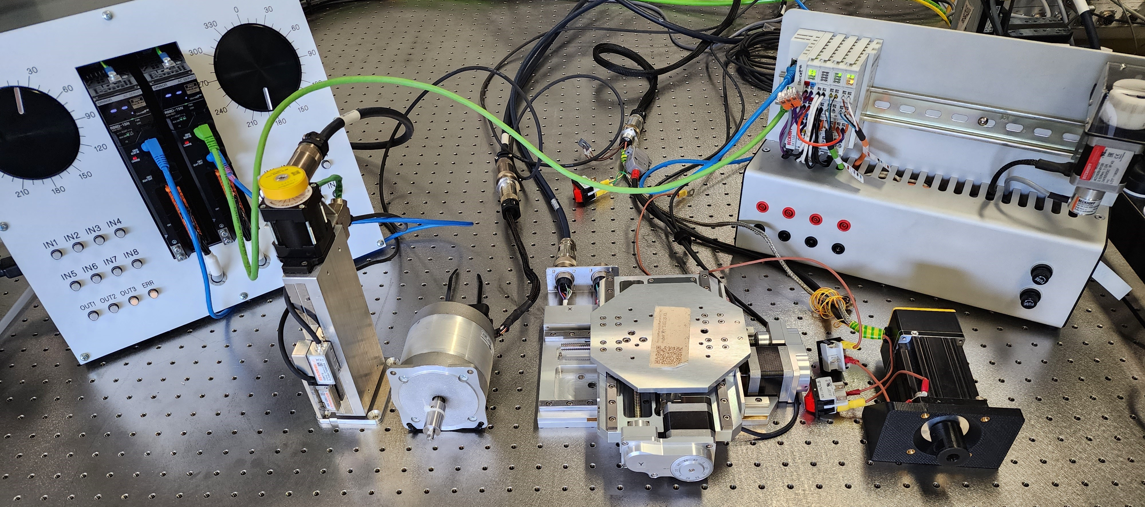
Test setup
Beckhoff: Bus Coupler(EK1100)
Stepper wi encoder(EL7047)
+ 4xAnalog outs (EL4134)
OMRON slave units:
Servo: R88D-1SN
closed loop stepper over ecat
closed loop servo
open loop steppers with incremental and absolute encoders

Slide 12
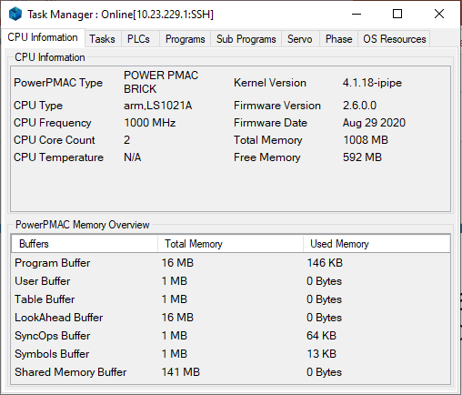
Test results
2KHz update rates achieved with 40-50% CPU load
All protections, limit switch reactions verified

Slide 13
Prototyping
Currently procuring for test prototypes
Testing for CPU capacity limits

Slide 14
Thank you!
To be continued…

