Slide 1
X-ray Beam Position Monitors
Developments at the Australian Synchrotron
Becky Lin, Sina Porsa, Jonathan McKinlay, Eugene Tan

Slide 2
Purpose / Why
Photon beam position monitors before the beamlines.
Some difference between photon and electron beam trajectories.
RF BPM
Dipole
Insertion Device (Source)
Not static
Dipole
RF BPM
e-beam
Apparent
e-beam trajectory
Measured
e-beam
position
Measured
e-beam
position
Photon
beam
trajectory
XBPM
XBPM

Slide 3
Challenges
Non-intercepting
Resolution ~100 nanometre
White beam → High power density (thermal challenges)
Photon spectrum and distribution can change
Types of XBPMs:
Photoelectric – measure drain current from metallic probes
Photoconductive – generally intercepting, not for white beam
Ionisation chambers – slow, low resolution

Slide 4
Prototype XBPM
XBPM for a Dipole radiation source:
Only vertical distribution
Low power densities, static photon spectrum and distribution.
Goals:
Difference in white beam response between W and Cu.
Increased number of sensors/blades used from 2 → 4.
Possibility of using pinhole masks to improve sampling of the photon distribution.
Simplified manufacturing: no brazing (Fe/Cu)

Slide 5
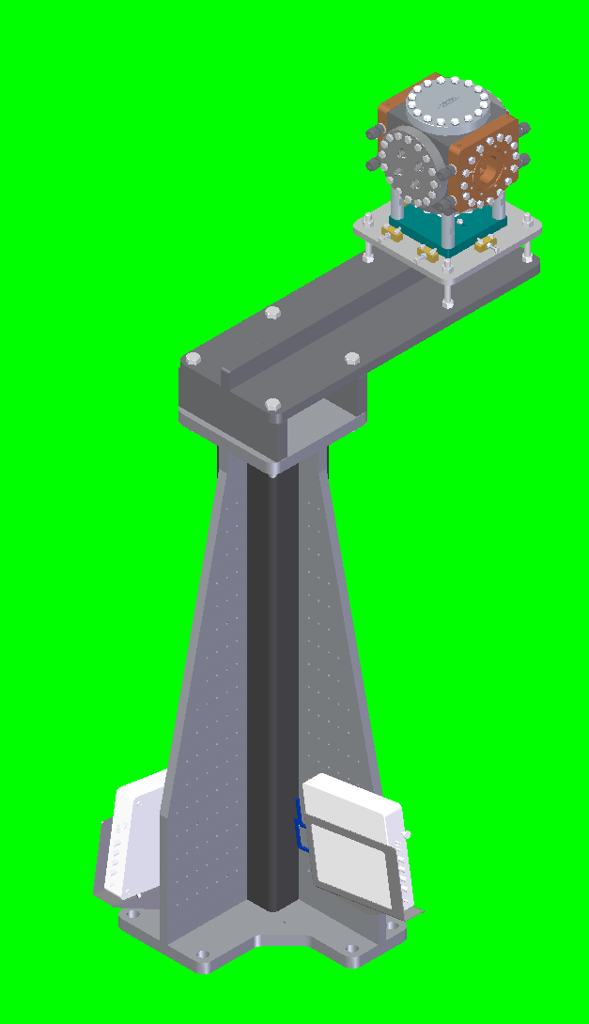
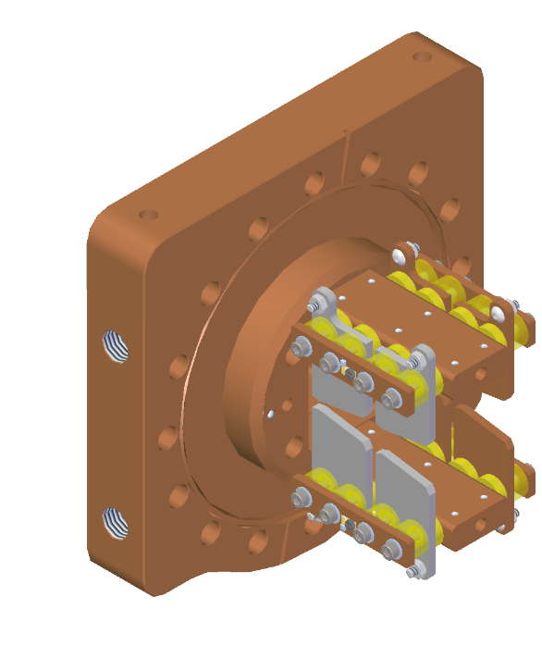
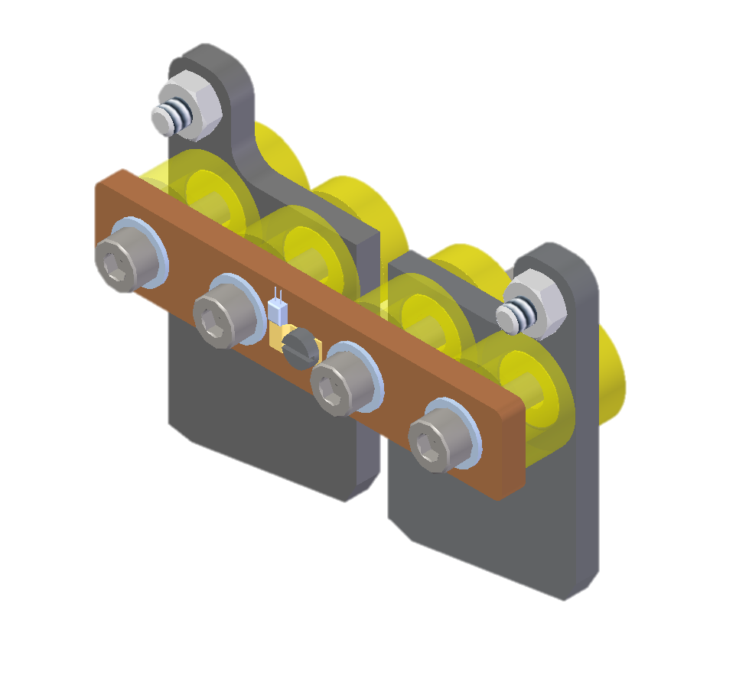
Prototype XBPM
ALUMINA BUSH
FIDUCIAL
XYZ
adjustments
LCW SUPPLY
PT100
KAPTON WIRE
RETURN
Libera photon
Notes:
So for our design we used similar principles.
Our blades are insulated with ceramic bushes made of alumina. This was good because it had good electrical insulation and thermal conductivity properties
The blades use Kapton wire used to connect to the triax feed throughs, added in PT100s to monitor the heat of the blades and mask.
Two fiducial mounts are placed in each mask, cooling through the mask
The XBPM itself is a cube with flanges on each side. The beam going in this direction, Triax feedthroughs on left and right, Sub d on top which the PT100s are connected to the two masks and a blank
The stand here is cantilevered because there are some lead blocks sitting directly below the xbpm.
There are slight adjustments that can be made in the xy and z. and the Libera photons sit here.
Currently there’s a vacuum level in the minus 9s, and the temperatures recorded are generally around 25degC .

Slide 6
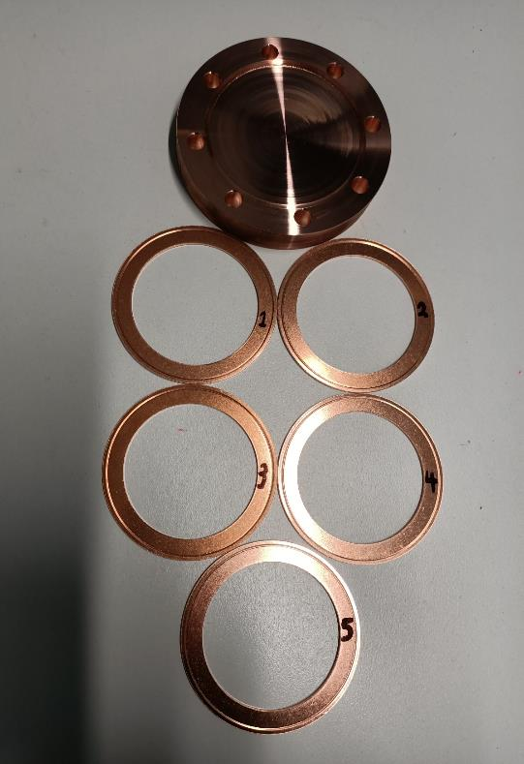
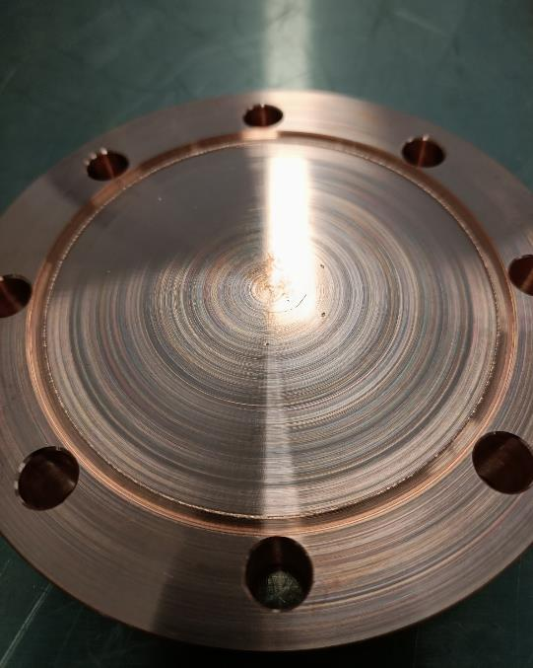
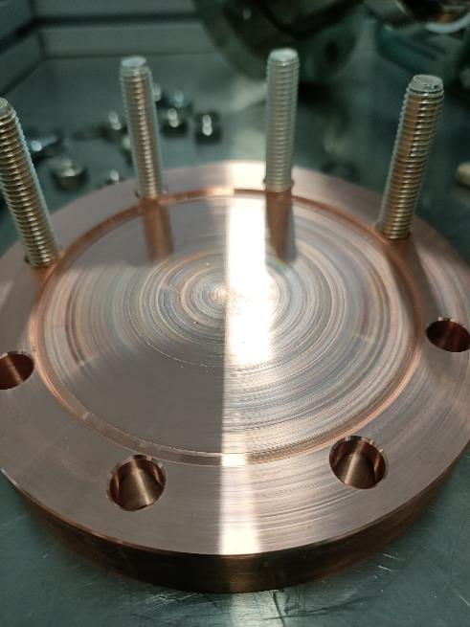
Experiments
CuCrZr alloy properties
Good thermal conductivity
324 Wm⁻¹ K
High softening temperature ~550°
High tensile strength
460MPa
Notes:
So because this was a prototype we used this opportunity to test ideas
Firstly the mask material CuCrZr alloy. It had good properties such as good thermal conductivity, high softening temperature (550) and mechanical strength.
When machined it acts like a hard aluminum. These pictures were from the first tests done to see how the knife edge handles.
On the left was the first vacuum test compared the right where it was the fifth. The edge looked like it was breaking down.
And these were using copper gaskets, so for the xbpm we decided to use annealed gaskets.

Slide 7
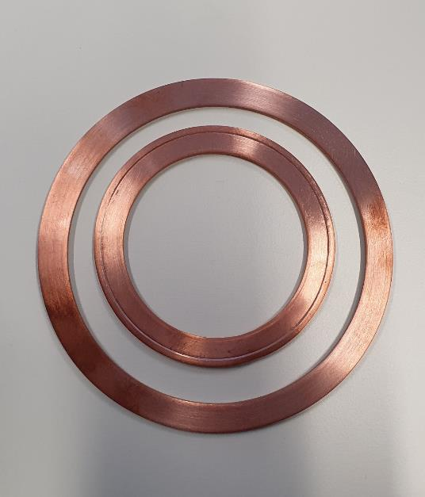
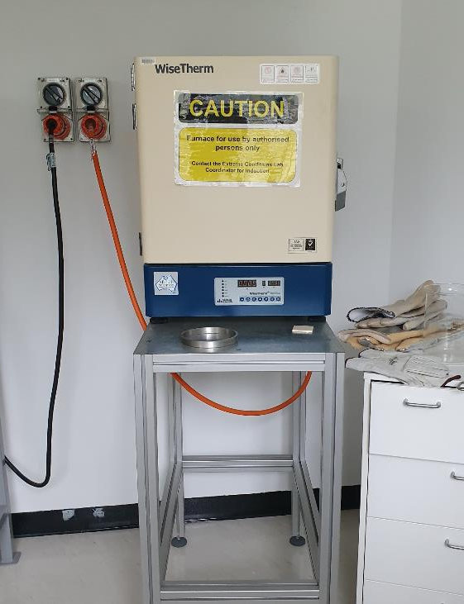
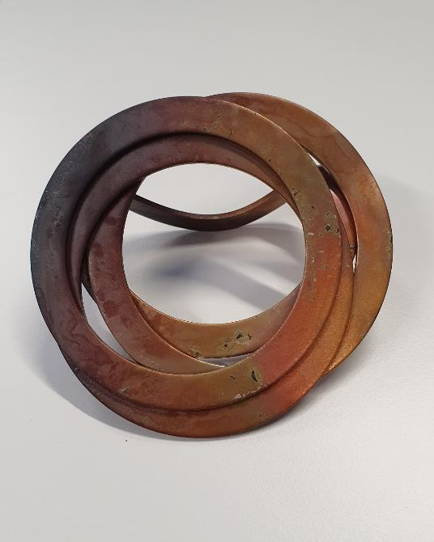
Experiments
Notes:
The purchase of annealed gaskets didn’t quite make it in time for the assembly so Jonathan came up with an idea to anneal them ourselves.
By using the furnace in the lab near PD, and heating it to 600 deg for around 20 mins in a steel foil case. That was probably the best setting we tried.
Just don’t try it with silver coated copper gaskets because they kind of end up all braised together, but it could have also been the 800deg.

Slide 8
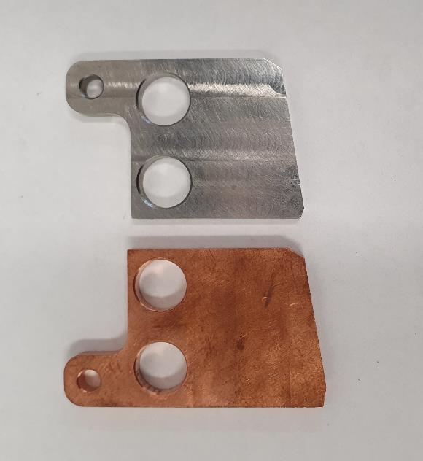
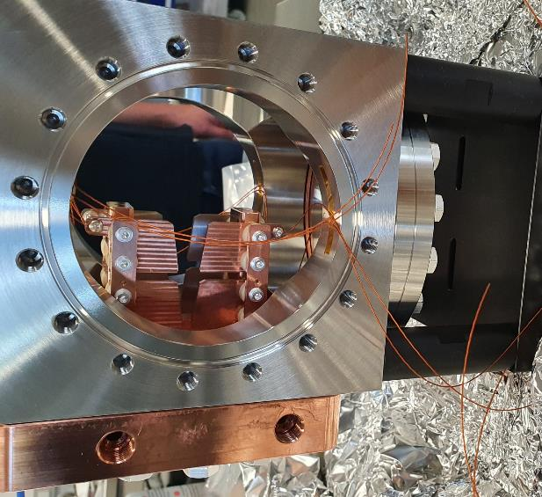
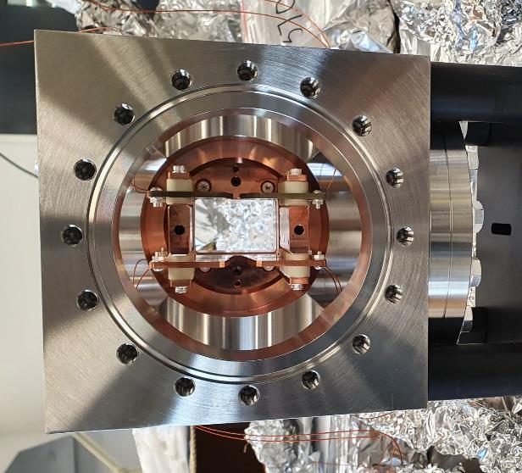
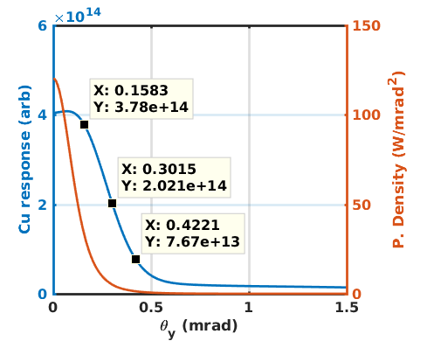
Experiments
Notes:
Secondly the blade materials. So looking up stream the copper blades are on the left and the tungsten blades are on the right.
This was to test if there was one material better than the other. How they would differ in sensitivity or accuracy
But also there was an intentional split in the blade, to pick up different sections of the response curve. To give more information if there was a misteer.

Slide 9
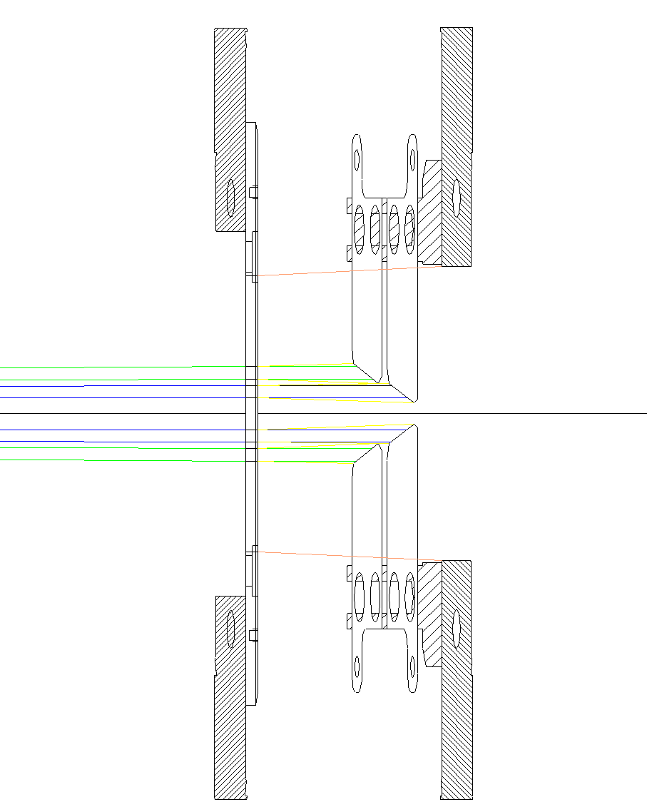
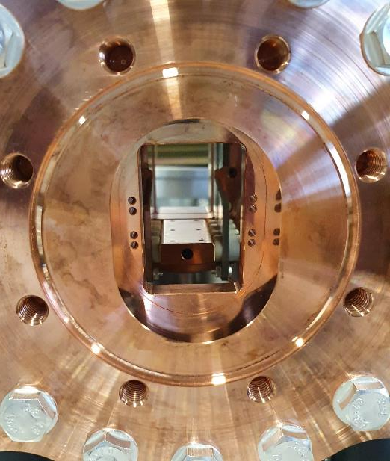
Experiments
Notes:
We also tried holes in the first mask to better focus the beam hitting the blade.
This helps increase the allowable tolerance of the blade position.
The green and blue lines are where it could hit the blade and the yellow lines have the acceptable range. The pin hole theoretically samples the distribution more accurately as it hits a specific part of the blade. And so any wrapping from the blades from heat will not affect the results.

Slide 10
Prototype XBPM - Installed

Slide 11
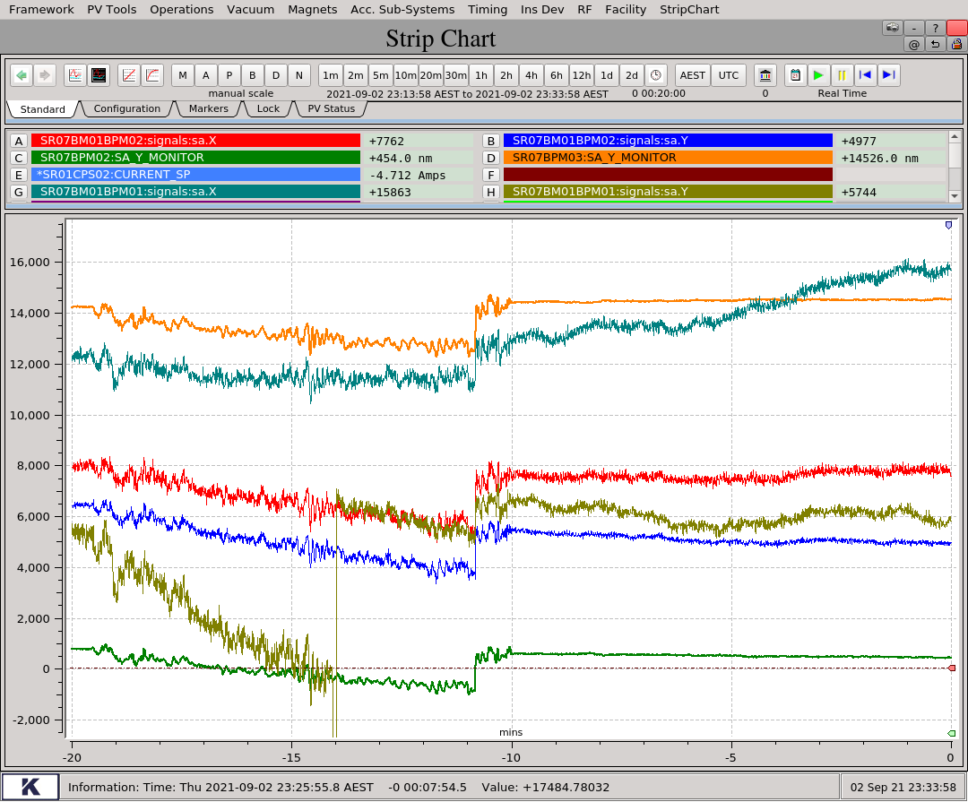
Prototype XBPM – Results/Learnings
Resolution < 200 nm.
Very sensitive to cooling water temperature.
Unexplained:
Horizontal position sensitivity
Factor 10 difference between similar blades.
Bursts of outgassing
Calibration gain changes over time
Fast Orbit Feedback OFF
Fast Orbit Feedback ON
Cu Inner
RF BPM
2 um
W Inner
Cu Outer
W Outer
RF BPM
10 mins
10 mins

Slide 12
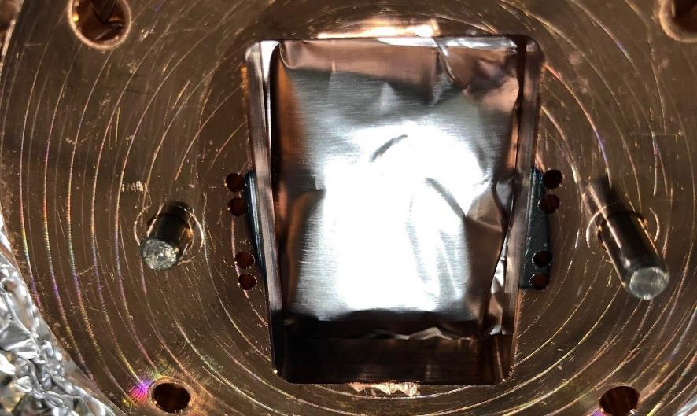
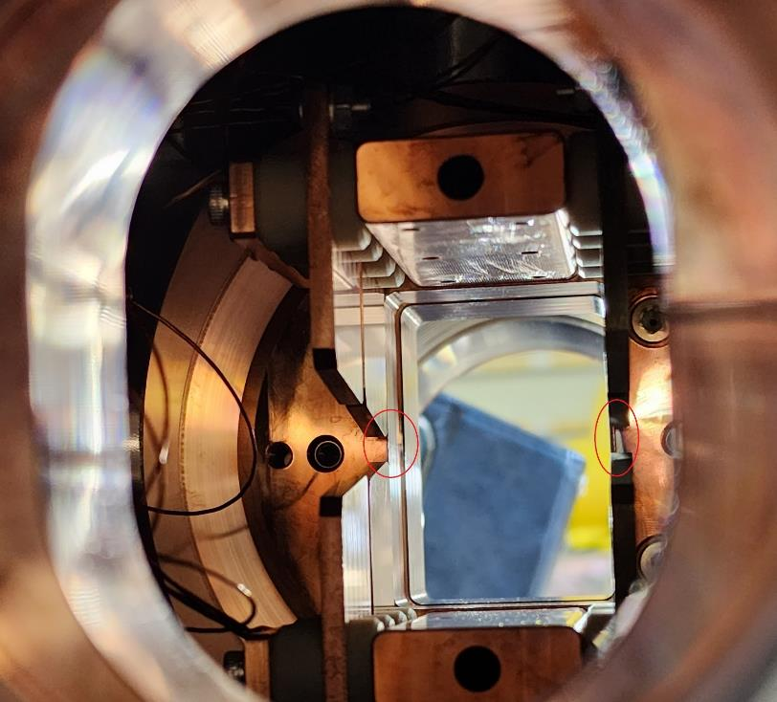
Prototype XBPM - Removed
Discovered that the photon beam was 5 mm narrower than expected and at an odd angle due to the first mask in the main chamber. Explains:
Explains the strange horizontal position sensitivity
Factor 10 in signal for similar blades

Slide 13
Prototype XBPM – 2nd Iteration
Photo electron re-capture:
Permanent voltage bias source.
Angle blades to flat surfaces don’t face each other
Narrower blade positioning and re-instate mask.
Lab tests to find source of “bursts” of outgassing.

Slide 14
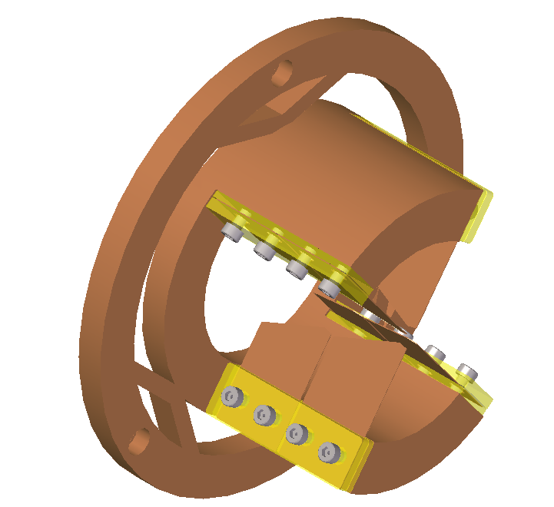
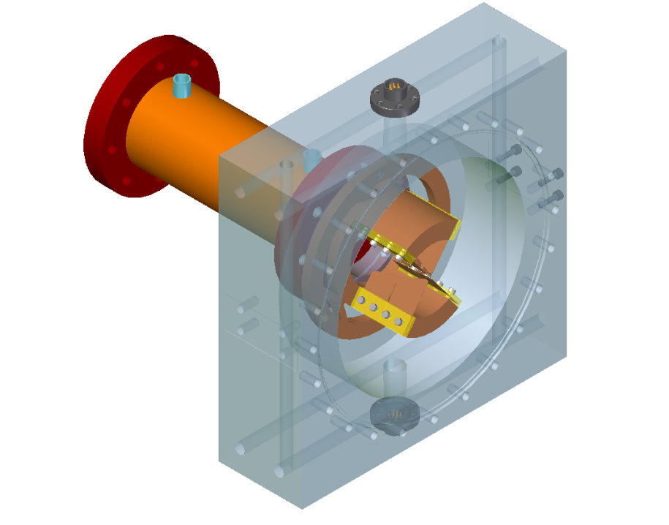
MX3 Beamline XBPM
SUB C FEEDTHROUGH
BEAM
Cu Blades
ALUMINA
Simplified design and easier wire management and access.
Flexures and beam height mounting to deal with thermal expansion
COOLING
LINES
Notes:
Simplified design, no need for cube- space efficiency, more than half the length gone. Easier to change (disassemble), easier wire management and access
Feedthroughs changed to sub C instead of triax, cables can still be triax/coax for signal maintenance.
More cooling lines for higher power density. Thinner blades for better sampling?
Elongated Mask with cooling surrounding mask due to higher power.
Mounting from horizontal center, and flexures of blade holder to give xbpm flexibility to move centrally with beam.

Slide 15
Surface coated Blades
Becky Lin, Jonathan McKinlay

Slide 16
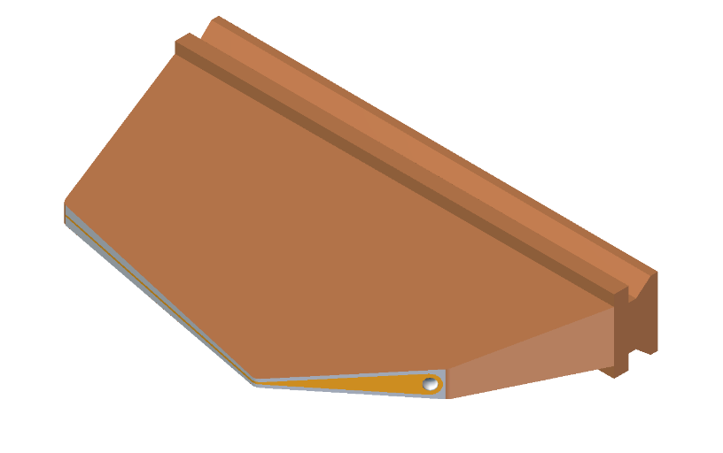
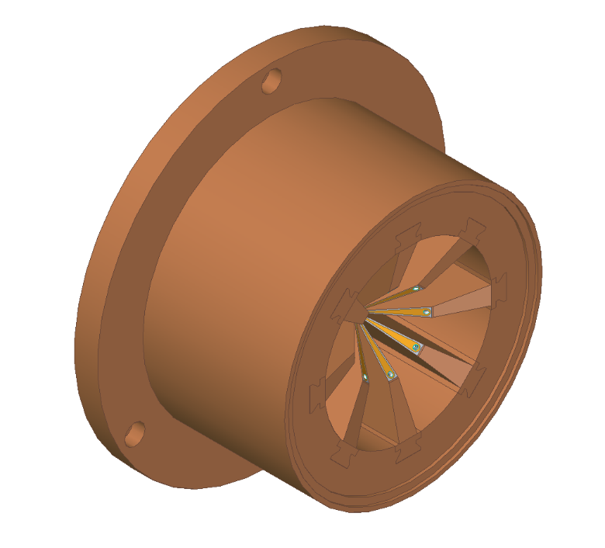
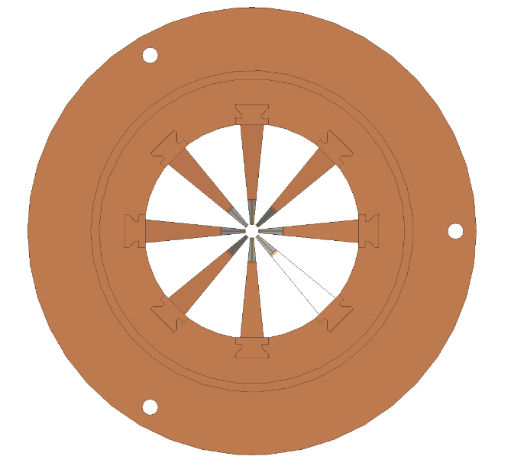
Coating Blade Design
BACK ISOMETRIC VIEW
FRONT VIEW
TAPERED
DOVETAIL
GOLD TRACK
FEEDTHROUGH
MOUNT HOLE
Significant reduction in complexity
Improved thermal distribution.
Improved photon beam sampling
Challenges: Suitable materials for robustness of insulation layer and tracks
Notes:
This is proposed simplified/basic design of the blades if this process is deemed successful.
Gold track for blade signal, and screw hole for feedthrough wire mount (on the back of blade so out of beam view), tapered dovetail for precise assembly.
Number of blades and angles can be changed. Flexures will be added to optimise heating centre.
Simplifies mechanical assembly significantly

Slide 17
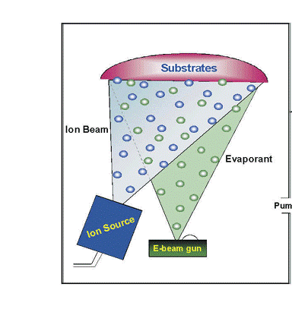
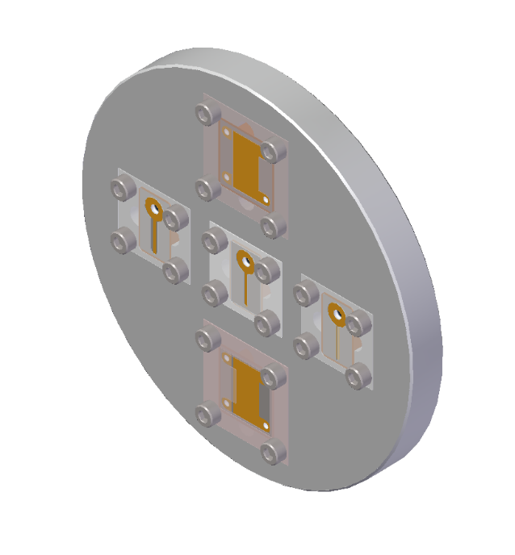
Evaporative Beam Deposition Test
Insulation: SiO₂ 500nm
Signal Path: Au 100nm
Vacuum Chamber
TEST
PIECES
Notes:
Method used to coat metal substrate: evaporative beam deposition. Coats the face the ion source and e-beam gun is directed to, so material finish and masking is critical for desired outcome.
Testing on copper parts, insulation material: silicon dioxide, signal path Gold.
Challenges in matching thermal expansion to avoid cracking due to major differences
Alternatively use different base metal or use non conductive material as base then deposit metal (however manufacturing non metals have it’s challenges too)

Slide 18
Thermomechanical BPM (TBPM)
Sina Porsa, Becky Lin

Slide 19
Thermomechanical BPM (TBPM)
Problems with photoemission
Signal depends on material surface properties and photon spectrum.
Photon spectrum and distribution changes as beamlines request different energies.
Free electron recapture
Potential solution: use the power density
Not applicable for all beamlines

Slide 20
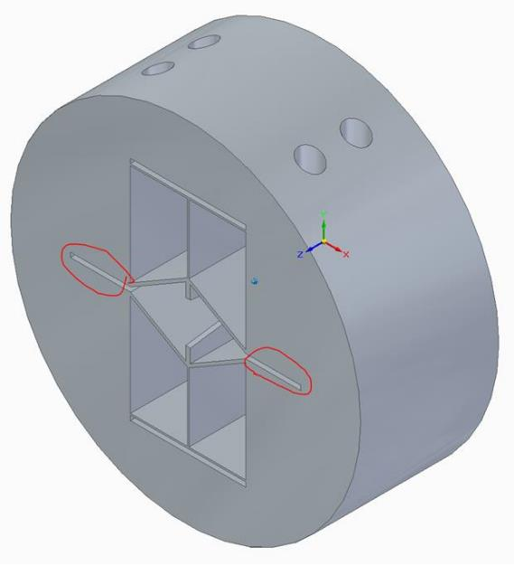
TBPM Design
No feedthroughs
Single water-cooled Cu block
Temperature changes to the probes causes the flexure to move vertically.
Differential measurement to measure shift in the beam centroid.
PROBES
Cuts to increase thermal gradient.
Movement direction

Slide 21
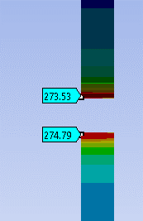
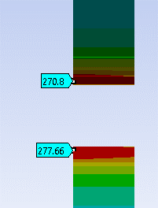
TBPM – FEA Studies
Y = 0 um
Y = -5 um

Slide 22
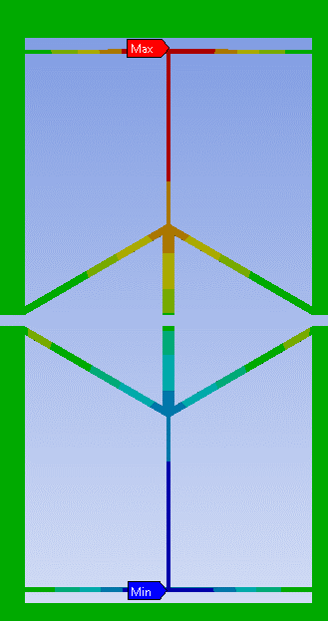
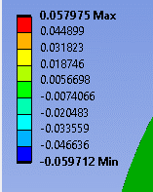
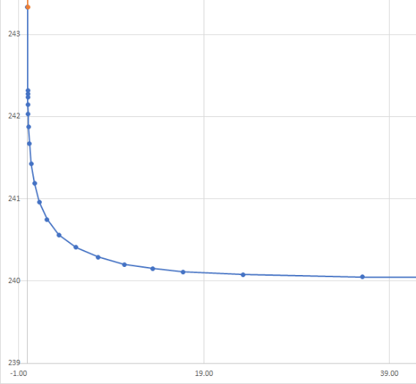
TBPM – FEA Studies
Y = -5 um beam shift → 1.8um difference in flexure position.
Response time ~10 s.
20 seconds

Slide 23
Questions and Feedback

Slide 24
Thank You

