Slide 1
An EPICS solution for Galil products that can provide a comprehensive, and high performance motor and PLC control system for use at synchrotrons and other research laboratories

Slide 2
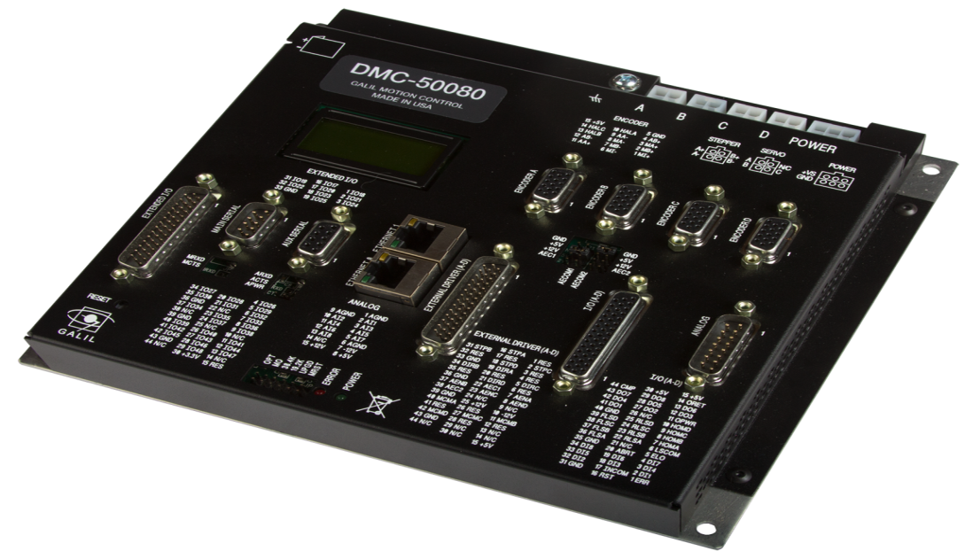
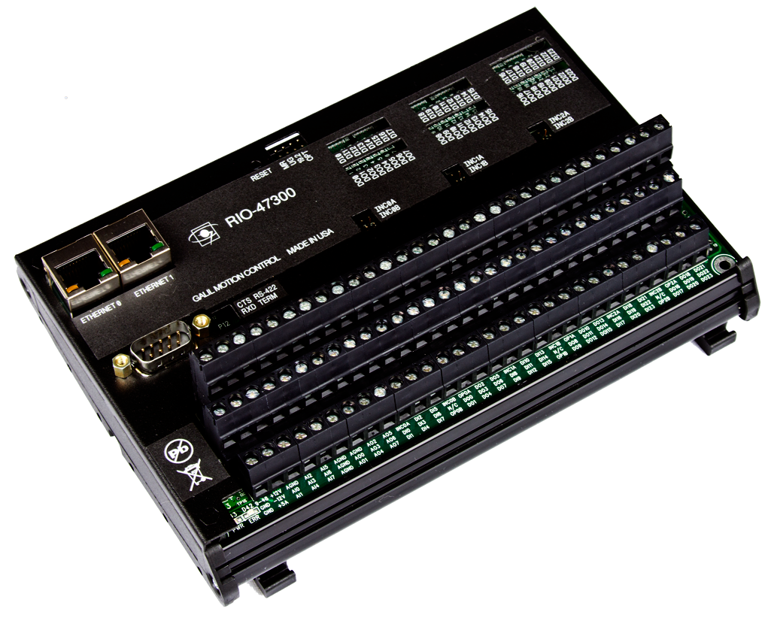
EPICS Galil Driver 3-1
Replacement for Galil 1-5
ASYN model 3 architecture
Connects to all Galil controllers
Uses EPICS motor record
Adds a litany of new features such as
Auto amplifier on/off
Auto brake on/off
Profile motion
Coordinate system motors
Simple and intuitive to use
Provides high performance and flexibility
The easy way to meet your demanding requirements

Slide 3
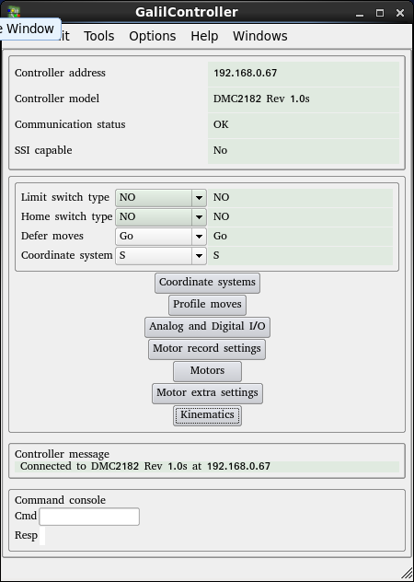
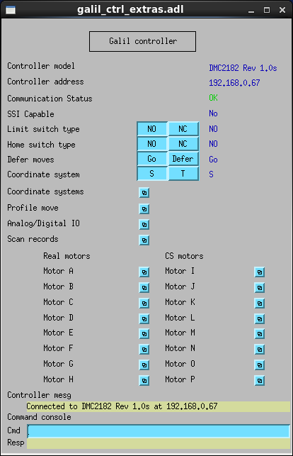
Bundled software
Example IOC
Autosave request files
QE framework and MEDM screens
QE screens are based on Qt and provide for a more intuitive experience
Especially true for the more complex functions (eg Kinematics definition)

Slide 4
Communications
ASYN based communications
Two connections per controller
TCP Synchronous command/response
UDP Asynchronous stream
Serial also supported
Time between UDP packets
RIO PLC – 2ms
DMC-2xxx-8ms
DMC-4xxx-2ms
Sophisticated connection management
Manage controller code

Slide 5
Low level programming
Sophisticated code generator
Behaviour when limits activated, home program
Provided home program is feature rich and features can be enabled/disabled (eg. Use encoder index, jog after home to).
Most cases require no code at all
Supports construction of code from template
Header, axis1, axis2, .., footer
Supports complete custom code and will manage it’s delivery to controller

Slide 6
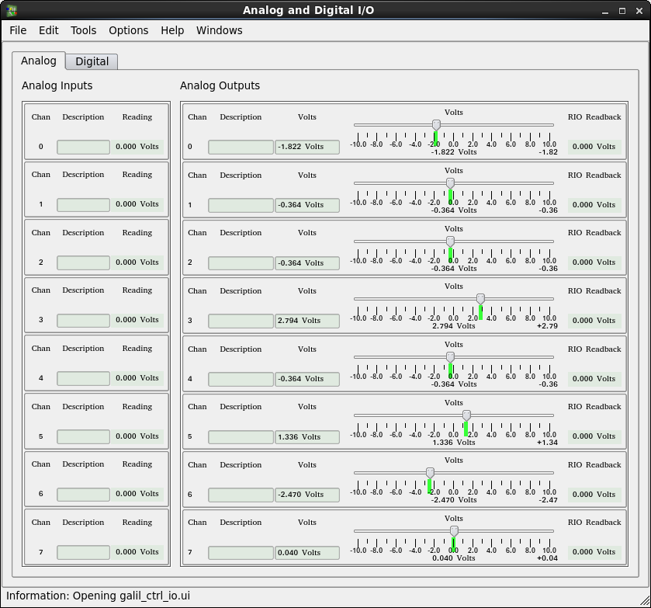
RIO PLC control
Cost effective option for general control < $500 USD
Dual ethernet
Provides access to digital and analog IO
Example IOC provides access to 24 Digital In/Out and 8 Analogs
ADC 16 bit option
2ms UDP updates

Slide 7
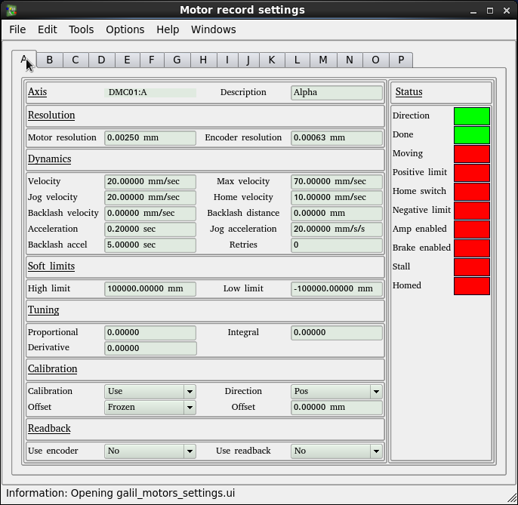
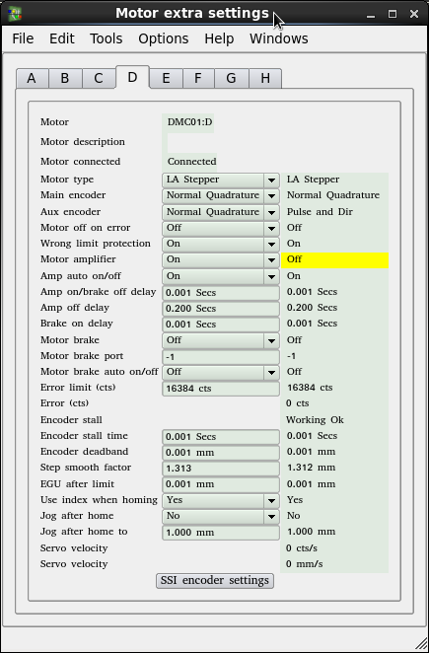
Standard motor control
Motor record used for both real, and CS motors
Standard motor records settings are available, but not all apply to CS motors (eg. use encoder if present)
Additional features for real motors:
Wrong limit protection
Encoder stall definition

Slide 8
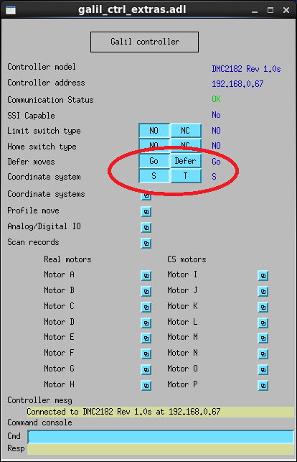
Ad-hoc coordinated motion
Deferred moves facility
Select deferred
Select coordinate system
Move all motors
Select go
Motion coordinated by
hardware

Slide 9
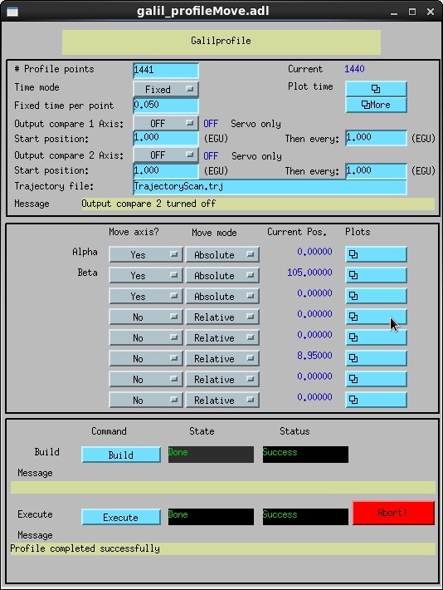
Profile moves

Slide 10
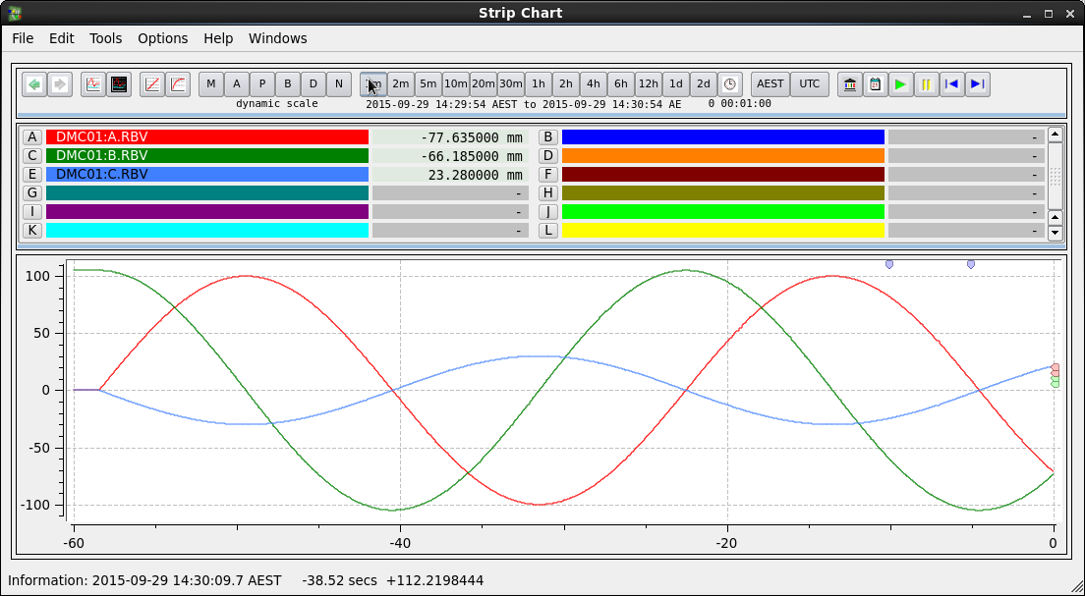
Profile moves
Available on 21x3 model and above
From spreadsheet to delivery takes only minutes
Tools provided to analyse the trajectory and ensure it’s within constraints
Relative and absolute modes
Position compare can be used to trigger external detectors

Slide 11
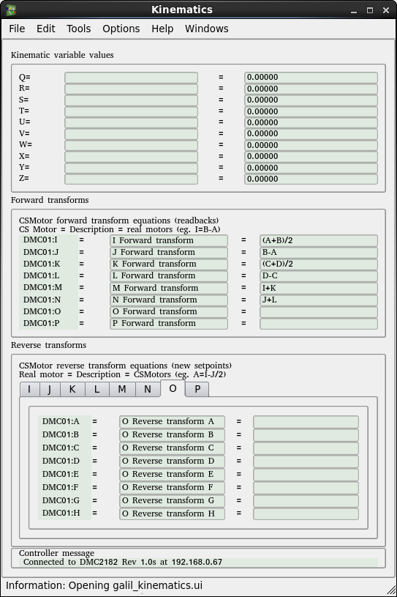
Coordinate system (CS) motors
8 coordinate system motors per controller. Axis I to P.
10 variables for use in kinematics
Coordinate system motors contain kinematic methods
Parse equations
Forward transform
Reverse transform
Kinematics and variables all database adjustable whilst IOC running
Multi-mode coordinated motion easily implemented
Nesting allowed

Slide 12
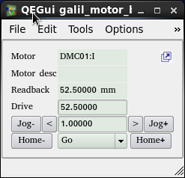
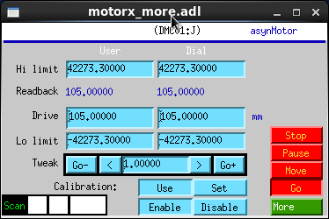
Coordinate system (CS) motors
Mix closed-loop and open loop motors
Mix different gear ratios, and resolution
Limits reporting
Underlying kinematics model could be used on any controller that supports coordinating groups of motors

Slide 13
Conclusion
Download http://motorapp.github.io/Galil-3-0/
Demo at Motion Solutions Australia booth
Questions?

