Slide 1
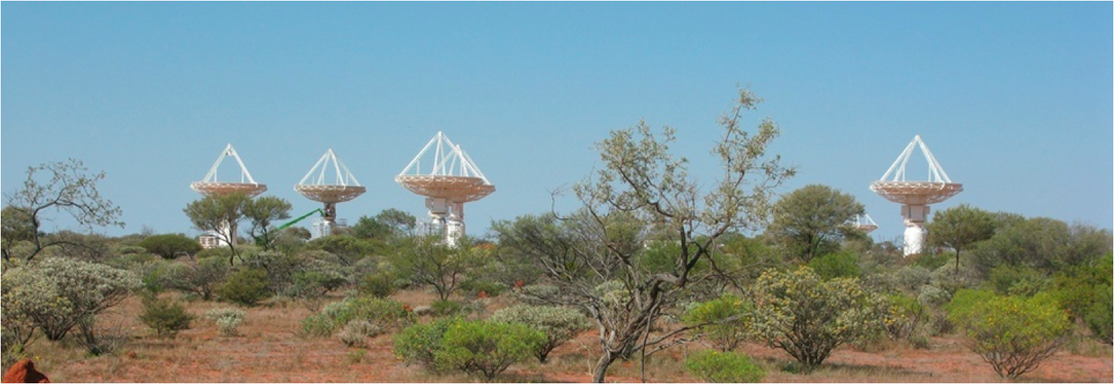
EPICS Development for the ASKAP Design Enhancements Program
Craig Haskins
18th October 2015
EPICS User Meeting – Melbourne 2015
Astronomy and Space Science

Slide 2
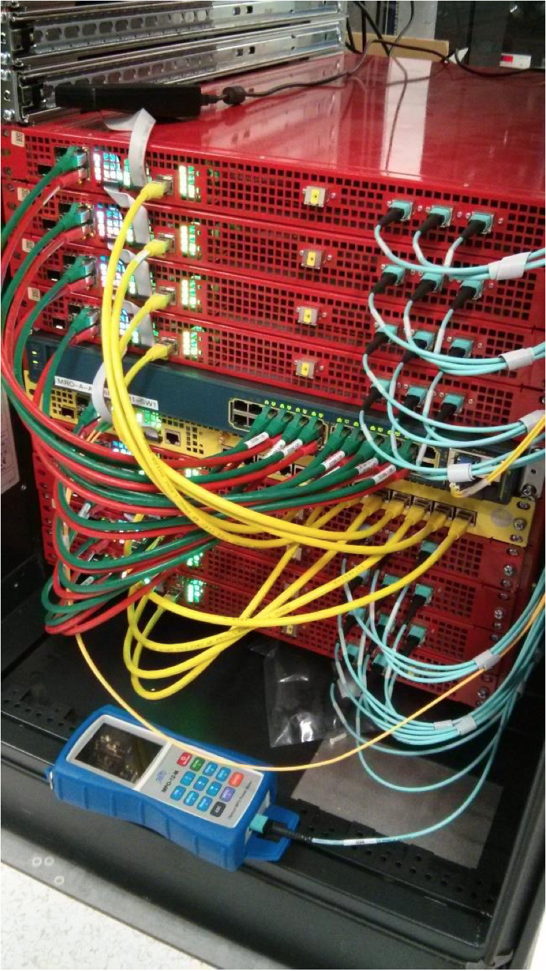
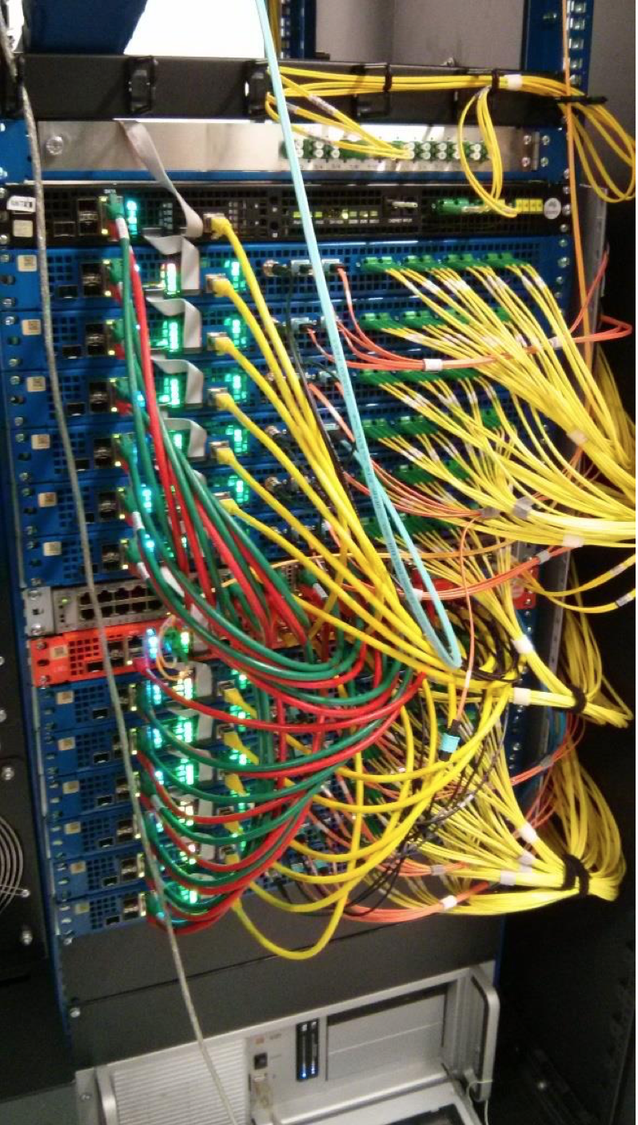
ASKAP Design Enhancements (ADE) Program
Refresh of electronics hardware
Mk II Phased Array Feeds (PAF)
RF over optical fiber
Digital hardware moved out of pedestals to central site
Opportunity to revise our EPICS implementation

Slide 3
ASKAP Control & Monitoring Hierarchy
Array
Antenna 1
Timing
PAF
Digital Receiver
Beamformer
Card 1
Card 1
FPGA 1
Correlator
Card 1
Block 1
FPGA 1
FPGA 2
Card 2..12
Block 2..8
Antenna 2..36
Card 2..8
FPGA 2..6
Card 2..12
FPGA 2..4
FPGA 1

Slide 4
Problem
Hardware configuration is dynamic
number of antennas
number of cards
features present on cards
Large number of similar devices to configure and control in parallel
Large number of hierarchical monitoring points
Must keep EPICS 3.14

Slide 5
Solution
Monitoring points in C structures provided by a Hardware Abstraction Layer (HAL) library annotated with xml tags
Build time tools to parse xml and generate IOC configuration files
Runtime enhancements to handle disabled, not present or unselected hardware (bigASub, summary & fanout records)
Logical control & monitoring groupings via composite IOCs

Slide 6
EPICS DB Generation
Hierarchical EPICS DB
C data structures with embedded XML tags
asyn parameter list
xml parser
C structured data to EPICS update functions
moniCA (archiver) PV configuration
CSS BOY PV table configuration

Slide 7
EPICS DB Generation Example
/// @brief cooling fan info
///
/** @xmlonly <iocStructure name=”FanInfo"> @endxmlonly */
typedef struct FanInfo
{
AdbeStatus status; ///< hardware status, e.g. ADBE_NOT_PRESENT (maps to asynDisabled)
float voltage; ///< fan voltage
/** @xmlonly <iocPoint name=”volts" type=”float" egu=”V” comment=”fan volts"/> @endxmlonly */
float speed; ///< fan speed
/** @xmlonly <iocPoint name=”speed" type="float" egu=”rpm” comment=”speed"/> @endxmlonly */
} FanInfo;
/** @xmlonly </iocStructure> @endxmlonly */

Slide 8
EPICS DB Generation Example
/// @brief a top level structure representing all the monitoring points
///
/** @xmlonly <iocStructure name=”ChassisInfo" type="top"> @endxmlonly */
typedef struct ChassisInfo
{
AdbeStatus status;
float temp; ///< temperature
/** @xmlonly <iocPoint name=”temp" type=”float" egu=”C" comment=”temp"/> @endxmlonly */
FanInfo fan; ///< chassis fan
/** @xmlonly <iocStructure name=”fan" type=”FanInfo" comment=”chassis fan”/>
} ChassisInfo;
/** @xmlonly </iocStructure> @endxmlonly */
/// @brief get current chassis info
ChassisInfo* getChassisInfo();

Slide 9
EPICS DB Generation Example
Parsing the XML will generates EPICS records
$(p)ChassisInfo:temp
$(p)ChassisInfo:fan:voltage
$(p)ChassisInfo:fan:speed
And to update the records at runtime we call a HAL library method & a generated update function
TestInfo* info;
// get structured data from hardware
info = drv->getChassisInfo();
// a single call to update structured EPICS PVs via asyn parameters
Update_ChassisInfo(ASYN_INDEX(ChassisInfo_BEGIN), info);
callParamCallbacks(0);
Can use structure status to set PV alarm status, e.g. asynDisabled
Other types supported such as arrays, enums
PV attributes such as alarm states can be specified

Slide 10
BigASub Record
Forked from aSub record
More inputs INP001..INP128
More outputs OUT001..OUT128
Numbered I/O for easier partial records
Mask Input Link MSKL for masking out I/O
INP001
bigASub
OUT001
INP002
OUT002
INP128
OUT128
MSKL

Slide 11
Summary Records
Summary records combine an aggregation function with alarm propagation. (.e.g. a summary temp will show max temp plus maximum alarm condition)
Inputs can be excluded from aggregation & propagation by either being in DISABLE_ALARM state or by being masked out
Supports variable number of inputs via partial records.
Automatically generated from an XML definition
<iocSummary name="temps" type="max" egu="C” comment="max temp">
<iocSearch name="CtrlMonitorData" egu="C"/>
<iocSearch name="RedbackMonitorData" egu="C"/>
</iocSummary>

Slide 12
Composite IOCs
ASKAP hardware consists of many instances of identical hardware
All instances need to be controlled in parallel
Control commands are fanned out using bigASub
Monitoring points are aggregated using bigASub
Handles heterogeneous subsystems
Handles command sequencing
IOC load time configuration of components (antennas or subsystems)
IOC runtime selection of antennas/subsystem via bigASub mask input link

Slide 13
Composite IOCs
Single set of PV definitions (csv file) for generating Composite IOC database at both antenna and array level. e.g.
PV | desc | TRD | FEC | DRX | BMF
ctrl1 | Control to all subsystems | x | x | x | x
ctrl2 | Control to 2 subsystems |  |  | x | x
ctrl3 | Sequenced control to 3 subsystems | 1 |  | 3 | 2

Slide 14
ASKAP Control & Monitoring Hierarchy
Array
Antenna 1
Timing
PAF/FEC
Antenna 2..36
Digital Receiver
Beamformer
Card 1
FPGA 1
FPGA 2..4
Card 1
FPGA 1
Card 2..8
Correlator
Card 1
Block 1
FPGA 1
FPGA 2..6
Card 2..12
Block 2..8
Card 1
Card 2..12
FPGA 2..6
Antenna Composite IOC
HAL
Subsystem IOC
Array Composite IOC
Card 2
Asyn port drivers
x1
x36
x152
x888
x4032

Slide 15
Composite IOC – Control Hierarchy

Slide 16
ASKAP Monitoring Point Hierarchy

Slide 17
Thank you
CSIRO Astronomy and Space Science
Craig Haskins
Software Engineer
t +61 8 6436 8620
e Craig.Haskins@csiro.au
w http://www.atnf.csiro.au
Astronomy And Space Science

