Slide 1
Future Developments in Compact Light Sources
Eugene Tan, Senior Accelerator Physicist, AS – ANSTO
Australian Compact Light Source Workshop 2021 (Virtual - ANSTO)

Slide 2
What is compact?
Compact/Affordable: universities, hospitals, manufacturing and industry
Bright and Versatile (tunable/broadband).
Average storage ring based “Source” costs AUD$300 - 500 million for 20 sources and >25,000 m² of space.
“Affordable” means reducing this by one or two orders of magnitude.
Notes:
As we investigate nature, both biological and non-biological, we find the need to understand it at the atomic and macroscopic level simultaneously. The atomic level gives us the fundamental individual building blocks and relationships/processes, however as these aggregate into a macroscopic system its behaviour can become unique, emergent characteristics. For probes the most useful has been photons, electrons and neutrons have their place however photons are still the easiest and most convenient tool to probe the structure of matter.

Slide 3
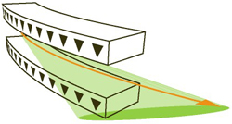
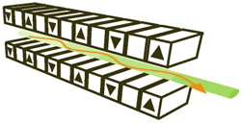
Current Methods
How the “light” is generated
Bremsstrahlung (electrons in matter)
Synchrotron radiation (electrons in magnetic fields from magnets)
Dipole: $E_{ph}∝{{E_{e}}^{3}}/r$
$E_{e}\sim GeV and r \sim \text{meter}\text{ (}\text{B} \sim \text{Tesla})$
Undulator: $1 \text{keV} >E_{ph}∝{{E_{e}}^{2}}/{λ_{u}}<100 \text{keV}$
$E_{e}\sim GeV and λ_{u} \sim 10 \text{mm}$
$$r$$
$$λ_{u}$$
Notes:
Generation of photons at will has been developing/improving since we first discovered fire (chemical reactions)
Harmonic oscillation of the electrons in specially made devices called insertion devices to transversally accelerate the electrons to multiply the effect of a single acceleration with a dipole magnet. These are wigglers or undulators.
To reduce the period further

Slide 4
New sources of “light”
Relationships: $E_{ph}∝{{E_{e}}^{3}}/r$ and $E_{ph}∝{{E_{e}}^{2}}/{λ_{u}}$
Impossible to simply shrink storage ring based light sources.
FEL… Dielectric accelerators (later)
Inverse Compton (electrons in photon field) → optical undulator
$λ_{u} \sim 10 \text{mm} →1 μ\text{m}$ $E_{e}\sim GeV →10s MeV$
Beta radiation (electrons in plasma)
$r \sim \text{m}\text{m}$ $E_{e}\sim GeV →10s MeV$
Notes:
Generation of photons at will has been developing/improving since we first discovered fire (chemical reactions)
Harmonic oscillation of the electrons in specially made devices called insertion devices to transversally accelerate the electrons to multiply the effect of a single acceleration with a dipole magnet. These are wigglers or undulators.
To reduce the period further

Slide 5
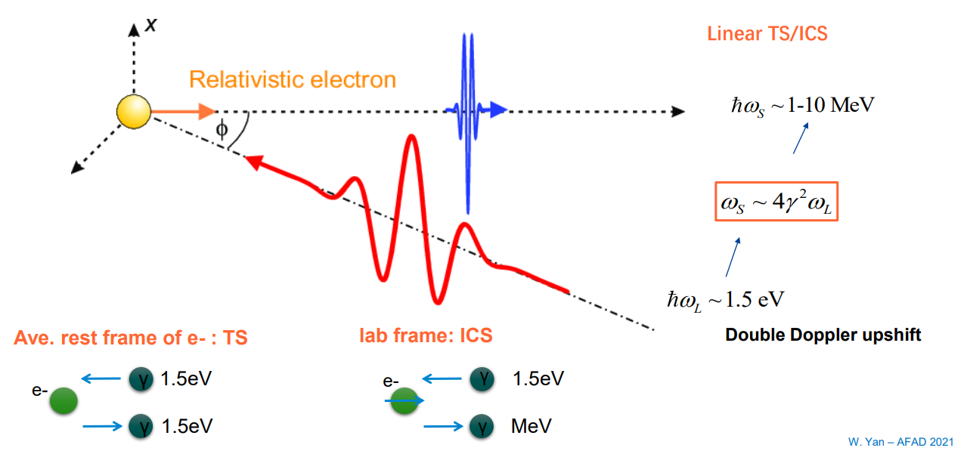
Inverse Compton Scattering (ICS)
For 100 keV you need an electron beam energy of ~ 80 MeV.
Electron-Photon cross section is small so you need a very intense laser.
Scattering laser pulse

Slide 6
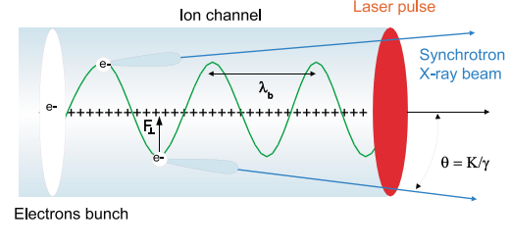
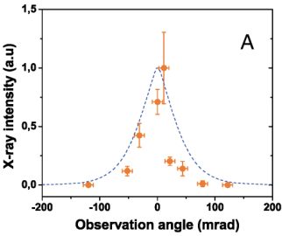
Beta Radiation
“Parasitic” in Laser/Beam driven wakefield acceleration.
Rousse, Antoine, Kim Ta Phuoc, Rahul Shah, Alexander Pukhov, Eric Lefebvre, Victor Malka, Sergey Kiselev et al. "Production of a keV X-ray beam from synchrotron radiation in relativistic laser-plasma interaction." Physical review letters 93, no. 13 (2004): 135005.

Slide 7
Acceleration
Only electric fields accelerate charged particles. Therefore compact accelerators require high field gradients.
Metal Medium
S-Band (2-4 GHz) and C-band (4-8 GHz)
Superconducting RF
X-band (8-12 GHz)
THz: 300 GHz → 3 THz (Boundary between electrical and optical)
Dielectric/Plasma Medium
Dielectric Laser Acceleration (DLA)
Laser/Beam Driven Plasma Wakefield Acceleration
Widely used
10 MeV/m
40 MeV/m
100 MeV/m
R & D
1,000 MeV/m
50,000 MeV/m

Slide 8
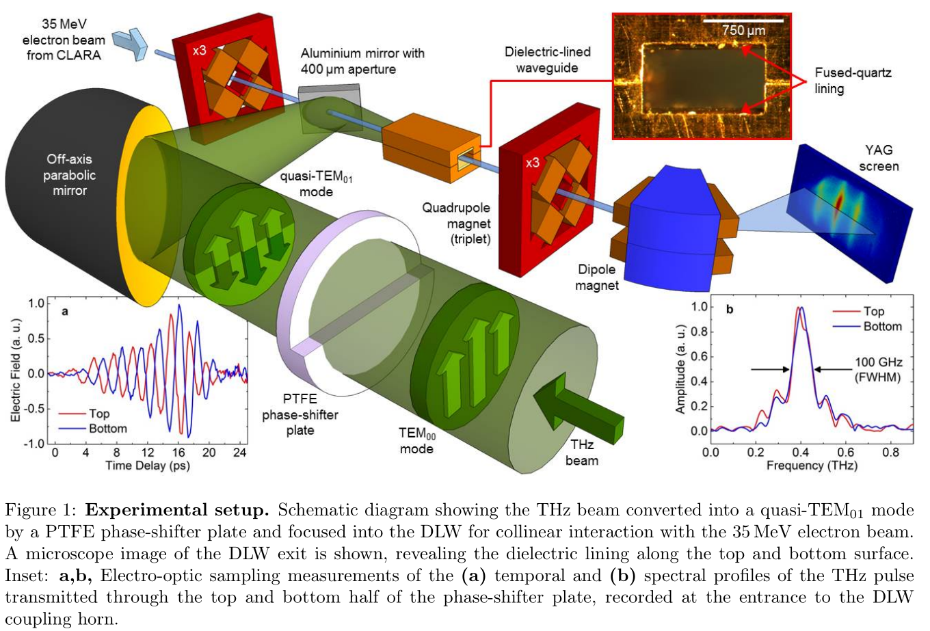
THz Accelerators (> 300 GHz)
Hibberd, Morgan T., Alisa L. Healy, Daniel S. Lake, Vasileios Georgiadis, Elliott JH Smith, Oliver J. Finlay, Thomas H. Pacey et al. "Acceleration of relativistic beams using laser-generated terahertz pulses." Nature Photonics 14, no. 12 (2020): 755-759.
THz laser pulse + dielectric lined waveguide (DLW) as the “accelerating structure” → up to 1 GV/m with mJ pulses.

Slide 9
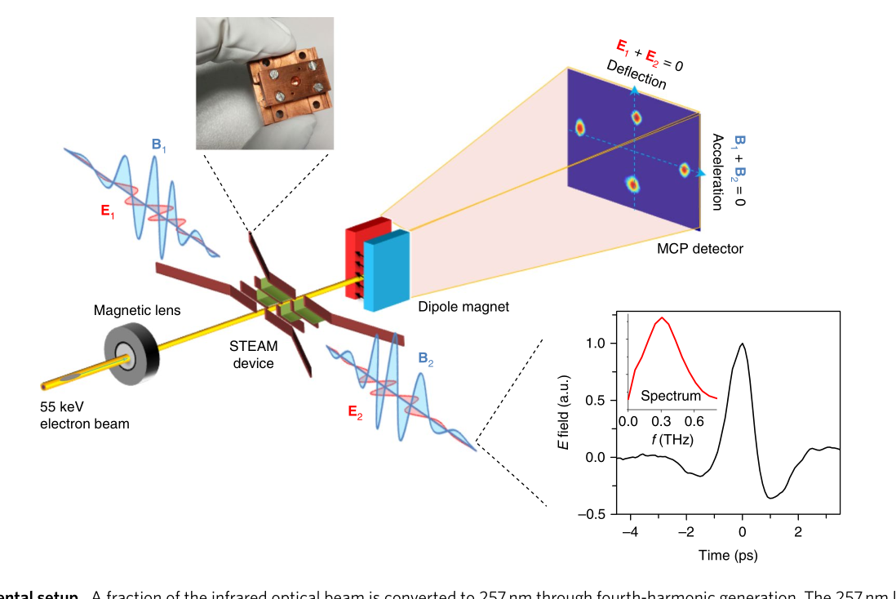
THz Accelerators (> 300 GHz)
Zhang, Dongfang, Arya Fallahi, Michael Hemmer, Xiaojun Wu, Moein Fakhari, Yi Hua, Huseyin Cankaya et al. "Segmented terahertz electron accelerator and manipulator (STEAM)." Nature photonics 12, no. 6 (2018): 336-342.
STEAM (AXSIS project, DESY)
THz radiation for electron manipulation.
Bunching and streaking
Limited by sources
Optical down conversion from visible to THz using nonlinear crystals.
THz quntum cascade lasers (cryogenic temp)
High power THz Gyrotrons.

Slide 10
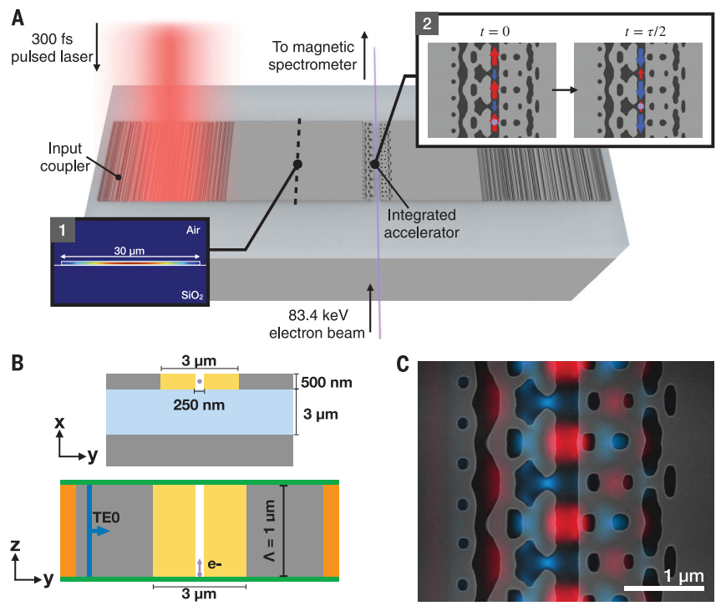
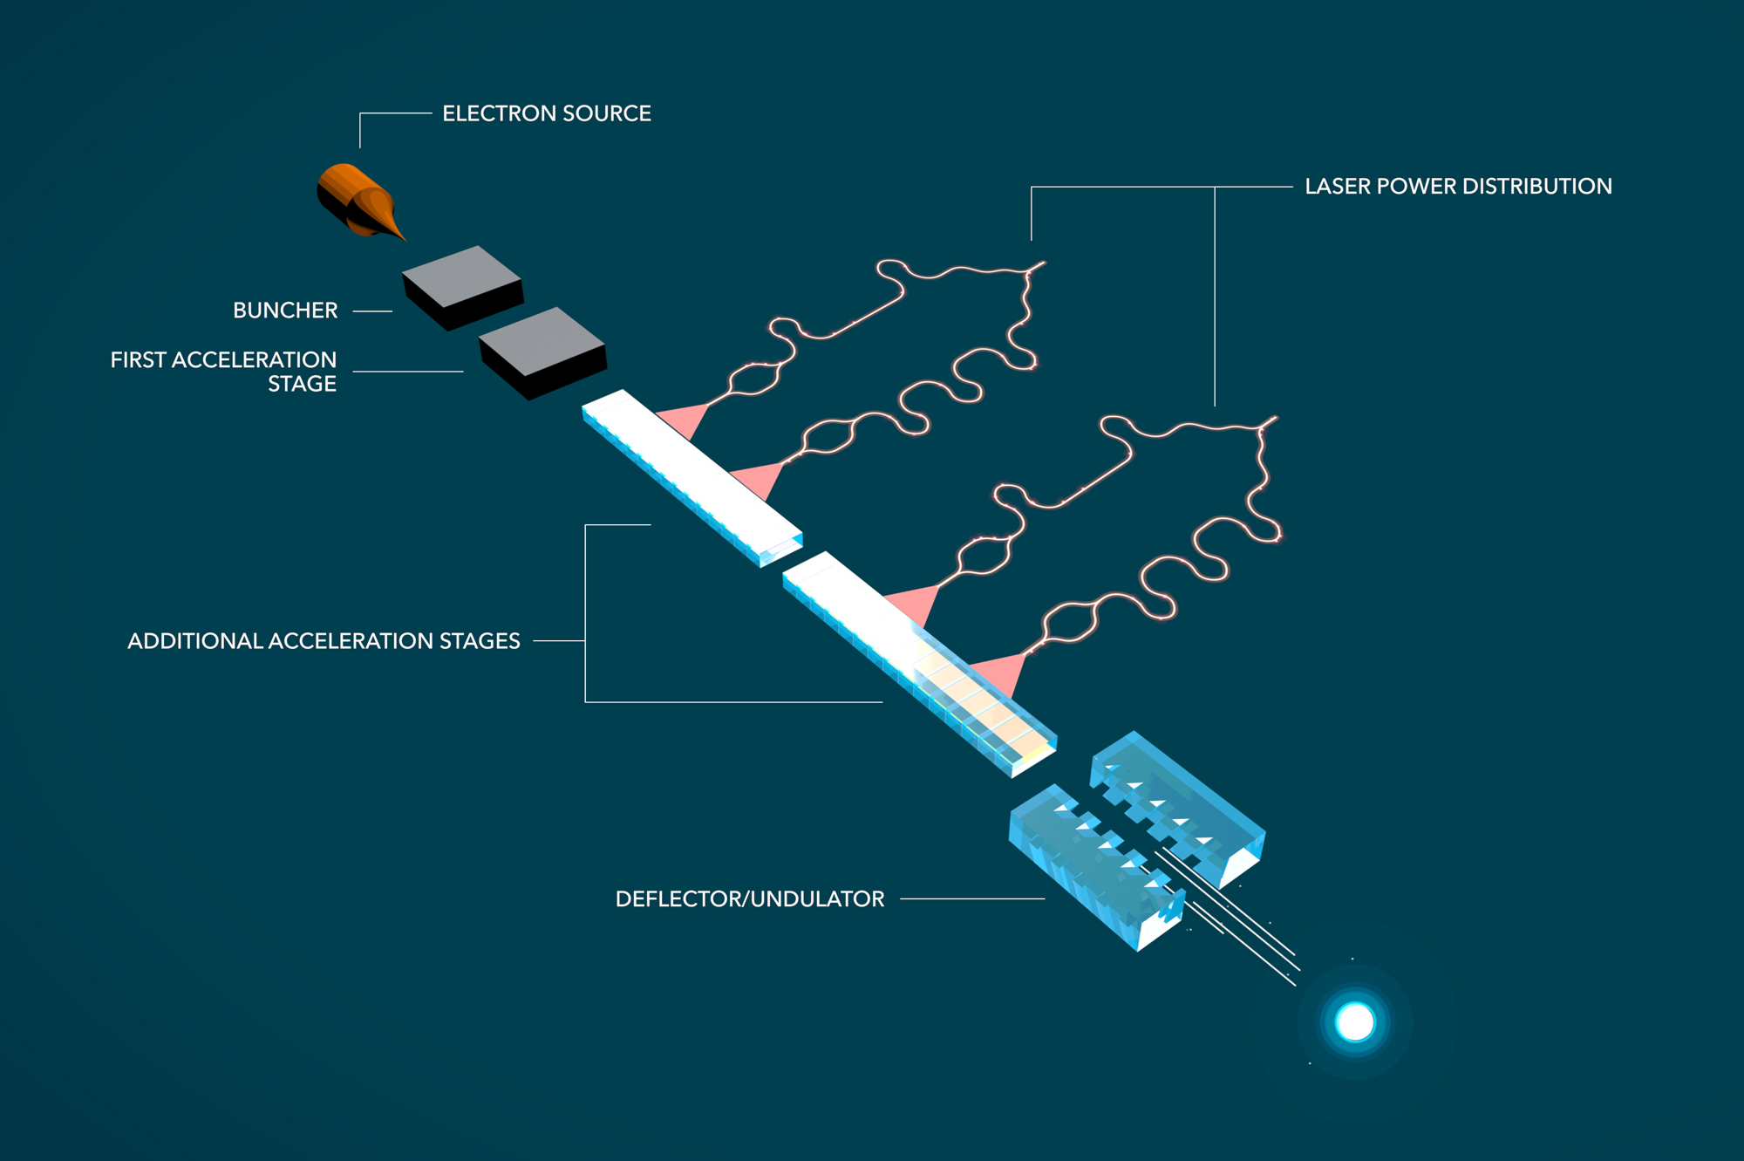
Dielectric Accelerators
Accelerator on a Chip International Program
Sapra, Neil V., Ki Youl Yang, Dries Vercruysse, Kenneth J. Leedle, Dylan S. Black, R. Joel England, Logan Su et al. "On-chip integrated laser-driven particle accelerator." Science 367, no. 6473 (2020): 79-83.
Measured average acceleration over 30 um of 31 MeV/m.
Significant challenges.

Slide 11
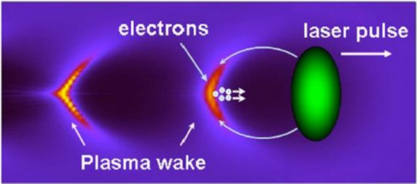
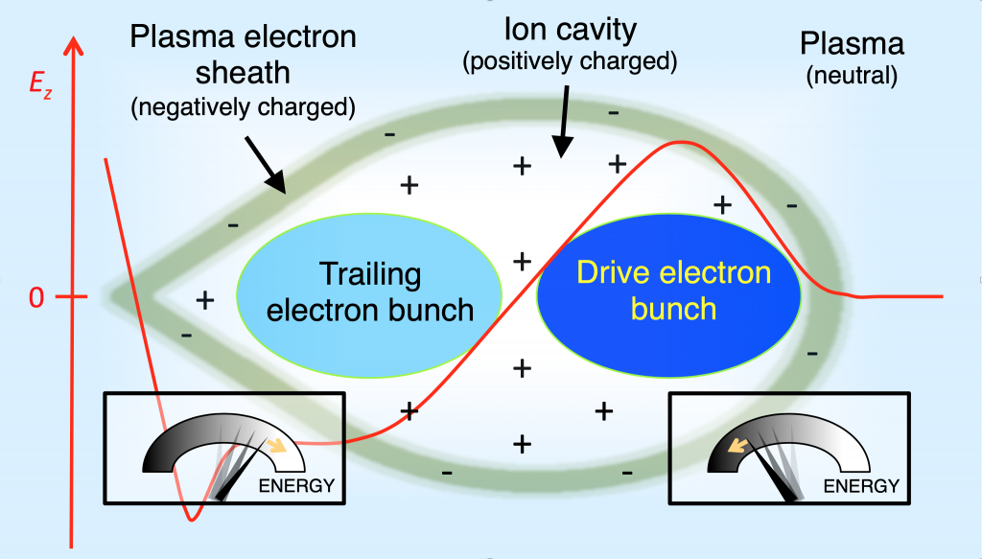
Laser/Beam Driven Plasma Wakefield Acceleration
Laser Driven (LWFA/LPA)
Wakefield generated by a high powered (fs, mJ/pulse, power ~ TW)
Can introduce a witness beam to boost its energy.
Beam/Particl Driven (PWFA)
Wakefield generated by a particle beam (electron/proton)
Drive beam followed by a witness beam.
Plasma (Channel or Jet)
https://loa.ensta-paris.fr/research/upx-research-group/particle-beam-driven-plasma-wakefield-acceleration/

Slide 12
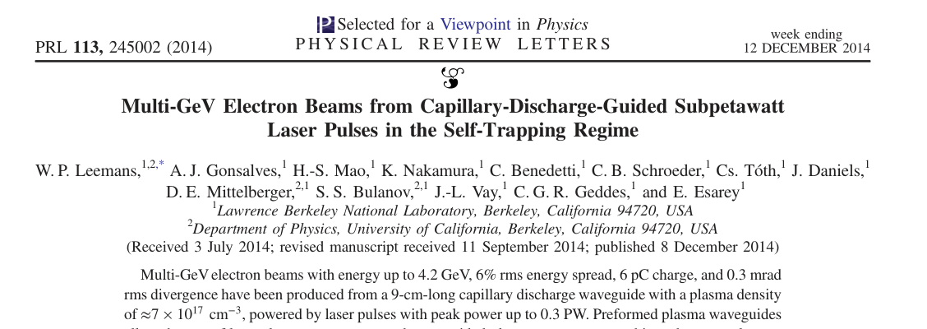
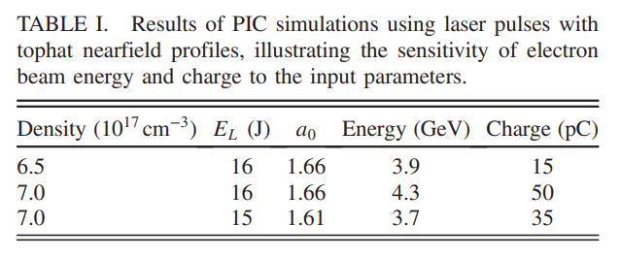
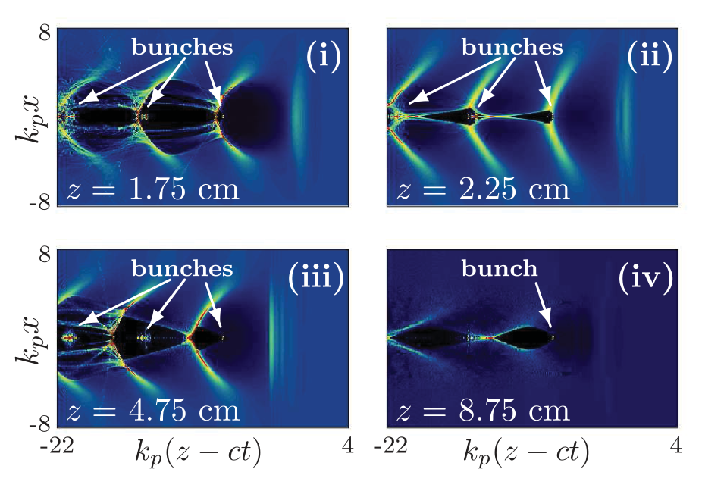
Laser/Beam Driven Plasma Wakefield Acceleration
300 TW laser, 40 fs pulse
~40 GeV/m… but 6% energy spread.

Slide 13
Laser/Beam Driven Plasma Wakefield Acceleration
CEPC Plasma Injector (Beam)
1000 m → 10 m long booster
Boost 10 GeV to 45.5 GeV
LWFA as FEL injector
Jena-KIT
SIOM-SINAP-SLAC
Wei Lu, Overview of CEPC Plasma Injector, AFAD 2021
Axel Bernhard, Progress on Experiments towards LWFA/TGU-Based FELs

Slide 14
Laser/Beam Driven Plasma Wakefield Acceleration
DESY – LUX (Laser)
1 Hz, 48 TW peak
368 MeV (±2.4% rms)
25 pC (±11% rms)
Energy spread ±4%
Energy spread issue: Design of a 500 MeV injector for a light source or FEL (TUPAB151/ TUPAB05, IPAC21).
Maier, Andreas R., Niels M. Delbos, Timo Eichner, Lars Hübner, Sören Jalas, Laurids Jeppe, Spencer W. Jolly et al. "Decoding sources of energy variability in a laser-plasma accelerator." Physical Review X 10, no. 3 (2020): 031039.

Slide 15
Laser/Beam Driven Plasma Wakefield Acceleration
Plasma based de-chirper

Slide 16
THz Accelerator + ICS
AXSIS project

Slide 17
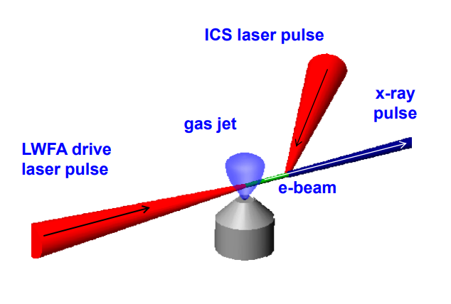
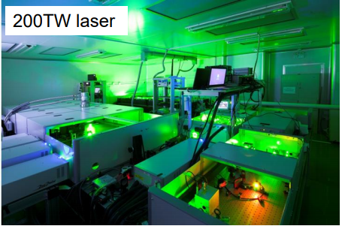
LWFA + ICS
All optical inverse Compton source
No need for RF sources (modulators, Klystrons, etc)
Just big rooms filled with laser systems…
Wenchao Yan, Inverse Compton scattering via laser wakefield
Acceleration, AFAD 2021
Liming Chen, Laser driven high charge electron acceleration for X/γ-ray radiation, AFAD 2021

Slide 19
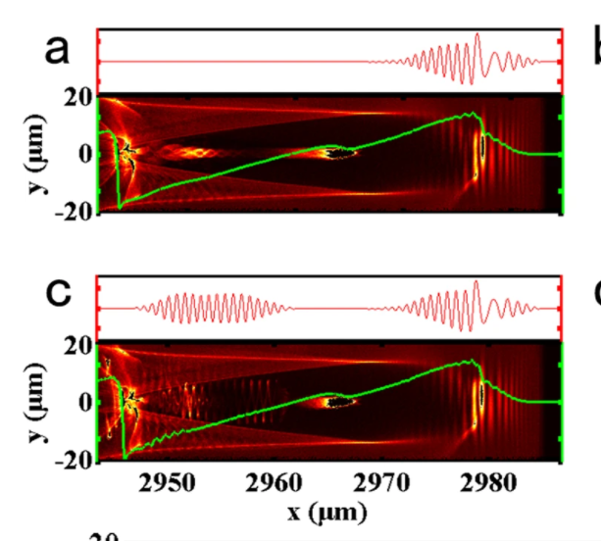
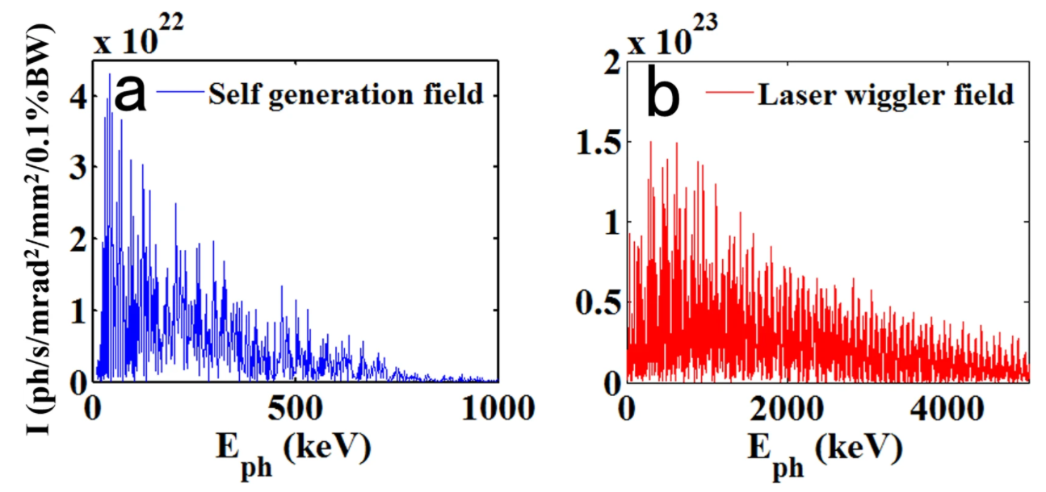
LWFA + Beta radiation
Single Pulse
Double laser pulses: 3 J, 30 fs driving laser pulse and a 1.5 J, 30 fs second laser pulse.
Ultra-fast radiation pulses
Exceeds brilliance of 3rd generation storage ring light sources @ 1 MeV.
Dual Pulse
Feng, Jie, Yifei Li, Jinguang Wang, Dazhang Li, Fang Li, Wenchao Yan, Weimin Wang, and Liming Chen. "Gamma-ray emission from wakefield-accelerated electrons wiggling in a laser field." Scientific reports 9, no. 1 (2019): 1-7.

Slide 20
Conclusion
All dielectric source powered by a laser still has a long way to go.
Future of compact light source will be a combination of RF accelerator/LWFA + ICS.
Still many technological issues to address, but many groups are now working on this problem. Its only a matter of time…

Slide 21
Superconducting RF / S and C Band (4-8 GHz)
S band: ~10 to 20 MV/m
SLAC Linac (1960 - 1980)
AS, DLS and SLS 100 MeV Linac (1990 - 2000)
C band: ~20 to 40 MV/m
SACLA (2011), Swiss FEL (2016)
Superconducting RF (20 to 35 MV/m)
Euro XFEL (2017), ESS (2018)
ILC (proposed)
Pulsed (< 100 Hz)
Continuous

Slide 22
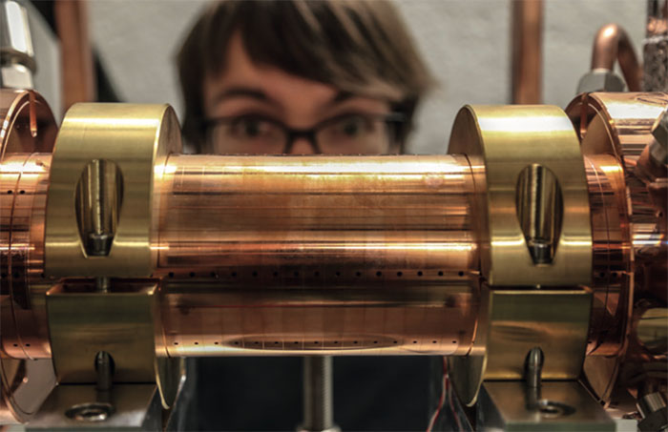
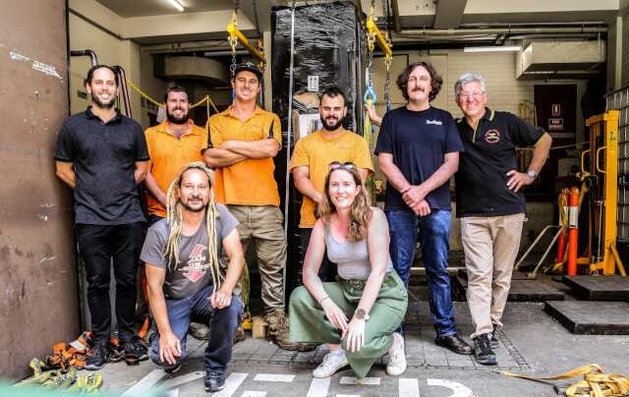
X Band (8-12 GHz)
https://home.cern/news/news/knowledge-sharing/clic-technology-lights-way-compact-accelerators
X band: ~20 to 100 MV/m
CLIC 12 GHz (CERN)
MelBOX arrives at the University of Melbourne - XLAB (Image: Matteo Volpi/University of Melbourne), 2020
N. Catalan Lasheras, X-BAND TECHNOLOGY PROJECTS AND INDUSTRY STATUS,, CLIC Workshop 2018

Slide 23
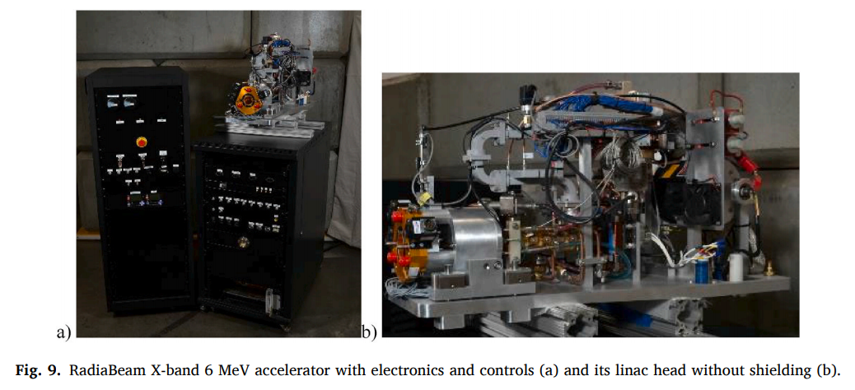
X Band (8-12 GHz)
X band: ~20 to 100 MV/m
CLIC 12 GHz (CERN)
RadiaBeam 9 GHz / 6 MeV Linac for Radio therapy and security (2021)
Pulsed (~100 Hz)
~0.6 m
Kutsaev, S. V., R. Agustsson, A. Arodzero, R. Berry, A. Bezhanov, S. Boucher, O. Chimalpopoca et al. "Compact X-Band electron linac for radiotherapy and security applications." Radiation Physics and Chemistry 185 (2021): 109494.

