Slide 1
ScienceNet Update
Instrumentation and Controls (IC) Meeting 28 May 2021
Ron Bosworth, Nick Howarth
ANSTO IT

Slide 2
Overview
Context
The Vision
How we’ll get There
What we Need from You

Slide 3
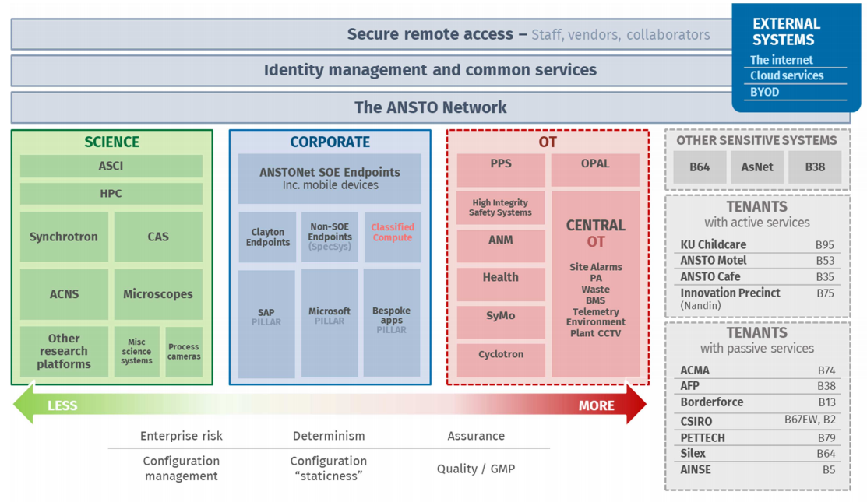
Context
ANSTO has a very diverse technology/risk landscape

Slide 4
Context
ANSTO has a very diverse technology/risk landscape

Slide 5
Context
ANSTO doesn’t have an appropriately segmented network
*Approximate Only

Slide 6
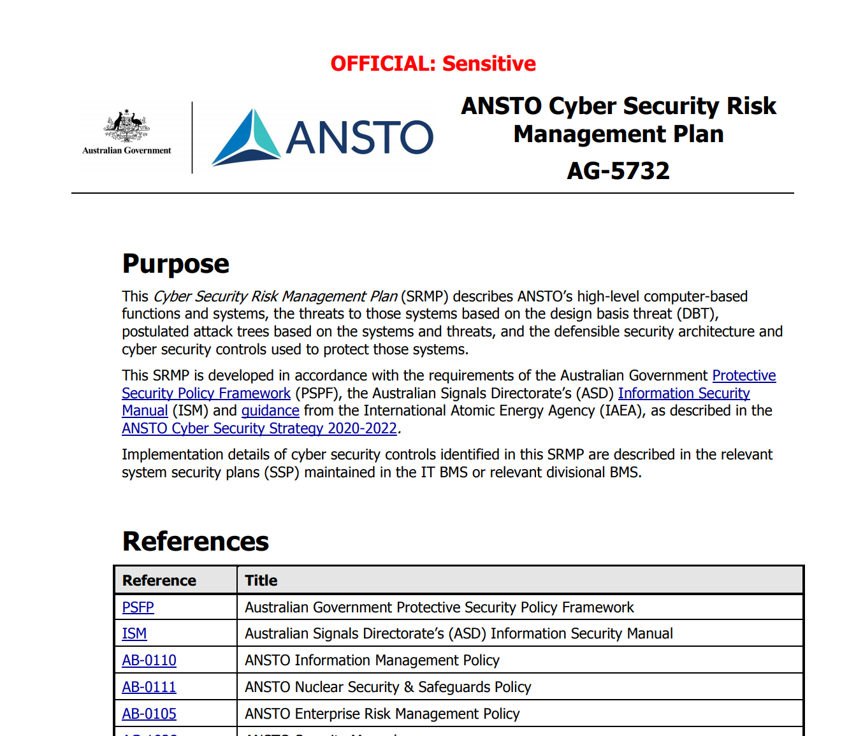
Context
We have clear asset management and cyber security requirements from international and domestic guidance and regulation

Slide 7
Context
We need to better segment our IT landscape, commensurate to risk
We have demand for “better IT platforms” for Scientific Things

Slide 8
The Vision – Network Segmentation
Separate Lucas Heights PPS onto physically separate infrastructure, PPSNet
Separate Classified IT systems onto physically separate infrastructure, ClassifiedNet
Fully deploy ANSTONet corporate IT network to Clayton
Establish ScienceNet and migrate scientific platforms to it

Slide 9
The Vision – ScienceNet
Network, compute, storage resources and IT services for the scientific community
Engineers of scientific platforms
Scientists and other users of those platforms
Self-service as much as reasonable achievable
“More open” for engineers and scientists, commensurate with risk

Slide 10
ANSTONet vs. ScienceNet
 | ANSTONet | ScienceNet
Description | ANSTO’s Corporate IT Network | ANSTO’s Scientific IT/OT Network
Use Cases | Corporate computing functions, the ANSTO IT Service Catalogue e.g. ERP, intranet, email, web browsing | Engineering, maintenance, operation of Scientific platforms Scientific computing e.g. HPC
Cyber Security Controls | CSL3 | CSL4
General web browsing and email | Yes | No
Engineering and scientific tools | No | Yes
Remote access | Yes | Yes
Privileged access | “No” | “Yes”

Slide 11
ANSTONet vs. ScienceNet
You do your corporate computing work on an ANSTONet endpoint, and you do your scientific/engineering work on a ScienceNet endpoint
E.g. you don’t browse the internet/read email on your ScienceNet endpoint, like you don’t use engineering tools on your ANSTONet endpoint

Slide 12
ScienceNet: Phase 1
ScienceNet physical network infrastructure
Grouping instruments, workstations, network connected devices depending on requirements
Does not include safety systems or ANSTONet corporate devices (CSL2 or 3)
Dedicated Hypervisor Infrastructure
Create and control your platform’s virtual machines (Still need cyber security controls as per SRMP)
Dedicated Storage Infrastructure
Provides storage for virtual machines, scientific data, logs
Automated snapshots and backups
Accessible from ANSTONet and ScienceNet

Slide 13
ScienceNet: Phase 1 (Cont.)
Web based DNS/DHCP control
Assign and modify DNS for your zone
Static DHCP assignment for simplified and centralised network management
One authority for all network connected devices
ANSTO account authentication
Staff accounts for role based access control
Guest accounts to support external users
Logging, Monitoring and alerting
Early warning signs
Root cause analysis
Password vault
Keep secrets safe

Slide 14
ScienceNet: Phase 2
Migration of systems to ScienceNet
Develop an asset lifecycle management plan for all IT systems and software
Identify out of support and hard to replace assets
Virtualise where possible
Infrastructure as code and manual system rebuild documentation to enable rapid recovery from failure
Standard Operating Environment Templates
Virtual machine templates, customised to cover your platform’s standard operating environments to support rapid deployment of new systems

Slide 15
ScienceNet: Phase 3 and beyond
Data management system
Manage and access data sets across all ANSTO NSTLI platforms
Web accessible tools
Remote, web accessible tools and desktop environments to support data processing, analysis and visualisation
Secure, controlled operator access to instruments and systems

Slide 16
How we’ll get There
The Network Segmentation Project has started, and is partially funded to begin this work
FY21 (now)
FY22
FY23
PPSNet Procurement
Clayton ANSTONet Pilot
Clayton ANSTONet Full Deployment
PPSNet Build
ScienceNet Pilot (CAS)
Begin ScienceNet Full Deployment
Fully funded
Scoped, not yet funded
Being Scoped
ClassifiedNet Build
IsoNet Procure and Build
ClassifiedNet Procurement

Slide 17
What we Need from You
System map
How do systems currently connect to each other
Frequently used workflows, stable systems
Ad hock workflows, areas of active development
Current asset state
Existing and expired maintenance agreements
Known software install processes
Known system failure risks
Impending changes and future plans
Ideas for additional systems and services that you would like to see

